Slide 1

Concordia Institute for Information Systems Engineering (CIISE)
INSE 6620 – Cloud Computing Security and Privacy
Project Proposal:
IMPLEMENTING NETWORK BASED ATTACK ON OPENSTACK CLOUD PLATFORM
Submitted to
Professor Lingyu Wang
Name | Student Id | Name | Student Id
Md. Saiduzzaman | 40256249 | Tejas Surani | 40248859
Bhavya Patel | 40254222 | Devina Shah | 40238009
Jenil Pansuriya | 40256184 | Mansoureh Navidpanahtoupkanlou | 40221901
Md. Aminul Islam | 40203451 | Jenish Patel | 40256632
Nikunj Pathak | 40203713

Slide 2
Introduction and Objective
Implementation of cloud platform “Open stack” and launching a network-based attack.
OpenStack:
free and open standard cloud computing platform
used in public and private clouds
operates as infrastructure-as-a-service
providing virtual servers and other resources to users
Snort:
Snort is a free, open-source network intrusion detection and prevention system.

Slide 3
Resources & Tools
Real scenario:
At least three nodes: Controller node, Compute node, Storage node.
We could use three virtual machine for each mentioned node
Resource constraint
Network complexity with virtual machine implementation
Routing issue between External and Internal Network
We used the dual boot device : Ubuntu 22.04 LTS
10GB Ram , 50GB SSD, corei7 9th generation

Slide 4
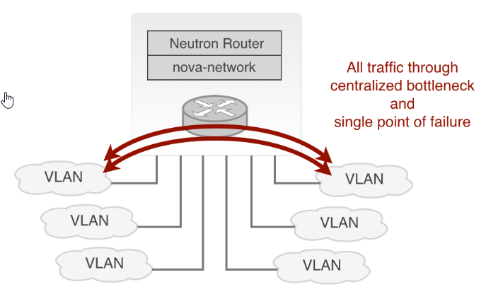
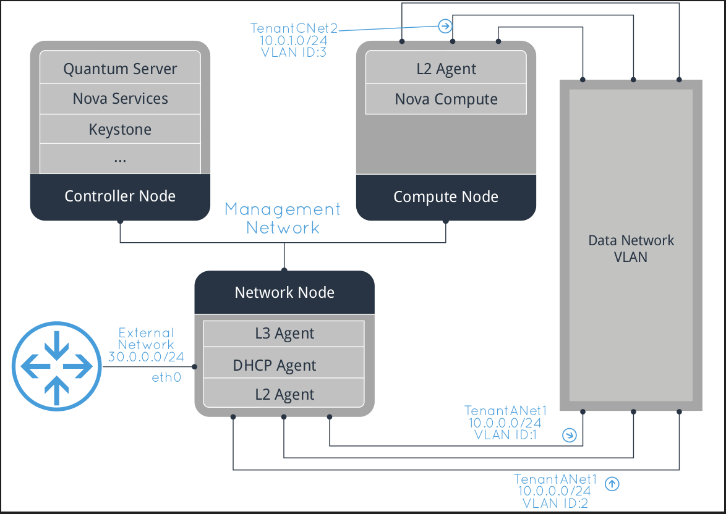
Methodology & Challenges
OpenStack Architecture
Single Node Architecture
Multi Node Architecture
Control Node
Compute Node
Network Node
Hypervisor Type-2 Complexity:
Provision instances on top of Virtual Platform
Mapping network blocks
Routing issues
Processing delay

Slide 5
Technological Stack
Host Node (Physical) Ubuntu 22.04 LTS (On DUAL BOOT) RAM – 10GB CPUs – 8 Core Disk – 50 GB
Target Node Platform – ubuntu 22.04 LTS Flavor – ds2G RAM – 2GB VCPUs – 2 Disk – 20 GB | Hacker Node Platform – Kali Linux (Debian 2023.2 Flavor – m1.small RAM – 2GB VCPUs – 1 Disk – 20 GB
Tools Performing the attack - hping3 (version 3.0.0-alpha) Detection the attack - SNORT (version 2.9.15.1 GRE)

