Slide 1
Ad Churn Prediction
2025-02-13
UCLA STATS414 W25 TEAM G: STEPHANIE LU, ASHWIN RAMASESHAN,
HOCHAN SON, JUYI YANG
Notes:
SL

Slide 2
Agenda
01
04
02
05
03
06
Introduction
Results
Data Overview
Implications
Methodology
Next Steps
Notes:
SL

Slide 3
Introduction
Ad efficacy directly impacts marketing ROI and overall revenue
Understanding how consumers interact with ads is critical for optimizing campaigns, maximizing engagement
Improvement in ad targeting can lead to significant gains in click-through rates (CTR) and therefore conversions
Gaining a deeper understanding of what drives users to engage or disengage with ads could give a digital marketing agency an edge in the ever-competitive market
Notes:
SL

Slide 4
Objective
Build a predictive model to predict user ad click behavior based on factors such as:
Demographics: Age, gender, location.
Device and App Usage: Device type, app preferences.
Behavioral Data: Ad click history, interaction patterns.
This would enable data-driven decision-making to:
Improve Ad Targeting: Deliver personalized ads to the right users at the right time.
Increase Engagement: Boost click-through rates and reduce churn.
Maximize Revenue: Optimize marketing spend and drive higher ROI.
Notes:
SL

Slide 5
Dataset Overview
Dataset Source: Ad logs, user profiles, and cross-domain data (news feed as source domain, ads as target domain).
Purpose: Predict Click-Through-Rate (CTR) by leveraging user interaction and ad performance data.
Notes:
AR

Slide 6
Data Overview: Key Variables
User Data: Age, gender, residence, city, city rank.
Device Data: Device type, software version, network type.
Ad Data: Ad campaign ID, advertiser ID, ad type.
Behavioral Data: Ad clicks, ad closes, user interests, app refresh rate.
Behavior-Based Segmentation: Users are categorized based on engagement with different types of content, such as news, social media, and entertainment.
Notes:
AR

Slide 7
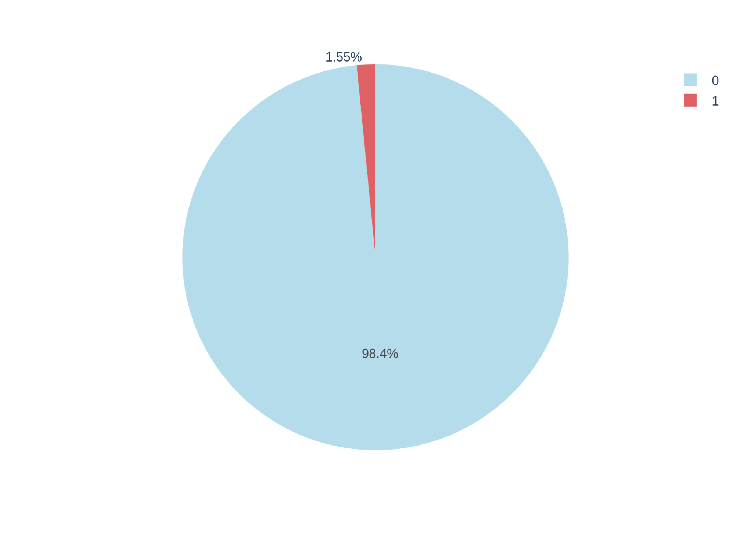
Data Overview: Challenges
Large dataset size :
Computational overhead in feature engineering and model training
size: 1.2GB training dataset
Memory usage (up to 12.x GB)
Class Imbalance:
Majority of users do not click on ads, leading to skewed target variable
Strategy:
10% Resampling: 70:1 ratio
Down sampling majority class: 2:1 ratio
Time Zone Inconsistencies:
Wanted to include time-of-day analysis
Removed due to lack of clarity in time zones
churn
Notes:
HS: Let me start with our key data challenges. We faced three major hurdles:
A significant dataset size of 1.4GB with memory usage up to 12GB and crashes
A severe class imbalance where only 1.55% of users clicked ads, Down sampling majority class to 2:1 ratio
Time zone inconsistencies that prevented detailed temporal analysis
For QnA:
Q: Can you break down the key challenges regarding dataset size? A: The dataset presented three main size-related challenges:
Computational overhead for feature engineering and model training
A large training dataset size of 1.2GB
High memory usage requirements up to 12.x GB during processing This impacted our processing speed and required careful resource management.
Q: There's mention of a class imbalance problem - could you explain what this means and your solution? A: The class imbalance challenge was significant because:
The vast majority of users (98.4%) do not click on ads
Only 1.55% of users clicked ads (shown in the pie chart)
We addressed this through two strategies:
10% Resampling with a 70:1 ratio
Down sampling the majority class to achieve a 2:1 ratio
Q: Why was the time zone analysis removed from the study? A: The time zone analysis was removed because:
Initial plans included analyzing time-of-day patterns
Lack of clarity in time zone data made this unreliable
Including uncertain time data could introduce noise into our model
We prioritized data quality over potentially misleading insights
Q: Looking at the pie chart, what does it tell us about the nature of ad engagement? A: The pie chart reveals:
A severe imbalance in our target variable
98.4% of instances represent non-clicks (shown in light blue)
Only 1.55% represent clicks (shown in red)
This distribution is typical for ad click data but presents modeling challenges
Q: How did these challenges influence your modeling approach? A: These challenges influenced our approach by:
Requiring efficient data processing strategies for the large dataset
Necessitating specialized sampling techniques for class imbalance
Focusing on robust features that don't depend on time zone data
Shaping our choice of evaluation metrics to handle imbalanced classes

Slide 8
EDA
Box plots of variables vs click through rate
Histograms of variables to view general distributions
Converted pt_d to datetime format
Created day_of_the_week
Wanted to take time of day into account (e.g. morning, night) but time zones unclear, don’t want to add unnecessary noise
Created boolean features indicating whether key IDs (task_id, adv_prim_id, spread_app_id) appeared in corresponding ad click, close lists (v001, v002, v003).
209 unique news interest categories (u_newsCatInterestsST) - too many for one hot encoding, thus top-k selection
K = 70 captures 90% of the information
Notes:
Only showing those of interest today
Captured user engagement signals from both click and close interactions to enhance model interpretability.

Slide 9
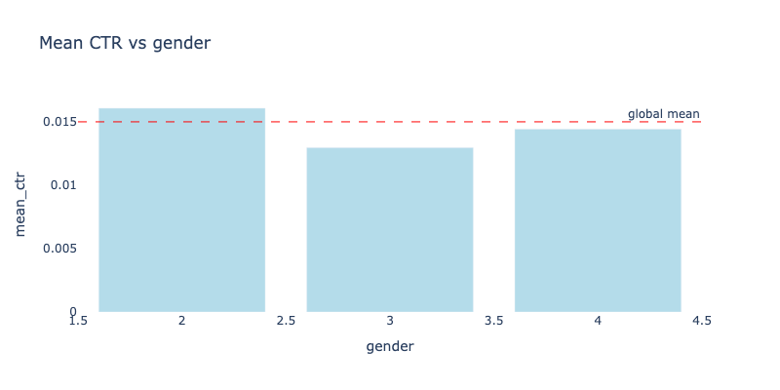
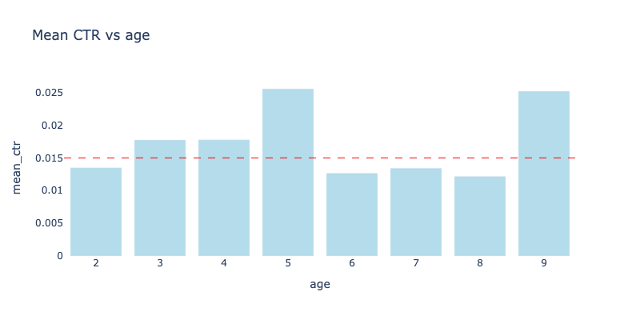
CTR vs Demographics & CTR vs Refresh_Times
Notes:
JY
Nontraditional representation, treating as categorical

Slide 10
Data Overview: Feature Engineering
Boolean features: Identify whether key IDs (task_id, adv_prim_id, spread_app_id) appear in ad click/close lists.
Applied top-K selection to 209 unique news interest categories (u_newsCatInterestsST), retaining K = 70 to capture 90% of the information while balancing dimensionality
Notes:
SL

Slide 11
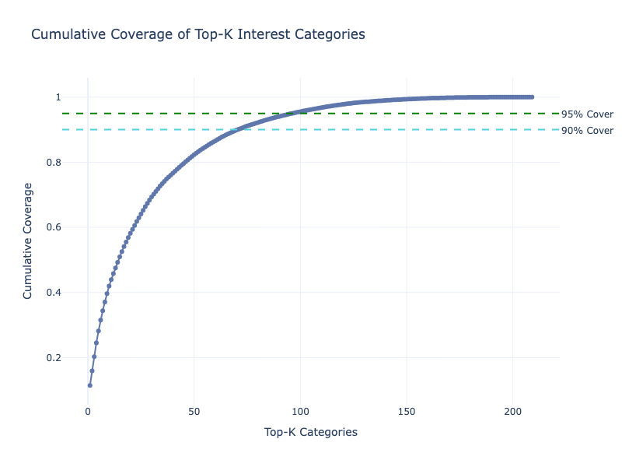
Feature Engineering: News Interest Categories
70
Notes:
SL

Slide 12
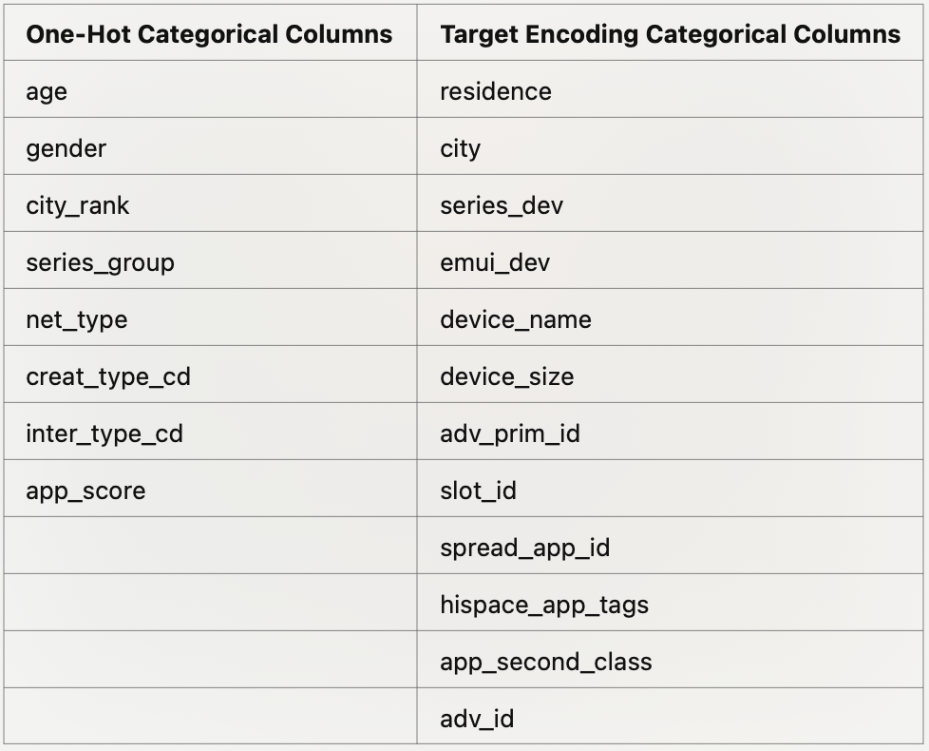
Data Overview: Feature Engineering
For Columns that had way too many distinct values:
Targeted Encoding:
Converted categorical variables into numerical values using aggregated statistics (e.g., mean target value) to capture relationships with the target.
Integrated cross-validation to prevent overfitting and ensure robust model performance.
Adjusted the smoothing alpha parameter dynamically—set a higher alpha for columns with more distinct values to stabilize encoding while preserving meaningful variations.
One-Hot Encoding:
Applied one-hot encoding to the remaining categorical variables.
Notes:
JY

Slide 13
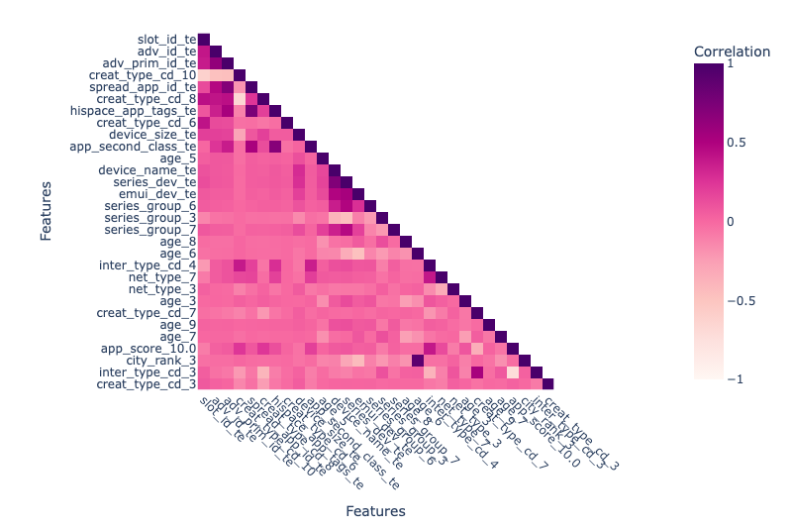
Correlation Heatmap
Top 30 correlated with ‘label’
*9 highly correlated pairs
Notes:
JY

Slide 14
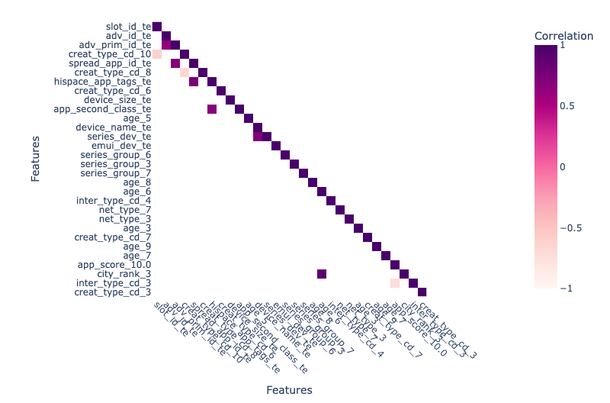
Correlation Heatmap
Top 30 correlated with ‘label’
*9 highly correlated pairs
Correlation > 0.6
Notes:
SL
Multicollinearity “ok” for xgboost and lasso although never ideal
Not ok for log reg

Slide 15
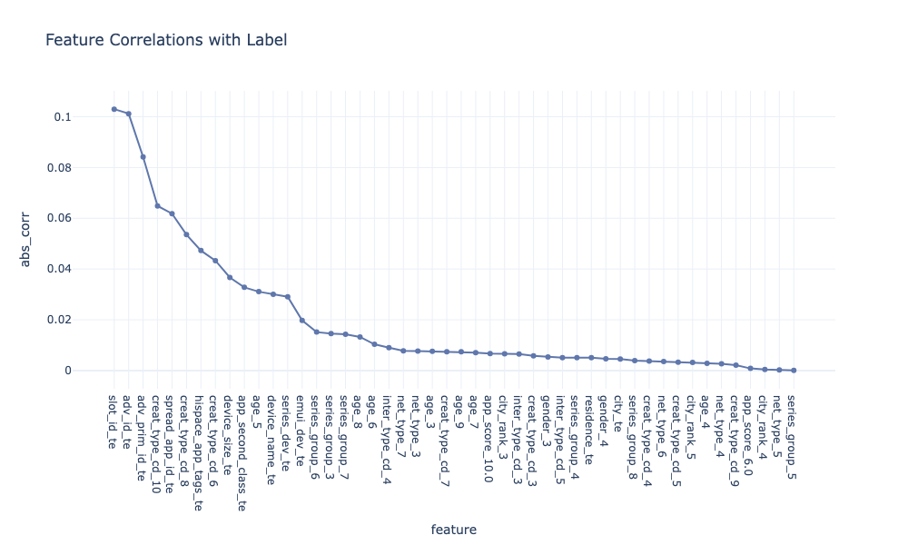
Select Features
Notes:
SL

Slide 16
Methodology - Model Selection
Ensemble methods: Boosting, Bagging, Stacking, Voting, etc.
Our choices: Boosting, Stacking
 | Model 1 | Model 2 | Model 3
LASSO |  |  | X
XGBOOST |  | X
LOGISTIC | X |  | X
ENSEMBLE |  | X(Boosting) | X(Stacking)
Notes:
HS: For our methodology, we implemented three main modeling approaches:
Logistic regression as our baseline model (model1)
XGBoost, which proved most effective for handling our non-linear data (model2)
LASSO regression with L1 normalization for feature selection (model3)
For Ensemble, Boosting, and Stacking (model 2 and 3 respectively)
For QnA:
Q: Could you explain the ensemble methods you considered for this project?
A: We explored several ensemble approaches including Boosting, Bagging, Stacking, and Voting.
After careful evaluation, we chose to focus on Boosting and Stacking as our primary ensemble methods based on their effectiveness for our specific use case.
Q: Can you break down the model selection table you've shown?
A: The table shows our three-model approach:
Model 1 uses Logistic Regression as its base
Model 2 incorporates XGBoost and uses Boosting as its ensemble method
Model 3 combines LASSO, Logistic Regression, and uses Stacking as its ensemble technique
Q: Why did you choose these particular combinations for each model?
A: We strategically paired different algorithms to leverage their unique strengths:
Logistic Regression provides a solid baseline with good interpretability
XGBoost with Boosting handles complex non-linear relationships effectively
The combination of LASSO and Stacking helps manage feature selection while maintaining model robustness
Q: What was the reasoning behind using both Boosting and Stacking rather than just one ensemble method?
A: Both techniques serve different purposes. Boosting helps improve prediction accuracy by sequentially learning from previous models' mistakes,
while Stacking allows us to combine predictions from different types of models in a way that leverages each model's strengths.
Q: How did you decide which model would use which ensemble method?
A: For Model 2, we chose Boosting to enhance XGBoost's already strong predictive capabilities.
For Model 3, we used Stacking to effectively combine the different predictions from LASSO and Logistic Regression, as these models have complementary strengths in terms of feature selection and probability estimation.

Slide 17


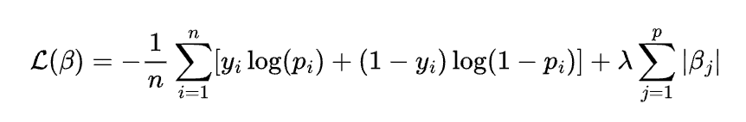
Methodology - LASSO
Regularization:
L1 normalization penalty
Shrinkage method (estimator)
Log Loss
Notes:
HS: Mentions: Our LASSO implementation helped with feature selection through L1 regularization
(for QnA:
Q: Could you explain what LASSO regression is and why you chose it for this project? A: LASSO (Least Absolute Shrinkage and Selection Operator) is a regression method that performs both regularization and feature selection. We chose it because it helps prevent overfitting through L1 normalization penalty and can automatically handle feature selection, which was crucial given our large feature set.
Q: The page shows three mathematical equations. Could you break down what the L1-norm penalty equation means? A: The L1-norm penalty equation ||β||1 = Σᵖⱼ₌₁|βⱼ| represents the sum of the absolute values of the model coefficients. This penalty term helps:
Shrink less important feature coefficients to exactly zero
Create a more sparse and interpretable model
Perform automatic feature selection
Q: What does the Shrinkage method equation represent? A: The shrinkage method equation β̂lasso = argminβ(y - Xβ)ᵀ(y - Xβ) + λ||β||1 combines:
The standard least squares term (y - Xβ)ᵀ(y - Xβ) which measures model fit
The L1 penalty term λ||β||1 which controls model complexity
λ (lambda) is the tuning parameter that balances these two objectives
Q: Why do we need the Log Loss function shown in the third equation? A: The Log Loss function ℒ(β) = -1/n Σⁿᵢ₌₁[yᵢlog(pᵢ) + (1-yᵢ)log(1-pᵢ)] + λΣᵖⱼ₌₁|βⱼ| is crucial because:
It measures the performance of our classification model
It heavily penalizes confident but wrong predictions
It incorporates both the prediction accuracy and the regularization penalty
Q: How does the λ (lambda) parameter affect the model? A: Lambda controls the strength of the regularization:
Larger λ values create stronger penalties and more sparse models
Smaller λ values allow more features to remain in the model
Finding the optimal λ is crucial for balancing model complexity and performance

Slide 18
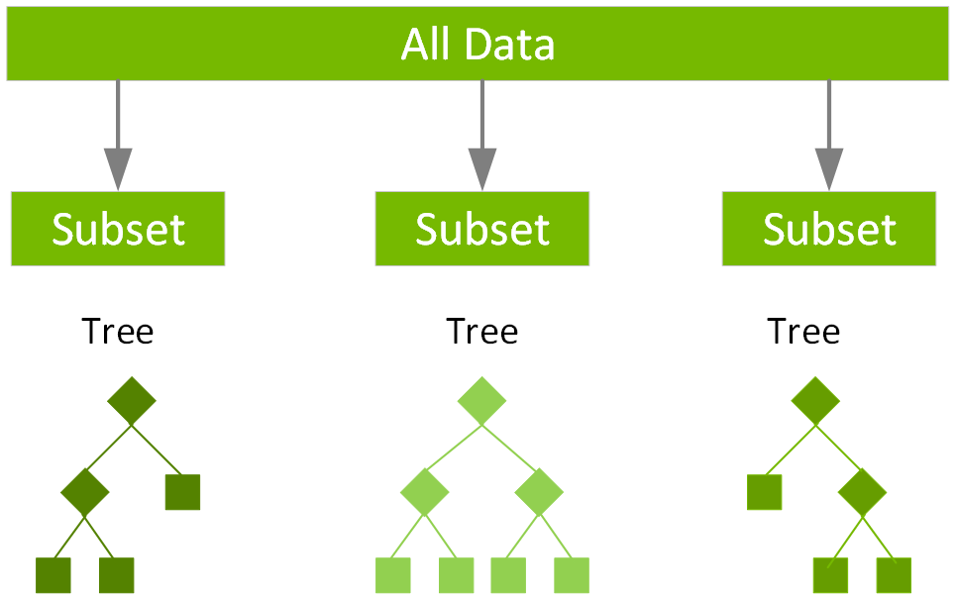
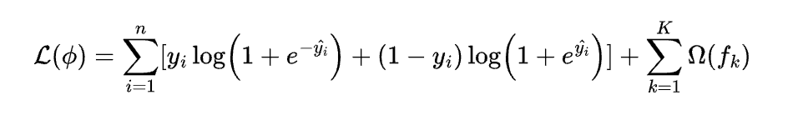
Methodology - XGboost
Ensemble methods (Boosting, bagging, and Stacking)
XGboost stands for Extreme Gradient Boosting
High Performance:
XGBoost has shown highly performed algorithm on complex non-linear data.
Task distribution
Better for parallel GPU workload
Log Loss function
figure 1) Distributed Gradient Boosting methods
Notes:
HS: The XGBoost model showed particularly strong performance on non-linear relationships also follow log loss For QnA
Q: What makes XGBoost "Extreme" Gradient Boosting, and how is it different from regular Gradient Boosting? A: XGBoost is "Extreme" because it offers:
Superior parallel computing capabilities with better GPU workload distribution
Optimized tree pruning for better model structure
Advanced regularization to prevent overfitting
Specialized handling of sparse matrices and missing values These features make it more efficient and powerful than traditional gradient boosting.
Q: The diagram shows "All Data" split into subsets with trees. Could you explain this structure? A: The diagram illustrates XGBoost's distributed learning approach where:
The main dataset is divided into multiple subsets
Each subset trains its own decision tree
Trees are built sequentially, with each new tree correcting errors from previous trees
The final prediction combines the outputs from all trees
Q: Why is XGBoost particularly good for handling non-linear data? A: XGBoost excels with non-linear data because:
It creates multiple decision trees that can capture complex patterns
Each tree focuses on correcting the mistakes of previous trees
It can automatically handle feature interactions
The algorithm can learn very sophisticated non-linear relationships through tree ensemble
Q: The page mentions "High Performance" - what contributes to XGBoost's efficiency? A: XGBoost's high performance comes from:
Better parallelization with GPU support
Optimized data structures for faster computation
Cache-aware access patterns
Advanced algorithmic optimizations for splitting and growing trees
Q: Could you explain the Log Loss function shown in the equation? A: The Log Loss function for XGBoost: ℒ(ϕ) = Σⁿᵢ₌₁[yᵢlog(1+e⁻ŷᵢ) + (1-yᵢ)log(1+eŷᵢ)] + Σᵏₖ₌₁Ω(fₖ) Includes:
Binary cross-entropy loss for classification
A regularization term Ω(fₖ) to control model complexity
Optimization for both prediction accuracy and model simplicity

Slide 19
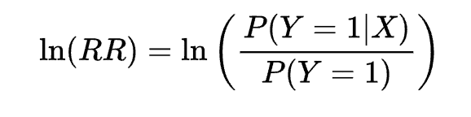
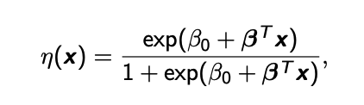
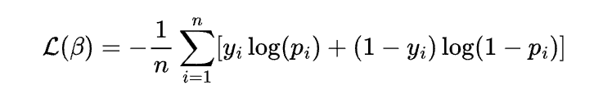
Methodology - Logistic Regression
Log odds ratio
Logistic Function
Log Loss
Notes:
HS: Logistic regression follows log loss by default. So, we choose LOG LOSS for all three models
For QnA:
Q: Can you explain what the Log odds ratio equation means in the context of ad click prediction? A: The Log odds ratio equation ln(RR) = ln(P(Y=1|X)/P(Y=1)) represents:
The natural logarithm of the ratio between:
The probability of a click given our features (P(Y=1|X))
The baseline probability of a click (P(Y=1)) This helps us understand how our features affect the likelihood of an ad click relative to the baseline click rate.
Q: The page shows a Logistic Function η(x). How does this function work for predicting ad clicks? A: The Logistic Function η(x) = exp(β₀ + βᵀx)/(1 + exp(β₀ + βᵀx)):
Takes any input value and transforms it to a probability between 0 and 1
β₀ is the baseline probability (intercept)
βᵀx represents the weighted combination of all our features
The output directly gives us the probability of an ad click
Q: What advantages does the Log Loss function provide for our ad click prediction model? A: The Log Loss function ℒ(β) = -1/n Σⁿᵢ₌₁[yᵢlog(pᵢ) + (1-yᵢ)log(1-pᵢ)] is beneficial because:
It severely penalizes confident wrong predictions
It provides a smooth, differentiable function for optimization
It naturally handles probability predictions
It works well with imbalanced datasets like our ad click data
Q: How do these three equations work together in our model? A: The equations work together in this sequence:
Log odds ratio helps us understand the relationship between features and clicks
Logistic function converts our feature inputs into click probabilities
Log Loss function measures how well our predictions match reality and guides model optimization
Q: What makes Logistic Regression suitable for ad click prediction despite its simplicity? A: Logistic Regression is suitable because:
It naturally outputs probabilities
It's highly interpretable
It handles binary outcomes well
It's computationally efficient
It provides a good baseline for comparing more complex models

Slide 20
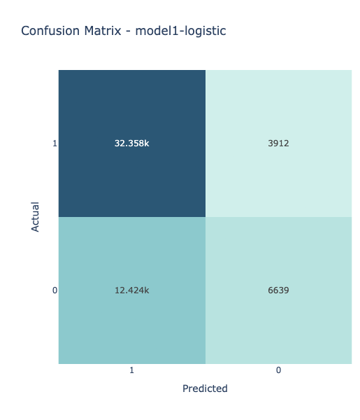
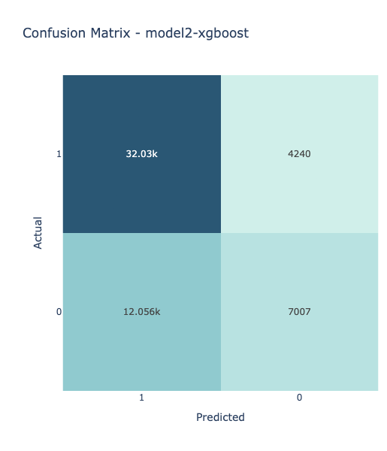
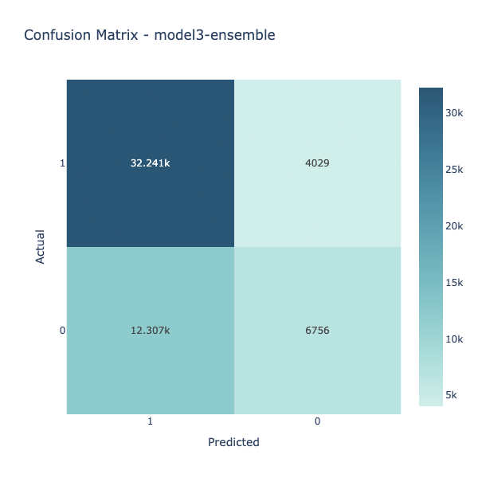
Results: Confusion Matrices
Notes:
SL Our confusion matrices and ROC curves demonstrate the models' predictive capabilities

Slide 21
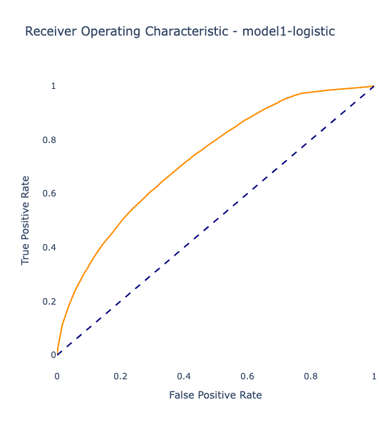
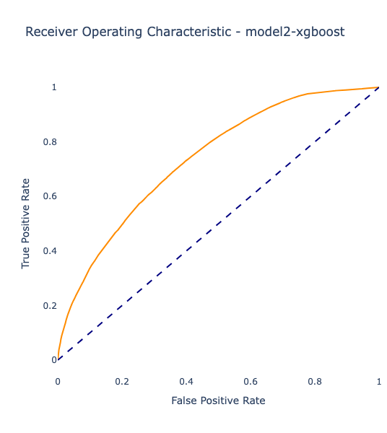
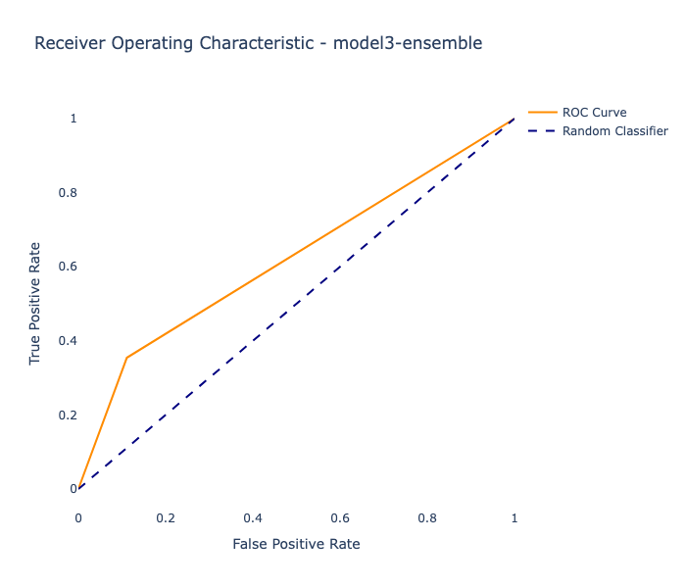
Results: ROC Curves
Notes:
SL

Slide 22
Model performance
F1-score: higher is better,
AUC-ROC: higher is better,
RMSE: lower is better
R-squared: higher is better
Accuracy: higher is better
XGBoost Wins!
No | Model | F1 Score | AUC-ROC | RMSE | R-squared | Accuracy
1 | Logistic | 0.448369 | 0.729355 | 0.543351 | 0.704769 | 0.704769
2 | XGBoost | 0.462356 | 0.737198 | 0.542686 | 0.705492 | 0.705492
3 | Lasso | 0.447896 | 0.729410 | 0.543584 | 0.704516 | 0.704516
3 | Logistic | 0.448369 | 0.729355 | 0.543351 | 0.704769 | 0.704769
3 | Ensemble | 0.452694 | 0.729410 | 0.543351 | 0.704769 | 0.704769
Notes:
HS:
In each case, we carefully evaluated model performance using various metrics. - F1-score, AUC-ROC, R-squared, and Accuracy: Higher is better, - For RMSE: Lower is better}
As you can see the result, we also concluded model2-XGBoost wins! (Just in case For QnA) Q: The table shows multiple performance metrics. Which metrics were most important and why? A: The key metrics were:
F1 Score: Balances precision and recall, crucial for imbalanced datasets
AUC-ROC: Shows model's ability to distinguish between classes
RMSE: Measures prediction error magnitude
Accuracy: Overall correct prediction rate XGBoost performed best across all metrics.
Q: Could you break down the performance comparison between the models? A: Looking at the performance comparison:
XGBoost led with:
F1 Score: 0.462356
AUC-ROC: 0.737198
RMSE: 0.542686
R-squared: 0.705492
Other models showed slightly lower performance across all metrics
Ensemble methods didn't significantly improve over XGBoost
Q: Why is XGBoost's performance (0.462356 F1 Score) considered a win despite seeming low numerically? A: XGBoost's performance is considered strong because:
We're dealing with a highly imbalanced dataset
Ad click prediction is inherently challenging
The improvement over baseline models is significant
The results are consistent across all evaluation metrics
Q: What does the "No" column in the table represent? A: The "No" column represents:
The model iteration number
Models 1 and 2 are standalone implementations
Model 3 has multiple variations (Lasso, Logistic, Ensemble)
Helps track different model configurations systematically
Q: Looking at R-squared values, what does this tell us about model fit? A: The R-squared values (around 0.70) indicate:
Models explain about 70% of variance in the data
XGBoost achieves slightly better fit at 0.705492
All models have similar explanatory power
There's still unexplained variance, suggesting room for improvement

Slide 23
Cross Validation
We used K-Fold (K=3) to maintain class balance across folds, given our imbalanced dataset.
This allowed each model to be tested on multiple validation sets, making our evaluation more reliable.
XGBoost outperformed Logistic Regression, achieving an F1-Weighted Score of 0.7998 compared to 0.7012 for Logistic Regression
XGBoost is the better model for our dataset, as shown by its higher F1 score across multiple validation splits.
Notes:
AR

Slide 24
Implications
Reducing Ad Churn: Identifies why users disengage and improves retention.
CTR Optimization: Enhances targeting for high-intent users, boosting conversions and reducing ad spend.
User Behavior Insights: Predicts engagement patterns for personalized ads and content.
Data-Driven Strategy: Enables businesses to refine ad placement based on real engagement data.
Revenue & Growth Impact: Higher CTR increases ROI, reduces costs, and scales across platforms.
Notes:
AR

Slide 25
Limitations
Severe Class Imbalance – Minority class underrepresented, requiring resampling techniques
Low Feature Interpretability – Hard to interpret obfuscated features (gender, age, etc.)
Potential Overfitting Risk – Complex transformations may capture noise rather than signal.
Data Processing Bottlenecks – Large-scale data or complex feature interactions slow down training and inference.
Labeling Issues – Class imbalance might also indicate noisy or ambiguous labels, affecting model reliability.
Notes:
JY

Slide 26
Next Steps
Refine class imbalance strategy (SMOTE, focal loss, etc.) to enhance minority class detection
Analyze VIF (Variance Inflation Factor) alongside correlations to eliminate redundancy
Implement grid search or Bayesian optimization to fine-tune XGBoost, Lasso, and Logistic Regression hyperparameters for better performance
Optimize model training pipelines to handle processing bottlenecks
Notes:
SL

Slide 27
Thank You!
Questions?
Notes:
SL

