Slide 1

D VE

Slide 2


Country ABC
Country XYZ
Suspicious “incident” activities
NPO/NGP/Government created project to defend Country ABC from the attack from Country XYZ
NPO/NGO/Government
Create and manage Project
Backer 1
Project:
Defend Country ABC
Backer 2
Backer 3
Advance donations are pooled in the project (can be pulled back before the actual incident)

Slide 3


Country ABC
Country XYZ
Once “incident” actually happen
If the pooled amount is visible to Country XYZ and enough huge, it can be expected to suppress the incident happen.
NPO/NGO/Government
Backer 1
Project:
Defend Country ABC
Backer 2
Backer 3
As like the opened vault, the NPO/NGO/Government can withdraw the pooled Solana to support the Country ABC

Slide 4



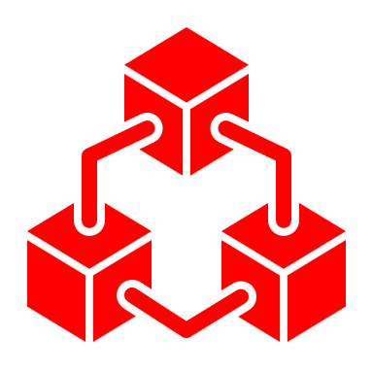

Country ABC
Country XYZ
The blockchain is immutable and cannot be altered or deleted by anyone, even Country XYZ.
NPO/NGO/Government
Backer 1
Project:
Defend Country ABC
Backer 2
Backer 3
All projects are managed on the Solana blockchain, which is decentralized, scalable, fast, and energy-efficient blockchain.

Slide 5

Country ABC
Country XYZ
The decision if the “incident happened” will be decided by the DAO basis on the weighted average of the backers’ votes and their donations.
NPO/NGO/Government
Backer 1
Backer 2
Backer 3
Backer 1
Project:
Defend Country ABC
Happen
1 SOL
Happen
0.5 SOL
Not happen
1.2 SOL
Backer 2
Open the vault!
Backer 3
As like the opened vault, the NPO/NGO/Government can withdraw the pooled Solana to support the Country ABC
Happen
1.5 SOL
Not happen
1.2 SOL

