Slide 1
MAISON AURORE ROSTER
One system, four roles — the full store-operations
loop from schedule generation to the floor.
Product overview and budget brief for stakeholders evaluating rollout across boutiques.
4
8
2
ROLE-BASED PORTALS
CONFIGURABLE RULES
BOUTIQUES IN THE CURRENT DATASET

Slide 2
EXECUTIVE SUMMARY
A scheduling system built around who actually touches it.
✦ All four role-scoped portals are now live — Admin, Approver, Staff and Reader — each behind its own sign-in. Every user lands directly in the screen built for their job.
✦ Every roster follows the same lifecycle: draft → submitted → approved → published, with reject and amend paths and a full audit trail. One scoring engine judges both automatic generation and manual edits.
✦ Staff, VIC clients, shifts and rules are all configured per boutique in one data model. The current dataset covers two boutiques (Sydney and Melbourne); adding a third is configuration, not new engineering.
WHO IT'S FOR
Operations admins, the manager who approves each roster, floor staff checking their shifts, and read-only viewers browsing published rosters.
WHAT CHANGED RECENTLY
Skill requirements can now be scoped to a specific area of the floor (Counter, Fitting Room, Concierge…), not just the shift as a whole — carried through generation, manual edits, exports and each employee's own schedule.
WHY IT MATTERS FOR BUDGET
One codebase, one data model, every boutique — a new store is configuration, not a rebuild.

Slide 3
HOW IT'S ORGANIZED
Four portals, one login each.
Every user signs in once and lands in the portal that matches their role — no menu of features they don't need.
ADMIN
APPROVER
STAFF
READER
Operations control
Sign-off & publish
My Schedule
Published Rosters
Generate and edit rosters, manage staff, VIC clients, shifts, rules and leave — all scoped to the active boutique.
A focused inbox of rosters awaiting review, with approve, reject and publish — kept separate from whoever built the draft.
Employees see their own upcoming shifts straight from the published roster, no admin access required.
A read-only roster browser with one-click CSV and PDF export, for a shared back-of-house screen or printout.
Store / regional admin
Boutique / regional manager
Floor staff
Shared / front-of-house

Slide 4
THE ROSTER LIFECYCLE
From a blank date to a shift someone sees on their phone.
Every roster — machine-generated or hand-built — moves through the same six steps, with a permanent record at each one.
1
ADMIN · ROSTERS
2
ADMIN · ROSTERS
3
ADMIN → APPROVER
Generate a draft
Review & adjust
Submit for approval
Pick a date. The engine reads that boutique's staff, skills, VIC appointments, leave and shift rules and proposes a scored roster.
Unmet requirements and rule flags are called out per shift. Add or remove staff by hand — the score recalculates live.
The draft leaves the admin's queue and appears in the approver's Approval Inbox, score and overrides visible.
4
APPROVER · INBOX
Approve or reject
The approver — a separate role from whoever built the draft — checks it and decides.
APPROVED
Moves on to publish.
REJECTED
Returns to Draft with a note, back to step 2 — no dead end.
5
APPROVER · INBOX
6
STAFF · MY SCHEDULE
Publish
Live for staff
If another roster is already published for that boutique and date, it's automatically marked Amended and superseded.
Every linked staff member on that roster sees the shift on My Schedule the moment it publishes — no announcement needed.

Slide 5
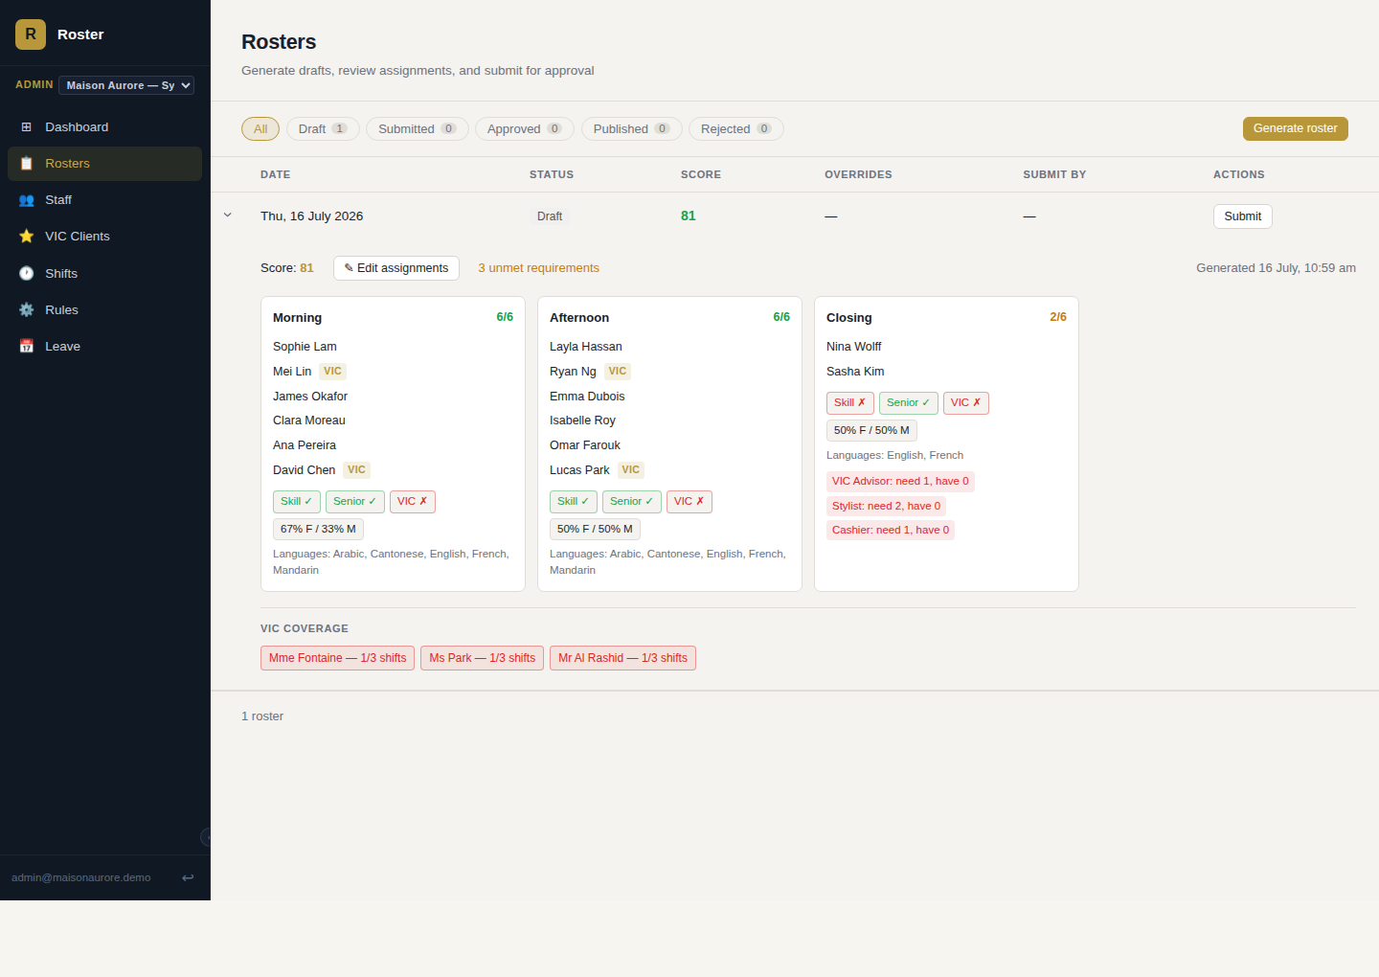
ADMIN · ROSTERS
Generate a full roster in one click, see exactly what's short.
The engine reads active staff, skills, VIC appointments, leave and shift rules for the target date and proposes a complete roster — scored out of 100, with every unmet requirement surfaced immediately.
✦ One-click generation per date, respecting leave and day-of-week availability
✦ Live skill / seniority / VIC-coverage / gender-balance breakdown per shift
✦ Draft → Submitted → Approved → Published status tracked with full history
Generated draft — scored automatically, with gaps called out per shift

Slide 6
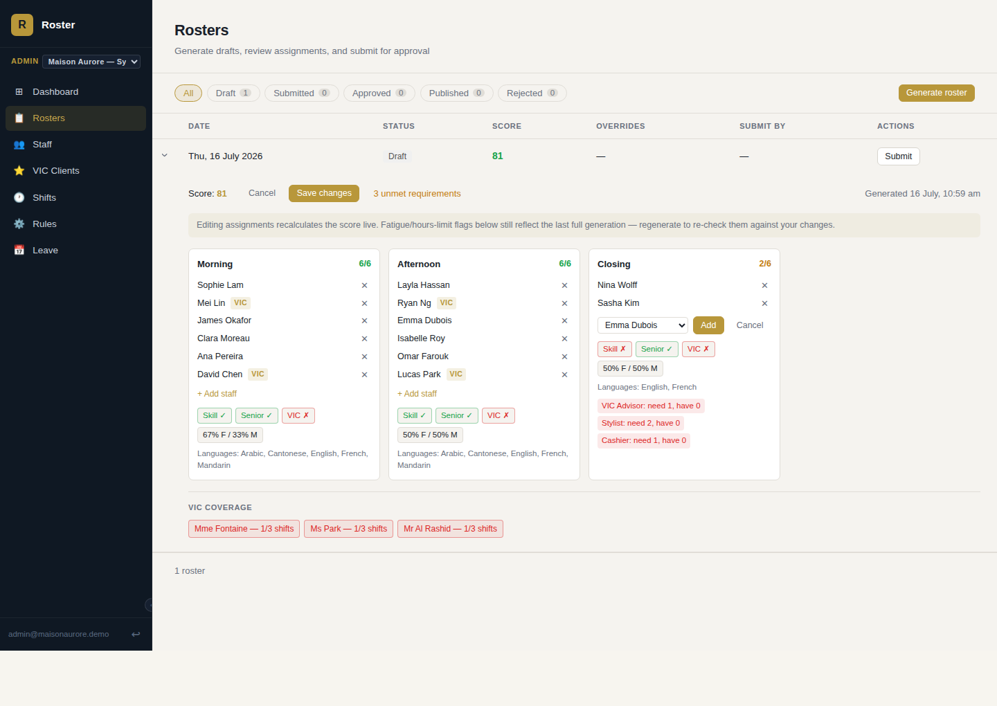
ADMIN · ROSTERS
Managers keep the final say, with the score watching in real time.
Add or remove anyone from a shift and the score, skill coverage and VIC-coverage badges recompute instantly — using the same scoring logic the generator itself uses.
✦ Add-from-bench and remove-in-place, no page reload
✦ Reassign which area of the floor a staff member is covering, right from the same edit view
✦ Overrides are tracked and shown to the approver for context
✦ Nothing is submitted until a manager is satisfied with the result
Filling a gap by hand — the score updates before saving

Slide 7
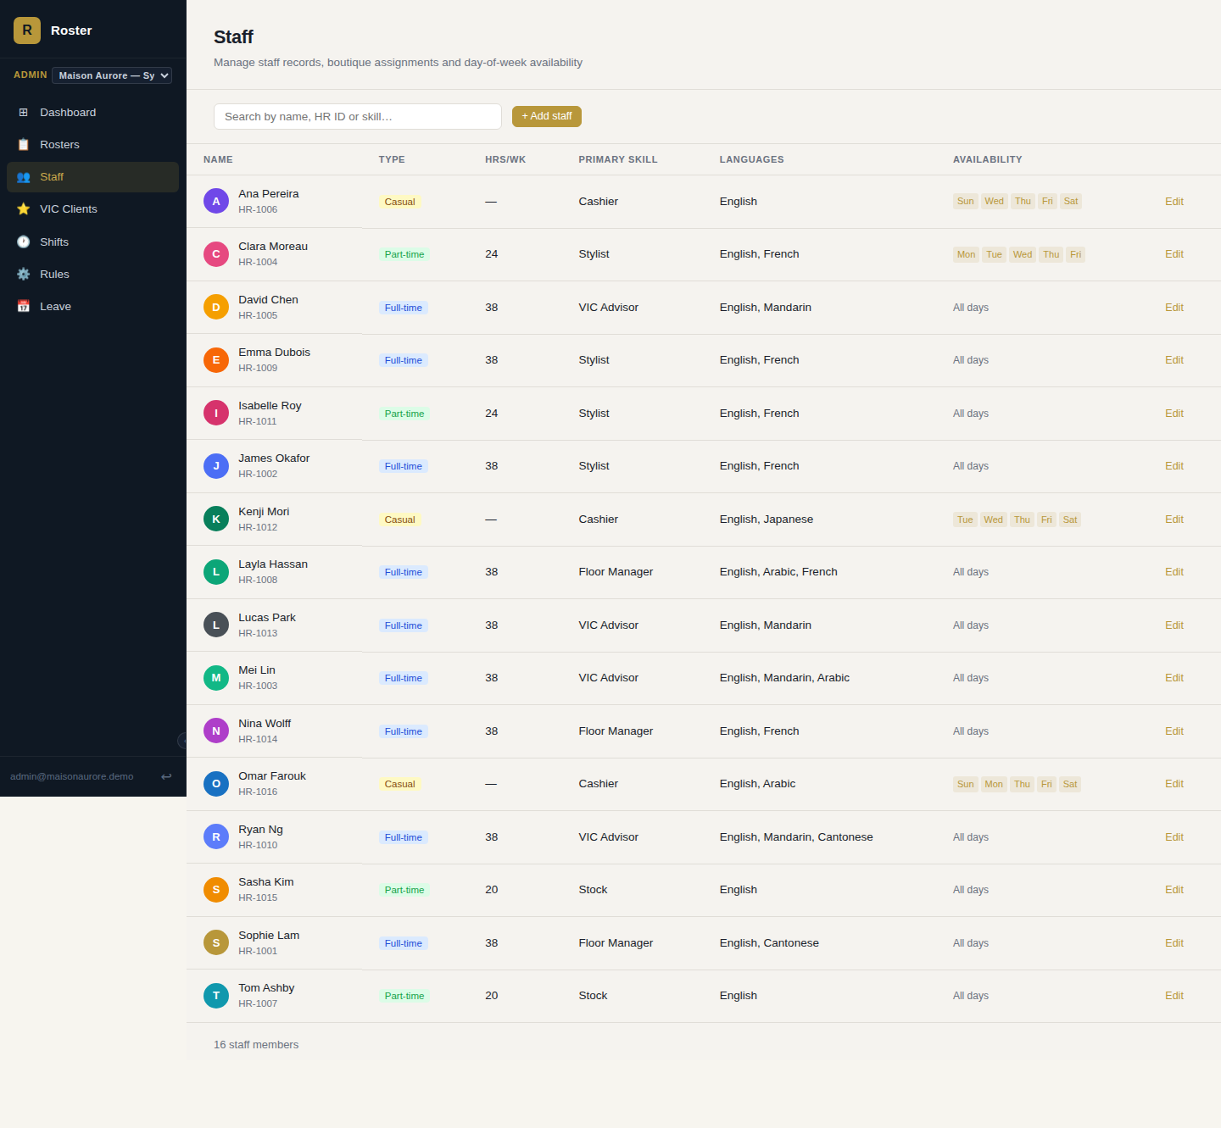
ADMIN · STAFF
One record per employee, shared by every downstream feature.
Employment type, contracted hours, seniority, languages, primary skill and day-of-week availability all live on the staff record — the same data the scheduling engine, VIC assignment and leave tracker all read from.
✦ Full-time, part-time, casual and contractor employment types
✦ Per-boutique day-of-week availability, not just a blanket flag
✦ Search by name, HR ID or skill
Staff directory — employment type, skills, languages, availability

Slide 8
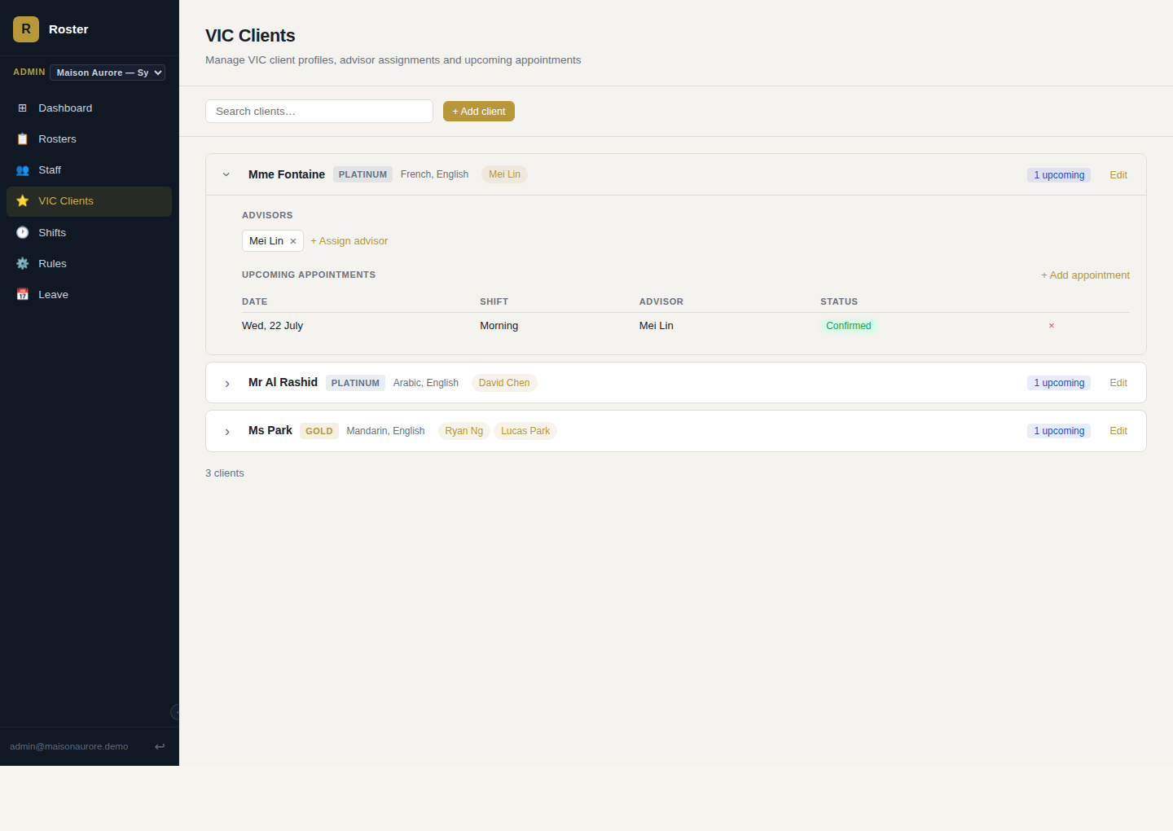
ADMIN · VIC CLIENTS
High-value clients always have a matched advisor on the floor.
Platinum, gold and silver clients each carry preferred languages and a list of affiliated advisors — the roster engine treats an unstaffed VIC appointment as a scoring penalty, not an afterthought.
✦ Tiered client profiles with preferred-language matching
✦ Advisor assignment independent of the roster-generation run
✦ Upcoming appointments tracked per client, with status
VIC client card — tier, advisors, upcoming appointment

Slide 9
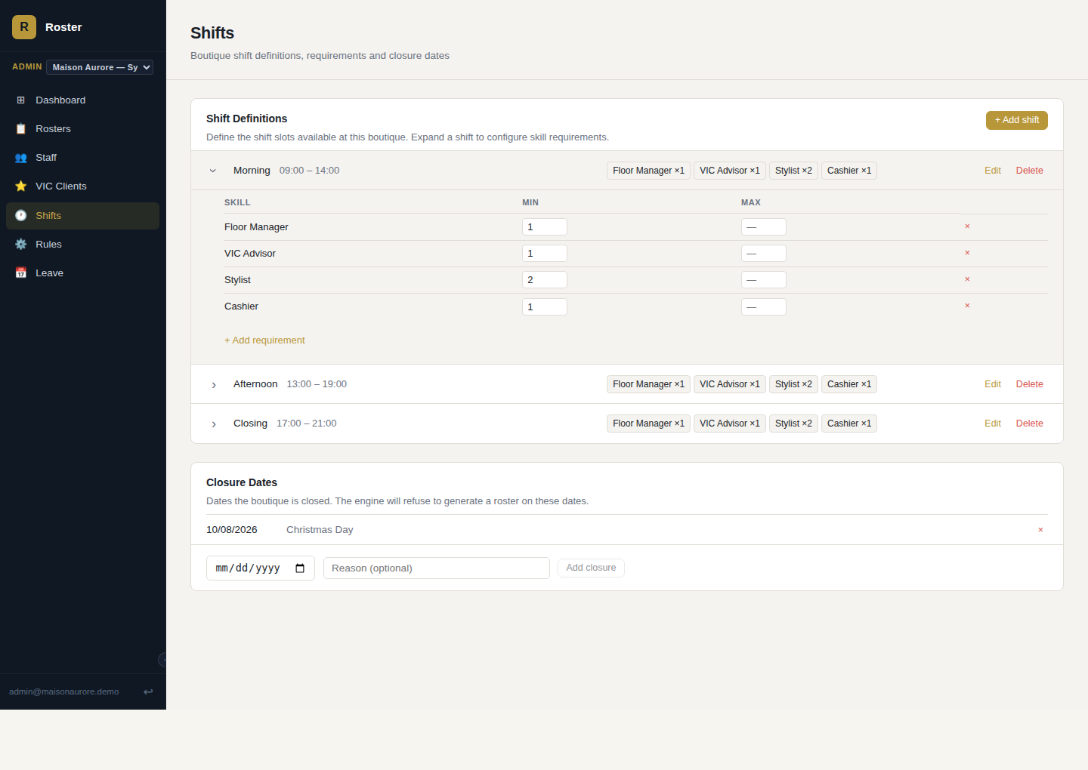
ADMIN · SHIFTS
Every boutique defines its own shifts and staffing minimums.
Shift times, sort order and validity windows are configured per boutique, each with its own per-skill minimum headcount — plus a closure calendar the engine refuses to schedule against.
✦ Independent shift definitions per boutique — no shared template lock-in
✦ Minimum (and optional maximum) headcount per skill, per shift
✦ Closure dates the engine automatically respects
Shift definitions with per-skill minimum staffing

Slide 10
ADMIN · SHIFTS & ROSTERS
Staffing minimums for a specific part of the floor, not just the shift as a whole.
Shift: Opening — requirements by area
Counter
CASHIER ×1
Areas — Counter, Fitting Room, Concierge, Stockroom, or however a boutique lays out its floor — carry their own skill requirements alongside the shift-wide ones. The scheduling engine fills the tighter, area-specific need first, then rounds out the rest of the shift from whoever's left.
Fitting Room
SR. STYLIST ×1
Concierge
VIC ADVISOR ×1
Shift-wide
FLOOR MANAGER ×1
✦ Define any number of areas per boutique, activated or retired independently — no code change to add one
✦ A requirement can be area-specific or shift-wide, and both are supported side by side on the same shift
✦ Every assignment carries its area end to end: roster editing, CSV/PDF export, and each employee's own schedule
Illustrative — a shift's skill requirements, broken out by area of the floor

Slide 11
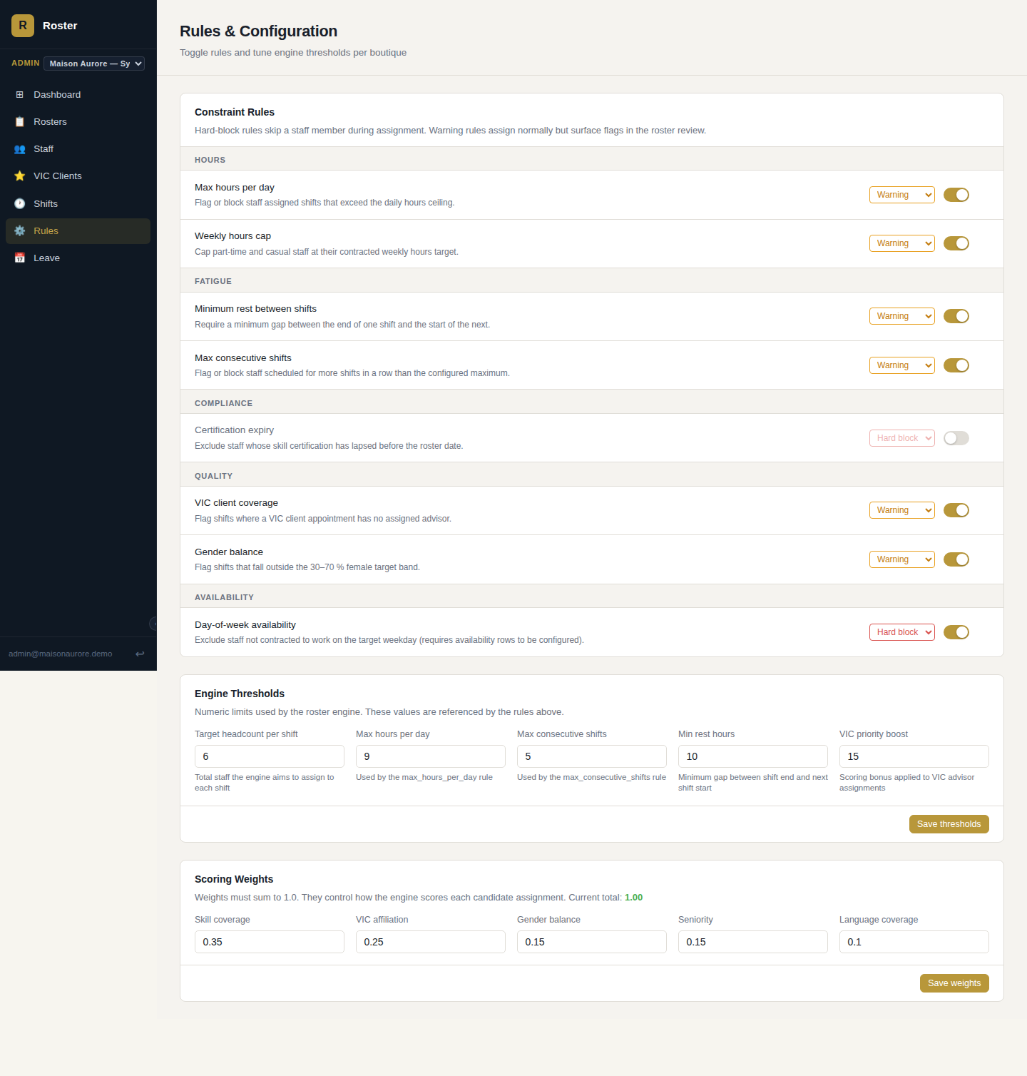
ADMIN · RULES
Tune the engine without touching a line of code.
Eight constraint rules — hours, fatigue, compliance, coverage and availability — can each be switched between warning and hard-block, independently per boutique.
✦ Hard-block vs. warning severity, set per rule
✦ Target headcount, max hours, rest hours and VIC boost all editable
✦ Scoring weights validated to sum to 1.0 before saving
Eight constraint rules, engine thresholds and scoring weights — all per boutique

Slide 12
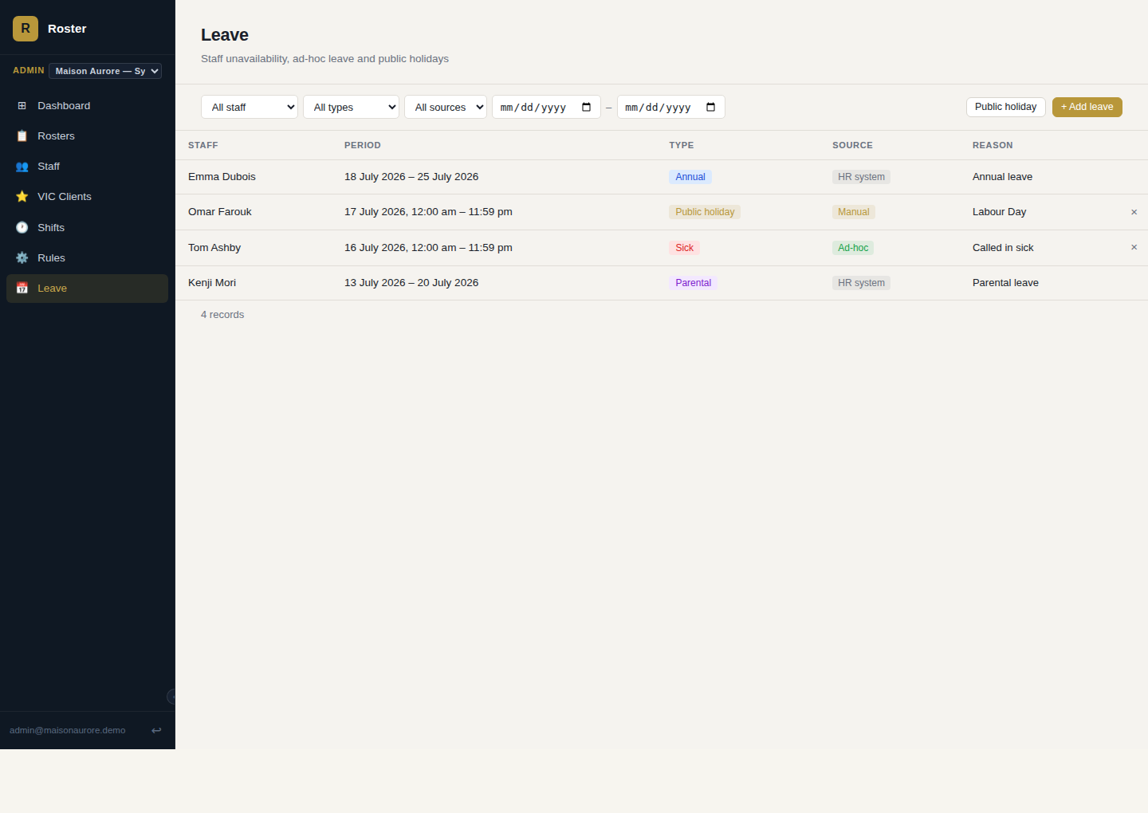
ADMIN · LEAVE
Leave feeds straight into who the engine considers available.
Annual, sick, parental, unpaid and public-holiday leave are tracked per staff member, tagged by source, and automatically exclude that person from generation on those dates.
✦ Bulk "public holiday" entry for every staff member in one action
✦ HR-synced records are protected from accidental deletion
✦ Filterable by staff, leave type, source and date range
Leave register — HR-synced, ad-hoc and manual records side by side

Slide 13
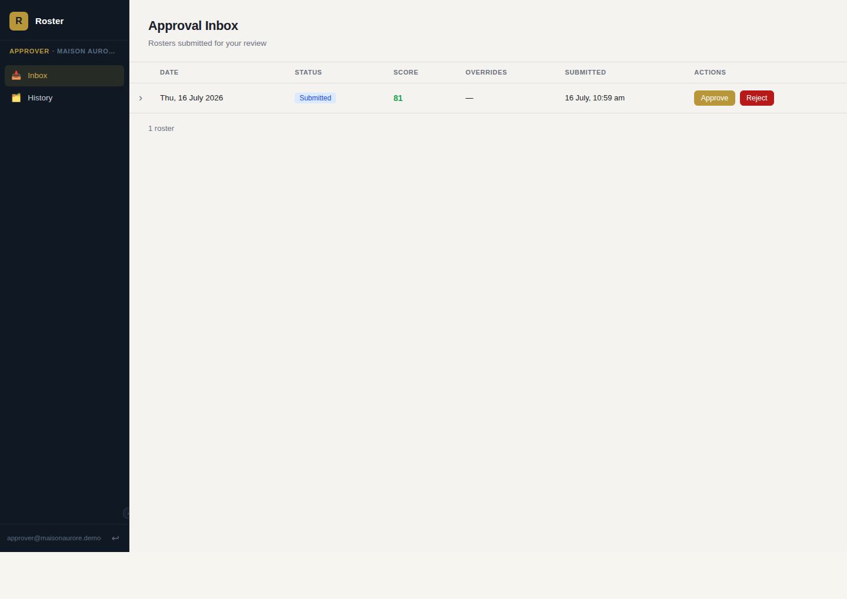
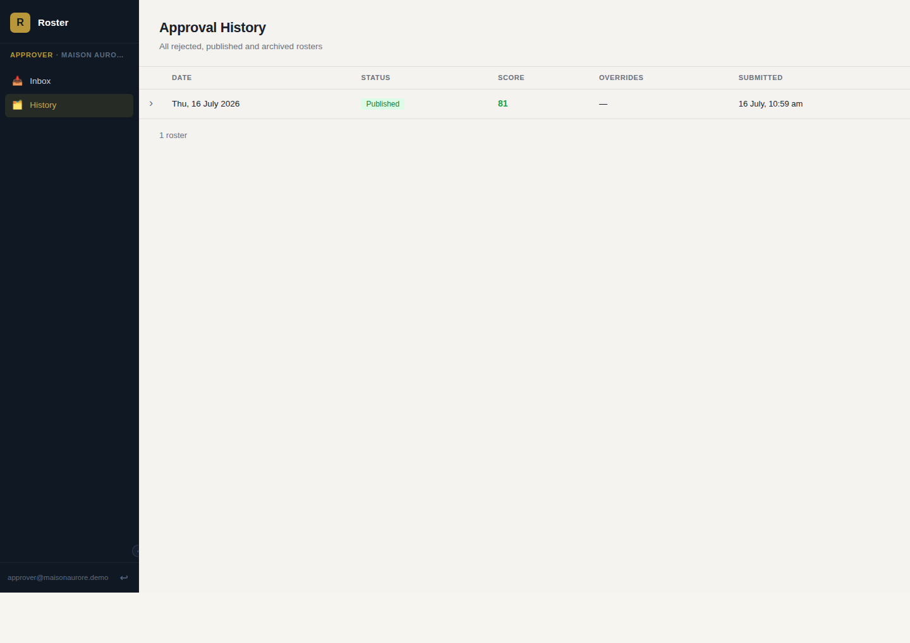
APPROVER · INBOX & HISTORY
A second pair of eyes, kept structurally separate from the drafter.
Approvers get a dedicated inbox of submitted rosters — score, overrides and full shift detail — with approve, reject (with a note back to the admin) and publish.
Approval Inbox
✦ Rejection returns a roster to draft with a reason, no dead ends
✦ Publishing safely replaces any previously published roster for that date
✦ Full approval history — published, rejected and archived — kept separately
Approval History — amended vs. published, kept apart

Slide 14
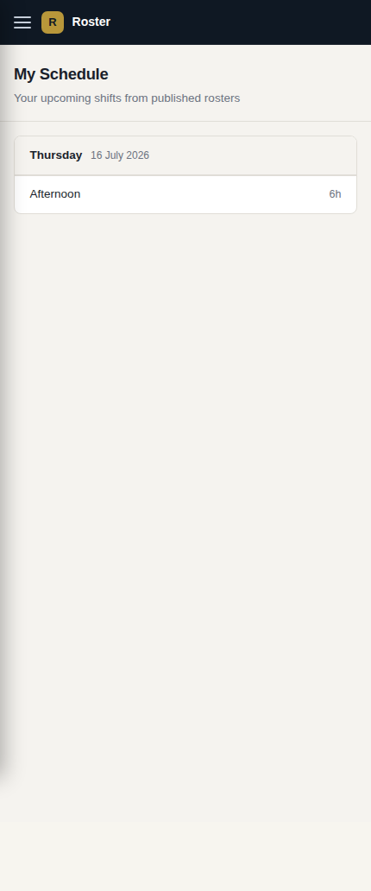
STAFF · MY SCHEDULE
Every employee can check their own shifts without asking a manager.
Once a roster is published, each staff member with a linked account sees their own upcoming shifts — shift name, VIC flag and duration — grouped by day, on a mobile-first layout built for checking on the go.
✦ Reads only published rosters — never a draft in progress
✦ No admin or approver access required, just a linked staff record
✦ Leave requests and a team view are scoped for a later phase
My Schedule — an employee's own view, on their own phone

Slide 15
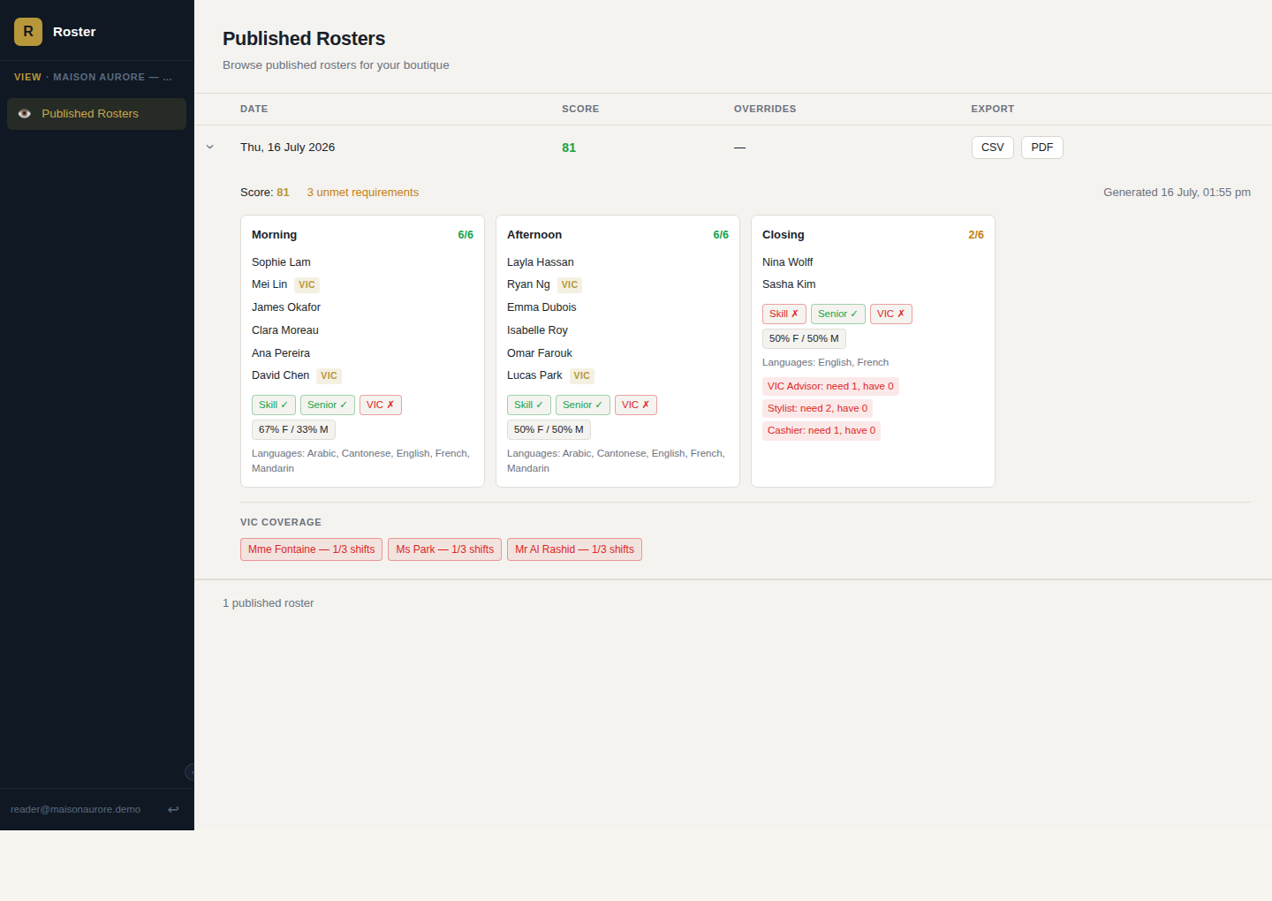
READER · PUBLISHED ROSTERS
A shared screen or a printout, without a spreadsheet in between.
Lists every published roster for its boutique and expands to the identical staff-mix and rule-flag detail view admins and approvers see, minus any edit controls. Every row exports straight to CSV or a print-ready PDF.
✦ Shows published rosters only — drafts and pending approvals stay invisible
✦ One-click CSV export for downstream systems, PDF for printing or a shared screen
✦ No admin or approver access required — a login scoped to one boutique, read-only
Read-only roster detail, with CSV and PDF export on every row

Slide 16

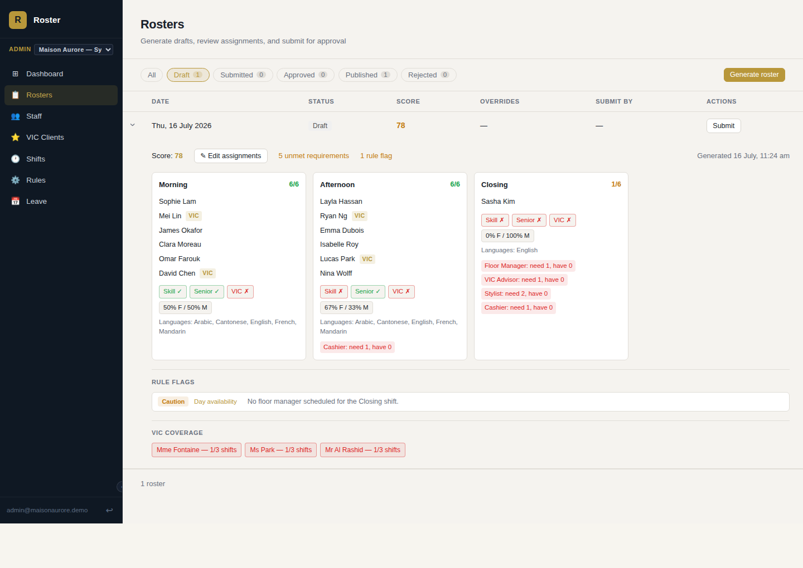

BUSINESS AGILITY, IN PRACTICE
A staff member calls in sick — the morning of a published shift.
A real run-through, captured from the app: a rostered stylist becomes unavailable after her shift is already live, and the correction goes out through the normal review path in minutes.
1
2
3
LOG THE LEAVE
REGENERATE
RE-APPROVE & PUBLISH
Admin · Leave
Admin · Rosters
Approver · History
The admin adds an ad-hoc sick-leave record for today, on the spot — timestamped and attributed like every other leave record.
Re-running Generate for the same date automatically excludes her and fills the shift from the bench — no one hunts for a replacement.
Submitted and published through the same approval step as any roster. The record for this date now shows both versions.
✦
Same day, one date, two versions, zero manual reconciliation: the corrected roster is published, the original is kept as an Amended record rather than deleted.

Slide 17
BUDGET PLANNING
What each role's screen time is worth.
Framed the way a budget review usually wants it: who uses which portal, and what it replaces.
PORTAL | TYPICAL USER | REPLACES / REDUCES | VALUE
Admin Rosters, Staff, VIC, Shifts, Rules, Leave | Store or regional operations admin | Manual spreadsheet rostering, side-channel leave tracking | One generation run replaces hours of manual shift-building per boutique per week
Approver Inbox, History | Boutique or regional manager | Ad-hoc email/print sign-off with no audit trail | A single queue with a permanent, searchable approval record
Staff My Schedule | Every floor employee | "What's my shift?" messages to the manager | Removes a constant low-value interruption from every admin's day
Reader Published Rosters | Shared/back-of-house display | Printed roster taped to a wall, manual CSV exports | Always-current view, plus one-click CSV/PDF export, with no reprint cycle
COST OF SCALING TO MORE BOUTIQUES
Staff, VIC clients, shifts, rules and scoring weights are configured per boutique inside the same deployment. Adding a store is a data-entry and configuration exercise, not a new engineering project.
No backend server to run
No compute costs for the scheduling engine
One data model across every boutique
Auto-deploy on every change

Slide 18
WHAT'S NEXT
Scoped, not hidden.
A few screens are intentionally stubbed for a later phase rather than rushed — worth knowing for planning purposes.
PHASE 4
PHASE 4
Staff leave requests
Team view for staff
Let employees submit their own unavailability instead of going through an admin.
Let staff see the published roster for their whole boutique, not just their own shifts.

Slide 19
✦
Four roles. One system. Built to add the
next boutique, not rebuild for it.
Product overview for internal budget review

