Slide 1
IV
MEDIA STUDIES 9607 · UNIT II
Sound
Media Language · Lesson 04 of 19
Two days · Wednesday 16 (double) to Friday 18 September · second of the four technical elements
Notes:
The double is the right home for day one: the sound-only opener needs twenty uninterrupted minutes and it is the only activity in the band that makes an invisible element visible.

Slide 2
IV
HOW THIS LESSON OPENS
The screen
goes black.
Notes:
No preamble. Play the sequence twice with no picture before a single term is introduced.

Slide 3
TWENTY MINUTES, NO PICTURE
THE COURSEBOOK'S OWN ACTIVITY
Build the scene from the soundtrack
01
02
03
First pass
Second pass
Then the picture
Screen black. Write down every sound you hear. Include the small sounds you usually ignore.
Same audio. Now write what you think is happening and what the picture will show. Commit to your guess.
Watch it properly. Compare the scene you built against the scene that exists, out loud, as a class.
KEY POINT You built a whole scene from audio alone. Sound was doing that work all along, unnoticed.
MEDIA STUDIES 9607 · SEMESTER I
01
Notes:
PROPOSED content: the chosen sequence must be dense in ambient sound and score with no decodable dialogue; note the text and timecodes here before teaching. D2 opens with Lexicon Bingo as retrieval and the three-minute blind listen; the D1 homework is three sounds collected from your own environment, recorded on a phone.

Slide 4
“
Sound is often neglected ... it is worth doing some targeted work on this, in particularly helping learners to develop a vocabulary of sound terminology.
Cambridge Scheme of Work (2021), Component 2 Section A
IN PLAIN WORDS Most candidates write very little about sound. Learn the sound terms and you stand out.

Slide 5
THE SYLLABUS LIST
EVERY TERM IS EXAMINABLE
What you can now name
Where it lives
How it moves
diegetic · non-diegetic
synchronous · asynchronous
sound bridge · sound motif
sound perspective · ambient sound
Who speaks
The soundtrack
dialogue · voiceover
direct address · sound mixing
score · incidental music
themes and stings · sound effects
STRETCH TERMS Rare in exam scripts, easy to learn: harmony, dissonance, discordance, rhythm, crescendo, pitch, timbre.
MEDIA STUDIES 9607 · SEMESTER I
02
Notes:
Land each term on a moment from the sequence they just heard blind, not on an abstract definition. Sound effects restored to the list 2026-08-24: it is on the syllabus list and WS 2.2.

Slide 6
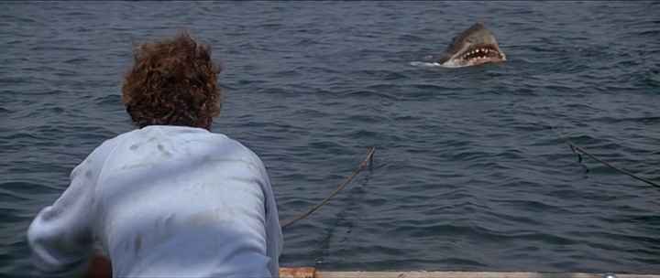
THE SOUND MOTIF
TWO NOTES, AND YOU KNOW
Jaws (1975), dir. Steven Spielberg: the fin surfaces behind the chum line
TERM Sound motif: a repeated sound attached to a character or idea, until the sound alone carries it.
THE CASE Jaws attaches two low notes to the shark. After the first attack, the notes alone create the fear.
EXAM SENTENCE “The recurring two-note motif signals the shark's presence before we see it.”
MEDIA STUDIES 9607 · SEMESTER I
03
Notes:
Coursebook 2.3 names the Jaws shark theme as the classic sound-motif example, and the film already anchors the camera deck, so the set coheres. Ask: what would your opening's motif be, and what would it be welded to?

Slide 7
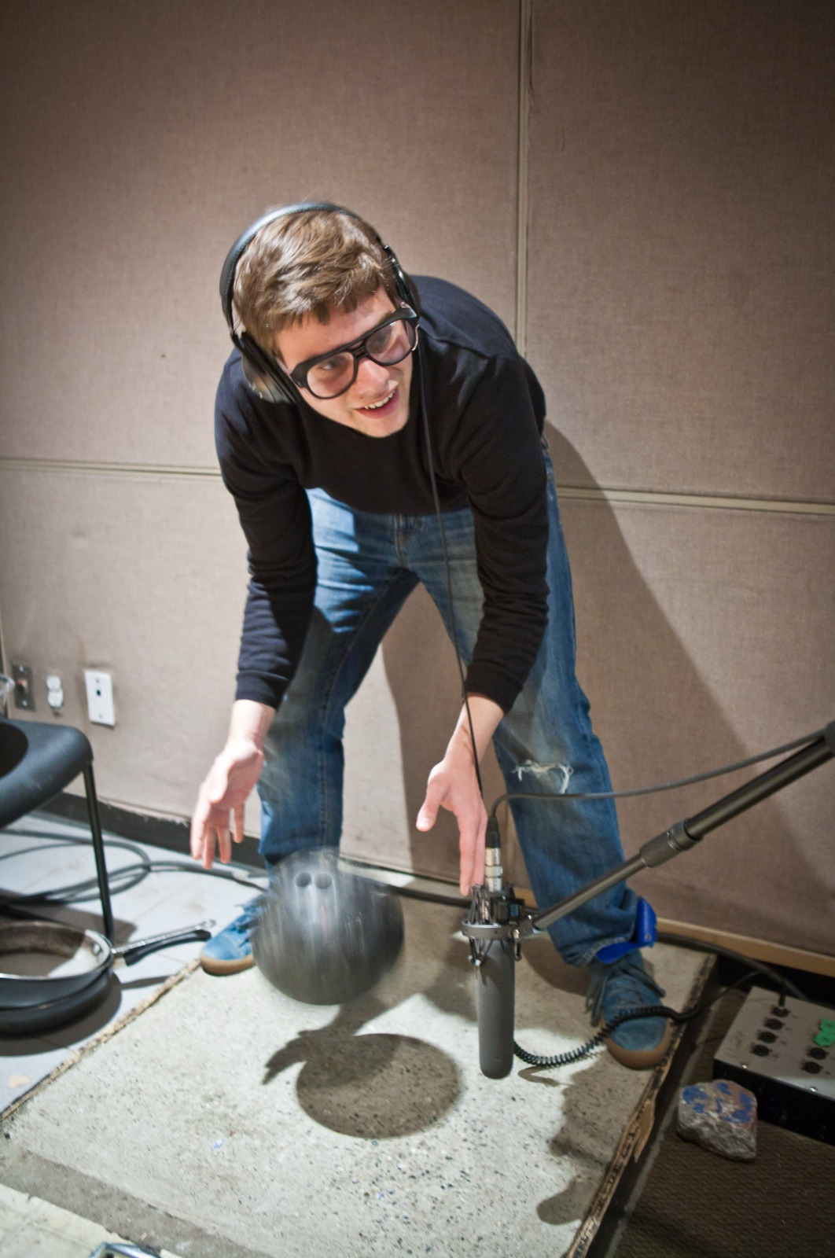
SOUND, MADE VISIBLE
The room where sound is built
TERM Foley: sound effects performed and recorded after filming.
Almost nothing you hear in a finished scene was recorded on set. Footsteps, cloth, a glass, a door: all performed later, in a room like this.
KEY POINT Every sound was chosen and placed. If you can hear it, someone decided you would.
A foley room at work. Vancouver Film School, CC BY 2.0
Notes:
The one image the 2026-08-12 pass added; it stays. The stations slide later makes the room's work the students' own.

Slide 8
THE LINE, AND CROSSING IT
NAMING THE CROSSING EARNS THE MOST
A car radio, then a kitchen
Diegetic
Non-diegetic
The song plays on the car radio. It exists in the world of the text and the character can hear it.
The same song continues over the next scene, in a kitchen, with no radio. Only you can hear it now.
INT. CAR
INT. KITCHEN
the cut
TERM Sound bridge: one sound continues, unbroken, across a cut.
EXAM SENTENCE “The sound bridge connects the car and the kitchen, so the two spaces feel like one story.”
MEDIA STUDIES 9607 · SEMESTER I
04
Notes:
The waveform runs under both boxes and straight through the cut: that continuity is the whole concept. If a screened pair is wanted, any cold open with a carried song does it; keep it exam-eligible.

Slide 9
THE FASTEST PROOF IN THE COURSE
Same pictures.
Different music.
Different genre.
We watch the same scene twice with two soundtracks. The genre changes. That is the proof: non-diegetic music is not decoration. It tells you how to feel.
Notes:
Keep the source sequence and both beds exam-eligible. A Chinese-drama comparison is a legitimate spoken aside afterwards, per the exam-example rule. The canonical archive example is the Scary Mary recut of Mary Poppins, family-safe if screened.

Slide 10
FOLEY · TWENTY-FIVE MINUTES
PHONES RECORDING, HEADPHONES ON
It does not have to be the real thing
Cambridge defines it precisely: incidental sound effects which are created artificially to enhance the drama, but which are diegetic, that is, they exist within the world of the film.
Footsteps, three surfaces
A door, opened slowly and fast
Cloth movement, close to the mic
A punch
Liquid poured
Breath, gasp, hesitation
THE HABIT Headphones on for every take. Mic as close as the frame allows. Bad audio cannot be fixed later.
MEDIA STUDIES 9607 · SEMESTER I
05
Notes:
Also demonstrate the failure: twenty seconds of dialogue recorded near an open door, played back on a speaker, so the room hears what an uncontrolled space costs. Cambridge's own definition normalised here from an en dash to commas; all of its words are kept.

Slide 11
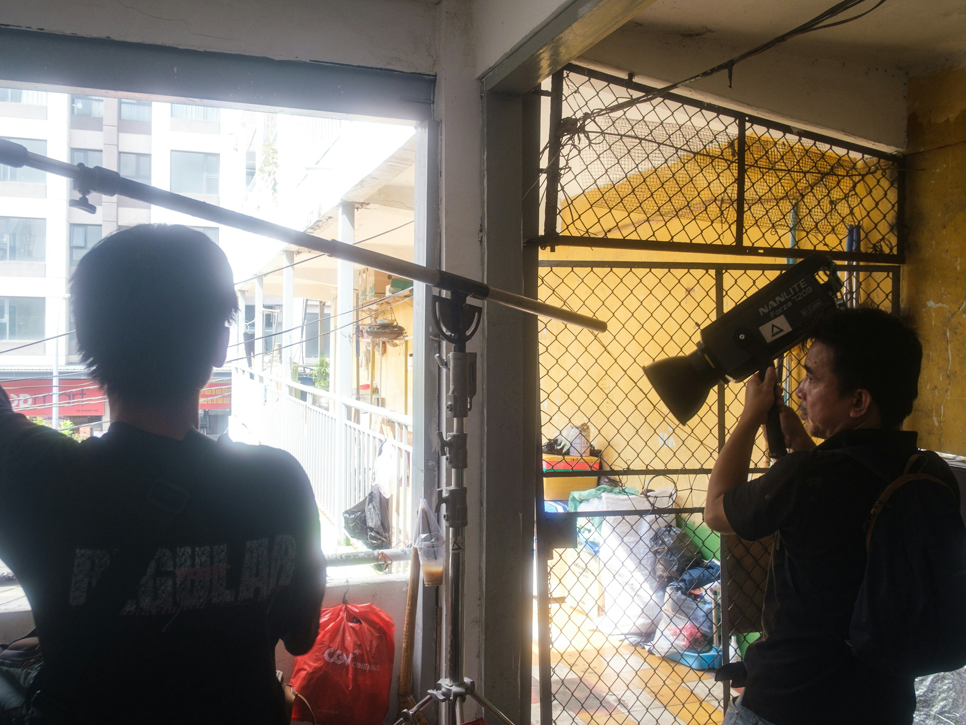
LOCATION SOUND
THE HABIT THAT SAVES THE SHOOT
Headphones on,
mic close
The boom pole holds the mic just outside the frame, as close as possible. On your shoots, the phone is the mic, and the habit is the same: listen on headphones during every take. If the sound is weak, move the mic closer. Do not turn the volume up.
Two crew, one job each: the frame, and the sound. Photograph: Tri Vo, Unsplash
MEDIA STUDIES 9607 · SEMESTER I
06
Notes:
The monitoring habit is policed at every shoot from CS4 onward. The photograph shows the division of labor a two-person student crew should copy.

Slide 12
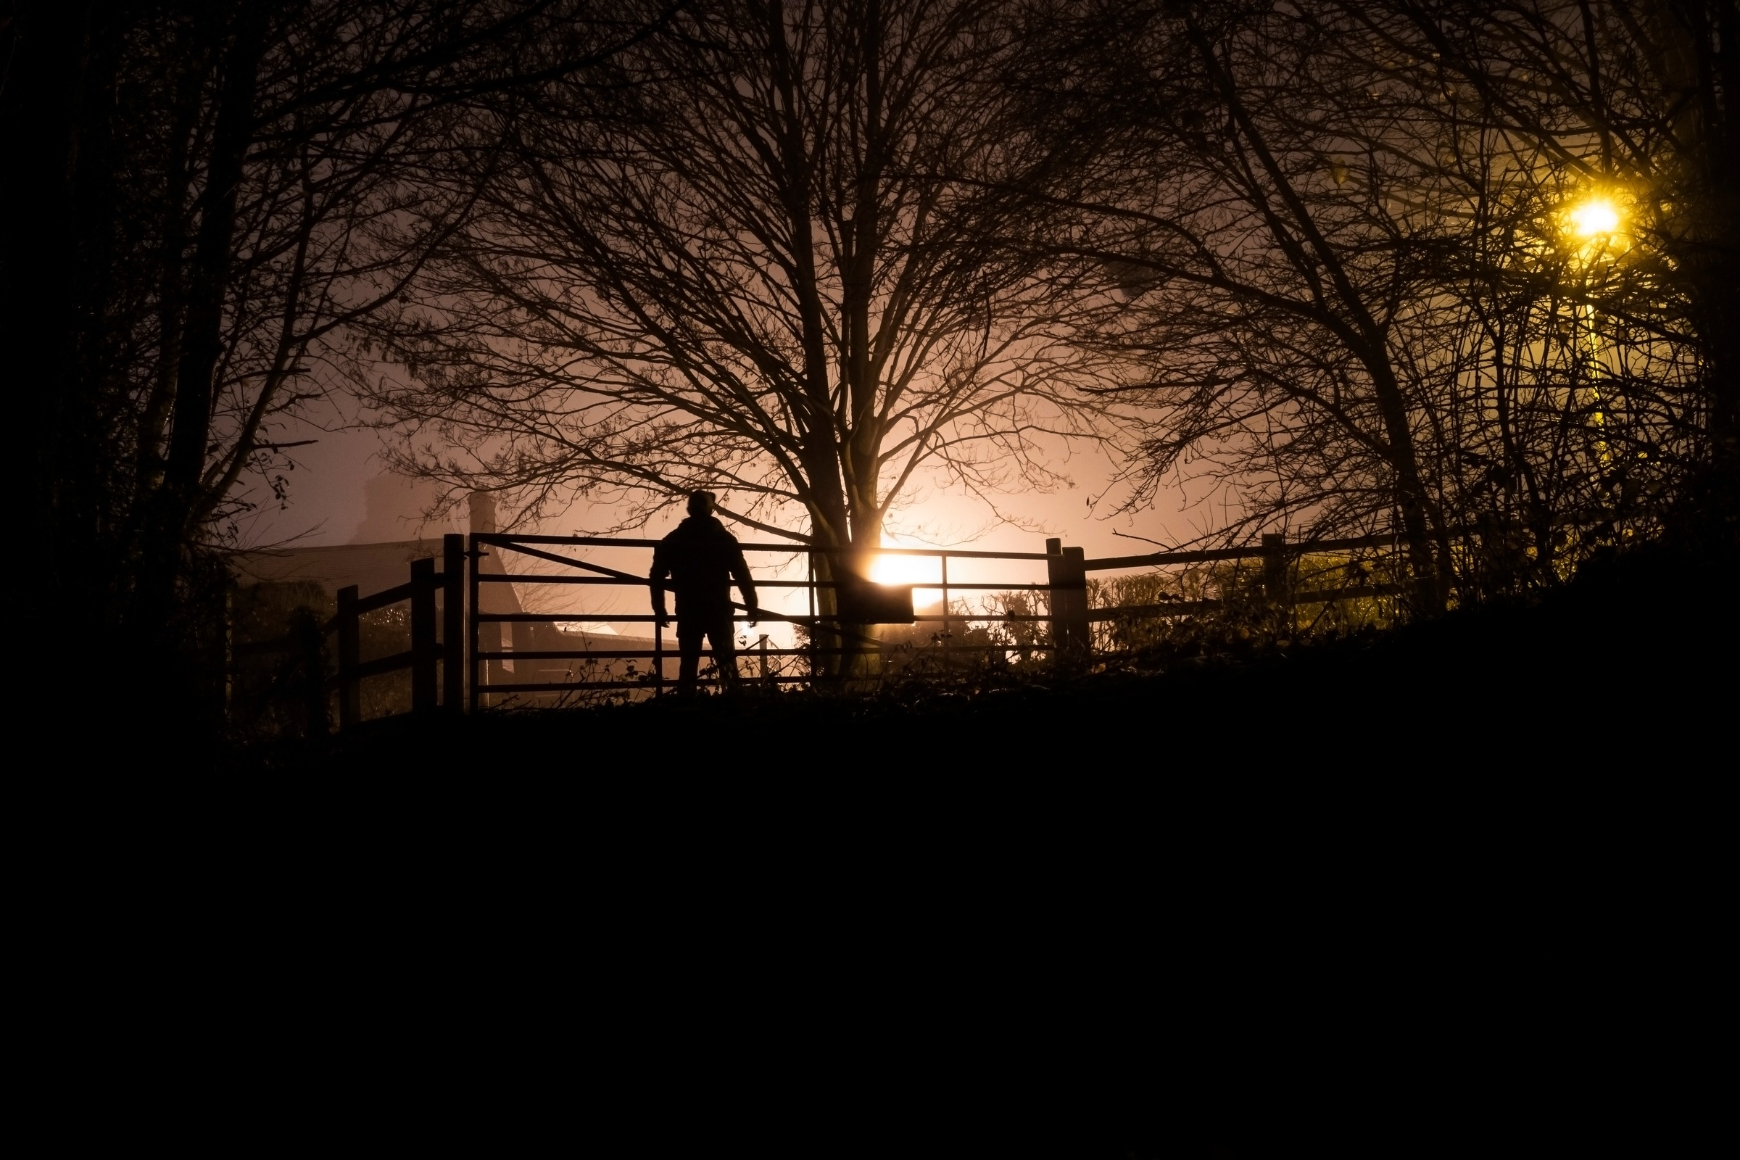
DELIVERABLE · CS4
FRIDAY, THIRTY MINUTES
Thirty seconds of your own opening
TASK Build it from your own recordings and the foley takes, plus one non-diegetic element. It must include:
One clearly diegetic sound
One clearly non-diegetic sound
One sound with clear perspective (near or far)
One sound bridge across an implied cut
THE BLOG Post it, dated, with a short rationale: name each choice by its term, and say what it does to the listener.
MARKED ON Terminology and intention, not polish.
Design the soundscape for this frame: the brief's own image (CUP Teacher's Resource)
MEDIA STUDIES 9607 · SEMESTER I
07
Notes:
The gate photograph is Deck U2.1 slide 2's own soundscape image, the coursebook's design-the-soundscape task: fog, a figure, one lamp. What do we hear, from where, and what carries over the cut?

Slide 13
WHY SOUND PAYS MORE THAN THE REST
NEGLECT IS AN OPPORTUNITY
The cheapest advantage in the course
THE FACT Cambridge says most candidates neglect sound. You are marked against those candidates.
An answer with no sound paragraph has a gap the examiner sees at once.
An answer that names a sound bridge or a shift in sound perspective stands out immediately.
LOOKING AHEAD In Grade 12, the Component 3 music and documentary briefs depend on sound. Every video task carries a mix.
MEDIA STUDIES 9607 · SEMESTER I
08

Slide 14
NEXT
Mise-en-scène
Lesson 05. Everything in the frame is a decision, and the design board you build is your Component 1 design document.
MEDIA STUDIES 9607 · SEMESTER I
09

