Slide 1
VI
MEDIA STUDIES 9607 · UNIT II
Editing
Media Language · Lesson 06 of 19
Two days · Wednesday 23 (double) then Monday 28 September · last of the four technical elements
Notes:
Five days separate the two sessions: Friday 25 is Mid-Autumn Festival. Open day two cold, with retrieval, and do not re-teach Wednesday.

Slide 2
VI
THE METHOD OF THIS LESSON
Invisible until
you break it.
Notes:
Wednesday builds a sequence that works. Monday builds the same sequence wrong on purpose, and the room watches the illusion collapse.

Slide 3
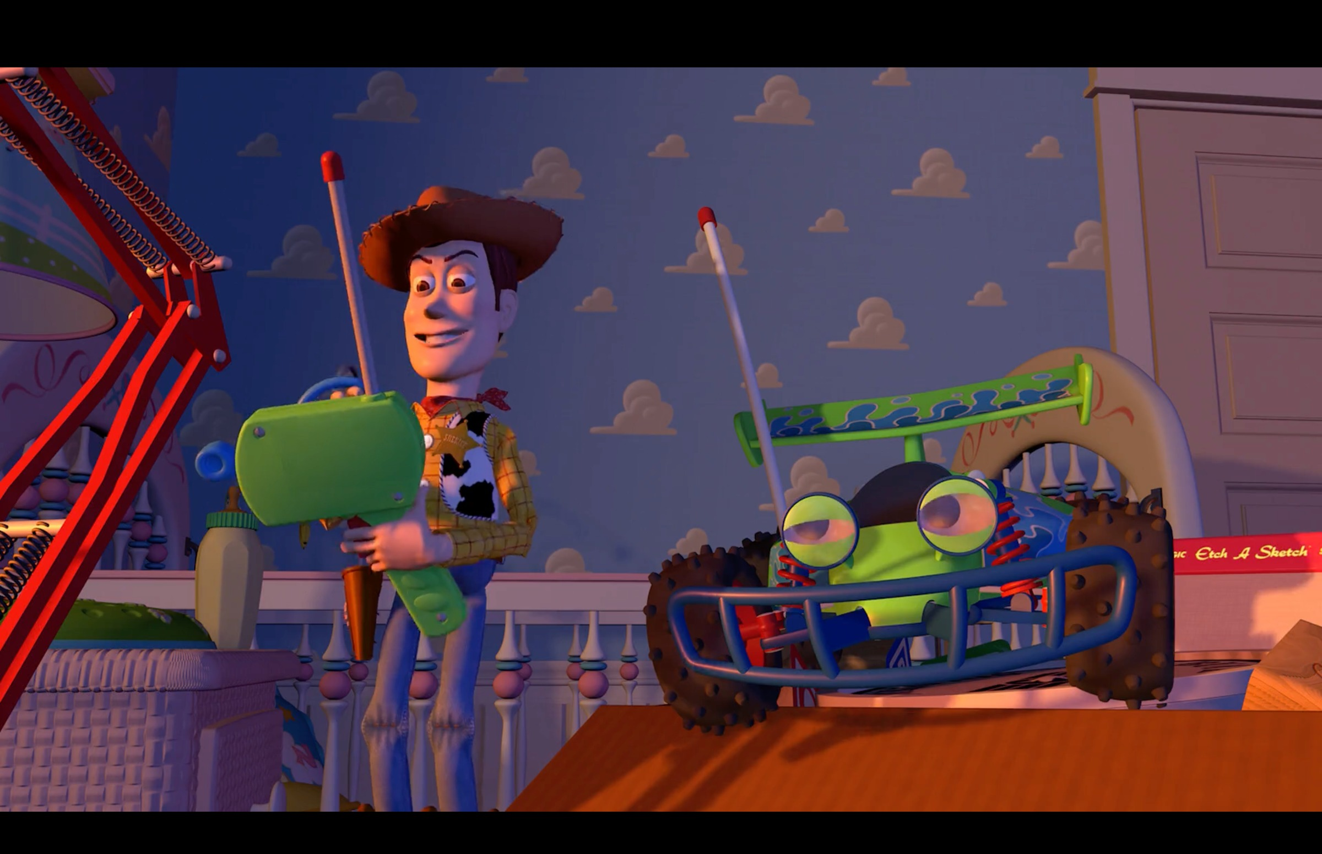
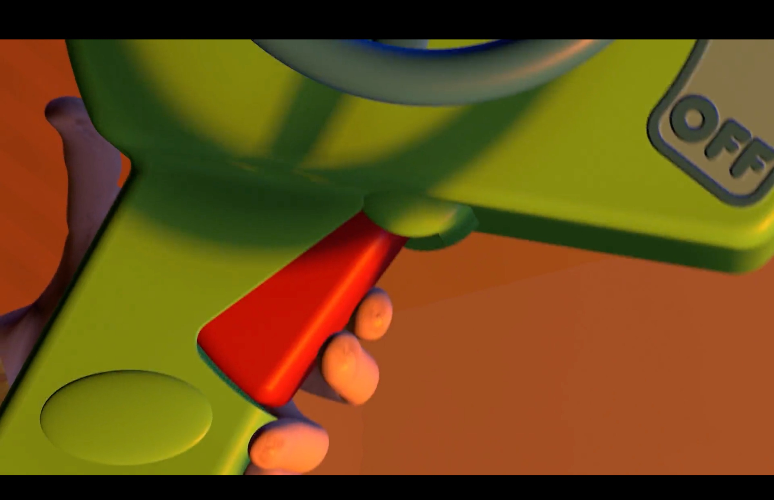
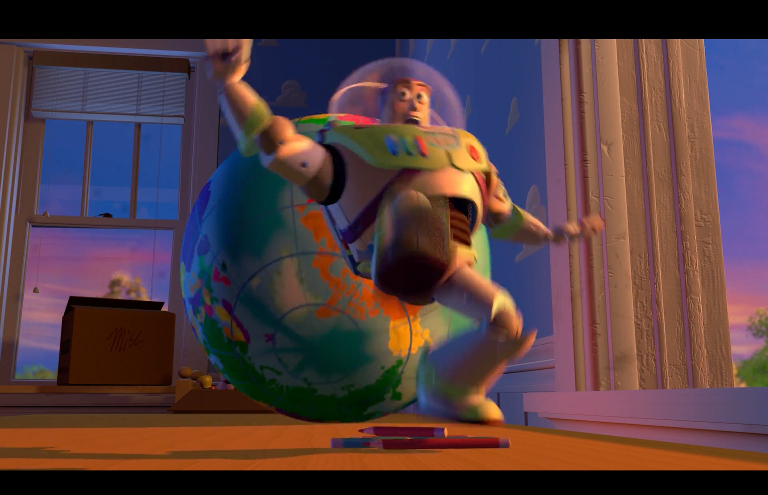
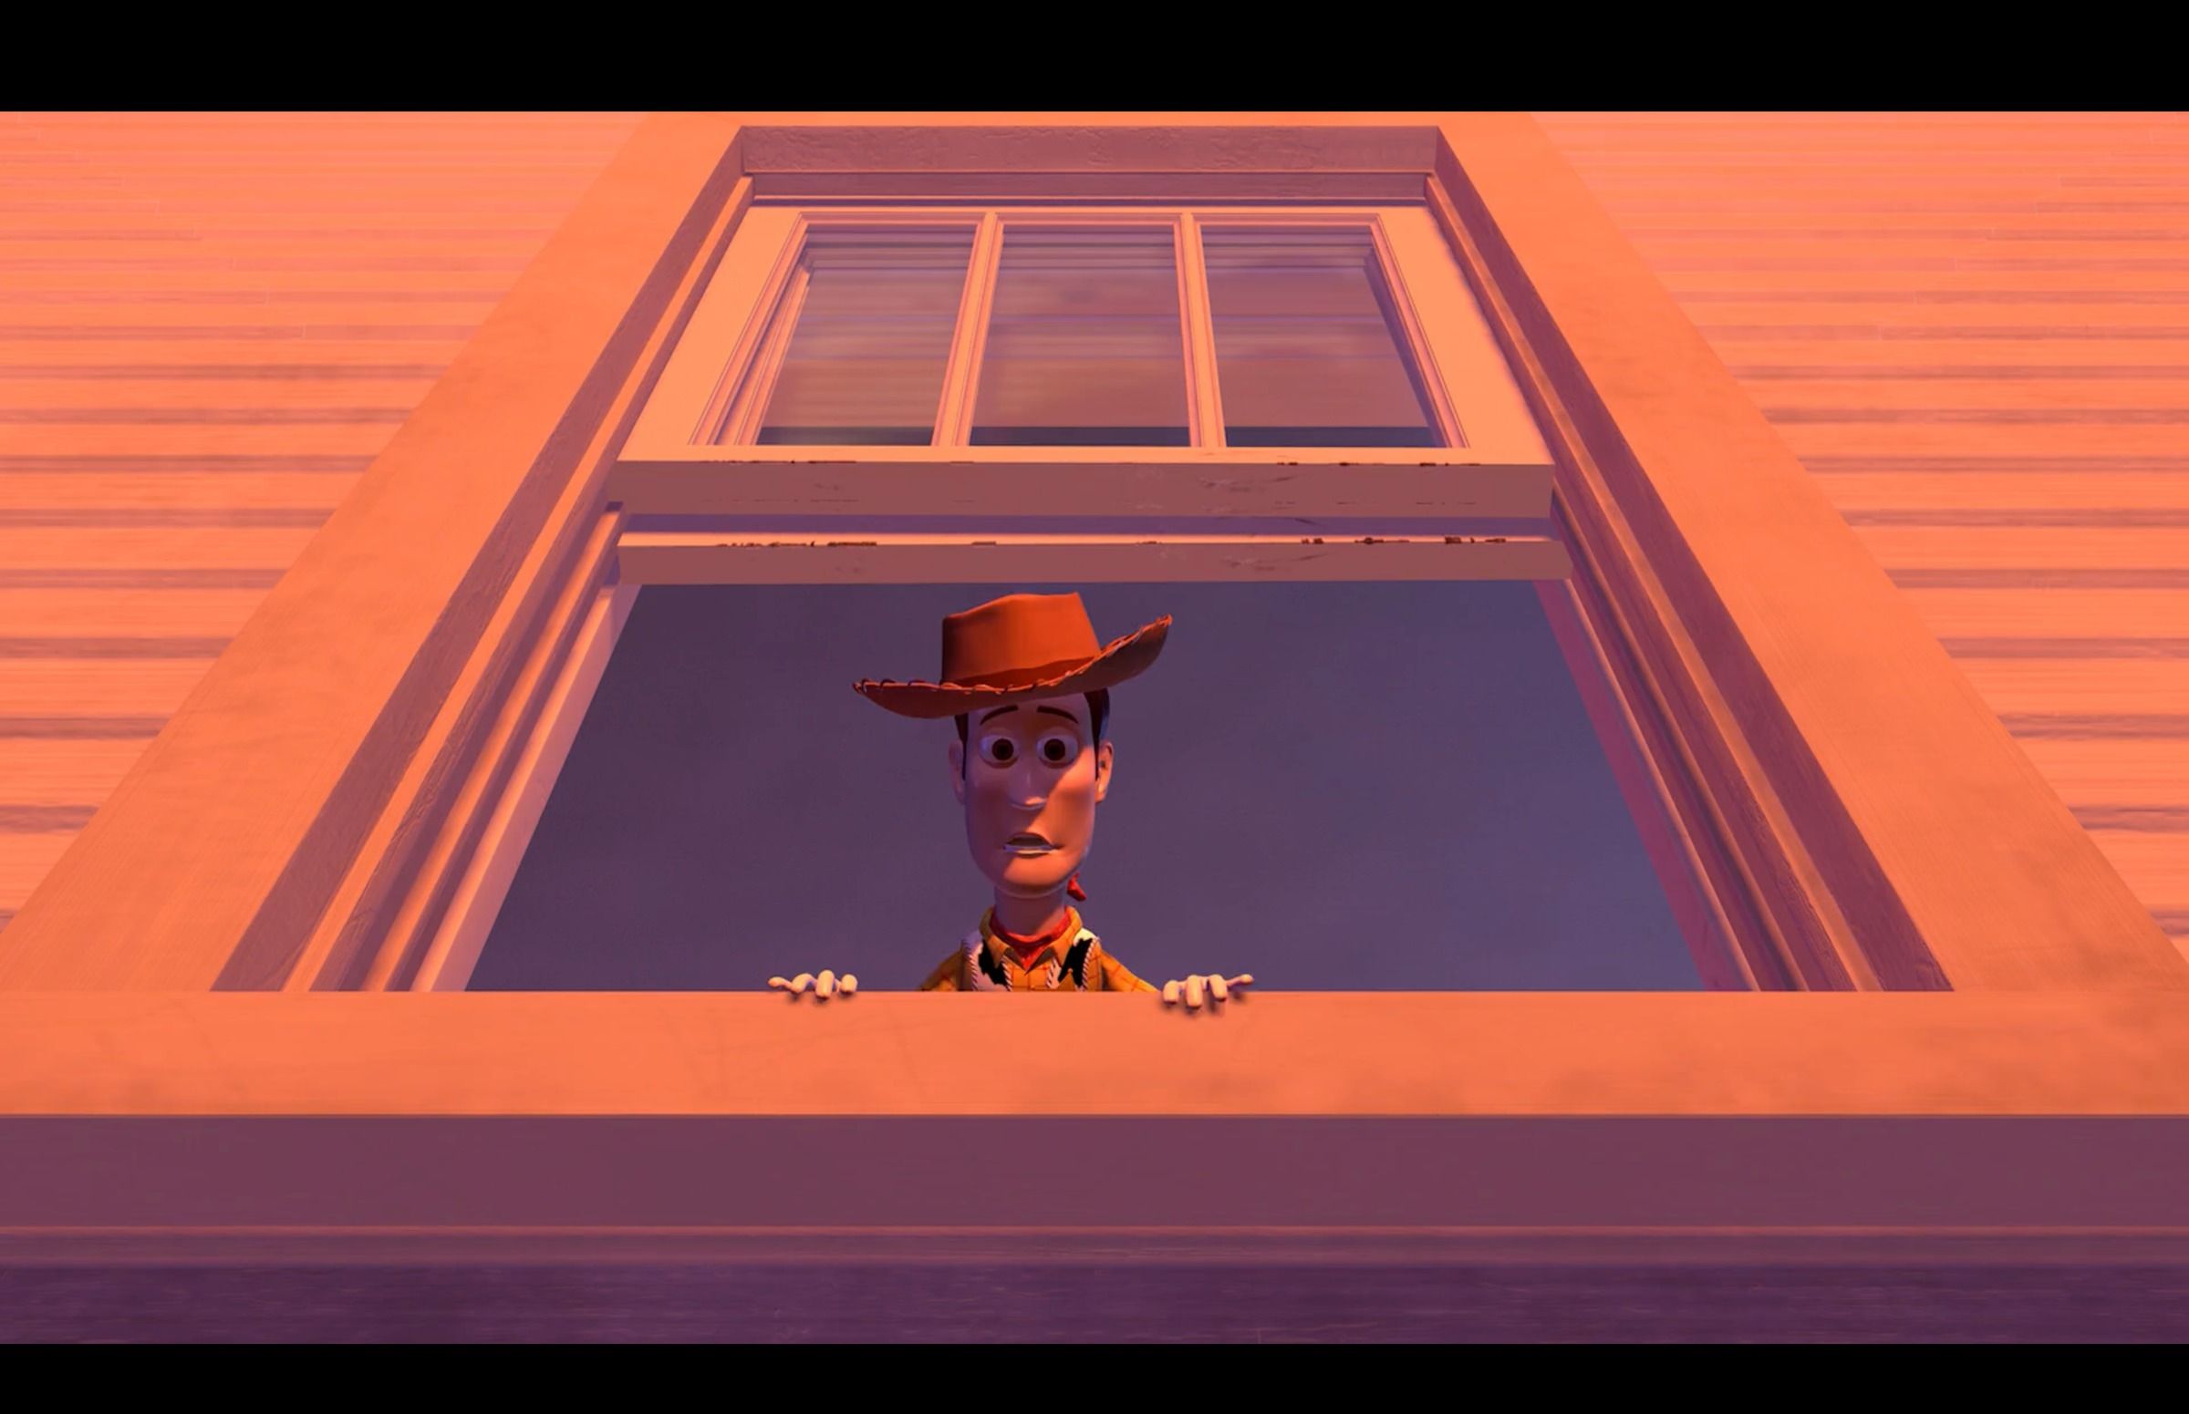
CLAP THE CUTS
THE COURSEBOOK'S ACTIVITY, FIFTEEN MINUTES
Count first, then say how it felt
✂
✂
✂
Toy Story (1995): four shots, three cuts, a few seconds. Mid shot, insert, action, reaction: clap-clap-clap.
01
02
03
How many claps?
How did you feel?
What was the editor doing to you?
The number is a fact. Write it down first.
Restless? Hurried? Calm? Given time to look?
Not what the scene shows: what the cutting speed does to your attention.
MEDIA STUDIES 9607 · SEMESTER I
01
Notes:
Two screened sequences, contrasting in pace: one dense-cut, one long take. Safeguarding: the prior plan used Adolescence, BBFC 15, with 1917 as the alternative. The Toy Story strip on the slide is the tally made visible: even a children's film cuts faster than the room expects.

Slide 4
“
Editing short sequences, just two or three shots to begin with: someone looking off-screen followed by the object they are looking at; shot / reverse shot for a conversation between two people (which is also an opportunity to highlight the 180-degree rule).
Cambridge Scheme of Work, Foundation Portfolio
IN PLAIN WORDS Start small: edit two or three shots. A look, then the thing seen. A conversation, cut shot by shot.

Slide 5
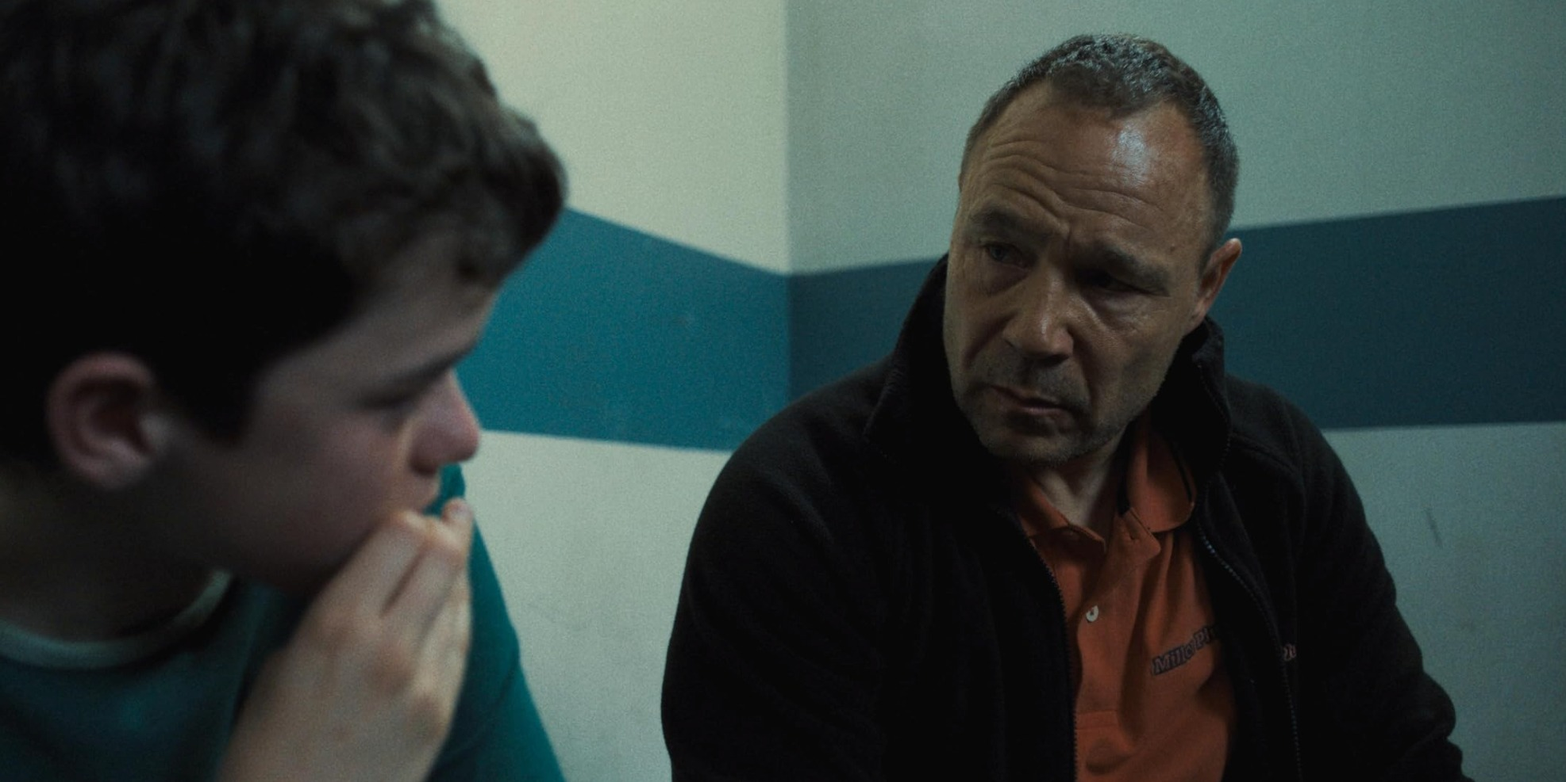
THE CONTINUITY SYSTEM
THE GRAMMAR OF INVISIBLE CUTTING
Shot / reverse shot
Eyeline match
Cutaway and insert
two angles that never share a frame
he looks down; the next shot is what he sees
a close detail that hides the join
C ✕
EXT.
wide
INT.
room
→
A
B
The 180-degree rule
Match on action
Establishing to interior
stay on one side and directions stay clear
cut during a movement and you never feel the join
outside first, then inside: the order tells you where you are
MEDIA STUDIES 9607 · SEMESTER I
02
Notes:
Frames: Adolescence (the over-the-shoulder; note the series is one continuous take, so its reframings do the work cuts normally do, which is itself the lesson) and Toy Story (eyeline, insert, match on action). The two drawn cells are the two ideas frames cannot carry alone.

Slide 6
THE 180-DEGREE RULE
CROSS IT AND THE ROOM FLIPS
Cross the line and two people
swap sides of the room
C
F1
F2
THE RULE Keep the camera on one side of the line between two speakers.
Cameras A and B keep each face on its own side of the screen. Camera C crosses the line, and the faces swap sides mid-conversation.
MONDAY Every pair will make this error on purpose: it is version two of CS6.
the line
A
B
Keep A and B on one side; C flips the geography.
MEDIA STUDIES 9607 · SEMESTER I
03
Notes:
Nobody who has made the error forgets the rule. The drawn cameras match the SoW's own exercise: shot / reverse shot with the rule highlighted.

Slide 7
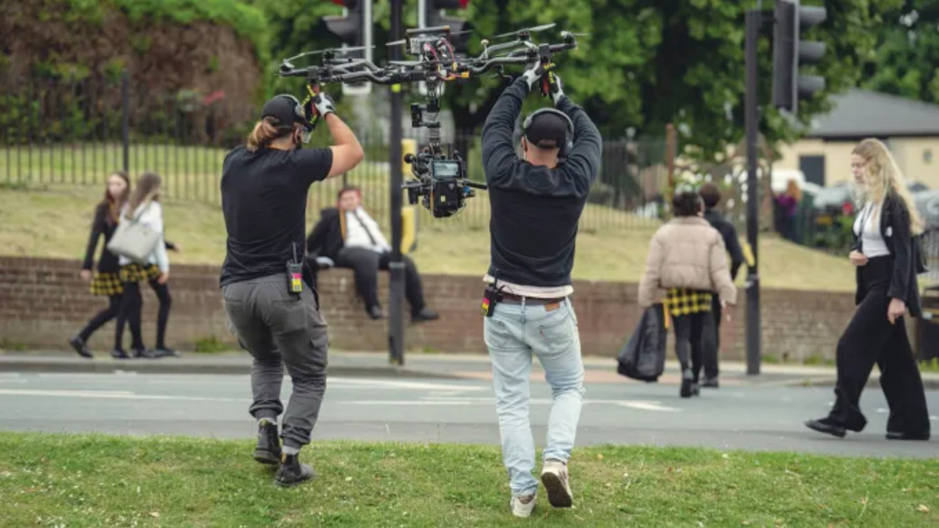
DURATION · THE CUT YOU NEVER GOT
Two crew members carry the camera mid-take. One episode, one shot: every minute without a cut was rehearsed and carried by hand.
Adolescence (Netflix, 2025), production photograph
Notes:
Not cutting is also an editing decision, and this photograph is what that decision costs to make. The interview-room frame from L02 is the same take, minutes deeper.

Slide 8
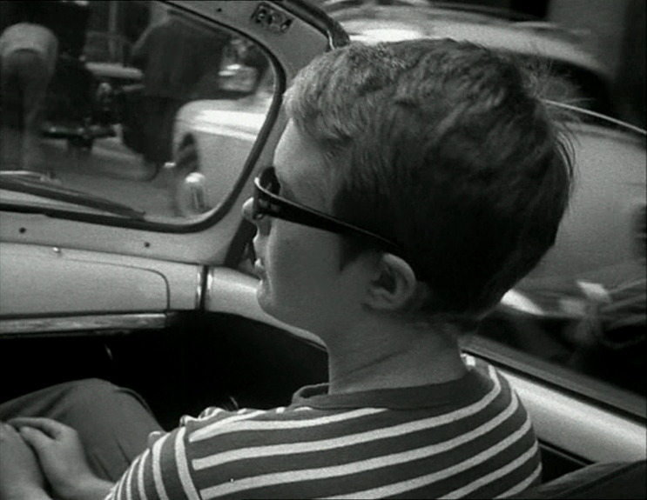
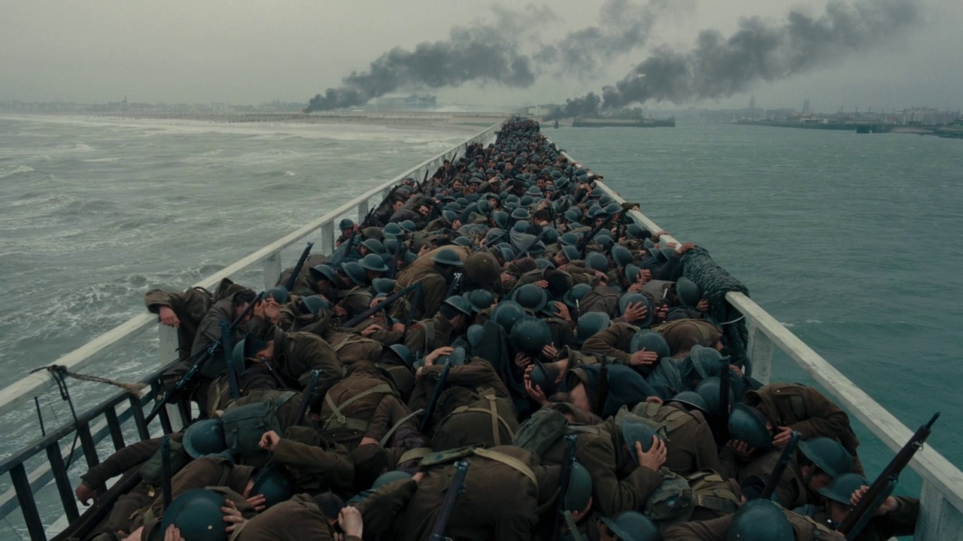
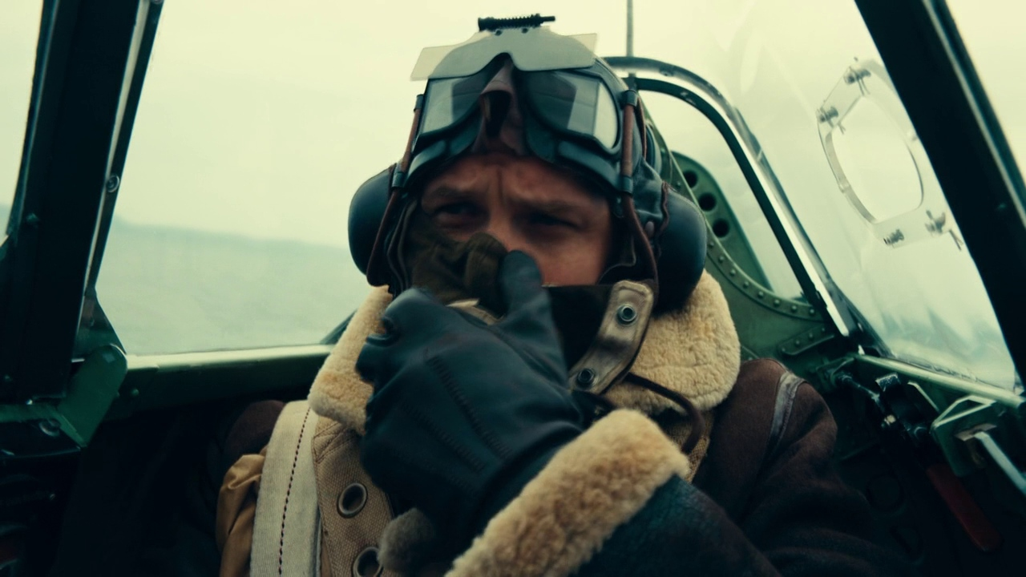
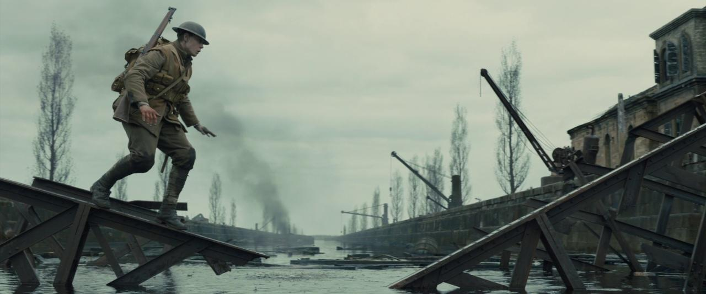
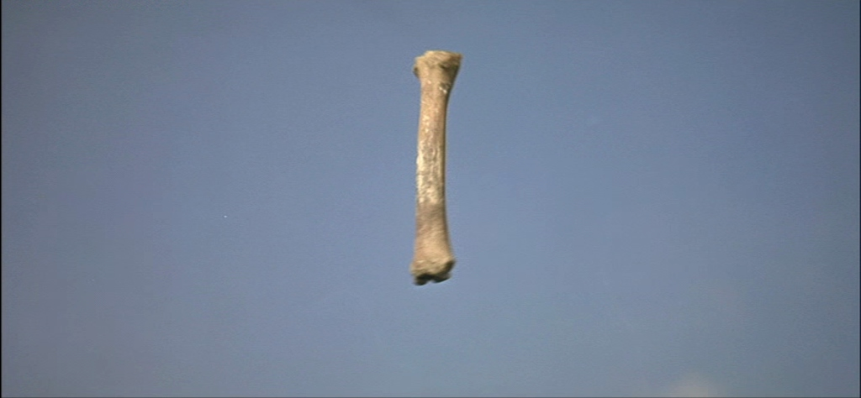
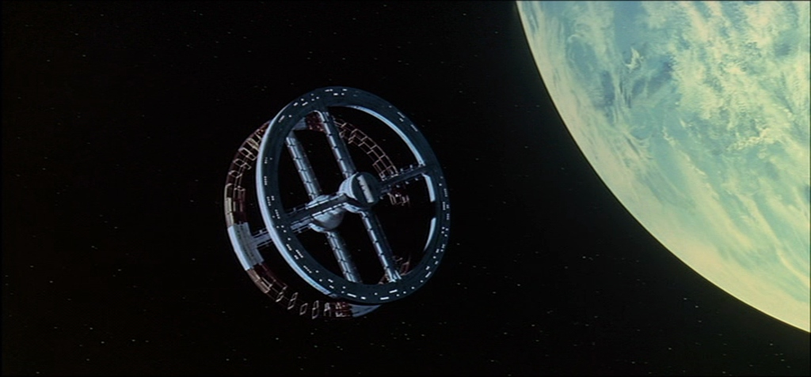
DAY TWO · JIGSAW
WHEN THE SYSTEM IS REFUSED
Jump cut
Breathless (1960): time jumps forward inside one shot. The jump cut breaks continuity on purpose.
Crosscutting
Dunkirk (2017): two places, cut against each other. Crosscutting builds one shared tension.
Graphic match
2001 (1968): a bone becomes a spaceship. The matching shape carries the cut across millions of years.
The long take
1917 (2019): two hours with no visible cut. The long take builds tension.
ALSO ON THE LIST ellipsis, expansion of time, slow motion, dissolves, fades, wipes, superimposition.
EXAM WARNING Long take, short take, and slow motion belong to editing, not camera. Candidates misfile them every year.
MEDIA STUDIES 9607 · SEMESTER I
04
Notes:
Four groups, four minutes, teach back. Psycho's eye close-up is in img/ as the second graphic-match example; slow motion is taught by clip (Chariots of Fire's beach run is the canonical case and is not frame-licensable from the archive, so it stays a screening).

Slide 9
REWRITING THE DEAD SENTENCE
EDITING'S VERSION OF THE NAMING PROBLEM
'The editing is fast-paced'
Worth nothing. No evidence, no effect, and every second script says it.
The sequence cuts eleven times in thirty seconds. The viewer never settles on one face, so the chase feels like disorientation, not observation.
THE FORMULA A count, an effect, and a claim about the viewer. The count is free: you learned it in the first fifteen minutes.
MEDIA STUDIES 9607 · SEMESTER I
05

Slide 10
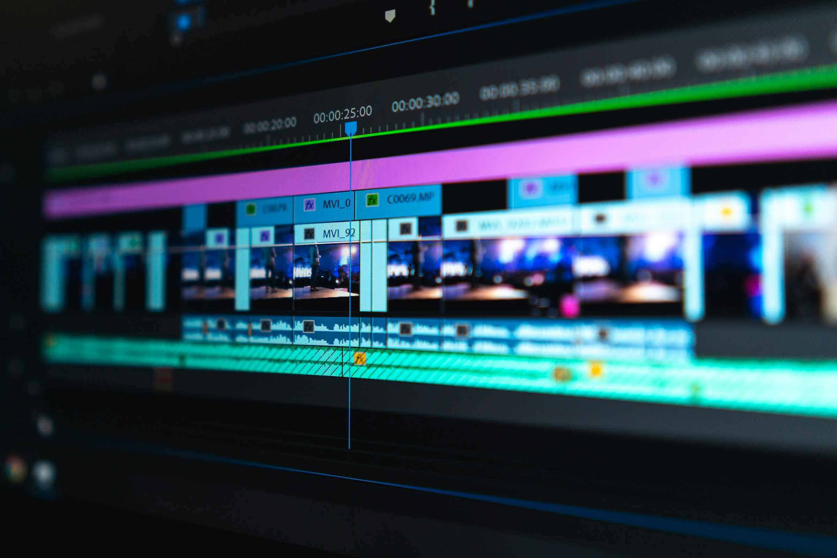
DELIVERABLE · CS6
MONDAY, TWENTY MINUTES
The same sequence, cut twice
Version one
Version two
Continuity held. An establishing shot, a shot / reverse shot exchange, one eyeline match. It must hold together. It does not have to be beautiful.
The 180-degree rule broken on purpose, plus one transition chosen and justified. The break must be the intended one, not an accident.
The cut, on any timeline you own: layers, trims, one dissolve. Photograph: Peter Stumpf, Unsplash
THE BLOG Post both versions, dated, with two or three sentences naming what breaks in version two.
MEDIA STUDIES 9607 · SEMESTER I
06
Notes:
Any editor works: CapCut, iMovie, a phone timeline. Also logged before leaving: the group's equipment decision, school sign-out or own kit, tested across the four builds; Wednesday's shootability checklist points at it.

Slide 11
FOUR ELEMENTS, FOUR BUILDS
WHAT IS NOW ON YOUR BLOG
The practice stage, evidenced
CS3
Camera
Six shots to a storyboard, focus and exposure held
CS4
Sound
A thirty-second soundscape, every choice named
CS5
Mise-en-scène
A six-cell design board, a connotation per cell
CS6
Editing
One sequence cut two ways, the difference explained
KEY POINT Four dated posts: the research-and-practice stage of Component 1, already complete.
LOOKING AHEAD The Grade 12 Component 3 video task is an editing task. The grade lives in the cut.
MEDIA STUDIES 9607 · SEMESTER I
07

Slide 12
NEXT
Integration and
the Planning Lock
Lesson 07. All four at once on one unseen extract, then a plan someone else could shoot.
MEDIA STUDIES 9607 · SEMESTER I
08

