Slide 1
IX
MEDIA STUDIES 9607 · UNIT III
Genre
Macro and Textual Analysis · Lesson 09 of 19
Two days · Friday 16 (Foreign Culture Day flag) to Monday 19 October · first of the macro elements
Notes:
Genre sits after A1 because Section A's prompt does not ask for it, and because a class that has shot four technical elements can now evidence an attribution properly.

Slide 2
IX
ALTMAN · NEALE
Genre is
a contract.
Notes:
Reframed from a box of tropes into an agreement between industry and audience: the version that earns marks.

Slide 3
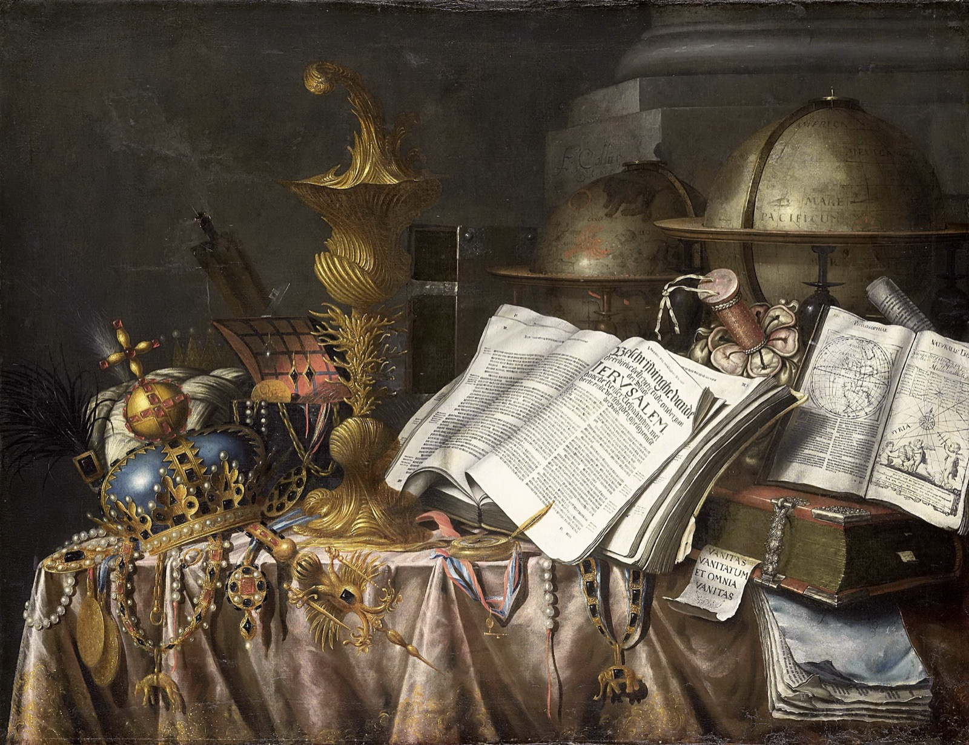
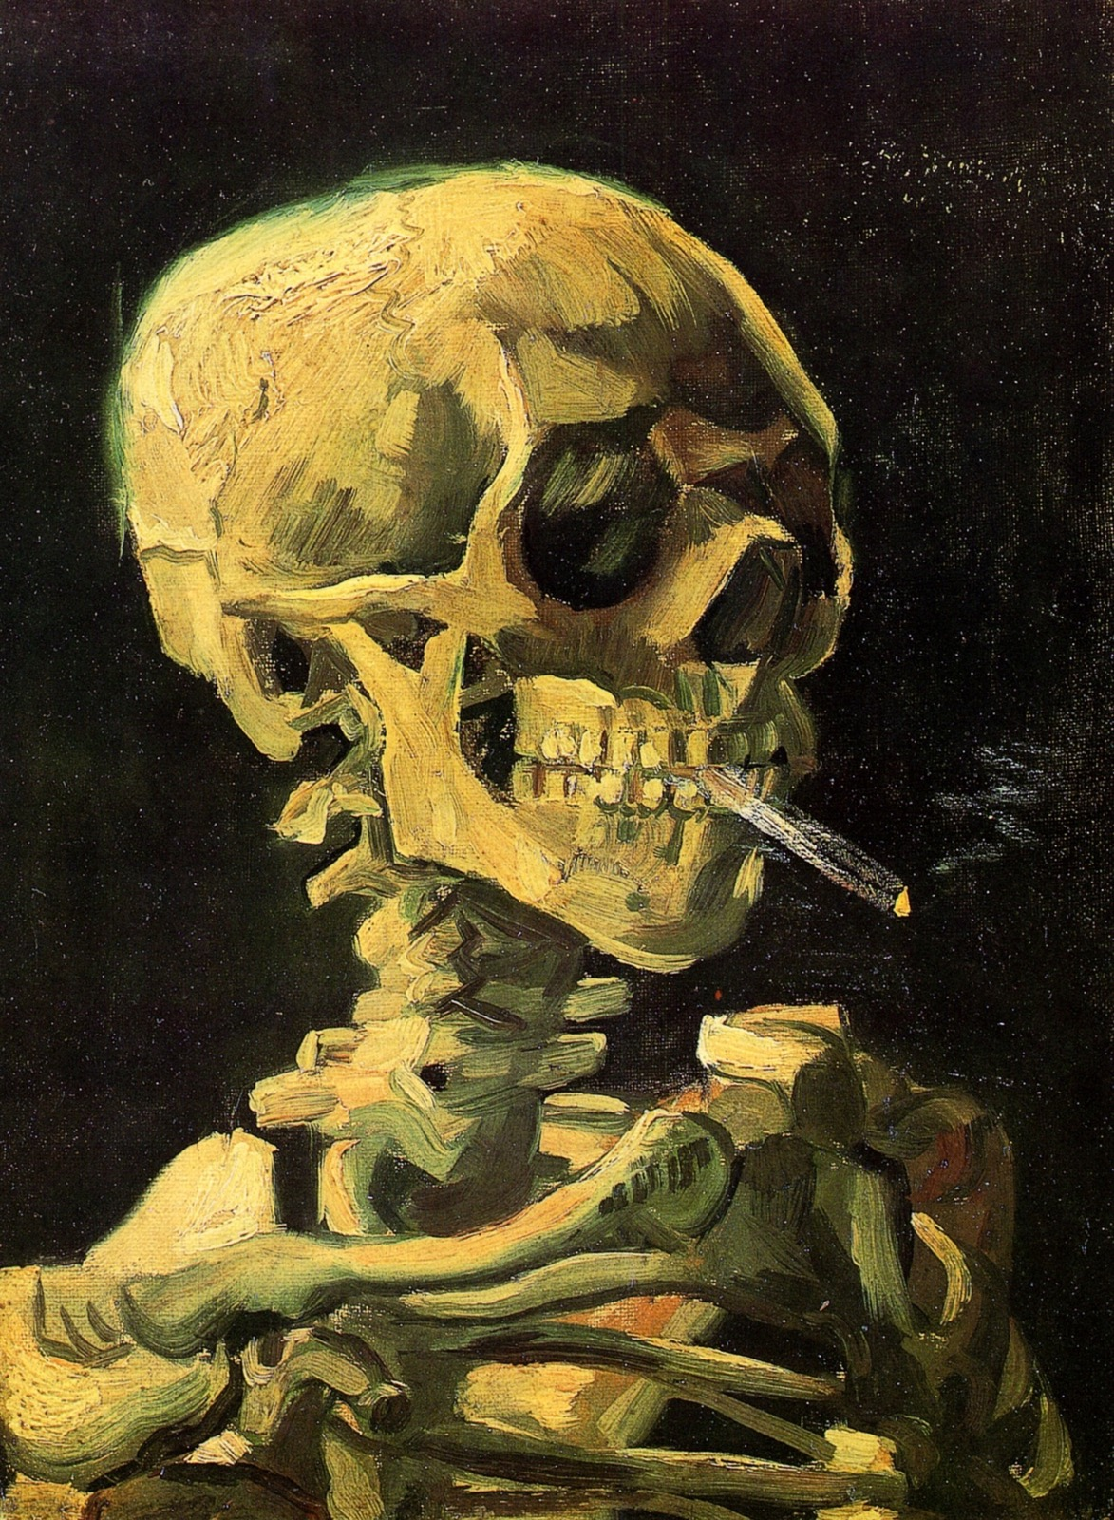
GENRE, WORKING
DIFFERENT PAINTERS, THREE CENTURIES APART
You knew instantly they belong together
Dutch vanitas still life, 17th century
Van Gogh, Skull with Burning Cigarette, 1885
Two skulls, three hundred years apart. You recognized the connection instantly, before any film term. That instant recognition is genre at work.
Notes:
Genre-recognition demonstrated on paintings students have never seen proves the mechanism is theirs already, before any film term is used. The plan scripts this starter; it stays.

Slide 4
“
Genres are instances of repetition and difference ... difference is absolutely essential to the economy of genre.
Steve Neale, Genre, 1980
IN PLAIN WORDS A genre repeats what audiences expect, and changes just enough. The change is what sells the ticket.

Slide 5
ALTMAN · THE DEAL
TWO SIDES OF ONE CONTRACT
Who gets what
The industry gets
The audience gets
A pre-sold product with a predictable budget. Genre lowers the risk: audiences already know what they are buying.
A promise of pleasure, with room for surprise. Enough of the familiar to trust it, enough difference to stay awake.
EXIT QUESTION Why does the industry need genre more than we do?
MEDIA STUDIES 9607 · SEMESTER I
01
Notes:
Stretch roster from the coursebook for fast readers: Lacey's repertoire of elements, Buckingham, Fiske.

Slide 6



REPETITION AND DIFFERENCE, ON ONE WALL
THE DEAL, PRINTED
Scream (1996), Scream 2 (1997), Scream 3 (2000): one-sheets
KEY POINT Same mask, same title style, same faces: repetition is the promise. The number is the difference that sells the ticket again.
TERM Neale calls this the economy of genre.
MEDIA STUDIES 9607 · SEMESTER I
02
Notes:
Posters used for classroom teaching. Ask which elements repeat cell to cell (mask, title type, ensemble grid) and which vary; the industry side of Altman's deal is visible in the sameness.

Slide 7
MAP A GENRE YOU KNOW
HORROR, CRIME DRAMA, SITCOM, DOCUMENTARY
Four questions of the contract
01
What repeats
02
What varies
The conventions the audience expects and would miss if absent.
The difference this instance offers: the reason to watch this one.
03
Who profits
04
What is promised
Who makes money from the repetition: the studio, the platform, the franchise.
The pleasure the audience is being sold: fear, romance, awe, comfort.
MEDIA STUDIES 9607 · SEMESTER I
03
Notes:
Each student maps one exam-plausible genre onto the contract. A C-drama or xianxia mapping is a legitimate spoken aside per the exam-example rule; the written mapping stays exam-facing.

Slide 8
“
Genre is not simply given by culture: rather, it is in a constant process of negotiation and change.
David Buckingham, 1993
IN PLAIN WORDS Genres are not fixed. Audiences and the industry keep re-negotiating what belongs in them.

Slide 9


TWO POSTERS, TWO CONTRACTS
WS 3.1: EXPECTATIONS AGAINST SIGNIFIERS
Expectations
What does each poster promise the evening will feel like?
Signifiers
Which exact elements carry the promise: type, palette, light, face, body?
The Conjuring (2013)
Free Solo (2018)
MEDIA STUDIES 9607 · SEMESTER I
04
Notes:
WS 3.1's two-poster comparison, which rehearses the L02 semiotics inside genre work: horror against documentary, dark serif dread against sunlit awe. Both one-sheets shown whole; the worksheet's columns run on exactly these two questions.

Slide 10

HYBRIDITY
Two contracts,
one ticket
TERM Hybridity: one text holding two genre contracts at once.
A romantic comedy, with zombies. The film keeps both promises: the warmth and the chaos. It needs both audiences.
TASK Name one hybrid text. Say what each parent genre contributes.
Shaun of the Dead (2004), one-sheet
Notes:
The D2 hybridity beat, with the canonical self-describing poster. The film is a 15; the poster is the teaching object, not a screening.

Slide 11
FOUR CORNERS · TITLES STRIPPED
THE BAR IS HIGHER THAN IT WAS IN SEPTEMBER
Evidence, not atmosphere
In September you would have said
Now you can say
It feels scary. The music is creepy and it is dark.
Low key lighting, faces held in shallow focus, eleven cuts in twenty seconds, and a non-diegetic drone under the whole thing.
TASK Four clips, titles removed. Four genres, four corners. Move to your corner, then defend it with two pieces of code evidence.
MEDIA STUDIES 9607 · SEMESTER I
05
Notes:
Genre must be recoverable from technical and symbolic codes alone: no famous faces. Safeguarding note from the pack applies to clip choices.

Slide 12
MONDAY · POSTED TO THE BLOG
A COMPONENT 1 RESEARCH ENTRY
What is your opening promising?
01
The genre
which one your opening is offering, named plainly
02
The promise
what the audience is being sold: fear, romance, awe, comfort
03
Three codes
which technical or symbolic codes carry that promise
04
The variation
what you will do differently, so it is not a copy
WHY NOW A group that cannot answer question four has designed a copy, and learns it eight days before A2, with time to fix it.
MEDIA STUDIES 9607 · SEMESTER I
06
Notes:
The genre-contract post is C1 blog evidence, audited as part of CS9 at L10; A2 falls Mon 10-26. If the Foreign Culture Friday claims D1, the input compresses into Monday's first half and hybridity is the cut, not Four Corners.

Slide 13
NEXT
Narrative, Barthes
and the Blog Audit
Lesson 10. Todorov and Propp, with the cases where they fail, then the blog audit that makes A2 safe.
MEDIA STUDIES 9607 · SEMESTER I
07

