Slide 1
XIII
MEDIA STUDIES 9607 · UNIT IV
The Creative
Critical Reflection
Representation · Lesson 13 of 19
Four days · Monday 16 to Friday 20 November
Notes:
One week, one artifact: the CCR that carries a fifth of the A3 marks in disguise, because it is where AO2 lives in the portfolio.

Slide 2
XIII
THE RULE AND THE SUCCESS CRITERION
Cut every sentence that
describes instead of reflects.
Notes:
The rule that governs all four days doubles as the success criterion, straight from the schedule.

Slide 3
THE CCR · FOUR SET QUESTIONS
PRESENTED CREATIVELY, USING TECHNOLOGY
The four questions
Q1 · Conventions
Q2 · Audiences
How the product uses or challenges conventions, and how it represents social groups.
Who the product engages, and how it would really reach and circulate to them.
Q3 · Skills
Q4 · Technology
How your skills grew from day-one footage to the rough cut, and what changed them.
Write technology as decisions: we used X so that Y. Not a list of software.
MEDIA STUDIES 9607 · SEMESTER I
01
Notes:
The syllabus wording sits behind these student-language versions; the plan issues them EN/ZH, which is the next slide.

Slide 4
同样的四个问题
IN STUDENT LANGUAGE, BOTH LANGUAGES
The same four, in both languages
Q1 · 常规与再现
Q2 · 受众与传播
你的作品如何运用或挑战媒体常规？它如何再现社会群体或议题？
你的作品吸引谁？它会怎样真实地到达并流通给这些受众？
Q3 · 技能成长
Q4 · 技术整合
从第一天的素材到粗剪，你的制作技能如何发展？是什么改变了它？
软件、硬件、网络：作为决定来写，我们用了X是为了Y，而不是清单。
MEDIA STUDIES 9607 · SEMESTER I
02
Notes:
The plan promises the four questions issued in student language, EN/ZH; both slides go on the wall. Both languages are legitimate in the room; the CCR itself is written in English.

Slide 5
THE ONE-LINE TEACHING OF THE WHOLE WEEK
PUT IT ON THE WALL
The tell
A description
A reflection
contains a sequence of events. It says what you did: we filmed, then we edited, then we uploaded.
contains a decision, a reason, or a change. It says why, and what you would do differently.
MEDIA STUDIES 9607 · SEMESTER I
03

Slide 6
THE TEST EVERY SENTENCE TAKES
A decision,
a reason, or a change.
Every reflective sentence contains at least one. If a sentence contains none of the three, it is description; cut it or convert it.
Notes:
The maxim is ours, not a quotation; it runs the sentence surgery and the CS11 review alike.

Slide 7
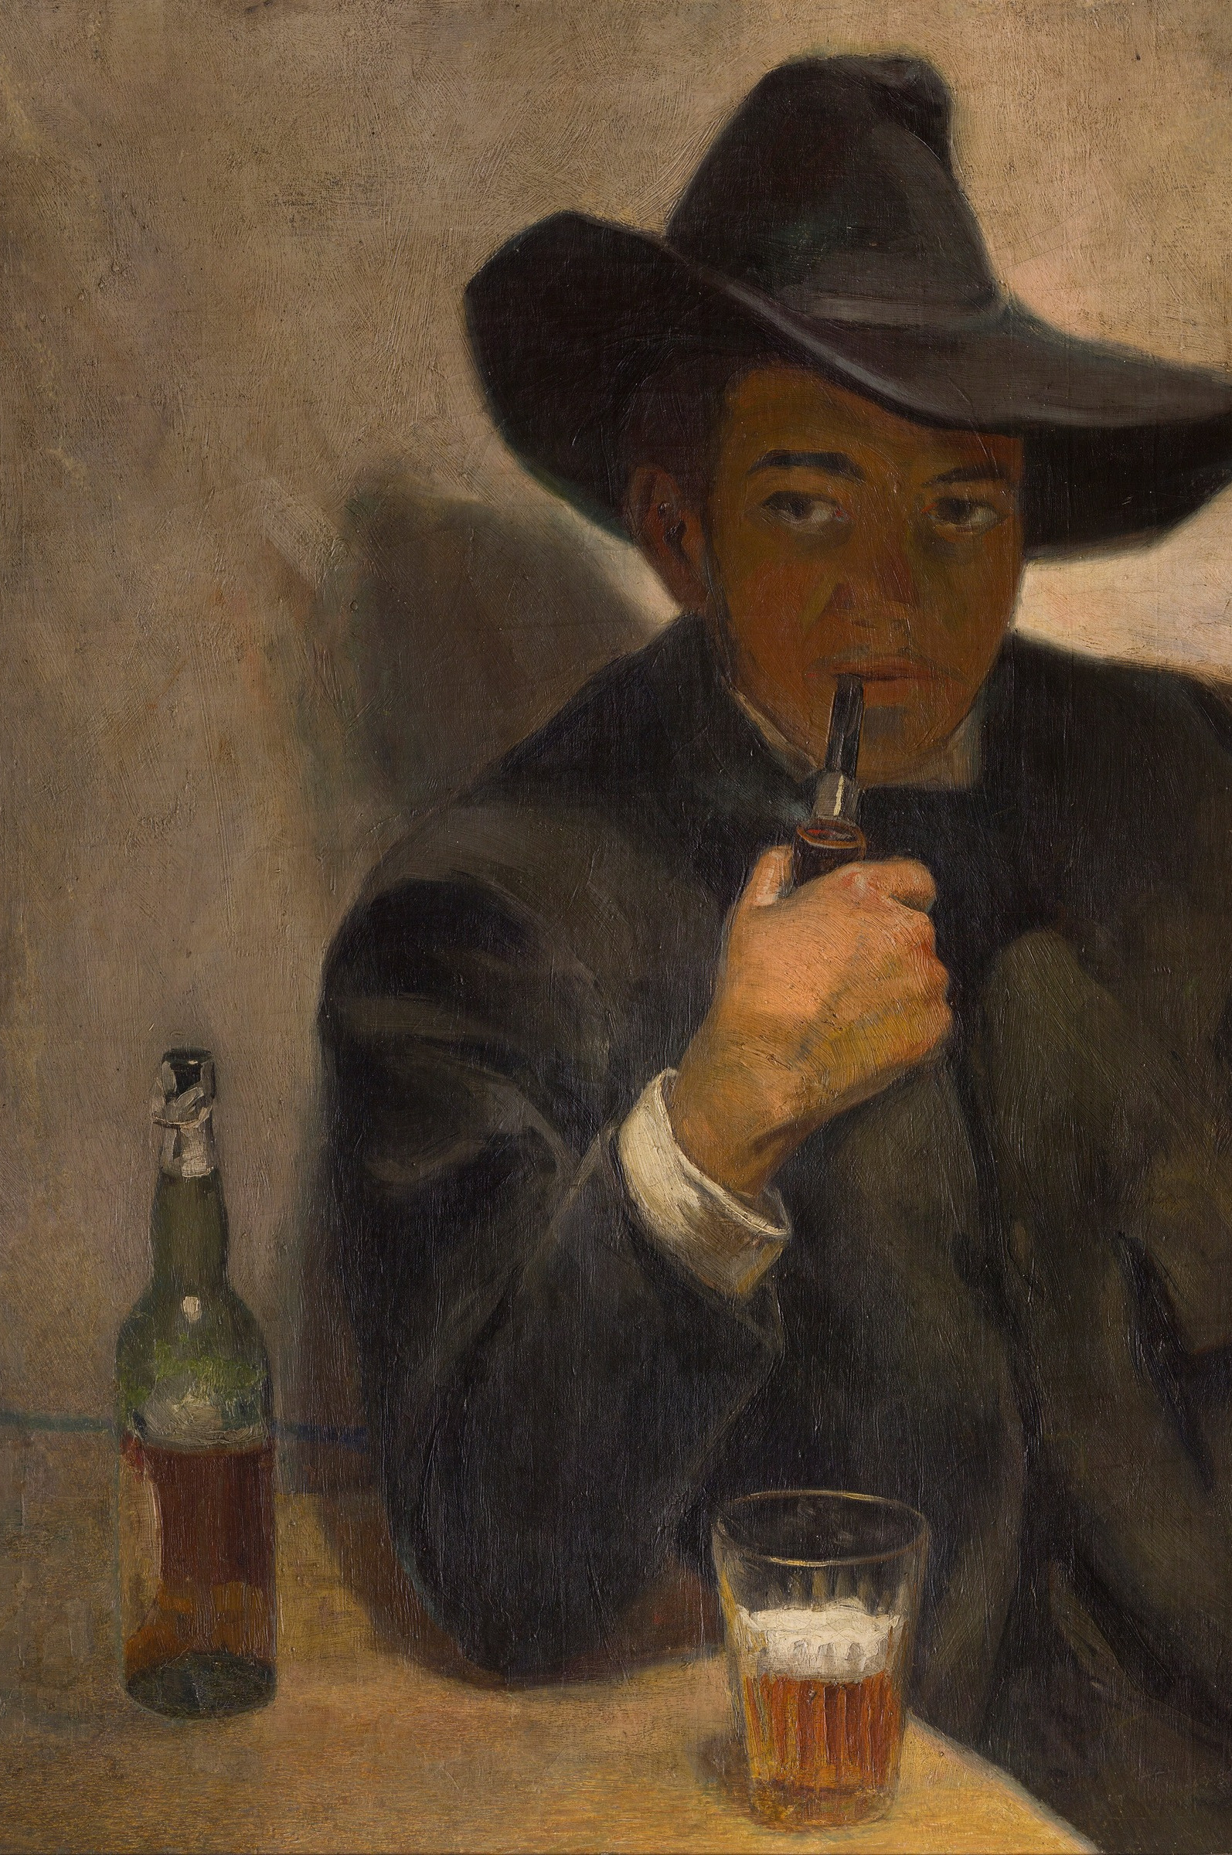
THE MAKER, TURNED INWARD
Examine your
own decisions
KEY POINT A self-portrait is the maker studying the maker. Here, a twenty-year-old student examines his own unfinished self, without flattery.
The CCR asks the same of you: examine the person who made the choices, not just the product.
BE HONEST Add one sentence that flatters nobody: “We chose the location because it was free, and it shows in the lighting.” Examiners read honesty as reflection.
Diego Rivera, Self-Portrait, 1907
Notes:
Restored 2026-08-24: the lesson names Rivera's 1907 self-portrait, replaced by Van Gogh in July only because the library scan was too small; a larger scan is now in img/. Update CREDITS if this ships.

Slide 8
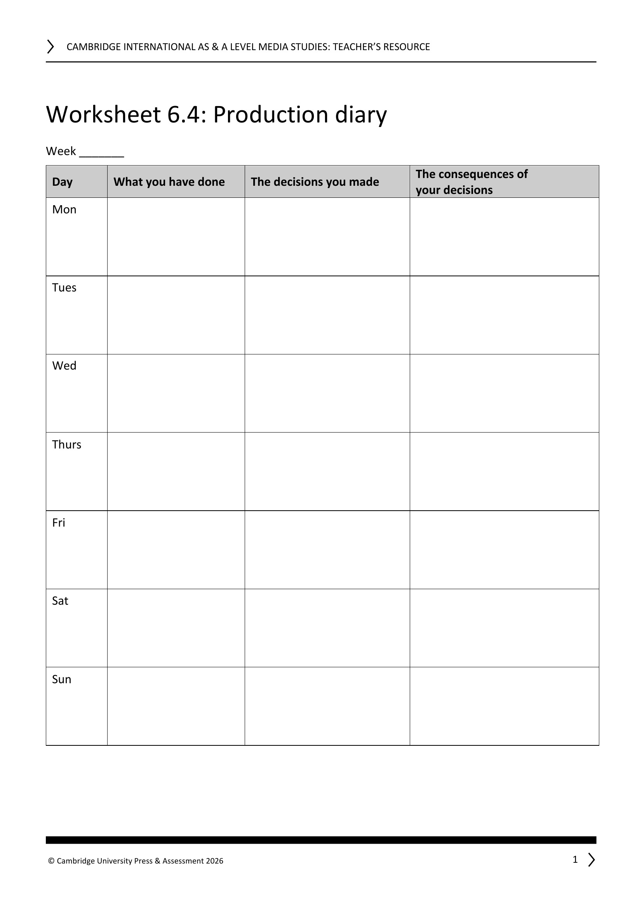
THE PRODUCTION DIARIES PAY OUT
ISSUED AT THE L07 LOCK, HARVESTED NOW
A ready-made reflection bank
TASK Open your WS 6.4 diary next to your draft.
KEY POINT Every entry in the decisions and consequences columns is already a reflection sentence.
DO Copy the three best entries into the draft.
Decided X, because Y. Consequence: Z.
WS 6.4: the diary's own columns, on screen
MEDIA STUDIES 9607 · SEMESTER I
04
Notes:
The lock was L07 (the old slide said L05, a pre-rebuild residue). The Q1 evidence base also includes the L11 stereotype-audit findings: a fixed stereotype is a reflection sentence waiting to happen.

Slide 9
“
To see oursels
as ithers see us.
Robert Burns, To a Louse, 1786 · to see ourselves as others see us

Slide 10
SENTENCE SURGERY
RUN THE TEST ON YOUR OWN DRAFT
One sentence, operated on
BEFORE · describes
AFTER · reflects
We filmed the scene in the car park and then edited it together.
We chose the car park because it was the only free location, and the flat light shows in the grade; next time we would scout for contrast.
→
Same event. One names a decision, a reason, and a change. That is the whole surgery.
Then format speed-pitches: 60 seconds each, in groups of four. Vote, and the format is final.
MEDIA STUDIES 9607 · SEMESTER I
05
Notes:
The surgery sheet is ten sentences, PROPOSED; the banned sentence is any variant of aimed at young people aged 15 to 25.

Slide 11
ONE TOOL IS NOT ENOUGH
CAMBRIDGE'S TWO PUBLISHED C1 EXEMPLARS
The moderators wrote the same criticism twice
Candidate A
Candidate B
Level 3
top of Level 5
All four questions answered in a single digital tool
All four questions answered in a single digital tool
KEY POINT Even the near-perfect portfolio lost its CCR marks the same way: everything in one tool.
RULE “Presented creatively, using technology” means more than one tool across the four questions.
THE MENU Director's commentary, voiceover presentation, podcast, screencast.
MEDIA STUDIES 9607 · SEMESTER I
06
Notes:
Both exemplars live on the School Support Hub (URLs in the plan's sources; teacher login). Candidate B's CCR strand was the only strand off the top band. This is the plan's strongest teacher note, now on a slide; the format spread is a hard requirement at D1.

Slide 12
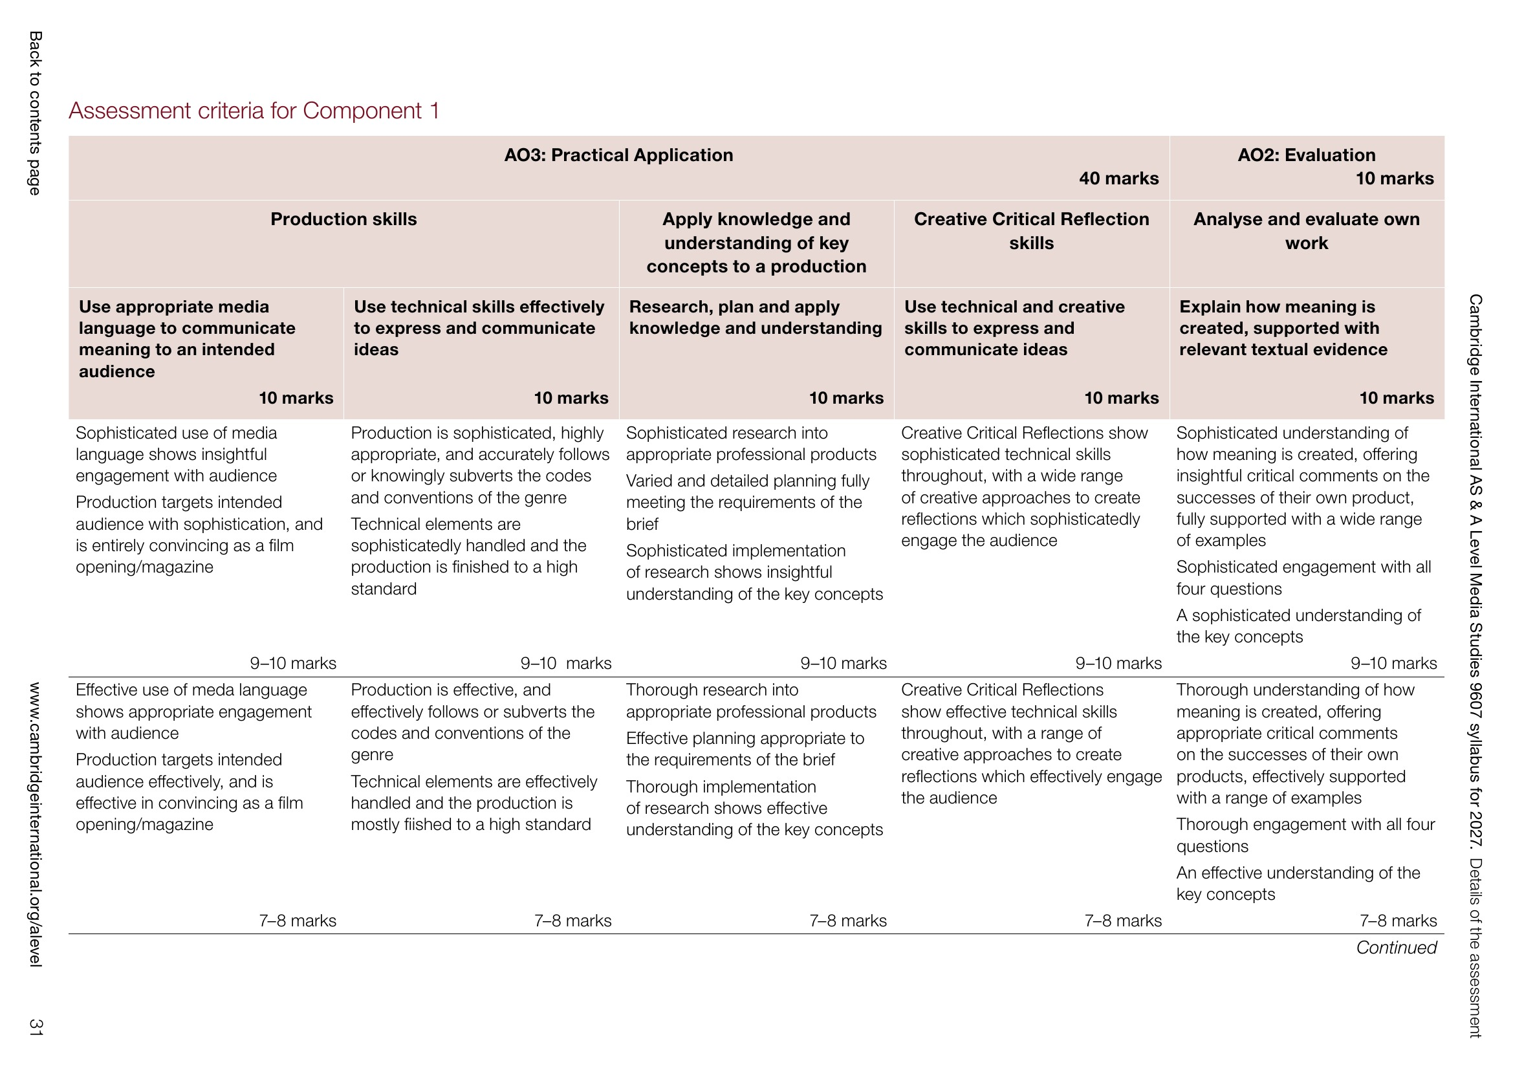
DELIVERABLE · CS11
DIRECT PRACTICE FOR A3
Reviewed against the real C1 criteria
REVIEW Full drafts reviewed by teacher and peers, in the C1 criteria's own words: describe, question, suggest.
LEAVE WITH A written action list for your draft.
BY FRIDAY Format chosen from the coursebook menu. More than one tool.
This cohort's CCR is the blog-era, four-question, creative-format artifact, coursebook 6.7.
The 2027 syllabus's own C1 assessment criteria
MEDIA STUDIES 9607 · SEMESTER I
07
Notes:
Review protocol runs Deck U6.1's Lerman-style structure. The criteria page on screen is the syllabus's own; the review is conducted in its language so A3's marking holds no surprises.

Slide 13
NEXT
Audiences and the
Portfolio Submission
Lesson 14. The Component 1 arc closes: A3 goes in, with no edits after.
MEDIA STUDIES 9607 · SEMESTER I
08

