Slide 1
XV
MEDIA STUDIES 9607 · UNIT V
Institutions and
Section A Craft
Media Contexts · Lesson 15 of 19
Four days · Monday 7 to Friday 11 December
Notes:
Component 2 becomes the destination. Morley explains why the same text reads differently; ownership explains why texts say what they say.

Slide 2
XV
OWNERSHIP
Who pays
shapes what is said.
Notes:
The court photographer's frame belonged to the court. Who pays shapes what gets said, in 1857 as now.

Slide 3
MORLEY · THE NATIONWIDE STUDY
READINGS TRACK SITUATION, NOT INTELLIGENCE
The same broadcast, different readings
The study
The finding
Real audience groups were shown the same broadcast, and their readings were gathered and compared.
The groups produced systematically different readings, and the differences tracked their social situations, not their intelligence.
KEY POINT Readings differ by social situation. So who makes the text matters even more. Tomorrow: ownership.
MEDIA STUDIES 9607 · SEMESTER I
01
Notes:
D1 replicates the study in miniature: one short text screened, readings gathered anonymously on cards, compared against situation. The disagreement is the finding.

Slide 4

THE BROADCAST ITSELF
BBC ONE, EARLY EVENING, 1969 TO 1983
Deliberately ordinary
An early-evening magazine show: local news, consumer stories, light fun. Morley chose it because it was ordinary and addressed to everyone.
KEY POINT If even this ordinary show produces different readings, then no text is neutral.
Nationwide title sequence, BBC One
MEDIA STUDIES 9607 · SEMESTER I
02
Notes:
The title card is the study's own object. D1 replicates the method on a text the class knows instead: same protocol, groups compared, readings tracked to situation.

Slide 5
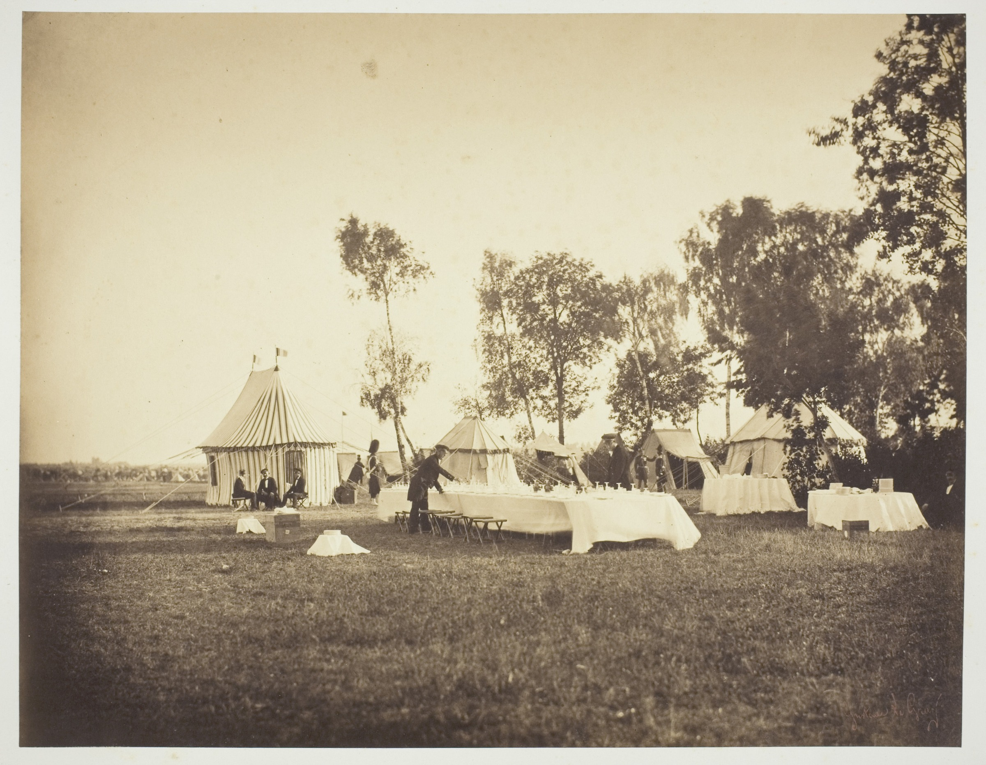
THE FRAME BELONGED TO THE PAYER
1857 AS NOW
A commissioned view
Le Gray was paid by the Emperor's court to photograph the camp. The set table, the servants, the tidy tents: every choice serves the payer's story of easy power.
KEY POINT Who pays shapes what gets said. This week traces that sentence through modern money.
Gustave Le Gray, Preparation of the Emperor's Table, Camp de Chalons, 1857
MEDIA STUDIES 9607 · SEMESTER I
03
Notes:
Re-derived from the library original and shown whole: the plate's composition is the argument, so it is never cropped. The historical proof in one image, before any modern example.

Slide 6
WHO PAYS, AND WHAT THEY BUY
PSB VERSUS COMMERCIAL
Follow the money
THE PAYER
WHAT THE MONEY BUYS
License fee or state
A remit: a duty to inform, educate, reach everyone. The UK license fee: 180 pounds a year from April 2026.
Advertisers
Your attention, delivered in the right demographic.
Subscribers
A product good enough that you keep paying for it.
The state directly
Content that aligns with the payer's interests.
THEORY Curran and Seaton: when fewer owners control more media, the range of stories narrows.
MEDIA STUDIES 9607 · SEMESTER I
04
Notes:
License-fee figure verified 2026-08-24: 180 pounds a year from 1 April 2026. The CCTV, Tencent and bilibili parallels stay spoken asides per the exam-example rule.

Slide 7
“
Freedom of the press is guaranteed only to those who own one.
A. J. Liebling, The New Yorker, 1960
IN PLAIN WORDS Press freedom belongs, in practice, to the people who own the press.

Slide 8
TRACE ONE VISIBLE DECISION
BACK TO WHO PAYS FOR IT
The chain
The decision
The incentive
Who pays
←
←
the ad break, the family-friendly cut, the product in shot, the story not covered
what that choice protects or earns for the maker
the advertiser, the subscriber, the state, the platform
READ IT Right to left: every on-screen decision traces back to who pays.
GAME Trace a chain against the clock. One point per link that survives challenge.
EXAM LINK Rehearse the chain on your case-study institution. That is the Section B answer.
MEDIA STUDIES 9607 · SEMESTER I
05
Notes:
Trace game rules: teams pick a visible decision from real current output, trace it link by link, a point per link that survives the room's challenge; the fastest verified chain presents first.

Slide 9
ONE OWNER, MANY SPOUTS
CONCENTRATION, DRAWN TO SCALE OF ONE COMPANY
Marvel
Lucasfilm
Pixar
20th Century
The Walt Disney
Company
ABC
Parks and merch
ESPN
Disney+
KEY POINT Eight familiar names, one approval desk. Many outlets, one owner: the choice of stories narrows.
TERM This is ownership concentration (conglomeration).
MEDIA STUDIES 9607 · SEMESTER I
06
Notes:
Replaced Underwood's parapet metaphor 2026-08-24: institutions own the platform, the schedule, the budget, the greenlight, shown as one real conglomerate. Disney is the Scheme of Work's own conglomeration example. The chart is drawn, not sourced, so it can be redrawn for any case-study institution.

Slide 10
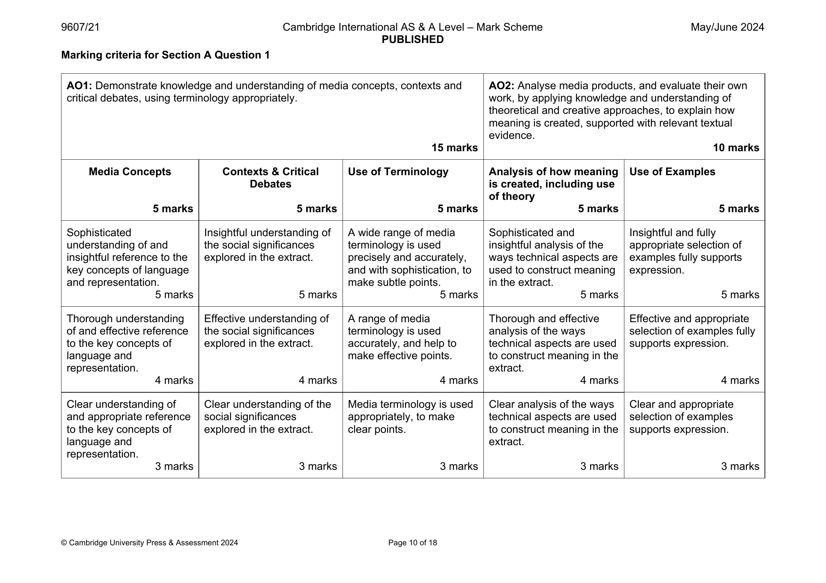
CS12 · SECTION A, DEMYSTIFIED
THE MARK SCHEME AS FURNITURE
Write it with the answers open
THE SET-UP The official five-criteria rubric sits open on every desk: concepts, contexts, terminology, analysis, examples. Five marks each.
TASK Draft your paragraphs solo. Stop any time to check the band language, and label your own margin: “this is my terminology evidence.”
REVIEW Label which criterion each paragraph fed. The one you never fed is your A4 target.
Next week: the same format, with the scaffold removed.
The furniture itself: June 2024 mark scheme, Section A criteria
MEDIA STUDIES 9607 · SEMESTER I
07
Notes:
CS12 is part collaborative by design. The find-your-unfed-criterion move sets each student's personal A4 target. Warm-up: Deck U5.2's context-terms quiz.

Slide 11
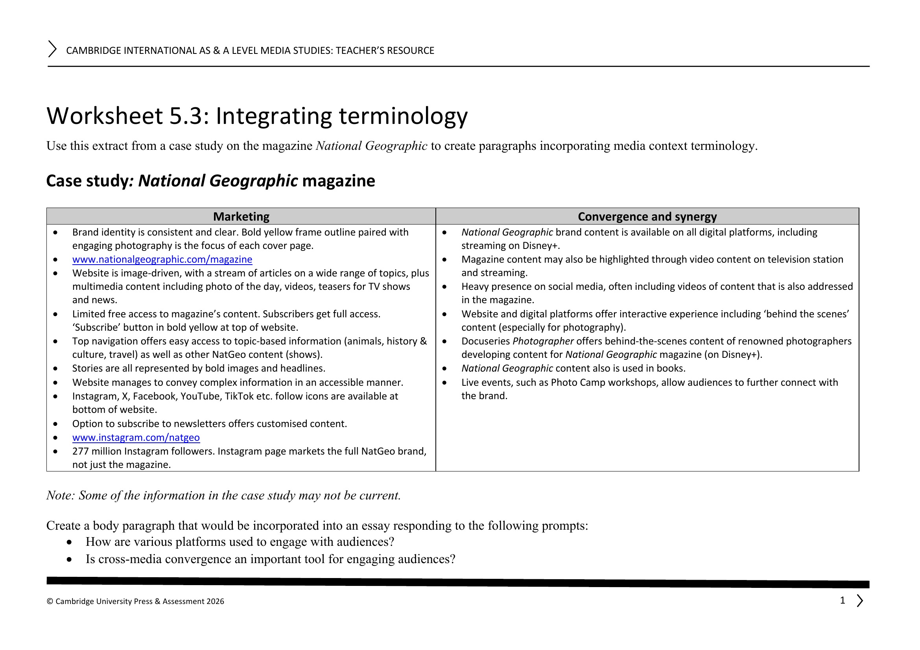
THE CASE-STUDY DOCUMENT
STILL IN USE IN MAY
One institution, tracked to Paper 2
01
Identity and ownership
02
Production patterns
03
Distribution and marketing
04
Audience and consumption
05
Regulation
06
Technology
07
Dated key facts
08
Coverage against the four Key Concepts
Date every entry. The exam wants examples from the last five years, so dates matter from today.
WS 5.3, the National Geographic sheet: the model of what good entries become
MEDIA STUDIES 9607 · SEMESTER I
08
Notes:
The document is the highest-leverage artifact this side of the blog: it feeds A4, the End of Term Exam, and Paper 2 in May. WS 5.3 is handed out as the model.

Slide 12
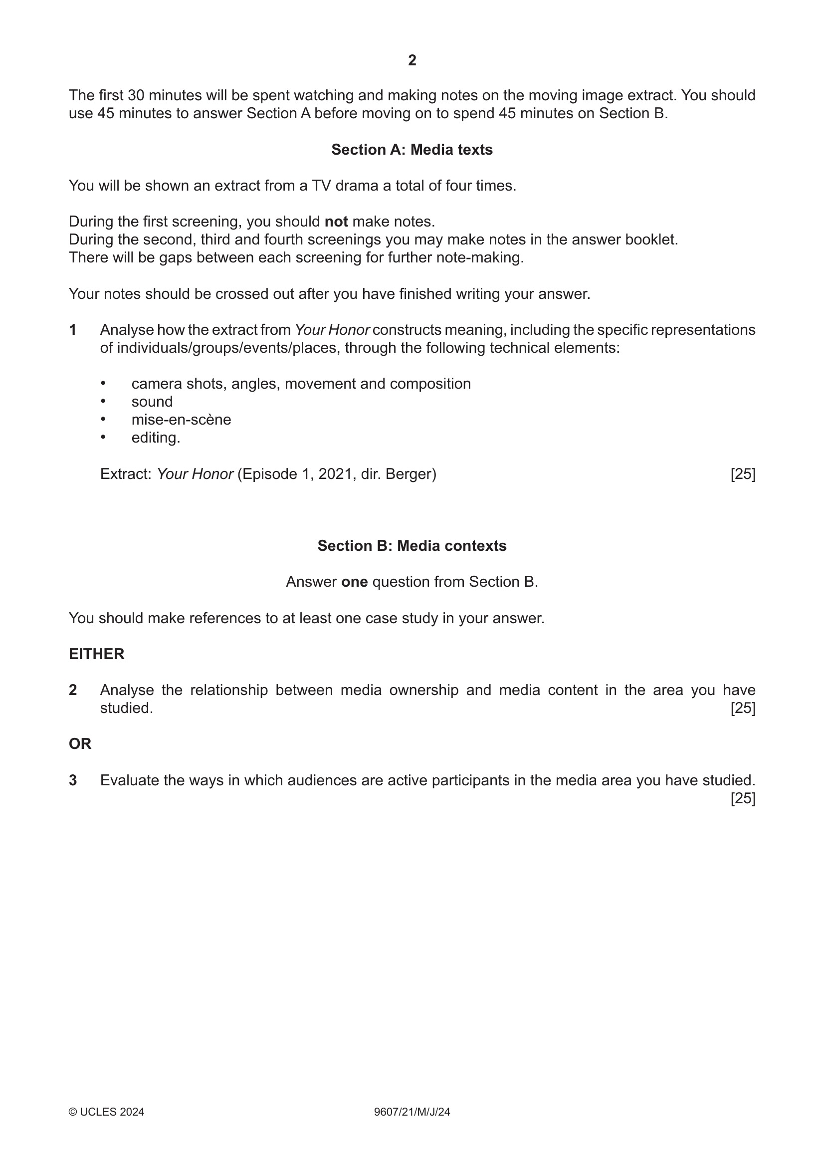
THE PAPER ITSELF
THIS LESSON'S TWO TOPICS, AS EXAM QUESTIONS
Section B already knows this week
THE MENU June 2024, Section B: analyze the relationship between ownership and content, or evaluate audiences as active participants.
KEY POINT This lesson's two topics are the real exam's two questions.
YOUR NOTES The case-study document you opened today answers either question.
June 2024 Paper 2/21, page 2
MEDIA STUDIES 9607 · SEMESTER I
09
Notes:
Only the June 2024/21 paper is rendered anywhere in the deck set: 22 and 23 name the End-of-Term text and stay sealed, as do all June 2025 variants.

Slide 13
NEXT
A4: Section A in
Authentic Format
Lesson 16. Integration, synergy, convergence, and the first authentic Section A sitting.
MEDIA STUDIES 9607 · SEMESTER I
10

