Slide 1
XVI
MEDIA STUDIES 9607 · UNIT V
A4: Section A in
Authentic Format
Media Contexts · Lesson 16 of 19
Four days · Monday 14 to Friday 18 December
Notes:
The Forecast Grade anchor. Two days trace one institution end to end; Wednesday is the first authentic Section A sitting.

Slide 2
XVI
THE MEDIA EVENT
One man,
every channel.
Notes:
Lindbergh, 1927: newsreels, press syndicates, radio, records, all selling the same story to itself. The media event predates the internet by seventy years.

Slide 3
THE EXAM'S THREE INSTITUTION WORDS
DEFINED AND SEPARATED
Integration, synergy, convergence
Integration
Synergy
Convergence
One company owns more of the chain: the stages (vertical) or the rivals beside it (horizontal).
The parts sell each other: the film sells the soundtrack sells the toy sells the sequel.
Media and platforms flow together: one story across screen, phone, print, and feed.
MEDIA STUDIES 9607 · SEMESTER I
01
Notes:
Defined and separated first; the next two slides carry them, 1995 and 2023, then 1927.

Slide 4
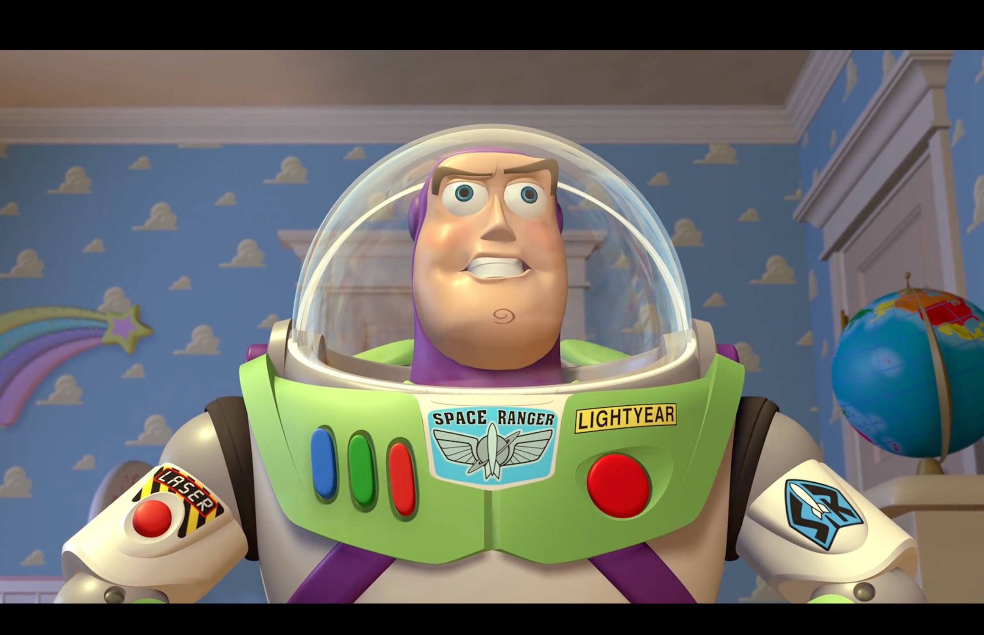
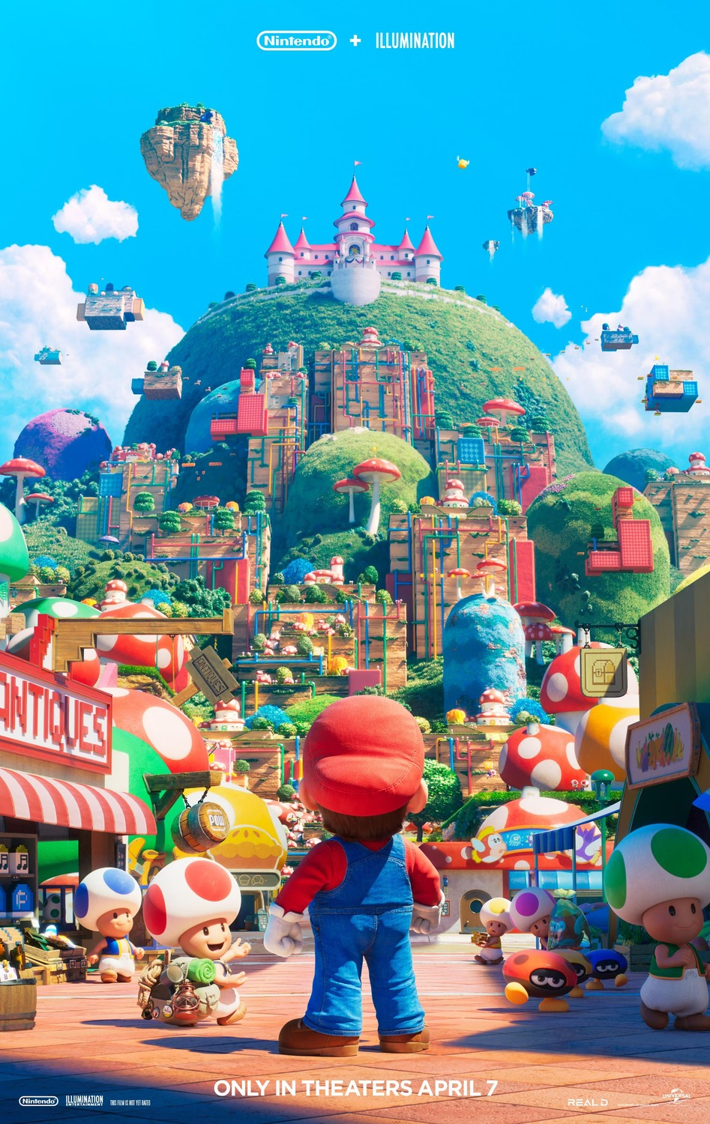
THE THREE WORDS, AT WORK
1995 AND 2023, SAME MACHINE
Toy Story (1995, Pixar/Disney): the film is literally the toy advert, and the toy is the film's premise
The Super Mario Bros. Movie (2023): Nintendo + Illumination + Universal
Integration: the owner holds game, studio and park. Synergy: each one sells the others. Convergence: one IP across console, cinema, phone and feed.
MEDIA STUDIES 9607 · SEMESTER I
02
Notes:
Disney/Pixar is the Scheme of Work's own conglomeration example; Mario is Deck U5.2's quiz case (Nintendo develops and owns the characters, Illumination produces, Universal distributes, Super Nintendo World extends). Hunt all three words in the students' own case-study institutions next.

Slide 5
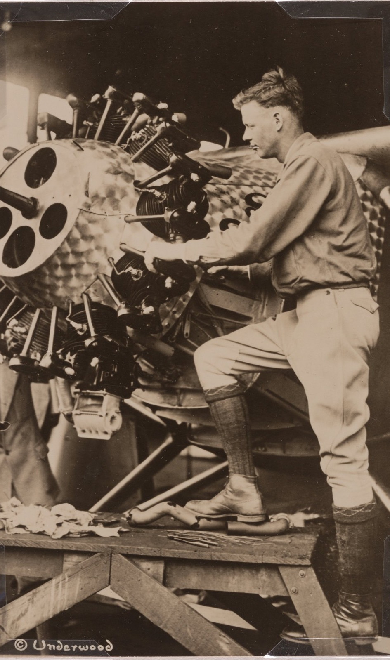
SYNERGY, 1927
Every channel,
one story
One man flies across the ocean. Every channel of 1927 sells the same story: newsreels, newspapers, radio, records, endorsements.
KEY POINT Media events, synergy, convergence: all of it existed seventy years before the internet named it.
Underwood & Underwood, Charles Lindbergh, 1927
Notes:
Lindbergh as the worked historical anchor: integration, synergy, and convergence visible in 1927.

Slide 6
“
It is not spontaneous, but comes about because someone has planned, planted, or incited it.
Daniel Boorstin, The Image, 1962, on the pseudo-event
IN PLAIN WORDS A pseudo-event does not just happen. Someone staged it so it would be reported.

Slide 7
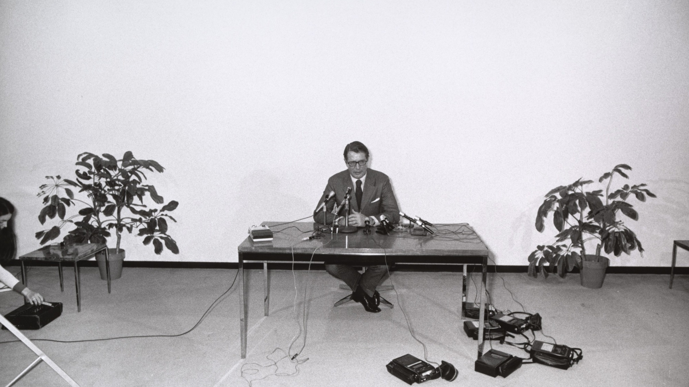
THE PSEUDO-EVENT, PHOTOGRAPHED
An event that exists in order to be reported: the press conference is its purest form.
Garry Winogrand, Elliot Richardson Press Conference, Austin, 1973
Notes:
Winogrand's press scrum: cameras photographing an event staged for cameras. Boorstin's definition made visible; the students' own media events (launches, drops, teasers) follow the same grammar.

Slide 8
ONE INSTITUTION, END TO END
GREENLIGHT TO YOUR FEED
Follow it all the way through
Greenlight
Produce
Distribute
Market
Meet
Revenue
1
2
3
4
5
6
who says yes
who makes it
who moves it
who sells it
where you find it
who is paid
TASK Annotate each link from your case-study document. Draw the whole chain on the board.
MEDIA STUDIES 9607 · SEMESTER I
03
Notes:
D2 also runs Beat the Examiner, lite: one paragraph from Cambridge's own specimen answers banded in pairs against the five criteria; the awarded level is revealed after. The unfed-criterion reread follows.

Slide 9
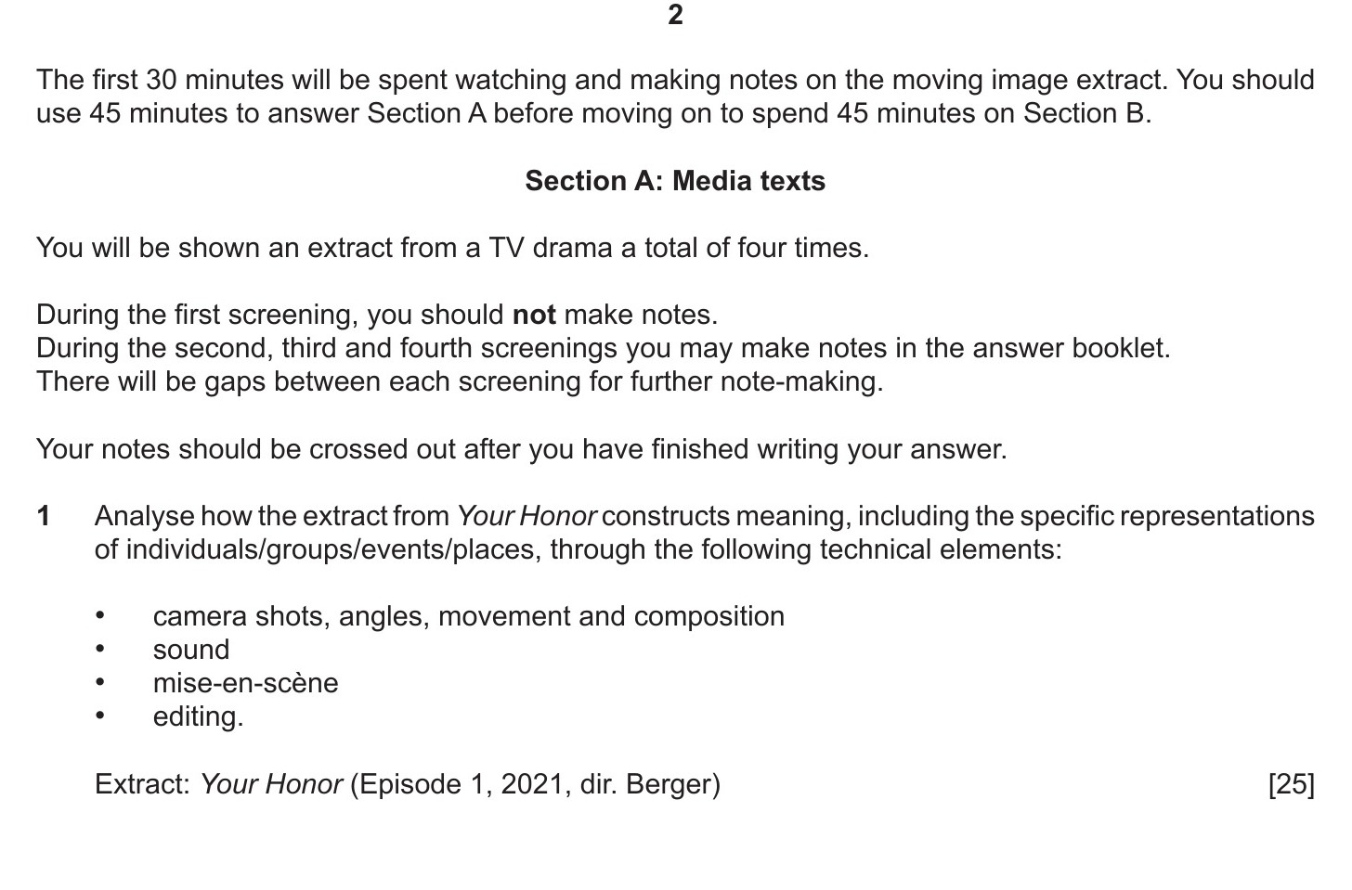
THE AUTHENTIC FORMAT
IN THE PAPER'S OWN TYPOGRAPHY
Thirty minutes of notes. Forty-five of writing.
June 2024 Paper 2/21: the rubric, the screenings, and the frozen stem. A different skill from A1's single hour: the viewing window is for structured notes, not a transcript.
MEDIA STUDIES 9607 · SEMESTER I
04
Notes:
Four screenings, no notes on the first, notes crossed out after writing begins: read the page's own words aloud once. A4 reuses the frozen stem with a different sealed extract.

Slide 10
THE VIEWING-NOTES FRAME
CAPTURE, DO NOT COMPOSE
The four-family grid
Technical
Symbolic
Written
Audio
DRILL Two 90-second drills: notes straight into the grid, then pens down. Capture, do not compose.
MEDIA STUDIES 9607 · SEMESTER I
05
Notes:
The drills run on a trailer, ninety seconds each, notes straight into the four families. Capture, do not compose.

Slide 11
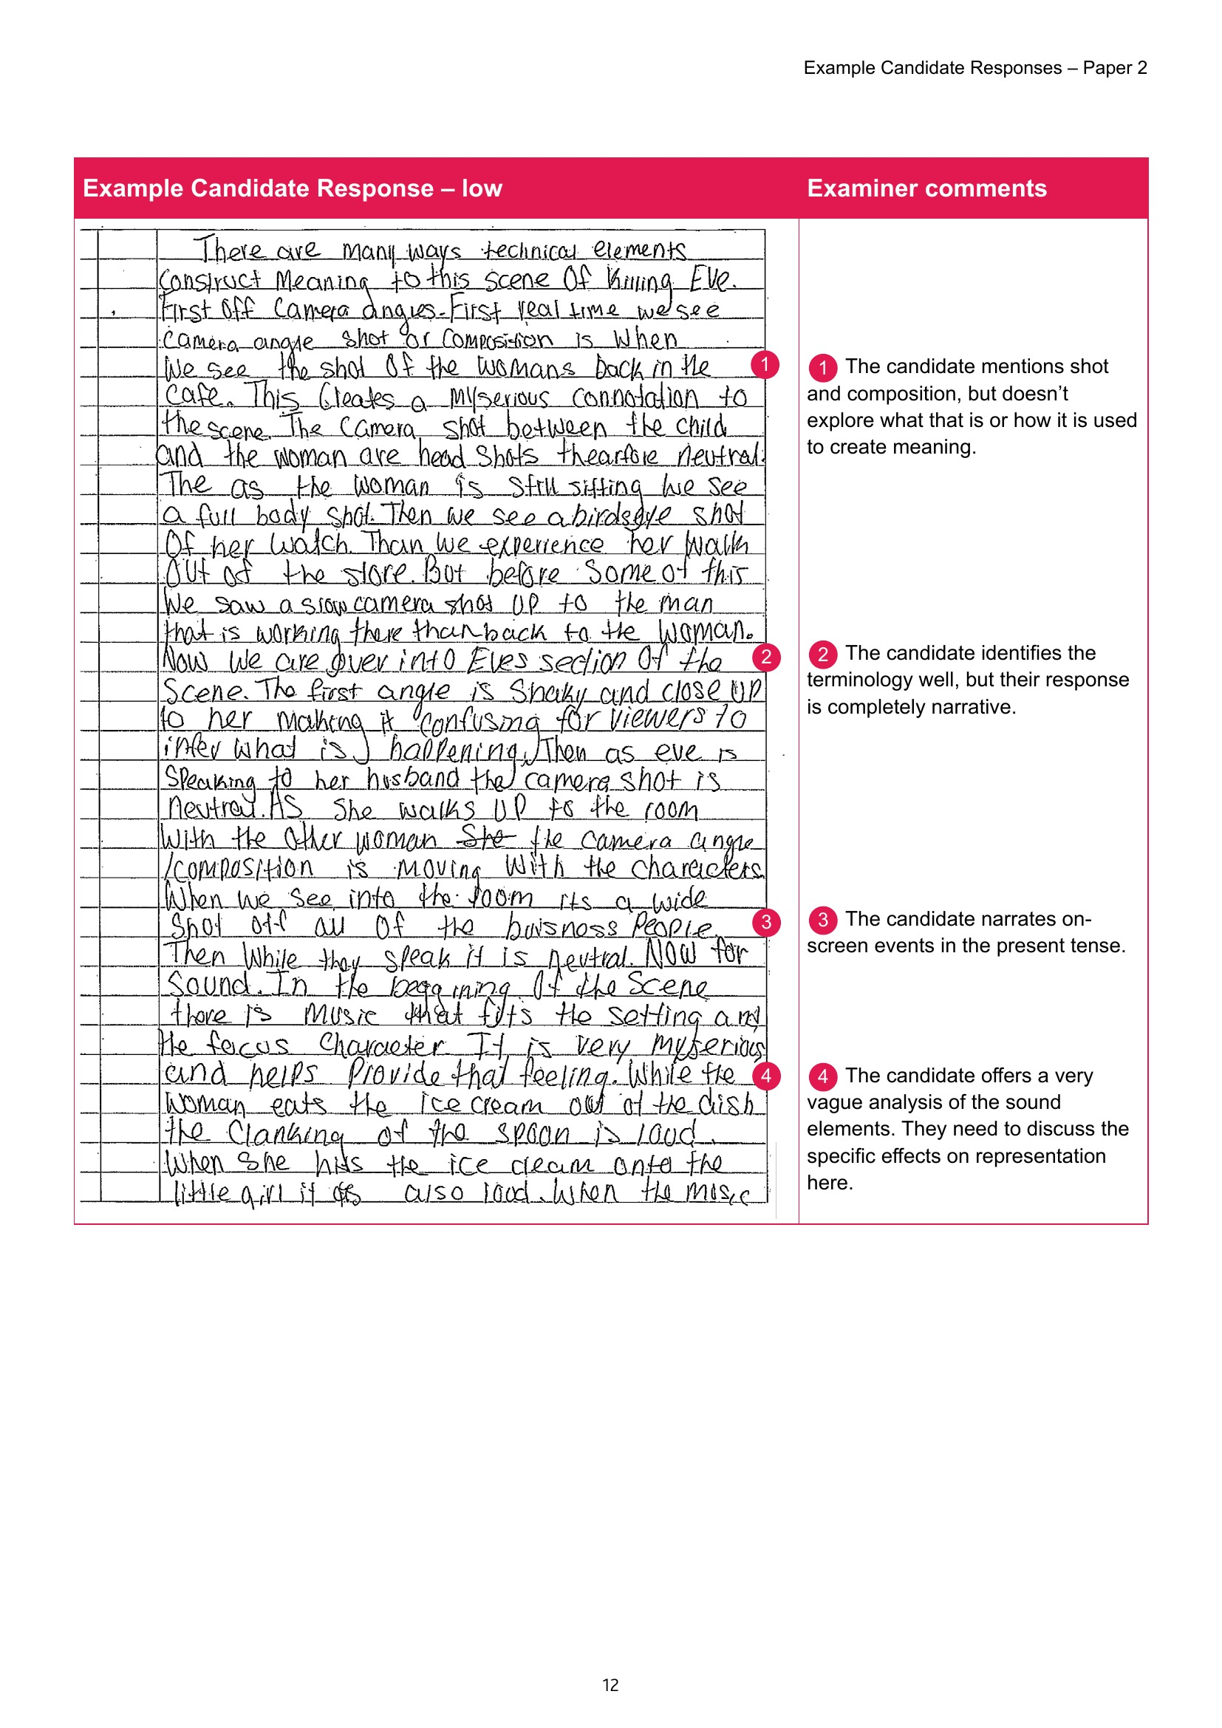
BEAT THE EXAMINER
THE CLASSIC MISTAKE, IN THE EXAMINER'S OWN HAND
Five out of twenty-five
THE MARGIN NOTE “The remainder of the answer is just narration.”
WHY IT FAILED A transcript of the screen. No technique named, no meaning claimed. Careful watching, fluent writing: five marks.
TASK Band one paragraph of it in pairs. Then reread your own CS12 for the same defect.
Cambridge Example Candidate Responses, Paper 2: the low script
MEDIA STUDIES 9607 · SEMESTER I
06
Notes:
The booklet's Section A is a June 2021 extract, not a held text, so it is safe to project. The high script (a wide range of media terminology, in the same booklet) is the counter-example; both pages are in img/ as ecr-narration and ecr-high.

Slide 12
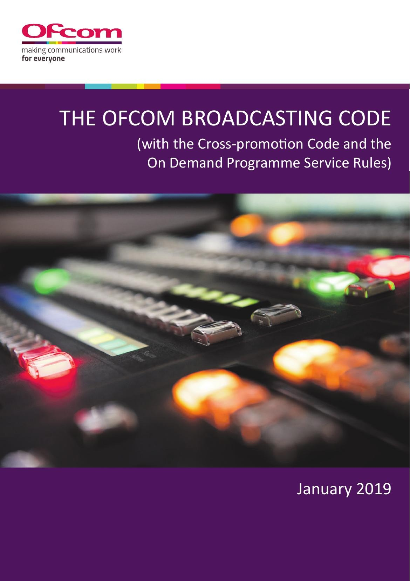
REGULATION, THE FOURTH CONTEXT
WHILE THE SIT IS FRESH
The chain, one link longer
decision ← incentive ← payer ← REGULATOR
ASK Who regulates your case-study institution? With what powers?
LOOK FOR What regulation visibly changes: scheduling, cuts, age ratings, and what never gets made at all.
TASK Add the regulation row to your document, and date it.
The Ofcom Broadcasting Code: a regulator's rulebook, in print
MEDIA STUDIES 9607 · SEMESTER I
07
Notes:
NRTA stays a spoken aside per the exam-example rule; the taught regulators are the case-study institutions' own.

Slide 13
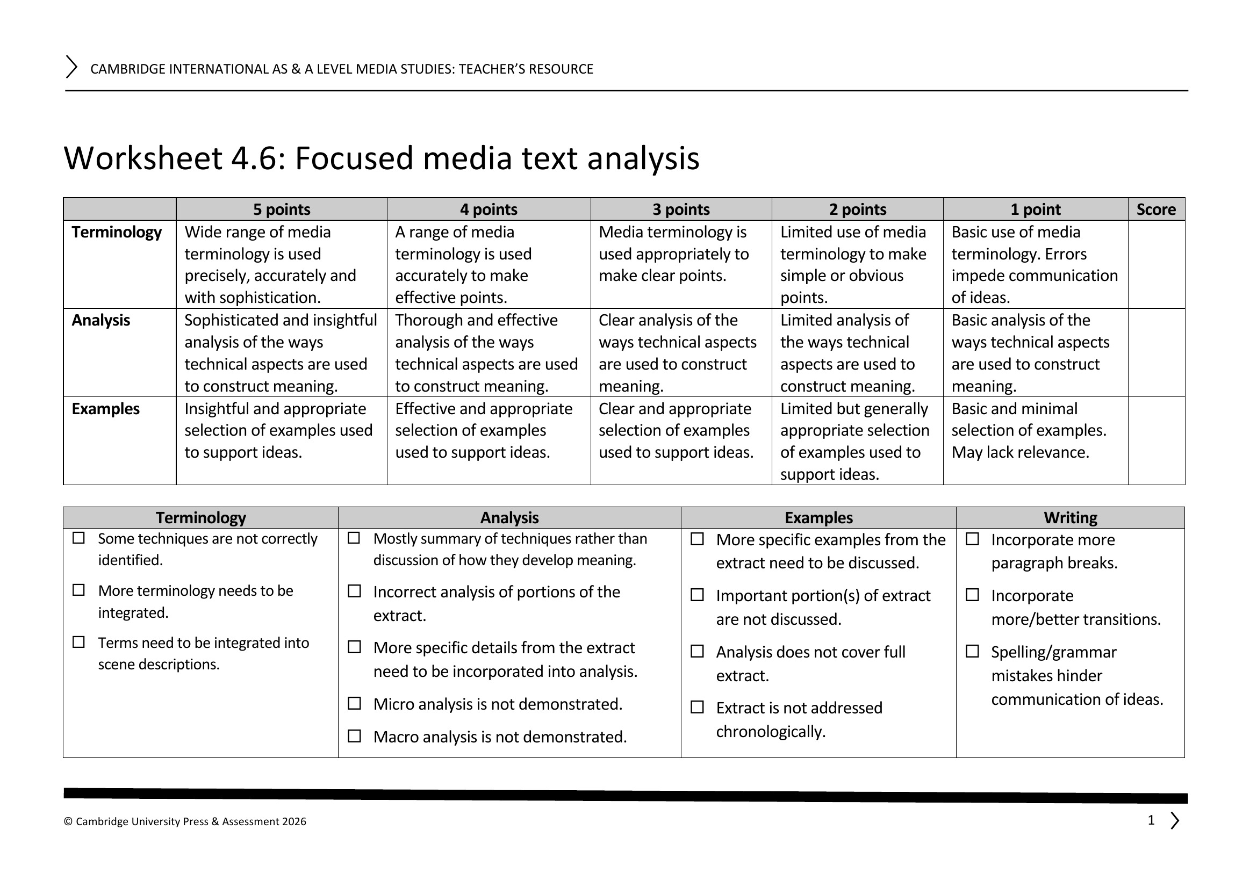
ASSESSMENT · A4
THE FORECAST GRADE ANCHOR
A4 sits Wednesday 16 December
FORMAT An unseen TV-drama extract. Thirty minutes of viewing and structured notes, then forty-five minutes of writing.
MARKED To the official band descriptors, criterion by criterion. AO splits recorded for the L17 review.
ON THE DAY No debrief, by design. The sit ends the way the real exam ends.
WS 4.6: the rubric rows and comment bank the feedback follows
MEDIA STUDIES 9607 · SEMESTER I
08
Notes:
The extract shortlist is sealed until the sit; no still of any candidate text appears in this deck on purpose. Screening protocol on the day: four screenings, no notes on the first, notes crossed out.

Slide 14
NEXT
Consolidation and
the Coverage Matrix
Lesson 17. The semester's knowledge, audited before the exam tests it.
MEDIA STUDIES 9607 · SEMESTER I
09

