Slide 1
II
GRADE 10 · PRE A LEVEL
The Media
of the Course
What you will work in, and what each one asks of you
Notes:
Two halves: the four unit media, then the hand materials that run underneath all of them. Keep the demos physical, not verbal.

Slide 2
?
THE PRINCIPLE
Every medium asks
a different question.
Notes:
Not four techniques to collect. Four different questions: how long can you look, where do you stand, what do two things say together, and what lands in three seconds.

Slide 3
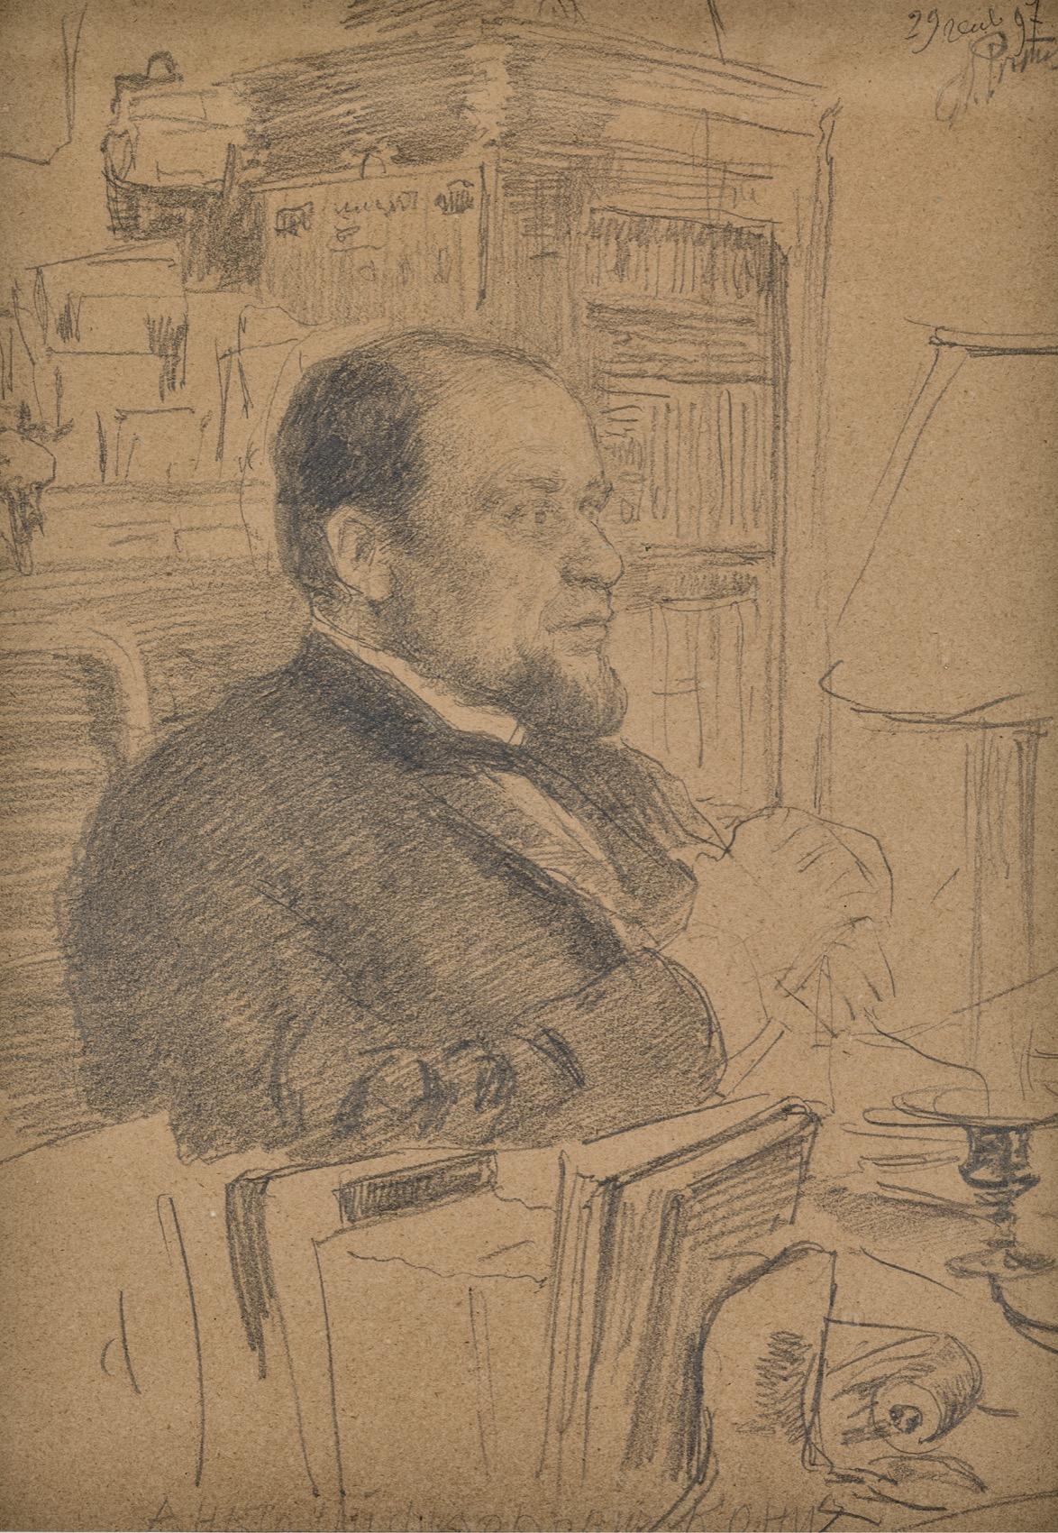
UNIT I · DRAWING
How long can
you look?
Drawing is the slowest medium here and the one everything else rests on. You build form with tone rather than outline, you learn that the shape of the air around an object is as drawable as the object, and you choose a composition before a mark goes on the good paper.
Ilya Repin, Portrait of Anatoly Koni, 1897. Public domain
Notes:
The rule that gets written on the board in week two: build form with tone, not outline. Students arrive drawing edges.

Slide 4
MATERIALS · THE DRY MEDIA
WHAT EACH ONE DOES
Three ways to make a grey
Graphite
Charcoal
Chalk and conté
Pencils run from 9H to 9B. H is hard and pale and holds a point; B is soft and dark and blunts fast. Most of your work needs three grades, not twelve.
Fast, dark, and hard to control, which is the point. It covers ground quickly and lifts back out with an eraser, so you can draw by removing as well as adding.
Works on toned paper, where the paper becomes the mid-tone and you add both the dark and the light. Old master drawings are mostly this.
GRADE 10 ART & DESIGN · SEMESTER I
01

Slide 5
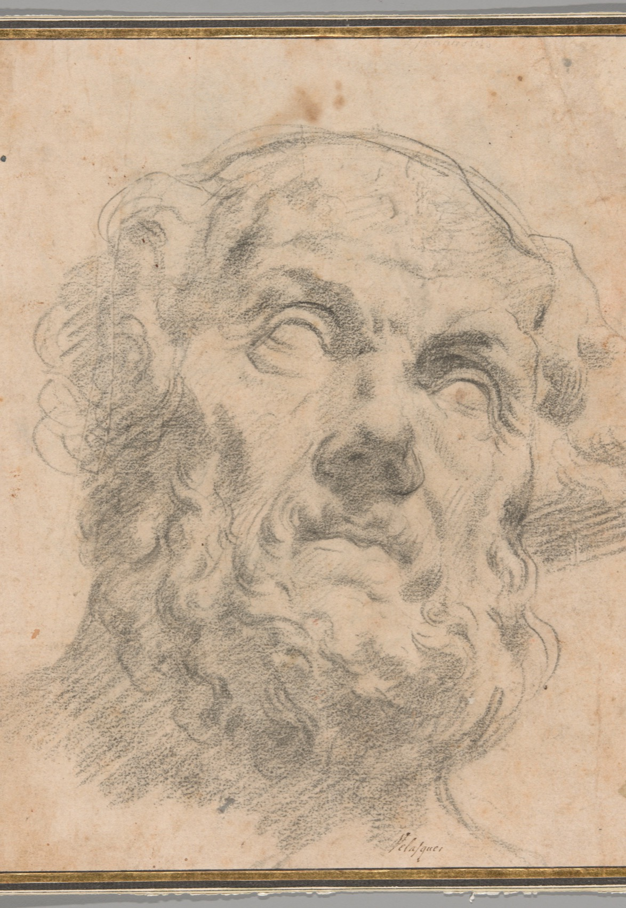
MATERIALS · THE WET MEDIA
Ink, paint, digital
Ink
Committed. A line you cannot take back, which makes you decide before you move.
Paint
Colour and edge at once. Slower to correct than pencil, faster to cover than anything.
Digital
Infinite undo, which is a trap. Use it for layout, scale tests and colour trials, not for avoiding decisions.
Peter Paul Rubens, head study. Public domain
Notes:
Rubens worked chalk and ink on toned paper. Show the sheet and ask which marks were added and which were lifted out.

Slide 6
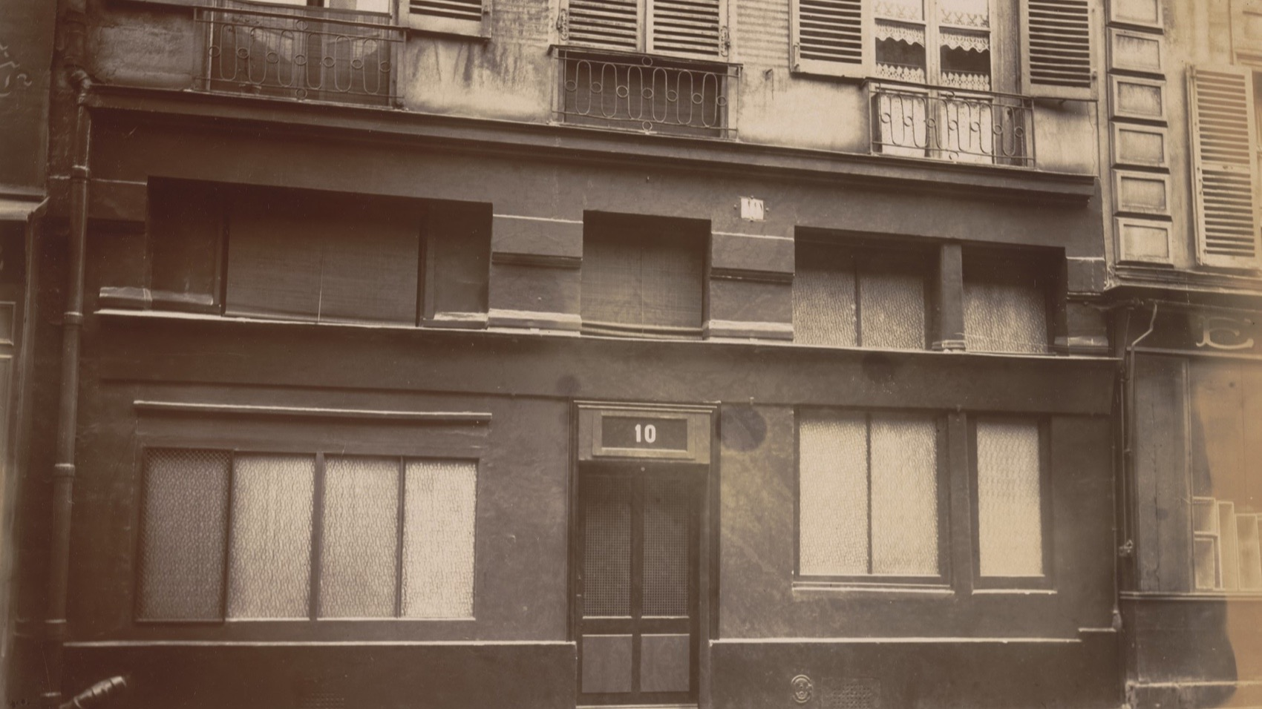
UNIT II · PHOTOGRAPHY
The interesting decisions happened before the shutter opened.
Eugène Atget, 10 rue Mazet, Paris, 1907. Public domain
Notes:
Atget photographed the same city for thirty years, always from a considered position. Where you stand is the whole argument.

Slide 7
UNIT II · PHOTOGRAPHY
WHERE DO YOU STAND?
A camera is a way of deciding
Framing and viewpoint
Light
The series
What is in, what is out, and where you put yourself. Move your feet before you touch a setting.
Direction and quality, not brightness. The same object in front light, side light, back light and diffused light is four different objects.
Six to eight photographs that are one idea looked at repeatedly. Take any one away and the group should lose something.
Any camera, including a phone. Editing in Photoshop, Affinity, or whatever you already use.
GRADE 10 ART & DESIGN · SEMESTER I
02

Slide 8
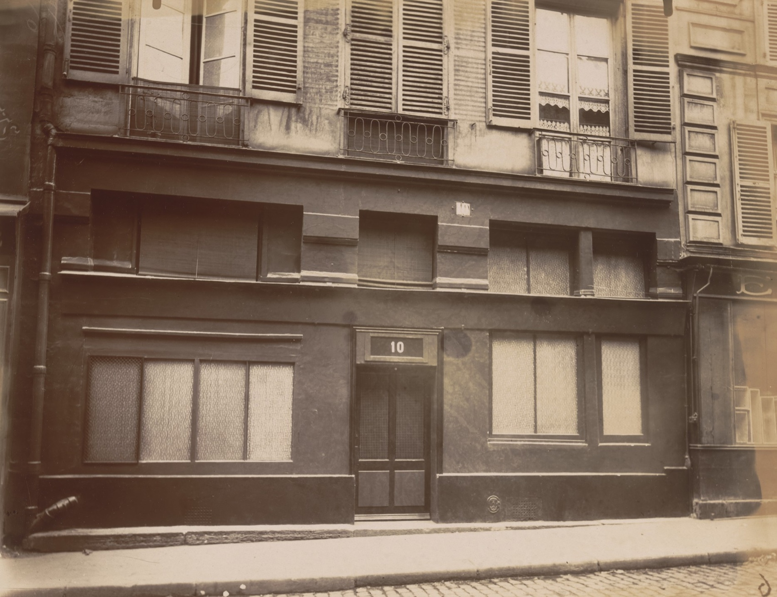
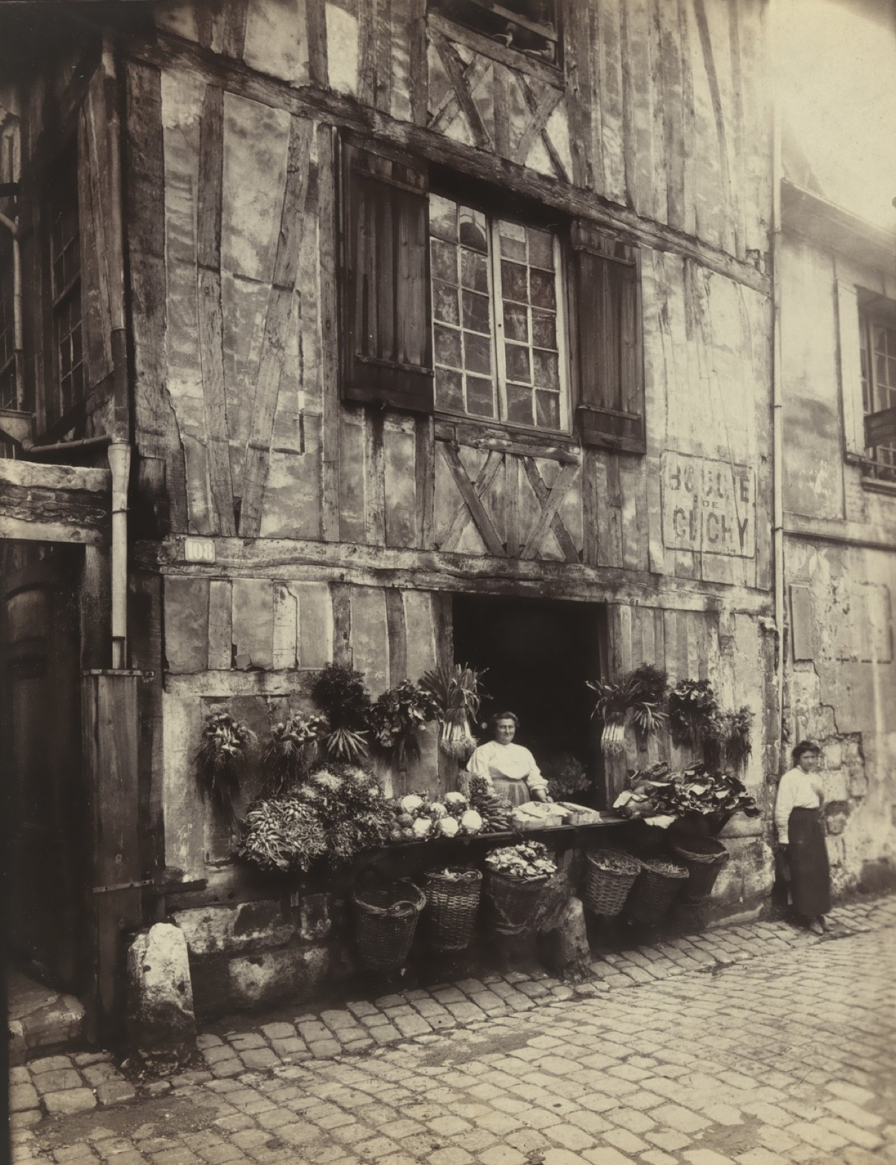
WHAT MAKES A SERIES
SAME EYE, DIFFERENT SUBJECT
One idea, looked at repeatedly
Atget, 10 rue Mazet, 1907
Atget, 108 rue Molière, 1908
GRADE 10 ART & DESIGN · SEMESTER I
03
Notes:
Both are doorways, both from the same distance, both in the same flat light. That consistency is what makes them read as one project rather than two photographs.

Slide 9
“
Shoot many, keep few, know why.
The photography unit, in six words

Slide 10
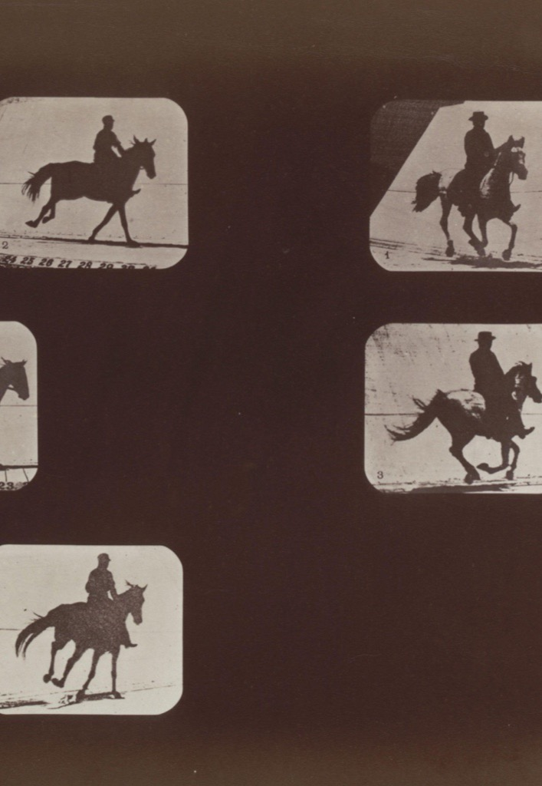
UNIT III · COLLAGE
Two images say
a third thing
In photography you chose images. Now you cut them apart and make them argue. Two cheap tools do most of the work: juxtaposition, which puts together things that do not belong, and scale, which makes something the wrong size on purpose. What is in front is what wins, and a torn edge is a different decision from a cut one.
Eadweard Muybridge, motion studies. Public domain
Notes:
Muybridge is not collage, but the grid is the same move: many frames on one surface, read together. Use it to introduce sequence and adjacency.

Slide 11
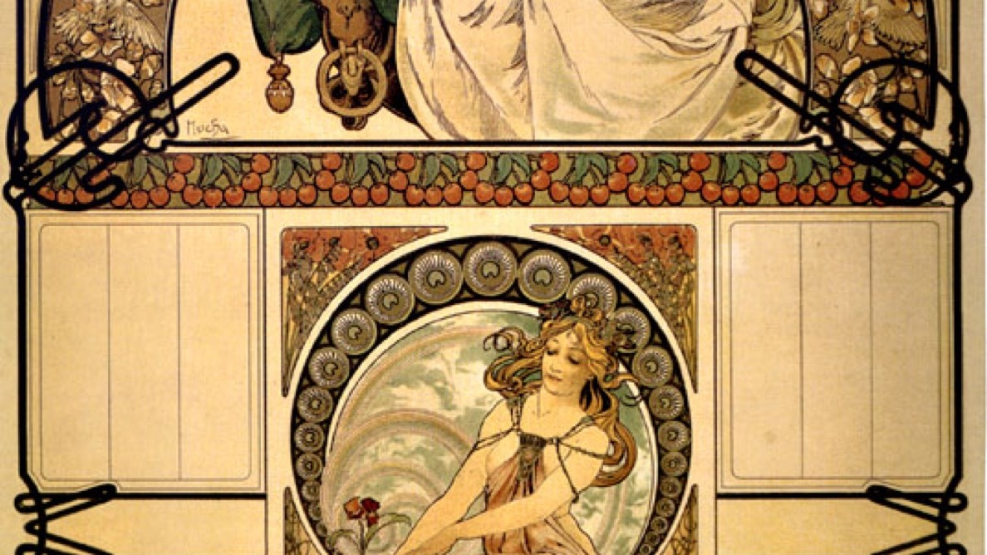
UNIT IV · THE POSTER
One message, one audience, and about three seconds to land it.
Alphonse Mucha, Calendar of cherry blossom, 1898. Public domain
Notes:
Mucha made commercial work that had to stop a person in the street. Ask what reads first here, and what reads second.

Slide 12
UNIT IV · GRAPHIC DESIGN
FOUR QUESTIONS
A poster cannot wait to be understood
01
What does it say?
02
Who is it for?
One message. If you need two sentences to state it, it is not a poster yet.
A named audience, not everyone. The audience decides the tone before you draw anything.
03
What reads first?
04
What does the type sound like?
Hierarchy. Something has to be biggest, and it should be the thing that matters.
Letterforms carry a voice before they carry information.
The test: pin it up, walk back three meters, count three seconds.
GRADE 10 ART & DESIGN · SEMESTER I
04

Slide 13
UNDERNEATH ALL FOUR
The sketchbook
carries the lot.
Whatever the medium, the thinking lives in the book.
GRADE 10 ART & DESIGN · SEMESTER I
05

