Slide 1
II
MEDIA STUDIES 9607 · UNIT II
Semiotics:
How Images Mean
Media Language · Lesson 02 of 16
Four days · Monday 7 to Friday 11 September
Notes:
The words circled in the CS1 exit swap get their name on Monday. The name is connotation.

Slide 2
II
THE INSTRUMENT
The sign,
taken apart.
Notes:
Semiotics is a tool, not a philosophy. This week it takes the sign apart and hands the parts back with names.

Slide 3
SAUSSURE · THE SIGN
TWO PARTS, ONE MEANING
Every sign has two halves
SIGNIFIER
SIGNIFIED
+
The form you perceive: the marks, the sound, the letters r-o-s-e.
The idea it calls up: the concept of a rose, formed in your mind.
= THE SIGN, the unit that carries meaning
MEDIA STUDIES 9607 · SEMESTER I
01

Slide 4
“
The bond between the signifier and the signified is arbitrary.
Ferdinand de Saussure, Course in General Linguistics, 1916

Slide 5
THE PARKED LIST GETS ITS NAME
TWO LAYERS OF MEANING
What it shows, what it suggests
01
02
Denotation
Connotation
The literal, first-order meaning: what is simply there. A red flower on a stem.
The second-order meaning it carries: romance, passion, grief, apology. The parked list from CS1, now legal.
MEDIA STUDIES 9607 · SEMESTER I
02

Slide 6

CONNOTATION CHAINS
Rose, and
everything after
rose → romance → Valentine's → spending
Each link feels natural. None of it is. Challenge every arrow with one question: who taught you that? Connotation is learned, and what is learned can be unlearned, or sold back to you.
Pierre-Joseph Redouté, Rosa gallica regalis, c. 1817
Notes:
Pairs build the chain, then challenge each link. The point is that connotation is cultural, not natural.

Slide 7
CONNOTATION IS CULTURAL, NOT NATURAL
THE CLOSING ASIDE: WHERE CULTURES DIVERGE
Same signifier, split meaning
SIGNIFIER
One reading
Another reading
White
Purity, the bride, the wedding
Mourning, the funeral, loss
Red
Danger, stop, warning, debt
Fortune, joy, the wedding envelope
The number four
An ordinary number
四 sounds like 死: avoided in floors and phone numbers
The core runs on the sets a Cambridge extract trades in: red, white, black, the rose, the dove, the suit. This aside proves the wheel is culture-bound; the paper only ever asks about the first set.
MEDIA STUDIES 9607 · SEMESTER I
03

Slide 8
“
All images are polysemous: underlying their signifiers, a floating chain of signifieds, the reader free to choose some and ignore others.
Roland Barthes, Rhetoric of the Image, 1964

Slide 9
MODES OF ADDRESS
WHO THE TEXT THINKS YOU ARE
Texts construct their readers
The question
The trick
How old does this text think you are? Not who buys it, but who the address is built for: the pronouns, the mood invited, the knowledge assumed.
A text does not just find an audience. It constructs one. Finish the sentence honestly: this text addresses me as... but I am...
Wednesday's commitment: the media area you will still be feeding in May, logged on the blog with one line of justification.
MEDIA STUDIES 9607 · SEMESTER I
04

Slide 10
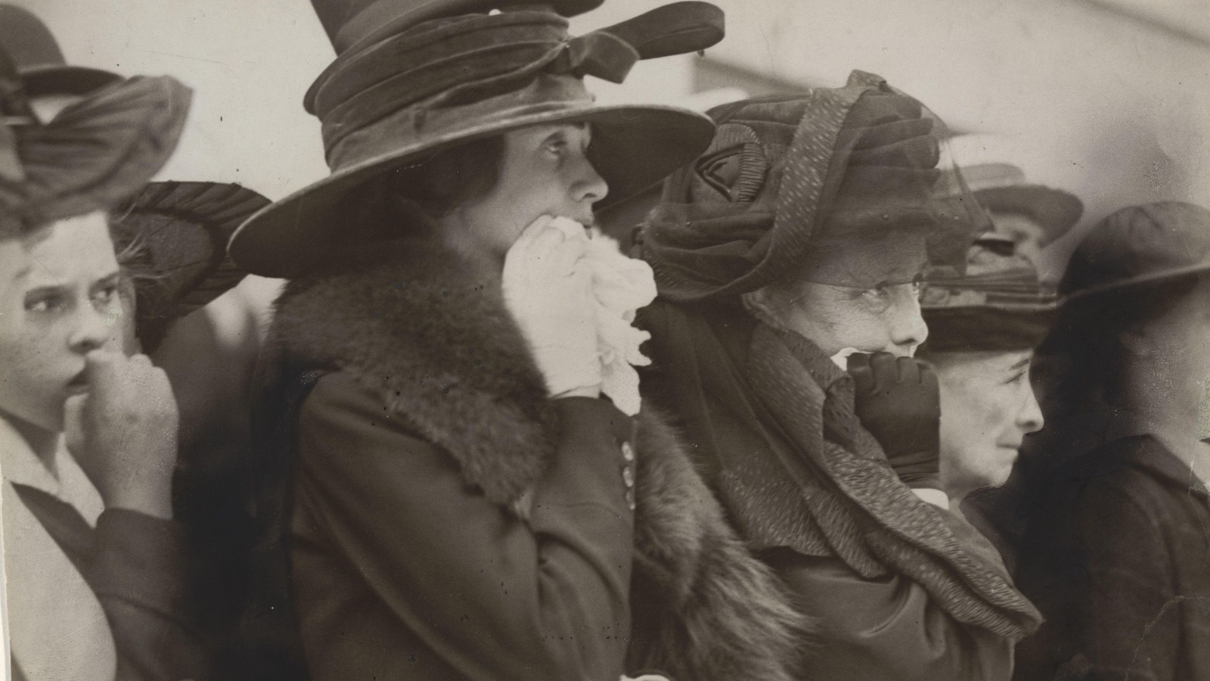
ANCHORAGE · THE CAPTION RETURNS
The words pin down which meaning you take. Barthes calls it anchorage.
Underwood & Underwood, Seventh Regiment marching to war, c. 1917
Notes:
L01's stereograph returns with a theorist's name. Anchorage fixes the floating chain; relay is when words and image take turns carrying the story.

Slide 11
DELIVERABLE · CS2
FRIDAY, HOMEWORK-BASED
Six labels, one everyday text
Annotate a media text from your own daily life with at least six accurate code labels: signifier, signified, denotation, connotation, anchorage, mode of address. The bar is accuracy, not quantity, and the cap is thirty minutes.
The theory-card box opens this week: Saussure and Barthes are the first two cards. Every theorist from now gets one; the box sits on the shelf until June.
MEDIA STUDIES 9607 · SEMESTER I
05

Slide 12
NEXT
Sign Types
and Codes
Lesson 03. Peirce's triad, and the four code families you will run for two years.
MEDIA STUDIES 9607 · SEMESTER I
06

