Slide 1
III
MEDIA STUDIES 9607 · UNIT II
Sign Types
and Codes
Media Language · Lesson 03 of 16
Four days · Monday 14 to Friday 18 September
Notes:
Two weeks of terminology consolidated into vocabulary students own under pressure. Peirce sorts signs by how they mean.

Slide 2
III
PEIRCE'S TRIAD
How a sign means,
not just what.
Notes:
Three images: a portrait, a footprint, a flag. All three mean something. Do they mean the same way?

Slide 3
PEIRCE · THREE WAYS TO MEAN
SORT WARS · BLENDS ARE CONTESTED
Icon, index, symbol
Icon
Index
Symbol
Means by resembling.
Means by physical trace.
Means by convention alone.
A portrait, a map, an emoji face. It looks like the thing it stands for.
Smoke, a footprint, a photograph. The thing was really there and left a mark.
A flag, a word, a sacred deer. Only agreement makes it mean; nothing natural links them.
The interesting case: a photograph is an index that looks like an icon. That tension runs through the whole subject.
MEDIA STUDIES 9607 · SEMESTER I
01

Slide 4
“
We think only in signs.
Charles Sanders Peirce, What Is a Sign?

Slide 5
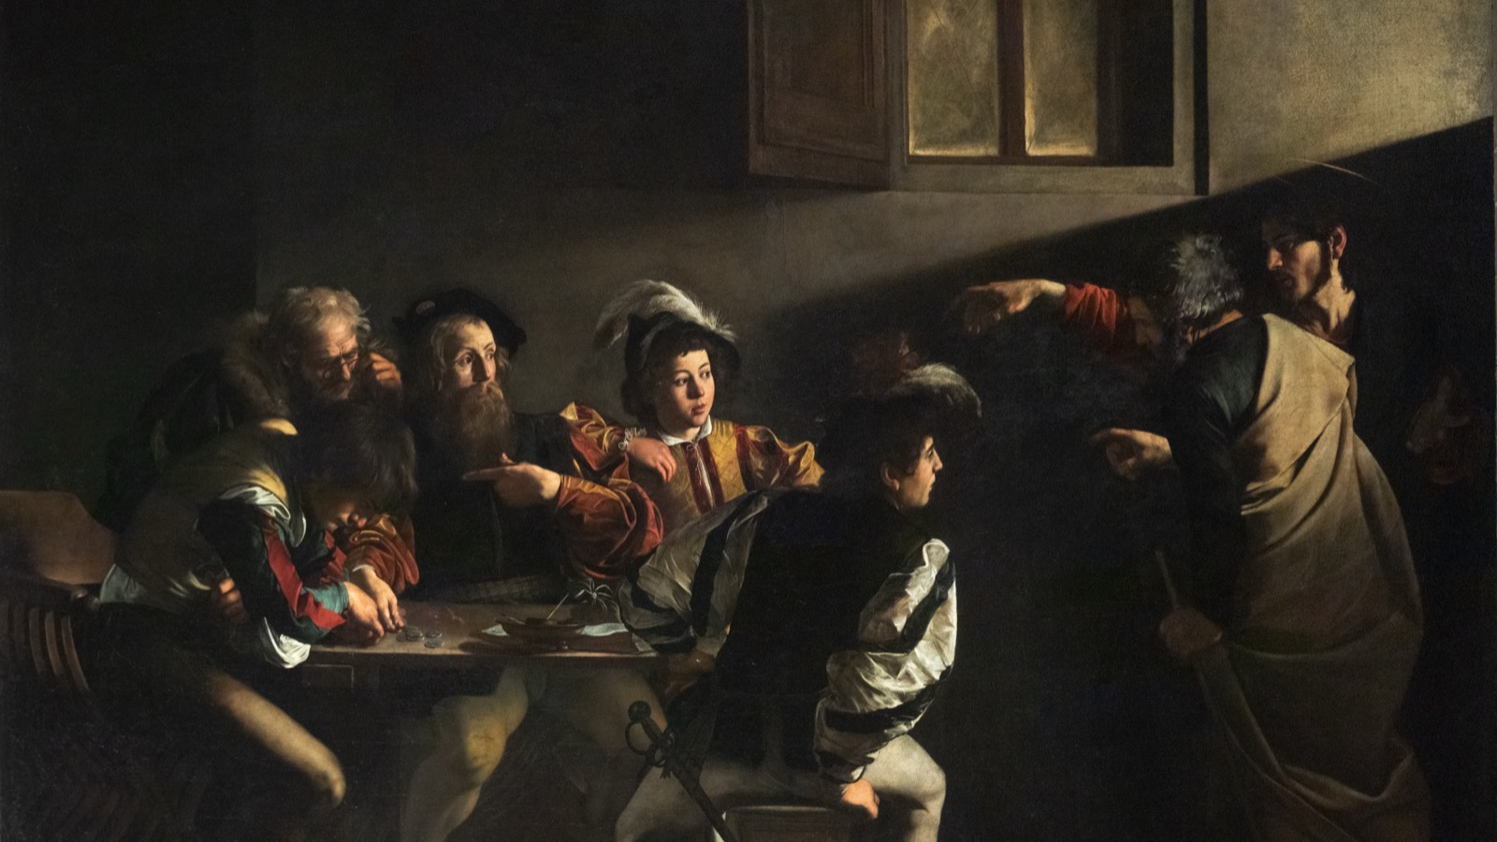
THE COLD READ · AN OLD MASTER
No dialogue, no famous faces, nothing but codes: where the light falls, who points at whom.
Caravaggio, The Calling of Saint Matthew, 1599
Notes:
The model still is a painting on purpose: it forces pure code-reading. Three minutes silent noticing, then the four families out loud.

Slide 6
“
The photograph as such and the object in itself share a common being, after the fashion of a fingerprint.
André Bazin, The Ontology of the Photographic Image, 1945

Slide 7
THE TWO-YEAR CHECKLIST
RUN ALL FOUR ON EVERY EXTRACT
Four code families
01
Technical
02
Symbolic
Camera, light, editing: how the image is shot and cut.
Objects, color, gesture, dress: what the things in frame claim.
03
Written
04
Audio
Any text in frame: titles, captions, signs, subtitles.
Sound, music, silence, and what is deliberately absent.
MEDIA STUDIES 9607 · SEMESTER I
02

Slide 8
THE READING PROTOCOL
THREE MINUTES OF SILENCE FIRST
Five questions, every image
1
Where is the light coming from, and what does it do?
2
Who gestures at whom?
3
What does each garment or object claim?
4
What text is present, or deliberately absent?
5
What would this room actually sound like?
MEDIA STUDIES 9607 · SEMESTER I
03

Slide 9
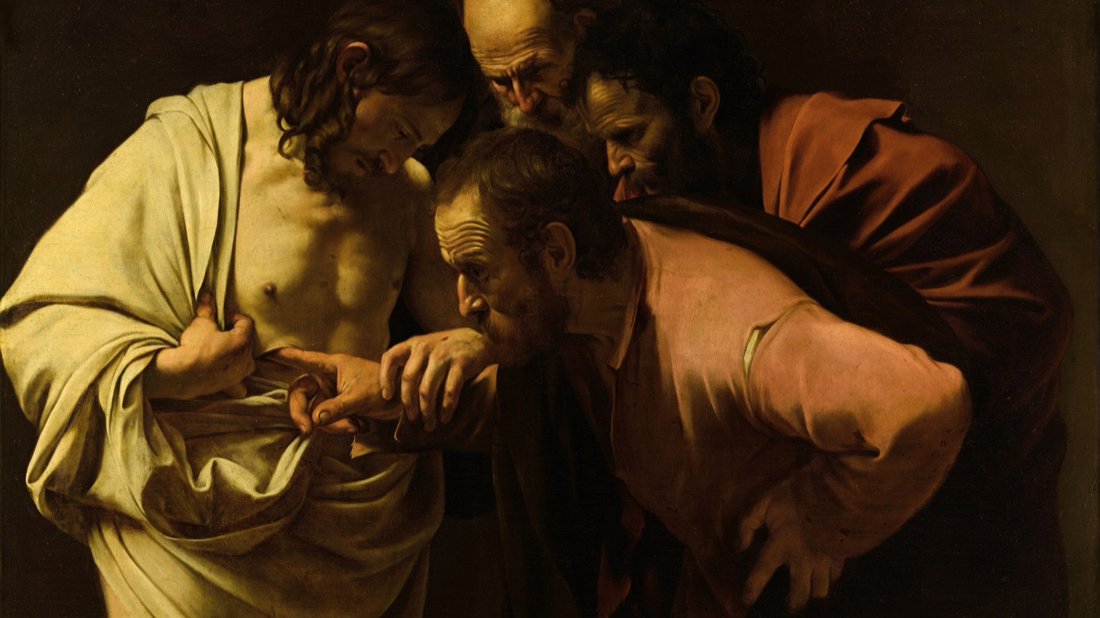
PRECISION BEATS QUANTITY
One exact observation, the finger entering the wound, outranks five vague ones.
Caravaggio, The Incredulity of Saint Thomas, c. 1602
Notes:
The reward structure said out loud: one precise technical observation tied to its effect beats a list. This is what the exam pays for.

Slide 10
THE POCKET INSTRUMENT
CARRIED INTO A1 AND PAPER 2
Build your own checklist
Each student writes a personal code checklist: the four families, the reading order, the terms you keep forgetting. It is the pocket version you will carry into every timed analysis for the next two years. Precision is a habit you build now, not a talent you are born with.
MEDIA STUDIES 9607 · SEMESTER I
04

Slide 11
DELIVERABLE · CS3
FRIDAY, TWENTY MINUTES
Twenty terms, under pressure
Twenty items in twenty minutes: define the term, label the example. Then self-mark against the definitions on screen, correcting every missed term into the lexicon on the spot. The self-marking does more teaching than the quiz; protect it.
Target: fifteen of twenty, or every missed term logged with its correction.
MEDIA STUDIES 9607 · SEMESTER I
05

Slide 12
NEXT
Genre
and Camera
Lesson 04. Genre as a contract, and the camera read as verbs.
MEDIA STUDIES 9607 · SEMESTER I
06

