Slide 1
IV
MEDIA STUDIES 9607 · UNIT II
Genre
and Camera
Media Language · Lesson 04 of 16
Three days · Monday 21 to Wednesday 23 September
Notes:
Genre theory and camera vocabulary land together because A1 will demand them in the same paragraph. The Friday is lost to Mid-Autumn Festival.

Slide 2
IV
ALTMAN · NEALE
Genre is
a contract.
Notes:
Genre reframed from a box of tropes into an agreement between industry and audience: the version that earns marks.

Slide 3
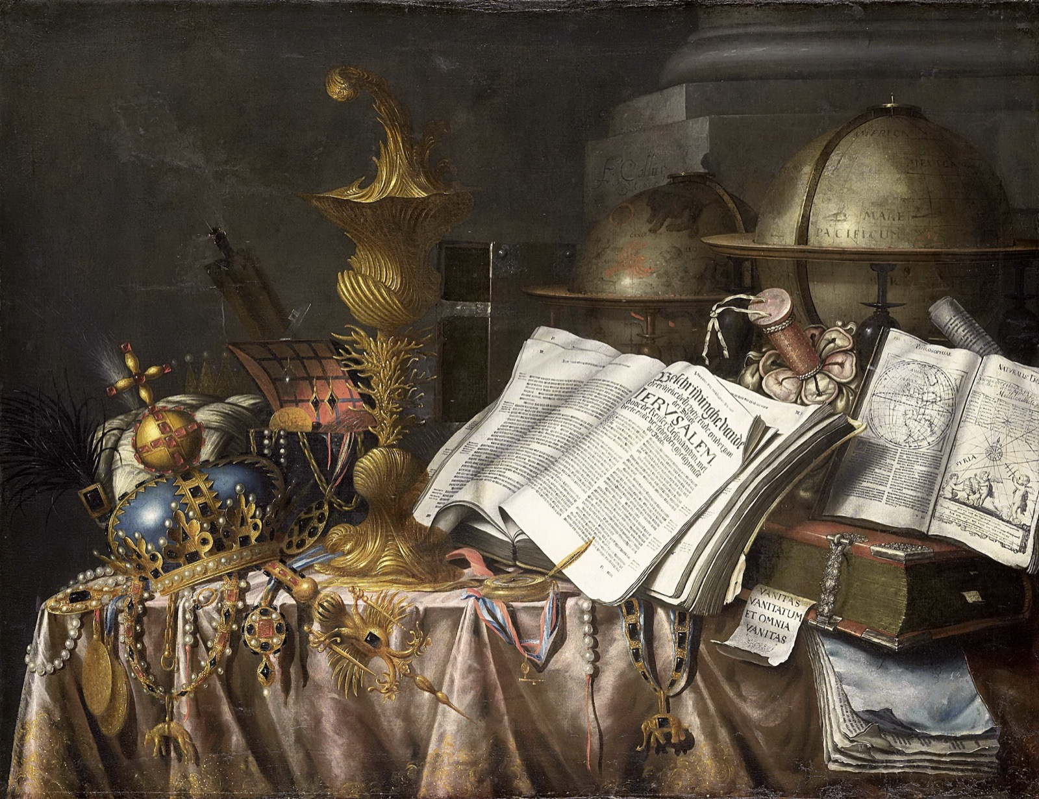
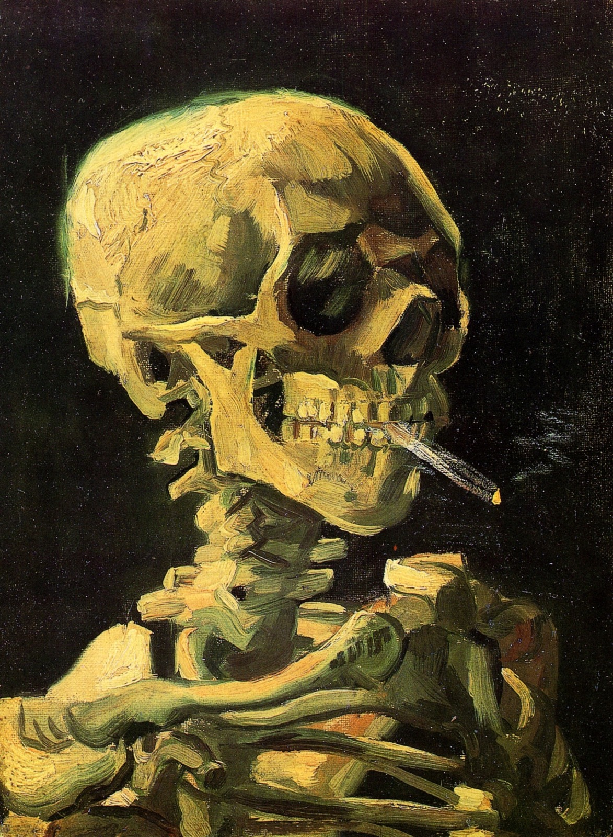
GENRE, WORKING
DIFFERENT PAINTERS, THREE CENTURIES APART
You knew instantly they belong together
Dutch vanitas still life, 17th century
Van Gogh, Skull with Burning Cigarette, 1885
Two skulls, two centuries apart. The recognition was instant, and it happened before a single film term. That recognition is genre working.
Notes:
Genre-recognition demonstrated on paintings students have never seen proves the mechanism is theirs already, before any film term is used.

Slide 4
“
Genres are instances of repetition and difference, and difference is absolutely essential to the economy of genre.
Steve Neale, Genre and Hollywood

Slide 5
ALTMAN · THE DEAL
TWO SIDES OF ONE CONTRACT
Who gets what
The industry gets
The audience gets
A pre-sold, budgetable product. Genre lowers the risk: audiences already know roughly what they are buying.
A promise of pleasure, with room for surprise. Enough of the familiar to trust it, enough difference to stay awake.
Exit question: why does the industry need genre more than we do?
MEDIA STUDIES 9607 · SEMESTER I
01

Slide 6
MAP A GENRE YOU KNOW
HORROR, CRIME DRAMA, SITCOM, DOCUMENTARY
Four questions of the contract
01
What repeats
02
What varies
The conventions the audience expects and would miss if absent.
The difference this instance offers: the reason to watch this one.
03
Who profits
04
What is promised
Who banks on the repetition: the studio, the platform, the franchise.
The pleasure the audience is being sold: fear, romance, awe, comfort.
MEDIA STUDIES 9607 · SEMESTER I
02

Slide 7
“
Genre is not simply given by the culture: it is a constant process of negotiation and change.
David Buckingham

Slide 8
THE CAMERA AS VERBS
WHAT IT DOES, THEN WHAT IT DOES TO YOU
The shot ladder
ECU
Extreme close-up
Angles
high · low · eye · canted
CU
Close-up
MS
Mid shot
Movement
LS
Long shot
pan · tilt · track · dolly · zoom · handheld
ELS
Extreme long shot
Name each as a verb: the camera looks up at, creeps toward, refuses to follow.
MEDIA STUDIES 9607 · SEMESTER I
03

Slide 9
“
Low angle: he towers.
I am small.
Name the move, then what it does to you: a Ladder sprint, rungs one to three, a point per verified call. The effect is the analysis; the label alone earns nothing.

Slide 10
DELIVERABLE · CS4
WEDNESDAY DOUBLE, FIRST HALF
A1, with the stakes off
From an unlabeled clip, chosen after the Four Corners genre round, one analytical paragraph in exam register: a genre claim, technical evidence in camera verbs, symbolic evidence, and what the audience is being promised. Marked in the official Paper 2 language so the feedback transfers straight to A1.
Concepts · terminology · analysis of how meaning is created · examples.
MEDIA STUDIES 9607 · SEMESTER I
04

Slide 11
CAMERAS IN HAND
THIRTY MINUTES, ONE WEEK OUT
The three that kill student footage
01
02
03
Audio
Continuity
Focus and exposure
Twenty seconds of dialogue recorded by the open door, played back on a speaker. Hear the room. Then the rule: monitor every take, and mic as close as the frame allows.
One action, sitting down with a cup, shot wide then close. Find the cut point where the hands match. Cheaper to shoot twice than to repair in the edit.
A face against the bright window. Auto first, then tap to lock. Watch the face go dark, and fix it here rather than on location.
Shot on the kit you will actually use over the break: a school camera signed out, or your own. Log the choice before you leave, and the one mistake your group will police.
MEDIA STUDIES 9607 · SEMESTER I
05
Notes:
Three stations, about seven minutes each, in production groups. The point is that the failure is audible or visible in the room rather than described. Close by collecting the equipment decision: school sign-out slips go to the equipment room before Mid-Autumn, and the choice is re-confirmed at the L05 lock so the shootability checklist points at a kit the group has actually tested.

Slide 12
NEXT
Narrative and
the Planning Lock
Lesson 05. Todorov, Propp, and a plan someone else could shoot.
MEDIA STUDIES 9607 · SEMESTER I
06

