Slide 1
V
MEDIA STUDIES 9607 · UNIT II
Narrative and
the Planning Lock
Media Language · Lesson 05 of 16
Four days across the National Day break · Monday 28 September to Friday 9 October
Notes:
Narrative theory and production planning converge on one Wednesday: every C1 plan locked to the standard of a plan someone else could shoot.

Slide 2
V
THE STANDARD
A plan someone else
could shoot.
Notes:
Rubens' assistants painted whole ceilings from his sketches. That is the bar: a plan complete enough to be executed without asking questions.

Slide 3
TODOROV · THE NARRATIVE ARC
WHERE IS THE DISTURBANCE IN YOUR OPENING?
Five stages, one movement
Equilibrium
Disruption
Recognition
Repair
New equilibrium
1
2
3
4
5
a stable world
a force breaks it
the break is seen
an attempt to fix
a changed calm
The caveat that earns marks: the model fails on non-linear narratives, and saying so is the top-band move.
MEDIA STUDIES 9607 · SEMESTER I
01

Slide 4
“
The minimal complete plot can be seen as the shift from one equilibrium to another.
Tzvetan Todorov, The Poetics of Prose

Slide 5
PROPP · CHARACTERS BY FUNCTION
WHAT THEY DO, NOT WHO THEY ARE
Seven roles a story fills
Hero
seeks, and is tested
Villain
struggles against the hero
Donor
gives the hero a tool or gift
Helper
aids the hero on the way
Princess
the sought-for person or prize
Dispatcher
sends the hero out
False hero
claims the reward unearned
The caveat: folk tales, 1928; apply with judgment. Dealt as Sort Wars cards: rebuild a scrambled tale, then ask your own opening: who is your donor, and do you even have one?
MEDIA STUDIES 9607 · SEMESTER I
02

Slide 6
“
The functions of characters serve as stable, constant elements in a tale, independent of how and by whom they are fulfilled.
Vladimir Propp, Morphology of the Folktale, 1928

Slide 7
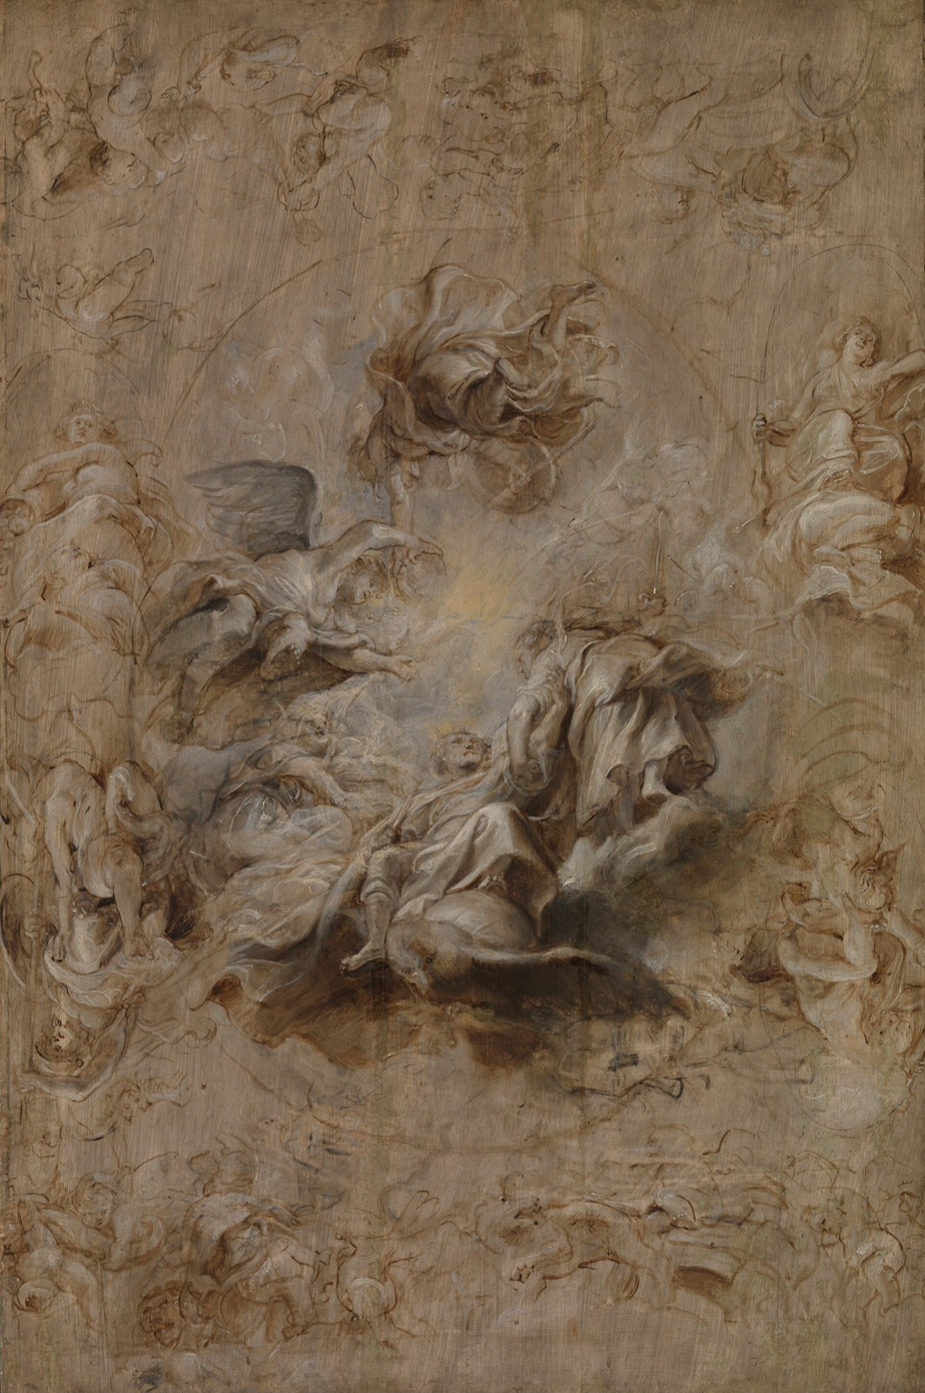
THE BAR
Painted from
the sketch
Rubens' assistants painted a whole ceiling from a sketch this size, because the plan answered every question before the brush touched the wall. Your C1 plan is locked when it could be shot the same way: by someone who was not in the room.
Rubens, Multiple Sketch for the Banqueting House Ceiling, c. 1629
Notes:
The Rubens sketch sets the standard for the lock: a plan complete enough to hand off.

Slide 8
THE LOCK · TEN ITEMS
DESCRIBE, QUESTION, SUGGEST
The shootability checklist
01
Numbered shots
06
Assigned roles
02
Confirmed locations
07
Costume and props
03
Cast attached to dates
08
Storyboard matches shot list
04
Equipment per session
09
Schedule fits the break
05
A contingency day
10
No outside dependencies
Run as launch clearance: ten green lights or the plan does not fly. Locked means locked: later changes are documented decisions in the diary, not silent swaps.
MEDIA STUDIES 9607 · SEMESTER I
03

Slide 9
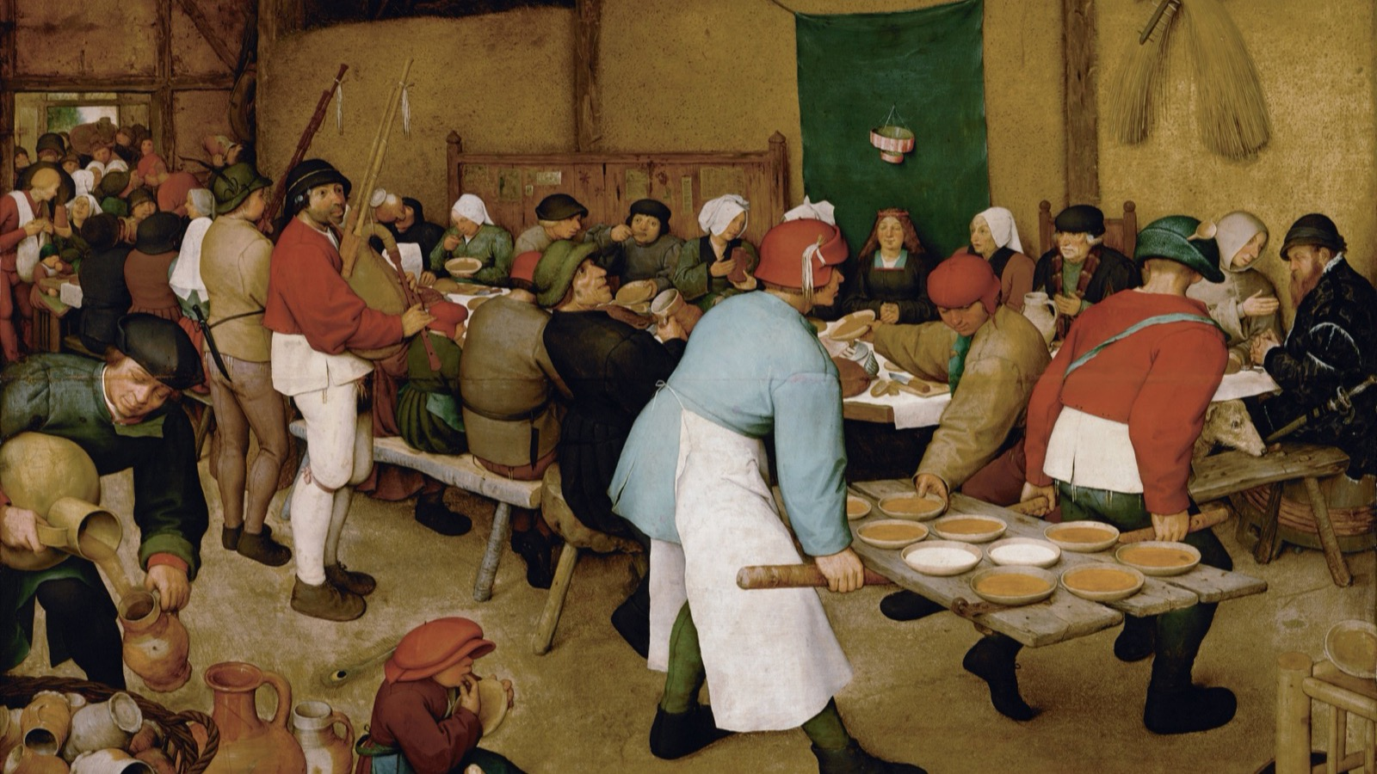
A PLAN EXECUTED
Dozens of figures, every one with a job: the pourers, the carriers, the seated guests.
Pieter Bruegel the Elder, The Peasant Wedding, 1567
Notes:
A complex scene where everyone knows their role: what a locked plan looks like when it reaches the day of the shoot.

Slide 10
THIS LESSON CARRIES
BLOG, BREAK TASK, AND THE A1 DATE
Three things go on the record
LB1
Blog punctuality, posts 1 to 5. Ten minutes reserved to bring lagging blogs current.
TUE 29 SEP
HW1
An A1-format analysis of a self-chosen sequence over the break, plus the production shoot window.
SET WED 30 SEP
A1 announced
The first attainment, announced today because its notice window falls inside the holiday.
SITS WED 14 OCT
MEDIA STUDIES 9607 · SEMESTER I
04

Slide 11
NEXT
A1: Timed Media
Language Analysis
Lesson 06. The theory put under load, then the first sit.
MEDIA STUDIES 9607 · SEMESTER I
05

