Slide 1
VI
MEDIA STUDIES 9607 · UNIT III
A1: Timed Media
Language Analysis
Macro and Textual Analysis · Lesson 06 of 16
Three days · Monday 12 to Wednesday 14 October
Notes:
The first attainment of the course. Monday and Tuesday put Propp and Todorov under load; Wednesday is the sit.

Slide 2
VI
THE TOP-BAND MOVE
Where the theory
strains.
Notes:
The theory fitting perfectly is almost never true or interesting. The strain is exactly what a top-band answer discusses.

Slide 3
PUT THE MODELS UNDER LOAD
HUNT FOR WHERE THEY STRAIN
Two theories, on real texts
Propp on a trailer
Todorov across an episode
Map the cast onto functions, then find the break: the false hero who is also the donor, the villain hidden on purpose. A withheld function is a marketing decision.
Where is the disruption really? Does the new equilibrium arrive, or is it withheld for the season arc? Serial television bends the model. Name the bend.
MEDIA STUDIES 9607 · SEMESTER I
01

Slide 4
“
All models are wrong, but some are useful.
George E. P. Box, 1979

Slide 5
THE STRAIN LOG
AMMUNITION, NOT A COMPLAINT BOX
Keep a running list
Every place a model failed to fit goes in a list titled Where the theory strains. It is not a complaint that the theory is broken. It is the raw material of a top-band paragraph, and it converts frustration into marks.
Todorov's model illuminates X, although the extract complicates it by Y.
Exit: Beat the Examiner, lite. One anonymized paragraph on screen, pairs call the band against the five criteria, teacher reveals.
MEDIA STUDIES 9607 · SEMESTER I
02

Slide 6
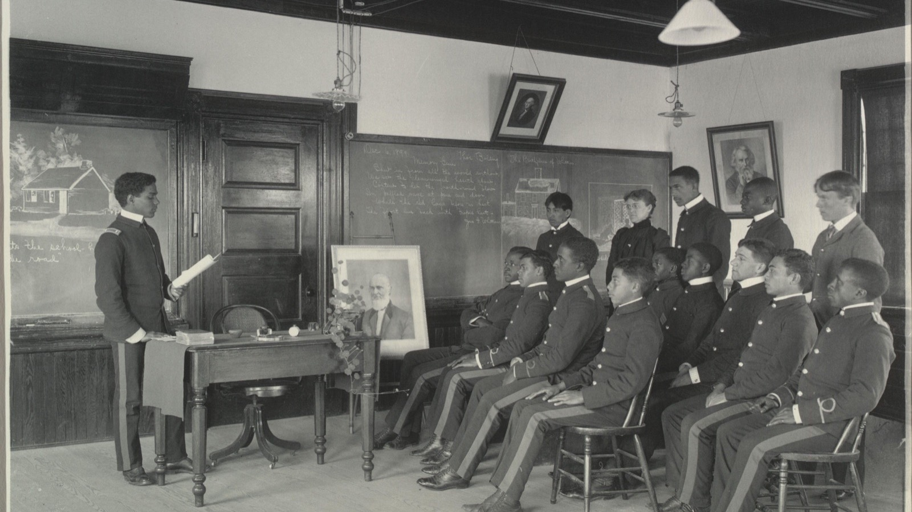
THE DISCIPLINE IS THE SKILL
Systematic reading is a habit you build, not a talent: the same order, every text, every time.
Frances Benjamin Johnston, an English Literature class, Hampton, c. 1899
Notes:
The photograph shows the attention the exam rewards. Same order, no hurry, nothing skipped.

Slide 7
THE SCREENING PROTOCOL
THE EXAM'S OWN RUBRIC
Four viewings, one extract
First
Second
Third
Fourth
1
2
3
4
JUST WATCH
CAMERA & EDITING
SOUND & MISE-EN-SCENE
NARRATIVE & MEANING
No notes. See the whole thing before you dissect it.
Track the technical codes: shots, angles, movement, cuts, pace.
Music, silence, diegetic sound; setting, props, dress, gesture.
Structure, enigma, what the extract argues, and where it strains.
MEDIA STUDIES 9607 · SEMESTER I
03

Slide 8
HOW A1 IS MARKED
THE OFFICIAL PAPER 2 RUBRIC
Five criteria, best-fit, 0 to 5 each
AO
Criterion
Band
AO1
Media Concepts: language and representation
/5
AO1
Contexts and Critical Debates
/5
AO1
Use of Terminology
/5
AO2
Analysis of how meaning is created
/5
AO2
Use of Examples
/5
Band words: 5 Sophisticated · 4 Thorough · 3 Clear · 2 Limited · 1 Basic. So A1 is AO1 60 / AO2 40.
MEDIA STUDIES 9607 · SEMESTER I
04

Slide 9
“
Sixty minutes.
One unseen extract.
How the extract constructs meaning through camera, sound, mise-en-scene, editing. Everything since Week 1 is in play.

Slide 10
THE DEBRIEF
NO MARKS DISCUSSED, BY DESIGN
Three honest questions
01
02
03
What did it reward?
First and forgotten
One thing differently
Which codes carried the meaning, and which the extract simply did not use.
Which code family you reached for first, and which you forgot, with evidence this time.
With the same sixty minutes: what one change would have bought the most marks?
MEDIA STUDIES 9607 · SEMESTER I
05

Slide 11
ASSESSMENT · A1
THE FIRST ATTAINMENT
A1 sits Wednesday 14 October
Timed media language analysis of an unseen TV-drama extract, sixty minutes, full exam conditions. Marked with WS 4.6's rubric in the official five-criteria language, so the feedback transfers straight to Paper 2. Scripts back within five working days.
Also today: A2 announced, due Monday 26 October, blog posts 1 to 7 to the mid-point standard.
MEDIA STUDIES 9607 · SEMESTER I
06

Slide 12
NEXT
Reading
Systematically
Lesson 07. Barthes, the reading order, PEEM, and the blog audit that makes A2 safe.
MEDIA STUDIES 9607 · SEMESTER I
07

