Slide 1
VII
MEDIA STUDIES 9607 · UNIT III
Reading
Systematically
Toward the Blog Mid-Point · Lesson 07 of 16
Five days · Friday 16 to Friday 23 October
Notes:
Five days that turn analytical instinct into analytical method, wrapped around the audit that makes A2 safe.

Slide 2
VII
THE FIX
Procedural,
not talent.
Notes:
The commonest A1 gap is coverage: whole code families left unvisited. The fix is an order, run the same way every time.

Slide 3
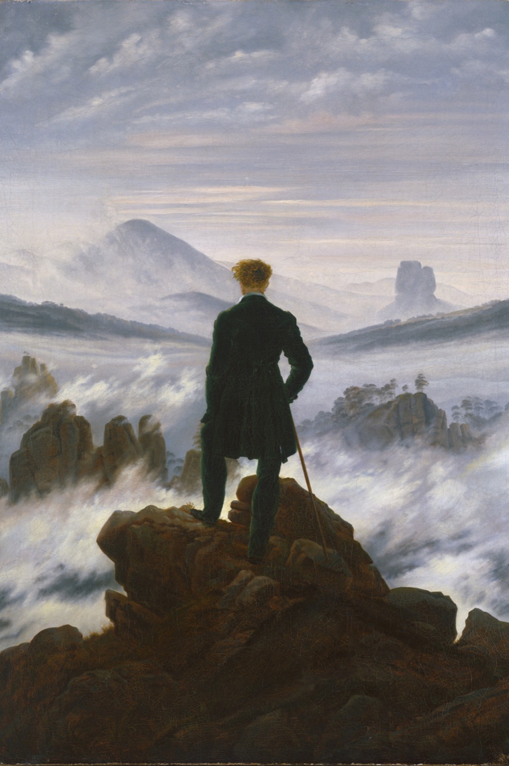
THE ENIGMA CODE
You leaned in
A figure on a rock, his back turned. Who is he? What does he see? The picture plants a question and refuses to answer it, and you leaned in to find out. That lean is Barthes's enigma code working, and every opening is engineered to owe you answers.
Caspar David Friedrich, Wanderer Above the Sea of Fog, 1818
Notes:
D1: one TV cold open screened twice. First pass, list every question the text plants; second, every promise it makes.

Slide 4
BARTHES · TWO OF THE FIVE CODES
THE QUESTION AND THE PROMISE
What a text owes you
Enigma code
Action code
The question a text plants and refuses to answer yet. It creates the debt that keeps you watching: who did it, what is behind the door, will they survive?
The promise that something will happen, and soon. A loaded gun, a lit fuse, a packed suitcase: the text owes you a consequence.
MEDIA STUDIES 9607 · SEMESTER I
01

Slide 5
“
The birth of the reader must be at the cost of the death of the Author.
Roland Barthes, The Death of the Author, 1967

Slide 6
THE SYSTEMATIC READING ORDER
SAME ORDER, EVERY EXTRACT, EVERY TIME
The order is the discipline
1
Framing
what is in, what is out
2
Camera
shot, angle, movement
3
Light
source, direction, mood
4
Mise-en-scene
setting, props, dress, gesture
5
Sound
music, silence, diegetic sound
6
Edit
cut, pace, transition
7
Narrative codes
enigma, action, structure
The Ladder arrives in full: the order climbs rungs one and two; PEEM climbs the rest.
MEDIA STUDIES 9607 · SEMESTER I
02

Slide 7
PEEM
THE PARAGRAPH THAT PROVES
Prove, do not assert
Point
Evidence
Effect
Meaning
P
E
E
M
the claim you are making
pinned to a signifier in frame
what it does to the viewer
tied back to the concept
The A1 pile's commonest failure is assertion: a claim with no evidence, no effect, no link. PEEM is the repair: rungs three to five of the Ladder, climbed by cold call.
MEDIA STUDIES 9607 · SEMESTER I
03

Slide 8
“
Systematic
beats brilliant.
The order run silently, notes in order, no wandering. The discipline is the exercise, not a warm-up for it.

Slide 9
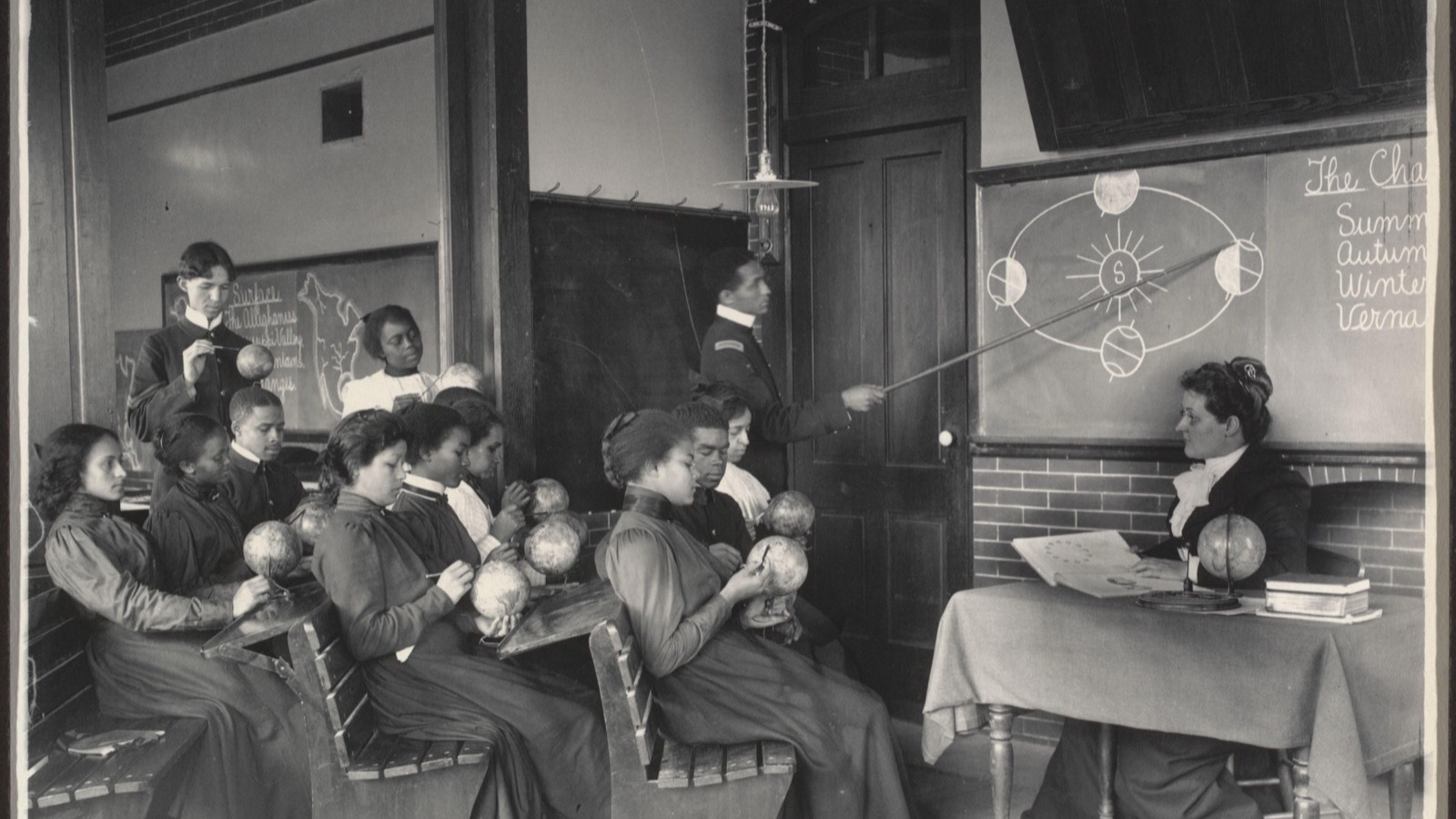
CS5 · THE BLOG AUDIT
Every blog read by a peer against the same checklist A2 is marked with, three days before it is due.
Frances Benjamin Johnston, a Geography class, Hampton, c. 1899
Notes:
The audit is A2's marking preview. It sits with working days to spare so there is still time to act on what it finds.

Slide 10
THE MID-POINT CHECKLIST
EVERY POST DATED, CONTRIBUTIONS LABELED
Seven posts, no gaps
01
Brief and group registered
02
Research into similar products
03
Audience profile
04
Pitch
05
Planning suite
06
Production log opening
07
Early production evidence
Findings written as actions, not comments: post 3 has no audience data, add the survey screenshot, beats more detail.
MEDIA STUDIES 9607 · SEMESTER I
04

Slide 11
DELIVERABLE · CS5
THE AUDIT THAT MAKES A2 SAFE
Three teaching days to Monday
CS5 is a peer blog audit against the mid-point checklist, the same instrument A2 is marked with. It is placed with working days to spare on purpose, so the deadline surprises nobody. A2 is submitted work, not a sitting: it is due the Monday after this lesson ends.
MEDIA STUDIES 9607 · SEMESTER I
05

Slide 12
NEXT
Representation,
Applied
Lesson 08. Hall, construction and reading positions, turned on your own product.
MEDIA STUDIES 9607 · SEMESTER I
06

