Slide 1
VIII
MEDIA STUDIES 9607 · UNIT IV
Representation,
Applied
Representation · Lesson 08 of 16
Six days · Monday 26 October to Tuesday 3 November
Notes:
Representation theory taught, then immediately turned on the students' own work, while there is still production time to fix what it finds.

Slide 2
VIII
THE CLAIM
It constructs.
It does not reflect.
Notes:
Representation does not reflect the world; it constructs a version of it, by selection and combination. Never objective.

Slide 3
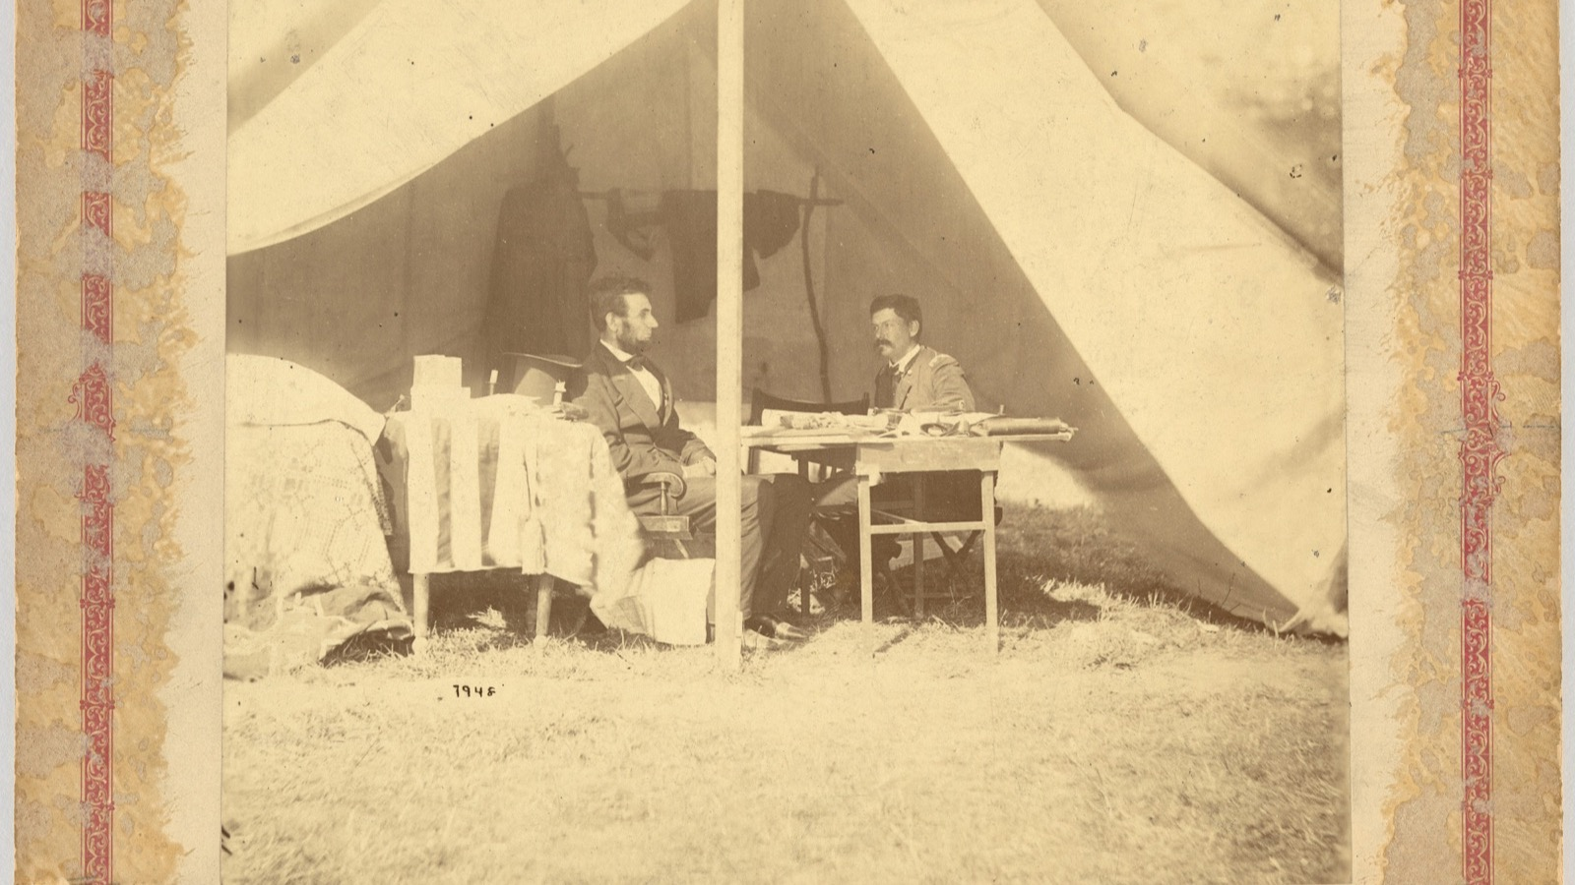
THE PHOTO-OP IS OLDER THAN THE WORD
The tent, the table, who sits and who stands: every choice is doing representation work.
Alexander Gardner, Lincoln and McClellan at Antietam, 1862
Notes:
Lincoln and McClellan posed in a tent at Antietam, 1862. The staged image of power predates the word representation as we use it.

Slide 4
“
Representation connects meaning and language to culture.
Stuart Hall, The Work of Representation, 1997

Slide 5
HOW CONSTRUCTION WORKS
NEVER OBJECTIVE
Selection and combination
Selection
Combination
What is chosen to appear, and what is left out. The frame is an argument before anyone speaks.
How the chosen elements are arranged together. Meaning is built from what sits next to what.
The turn inward: my C1 product represents ... as ... . Every day this week tests that sentence.
MEDIA STUDIES 9607 · SEMESTER I
01

Slide 6
HALL · ENCODING AND DECODING
MEANING IS FINISHED IN THE AUDIENCE
Three reading positions
Dominant
Negotiated
Oppositional
The audience reads the preferred meaning the maker encoded, and accepts it.
The audience accepts the broad meaning but bends it to their own situation.
The audience understands the preferred meaning and reads against it, on purpose.
Run as Four Corners: dominant, negotiated, oppositional, plus an abstain-and-justify center. Could your C1 product survive an oppositional reading? The disagreement is the theory working.
MEDIA STUDIES 9607 · SEMESTER I
02

Slide 7
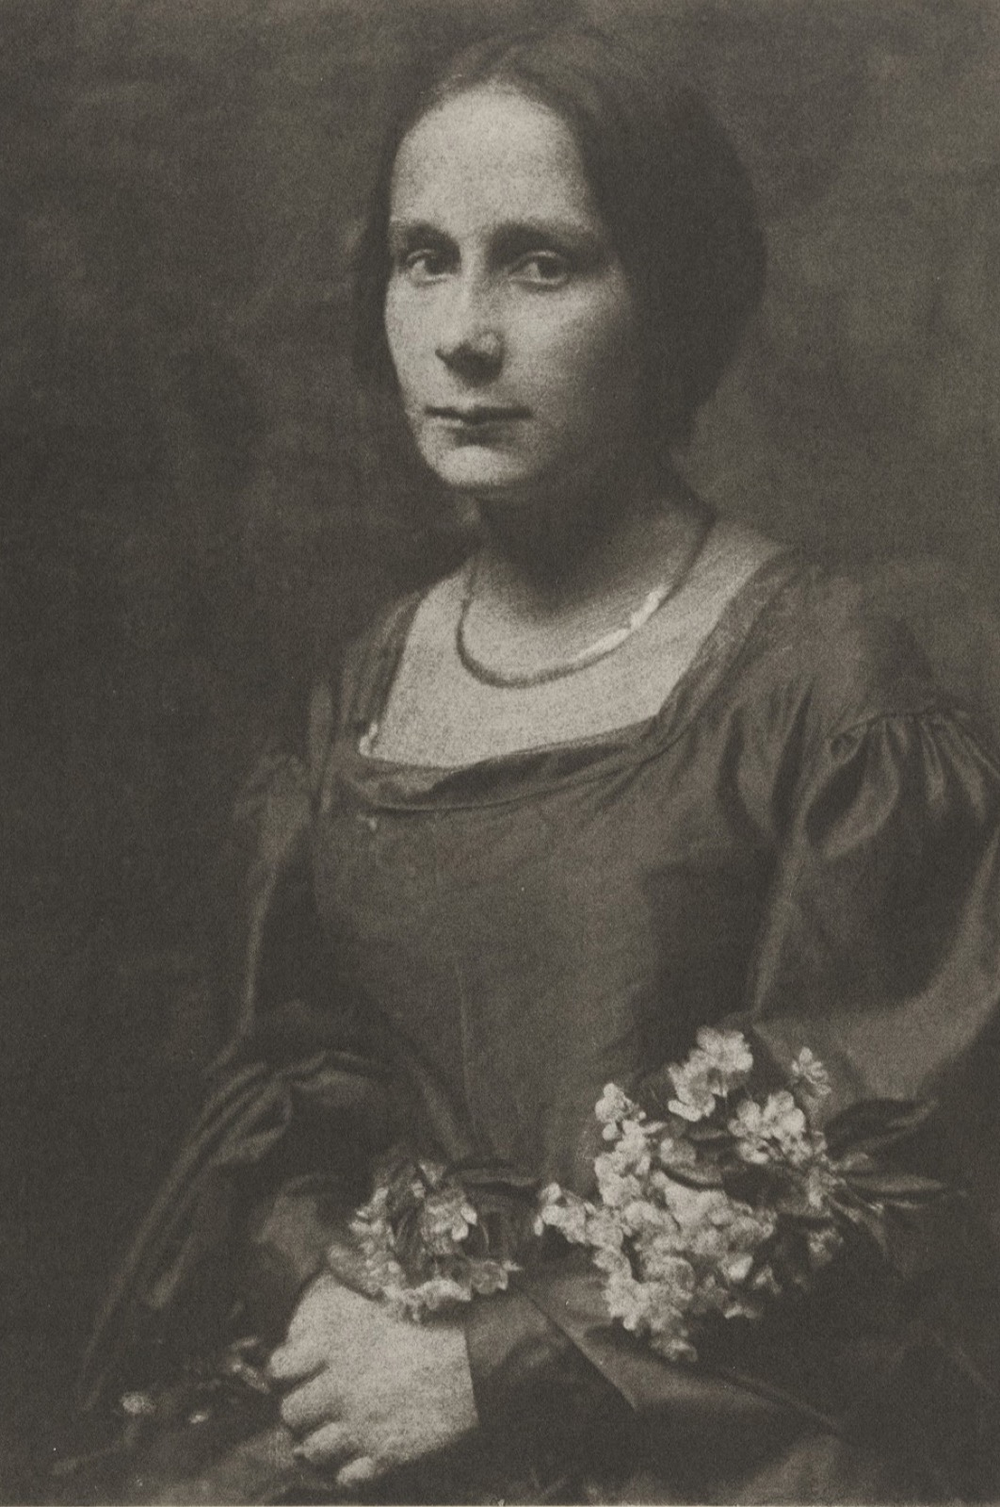
SAME PERSON, THREE WAYS
The person never
changed
A studio portrait is a built thing: pose, light, backdrop, retouch. Take one public figure and three found images, an official portrait, a news photo, a fan edit, and list what each version selects, combines, and asks you to conclude. The construction changed; the person did not.
Gertrude Kasebier, a studio portrait, c. 1900
Notes:
A studio portrait models representation as construction. The three-image same-person exercise makes the point on a figure the room knows.

Slide 8
“
Stereotyping reduces, essentializes, naturalizes and fixes difference.
Stuart Hall, The Spectacle of the Other, 1997

Slide 9
STEREOTYPING AS POWER
WHO BENEFITS, WHO PAYS
A shortcut with a beneficiary
A stereotype is not a lie. It is a shortcut, and every shortcut has a beneficiary and someone who pays the toll. Ask both questions of every case: who is served by this being the quick version, and who is cost by it? A counter-stereotype, like Carl in UP, registers as surprising only because the shortcut is so well worn.
MEDIA STUDIES 9607 · SEMESTER I
03

Slide 10
“
What is never in the frame
cannot be argued with.
Who never appears cannot complain. Run the inventory on your own product: who is missing, and did you choose that or default to it?

Slide 11
THE SELF-AUDIT
THE WEEK'S FULL TOOLKIT, ON YOUR OWN CUT
Four questions of your own product
01
Construction
02
Positions
What did we select and combine, and what did that leave out?
What reading did we assume our audience would take?
03
Power
04
Absence
Whose shortcut did we borrow, and who pays for it?
Who is missing from our product, by choice or by default?
A2 in Monday; the response cards become evidence Tuesday; LB3 posted on screening quality. The pickups are the homework.
MEDIA STUDIES 9607 · SEMESTER I
04

Slide 12
NEXT
The Gaze
Lesson 09. Van Zoonen, Mulvey, and hooks: who is the looking arranged for?
MEDIA STUDIES 9607 · SEMESTER I
05

