Slide 1
IX
MEDIA STUDIES 9607 · UNIT IV
The Gaze
Representation · Lesson 09 of 16
Four days · Monday 9 to Friday 13 November
Gaze theory taught as live questions, not settled answers.
Notes:
The block builds van Zoonen and Mulvey; the double stress-tests Mulvey; hooks reframes the whole week.

Slide 2
IX
THE WEEK'S QUESTION
Who is the looking
arranged for?
Notes:
Not who buys the perfume: who is the looking arranged for? That is the whole week in one question.

Slide 3
VAN ZOONEN · GENDER AS PERFORMANCE
ASSEMBLED, NOT PHOTOGRAPHED
If it is assembled, it can be assembled otherwise
Gender in media is not a fact being photographed. It is a performance, built from repeatable conventions:
Pose
Gaze direction
Fragmentation
Setting
how the body is arranged
where the eyes are sent
the body shown in parts
the world built around it
Swap the conventions between two ads on paper: what breaks, and why does the break feel like information?
MEDIA STUDIES 9607 · SEMESTER I
01

Slide 4
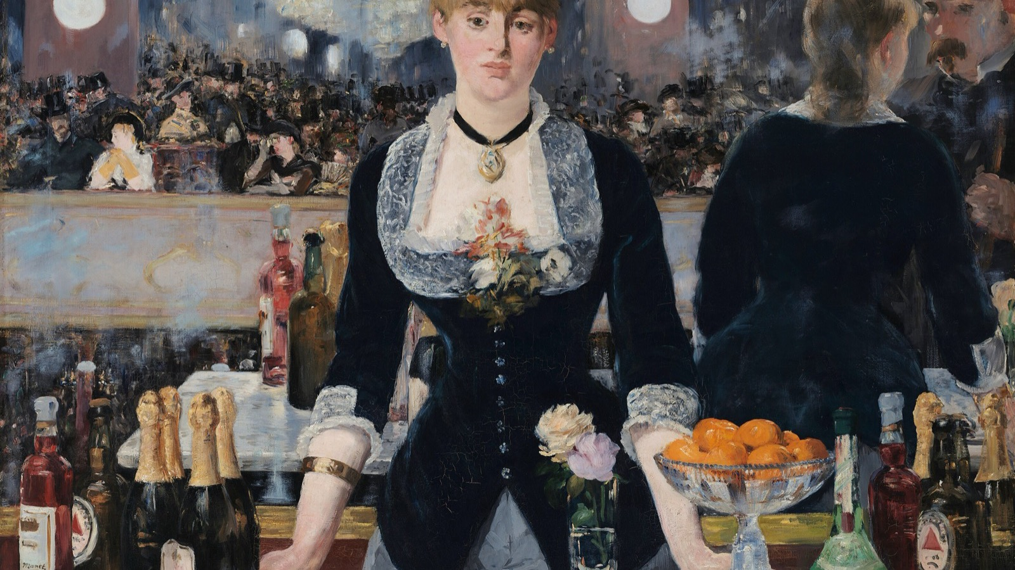
THE LOOKING THAT WILL NOT RESOLVE
The mirror behind her does not add up. Who is she looking at, and who is looking at her?
Edouard Manet, A Bar at the Folies-Bergere, 1882
Notes:
The mirror does not add up and the barmaid looks past us. Manet painted the problem the week is about: who looks at whom.

Slide 5
MULVEY · A CLAIM FROM 1975
MADE TO BE TESTED
Three looks, classically aligned
01
02
03
The camera's
The characters'
The audience's
How the shot itself frames, lingers, and fragments the figure on screen.
How people within the story look at one another inside the narrative.
How we are positioned to look, and whose looking we are lent.
Classically, all three align on woman as spectacle. This is a claim from 1975 about a system, made to be tested, not recited.
MEDIA STUDIES 9607 · SEMESTER I
02

Slide 6
“
In their traditional exhibitionist role, women are simultaneously looked at and displayed... so that they can be said to connote to-be-looked-at-ness.
Laura Mulvey, Visual Pleasure and Narrative Cinema, 1975

Slide 7
THE DECADE TEST
THE VARIABLE IS ERA
Hold, shift, or invert?
Take a genre pair, one text before 2000 and one after 2018, with a comparable scene function so the only variable is era. Gather timecoded evidence for the camera-look, the character-look, and audience positioning in each. Then reach a verdict with the evidence attached: did the gaze hold, shift, or turn out to be the same structure pointed elsewhere?
Every verdict must survive one structured counter: challenger named in advance, evidence required.
MEDIA STUDIES 9607 · SEMESTER I
03

Slide 8
“
There is power in looking.
bell hooks, The Oppositional Gaze, 1992

Slide 9
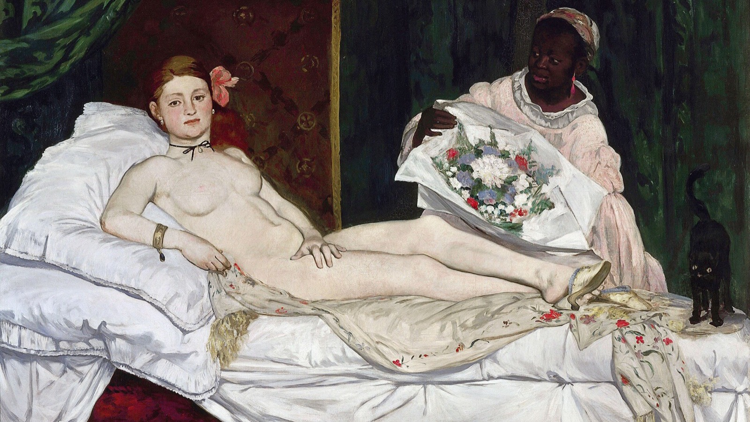
A LOOK SENT BACK
She is looked at, and she looks straight back, refusing to be only an image.
Edouard Manet, Olympia, 1863
Notes:
Olympia stares straight back and returns the viewer's look. Use it as the bridge to hooks and the oppositional gaze.

Slide 10
HOOKS · THE OPPOSITIONAL GAZE
THE WEEK'S QUESTION, FLIPPED
Looking back at what never expected you
bell hooks flips the week's question. Not how the text looks at its subjects, but who the looking was built for, and what happens when someone else does it. Refusing a text, and reading it again against itself, is critical work. The oppositional gaze looks back at a text that never expected you to be watching.
MEDIA STUDIES 9607 · SEMESTER I
04

Slide 11
DELIVERABLE · CS6
A THEORIST DOING ANALYTICAL WORK
Not decoration, analysis
One close-reading paragraph on a still or short clip: a claim, evidence, and a theorist working inside the analysis. As Mulvey's camera-look predicts... beats Mulvey said the male gaze. The theorist earns their place by doing work, not by being named.
Before scripts come in, a Smuggler Hunt: partners hunt for a decorated theorist, named but doing no work.
A3 announced today: the complete C1 portfolio, due Friday 27 November, exactly 14 days.
MEDIA STUDIES 9607 · SEMESTER I
05

Slide 12
NEXT
The Creative
Critical Reflection
Lesson 10. Where AO2 lives in the portfolio: cut every sentence that describes instead of reflects.
MEDIA STUDIES 9607 · SEMESTER I
06

