Slide 1
X
MEDIA STUDIES 9607 · UNIT IV
The Creative
Critical Reflection
Representation · Lesson 10 of 16
Four days · Monday 16 to Friday 20 November
Notes:
One week, one artifact: the CCR that carries a fifth of the A3 marks in disguise, because it is where AO2 lives in the portfolio.

Slide 2
X
THE RULE AND THE SUCCESS CRITERION
Cut every sentence that
describes instead of reflects.
Notes:
The rule that governs all four days doubles as the success criterion, straight from the schedule.

Slide 3
THE CCR · FOUR SET QUESTIONS
PRESENTED CREATIVELY, USING TECHNOLOGY
The four questions
Q1 · Conventions
Q2 · Audiences
How the product uses or challenges conventions, and how it represents social groups.
Who the product engages, and how it would really reach and circulate to them.
Q3 · Skills
Q4 · Technology
What developed from day-one footage to the rough cut, and what changed it.
Software, hardware, online: as decisions, we used X so that Y, not an inventory.
MEDIA STUDIES 9607 · SEMESTER I
01

Slide 4
THE ONE-LINE TEACHING OF THE WHOLE WEEK
PUT IT ON THE WALL
The tell
A description
A reflection
contains a sequence of events. It says what you did: we filmed, then we edited, then we uploaded.
contains a decision, a reason, or a change. It says why, and what you would do differently.
MEDIA STUDIES 9607 · SEMESTER I
02

Slide 5
“
A decision,
a reason, or a change.
Every reflective sentence contains at least one. If a sentence contains none of the three, it is description; cut it or convert it.

Slide 6
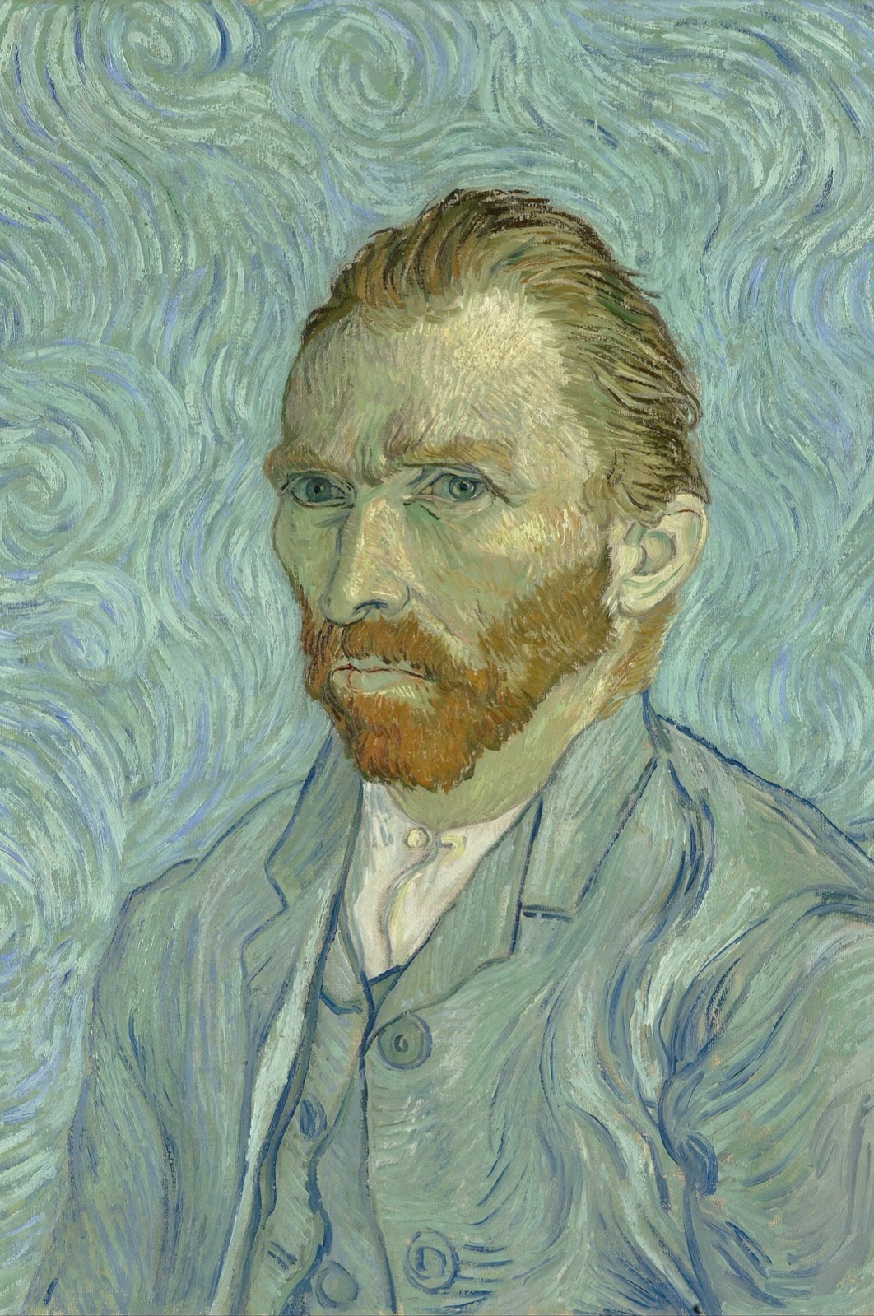
THE MAKER, TURNED INWARD
Examine your
own decisions
A self-portrait is the maker studying the maker. The CCR asks the same of you: not to describe the product, but to examine the person who made the choices. Add one honest sentence that flatters nobody. We chose the location because it was available, and it shows in the lighting. Honesty is what examiners read as reflection.
Vincent van Gogh, Self-Portrait, 1889
Notes:
The maker examining himself. One honest sentence per draft keeps out the promotional voice, which examiners read as description.

Slide 7
THE PRODUCTION DIARIES PAY OUT
ISSUED AT THE L05 LOCK, HARVESTED NOW
A ready-made reflection bank
Open the WS 6.4 diaries next to the drafts. Every entry in the decisions and consequences columns is already a reflection sentence: decided X because Y, consequence Z. This is why the lock's rule was documented decisions, not silent swaps. Transcribe the three best into the drafts.
Decided X, because Y. Consequence: Z.
MEDIA STUDIES 9607 · SEMESTER I
03

Slide 8
“
To see oursels
as ithers see us.
Robert Burns, To a Louse, 1786 · to see ourselves as others see us

Slide 9
SENTENCE SURGERY
RUN THE TEST ON YOUR OWN DRAFT
One sentence, operated on
BEFORE · describes
AFTER · reflects
We filmed the scene in the car park and then edited it together.
We chose the car park because it was the only free location, and the flat light shows in the grade; next time we would scout for contrast.
→
Same event. One names a decision, a reason, and a change. That is the whole surgery.
The surgery closes with format speed-pitches: 60 seconds each in fours, the four votes, format finalized.
MEDIA STUDIES 9607 · SEMESTER I
04

Slide 10
DELIVERABLE · CS7
DIRECT PRACTICE FOR A3
Reviewed against the real C1 criteria
Full drafts reviewed by teacher and peers in the C1 criteria's own language: describe, question, suggest. Every draft leaves with a written action list. The format is chosen by Friday from the coursebook menu, director's commentary, voiceover, podcast, or screencast, and presented creatively using technology is a requirement, not a suggestion.
This cohort's CCR is the blog-era, four-question, creative-format artifact, coursebook 6.7.
MEDIA STUDIES 9607 · SEMESTER I
05

Slide 11
NEXT
Audiences, and the
Portfolio Submission
Lesson 11. The Component 1 arc closes: A3 goes in, with no edits after.
MEDIA STUDIES 9607 · SEMESTER I
06

