Slide 1
XI
MEDIA STUDIES 9607 · UNIT V
Audiences and the
Portfolio Submission
Media Contexts · Lesson 11 of 16
Six days · Monday 23 November to Tuesday 1 December
Notes:
The Component 1 arc closes. Audience theory begins on schedule, but the week bends around Friday: A3 goes in, no edits after.

Slide 2
XI
THE REVERSAL
What people do
with media.
Notes:
Audiences do things with media; media does not simply do things to audiences. That reversal is the week.

Slide 3
WHO IS IT FOR?
EVERYONE IS ALMOST ALWAYS WRONG
Mass, niche, target
Mass
Niche
Target
Aimed at everyone at once: the gala, the blockbuster, the front page.
Aimed at a defined interest group: the specialist channel, the fan community.
Aimed at a precise profile: age, taste, platform, spending. What advertisers pay for.
Opened as Four Corners: mass, niche, target, undecided; commit by moving, one corner defends. Demographics vs psychographics: who they are, versus what they want.
MEDIA STUDIES 9607 · SEMESTER I
01

Slide 4
“
Not what media do to people, but what people do with the media.
Elihu Katz, 1959

Slide 5
EFFECTS MODELS, STATED FAIRLY THEN LIMITED
WHAT THEY CANNOT EXPLAIN
The models, and their edges
The models
The limit
Hypodermic: media injects a message and the audience absorbs it. Cultivation: heavy exposure slowly shapes a worldview.
The horror fan who sleeps fine. The ad seen a hundred times that never sold anything. Audiences are not needles waiting to be filled.
The counter-evidence log runs on myth-busting points: an example that survives the room's challenge scores.
MEDIA STUDIES 9607 · SEMESTER I
02

Slide 6
BLUMLER AND KATZ · USES AND GRATIFICATIONS
AUDIENCES AS ACTIVE CHOOSERS
Four jobs we need media to do
01
Diversion
02
Personal relationships
Escape and release: from routine, from problems, into feeling.
Company and connection: characters as friends, shared talk with real ones.
03
Personal identity
04
Surveillance
A mirror: comparing your own life and values against what you watch.
Information: knowing what is happening, in the world and your world.
MEDIA STUDIES 9607 · SEMESTER I
03

Slide 7
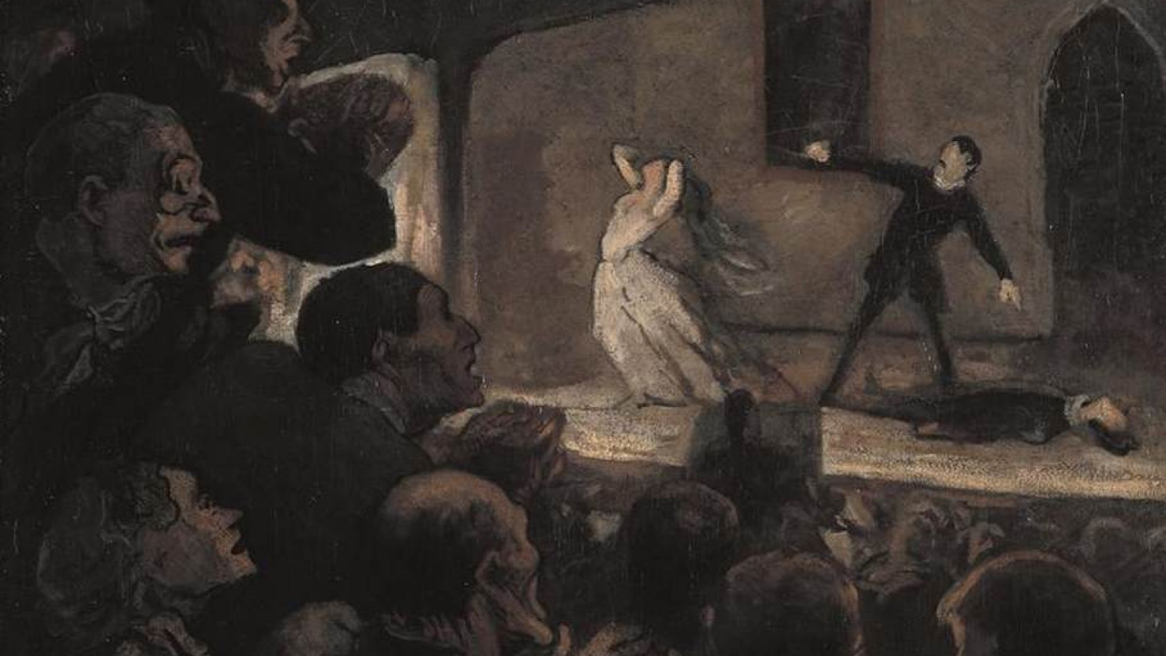
THE ACTIVE AUDIENCE
Leaning in, gripped, doing work: an audience is never a blank surface being written on.
Honore Daumier, The Drama, c. 1860
Notes:
Daumier's theatre crowd, rapt and forward-leaning: the active audience, a century before the theory named it.

Slide 8
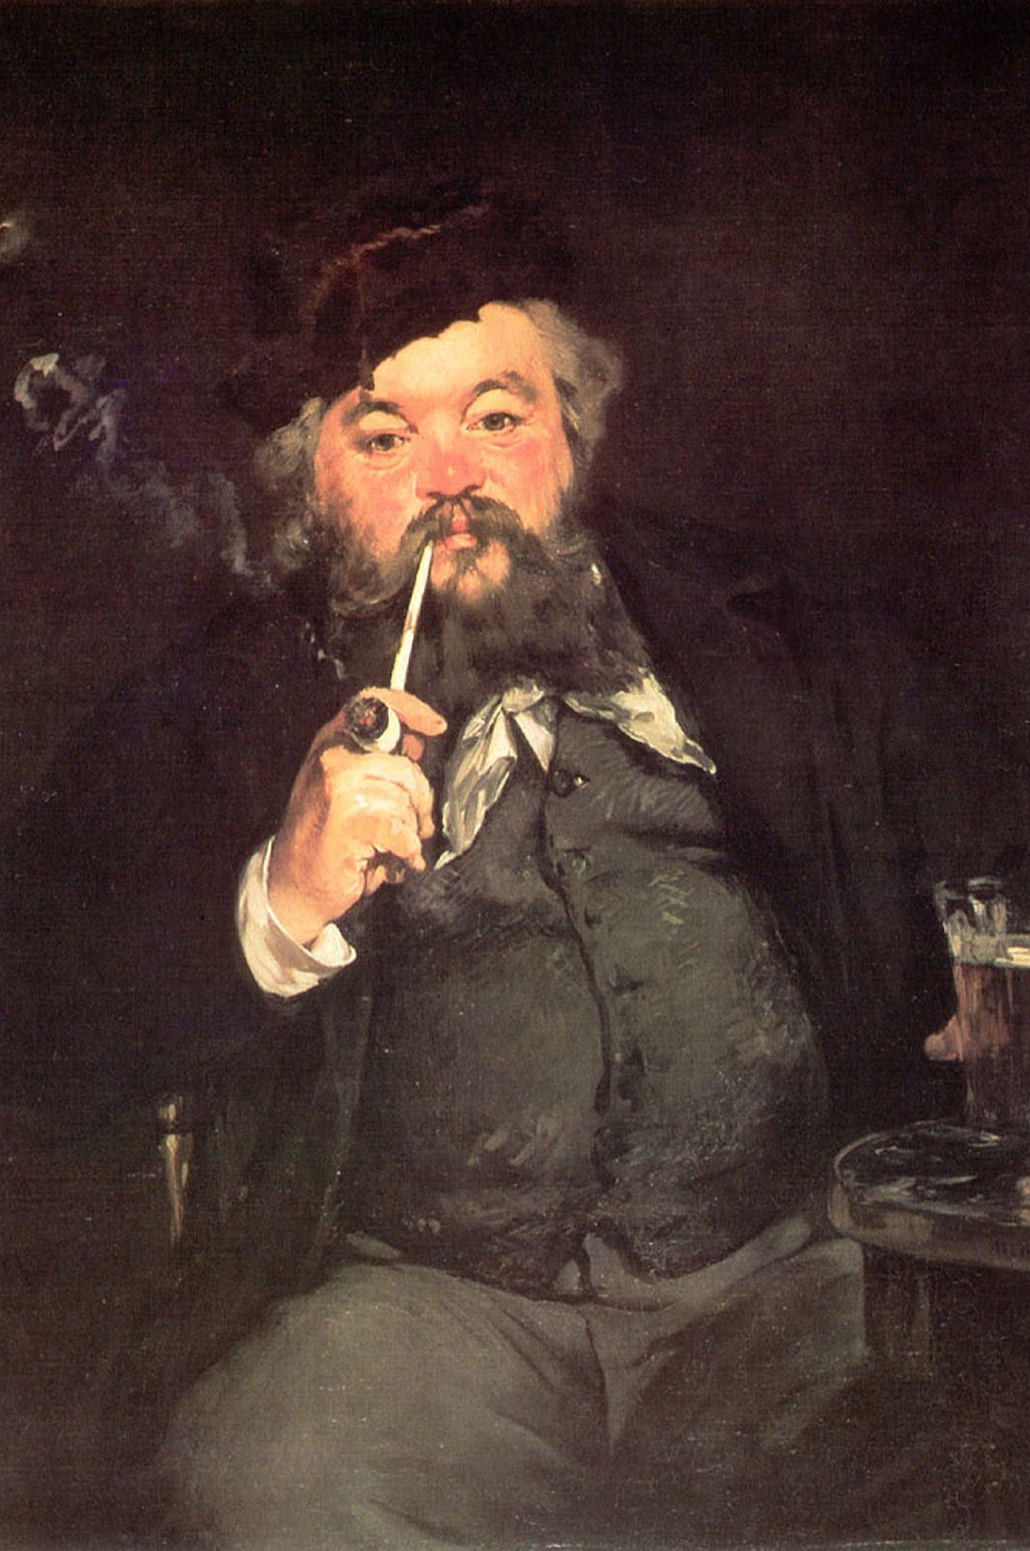
THE HONEST MAP
Gratification,
personified
A man, a beer, an evening off. Diversion, painted in 1873. Map your real weekly media use onto the four gratifications, the L01 log with a theory attached. The honesty rule is absolute: the comfort re-watch and the 2 a.m. scroll are data, not confessions. Which gratification does your own C1 product serve, and how would you know?
Edouard Manet, A Good Glass of Beer, 1873
MEDIA STUDIES 9607 · SEMESTER I
04

Slide 9
THE LAST HELP WINDOW
TRIAGE ORDER, NOT HAND-RAISING
CCR surgery, by triage
The double is the last room where help is available before submission. The queue is ordered by CS7 severity, not by who raises a hand: every student is seen, and the strongest drafts get peer support instead of teacher time. Each visit ends with one fix executed, not promised. Friday is logistics, not heroics.
MEDIA STUDIES 9607 · SEMESTER I
05

Slide 10
“
It goes in.
No edits after.
Product exported and playable, CCR posted, blog complete and dated, URLs logged. A3 in Friday 27 November. No edits after is in the register, and it is absolute.

Slide 11
THE RETURN, AND THE TARGET
SELF-BAND BEFORE THE MARK
A3 back, one target forward
Self-band first
Each student bands their own portfolio against the C1 criteria before the mark; the gap is the conversation.
One target (LB4)
Specific, evidenced, achievable in S2: hold focus in low light beats get better at filming.
A4 announced
Wednesday 16 December, Component 2 Section A. Today is the last session that clears the notice window.
MEDIA STUDIES 9607 · SEMESTER I
06

Slide 12
NEXT
Institutions and
Section A Craft
Lesson 12. Morley, ownership, and Section A with the mark scheme open.
MEDIA STUDIES 9607 · SEMESTER I
07

