Slide 1
XII
MEDIA STUDIES 9607 · UNIT V
Institutions and
Section A Craft
Media Contexts · Lesson 12 of 16
Four days · Monday 7 to Friday 11 December
Notes:
Component 2 becomes the destination. Morley explains why the same text reads differently; ownership explains why texts say what they say.

Slide 2
XII
OWNERSHIP
Funding follows
content.
Notes:
The court photographer's frame belonged to the court. Who pays shapes what gets said, in 1857 as now.

Slide 3
MORLEY · THE NATIONWIDE STUDY
READINGS TRACK SITUATION, NOT INTELLIGENCE
The same broadcast, different readings
The study
The finding
Real audience groups were shown the same broadcast, and their readings were gathered and compared.
The groups produced systematically different readings, and the differences tracked their social situations, not their intelligence.
If readings differ by situation, then who makes the text matters even more. Tomorrow: ownership.
MEDIA STUDIES 9607 · SEMESTER I
01

Slide 4
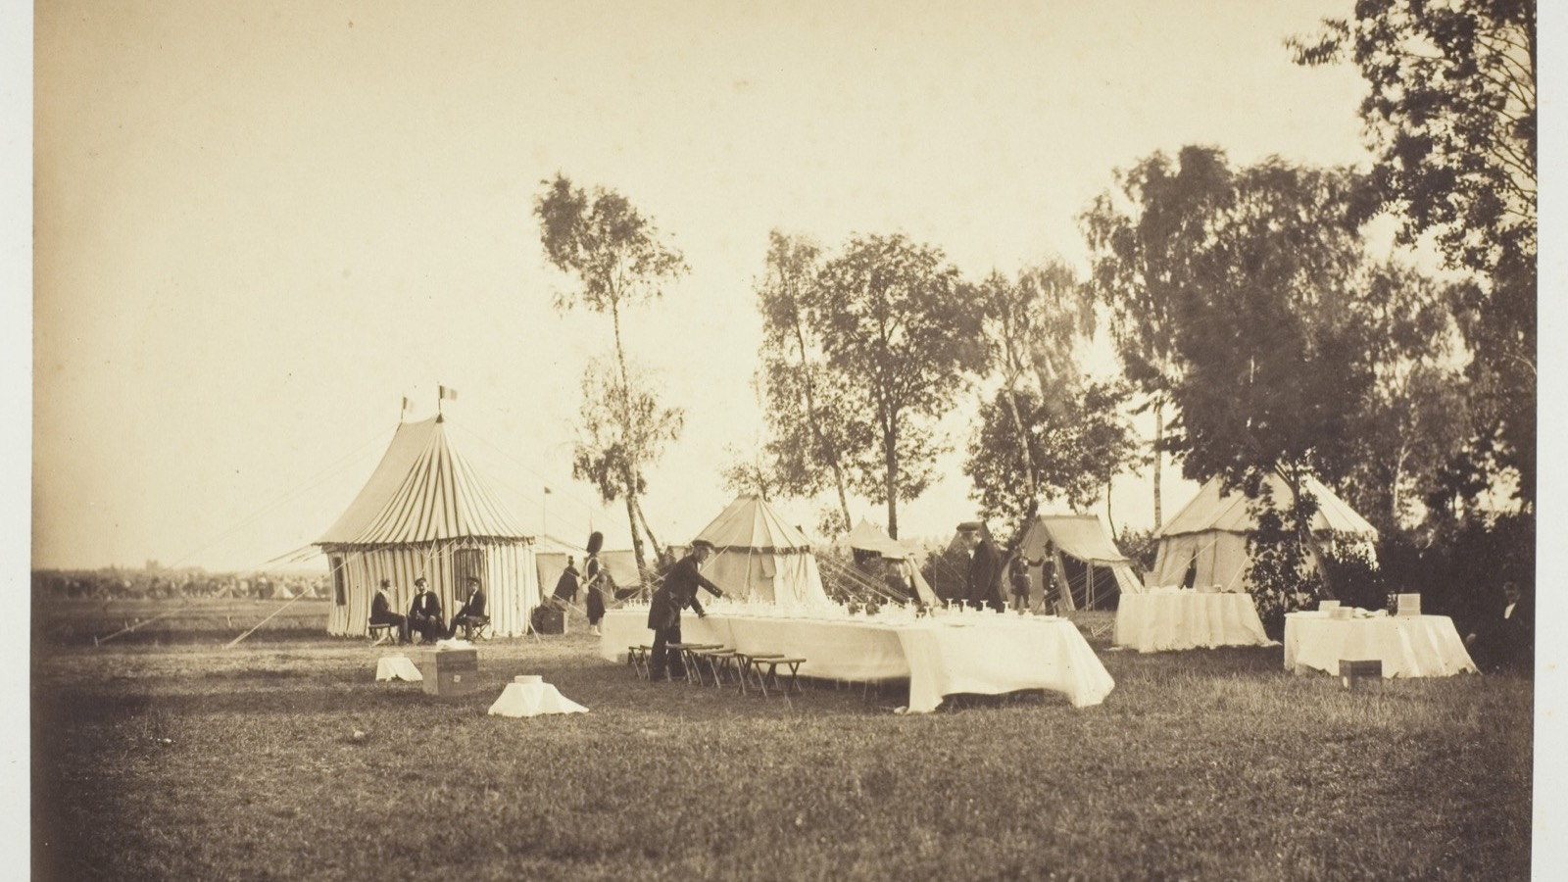
THE FRAME BELONGED TO THE PAYER
Le Gray photographed the Emperor's camp on commission: the frame belonged to who paid, in 1857 as now.
Gustave Le Gray, Camp de Chalons, 1857
Notes:
Le Gray's imperial commission: a photograph made to a paymaster's brief. Funding follows content, a century and a half before the streaming wars.

Slide 5
WHO PAYS, AND WHAT THEY BUY
PSB VERSUS COMMERCIAL
Follow the money
THE PAYER
WHAT THE MONEY BUYS
Licence fee or state
A remit: a duty to inform, educate, reach everyone.
Advertisers
Your attention, delivered in the right demographic.
Subscribers
A product good enough that you keep paying for it.
The state directly
Content that aligns with the payer's interests.
Curran and Seaton: ownership concentration narrows the range of stories that get told.
MEDIA STUDIES 9607 · SEMESTER I
02

Slide 6
“
Freedom of the press is guaranteed only to those who own one.
A. J. Liebling, The New Yorker, 1960

Slide 7
TRACE ONE VISIBLE DECISION
BACK TO WHO PAYS FOR IT
The chain
The decision
The incentive
Who pays
←
←
the ad break, the family-friendly cut, the product in shot, the story not covered
what that choice protects or earns for the maker
the advertiser, the subscriber, the state, the platform
Read it right to left: every decision on screen traces back to who pays. Traced against the clock, a point per link that survives challenge. Rehearse the chain on your case-study institution; that is the exam answer.
MEDIA STUDIES 9607 · SEMESTER I
03

Slide 8
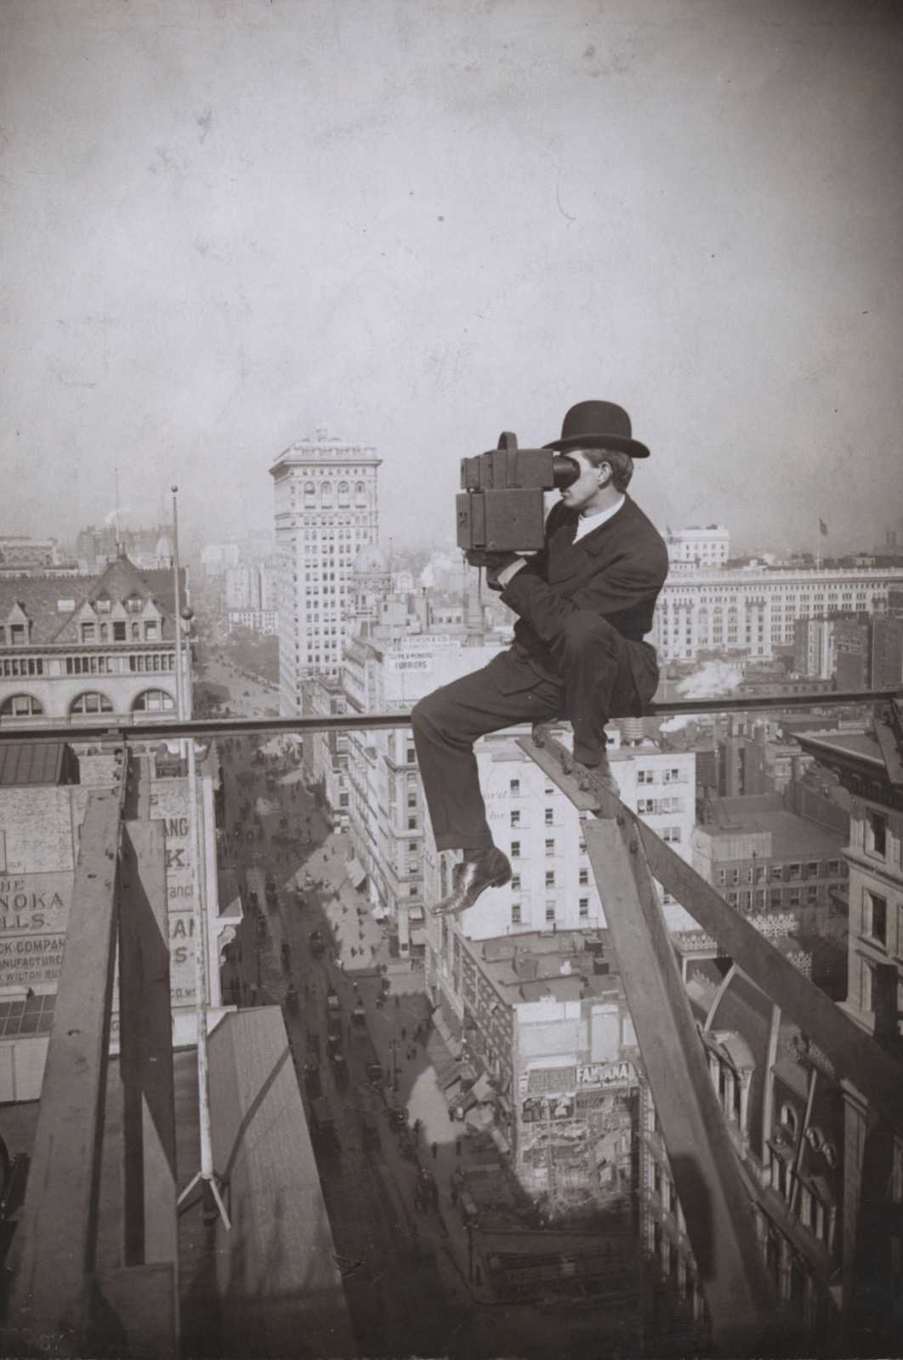
THE VIEW FROM ABOVE
Who owns the
vantage point
The camera operator on the parapet chooses the frame the city is seen through. Institutions own the vantage point: the platform, the schedule, the budget, the greenlight. What reaches you was chosen by someone standing where you cannot.
Underwood & Underwood, Above Fifth Avenue, Looking North
Notes:
Underwood's camera operator high above Fifth Avenue: the institution's chosen vantage point, from which the frame is set.

Slide 9
CS8 · SECTION A, DEMYSTIFIED
THE MARK SCHEME AS FURNITURE
Write it with the answers open
The official five-criteria rubric sits on every desk, consultable. Paragraphs are drafted solo, but any student may stop, check the band language, and annotate their own margin: this sentence is my terminology evidence. The mark scheme stops being an enemy the moment it becomes furniture. In review, each student labels which criterion each paragraph earned, and finds the one they never fed.
MEDIA STUDIES 9607 · SEMESTER I
04

Slide 10
THE CASE-STUDY DOCUMENT
STILL IN USE IN MAY
One institution, tracked to Paper 2
01
Identity and ownership
05
Regulation
02
Production patterns
06
Technology
03
Distribution and marketing
07
Dated key facts
04
Audience and consumption
08
Coverage against the four Key Concepts
Entries dated from today: the 5-year contemporaneity rule starts mattering now, and it is what makes the document Paper 2-legal in May.
MEDIA STUDIES 9607 · SEMESTER I
05

Slide 11
DELIVERABLE · CS8
SCAFFOLD REMOVED NEXT WEEK
Guided Section A, mark scheme open
A Section A response written with the mark scheme visible and consultable, part collaborative by design: the same format family as A4, with the scaffold removed next week. The find-your-unfed-criterion move sets each student's personal A4 target.
The case-study document feeds A4, the End of Term Exam, and Paper 2: the highest-leverage artifact this side of the blog.
MEDIA STUDIES 9607 · SEMESTER I
06

Slide 12
NEXT
A4: Section A in
Authentic Format
Lesson 13. Integration, synergy, convergence, and the first authentic Section A sitting.
MEDIA STUDIES 9607 · SEMESTER I
07

