Slide 1
XIII
MEDIA STUDIES 9607 · UNIT V
A4: Section A in
Authentic Format
Media Contexts · Lesson 13 of 16
Four days · Monday 14 to Friday 18 December
Notes:
The Forecast Grade anchor. Two days trace one institution end to end; Wednesday is the first authentic Section A sitting.

Slide 2
XIII
THE MEDIA EVENT
One man,
every channel.
Notes:
Lindbergh, 1927: newsreels, press syndicates, radio, records, all selling the same story to itself. The media event predates the internet by seventy years.

Slide 3
THE EXAM'S THREE INSTITUTION WORDS
DEFINED AND SEPARATED
Integration, synergy, convergence
Integration
Synergy
Convergence
Owning the stages (vertical) or the neighbors (horizontal). One company holds more of the chain.
The parts sell each other: the film sells the soundtrack sells the toy sells the sequel.
Media and platforms flow together: one story across screen, phone, print, and feed.
MEDIA STUDIES 9607 · SEMESTER I
01

Slide 4
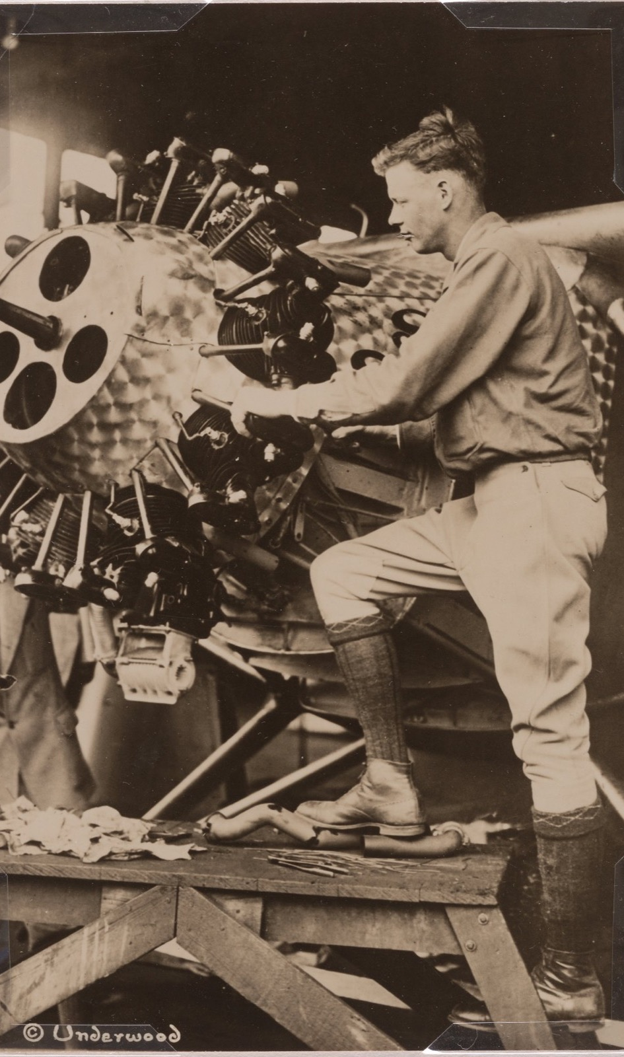
SYNERGY, 1927
Every channel,
one story
One man crosses an ocean, and every channel of the era sells the same story to itself: newsreels, press syndicates, radio, records, endorsements. The media event, the synergy, the convergence: all of it seventy years before the internet gave them names.
Underwood & Underwood, Charles Lindbergh, 1927
Notes:
Lindbergh as the worked historical anchor: integration, synergy, and convergence visible in 1927.

Slide 5
“
It is not spontaneous, but comes about because someone has planned, planted, or incited it... primarily for the purpose of being reported.
Daniel Boorstin, The Image, 1962, on the pseudo-event

Slide 6
ONE INSTITUTION, END TO END
GREENLIGHT TO YOUR FEED
Follow it all the way through
Greenlight
Produce
Distribute
Market
Meet
Revenue
1
2
3
4
5
6
who says yes
who makes it
who moves it
who sells it
where you find it
who is paid
Each link annotated from the case-study documents, drawn as one chain on the board.
MEDIA STUDIES 9607 · SEMESTER I
02

Slide 7
“
Thirty minutes of notes.
Forty-five of writing.
A different skill from A1's single hour. The viewing window is for structured notes, not a transcript: the grid, not sentences.

Slide 8
THE VIEWING-NOTES FRAME
CAPTURE, DO NOT COMPOSE
The four-family grid
Technical
Symbolic
Written
Audio
Two 90-second drills first: notes into the grid, pens down. The grid is the discipline the viewing window needs.
MEDIA STUDIES 9607 · SEMESTER I
03

Slide 9
REGULATION, THE FOURTH CONTEXT
WHILE THE SIT IS FRESH
The chain, one link longer
decision ← incentive ← payer ← REGULATOR
Who regulates the case-study institution (Ofcom, the FCC, platform self-regulation, per its home market), with what powers, and what that visibly changes: scheduling, cuts, ratings, and above all what never gets made. Add the regulation row to the document, and date it.
MEDIA STUDIES 9607 · SEMESTER I
04

Slide 10
ASSESSMENT · A4
THE FORECAST GRADE ANCHOR
A4 sits Wednesday 16 December
Component 2 Section A in authentic format: an unseen TV-drama extract, thirty minutes of viewing and structured notes, then forty-five of writing. Marked to the CIE band descriptors, per-criterion, with AO splits recorded per script for the L14 review. No debrief on the day, by design: the format is the lesson, and it ends the way the real one does.
MEDIA STUDIES 9607 · SEMESTER I
05

Slide 11
NEXT
Consolidation and
the Coverage Matrix
Lesson 14. The semester's knowledge, audited before the exam tests it.
MEDIA STUDIES 9607 · SEMESTER I
06

