Slide 1
XIV
MEDIA STUDIES 9607 · UNIT VI
Consolidation and
the Coverage Matrix
Revision · Lesson 14 of 16
Three days · Monday 21 to Wednesday 23 December
Notes:
The semester's knowledge gets audited before the exam tests it. Every case study crossed against the four Key Concepts until the uncovered cell is found.

Slide 2
XIV
THE STANDARD OF COVERAGE
No region
goes unexamined.
Notes:
A century ago two astronomers photographed the entire moon, plate by plate, so that no region went unexamined. That is the week's standard.

Slide 3
THE A4 REVIEW
SCRIPT AGAINST MARK SCHEME, NOT GRADE
Self-band first
Band yourself first
The target thread
Re-read your A4 script against the five criteria and band each one, before you see the mark. The gap between the two is the conversation.
Log one target from the AO splits, connected in writing to the L11 target. Two data points now: the Forecast Grade has evidence.
MEDIA STUDIES 9607 · SEMESTER I
01

Slide 4
A SECTION B ARGUMENT
NOT A PLAN, AN ARGUMENT YOU COULD WIN ALOUD
Four moves
Claim
Evidence
Counter
Response
1
2
3
4
the position you will defend
case-study facts that back it
the strongest opposing case
why your claim still stands
Argue it aloud in trios, one countering from the same case study; the talk is the drafting. Plans that survived a counter do not go stale.
MEDIA STUDIES 9607 · SEMESTER I
02

Slide 5
“
He who knows only his own side of the case knows little of that.
John Stuart Mill, On Liberty, 1859

Slide 6
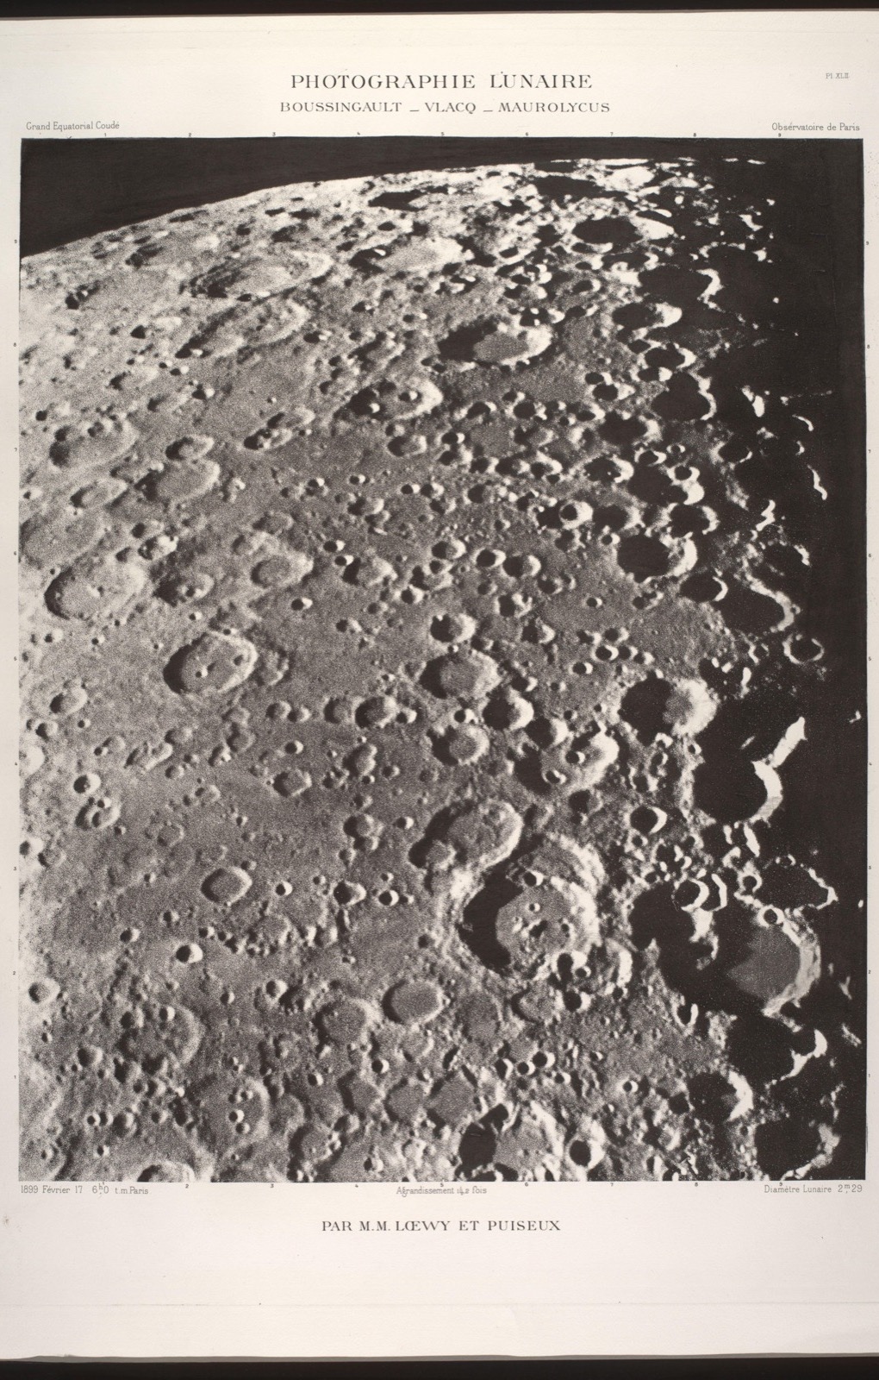
PLATE BY PLATE
Photograph
the whole moon
Two astronomers spent years photographing the entire moon, plate by plate, so that no region went unexamined. That is the standard this week. Every cell of the matrix gets looked at honestly, including the empty ones. Revisiting the topic you already like proves nothing.
Loewy and Puiseux, from the Atlas Photographique de la Lune, c. 1900
Notes:
The moon atlas sets the standard for coverage. The empty cell is the point of the exercise, so find it without flinching.

Slide 7
THE COVERAGE MATRIX
CASE STUDIES AGAINST THE FOUR CONCEPTS
Find the empty cell
Language
Represent.
Industry
Audience
A film studio
●
●
thin
empty
A streaming platform
thin
empty
●
●
A public broadcaster
●
thin
●
thin
Run as consolidation Jeopardy: teams claim a cell by producing the evidence, the room verifies: evidenced, thin, or empty. An honest empty scores too; the game rewards the audit, not the bluff.
MEDIA STUDIES 9607 · SEMESTER I
03

Slide 8
“
Your weakest cell,
named in writing.
Every student leaves with the emptiest cell of their own matrix named. That cell is the HW2 target, and the break exists to fill it.

Slide 9
THE BREAK, AND THE EXAM
SET THE LAST TEACHING SESSION BEFORE THE WINDOW
Two things on the record
HW2
One revision page per case study, plus one Section B essay plan aimed at the named weakest cell. Three to four hours across eleven days.
DUE MON 4 JAN
EoT announced
The full two-hour Component 2. Today is the last session that clears the 14-day notice; the format is A4's plus Section B, nothing new.
WINDOW FROM MON 11 JAN
MEDIA STUDIES 9607 · SEMESTER I
04

Slide 10
NEXT
Exam Rehearsal
Lesson 15. Making the exam boring: no surprises left in format, timing, or the mark scheme.
MEDIA STUDIES 9607 · SEMESTER I
05

