Slide 1
XV
MEDIA STUDIES 9607 · UNIT VI
Exam
Rehearsal
Revision · Lesson 15 of 16 · the last teaching week
Four days · Monday 4 to Friday 8 January
Notes:
The last teaching week is spent making the exam boring: no surprises left in format, timing, or the mark scheme's economics.

Slide 2
XV
THE AIM
Make the exam
boring.
Notes:
Musicians rehearse until the score disappears and only the playing is left. Same principle: rehearse the format until nothing about it can surprise you.

Slide 3
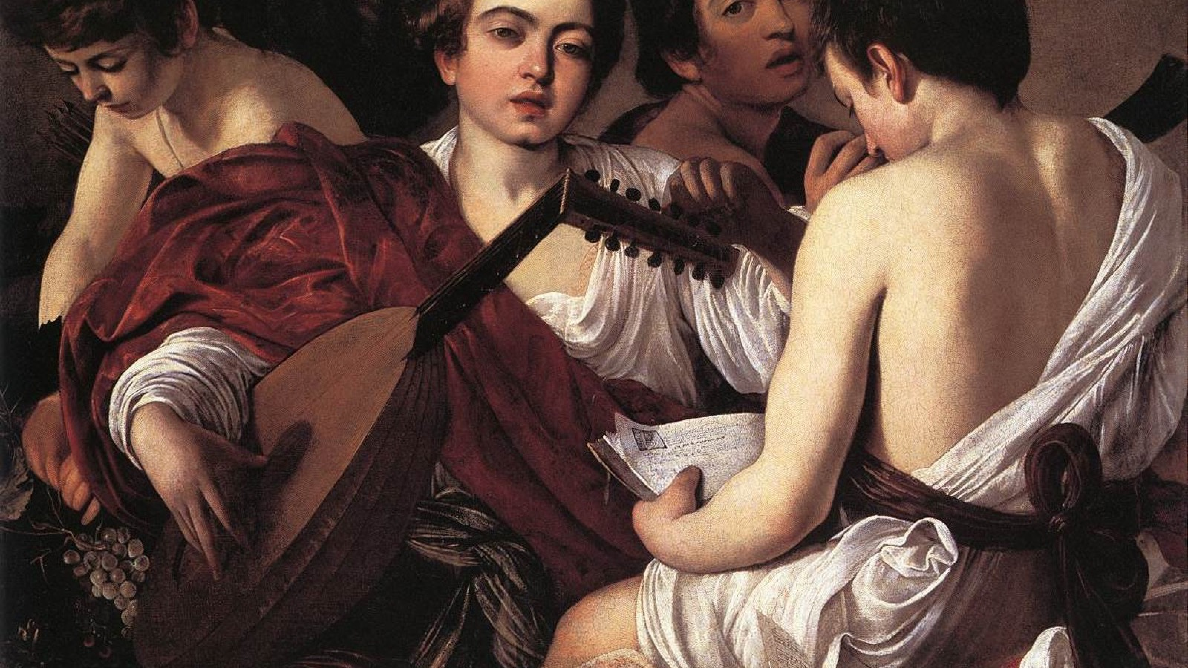
REHEARSAL, MID-NOTE
You rehearse until the score disappears and only the playing is left. The exam is the same.
Caravaggio, The Musicians, 1595
Notes:
Young musicians tuning and rehearsing. They practiced until the performance cost them nothing. That is the week's aim.

Slide 4
“
We are what we repeatedly do. Excellence, then, is not an act, but a habit.
Will Durant, on Aristotle, 1926

Slide 5
THE PAPER, END TO END
THE RUBRIC'S OWN CLOCK
Two hours, three segments
30 min
45 min
45 min
Viewing and notes
Section A
Section B
Four screenings inside the viewing window, no notes on the first. The frozen Q1 stem is verbatim in every sitting: know it cold by Friday.
Write your own minute budget inside each section: paragraphs, plan time, check time. A promise to Wednesday.
MEDIA STUDIES 9607 · SEMESTER I
01

Slide 6
PLANS AGAINST THE CLOCK
THREE ROUNDS, FIVE MINUTES EACH
Read, plan, pens down at five
Three rounds of five-minute Section B plans: read the question, plan claim, evidence, counter, response, plus the case-study facts, and stop at five minutes exactly. Round by round the plans get denser and calmer, and that is the drill working. Then swap: could you write this stranger's essay from their plan? If not, what is missing is what the examiner would miss too.
MEDIA STUDIES 9607 · SEMESTER I
02

Slide 7
CS9 · FULL DRESS
READING THE SCHEME AS A MARKER
Peer-marked, then moderated
Beat the Examiner, full dress. A full Section B, timed exactly, on your own case studies. Then every student marks a peer's script against the official five-criteria rubric, band words and all; the closest banding to the moderated mark takes the round. Reading the scheme as a marker is the lesson. The teacher moderates three scripts aloud, showing where the peer marks drifted.
MEDIA STUDIES 9607 · SEMESTER I
03

Slide 8
THE AO ECONOMY
WHERE THE 25 MARKS ACTUALLY SIT
AO1 fifteen, AO2 ten
AO1 · 15
AO2 · 10
Concepts · Contexts · Terminology
Analysis · Examples
Five criteria, best-fit per criterion. Map it against your CS9 result: which criteria the room feeds naturally, which it starves.
MEDIA STUDIES 9607 · SEMESTER I
04

Slide 9
“
Two loss points.
Two counter-moves.
Each student leaves with two named places marks leak, and the fix for each, on one card: I list techniques without effects, so every technique gets a 'so that' clause.

Slide 10
DELIVERABLE · CS9
WEDNESDAY, FULL DRESS
Timed Section B, peer-marked
A 45-minute Section B on your own case studies, peer-marked as Beat the Examiner, full dress: the official rubric, then live moderation. The last teaching day ends on the success check, stated from memory: the full paper structure and the per-section minute budget. Then logistics, once, calmly: bring nothing but pens.
MEDIA STUDIES 9607 · SEMESTER I
05

Slide 11
NEXT
End of Term Exam
and Return
Lesson 16. The semester closes the way Semester 2 will open: with evidence.
MEDIA STUDIES 9607 · SEMESTER I
06

