Slide 1
XVI
MEDIA STUDIES 9607 · UNIT VI
End of Term Exam
and Return
Revision · Lesson 16 of 16
Exam window from Monday 11 January · return Tuesday 19 · goals Wednesday 20 January
Notes:
The semester closes the way Semester 2 will open: with evidence. The full two-hour paper is sat in the exam window.

Slide 2
XVI
HOW THE SEMESTER ENDS
Close with
evidence.
Notes:
Not close with a feeling, or a promise: close with evidence, so Semester 2 opens on data the student wrote themselves.

Slide 3
THE EXAM · COMPONENT 2
WINDOW MON 11 TO MON 18 JANUARY
Two hours, the real thing
The full Component 2 paper, two hours, exam venue, full conditions: Section A on the unseen extract, thirty minutes of viewing and notes plus forty-five writing, then Section B from the contexts menu. The one logistical item that cannot be improvised is the screening: facilities for Section A are booked in advance.
The exam is an assessment event inside the lesson, not a taught day, per the counting convention.
MEDIA STUDIES 9607 · SEMESTER I
01

Slide 4
THE RETURN
SELF-ASSESSMENT FIRST, AT FULL DEPTH
The mark, then the gap
Self-band from memory
Gaps in AO language
Scripts face-down; band yourself per criterion from memory of what you wrote, then see the mark. The gap is now a familiar number.
Name your gaps in writing, in AO language, with the script as evidence: not Section B went badly, but AO1 contexts, my case-study facts were pre-2020.
MEDIA STUDIES 9607 · SEMESTER I
02

Slide 5
“
To make an end is to make a beginning.
T. S. Eliot, Little Gidding, 1942

Slide 6
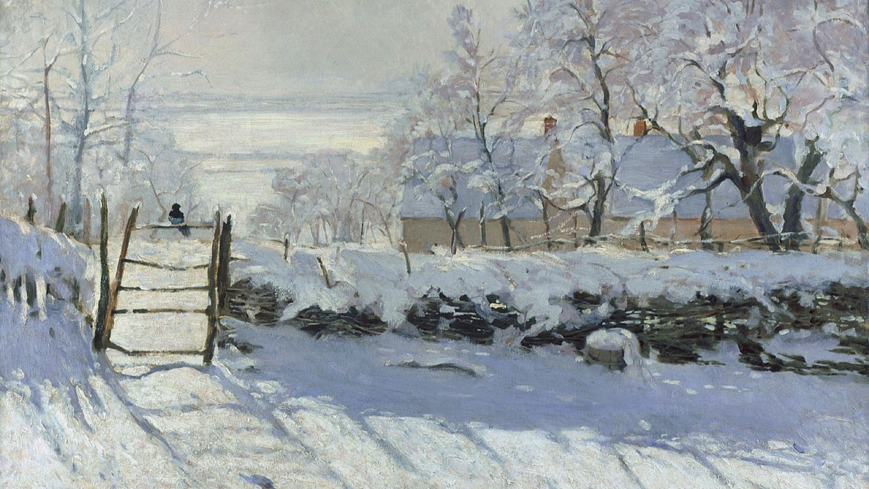
THE WORK IS DONE AND SAT
The paper is written. What is left is the reading of what it says about the term.
Claude Monet, The Magpie, 1869
Notes:
Monet's winter field, after the effort. Use it to slow the room down before the scripts come back.

Slide 7
THE TARGET SHEET
ONE PAGE, BUILT TO BE READ IN FEBRUARY
Four rows, per student
Gap
in AO language: which objective is the shortfall
Evidence
script plus the semester data: A1, A3, A4, EoT
Action
specific and Semester 2 shaped, not a resolution
Review date
a named S2 week, before the first S2 attainment
Built to survive being read in February by the person who wrote it in January. Posted as LB7.
MEDIA STUDIES 9607 · SEMESTER I
03

Slide 8
“
The gap has been
shrinking since October.
The distance between what you thought you wrote and what you scored: A1, A3, A4, EoT. For most of you it narrowed. Say that out loud, with the numbers.

Slide 9
THE CLOSE
SEMESTER 2, PREVIEWED HONESTLY
Two living artifacts cross the break
First, the September wager re-run: 'I'm not impacted by media', hands up, the count recorded next to week one's. Then C1 goes to Cambridge in the spring; the film-industry case study opens Section B properly; Paper 2 sits in June. Two artifacts make the crossing: the theory-card deck built since Lesson 02, and the case-study document opened at Lesson 12. These two are the memory.
Grades and comments due today. The semester ends with every promise the register made, kept.
MEDIA STUDIES 9607 · SEMESTER I
04

Slide 10
I
SEMESTER I COMPLETE
The theory cards and
the case study travel home.
Sixteen lessons, one arc: media language to the exam that tests it. Semester II opens with evidence.
MEDIA STUDIES 9607 · SEMESTER I
05

