Slide 1
IV
ATTAINMENT 4 · COMPONENT 1
The Final
Portfolio
The semester, assembled and submitted
Sits Thursday 7 January · Marked across AO1 to AO4 · Announced Monday 21 December
Notes:
The only attainment marked across all four objectives. It closes Semester 1 and it is the Portfolio that Cambridge eventually sees.

Slide 2
AO4
WHAT IS BEING MARKED
Submission is a
supervised craft,
not a scramble.
Notes:
The submission week is taught, session by session, precisely so that nobody spends the last night assembling a folder.

Slide 3
THE BRIEF
EVERYTHING, IN ORDER
What you hand in
01
The resolved outcome
Built in one sustained run, focal areas resolved, the whole surface unified.
02
The supporting portfolio
Recording, exploration, artist work and development, sequenced so it reads in order to a stranger.
03
Documentation
Every piece photographed as the version the examiner sees. The photograph is the work, at this point.
04
The edit
Whatever does not earn its place, cut. A shorter folder that argues beats a longer one that repeats.
A LEVEL ART & DESIGN 9479 · SEMESTER I
01

Slide 4
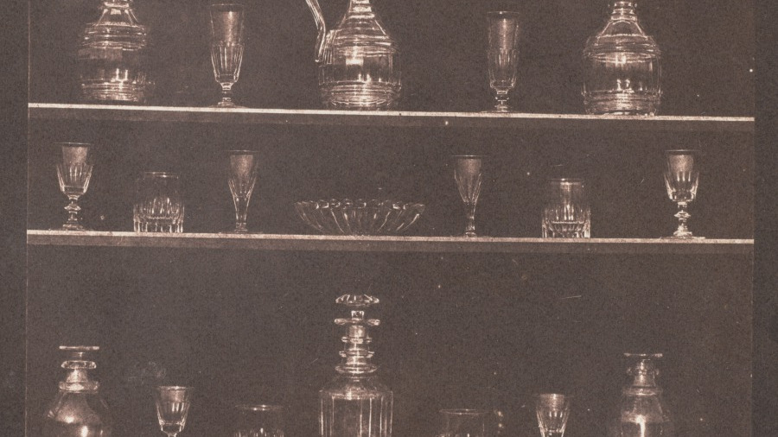
DOCUMENTATION
Photographed square, lit evenly, and cropped to the work itself.
William Henry Fox Talbot, Articles of Glass, 1844. Public domain
Notes:
Talbot arranged and lit these objects deliberately to record them clearly. The same discipline applies to photographing your own work: this is a record, not a mood shot.

Slide 5
AO4 · PRESENT, AND AO1 TO AO3 REVISITED
ALL FOUR OBJECTIVES, ONE SUBMISSION
What the final attainment rewards
A sequence that reads
Honest documentation
An edited folder
Someone who has never met you should be able to follow the journey in order, from intention through to outcome, without you explaining it.
The work photographed as it is, not as you wish it looked. Every page legible, every label present, nothing missing.
Presenting includes choosing. Three studies that show the development beat nine that show the same step three times.
A LEVEL ART & DESIGN 9479 · SEMESTER I
02

Slide 6
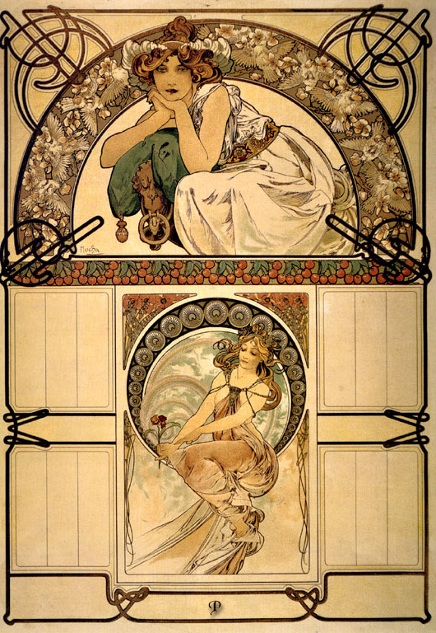
SEQUENCE
Order is
an argument
The order you put the work in tells the marker what you think matters. Lead with the intention, let the recording establish the looking, let exploration show the range you tested, let development show the decisions, and land on the outcome. Anything that interrupts that story comes out.
Alphonse Mucha, calendar, 1898. Public domain
Notes:
Sequencing is done on the Tuesday of submission week, in class, with everything laid out flat.

Slide 7
“
Nothing is edited after it goes in.
Submission week, Thursday

Slide 8
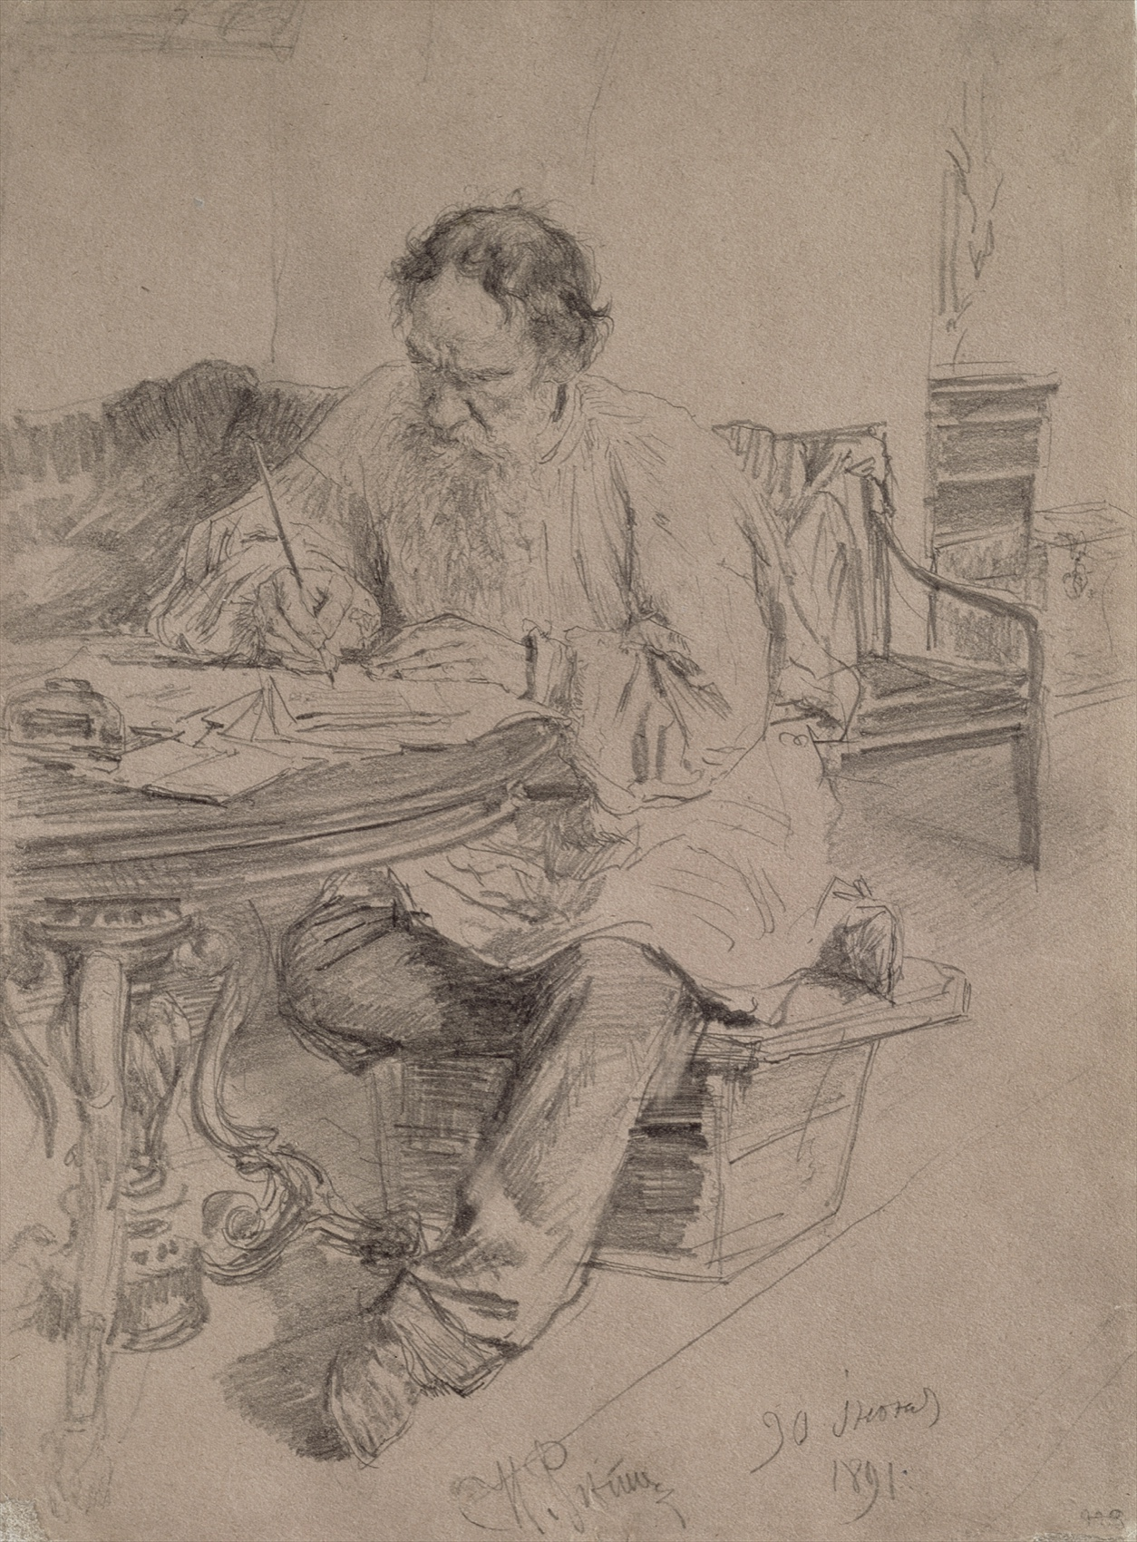
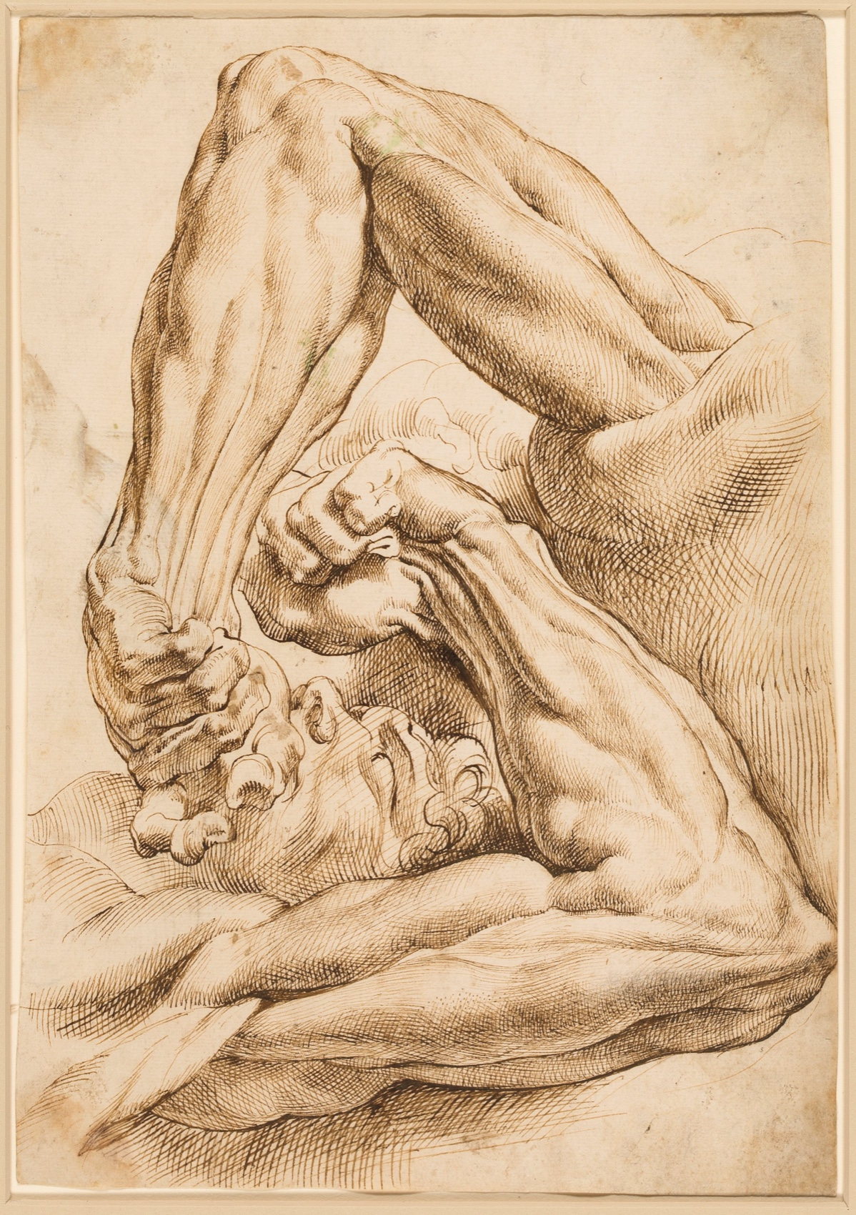
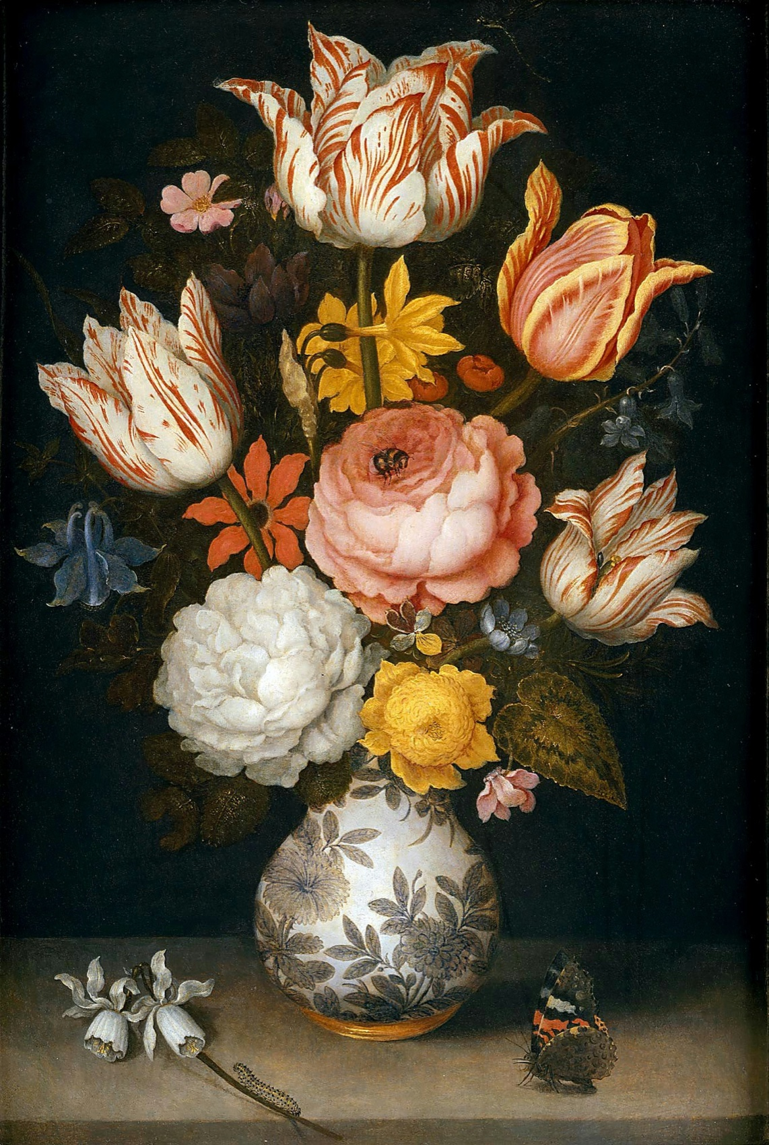
THE WEEK, IN ORDER
FIVE SESSIONS, ONE SUBMISSION
How submission week runs
Monday
Tuesday
Tuesday night
Photograph the outcome properly
Sequence the whole journey, then cut
The AO check at home, in writing, signed
Repin, Rubens and Bosschaert, public domain. Shown whole, as study material rather than as a style to copy.
A LEVEL ART & DESIGN 9479 · SEMESTER I
03

Slide 9
WHAT LOSES MARKS
EVERY ONE OF THESE IS AVOIDABLE
Four ways A4 goes wrong
Assembling on the night
It shows. The folder reads as a pile because it was made as one, and the sequence never gets thought about.
Photography left to the end
By then the work may be gone, damaged or in a dark room. Shoot it while it is in front of you and the light is good.
Keeping everything
An unedited folder makes the marker hunt for the argument. Cutting is part of the assessment, not a loss.
Editing after submission
There is no after. Thursday is the line, and work changed past it is a different problem entirely.
A LEVEL ART & DESIGN 9479 · SEMESTER I
04

Slide 10
DATES
ANNOUNCED AHEAD, IN WRITING
Three dates that matter
Announced
Sits
Then
Mon 21 Dec
Thu 7 Jan
Fri 8 Jan
Before the winter break, so the notice runs across the holiday and nothing is sprung on return.
The end of submission week. It goes in, and nothing is edited afterwards.
The last teaching day of the semester. The session looks back over the whole pipeline before Semester 2 opens on C3.
A LEVEL ART & DESIGN 9479 · SEMESTER I
05

Slide 11
AND THEN
Semester 2:
the theme is yours.
The Personal Investigation opens, and this time nobody hands you a menu.
A LEVEL ART & DESIGN 9479 · SEMESTER I
06

