Slide 1
I
MEDIA STUDIES 9607 · UNIT I
The Four
Key Concepts
Introduction to Media · Lesson 01 of 19
Three days · Wednesday 2 to Friday 4 September
Notes:
Day one is the founding wager: 'I'm not impacted by media.' Record the vote, promise to re-run it in June. Warm, ordinary, unhurried.

Slide 2
I
THE FOUNDING CLAIM
A version,
not a window.
Every media text is a made thing: someone chose the frame, the crop, the words.
Notes:
Every media text is a made thing: someone chose the frame, the crop, the words. Say it flat on day one; the whole semester proves it.

Slide 3
THE TWO-YEAR MAP
WHERE THIS COURSE GOES, IN ONE SLIDE
Four semesters, two exams, two products
S1 · now
S2 · spring
S3 · autumn
S4 · spring
Media language, the four technical elements, and your Component 1 product.
Component 1 goes to Cambridge. The film-industry case study. Paper 2 exam in June: AS finished.
A2 year begins: postmodern media, power and the media, and the start of the Component 3 campaign.
Component 3 submitted. Changing media environments. Paper 4 in June: the full A Level.
AS year
A2 year
KEY POINT Half of the AS grade is a product you make. The work starts this week, with a blog.
MEDIA STUDIES 9607 · SEMESTER I
01
Notes:
The opener's promised two-year map. Keep it under two minutes: the point is that the wager and the media-use log started something with a known destination.

Slide 4
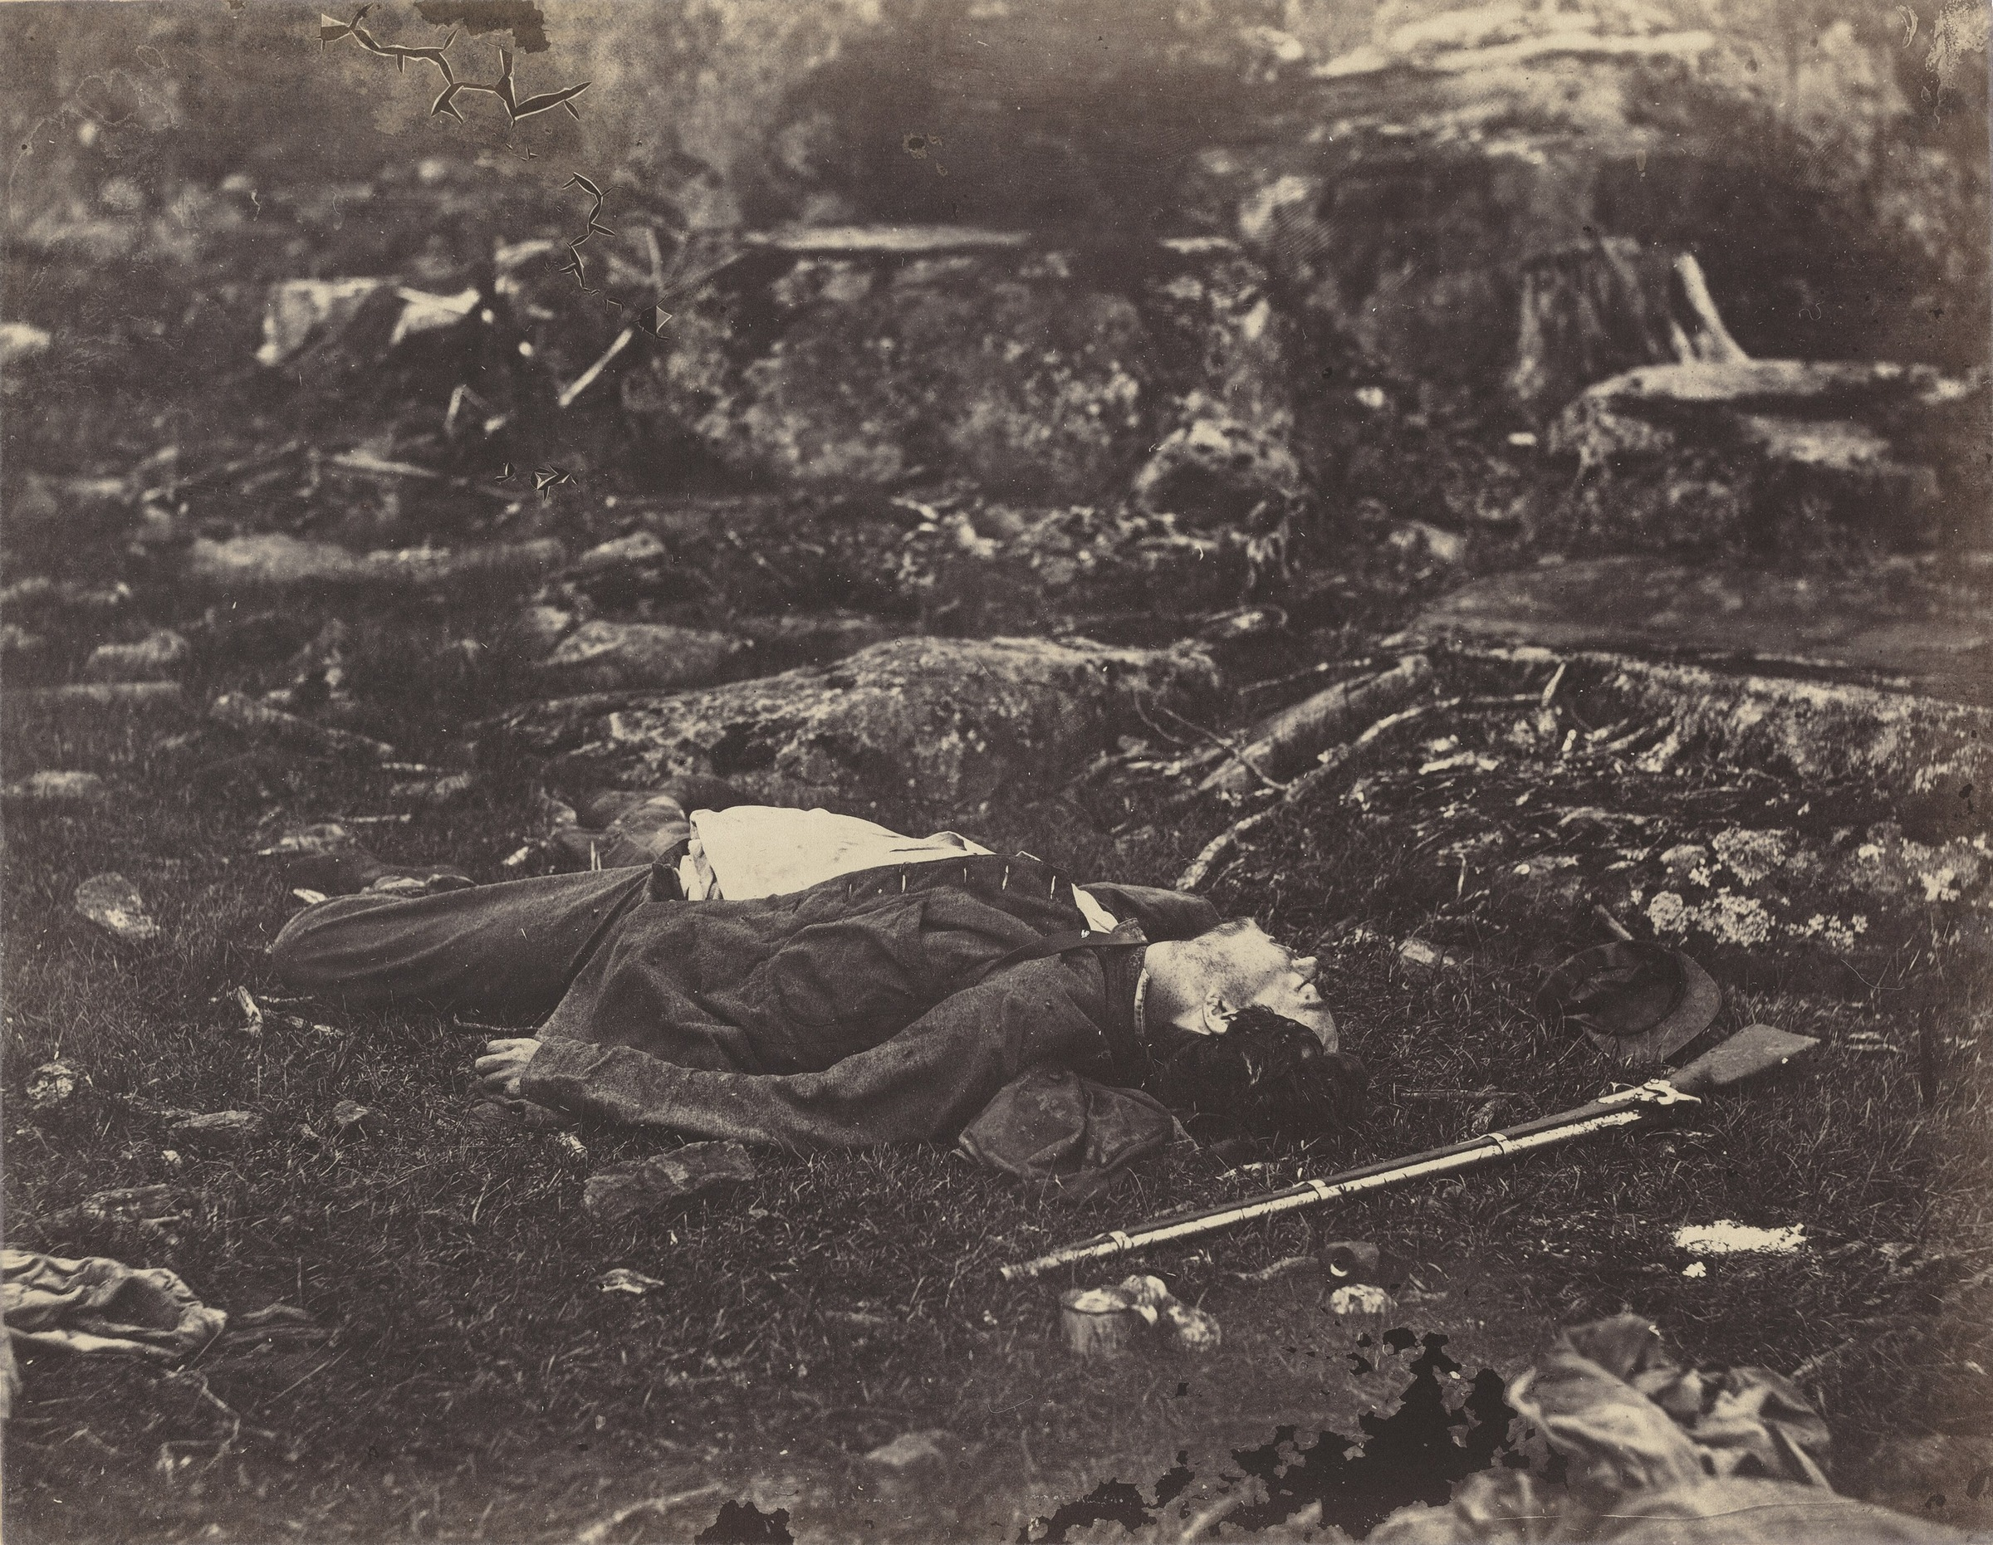
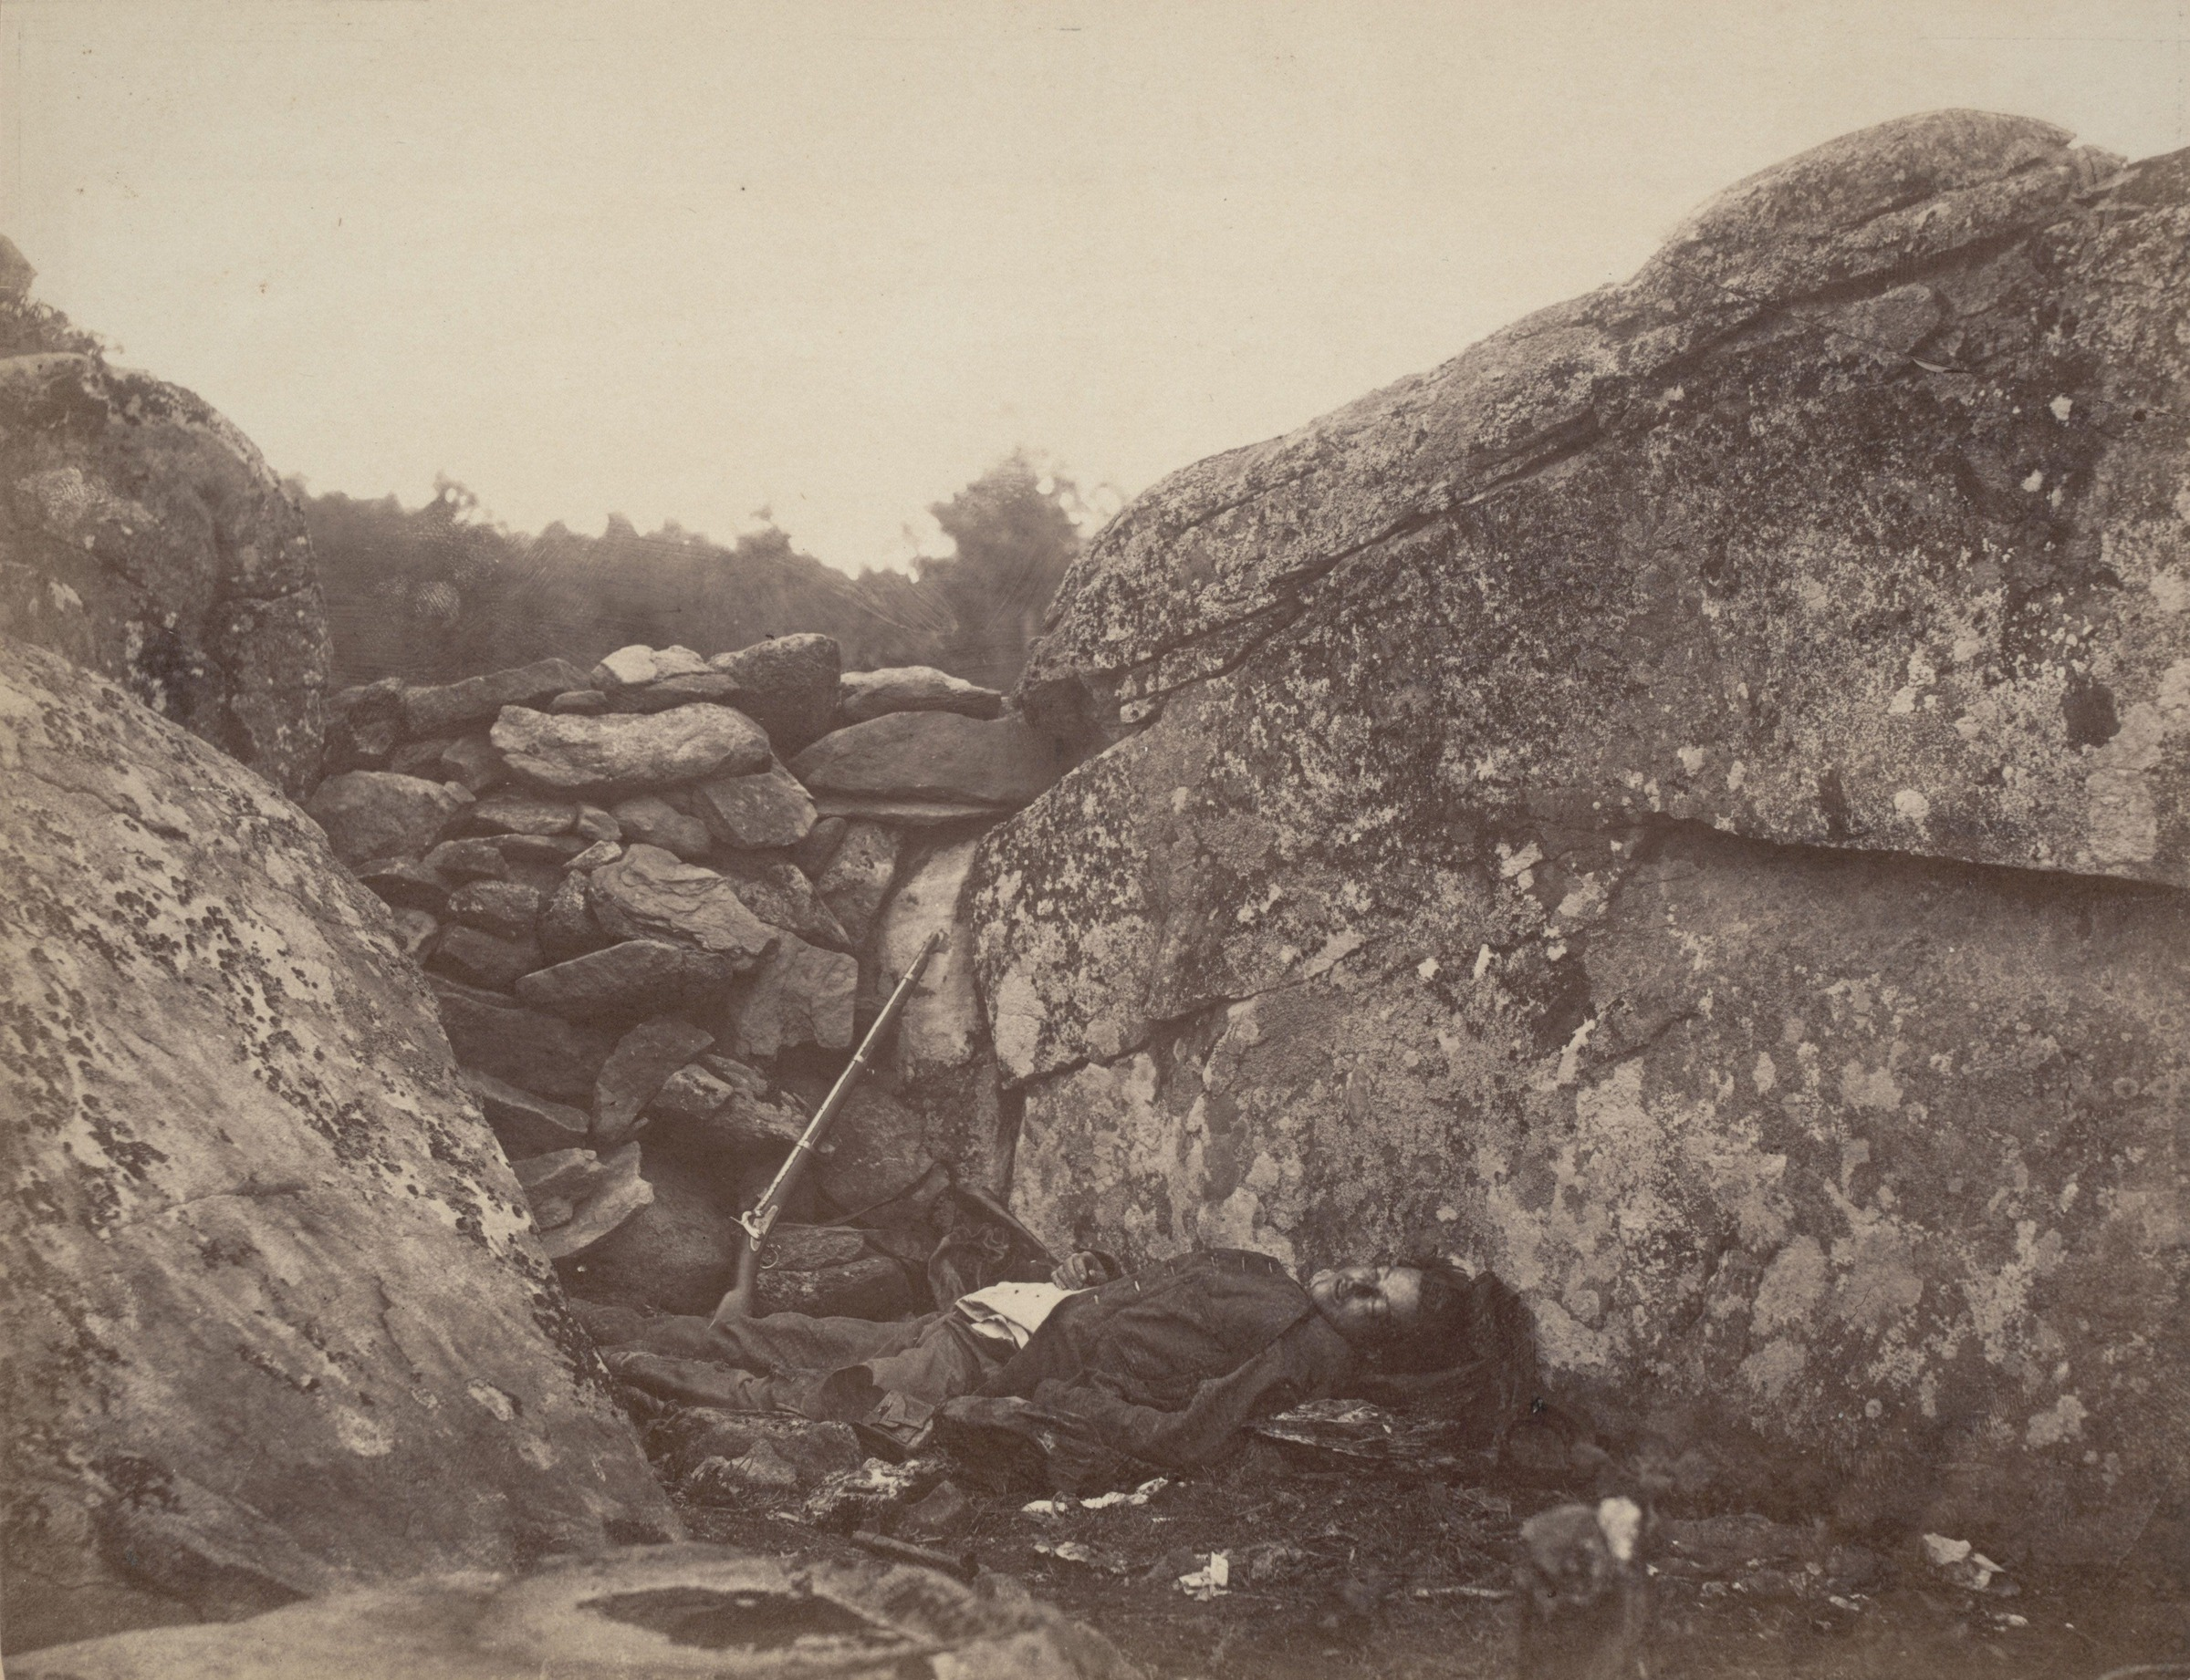
STAGING · PROOF ONE
THE EVIDENCE IS A SECOND PHOTOGRAPH
One soldier, two photographs
Where he fell: A Sharpshooter's Last Sleep
Where he was carried: Home of a Rebel Sharpshooter
TERM Staging: arranging the scene before the camera records it.
THE PROOF Gardner (Gettysburg, 1863) moved the soldier and propped the rifle. The photograph records an arrangement.
MEDIA STUDIES 9607 · SEMESTER I
02
Notes:
Both plates are Gardner's own, printed pages apart in his Sketch Book. The staging is not an accusation from historians; it is in the photographer's own captions. Content note: a dead soldier, photographed respectfully; name it plainly and move on.

Slide 5
“
A photograph passes for incontrovertible proof that a given thing happened.
Susan Sontag, On Photography, 1977
IN PLAIN WORDS People treat a photograph as certain proof that something really happened. This lesson tests that belief.

Slide 6
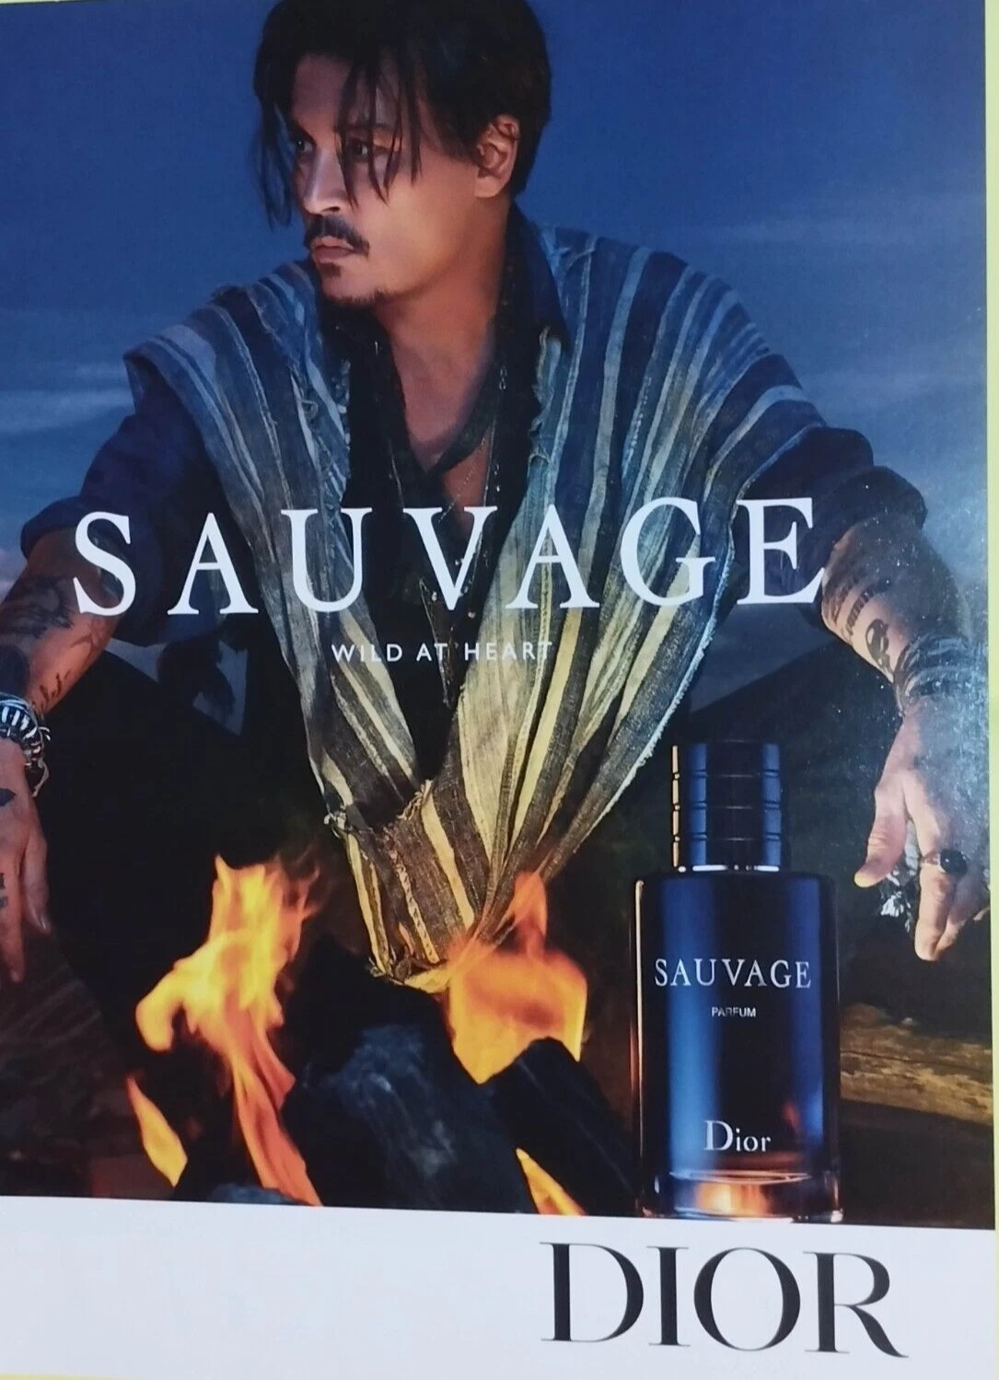
THE FOUR KEY CONCEPTS
READ EVERY TEXT FOUR TIMES
Four tools, not four words
01
Language
How the text makes meaning: the codes, framing, and choices that build the message.
02
Representation
How people, places and ideas are shown, and what each showing leaves out.
03
Industry
Who made it, who paid for it, and why. The money shapes the content.
04
Audience
Who it is for, and what they do with it. You are an audience before anything else.
The shared text: one print ad, read four times through four lenses
MEDIA STUDIES 9607 · SEMESTER I
03
Notes:
D2's teach: one shared text from the opening menu, read four times. The Dior Sauvage print ad (library, Print & Advertising) carries all four lenses in one object: codes, a man being sold as wildness, a luxury conglomerate, an implied reader. Name the four concepts aloud before defining them; board anchors go up now and stay up all semester.

Slide 7
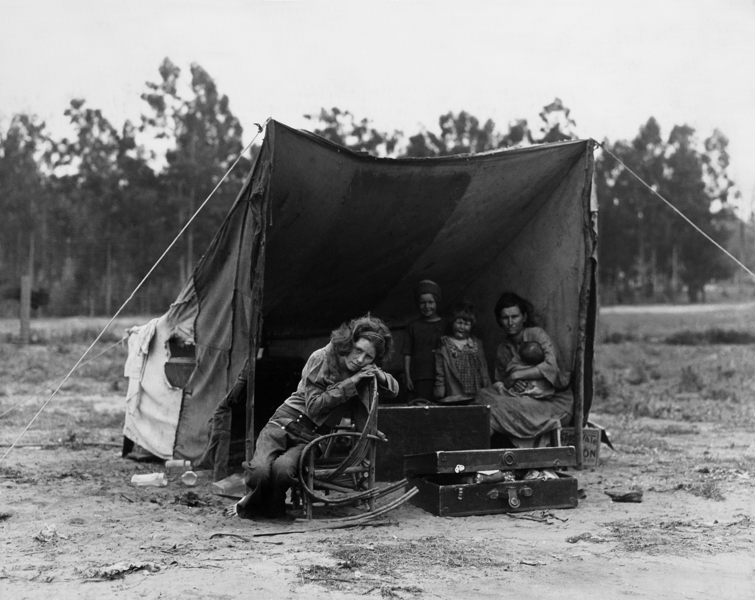
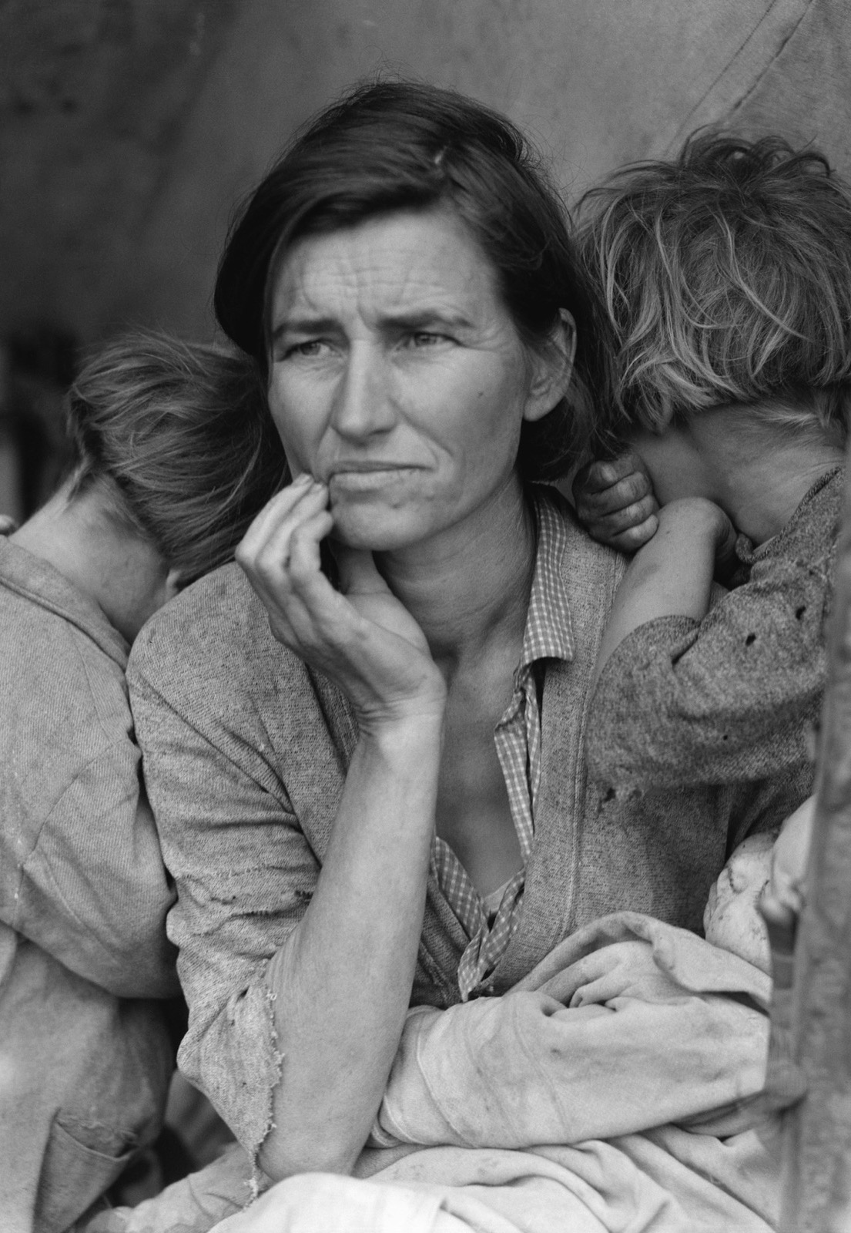
SELECTION · PROOF TWO
SIX FRAMES TAKEN, ONE FRAME CHOSEN
One frame of six
A frame nobody remembers: the tent, the setting, the faces
The frame the century kept: Migrant Mother
TERM Selection: choosing one frame and rejecting the rest.
THE PROOF Lange (Nipomo, 1936) took six exposures. One was chosen, cropped, and retouched. You never see the other five.
MEDIA STUDIES 9607 · SEMESTER I
04
Notes:
The Library of Congress holds the whole series; both frames are public domain FSA work. Tell the choosing as a story: the discard is invisible and decisive.

Slide 8
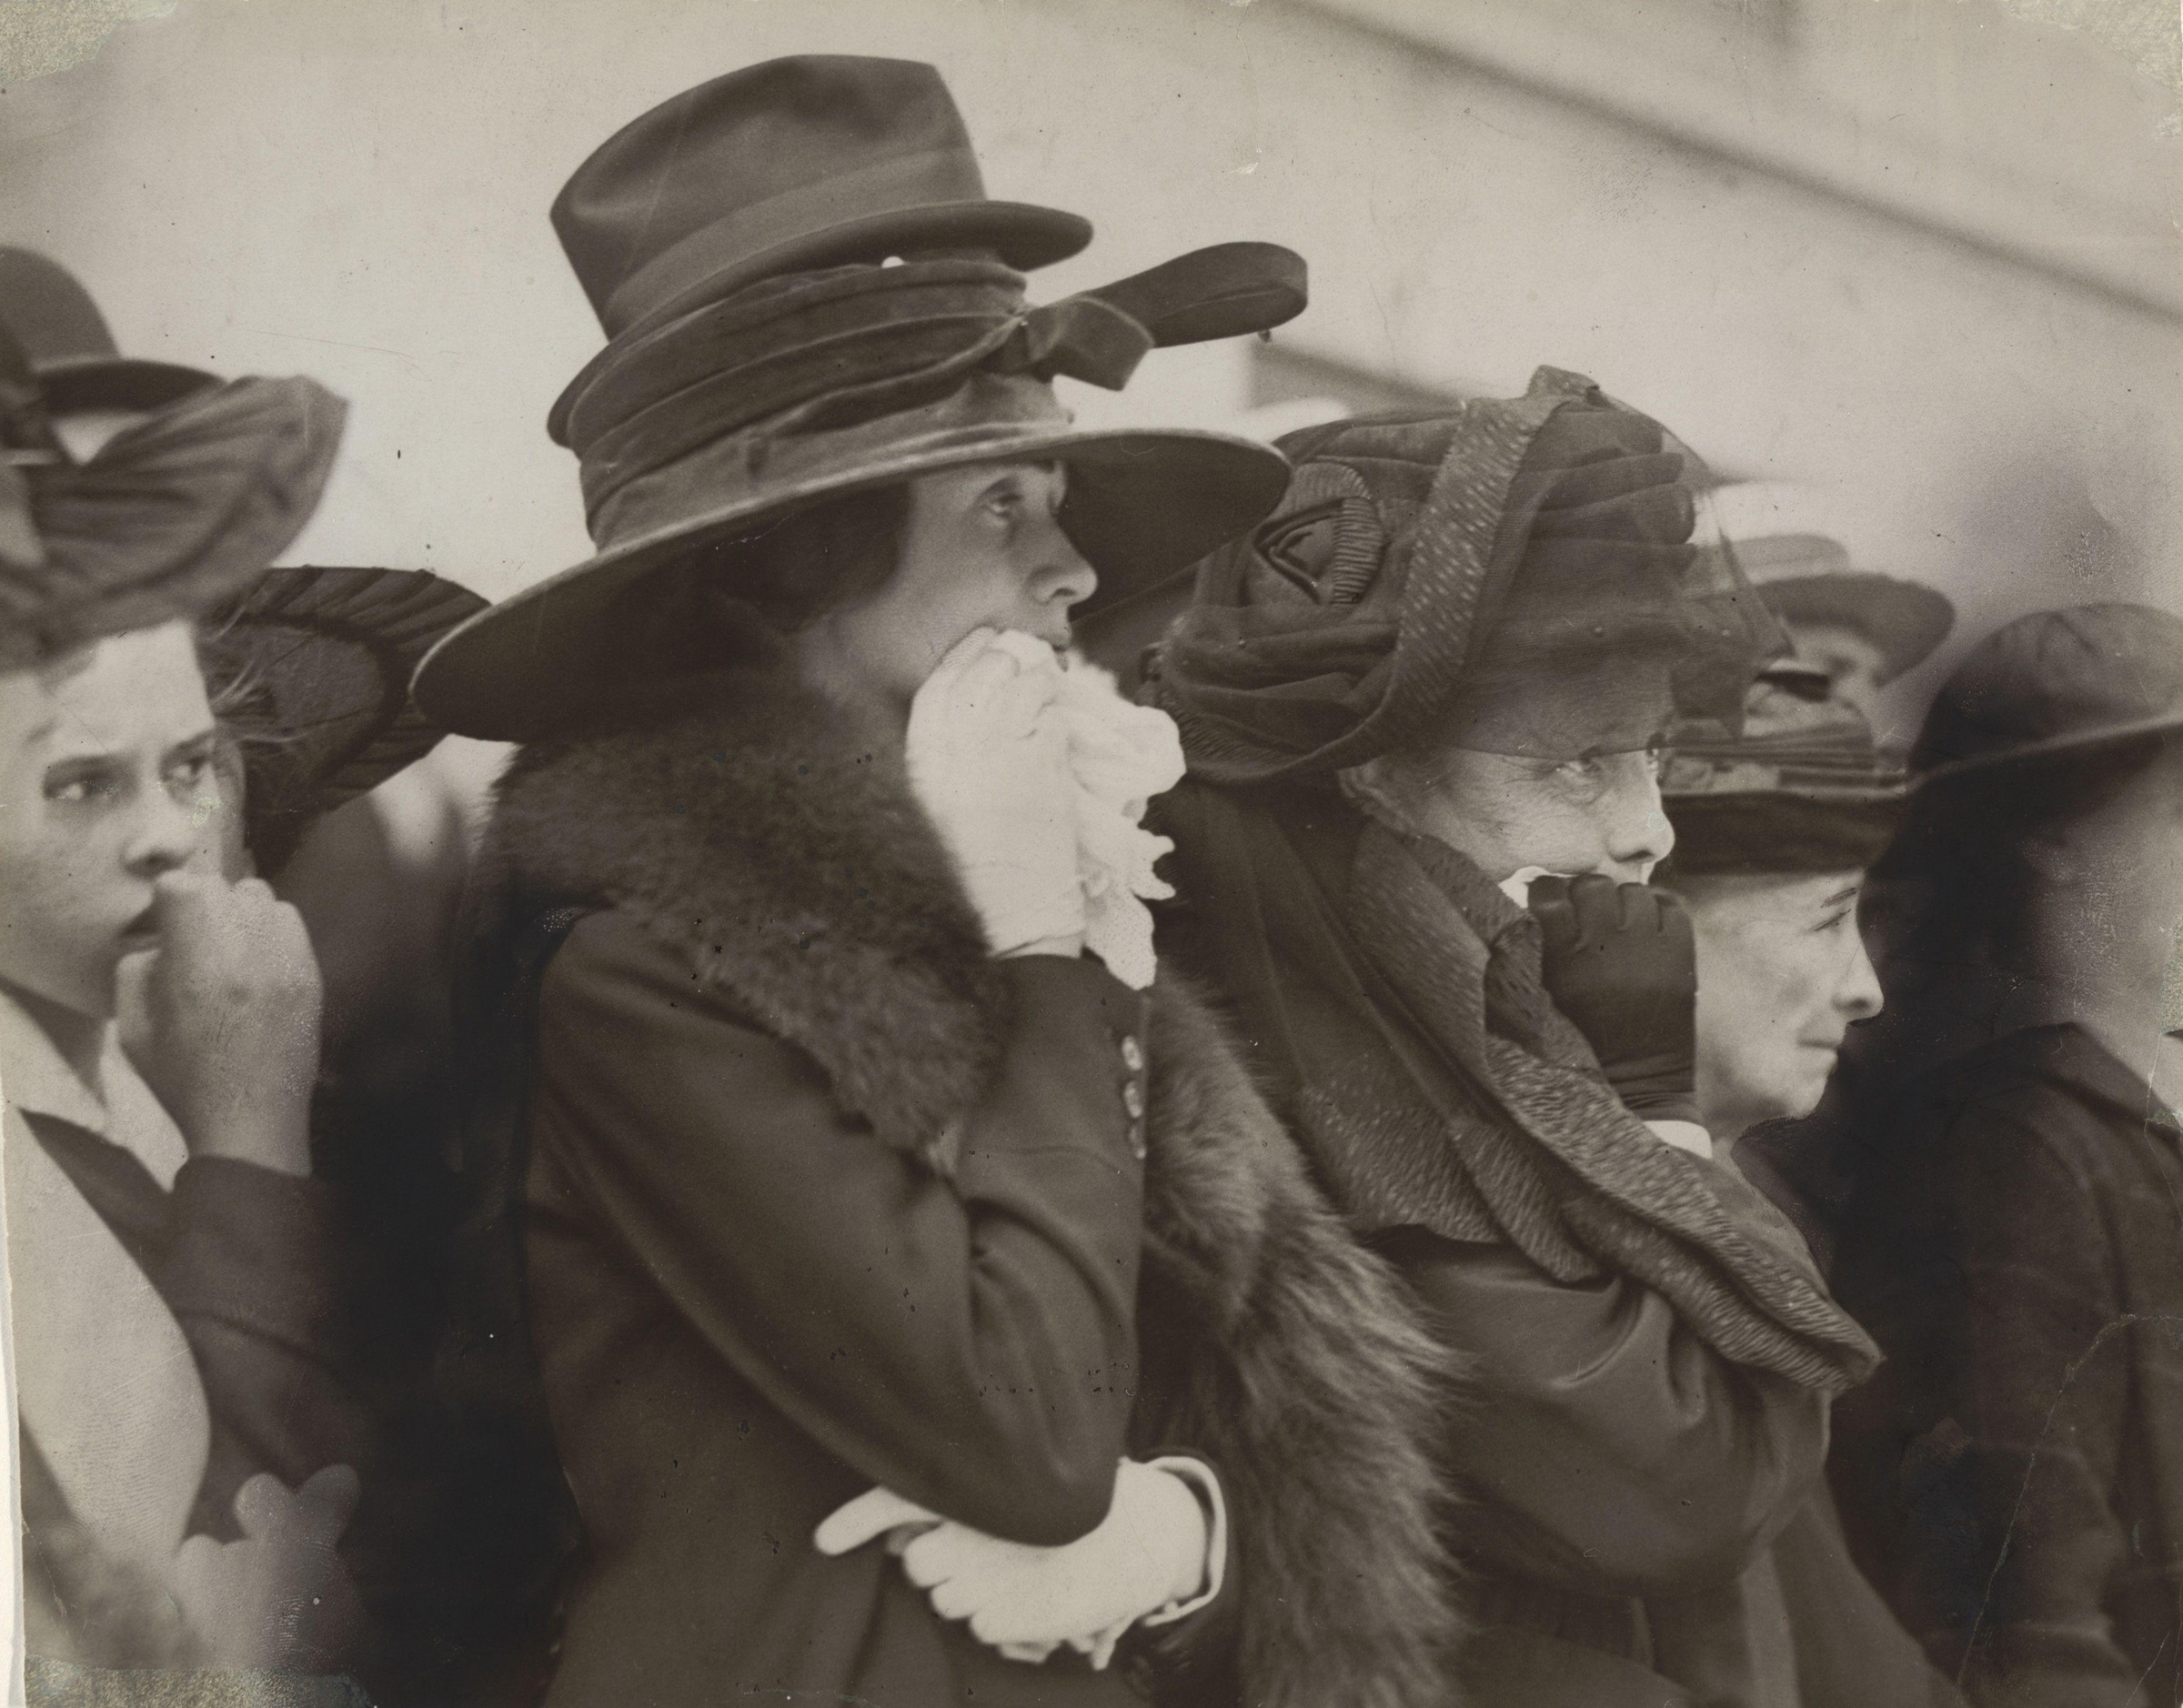
HOW MEDIATION WORKS
THREE MECHANISMS, THREE NAMES
Three terms you will reuse all course
Staging
Selection
Anchorage
Arranging the scene before the camera records it. Gardner moved the body.
Choosing this frame and this crop. Lange kept one exposure out of six.
The words that tell you how to read the image. The caption controls the meaning.
MEDIA STUDIES 9607 · SEMESTER I
05
Notes:
The three proofs, now with their mechanism names. The live turn follows: one staged classroom event photographed once, three pairs re-crop and re-caption it.

Slide 9
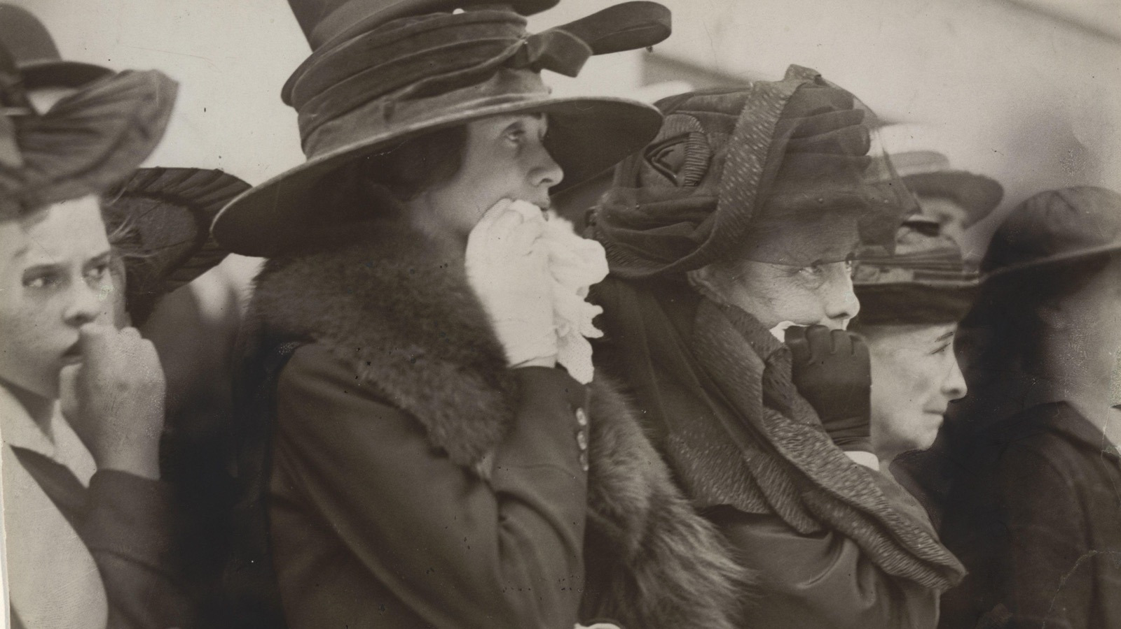
ANCHORAGE · PROOF THREE
The caption tells you who they are and how to feel: Mother, Wife, and Sweetheart.
Underwood & Underwood, Seventh Regiment marching to war, c. 1917
Notes:
Three women watch soldiers leave; the printed title names them and steers the emotion. The words carry meaning the image alone cannot fix. This returns in L02 as Barthes's anchorage.

Slide 10
“
Seeing comes before words. The child looks and recognizes before it can speak.
John Berger, Ways of Seeing, 1972

Slide 11
HOW IT RUNS
THREE SESSIONS
Three days, one habit
01
02
03
Wednesday
Thursday
Friday
The opening vote. The four Key Concepts, named and applied. Three proofs that a text is a version, not a window. Task: keep an overnight media-use log. Blog set-up begins.
Your logs become the room's data. Sort Wars: the 24 bilingual concept cards, three rounds, every placement defended aloud. Lexicon: five entries by Friday.
Denotation only: describe, do not interpret. Write CS1, then test it in the Smuggler Hunt.
MEDIA STUDIES 9607 · SEMESTER I
06
Notes:
The lexicon promise is on the objectives: at least five entries with EN and ZH labels by Friday, and both languages are legitimate in the room. The 24 bilingual concept cards run Sort Wars on Thursday.

Slide 12
DELIVERABLE · CS1
FRIDAY, IN CLASS
Describe only. Do not interpret.
TASK One paragraph on an unseen image. Pure denotation: what is there, not what it means.
PARKED Words like worried, poor, desperate go on the parked list. Lesson 02 collects them.
THE WIN Zero interpretation. A paragraph that survives the Smuggler Hunt.
THE FRAMES ON EVERY DESK
The image shows ... · In the foreground / background ... · The figure is positioned ... · The text reads ...
WHY The exam rewards describing before interpreting. We build that habit now, on day three.
MEDIA STUDIES 9607 · SEMESTER I
07
Notes:
CS1 announced day one to satisfy the 72-hour rule. Marked for discipline, not polish: zero interpretive claims is the single criterion. The frames are the ESL scaffold; using them costs nothing.

Slide 13
Language · Representation · Industry · Audience: the four Key Concepts, now yours.
NEXT
Semiotics,
Signs and Codes
Lesson 02. The parked list gets its name: connotation.
MEDIA STUDIES 9607 · SEMESTER I
08

