Slide 1
II
MEDIA STUDIES 9607 · UNIT II
Semiotics,
Signs and Codes
Media Language · Lesson 02 of 19
Four days · Monday 7 to Friday 11 September · the theory base for the four technical lessons
Notes:
Semiotics and sign theory in one week, compressed from two. The coursebook gives 2.1 four pages against thirty-eight for the technical sections; the days released here pay for camera, sound, mise-en-scene and editing. Taught from Deck U2.2 on D1; the WS 2.1 theory-card spine starts today with Saussure and Barthes.

Slide 2
II
WHERE THIS WEEK GOES
This week is the base.
The next four weeks
build on it.
Notes:
Say the road map out loud on Friday: students who hear codes as a glossary will treat the next four weeks as vocabulary weeks and under-invest in the shoots.

Slide 3
SAUSSURE · THE SIGN
TWO PARTS, ONE MEANING
Every sign has two halves
SIGNIFIER
SIGNIFIED
+
The form you see or hear: the letters r-o-s-e, or the spoken word.
The idea in your mind: the concept of a rose.
= THE SIGN, the unit that carries meaning
MEDIA STUDIES 9607 · SEMESTER I
01
Notes:
Taught from Deck U2.2's worked ad reading: sign, signifier, signified, then denotation and connotation on one advertisement, then polysemy: one image, many possible readings, until context and caption narrow them.

Slide 4
“
The bond between the signifier and the signified is arbitrary.
Ferdinand de Saussure, Course in General Linguistics, 1916
IN PLAIN WORDS Arbitrary: there is no natural link between a word's form and its meaning. Only agreement links them.

Slide 5

CONNOTATION CHAINS
Rose, and
everything after
rose → romance → Valentine's → spending
TERM Connotation: the extra meaning a culture attaches to a sign.
KEY POINT Connotation is learned, not natural. Nobody is born knowing a rose means love.
CHECK At each arrow, ask: who taught me this meaning? Who makes money from it?
Pierre-Joseph Redouté, Rosa gallica regalis, c. 1817
Notes:
Pairs build the chain, then challenge each link. The point is that connotation is cultural, not natural. The coursebook's own red-rose two-sentence task (2.1) closes the block.

Slide 6
CONNOTATION IS CULTURAL, NOT NATURAL
THE CLOSING ASIDE: WHERE CULTURES DIVERGE
Same signifier, different meanings
SIGNIFIER
One reading
Another reading
White
Purity, the bride, the wedding
Mourning, the funeral, loss
Red
Danger, stop, warning, debt
Fortune, joy, the wedding envelope
The number four
An ordinary number
四 sounds like 死: avoided in floors and phone numbers
KEY POINT Connotations change from culture to culture. This table is the proof.
EXAM NOTE The Cambridge paper uses the Western readings: red, white, black, the rose, the dove, the suit. Learn those.
MEDIA STUDIES 9607 · SEMESTER I
02
Notes:
Kept deliberately as one slide with the aside framing: the exam-example rule governs content examples, and the footnote keeps the core exam-facing.

Slide 7

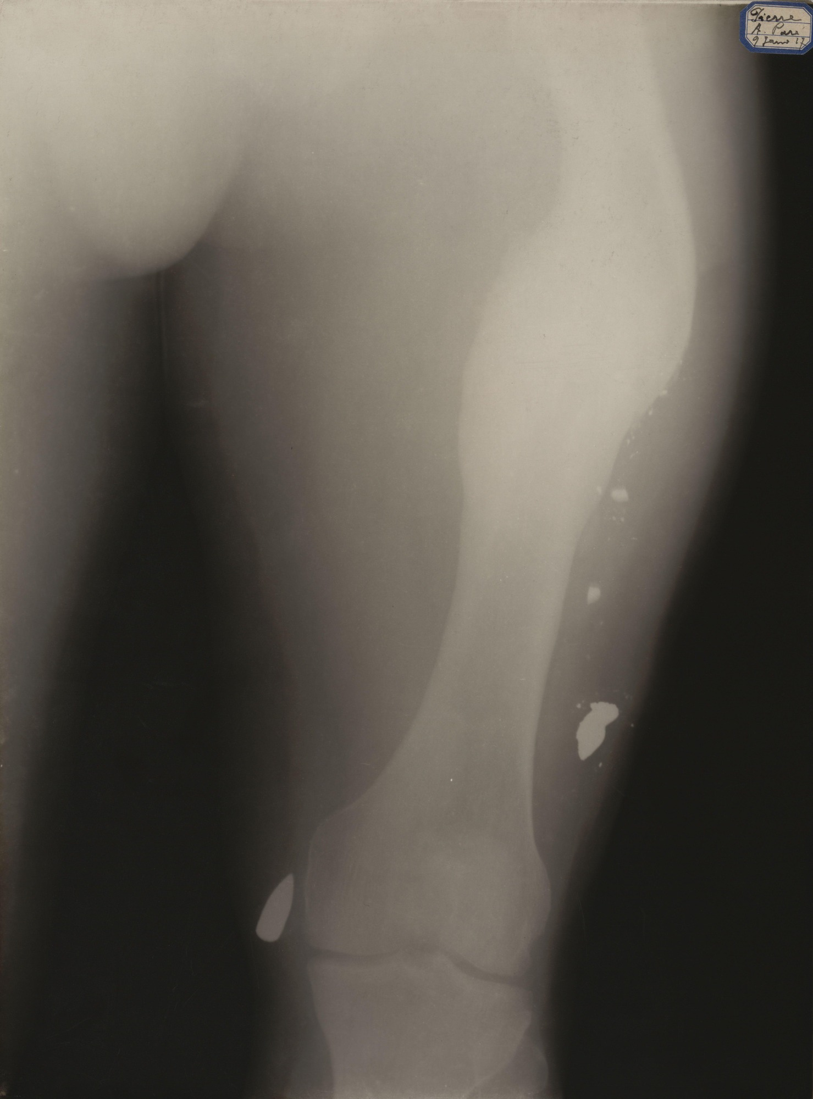

PEIRCE · THREE WAYS TO MEAN
SORT WARS · MIXED TYPES ARE ALLOWED
Icon, index, symbol
Icon
Index
Symbol
It looks like the thing.
It is a physical trace.
It means by agreement only.
An emoji face looks like the face it stands for.
X-rays passed through a real body and left this mark.
A flag means a nation only because we agree it does.
THE HARD CASE A photograph is an index (a light trace) that also looks like an icon. Both answers are correct.
MEDIA STUDIES 9607 · SEMESTER I
03
Notes:
Cells: Twemoji (CC BY 4.0), an early radiograph from the library, the Union flag (Commons). Sort Wars deals the twelve contested signs after: emoji, X-ray, wedding ring, siren, brand logo, thumbprint, crucifix, weather vane and friends; the blends are the fun.

Slide 8
“
The photograph as such and the object in itself share a common being, after the fashion of a fingerprint.
André Bazin, The Ontology of the Photographic Image, 1945
IN PLAIN WORDS A photograph is like a fingerprint: the real object made the mark. That is why it is an index.

Slide 9
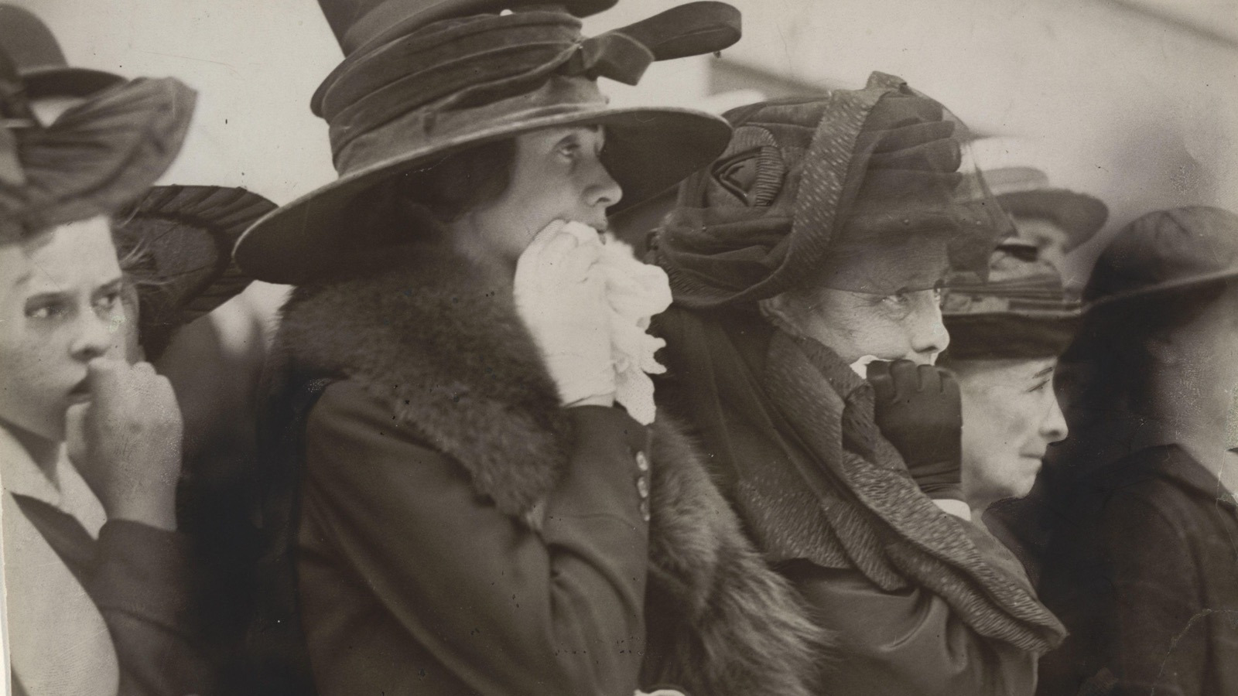
ANCHORAGE · THE CAPTION RETURNS
The caption fixes which meaning you take. Barthes calls this anchorage.
Underwood & Underwood, Seventh Regiment marching to war, c. 1917
Notes:
L01's stereograph returns with a theorist's name. Anchorage fixes the floating chain; relay is when words and image take turns carrying the story.

Slide 10
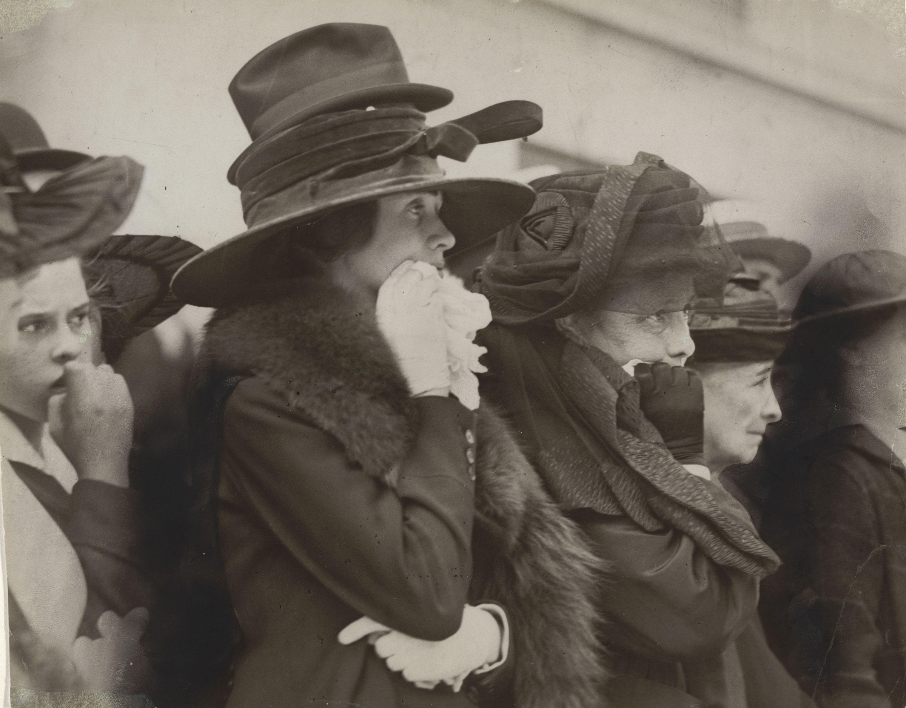
THE CAPTION SWAP
THE IMAGE NEVER CHANGED
SYMPATHY
Three women say goodbye to the men they love.
SUSPICION
The crowd cheers for a war that others will fight.
COMEDY
The best show in town, and the seats are free.
Underwood & Underwood, c. 1917
KEY POINT Same image, three captions, three different texts. Whoever writes the caption controls the meaning.
MEDIA STUDIES 9607 · SEMESTER I
04
Notes:
D3's caption swap staged on the slide so the mechanism is visible before pairs write their own three captions for a fresh image.

Slide 11

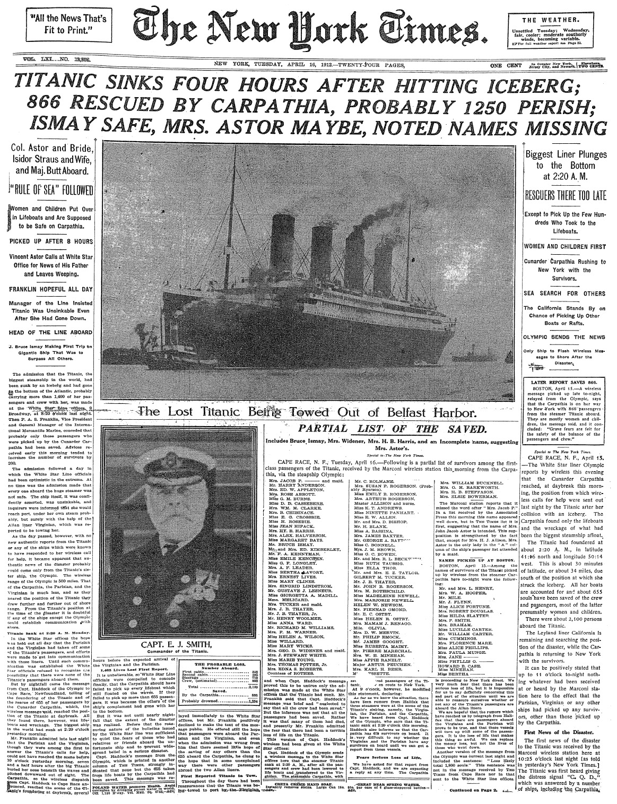
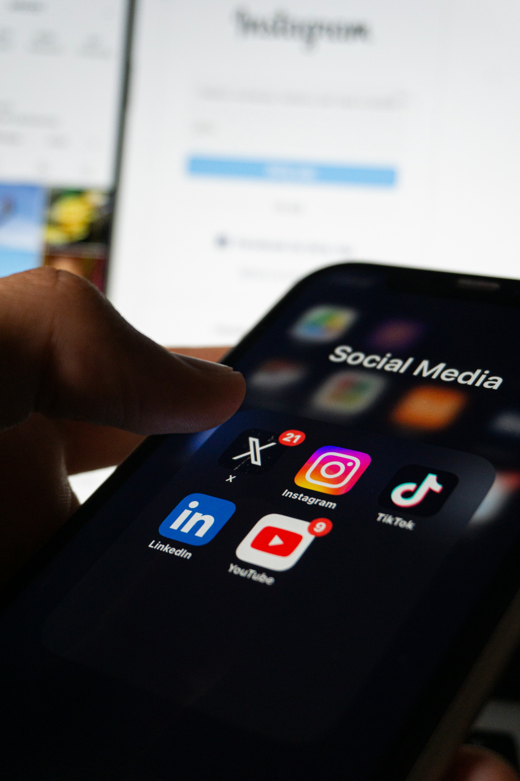
MODE OF ADDRESS
HOW OLD DOES THIS TEXT THINK YOU ARE?
Three texts, three implied readers
The luxury ad
The broadsheet front
The app splash
It expects money and taste. One word, gold light, no explanation needed.
It expects patience, prior knowledge, and trust in long columns of text.
It expects a thumb, a short attention span, and no patience at all.
TERM Implied reader: the reader a text expects and speaks to.
TASK Profile each one: age, income, knowledge, mood, and how the text would address you.
MEDIA STUDIES 9607 · SEMESTER I
05
Notes:
D3's 35-minute block, previously slide-less. Cells: Dior J'adore (library), a public-domain broadsheet front page, a social-app splash photograph (Unsplash, credited). Not a Chinese app as core, per the exam-example rule.

Slide 12
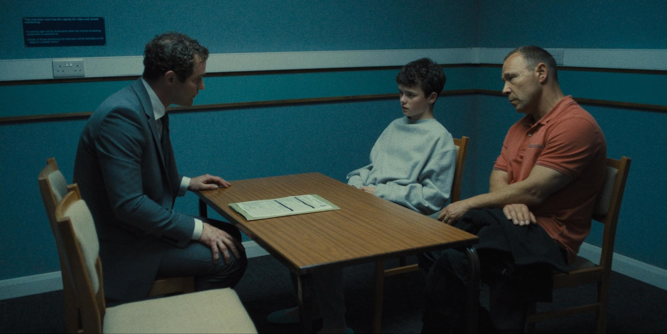
THE TWO-YEAR CHECKLIST
RUN ALL FOUR ON EVERY EXTRACT
Four code families, one dense still
01
Technical
wide, static, eye level, cold institutional light
02
Symbolic
the table between them, the sweatshirt, the bare walls
03
Written
the notice on the wall, the forms on the table
04
Audio
what the room would sound like: hum, chairs, silence
Adolescence (Netflix, 2025): the interview room
MEDIA STUDIES 9607 · SEMESTER I
06
Notes:
D4's mapping exercise on screen: one dense still, all four families in table form, then the personal code checklist. Audio is named as the family a still cannot show, which is itself the teaching.

Slide 13
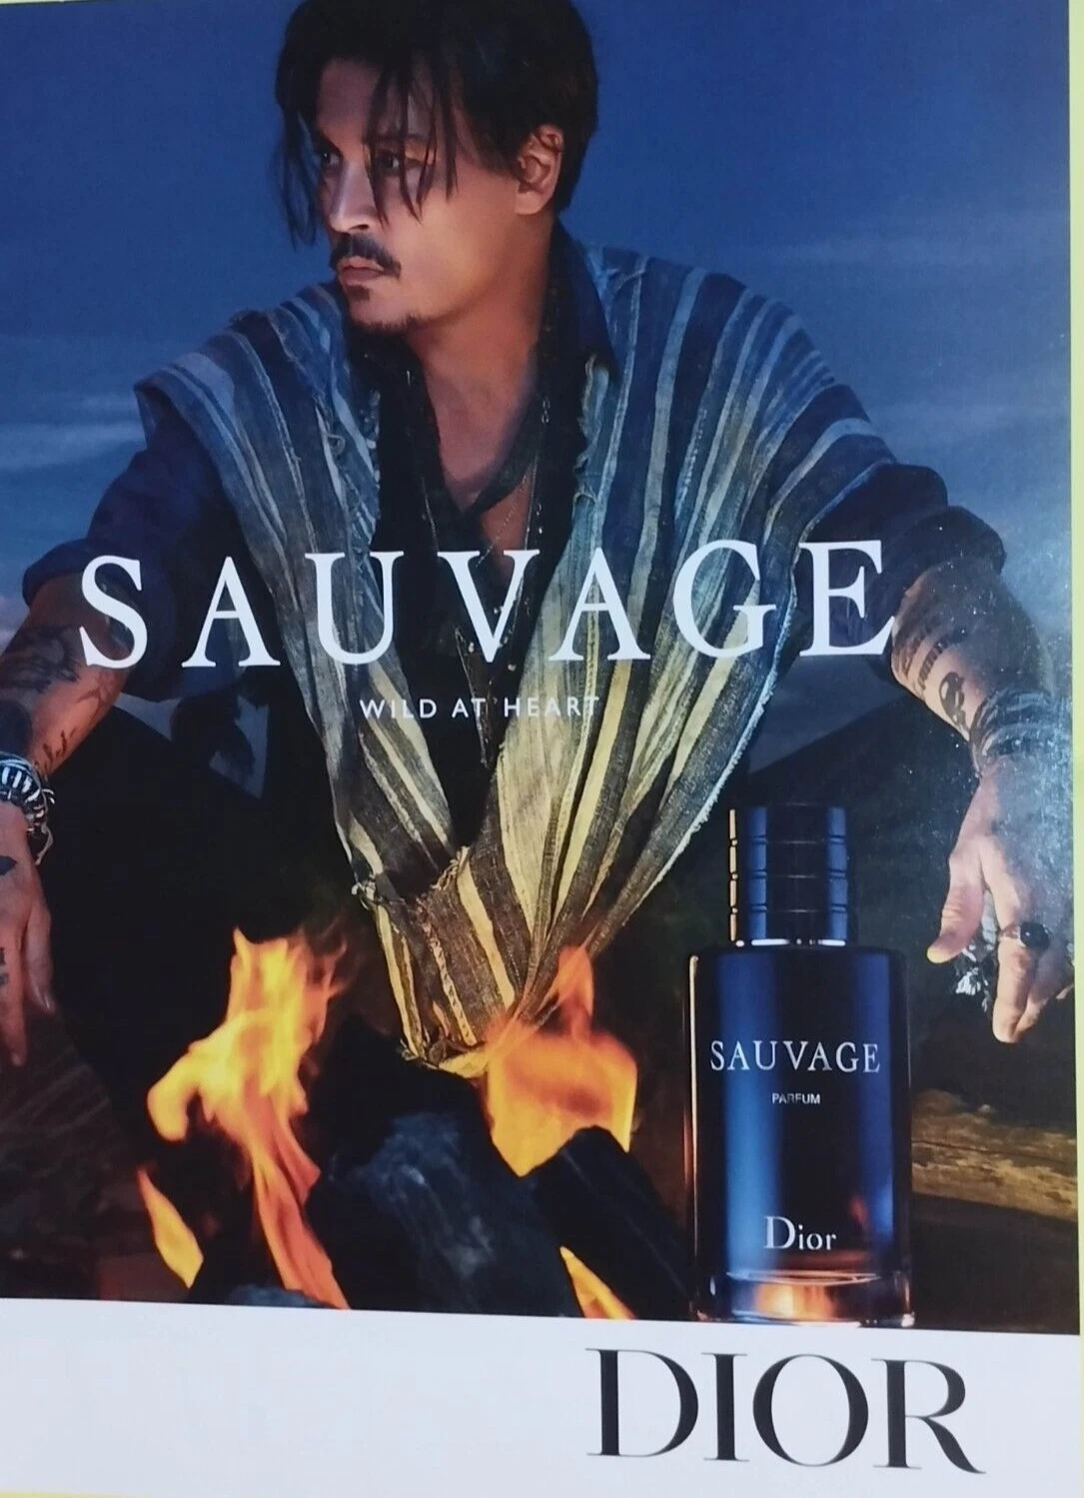
THE CS2 EXEMPLAR
SIX LABELS, ONE AD
WRITTEN
SAUVAGE, WILD AT HEART, DIOR: three ways to say one thing
SYMBOLIC
firelight, open shirt, tattoos, desert: wildness as a costume
SYMBOLIC
the bottle stays sharp and steady: the product is the calm center
TECHNICAL
low-key lighting, warm against cool, shallow focus on the face
TECHNICAL
eye level, direct address: he looks straight at you
AUDIO
a print ad has no sound: writing that down is also a label
Dior, Sauvage print campaign
CS2 Six accurate labels on a media text you choose. This ad is your model.
MEDIA STUDIES 9607 · SEMESTER I
07
Notes:
The exemplar is peer-checked against on Friday before CS2 is collected. The ad also served as D1's worked reading, so the room has seen it twice by now.

Slide 14
FRIDAY · TWO THINGS LEAVE THE ROOM
ONE COLLECTED, ONE COMMITTED
CS2, and a decision that lasts until May
CS2
Your media area
Choose an everyday media text. Label it with at least six accurate code labels. Check your work against the model ad before you hand it in.
Decide on Wednesday. Post it on the blog with one line: why this area? The choice feeds your Lesson 15 case study, and you cannot change it next week.
THE ROAD MAP Next: four lessons on the technical codes, with equipment in your hands. Every exercise you shoot becomes a dated post on your Component 1 blog.
MEDIA STUDIES 9607 · SEMESTER I
08
Notes:
The media-area commitment is Wednesday's milestone; the one-line justification goes on the blog the same day.

Slide 15
NEXT
Camera
Lesson 03. Shots, angles, movement, composition, and on Thursday you shoot six of them.
MEDIA STUDIES 9607 · SEMESTER I
09

