Slide 1
III
MEDIA STUDIES 9607 · UNIT II
Camera
Media Language · Lesson 03 of 19
Two days · Monday 14 and Thursday 17 September · first of the four technical elements
Notes:
First of four: camera, sound, mise-en-scene, editing, then integration. Monday teaches the whole lexicon as verbs. Thursday is the shoot: six shots on their own kit, posted to the blog as CS3.

Slide 2
III
THE FIRST QUESTION
Where are you standing,
and who put you there?
Notes:
Open on one frame. The camera position is a decision somebody made about you, and every term in this lesson is a name for one of those decisions.

Slide 3
“
How the following technical elements create specific representations of individuals/groups/events/places, and help to articulate specific messages and values that have social significance.
Cambridge International 9607, subject content
IN PLAIN WORDS How the technical elements shape how people and places are shown, and what messages they send.

Slide 4
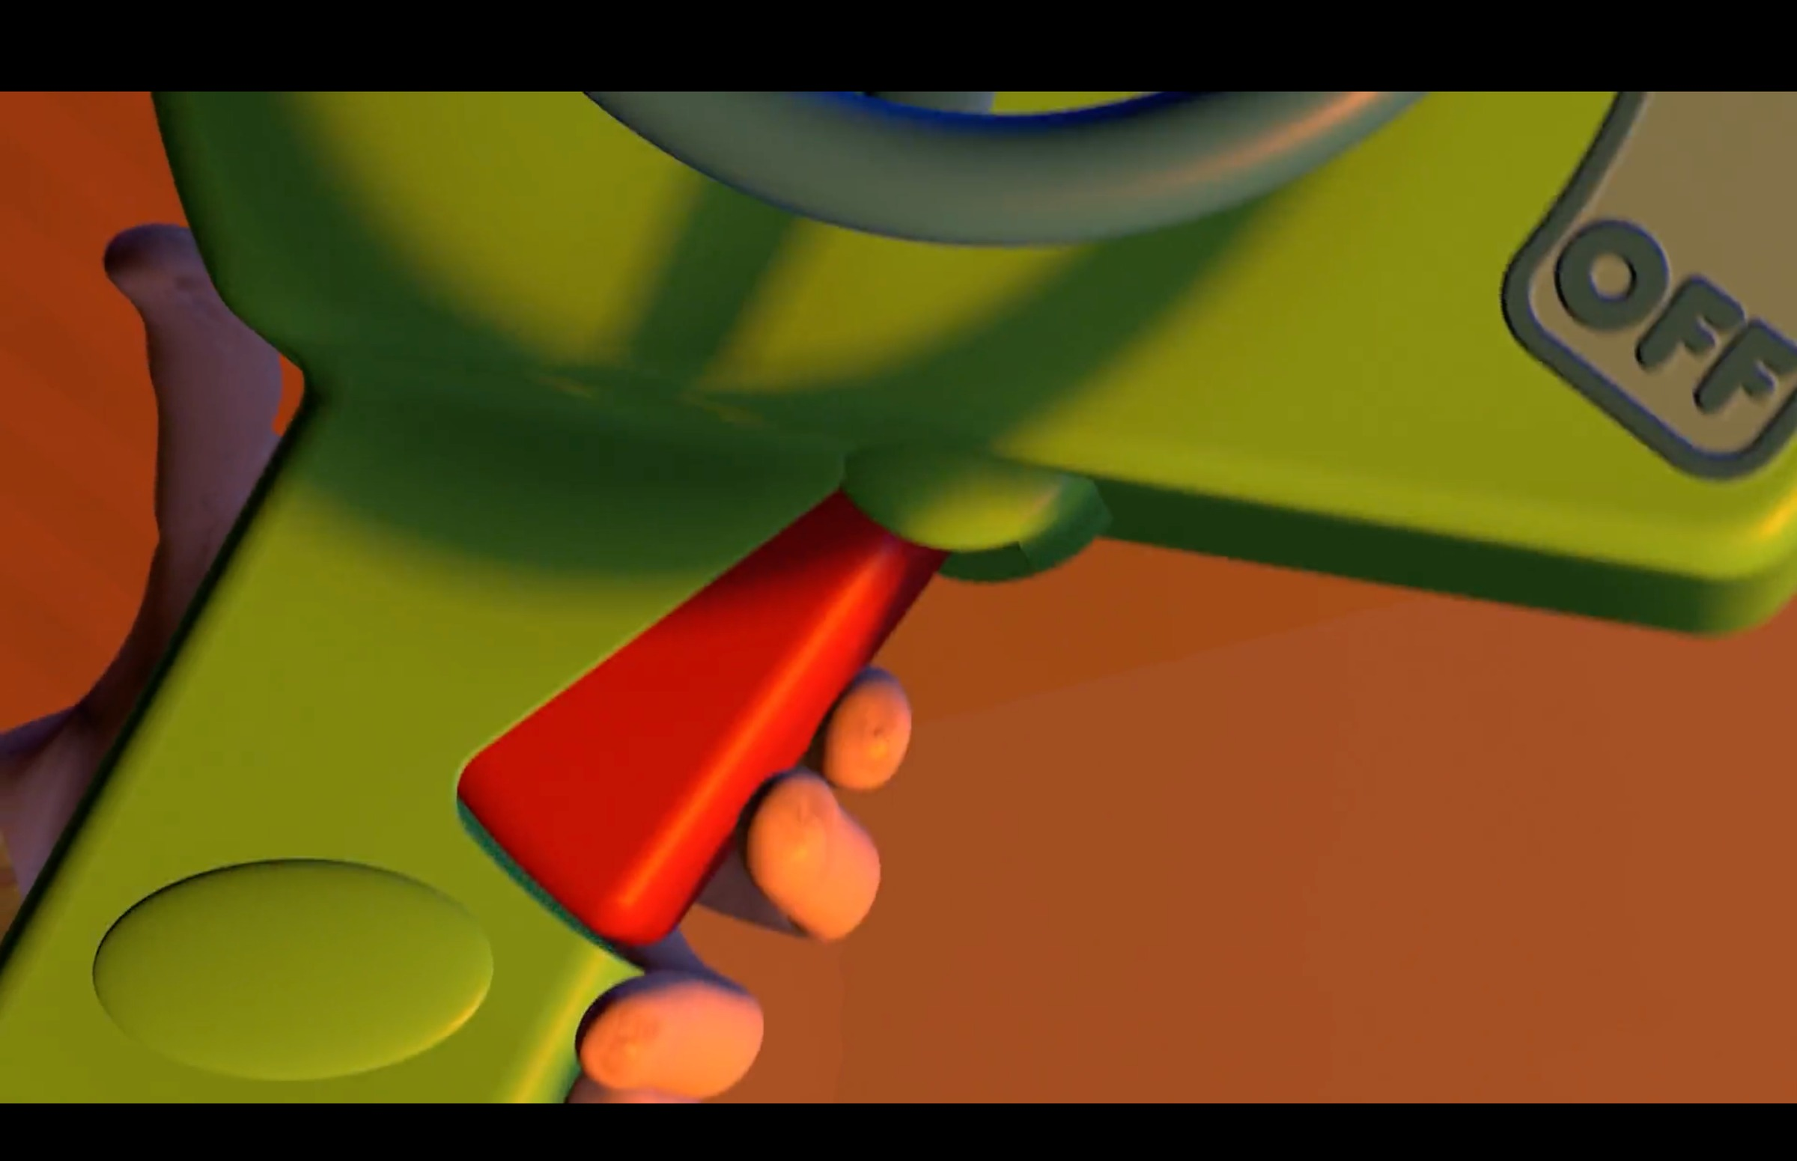
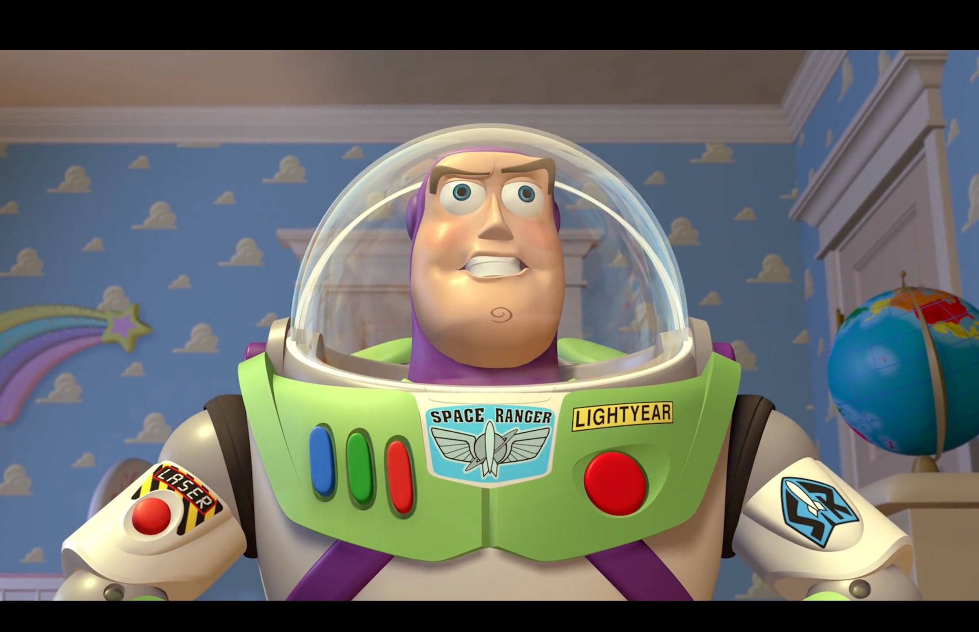
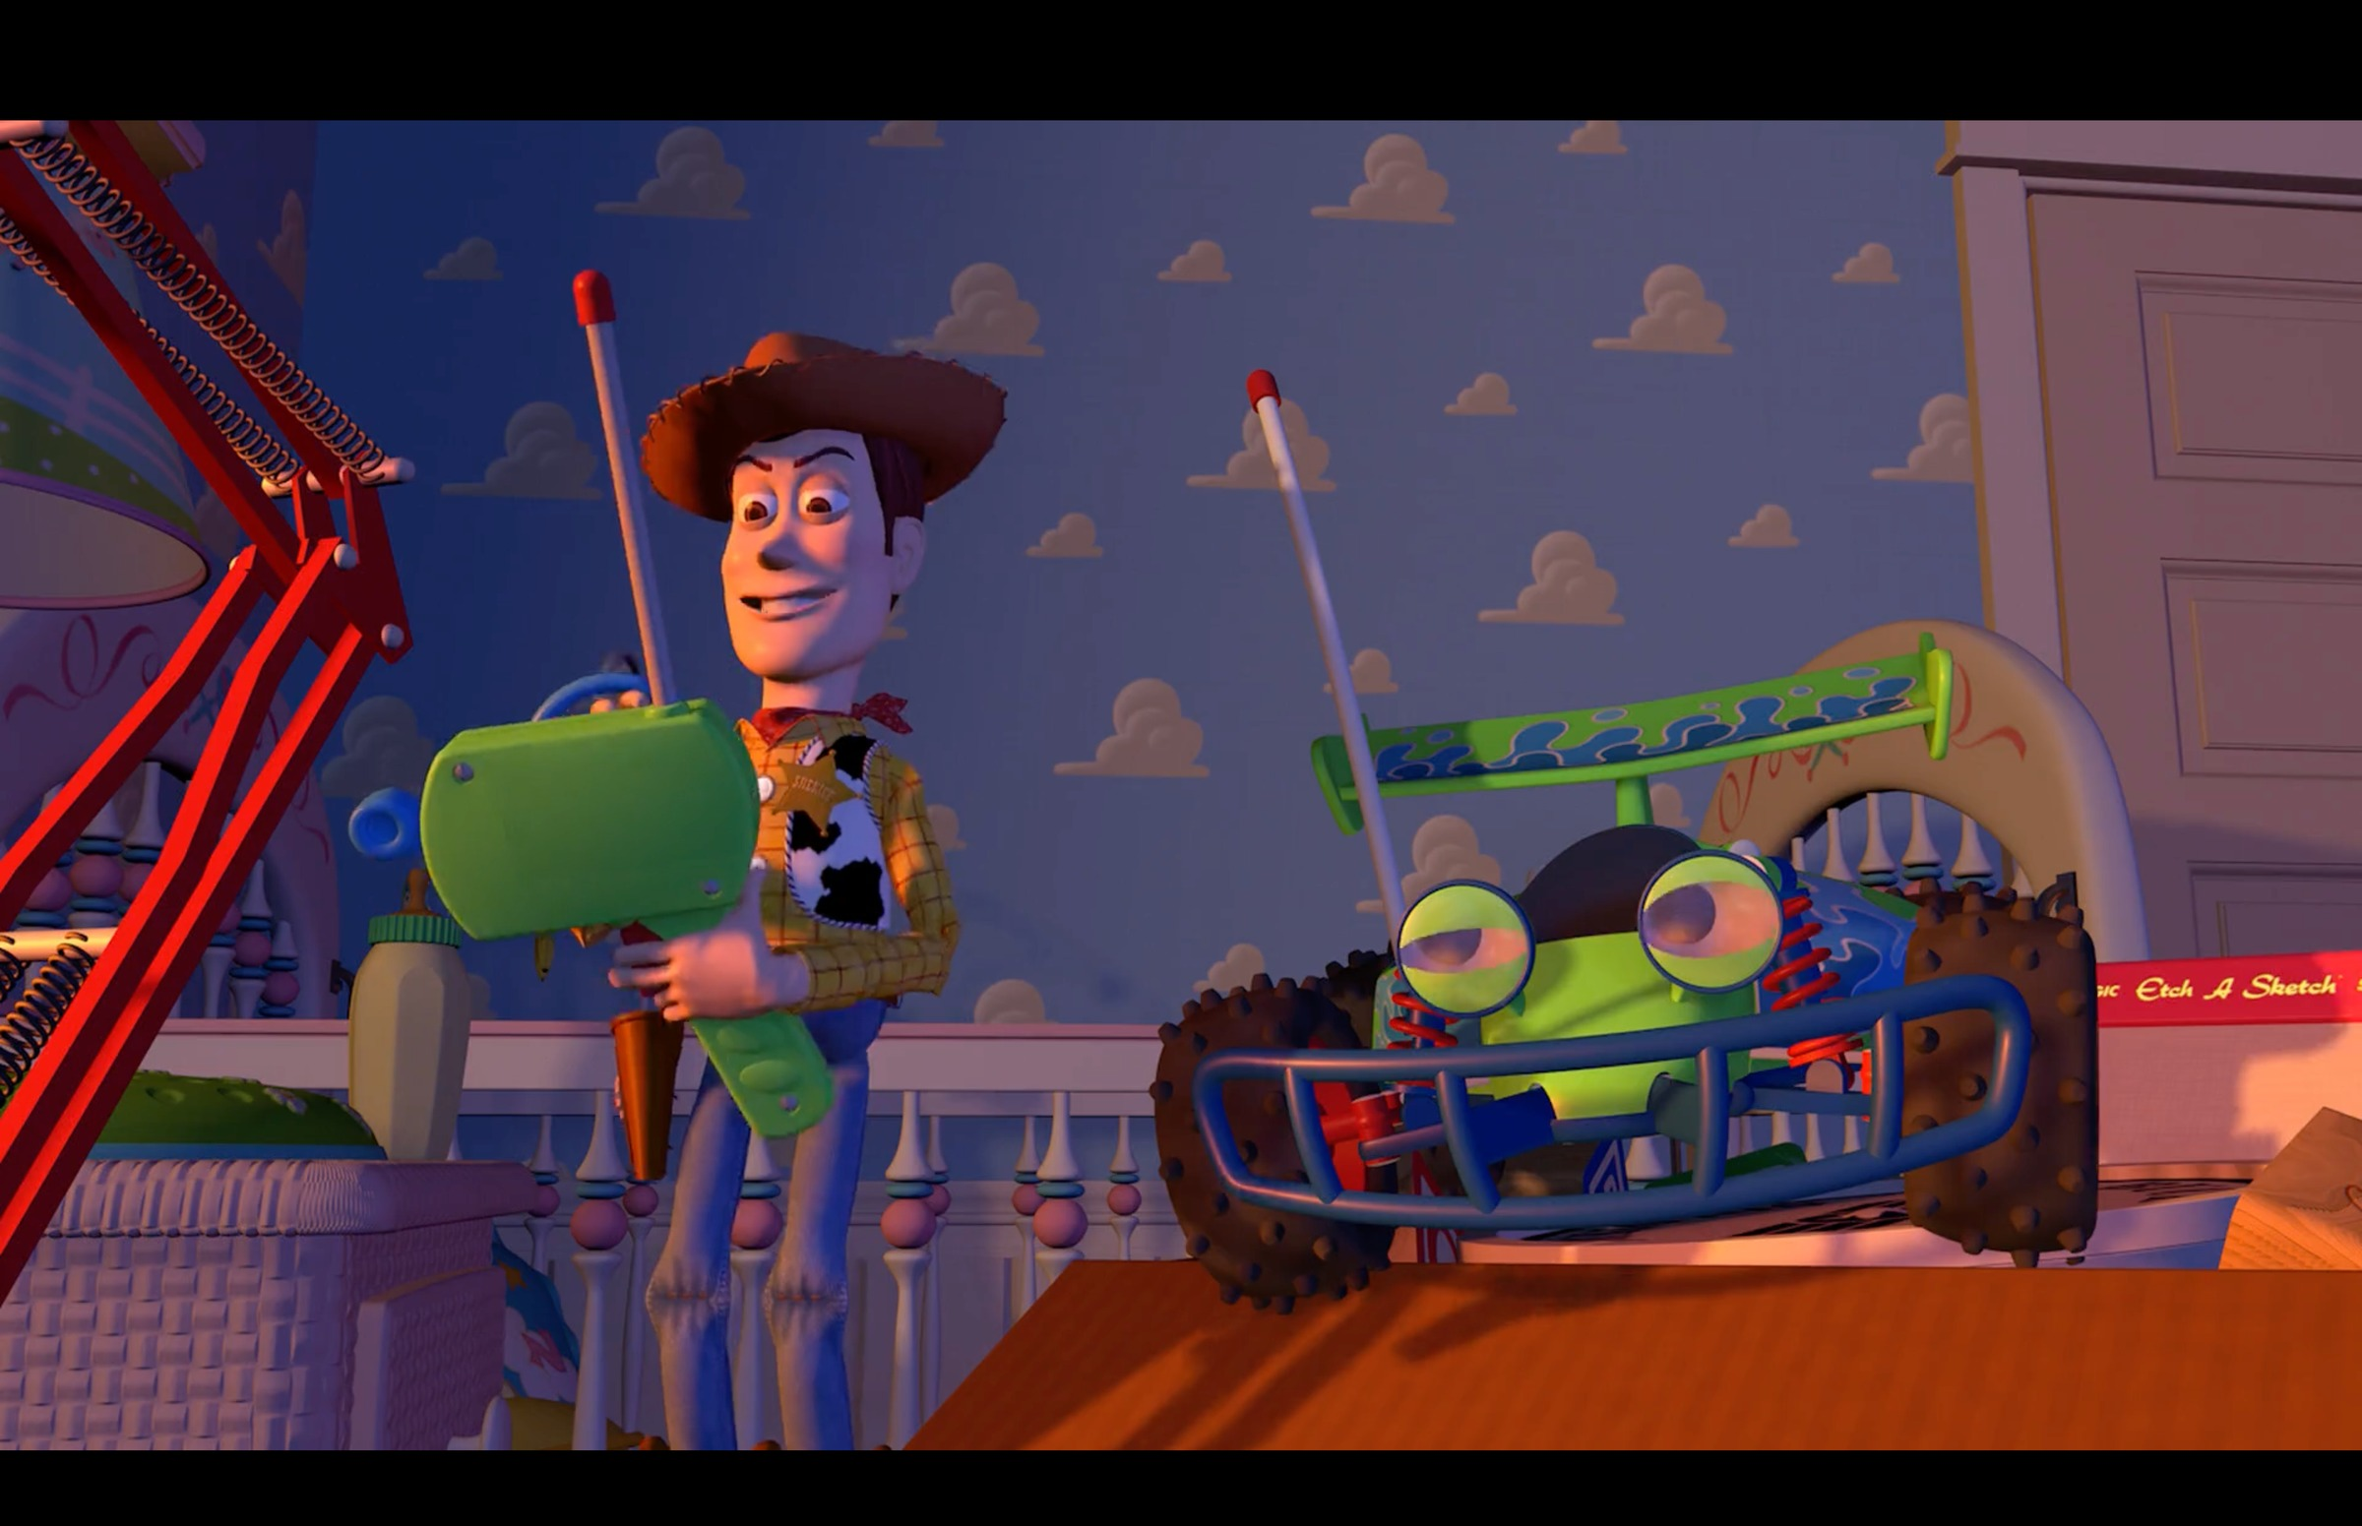
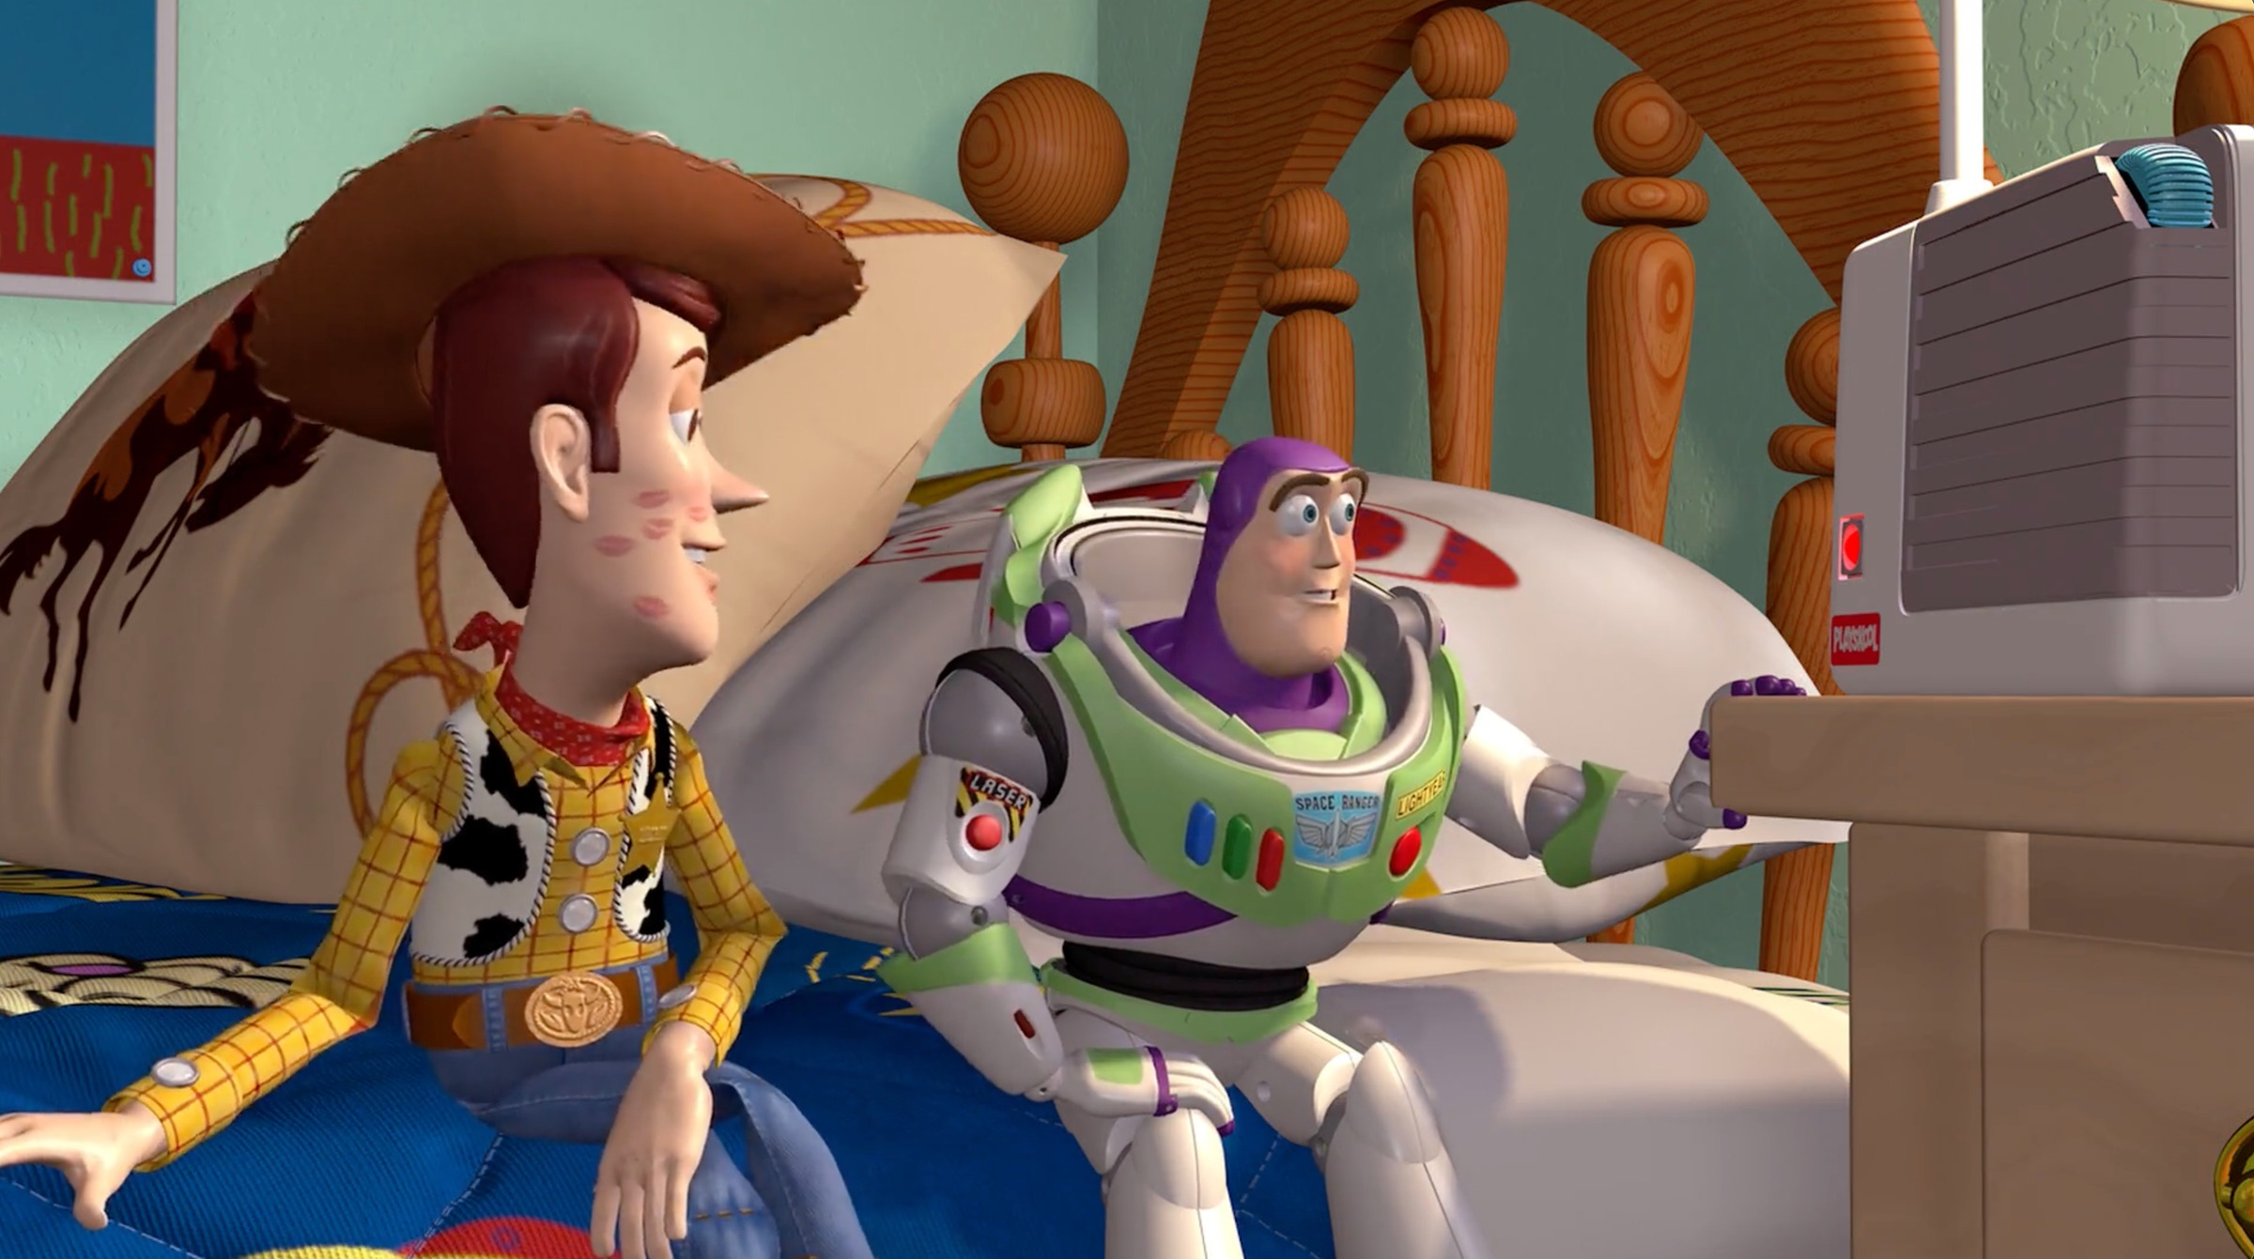
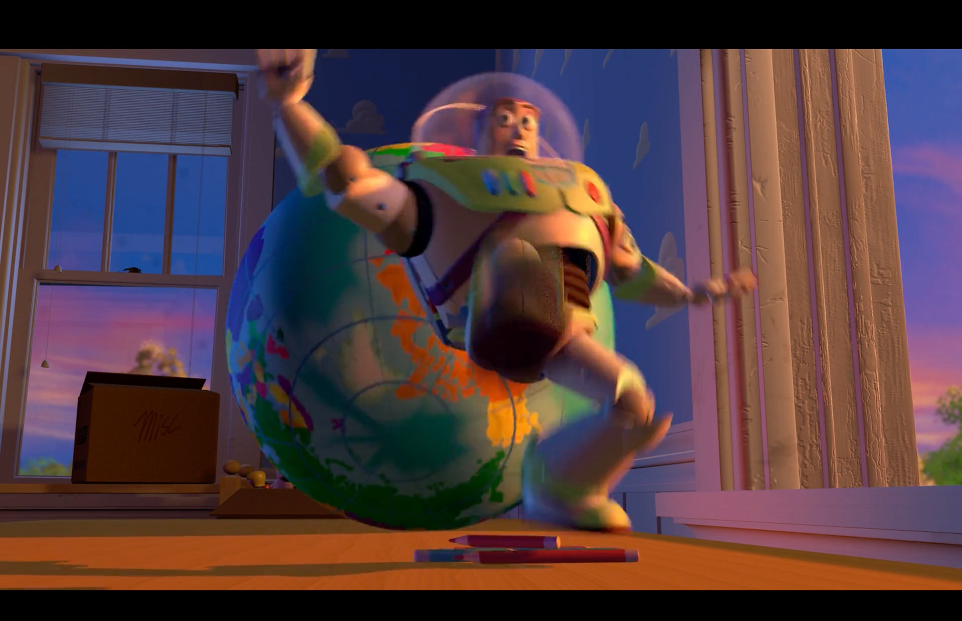
THE CAMERA AS VERBS
THE SYLLABUS'S OWN LIST
The shot ladder, in frames
ECU
CU
MS
Two-shot
LS
extreme close-up
close-up
mid shot
two subjects share it
long shot
Toy Story (1995, Pixar/Disney), one scene up and down the ladder
Shots
Angles
Movement + composition
establishing · master · wide
aerial · POV · over-the-shoulder
high · low · canted
pan · tilt · track · dolly · crane · steadicam · zoom · handheld | framing · rule of thirds · depth of field · focus pulls
SAY IT AS A VERB The camera looks up at him. The camera creeps toward the door. The camera refuses to follow.
MEDIA STUDIES 9607 · SEMESTER I
01
Notes:
The columns are the syllabus's own enumerations, complete: the frames illustrate the sizes, and the shots column names the ones a still cannot stage here (establishing, master, wide, aerial, POV, over-the-shoulder; the CS3 storyboard requires establishing and POV by name). Ladder sprint, rungs one to three, follows immediately.

Slide 5
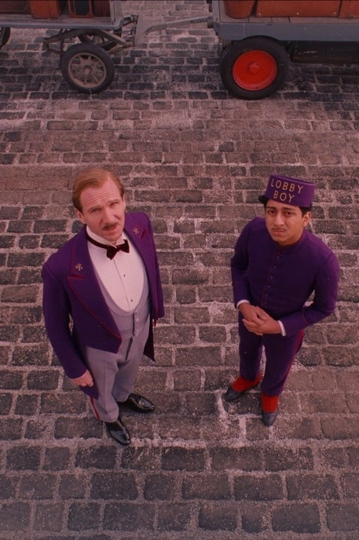
ANGLE · VIEWPOINT
A view nobody could have
TECHNIQUE Overhead angle (bird's-eye view). No person in the scene could stand here.
EFFECT From above, the two men look small, tidy, and equal. The street becomes a pattern.
CHECK Ask of any frame: could I stand where the camera stands? If not, the position is a choice with a meaning.
The Grand Budapest Hotel (2014), dir. Wes Anderson
MEDIA STUDIES 9607 · SEMESTER I
02
Notes:
A true overhead: students can name high angle in a second, and the mark is in the sentence after that. The same film returns on the mise-en-scene deck, shot from the front. The canted angle's canonical frame (The Third Man) waits in the CS8 quiz at L08.

Slide 6

THE HALF THAT EARNS MARKS
NAMING ALONE IS WORTH ALMOST NOTHING
Two sentences, not one
What the camera did
A low-angle wide shot places the two figures above us in an empty warehouse.
This half is easy. Anyone with the word list can write it.
What it did to you
We look up at them from below, so they seem powerful before anyone speaks.
This half earns the mark. Most students stop before it.
The frame the sentences describe (CUP Teacher's Resource)
RULE Always write both halves: the technique, then its effect on the audience.
MEDIA STUDIES 9607 · SEMESTER I
03
Notes:
The frame is the Teacher's Resource's own before-and-after starter image, reused so the hypothetical detective sentence became a checkable reading.

Slide 7
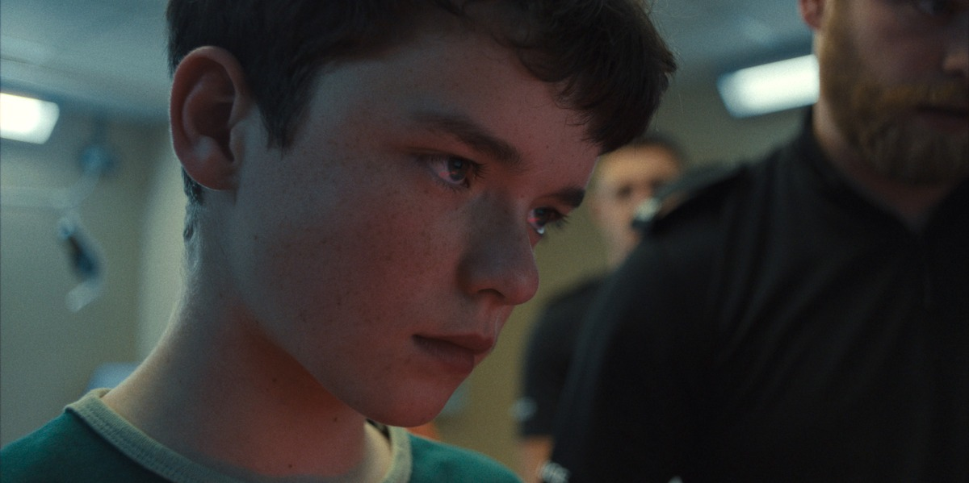
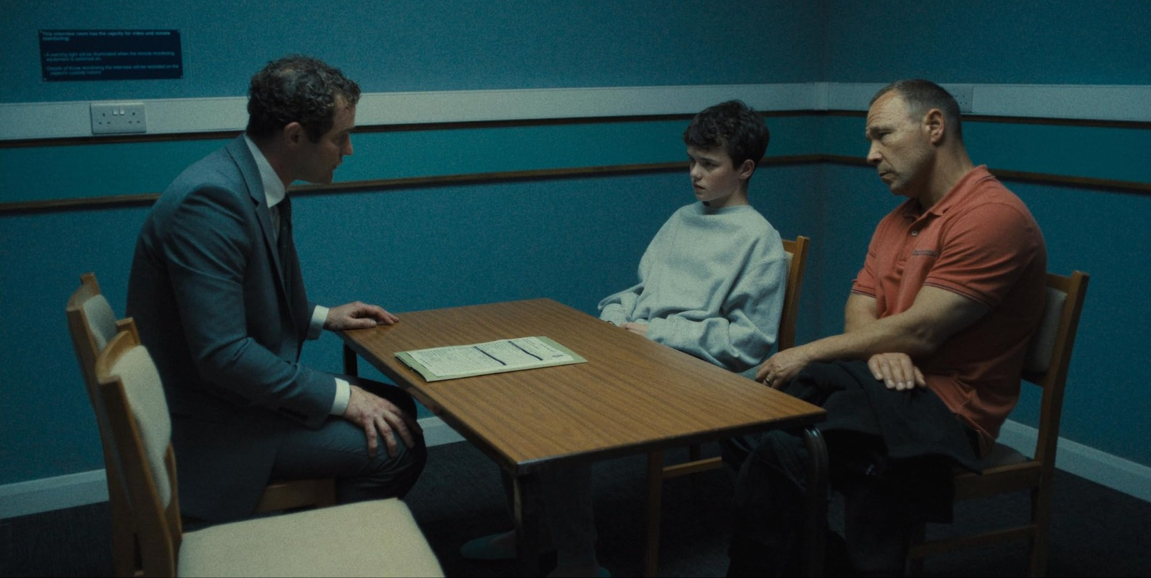
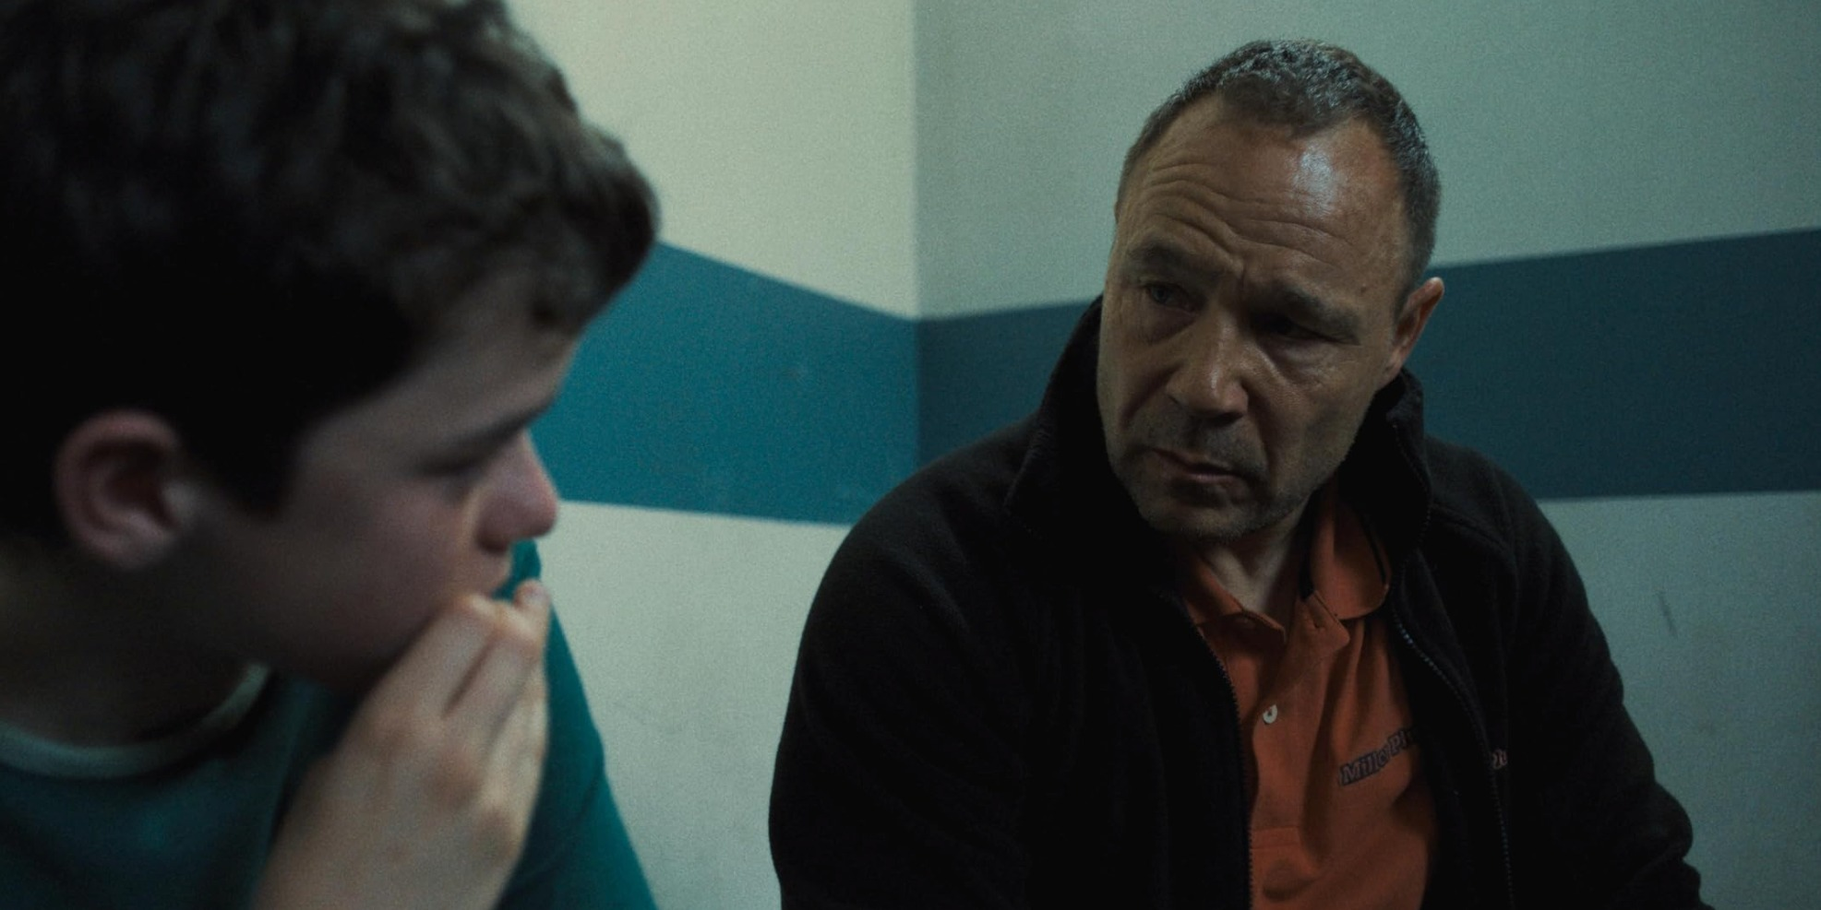
CAMERA POWER · THE REPRESENTATION TURN
CAMBRIDGE'S OWN EXERCISE
Four questions of one extract
01
Who is shot from below?
02
Who is shot from above?
The frame gives them height, threat, or authority.
They look small, watched, and easy to judge.
03
Who gets the close-ups?
04
Who stays in the wide shot?
We are invited to share their thoughts and feelings.
They stay a figure in a situation, not a person we know.
The boy gets the close-up: we share his feelings
The wide shot holds the table: cold procedure
Over the shoulder: whose view we borrow
Adolescence (Netflix, 2025). No dialogue needed: what does the camera say about power here?
MEDIA STUDIES 9607 · SEMESTER I
04
Notes:
Straight from the Scheme of Work's camera bank. The trio is the PROPOSED extract spec made real: a visible hierarchy between characters, no dialogue dependency. Safeguarding: the series is BBFC 15 for clip screening; these stills are benign and already on the student site.

Slide 8
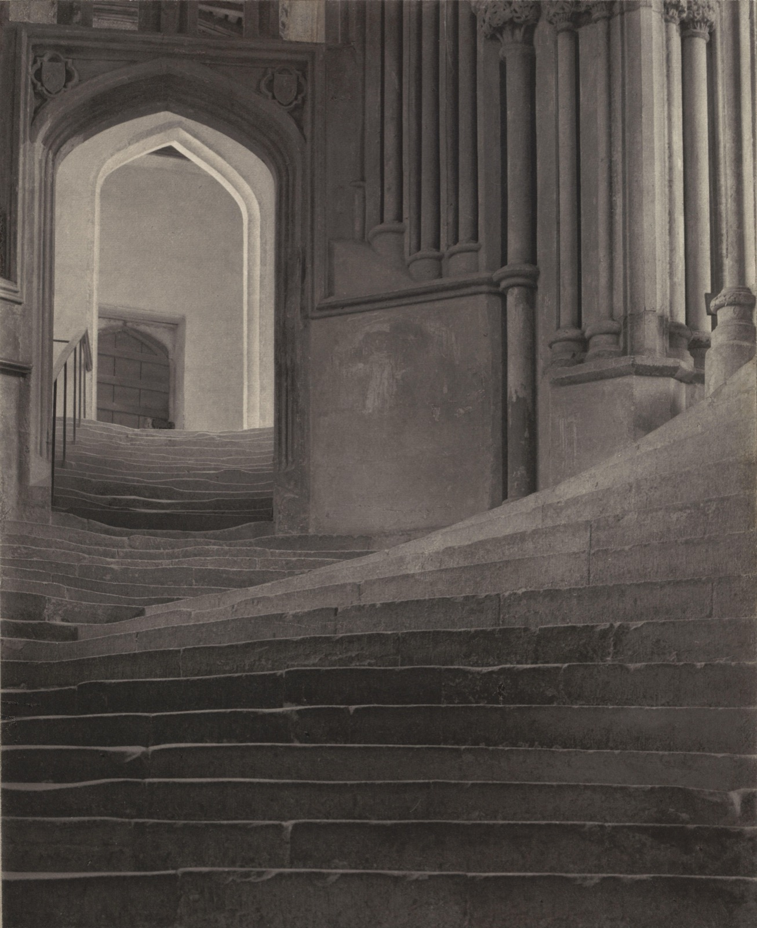
COMPOSITION
FRAMING · THIRDS · DEPTH
Nothing here is an accident
Framing
The arch makes a second frame inside the frame. Your eye goes where both frames point.
Leading lines
The steps form a path. Your eye follows it before you decide to.
Depth
Foreground stone, middle arch, far light. Three layers make the flat picture feel deep.
The rule of thirds
The bright doorway sits off center. Off center makes it a destination, not just an object.
Frederick H. Evans, A Sea of Steps, Wells Cathedral, 1903
Notes:
A photograph made about composition. Shown whole, never cropped: the composition is the content. Same four questions apply to any frame they shoot tomorrow. The dead-centre counter-example is next lesson's Grand Budapest concierge desk: centred on purpose, and the purpose is the point.

Slide 9
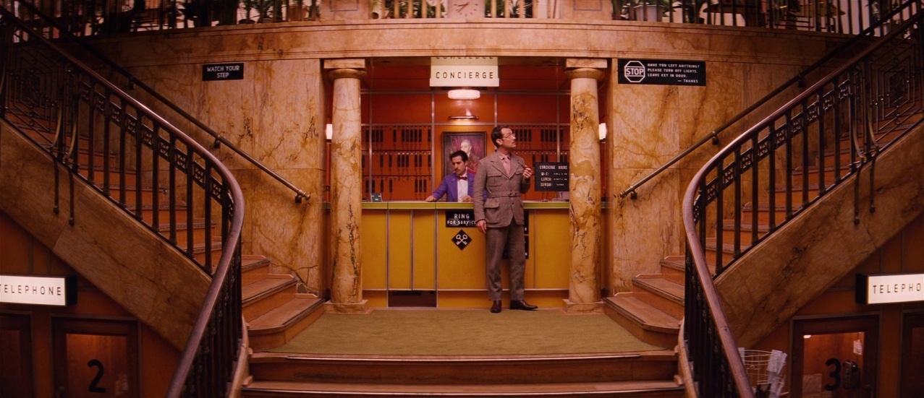
DEPTH OF FIELD
FOCUS IS A CASTING DECISION
Shallow focus: the boy is sharp, the officers blur away. Adolescence (Netflix, 2025)
Deep focus: steps, desk and key rack all sharp. The Grand Budapest Hotel (2014)
TERMS Shallow focus: one face sharp, the rest blurred. Deep focus: everything sharp at once.
EFFECT Focus controls where you are allowed to look. A focus pull moves that choice mid-shot.
MEDIA STUDIES 9607 · SEMESTER I
05
Notes:
The composition column's depth-of-field and focus-pull terms, given their frames. Tomorrow's hold-focus control is this slide inverted: autofocus makes the choice for you, badly.

Slide 10
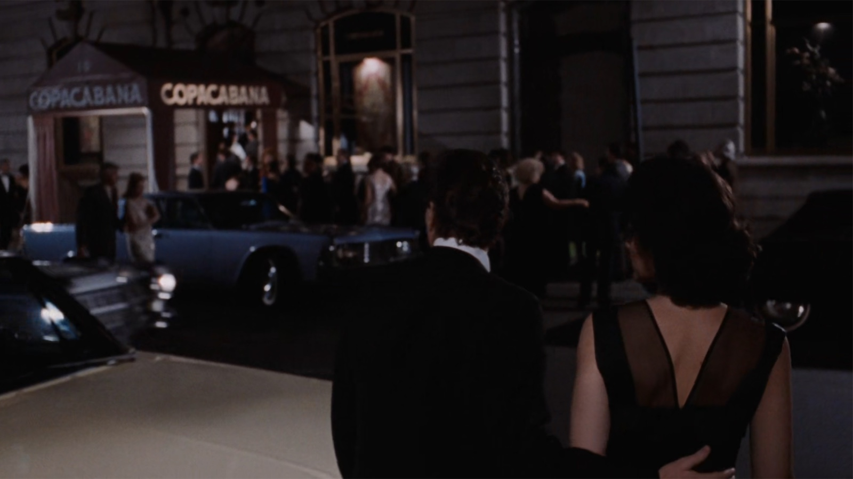
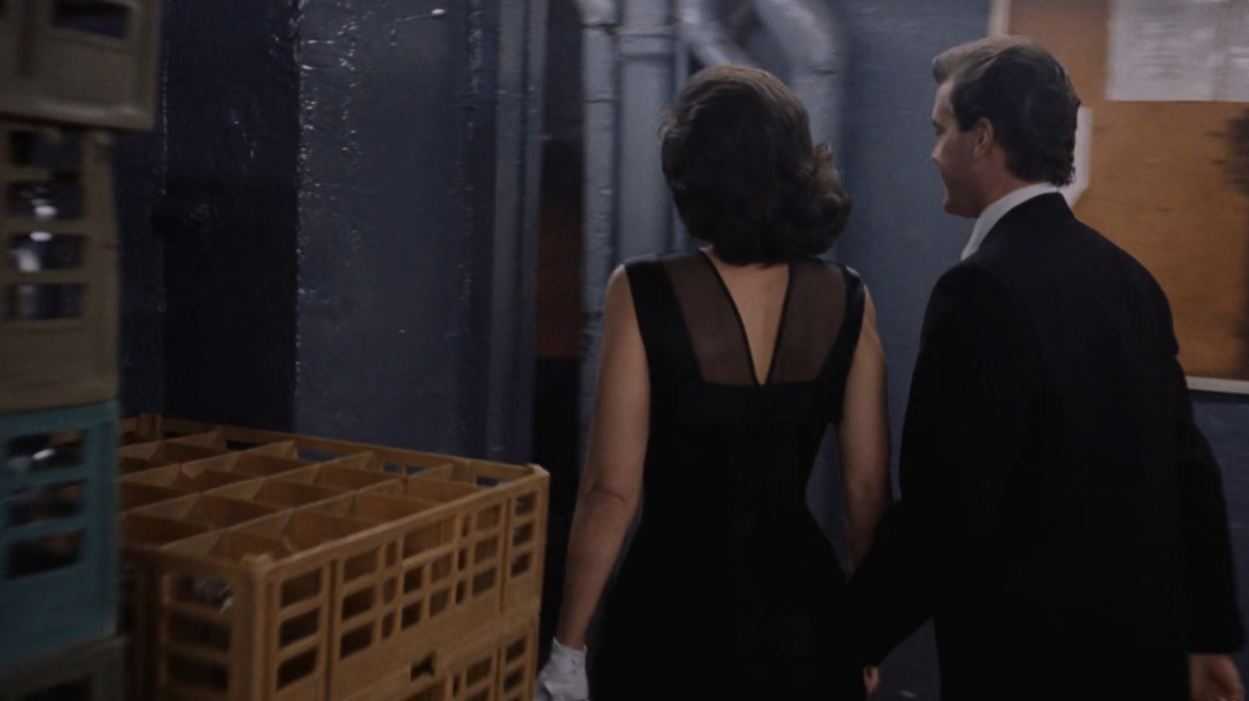
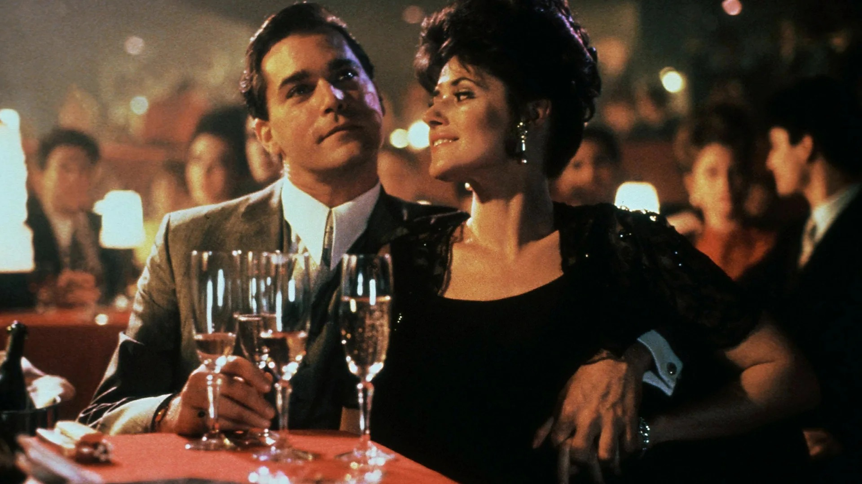
MOVEMENT
THE CAMERA REFUSES TO LET GO
One shot, three minutes, no cut
Past the queue, in at the side door
Down the corridor, no cut, still going
A table appears, front of the stage
TECHNIQUE Goodfellas (1990): one steadicam shot, three minutes, no cut.
EFFECT Doors open for Henry, and we enter as his guest. The unbroken movement means privilege and access.
EXAM SENTENCE “The continuous steadicam shot positions the audience inside Henry's privileged world.”
MEDIA STUDIES 9607 · SEMESTER I
06
Notes:
Steadicam is on the movement list they just met. Name the verb: the camera glides with him, refuses to cut away. Then the effect: his access becomes ours, which is why the shot feels like privilege. Three frames from one continuous take, dir. Martin Scorsese.

Slide 11
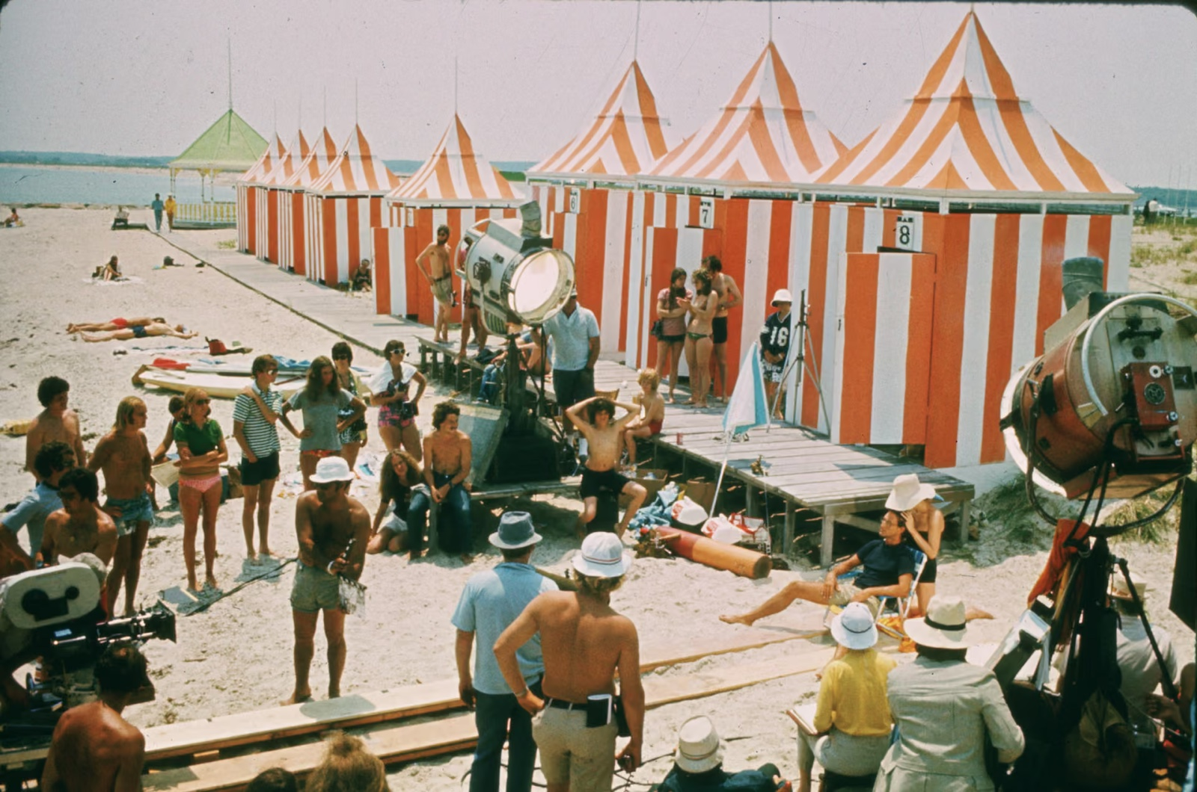
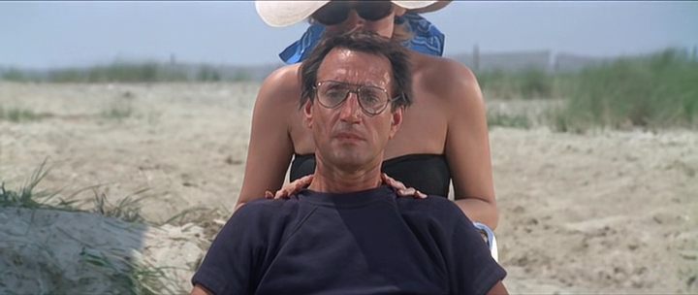
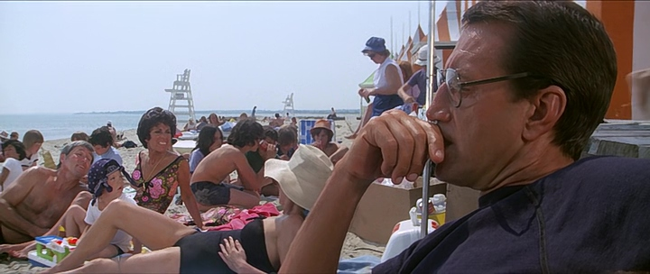
THE MACHINERY OF A MOVE
EVERY MOVEMENT IS BUILT
The rig, then the shot it makes possible
The beach set: lights, track, crew
The dolly zoom: the man stays the same size, the beach stretches behind him
TECHNIQUE Jaws (1975): the dolly zoom. The camera moves in while the lens zooms out.
EFFECT The background stretches behind a man frozen by shock. The world turns unstable.
MEDIA STUDIES 9607 · SEMESTER I
07
Notes:
The production still shows what a camera movement costs: track laid on sand, lights rigged at noon. The dolly zoom is two movements cancelling: the lens zooms out as the dolly pushes in, so Brody holds size while the background rushes away. The 480px single frame is retired; the pair brackets the moment. Dir. Steven Spielberg.

Slide 12
“
A series of short, self-contained exercises with camera (or even phone) can combine technical elements with story elements.
Cambridge Scheme of Work, Foundation Portfolio
IN PLAIN WORDS Short camera exercises, even on a phone, count as real practice. Tomorrow's shoot is one of them.

Slide 13
DELIVERABLE · CS3
THURSDAY, THE WHOLE SESSION
Six shots, your kit, posted before you leave
1
2
3
4
5
6
Establishing
MS on a character
Slow tilt up to reveal
CU on an object
Low angle, same character
POV
TASK In pairs, shoot this six-frame storyboard. No plot, no acting, no retakes. The exercise is the camera.
WRITE One line of intention per shot, using the syllabus terms.
MARKED ON Terminology, the three controls, and the intention line. Not on how good the footage looks.
THE BLOG Post it, dated, on your Component 1 blog. This post is not practice for the portfolio. It is the portfolio.
MEDIA STUDIES 9607 · SEMESTER I
08
Notes:
The storyboard's establishing shot and POV are the two the syllabus names that a still cannot rehearse; the tilt-to-reveal is the 2028 SoW's own practice exercise.

Slide 14
THREE CONTROLS, NON-NEGOTIABLE
EACH ONE IS A MARKING POINT
The three mistakes that ruin footage
☼
AF-L
01
02
03
Hold focus
Expose for the face
Frame to the thirds
Tap the screen to lock focus, then leave it. Autofocus jumps when anything crosses the frame, and jumping focus looks amateur.
Against a bright window, auto mode keeps the window and loses the face. Tap the face and lock. Let the window turn white.
Center everything and every shot looks the same. Put the subject on a third line and the frame gains direction.
LOOKING AHEAD The Grade 12 Component 3 video task uses exactly this vocabulary.
MEDIA STUDIES 9607 · SEMESTER I
09
Notes:
Phones are fine and often better: all three controls exist on a phone, and the drawn screens are exactly what the class will see. Circulate with one question only: what is that shot doing?

Slide 15
NEXT
Sound
Lesson 04. The screen goes black and we listen. Cambridge says most candidates neglect sound.
MEDIA STUDIES 9607 · SEMESTER I
10

