Slide 1
VII
MEDIA STUDIES 9607 · UNIT II
Integration and
the Planning Lock
Media Language · Lesson 07 of 19
Three days · Wednesday 30 September, then Thursday 8 and Friday 9 October after the break
Notes:
Four elements taught one at a time and shot one at a time. Wednesday locks the plans before the holiday; Thursday, back from the break, is where they stop being four lessons and start being one instrument.

Slide 2
VII
INTEGRATION
All four at once,
one pass.
Notes:
One extract, the protocol order, everything at the same time. That paragraph is A1 with the stakes off, six days early.

Slide 3
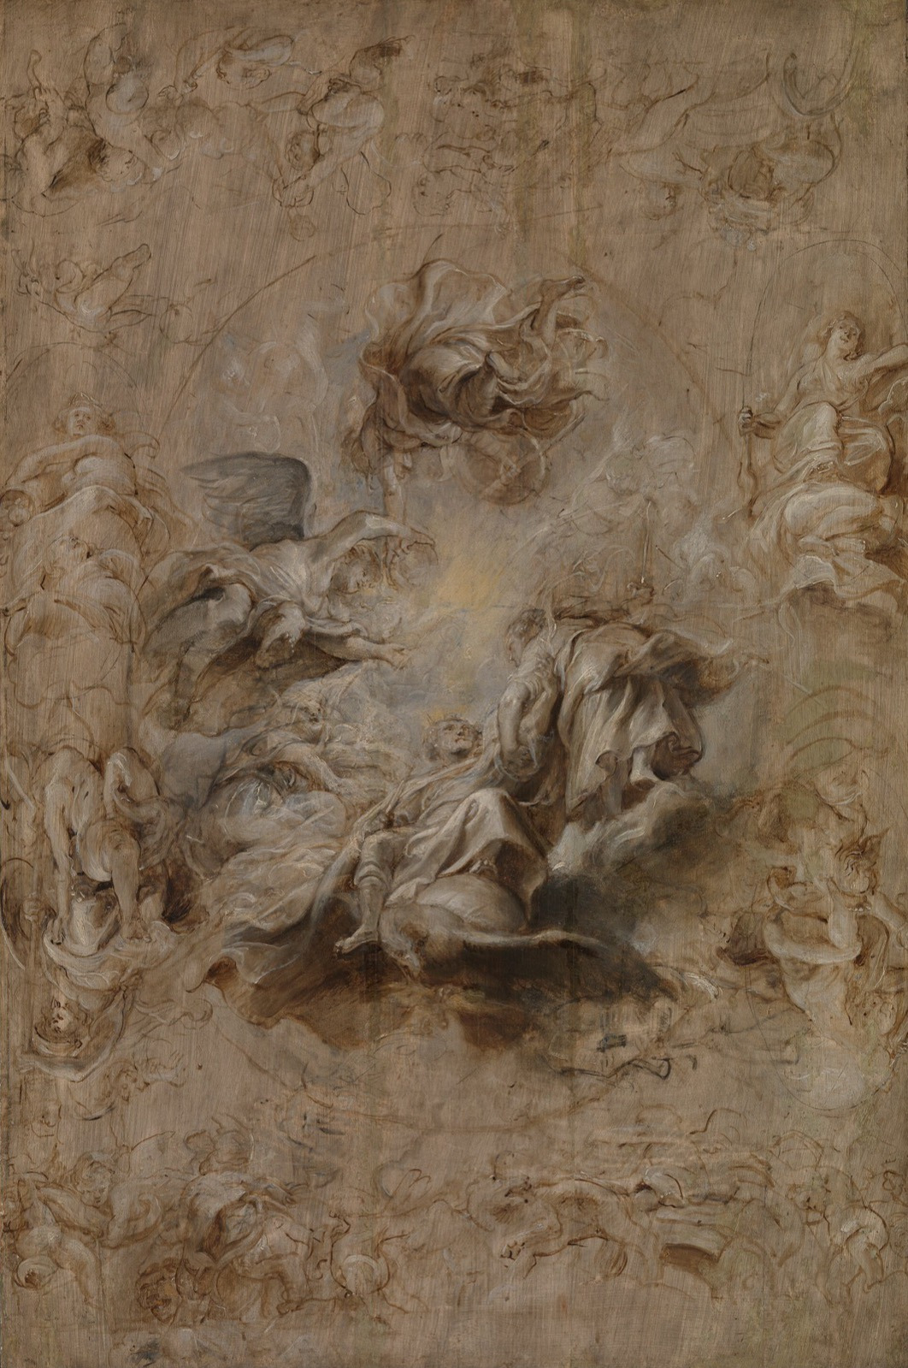
THE BAR
Painted from
the sketch
Rubens' assistants painted a whole ceiling from a sketch this size. The plan answered every question in advance.
THE STANDARD Your Component 1 plan is ready when a person who was not in the room could shoot it.
Rubens, Multiple Sketch for the Banqueting House Ceiling, c. 1629
Notes:
The Rubens sketch sets the standard for the lock: a plan complete enough to hand off.

Slide 4
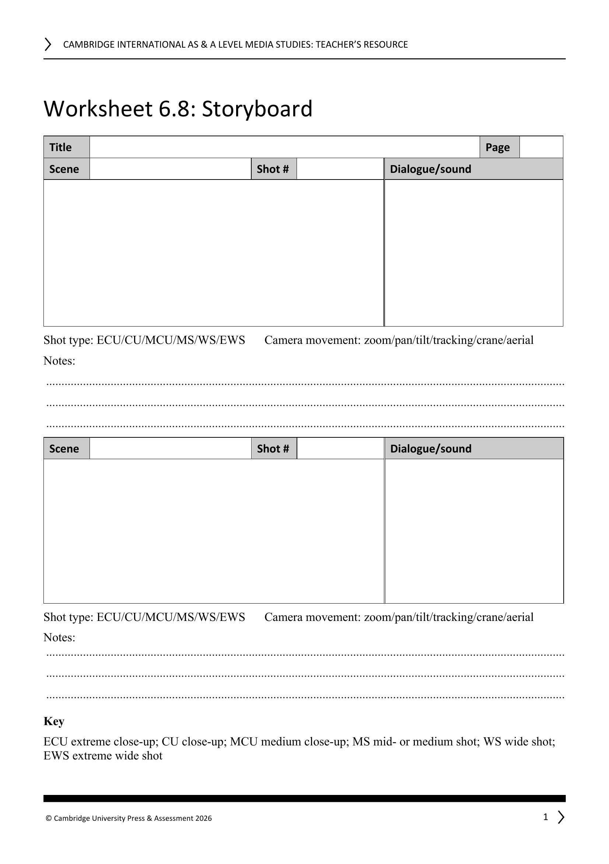
THE LOCK · TEN ITEMS
DESCRIBE, QUESTION, SUGGEST
The shootability checklist
01
Numbered shots
06
Assigned roles
02
Confirmed locations
07
Costume and props
03
Cast attached to dates
08
Storyboard matches shot list
04
Equipment per session
09
Schedule fits the break
05
A contingency day
10
No outside dependencies
THE RULE Ten green lights, or the plan does not pass. Locked means locked.
CHANGES Later changes must be written into the WS 6.4 production diary. No silent swaps. Equipment sign-out opens today.
WS 6.8, the storyboard sheet the plan is drawn on
MEDIA STUDIES 9607 · SEMESTER I
01
Notes:
Say the sentence explicitly: locked means locked. The WS 6.4 production diary is issued at the lock and harvested at L13; the equipment sign-out slips open Wednesday. Peer review runs describe, question, suggest with the group's own L05 design board open beside the plan.

Slide 5
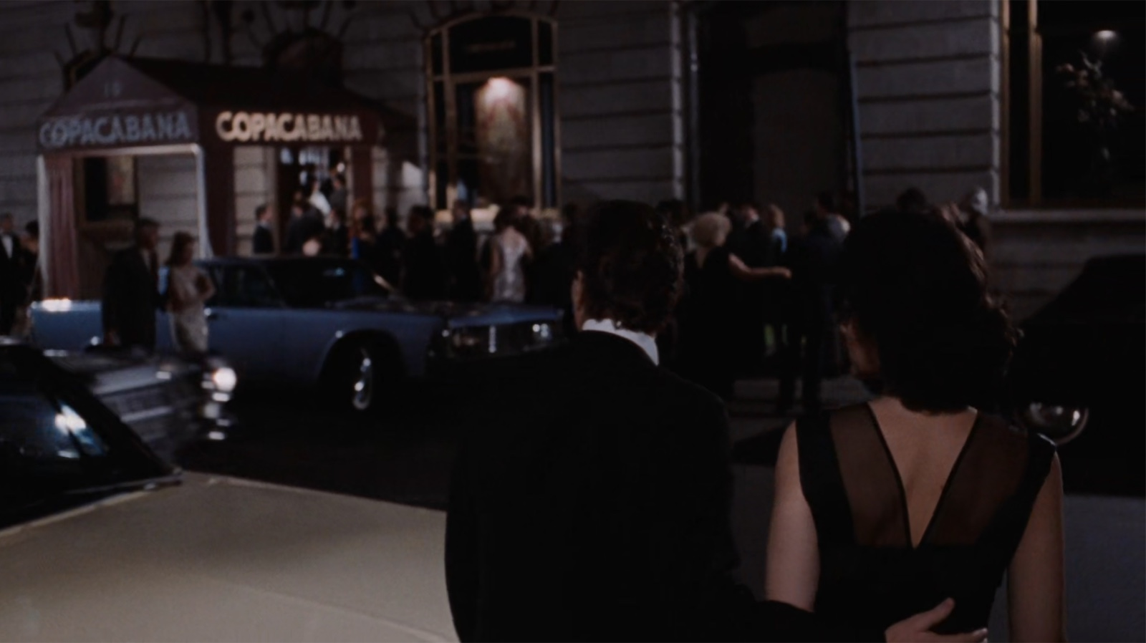
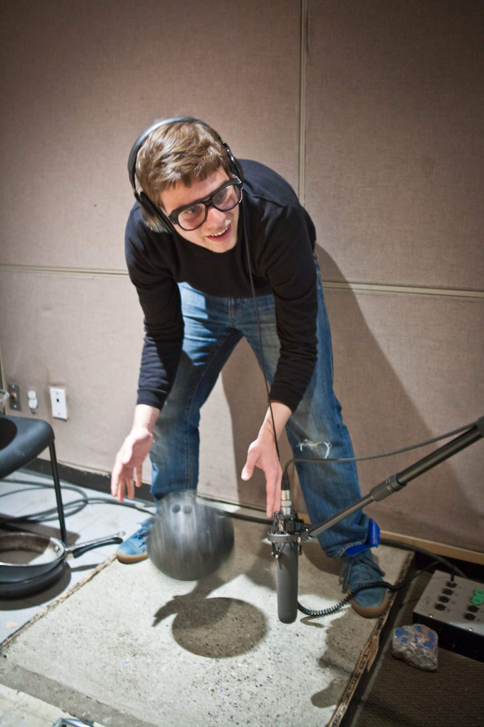
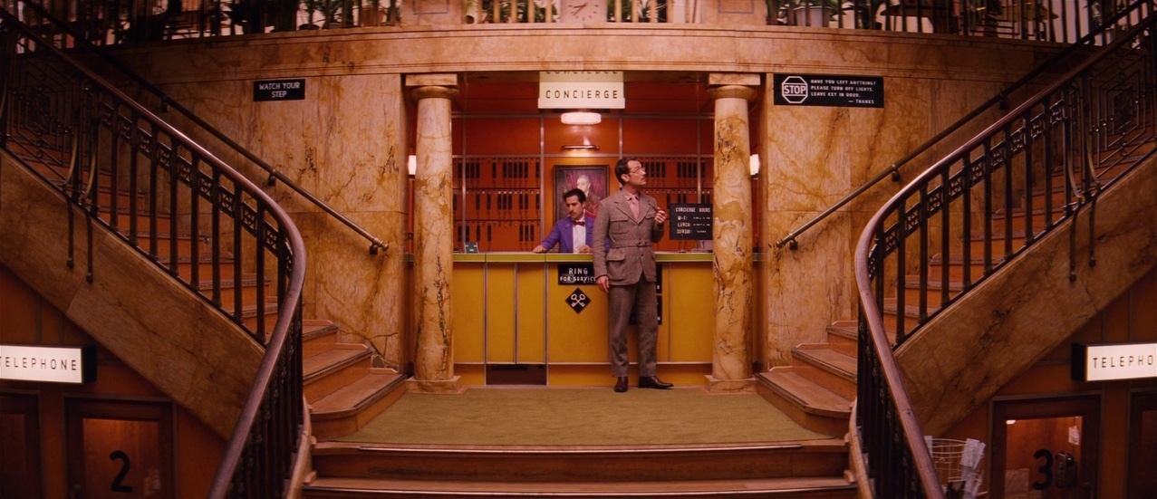
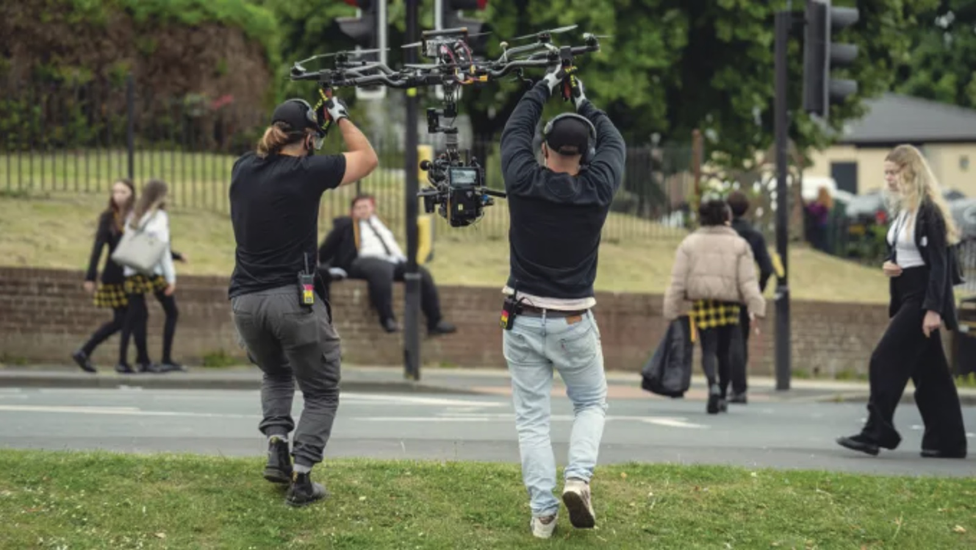
WHAT ARRIVES AT THE LOCK
FOUR BUILDS, ALREADY DATED ON THE BLOG
CS3 · Camera
a shot vocabulary, proven on six frames
CS4 · Sound
a soundscape for this opening, already built
CS5 · Design
a board the reviewer holds beside your plan
CS6 · Edit
a workflow tested, and a kit that works
MEDIA STUDIES 9607 · SEMESTER I
02
Notes:
The four frames are the ones the technical decks taught with: the room has already read every one of them. Reviewers keep the group's own design board open beside the plan; costume and properties must match it, or one of the two is wrong. Foley photograph: Vancouver Film School, CC BY 2.0.

Slide 6
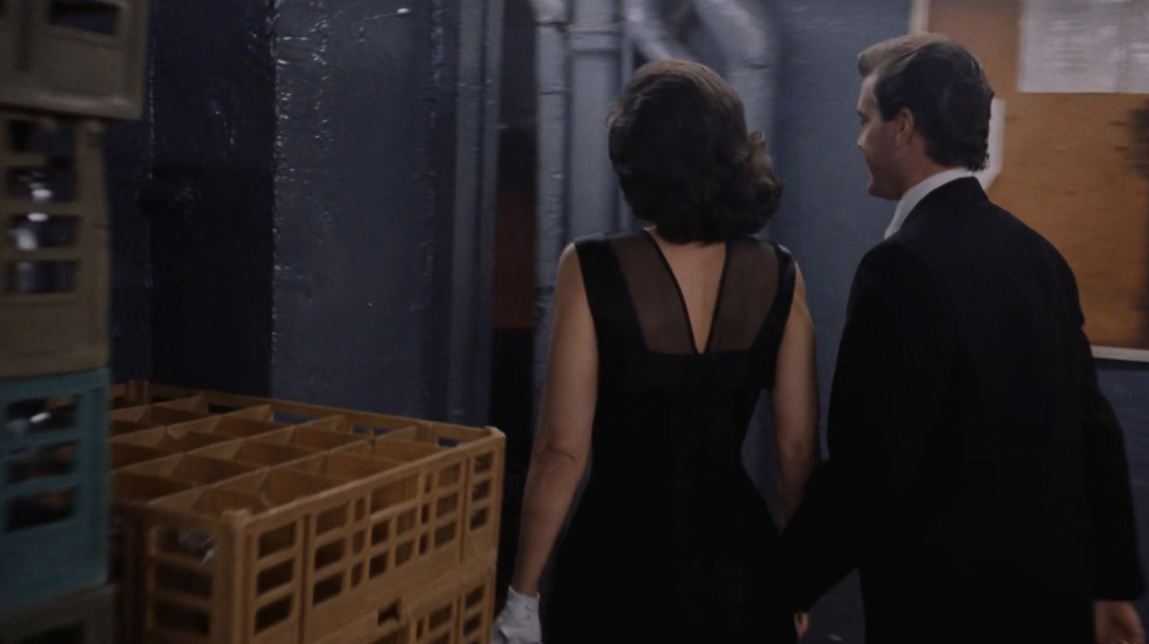
THE MODELLED READ
ONE FRAME THE ROOM ALREADY KNOWS
Everything at once, in order
1 · Framing
A narrow service corridor. The club floor is kept out of frame.
2 · Camera
Steadicam, eye level, gliding forward without a cut.
3 · Light
Bare bulbs, warm and uneven: a working space, not a showroom.
4 · Mise-en-scène
Crates, steel counters, kitchen uniforms: the back route in.
5 · Sound
The still cannot show it: the song plays over, the kitchen clatters under.
6 · Edit
No cut for three minutes. The unbroken take means privilege.
Goodfellas (1990), dir. Martin Scorsese. The Copacabana take, mid-corridor.
MEDIA STUDIES 9607 · SEMESTER I
03
Notes:
Ten minutes, teacher aloud, in protocol order, including one scripted moment of honest not-knowing: I do not know what that is called, so here is what it does. The class saw this shot in Lesson 03 as movement; today it is everything at once.

Slide 7
THE VIEWING PROTOCOL
SAME ORDER, EVERY EXTRACT, FOR TWO YEARS
Six passes, always in this order
1
Framing
What is in the frame, and what has been kept out of it.
2
Camera
Shot, angle, movement, composition. Lesson 03.
3
Light
Direction, quality, contrast, and what it makes important. Lesson 05.
4
Mise-en-scène
Location, costume, properties, colour. Lesson 05.
5
Sound
Diegetic and non-diegetic, perspective, the bridge. Lesson 04.
6
Edit
The cut rate, the system, what the order does. Lesson 06.
WHY THIS ORDER The most common failure is not ignorance. It is forgetting a whole code family. The order prevents that.
MEDIA STUDIES 9607 · SEMESTER I
04
Notes:
Modelled once on screen, then the room runs it: first extract read aloud in order, second extract twice with a cut count. Both extracts are PROPOSED content; note the chosen texts and timecodes here before teaching.

Slide 8
“
The principle here is to break down an extract from a TV drama into its component parts and then reassemble them in order to reach some insights into how it produces particular meanings.
Cambridge Scheme of Work, Component 2 Section A
IN PLAIN WORDS Take the extract apart into its four elements, then put it back together to see how it makes meaning.

Slide 9
DELIVERABLE · CS7
THURSDAY, FIFTEEN MINUTES
One paragraph, at least three elements
01
Technique named
in the syllabus's own term, not a description of it
02
Meaning created
what the choice does to the viewer, stated as an effect
03
Representation
what it therefore says about the person, place or event
MARKED Written in exam style and collected. Marked in the official Paper 2 language, so the feedback transfers straight to A1.
MEDIA STUDIES 9607 · SEMESTER I
05
Notes:
Fifteen minutes, exam register, collected. At least three of the four elements must appear. Marked in the five-criteria language; the margin notes transfer straight to A1.

Slide 10
THIS LESSON CARRIES
ONE PARAGRAPH, ONE BREAK TASK, TWO DATES
Four things go on the record
CS7
The four-element analytical paragraph on an unseen extract. Direct practice for A1, marked in the same language.
THU 8 OCT
HW1
Over the break: an A1-format analysis of a sequence you choose, plus your production shoot window.
SET WED 30 SEP
A1 announced
The first attainment, announced today because its notice window falls inside the holiday.
SITS WED 14 OCT
LB1
Blog punctuality across the four technical builds, HW1 returned on time, glossary current.
FRI 9 OCT
MEDIA STUDIES 9607 · SEMESTER I
06
Notes:
HW1 guardrails: not a taught text, A1 format exactly, three to four hours across the break including the shoot window. A1's announcement today keeps the notice window honest across the holiday.

Slide 11
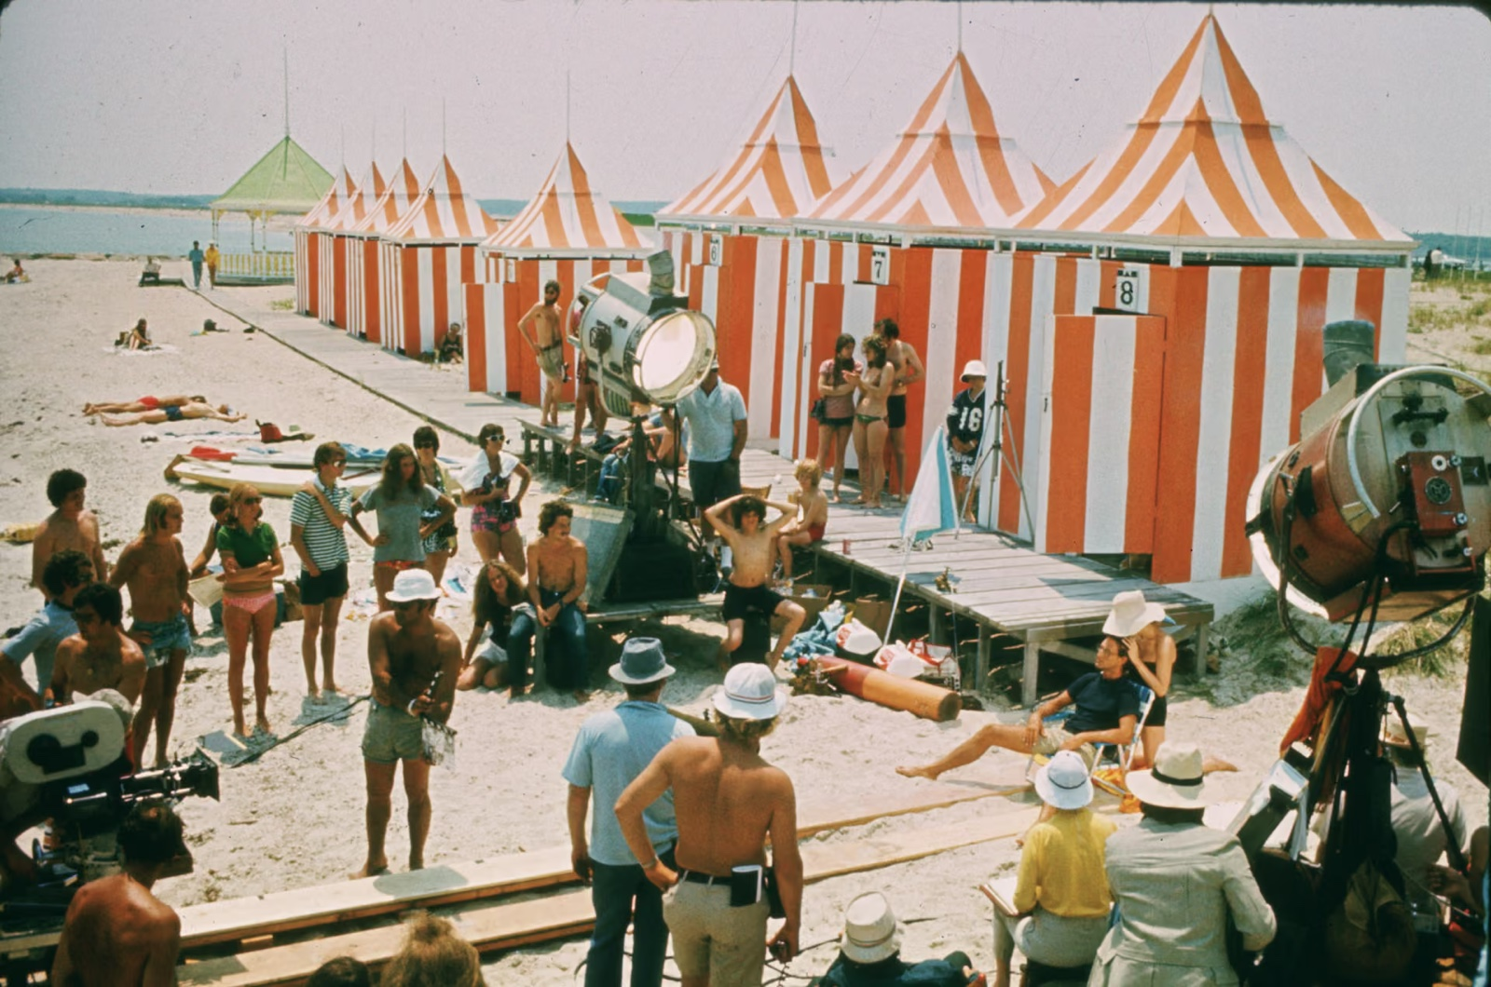
FRIDAY 9 OCTOBER · THE RETURN
NINETY SECONDS OF RAW FOOTAGE EACH
Name the one that failed, and why
TASK Screen ninety seconds of your raw footage. Using the syllabus terms, name one shot that worked and one that failed.
Exposure
Audio
A cut
lost on a bright background
recorded in a room nobody controlled
that will not match
Jaws (1975): the machinery a shot costs
Lesson 03
Lesson 04
Lesson 06
WHY TODAY This is the last day you can discover bad audio with two weeks left to reshoot.
HW1 Returned annotated, not graded. The margin notes are A1 feedback, five days early.
MEDIA STUDIES 9607 · SEMESTER I
07
Notes:
The three failure modes are the plan's own list. Annotated, not graded. The production photograph shows what a controlled shot costs: track on sand, lights at noon.

Slide 12
NEXT
The Viewing Protocol
and A1
Lesson 08. The lexicon tested, the paragraph built, then sixty minutes on an extract nobody has seen.
MEDIA STUDIES 9607 · SEMESTER I
08

