Slide 1
VIII
MEDIA STUDIES 9607 · UNIT III
The Viewing Protocol
and A1
Macro and Textual Analysis · Lesson 08 of 19
Three days · Mon 12 · Wed 14 (double) · Thu 15 October · the first attainment
Notes:
Four elements taught, four shot, one integrated paragraph written. This week converts that into a method that survives exam pressure.

Slide 2
VIII
THE CLAIM, NOW TRUE
Everything the prompt
names has been
taught, and shot.
Notes:
Until this build that sentence was false: sound and editing shared a fraction of the calendar and mise-en-scene had no session at all.

Slide 3
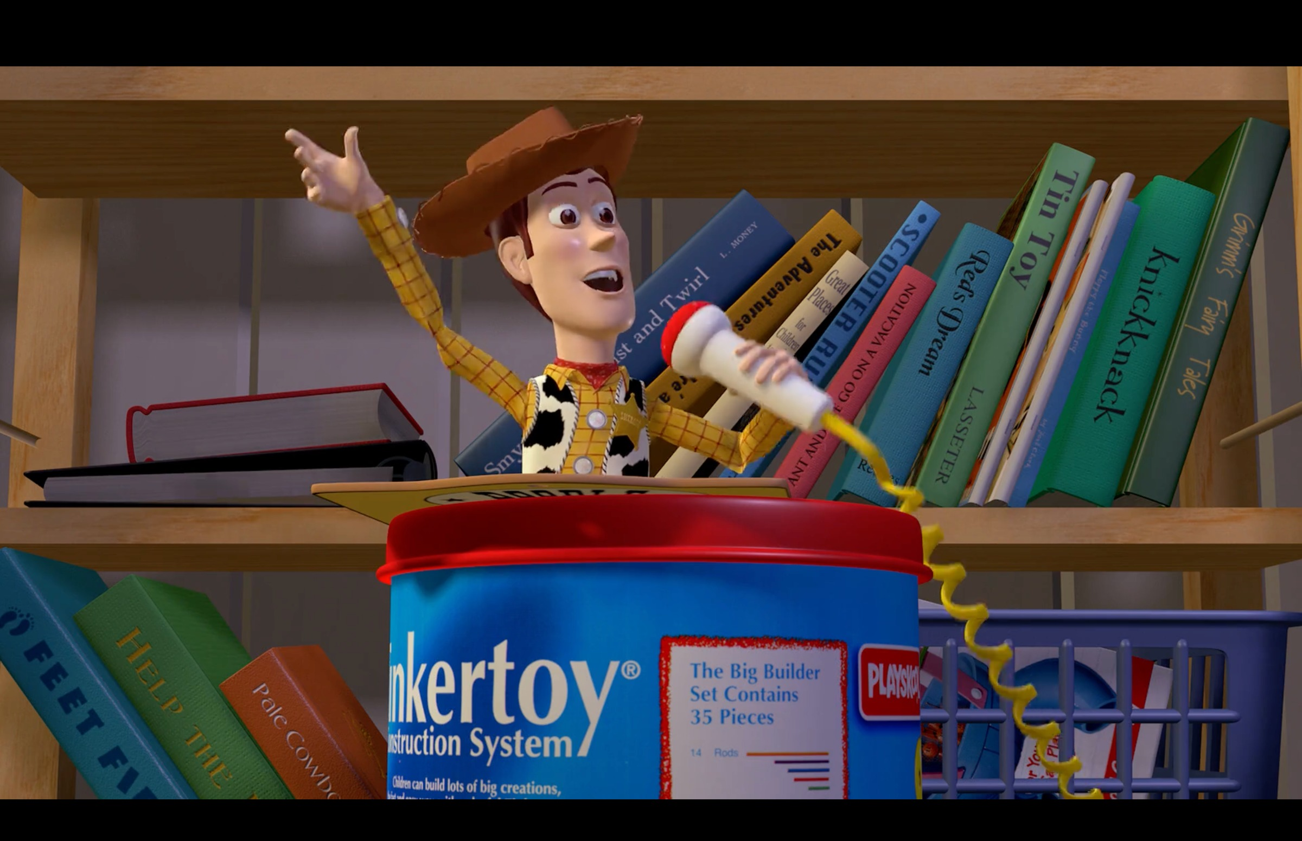
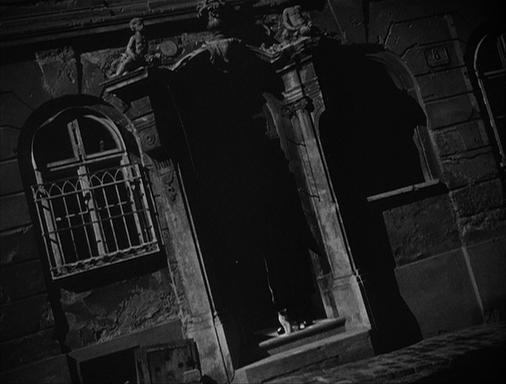
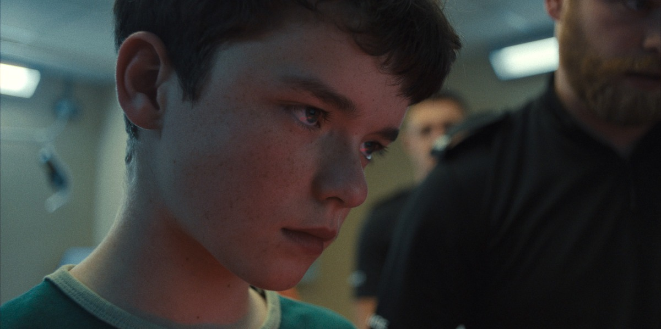
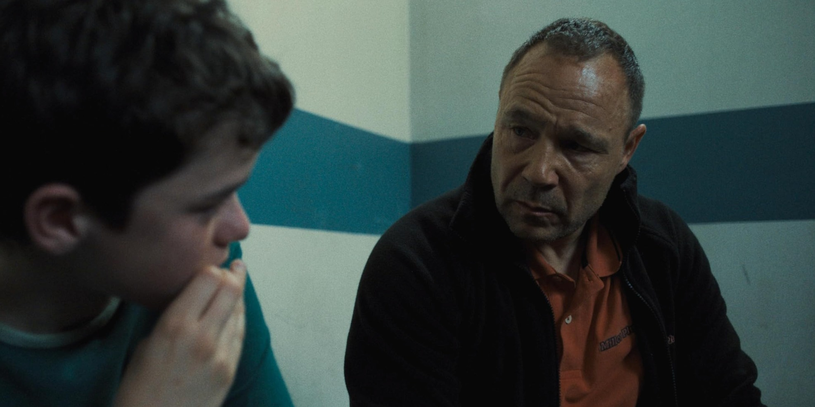
MONDAY · CS8
THIRTY ITEMS, TWENTY MINUTES
The whole lexicon, at last testable
name the focus
name the shot
name the lighting
name the angle
WARM-UP The answers: shallow focus, over-the-shoulder, high key, canted.
THE QUIZ Thirty items across all four elements. At least four each on sound and editing, because scripts forget those two.
Define the term
Label the example
Then self-mark
shot bridge, canted, high key, ellipsis, sound perspective
a named move, from a still or a short clip
immediately, against the definitions on screen
YOUR LIST Whatever you miss becomes your revision list for Wednesday.
ALSO MONDAY A2 announced: due Monday 26 October, blog posts 1 to 7 at the mid-point standard.
MEDIA STUDIES 9607 · SEMESTER I
01
Notes:
The A2 announcement sits on Monday, day one, exactly as the register requires; announcing it at the Wednesday sit would shortchange the notice window. Warm-up frames: Adolescence, Toy Story, The Third Man (the canted canon). The 30-item list is PROPOSED content; note where it lives.

Slide 4
THE SYSTEMATIC READING ORDER
SAME ORDER AS THE LOCK, AND FOREVER
The order is the discipline
1
Framing
what is in, what is out
2
Camera
shot, angle, movement
3
Light
source, direction, mood
4
Mise-en-scene
setting, props, dress, gesture
5
Sound
music, silence, diegetic sound
6
Edit
cut, pace, transition
The Ladder is complete: this order climbs rungs one and two. PEEM climbs the rest.
MEDIA STUDIES 9607 · SEMESTER I
02
Notes:
Six passes, identical to L07's list: narrative is not one of them. Narrative theory arrives at L10, after the sit, because Section A's prompt asks for the four technical elements, not for narrative theory. (The full-Ladder claim is contested between L07 and L08 on the routines page; the deck follows the plan until that is settled.)

Slide 5
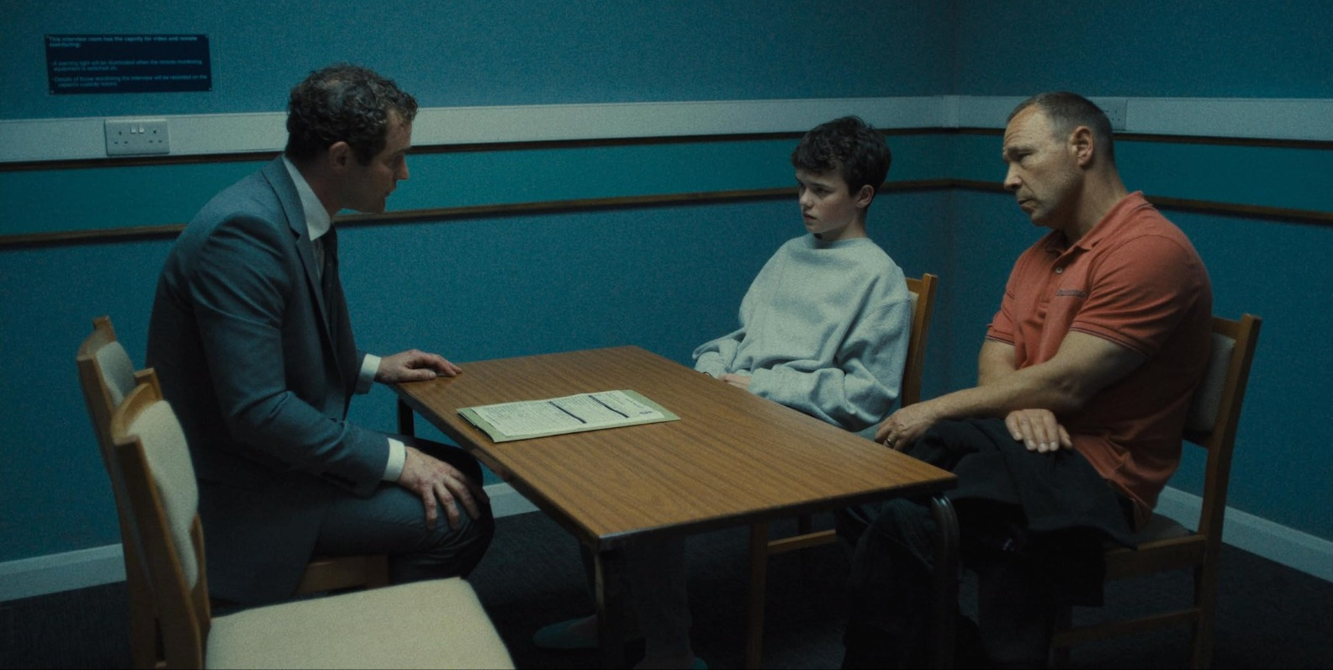
THE DISCIPLINE, APPLIED
ONE DENSE FRAME, READ IN ORDER
1 Framing
three figures, a table, an empty corner
2 Camera
wide, eye level, static: procedure
3 Light
cold, even, institutional
4 Mise-en-scene
the notice, the forms, the sweatshirt
5 Sound
a still cannot show it: name that too
6 Edit
one take; the reframings do the cutting
Adolescence (Netflix, 2025): the interview room
KEY POINT Systematic reading is a habit, not a talent. Same order, every text, every time.
MEDIA STUDIES 9607 · SEMESTER I
03
Notes:
The frame the room mapped for code families at L02 returns under the exam's discipline: same still, deeper read. The rehearsal read on D2 runs on an unseen extract, twice, with a cut count.

Slide 6
PEEM
THE PARAGRAPH THAT PROVES
Prove, do not assert
Point
Evidence
Effect
Meaning
P
E
E
M
the claim you are making
pinned to a signifier in frame
what it does to the viewer
tied back to the concept
THE PROBLEM The most common A1 failure is assertion: a claim with no evidence, no effect, no link.
THE FIX PEEM. Every claim carries its evidence, its effect, and its meaning.
MEDIA STUDIES 9607 · SEMESTER I
04
Notes:
One worked example on the board (the next two slides), then one deliberately bad example where effect and meaning are the same sentence twice.

Slide 7
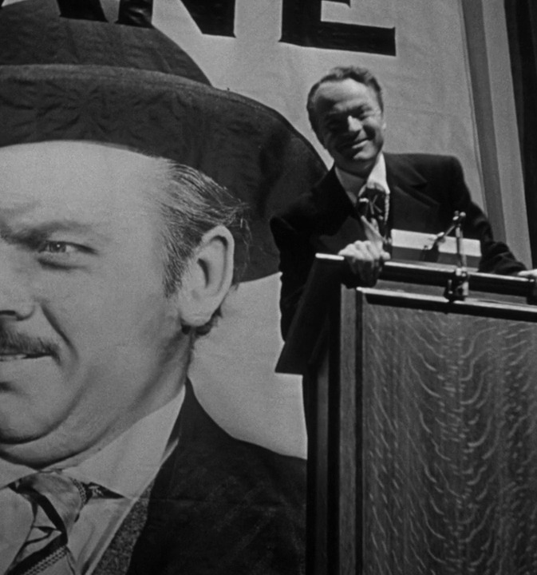
THE DEFECT TO DIAGNOSE
EFFECT AND MEANING COLLAPSED INTO ONE
If your two sentences
could swap places
The low angle makes him look powerful, which shows he has power in the scene.
One idea, written twice. The second half adds nothing new. Mid-band scripts are full of this.
EFFECT what the technique does to the viewer.
MEANING what it therefore says about the person, place, or event.
Citizen Kane (1941): the low angle the sentences argue about
MEDIA STUDIES 9607 · SEMESTER I
05
Notes:
The bad example matters more than the good one. Students cannot see this defect in their own writing until they have diagnosed it in someone else's. The frame gives the diagnosis a referent: Kane at the podium, the poster behind, the camera below the stage.

Slide 8
THE WORKED EXAMPLE
PEEM, ALL FOUR MOVES, ONE PARAGRAPH
What good looks like
The extract repeatedly frames the detective in low-angle mid-shots [Evidence]. This constructs his institutional authority [Point]. The viewer is positioned beneath him, so his power feels like a physical fact of the room [Effect]. The police are therefore represented as a power that does not need to argue for itself [Meaning].
CHECK No sentence could swap places with another. Each adds something new.
TASK Write the four labels in the margin of your CS7 rewrite. On Wednesday, the labels come off.
MEDIA STUDIES 9607 · SEMESTER I
06
Notes:
Board it live rather than showing it finished if time allows; the crossing-out is the teaching. Then Beat the Examiner lite on one specimen paragraph.

Slide 9
THE SCREENING PROTOCOL
THE PAPER'S RULE, OUR SPLIT
Four viewings, one extract
First
Second
Third
Fourth
1
2
3
4
JUST WATCH
CAMERA & EDITING
SOUND & MISE-EN-SCENE
THE INTEGRATED PASS
No notes: the paper's own rule. See the whole thing before you dissect it.
Track the technical codes: shots, angles, movement, cuts, pace.
Music, silence, diegetic sound; setting, props, dress, gesture.
Meaning assembled: what the extract argues, and which codes carry it.
THE PAPER'S RULE Four screenings, and no notes during the first. Cambridge fixes only that.
OUR SPLIT The per-viewing focus is this course's method. Use it because it works.
MEDIA STUDIES 9607 · SEMESTER I
07
Notes:
The old fourth-viewing label (narrative and meaning) was a pre-rebuild residue; narrative is L10's business, after the sit. The honest label is the integrated pass.

Slide 10
HOW A1 IS MARKED
IN THE OFFICIAL PAPER 2 LANGUAGE
Five criteria, best-fit, 0 to 5 each
AO
Criterion
Band
AO1
Media Concepts: language and representation
/5
AO1
Contexts and Critical Debates
/5
AO1
Use of Terminology
/5
AO2
Analysis of how meaning is created
/5
AO2
Use of Examples
/5
Band words: 5 Sophisticated · 4 Thorough · 3 Clear · 2 Limited · 1 Basic. So A1 is AO1 60 / AO2 40.
MEDIA STUDIES 9607 · SEMESTER I
08
Notes:
Marked with WS 4.6's rubric and comment bank, banded in the official Paper 2 five-criteria language. The per-criterion band descriptors on WS 4.6 are centre-authored, not Cambridge's; the criteria and band words are Cambridge's own.

Slide 11
WEDNESDAY, FULL CONDITIONS
Sixty minutes.
One unseen extract.
The question follows the Paper 2 stem: how does the extract construct meaning through camera, sound, mise-en-scene and editing? Everything since Week 1 counts.
Notes:
The extract shortlist is PROPOSED and sealed until the sit: no text taught to this cohort. The Your Honor paper stays unscreened, held for the L18 rehearsal per the release strategy.

Slide 12
ASSESSMENT · A1
THE FIRST ATTAINMENT
A1 sits Wednesday 14 October
FORMAT Sixty minutes, full exam conditions. Media language analysis of an unseen TV-drama extract.
MARKED With the WS 4.6 rubric, in the official five-criteria language. It transfers straight to Paper 2.
RETURNED Scripts come back within five working days.
Personal code checklists, built at L02, are returned at the door on the way in.
MEDIA STUDIES 9607 · SEMESTER I
09
Notes:
A2 was announced Monday (see slide 3): due Monday 26 October, posts 1 to 7 to the mid-point standard. Wednesday is the sit only; no announcements share it. Thursday P1 is the stakes-off re-run: retrieval, a fresh extract in protocol order, one PEEM paragraph to time, then Beat the Examiner lite.

Slide 13
NEXT
Genre
Lesson 09. Neale, Altman, and a genre claim defended with the codes you spent a month shooting.
MEDIA STUDIES 9607 · SEMESTER I
10

