Slide 1
X
MEDIA STUDIES 9607 · UNIT III
Narrative, Barthes
and the Blog Audit
Macro and Textual Analysis · Lesson 10 of 19
Three days · Wednesday 21 to Friday 23 October · A2 falls the following Monday
Notes:
The second macro element, and the audit that makes A2 survivable. Wednesday's double is the hinge of the whole month.

Slide 2
X
HOW THE MODELS ARE TAUGHT
Taught with the cases
where they fail.
Notes:
A top-band answer discusses where a model strains. The model fits perfectly is neither true nor interesting.

Slide 3
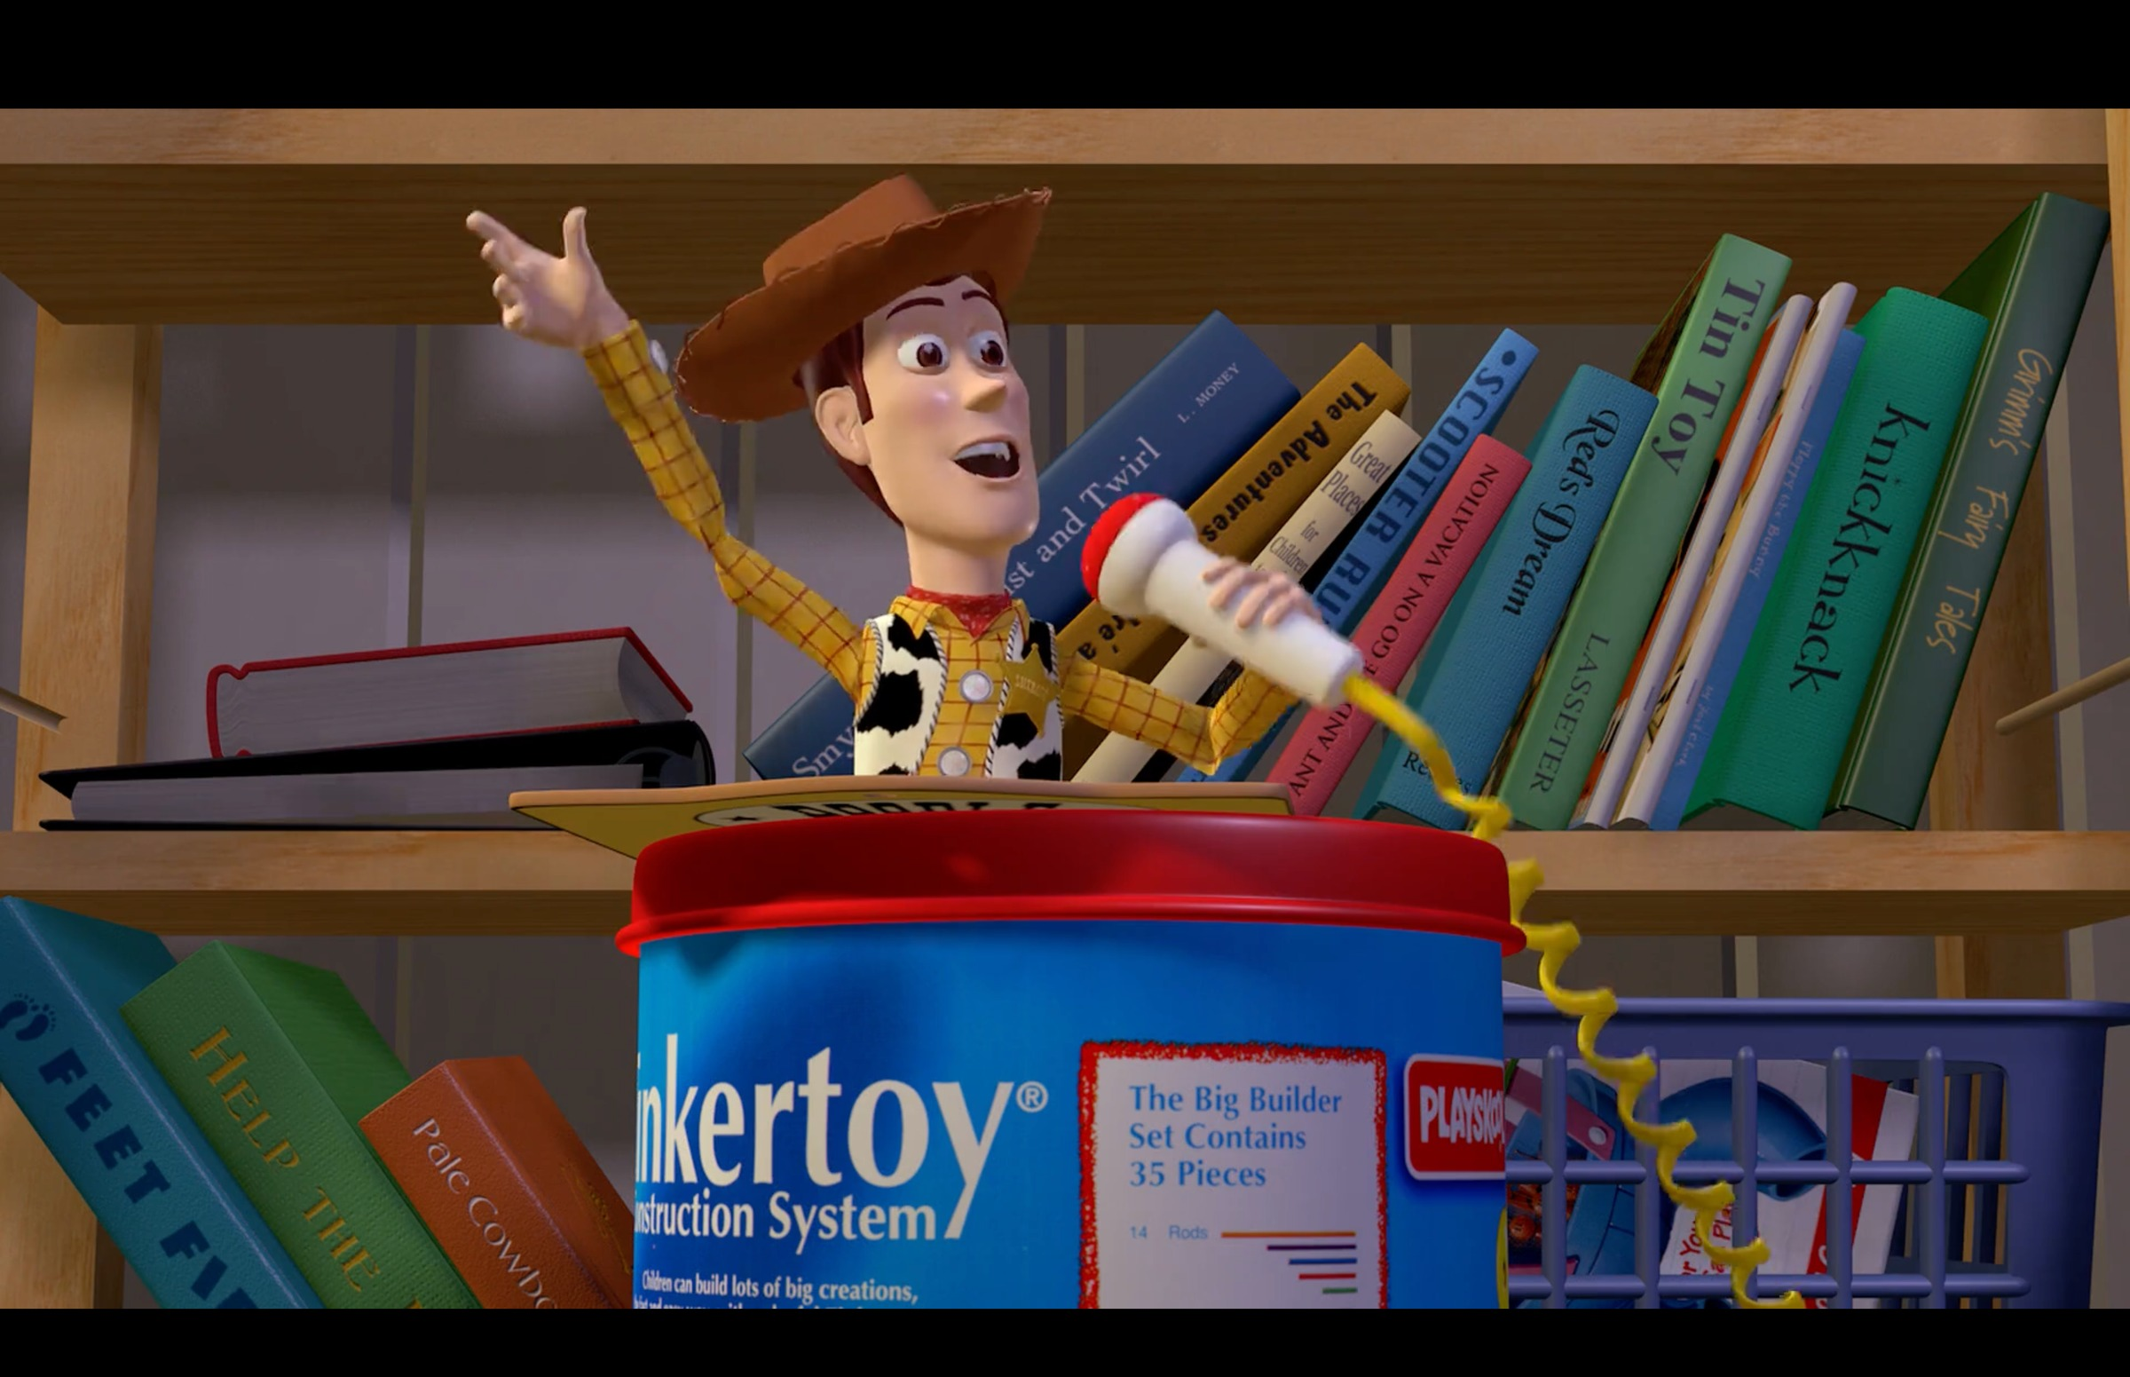
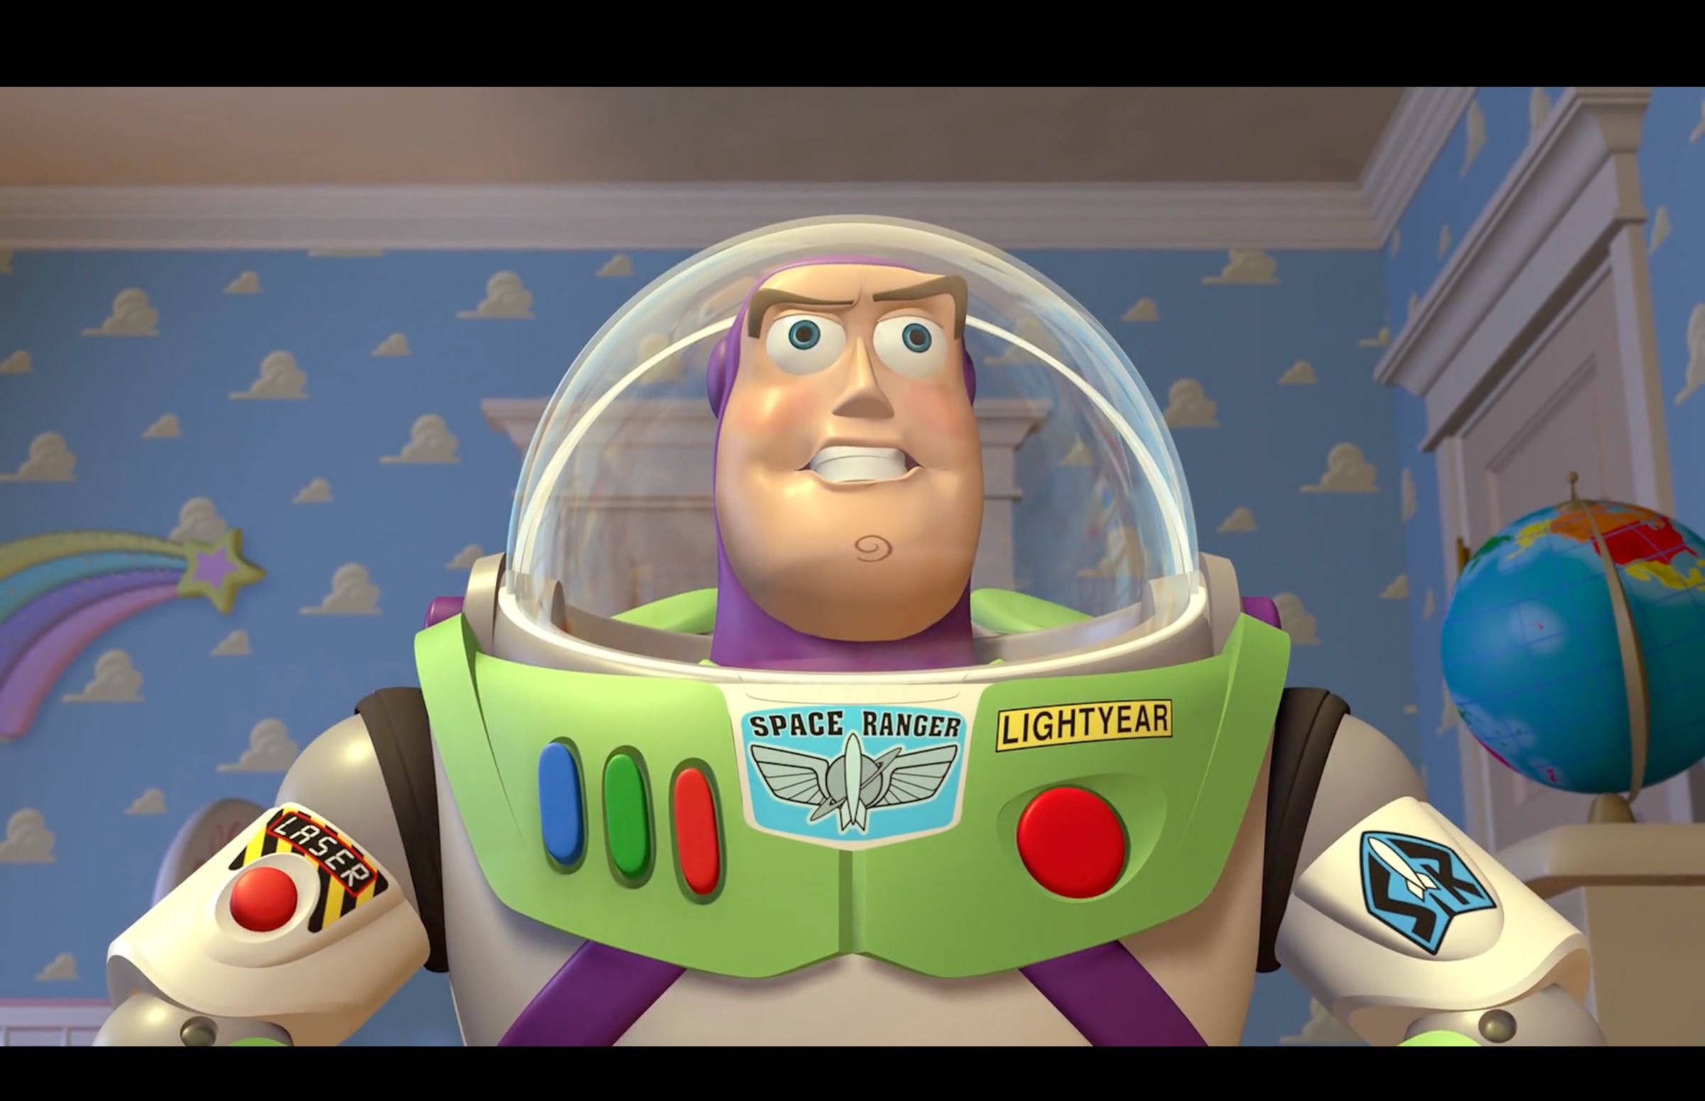
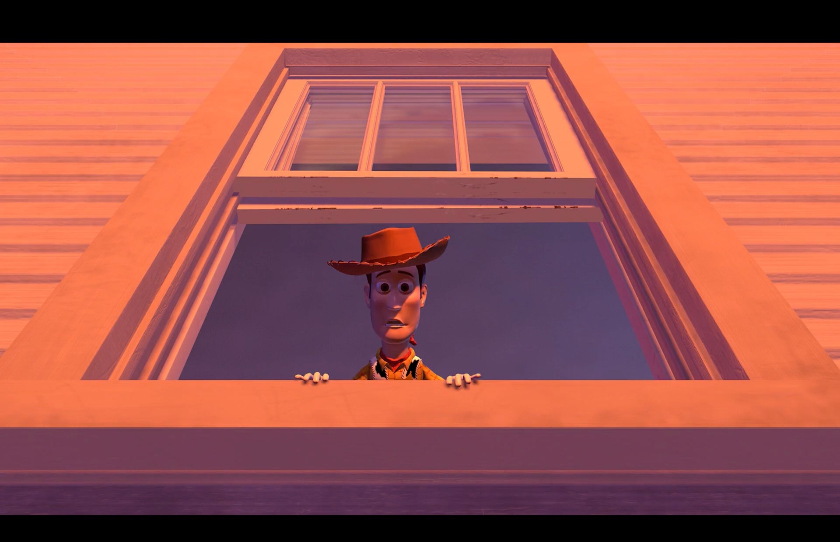
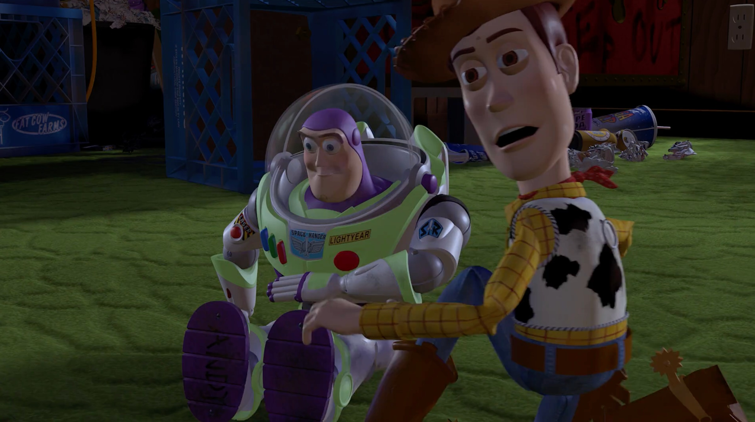
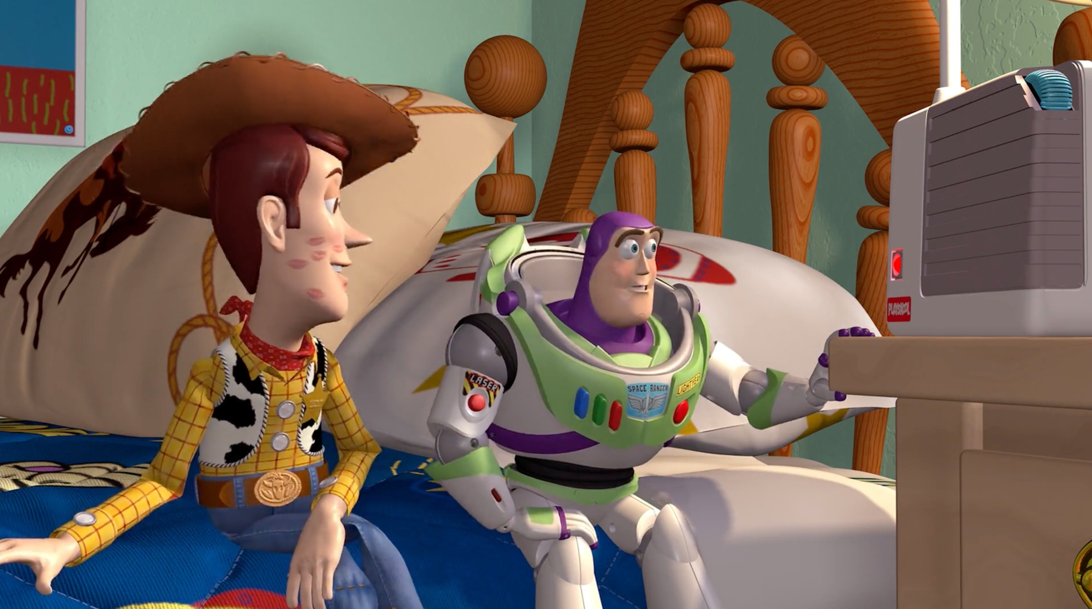
TODOROV · THE NARRATIVE ARC
WHERE IS THE DISTURBANCE IN YOUR OPENING?
Five stages, one movement
Equilibrium
Disruption
Recognition
Repair
New equilibrium
1
2
3
4
5
a stable world
a force breaks it
the break is seen
an attempt to fix
a changed calm
Toy Story (1995, Pixar/Disney): the coursebook's own worked arc, one frame per stage. Woody's world, Buzz's arrival, the window, Sid's room, the bed shared.
EXAM MOVE The model fails on non-linear stories. Saying where it fails is the top-band move.
MEDIA STUDIES 9607 · SEMESTER I
01
Notes:
Coursebook 3.2 teaches Todorov through Toy Story, so the frames match the reading students do. Run WS 3.2 as written: I-do on these frames, we-do on a second text, you-do on a story they know. The Christmas-window coda frame exists in img/ if you want the sequel joke: every new equilibrium is the next film's equilibrium.

Slide 4
“
The minimal complete plot consists in the passage from one equilibrium to another.
after Tzvetan Todorov, Structural Analysis of Narrative, 1969
IN PLAIN WORDS A complete story moves from one stable state, through disruption, to a new stable state.

Slide 5
PROPP · CHARACTERS BY FUNCTION
WHAT THEY DO, NOT WHO THEY ARE
Seven roles a story fills
Hero
seeks, and is tested
Villain
struggles against the hero
Donor
gives the hero a tool or gift
Helper
aids the hero on the way
Princess
the sought-for person or prize
Dispatcher
sends the hero out
Map this cast. Is Woody the hero, or act one's villain? Is Buzz a prize, a rival, a helper? Where Propp does not fit is your strain log's first entry.
False hero
claims the reward unearned
Propp studied folk tales in 1928, so apply him with care. Sort Wars: rebuild a scrambled tale from the cards. Then ask your own opening: who is your donor? Do you have one?
MEDIA STUDIES 9607 · SEMESTER I
02
Notes:
Binary oppositions follow via the TNS's worked Lupin table on the next slides: narratives run on conflicts of value, not just people. The strain log starts here and is harvested at L17.

Slide 6

THE ENIGMA CODE
You leaned in
THE FRAME White hair, tinted glasses, a borrowed name: the hero in disguise. Two questions pull you in. Will he be recognized? What is he here to take?
TERM The enigma code (Barthes): a question the text plants and delays answering.
TASK Your D1 table maps every question and promise this opening owes you.
Lupin, Part 3 (Netflix, 2023). Unit still
Notes:
D1: one TV cold open screened twice. First pass, list every question the text plants; second, every promise it makes. The TNS worked table for D1 is Lupin, so the frame and the table now match.

Slide 7
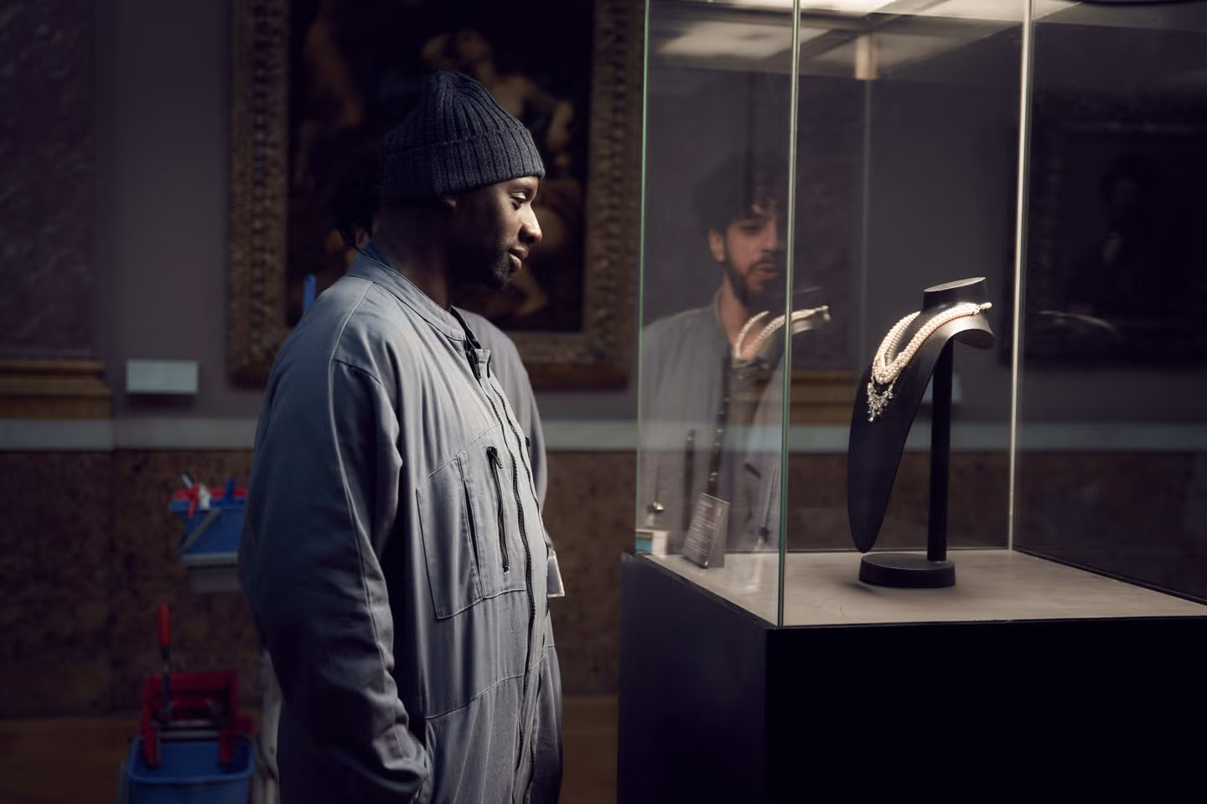
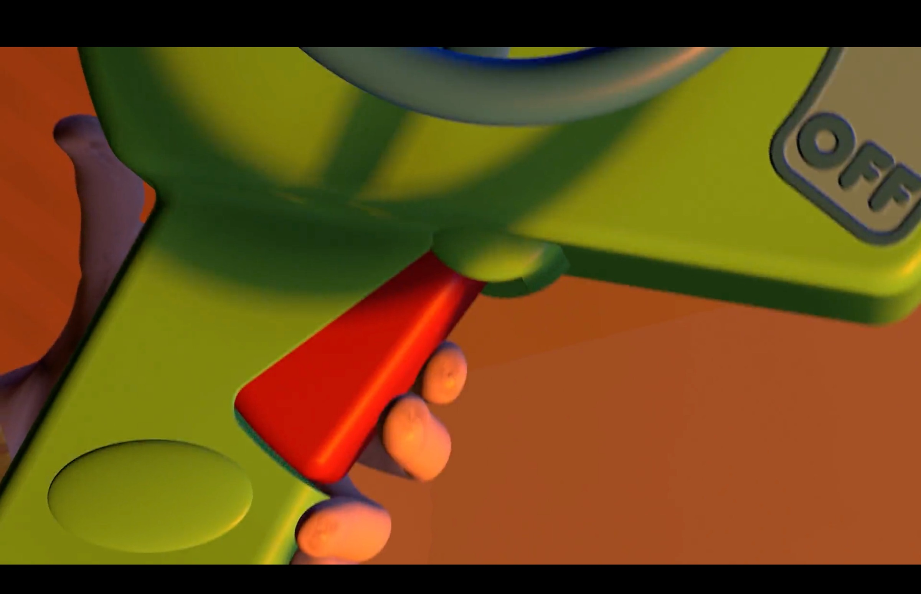
BARTHES · TWO OF THE FIVE CODES
THE QUESTION AND THE PROMISE
Lupin (Netflix, 2021): the cleaner nobody sees, at the necklace nobody guards
Toy Story (1995): a thumb on a trigger is a promise the scene must keep
Enigma code
Action code
The question a text plants and refuses to answer yet: who is he, what is he here to take?
The promise that something will happen, and soon: a loaded gun, a lit fuse, a pressed trigger.
MEDIA STUDIES 9607 · SEMESTER I
03
Notes:
The left frame owes you an answer; the right frame owes you a consequence. One makes you lean in with a question, the other with anticipation.

Slide 8
“
An enigma can be distinguished, suggested, formulated, held in suspense, and finally disclosed.
Roland Barthes, S/Z, 1970
IN PLAIN WORDS A story can hint at a mystery, state it, delay it, and finally reveal the answer.

Slide 9
BINARY OPPOSITIONS
NARRATIVES RUN ON CONFLICTS OF VALUE
One frame, four value conflicts
seen
vs
unseen
guardian
vs
thief
wealth
vs
service
light
vs
dark
TEST A real pair organizes the text: scenes, costumes, and settings line up on the two sides.
TASK Name your own opening's pair before Friday.
Lupin S1 E1 (Netflix, 2021): Assane at the glass display case
MEDIA STUDIES 9607 · SEMESTER I
04
Notes:
Run from the TNS's worked Lupin binary-oppositions table; the pairs on the slide are the frame's own, as prompts. Levi-Strauss via coursebook 3.2.

Slide 10
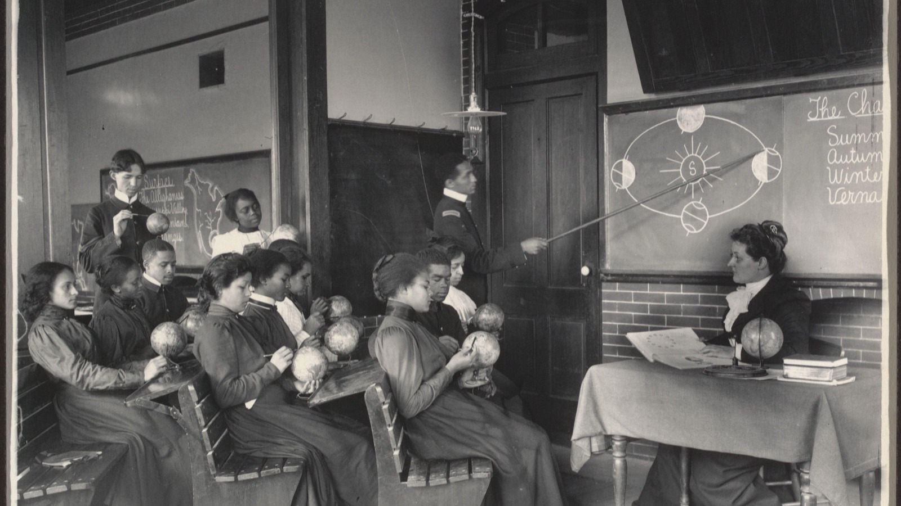
CS9 · THE BLOG AUDIT
Every blog read by a peer against the same checklist A2 is marked with, three days before it is due.
Frances Benjamin Johnston, a Geography class, Hampton, c. 1899
Notes:
The audit is A2's marking preview. It sits with working days to spare so there is still time to act on what it finds. Kept deliberately: the systematic-study mood image for the audit ritual; the checklist itself is the next slide.

Slide 11
CS9 · THE AUDIT
THE SAME CHECKLIST A2 IS MARKED WITH
Post by post, findings as actions
Brief and group
Research
Audience profile
Pitch
Planning suite
CS3 camera build
CS4 soundscape
CS5 design board
CS6 edit, both versions
Genre contract
Production log
Early evidence
THE STANDARD Every post dated on the day it happened. Contributions labeled. No gaps.
KEY POINT The four technical builds are Component 1 evidence. A blog missing them loses marks it already earned.
RULE Write findings as actions. “Add the survey screenshot to post 3” beats “more detail please.”
THE CLOCK Three teaching days to Monday.
MEDIA STUDIES 9607 · SEMESTER I
05
Notes:
Protocol is describe, question, suggest. Enforce findings-as-actions in the first five minutes or the audit degrades into politeness. Teacher circulates to the thinnest blogs first.

Slide 12
DELIVERABLE · CS9
THE AUDIT THAT MAKES A2 SAFE
Three teaching days to Monday
CS9 A peer blog audit, using the same checklist A2 is marked with.
WHY NOW Days to spare, on purpose. The deadline should surprise nobody.
A2 Submitted work, not an exam sitting. Due the Monday after this lesson.
MEDIA STUDIES 9607 · SEMESTER I
06
Notes:
A1 scripts also return Wednesday under the five-day rule: two minutes of silent reading, one written action each, the commonest gap named aloud from the pile.

Slide 13
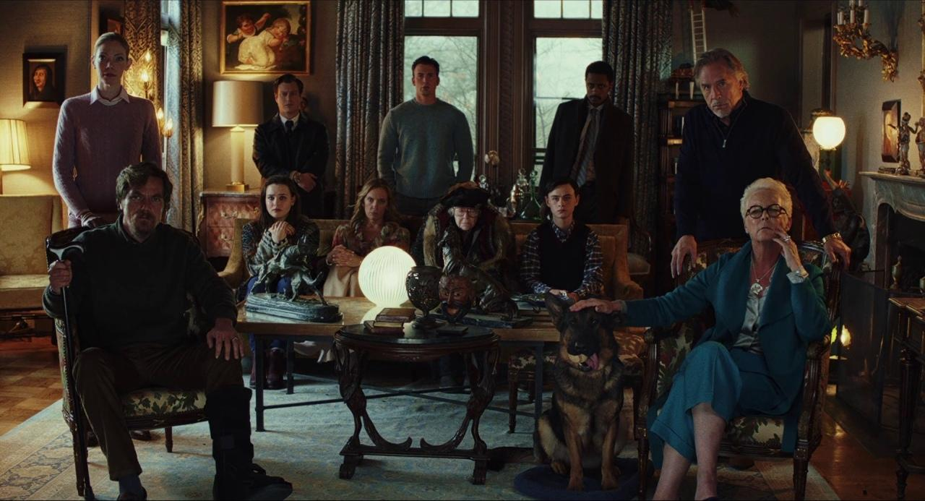
FRIDAY · NARRATIVE UNDER LOAD
THE STRAIN IS WHERE THE MARKS ARE
The exam sentence, rehearsed aloud
“Todorov's model illuminates X, although the extract complicates it by Y.”
KEY POINT The second half of the sentence earns the marks.
FIND Y Use your strain log: a false hero who is also the donor, a hidden villain, a story told out of order.
Coursebook 3.2 ends on Dil Chahta Hai: the arc fits, and the culture is not Hollywood's.
Knives Out (2019): Propp on a trailer. A hidden villain is a marketing decision.
MEDIA STUDIES 9607 · SEMESTER I
07
Notes:
D3: one contemporary trailer, cast mapped onto functions in pairs, then the harder question logged in writing: where did Propp fail to fit, and why is that interesting? Pairs trade logs to steal each other's best strain.

Slide 14
NEXT
Representation,
Applied
Lesson 11. A2 goes in on Monday, and representation turns on the product you are making.
MEDIA STUDIES 9607 · SEMESTER I
08

