Slide 1
XI
MEDIA STUDIES 9607 · UNIT IV
Representation,
Applied
Representation · Lesson 11 of 19
Five days · Monday 26 October to Monday 2 November
Notes:
Representation theory taught, then immediately turned on the students' own work, while there is still production time to fix what it finds.

Slide 2
XI
THE CLAIM
It constructs.
It does not reflect.
A media text builds a version of the world. It does not simply show the world.
Notes:
Representation does not reflect the world; it constructs a version of it, by selection and combination. Never objective.

Slide 3
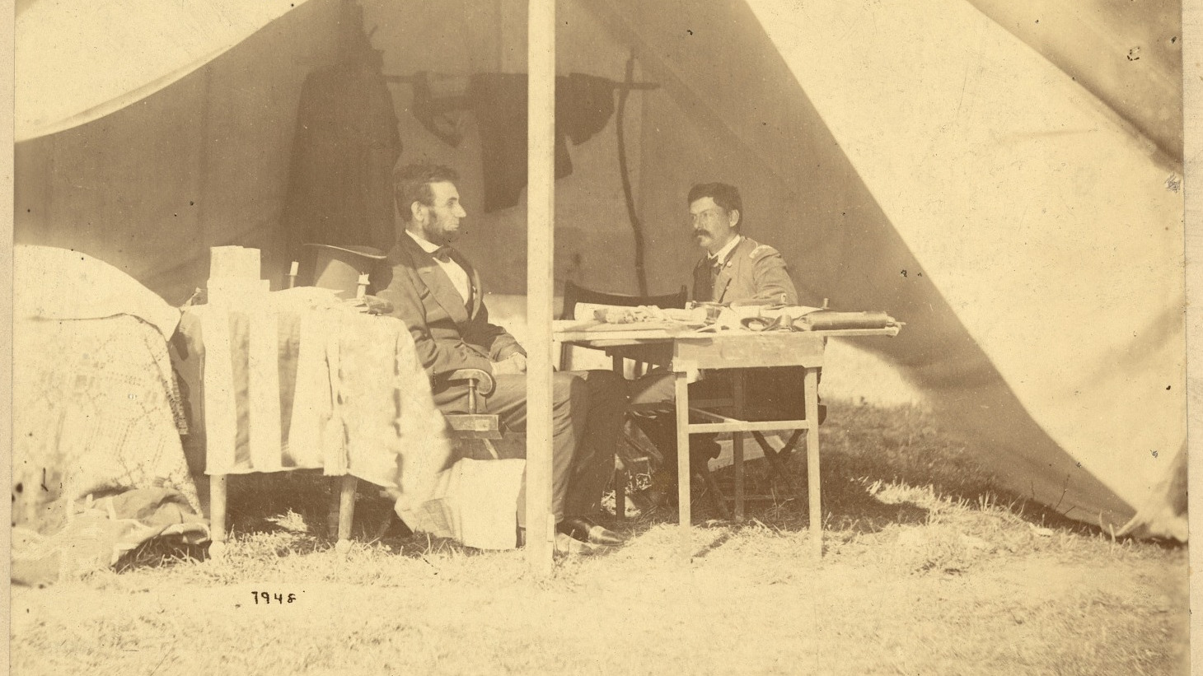
THE PHOTO-OP IS OLDER THAN THE WORD
The tent, the table, who sits and who stands: every choice is doing representation work.
Alexander Gardner, Lincoln and McClellan at Antietam, 1862
Notes:
Lincoln and McClellan posed in a tent at Antietam, 1862. The staged image of power predates the word representation as we use it.

Slide 4
“
Representation connects meaning and language to culture.
Stuart Hall, The Work of Representation, 1997
IN PLAIN WORDS How we show things in words and images shapes what they mean in a culture.

Slide 5
HOW CONSTRUCTION WORKS
NEVER OBJECTIVE
Selection and combination
Selection
Combination
What is chosen to appear, and what is left out. The frame is an argument before anyone speaks.
How the chosen elements are arranged together. Meaning is built from what sits next to what.
YOUR SENTENCE My Component 1 product represents ... as ... . Every day this week tests that sentence.
MEDIA STUDIES 9607 · SEMESTER I
01
Notes:
Coursebook 3.3's own phrase: never objective. The same-person-three-ways exercise (official portrait, news photo, fan edit of one figure the room knows) runs live after this; choosing the figure stays a classroom decision, per the plan's caution against active PRC political figures.

Slide 6
HALL · ENCODING AND DECODING
MEANING IS FINISHED IN THE AUDIENCE
Three reading positions
Dominant
Negotiated
Oppositional
The audience reads the preferred meaning the maker encoded, and accepts it.
The audience accepts the broad meaning but bends it to their own situation.
The audience understands the preferred meaning and reads against it, on purpose.
TASK Four Corners: dominant, negotiated, oppositional, or the center (abstain and justify).
CHECK Could your Component 1 product survive an oppositional reading?
MEDIA STUDIES 9607 · SEMESTER I
02
Notes:
One shared text on screen for the corners; a Downton frame from the next slide serves twice. Theory card: Hall.

Slide 7
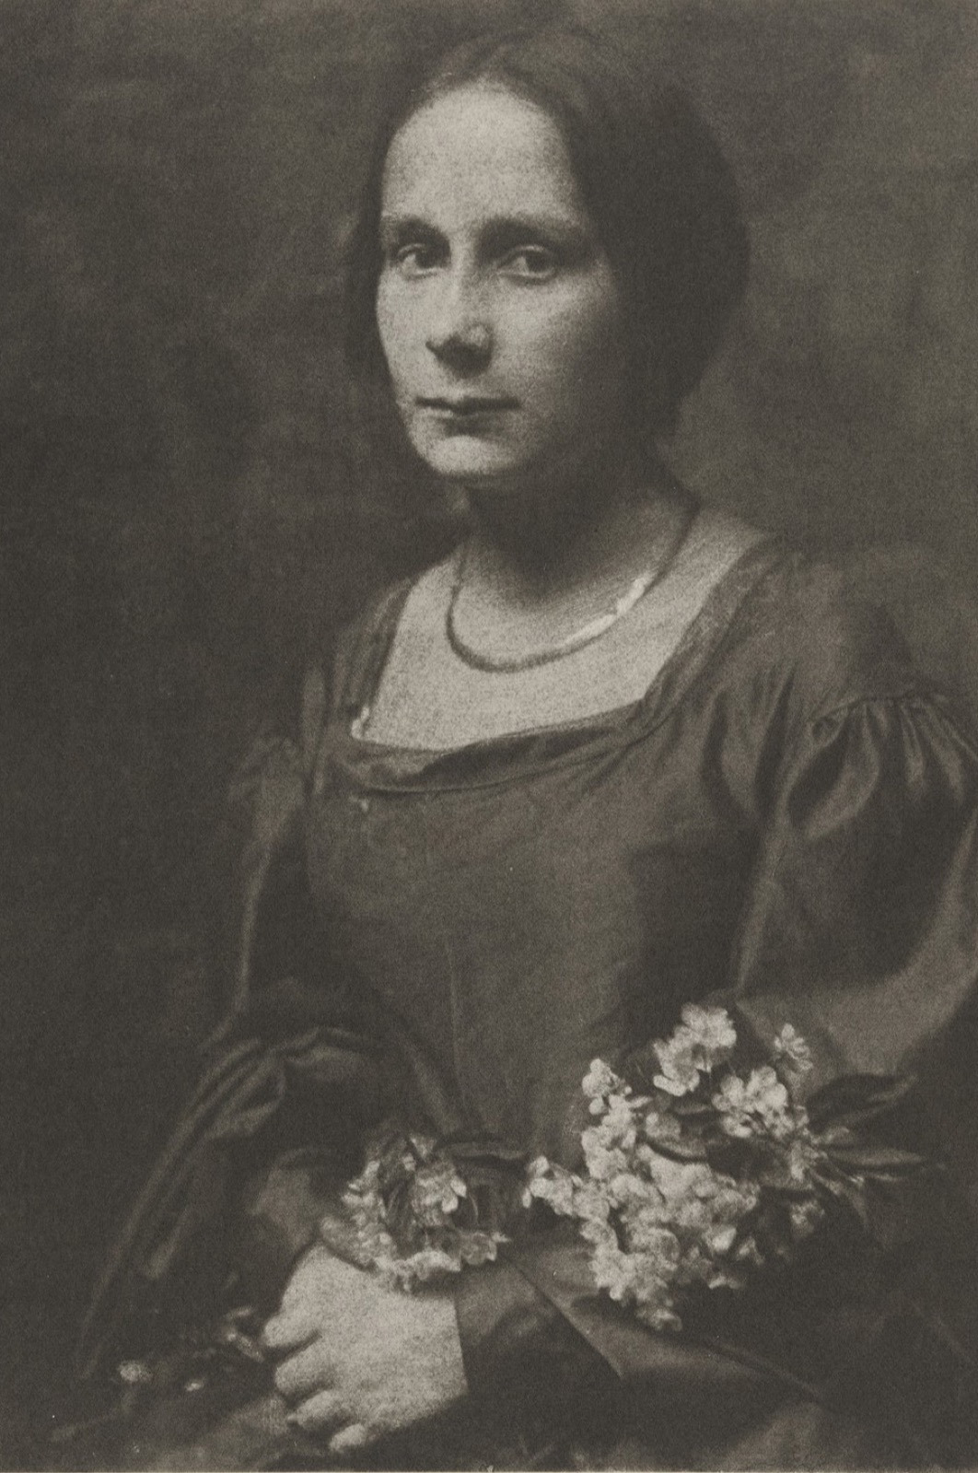
SAME PERSON, THREE WAYS
The person never
changed
A studio portrait is a built thing: pose, light, backdrop, retouching.
TASK Take one public figure and three images: official portrait, news photo, fan edit. List what each version selects, and what it wants you to conclude.
KEY POINT The construction changed. The person did not.
Gertrude Kasebier, a studio portrait, c. 1900
Notes:
A studio portrait models representation as construction. The three-image same-person exercise makes the point on a figure the room knows.

Slide 8
“
Stereotyping reduces, essentializes, naturalizes and fixes difference.
Stuart Hall, The Spectacle of the Other, 1997
IN PLAIN WORDS A stereotype shrinks a group to a few traits, treats those traits as natural, and freezes them there.

Slide 9
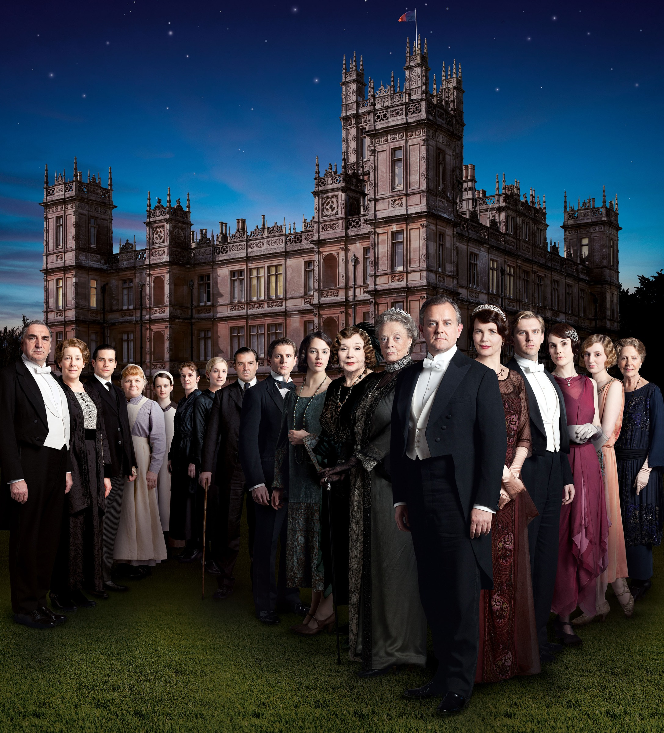
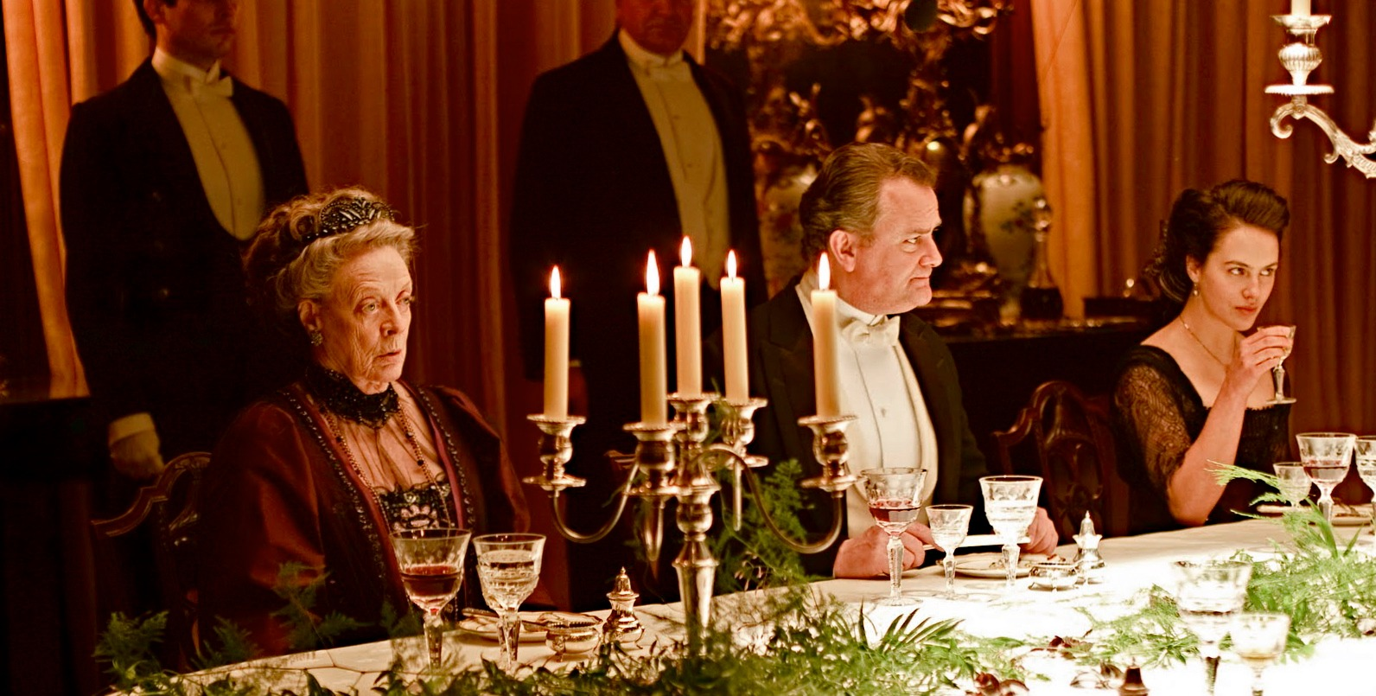
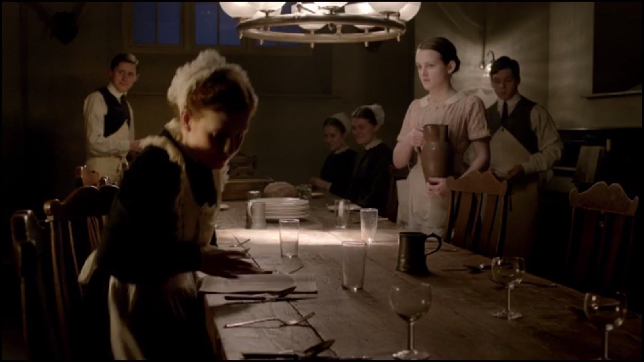
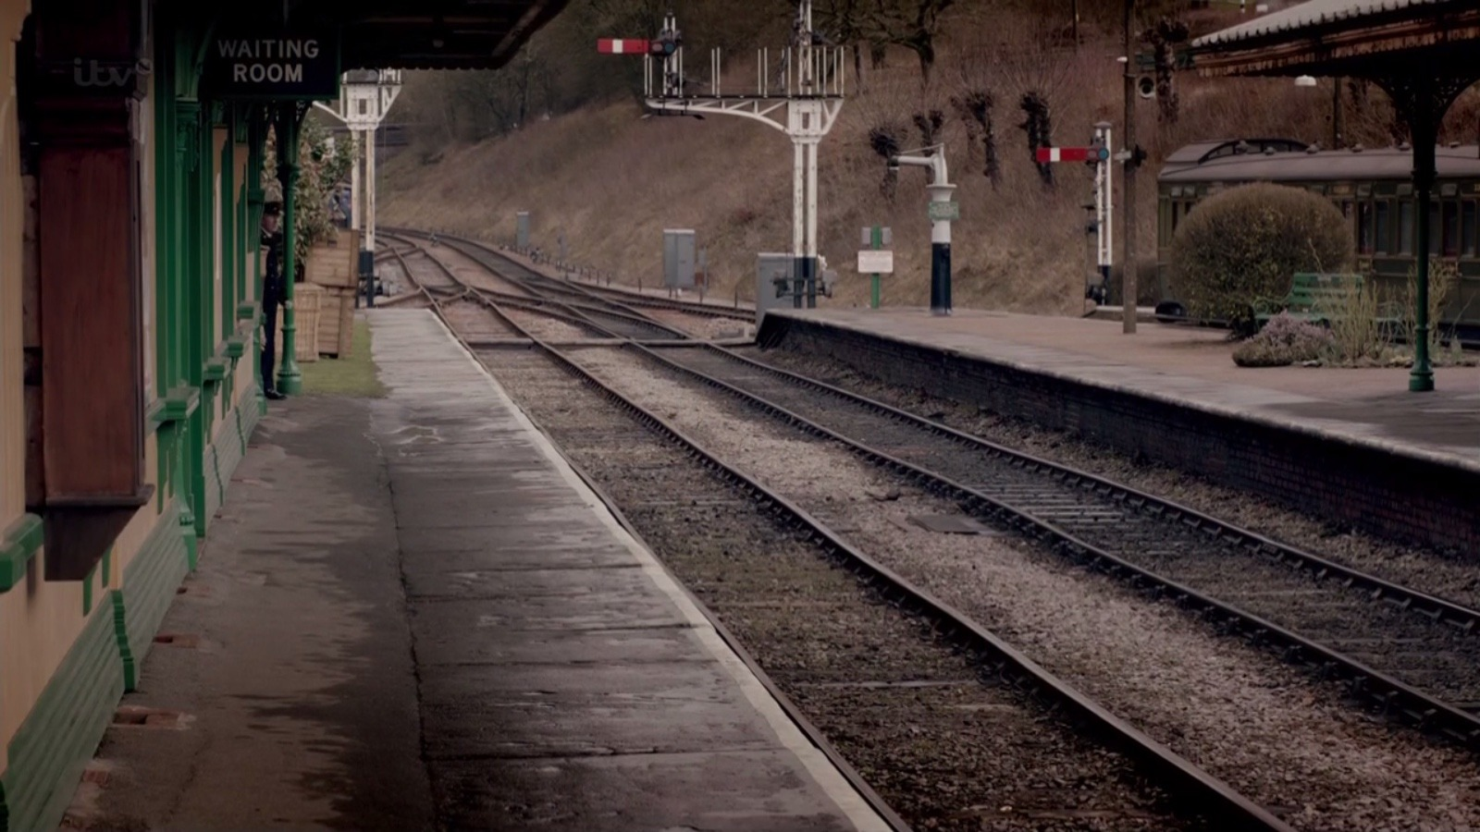
NATION BRANDING
DOWNTON'S BRITAIN, WORKED IN FULL
The house
The dinner
Below stairs
The village
heritage as the establishing shot
order, ritual, everyone in place
labor, visible but ranked
a nation with no cities in it
Downton Abbey (ITV, 2010 to 2015). The Britain brand, selected for global audiences
TASK For each cell, ask: what does a foreign viewer conclude Britain is? What had to disappear for that conclusion to hold?
SPOKEN ASIDE What would a China brand select, and what would it leave out?
MEDIA STUDIES 9607 · SEMESTER I
03
Notes:
D3's 25-minute block, previously slide-less. The coursebook's own-country prompt closes the block as a short spoken aside, as contrast, never as the written outcome, per the exam-example rule.

Slide 10
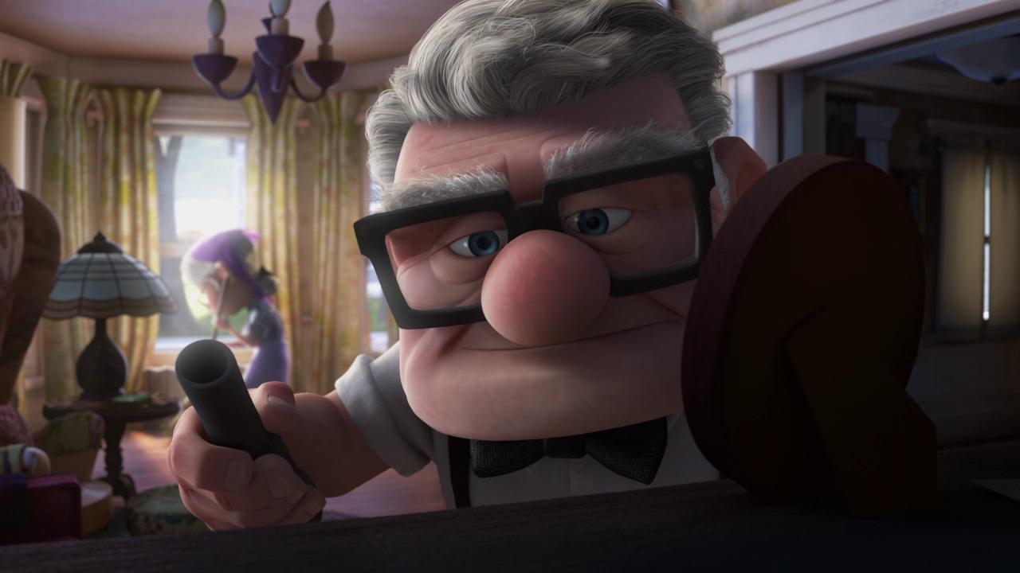
STEREOTYPING AS POWER
WHO BENEFITS, WHO PAYS
A shortcut with a beneficiary
KEY POINT A stereotype is not a lie. It is a shortcut. Every shortcut helps someone and costs someone.
ASK Who benefits from the quick version? Who pays for it?
TERM Counter-stereotype: a portrayal that breaks the shortcut. It surprises us, and the surprise is the evidence.
UP (2009, Pixar): Carl, the coursebook's own counter-stereotype
MEDIA STUDIES 9607 · SEMESTER I
04
Notes:
D3's case pair stays PROPOSED: one British TV stereotype, one Hollywood film stereotype, both exam-eligible, worked in groups with Hall's positions run across both. Deck U3.2 is the ready-made Hall lesson if wanted.

Slide 11
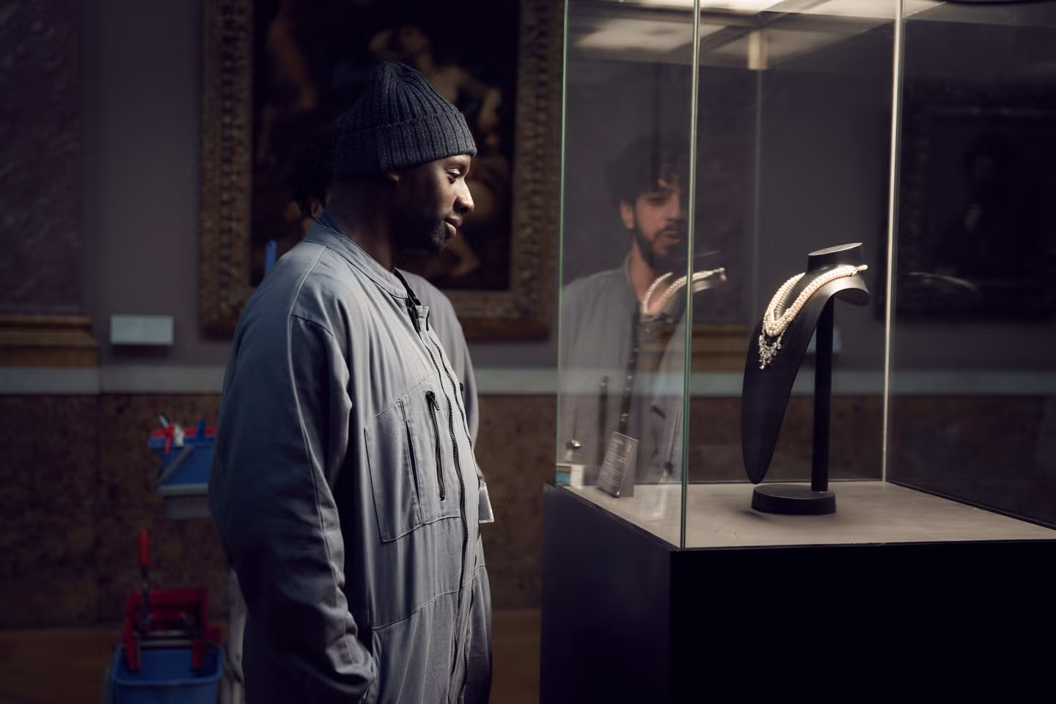
ABSENCE
SELECTIVE CONSTRUCTION'S QUIETEST TOOL
What is never in the frame
cannot be argued with
THE CASE Lupin's heist works because the museum never looks at the man in the worker's uniform. A whole class of people is left out of attention.
TASK Who is missing from your own product? Did you choose that, or did it happen by default?
Lupin (Netflix, 2021): the cleaner the institution does not see
MEDIA STUDIES 9607 · SEMESTER I
05
Notes:
An international text the room meets again at L10 as the enigma frame; here the same still carries Hall's absence. The absence inventory then runs on one text and on their own C1 planning.

Slide 12
THE SELF-AUDIT
THE WEEK'S FULL TOOLKIT, ON YOUR OWN CUT
Four questions of your own product
01
Construction
02
Positions
What did we select and combine, and what did that leave out?
What reading did we assume our audience would take?
03
Power
04
Absence
Whose shortcut did we borrow, and who pays for it?
Who is missing from our product, by choice or by default?
A2 goes in Monday. The screening Monday 2 November turns response cards into evidence, and LB3 is posted. The pickup shots are the homework.
MEDIA STUDIES 9607 · SEMESTER I
06
Notes:
D5 screening conditions: no introductions, no apologies, no pausing; response cards completed while watching and handed to makers unread by anyone else. D6 converts findings to production pickups with dates; LB3 posted.

Slide 13
NEXT
The Gaze
Lesson 12. Van Zoonen, Mulvey, and hooks: who is the camera looking for?
MEDIA STUDIES 9607 · SEMESTER I
07

