Slide 1
XII
MEDIA STUDIES 9607 · UNIT IV
The Gaze
Representation · Lesson 12 of 19
Four days · Mon 9 · Wed 11 (double) · Thu 12 · Fri 13 November
Gaze theory taught as live questions, not settled answers.
Notes:
The block builds van Zoonen and Mulvey; the double stress-tests Mulvey; hooks reframes the whole week. Homework issued Wednesday: the hooks extract, 300 to 400 words, glossed, EN with ZH support, read before Friday.

Slide 2
XII
THE WEEK'S QUESTION
Who was this looking
built for?
Notes:
Not who buys the perfume: who is the looking arranged for? That is the whole week in one question.

Slide 3
VAN ZOONEN · GENDER AS PERFORMANCE
ASSEMBLED, NOT PHOTOGRAPHED
If it is built, it can be built differently
Gender in media is not a fact being photographed. It is a performance, built from repeatable conventions:
Pose
Gaze direction
Fragmentation
Setting
how the body is arranged
where the eyes are sent
the body shown in parts
the world built around it
TASK Swap the conventions between two ads on paper. What breaks? Why does the break tell you something?
MEDIA STUDIES 9607 · SEMESTER I
01
Notes:
The D1 starter is one perfume ad and one question: who is this image for? The next slide is the worked pair.

Slide 4

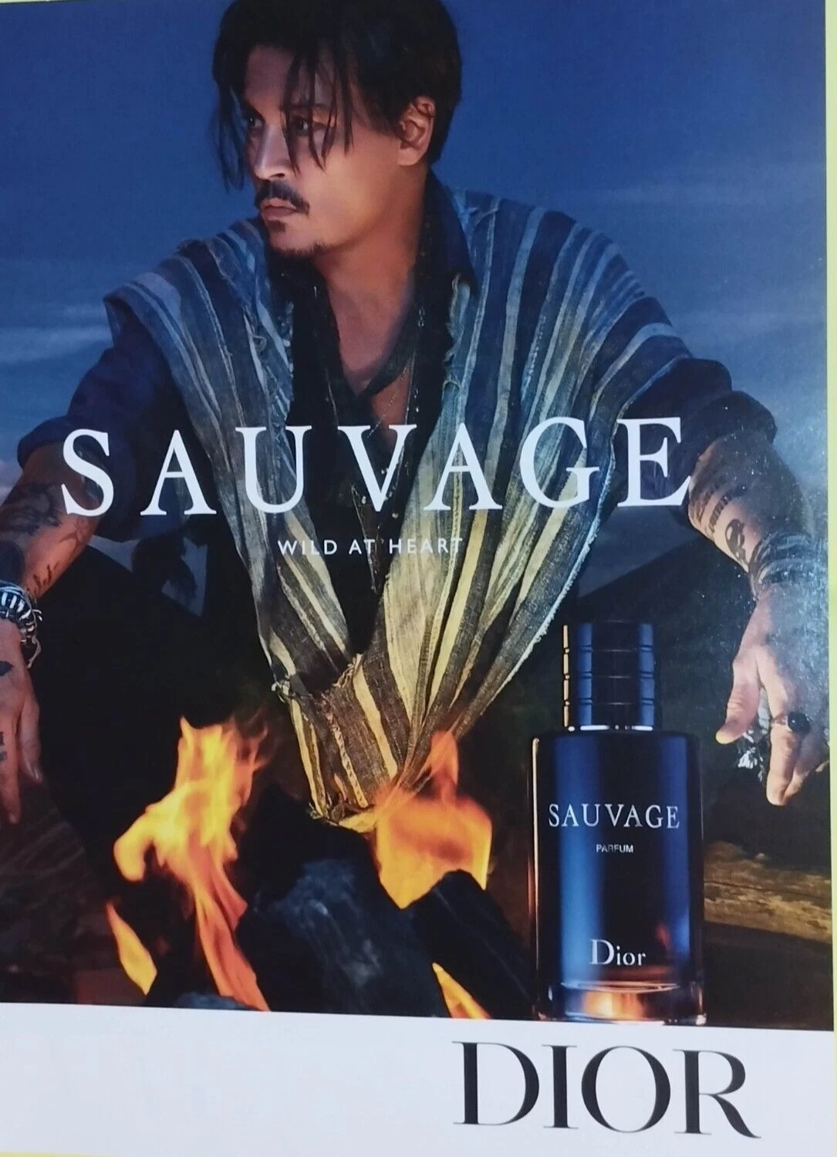
TWO ADS, ONE HOUSE
READ THE FOUR CONVENTIONS ACROSS BOTH
Pose
She holds a pose to be seen. He moves.
Gaze
Her eyes go past us. His meet ours.
Fragment
The dress is the body; the face is the man.
Setting
Golden sea against burnt desert.
Dior, J'adore
Dior, Sauvage
MEDIA STUDIES 9607 · SEMESTER I
02
Notes:
Same house, same product category, two genders sold. Pairs decompose both into the conventions, then swap them on paper: what breaks is the information. One perfume ad opens D1: who is this image for?

Slide 5
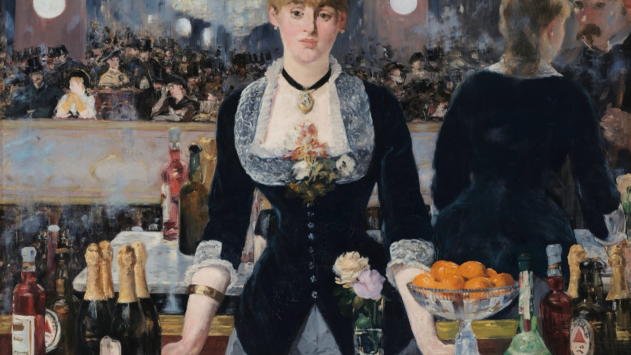
THE LOOKING THAT WILL NOT RESOLVE
The mirror behind her does not add up. Who is she looking at, and who is looking at her?
Edouard Manet, A Bar at the Folies-Bergere, 1882
Notes:
The mirror does not add up and the barmaid looks past us. Manet painted the problem the week is about: who looks at whom.

Slide 6
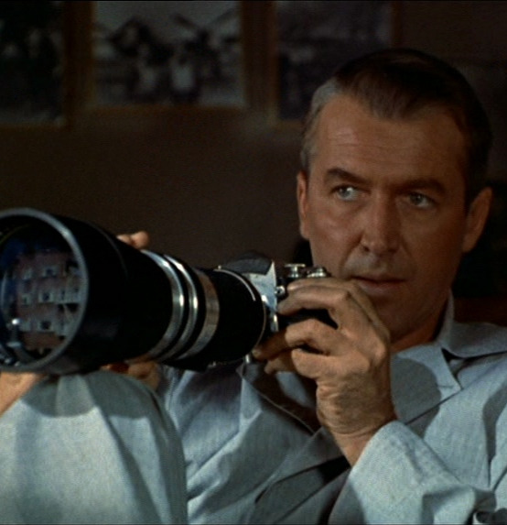
MULVEY · A CLAIM FROM 1975
MADE TO BE TESTED
Three looks, classically aligned
01
The camera's
How the shot itself frames, lingers, and fragments the figure on screen.
02
The characters'
How people within the story look at one another inside the narrative.
03
The audience's
How we are positioned to look, and whose view we are given.
Rear Window (1954): the audience's surrogate, lens raised
THE CLAIM In classic Hollywood, all three looks align on the woman as spectacle. A 1975 claim about a system: test it, do not just recite it.
MEDIA STUDIES 9607 · SEMESTER I
03
Notes:
Hitchcock's Jeff is the three looks in one body: he is the camera, the character, and us. The D2 first test tracks the three looks timecoded on one classical-era clip. Crib: Deck U2.1 slide 6 (Mulvey, Creed, Kuhn).

Slide 7
“
In their traditional exhibitionist role, women are simultaneously looked at and displayed... so that they can be said to connote to-be-looked-at-ness.
Laura Mulvey, Visual Pleasure and Narrative Cinema, 1975
IN PLAIN WORDS In these films, women are arranged on screen to be looked at. Being looked at becomes their role.

Slide 8


THE DECADE TEST
THE VARIABLE IS ERA
Hold, shift, or invert?
TASK Take one genre pair: a text before 2000, a text after 2018, with a similar scene. The only variable is the era.
EVIDENCE Timecode the camera-look, the character-look, and the audience position in each.
VERDICT Did the gaze hold, shift, or invert? Attach the evidence to your answer.
THE COUNTER Every verdict faces one challenge, with evidence. The challenger is named in advance.
One franchise, six decades: Dr. No (1962), No Time to Die (2021)
MEDIA STUDIES 9607 · SEMESTER I
04
Notes:
The posters are the slide-safe version of the PROPOSED screened pairs (action sequence, music video, perfume ad; same genre, comparable scene function). Bond is the cleanest single-franchise case: read the two posters' poses, gazes and fragmentation before any clip runs. Sourcing note: Goldfinger was the first choice and is excluded under the no-nudes rule (its key art carries the gold-painted figure in every variant); Dr. No's 007! sheet carries the same reading, clothed.

Slide 9
“
There is power in looking.
bell hooks, The Oppositional Gaze, 1992

Slide 10
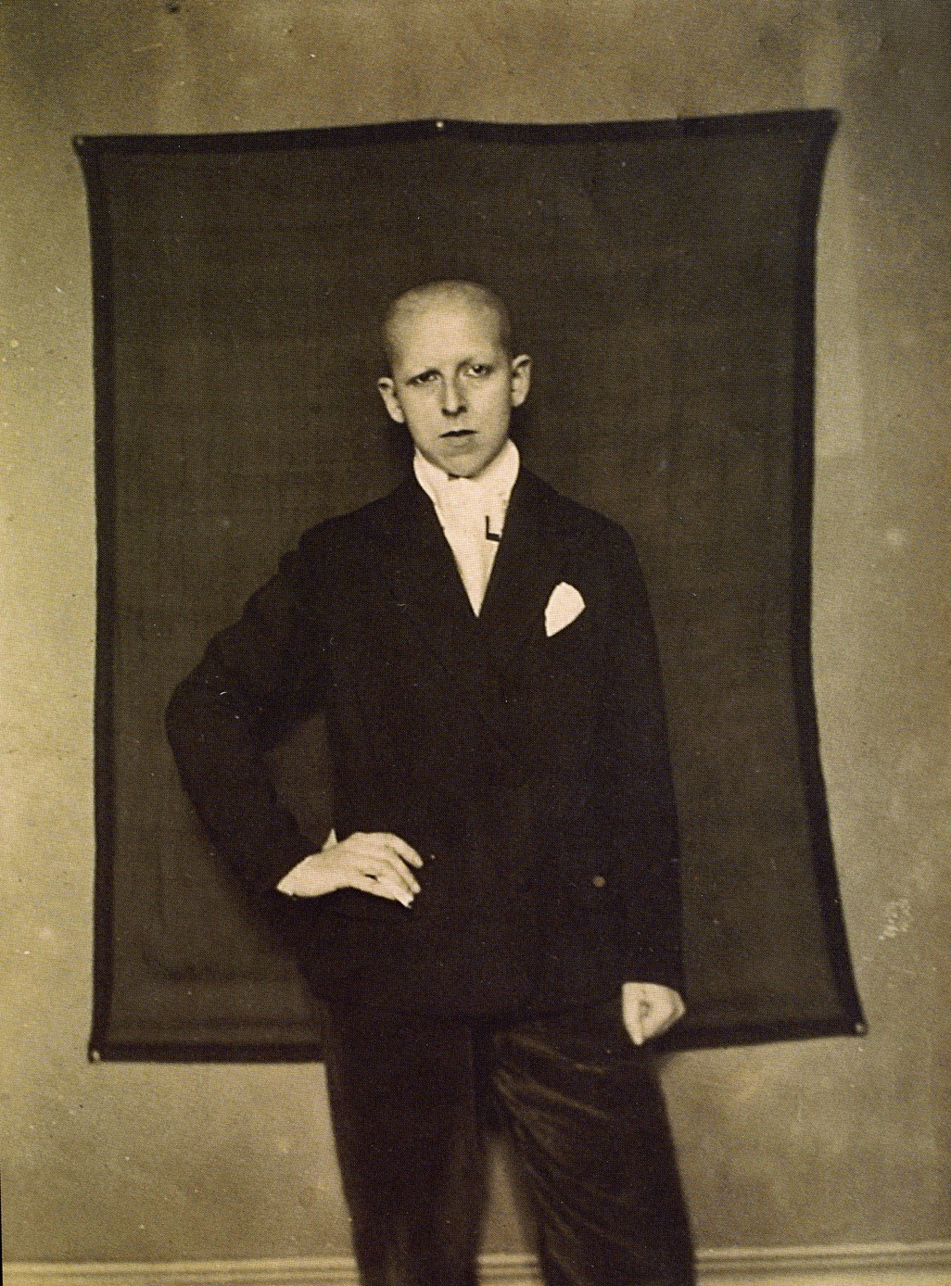
A LOOK SENT BACK
THE IMAGE THAT REFUSES ITS ASSIGNMENT
Refusing to be only an image
THE REFUSAL Shaved head, a suit, a hand on the hip, a direct stare. Every convention of the looked-at woman is refused in one frame, a century ago.
KEY POINT The portrait does not offer itself to you. It examines you.
ASK In any text this week: who may look? Who is looked at? What happens when someone refuses the role?
Claude Cahun, Self-Portrait, 1920
MEDIA STUDIES 9607 · SEMESTER I
05
Notes:
Swapped 2026-08-24: Manet's Olympia (a nude, against the no-nudes rule, and a July stand-in from the public-domain era) is retired; Cahun is the work the lesson names and the site already shows. The library scan is 1026x1388; shown whole as an image study.

Slide 11
HOOKS · THE OPPOSITIONAL GAZE
THE WEEK'S QUESTION, FLIPPED
Looking back at what never expected you
THE FLIP bell hooks turns the question around. Not: how does the text look at its subjects? But: who was the looking built for?
TERM The oppositional gaze: looking back, critically, at a text that never expected you to be watching.
KEY POINT Refusing a text, and reading it against itself, is critical work. It earns marks.
MEDIA STUDIES 9607 · SEMESTER I
06
Notes:
Taught from the read extract (300 to 400 words, glossed, EN with ZH support, issued Wednesday). Daughters of the Dust (1991) is hooks's own screen example if the room wants a text; the reframe then runs on the week's own ads and clips.

Slide 12
DELIVERABLE · CS10
A THEORIST DOING ANALYTICAL WORK
Not decoration, analysis
TASK One close-reading paragraph on a still or short clip: a claim, evidence, and a theorist doing work inside the analysis.
MODEL “As Mulvey's camera-look predicts ...” beats “Mulvey said the male gaze.”
RULE A theorist earns their place by doing work, not by being named.
THE HUNT Before you hand it in, partners hunt for a decorated theorist: named, but doing no work.
A3 ANNOUNCED The complete Component 1 portfolio, due Friday 27 November: exactly 14 days from today.
MEDIA STUDIES 9607 · SEMESTER I
07
Notes:
CS10 carries the theorist sentence-starters scaffold (ESL): the card is on every desk. The A3 date is hard: Fri 13 Nov to Fri 27 Nov, verified as exactly 14 days, which exceeds the register's one-week notice rule.

Slide 13
NEXT
The Creative
Critical Reflection
Lesson 13. Where AO2 lives in the portfolio: cut every sentence that describes instead of reflects.
MEDIA STUDIES 9607 · SEMESTER I
08

