Slide 1
XIV
MEDIA STUDIES 9607 · UNIT V
Audiences and the
Portfolio Submission
Media Contexts · Lesson 14 of 19
Five days · Monday 23 to Monday 30 November
Notes:
The Component 1 arc closes. Audience theory begins on schedule, but the week bends around Friday: A3 goes in, no edits after.

Slide 2
XIV
THE REVERSAL
What people do
with media.
Notes:
Audiences do things with media; media does not simply do things to audiences. That reversal is the week.

Slide 3
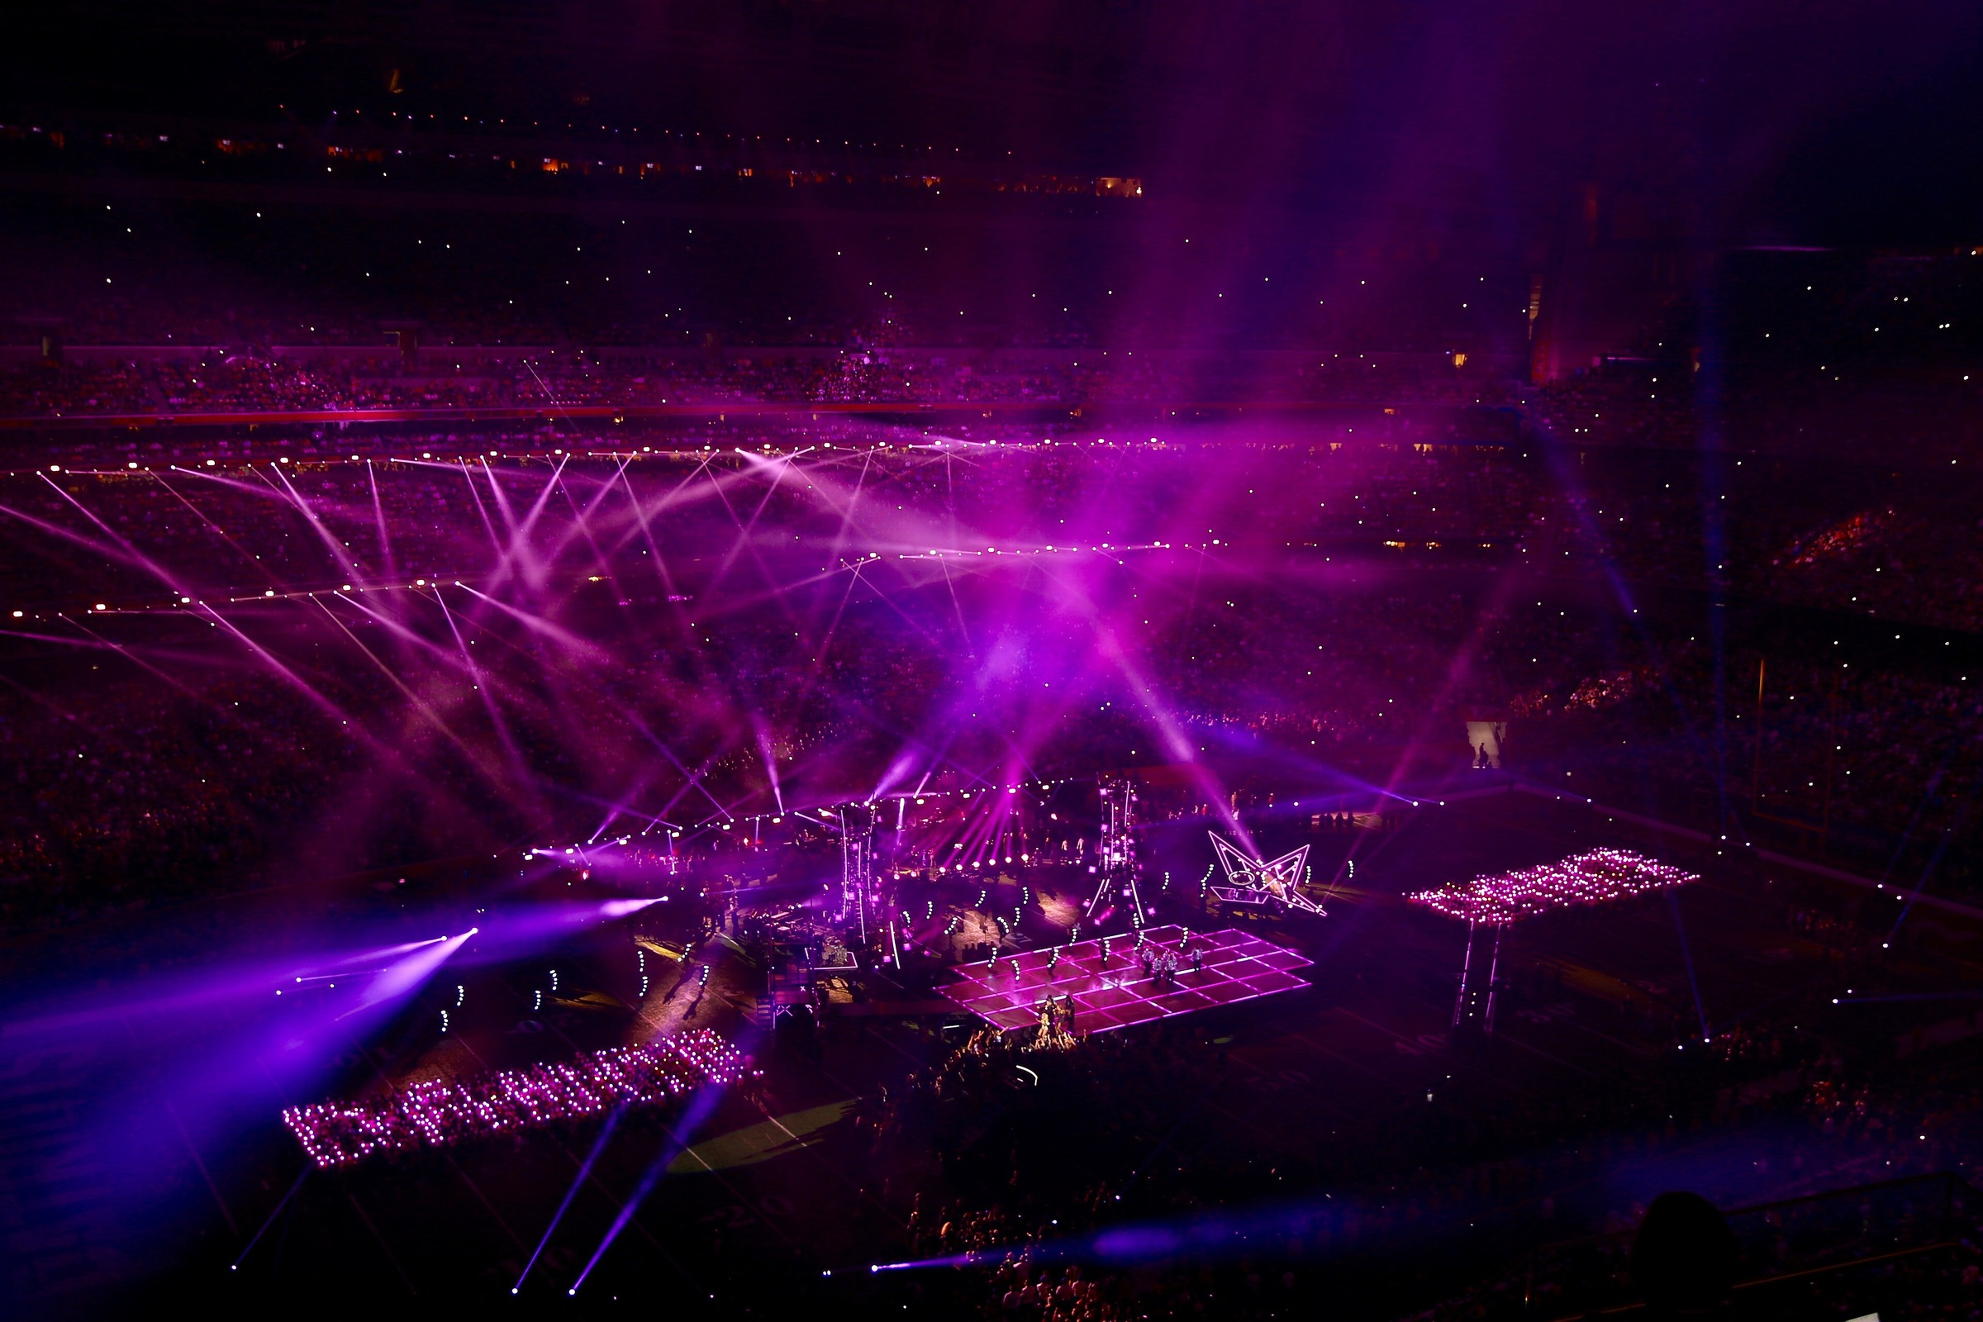
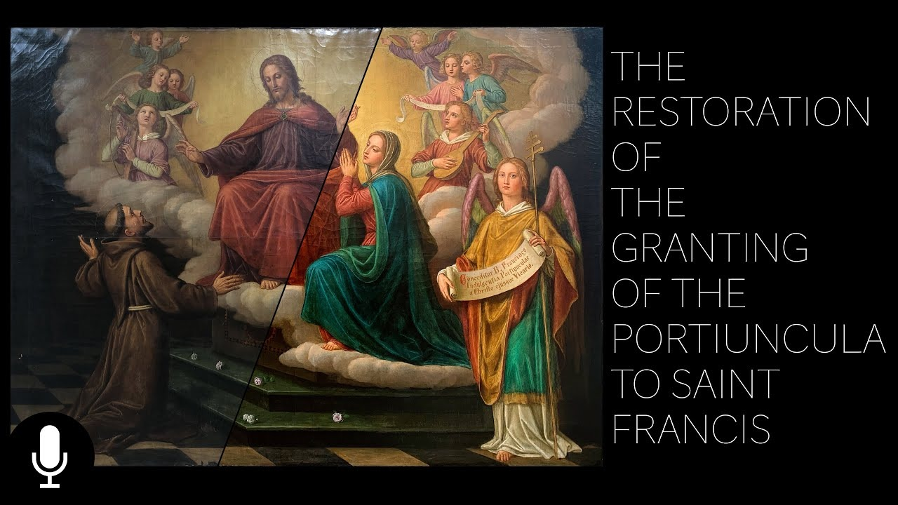
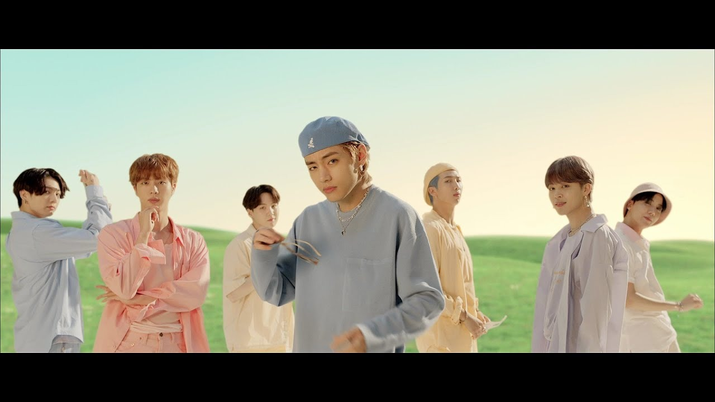
WHO IS IT FOR?
EVERYONE IS ALMOST ALWAYS WRONG
Mass, niche, target
Mass
Niche
Target
A Super Bowl half-time show: aimed at everyone at once, and priced that way.
A restoration channel: a small interest group that finds the text by itself.
A comeback teaser: a precise profile of age, taste, and platform. This is what advertisers pay for.
TASK Four Corners: mass, niche, target, or undecided. Move, then defend your corner.
TERMS Demographics: who the audience is. Psychographics: what the audience wants.
MEDIA STUDIES 9607 · SEMESTER I
01
Notes:
The three cells are the plan's own D1 texts: a Super Bowl half-time show (US Department of Defense photograph, public domain), a niche YouTube restoration channel, a K-pop comeback teaser (thumbnails credited in CREDITS). A CCTV-gala or bilibili parallel can be taken orally as an aside; the taught set stays exam-eligible.

Slide 4
“
less attention to what the media do to people and more to what people do with the media
Elihu Katz, 1959
IN PLAIN WORDS Stop asking only how media changes people. Ask what people use media for.

Slide 5
EFFECTS MODELS, STATED FAIRLY THEN LIMITED
WHAT THEY CANNOT EXPLAIN
The models, and their edges
The models
The limit
Hypodermic: media injects a message and the audience absorbs it. Cultivation: heavy exposure slowly shapes a worldview.
The horror fan who sleeps fine. The ad seen a hundred times that never sold anything. Audiences are not needles waiting to be filled.
THE LOG Collect counter-evidence. An example that survives the room's challenge earns a point.
MEDIA STUDIES 9607 · SEMESTER I
02
Notes:
State each model fairly before limiting it; the limit lands harder that way. Cultivation gets its due: long-horizon worldview effects are the version that survives scrutiny best.

Slide 6
A REAL WEEK OF WATCHING
MASS IS SMALLER THAN IT SOUNDS
The week's biggest audiences
Race Across the World
BBC One
5.78m
100 Years On Planet Earth
BBC One
4.73m
Believe Me
ITV1
4.09m
Britain's Got Talent
ITV1
3.76m
Amandaland
BBC One
3.62m
The Cage
BBC One
3.04m
Secret Service
ITV1
3.04m
SOURCE BARB (UK audience measurement), week of 4 to 10 May 2026, via TVZone.
KEY POINT The biggest program of the week reached less than a tenth of the country. Mass is relative.
MEDIA STUDIES 9607 · SEMESTER I
03
Notes:
BARB is the UK's audience measurement body; the figures are seven-day consolidated audiences. Use the bars to ask: who pays for each of these audiences, and what would an advertiser pay to reach each one?

Slide 7
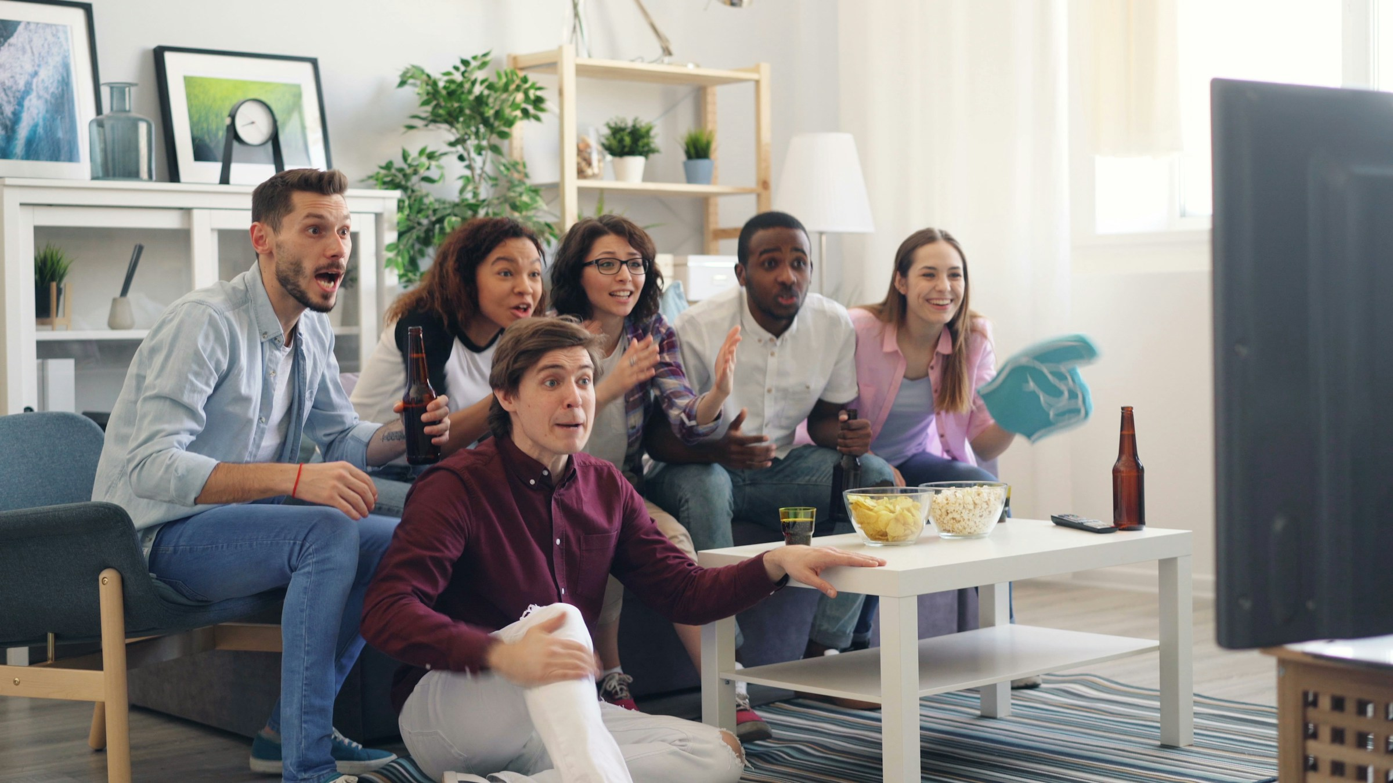
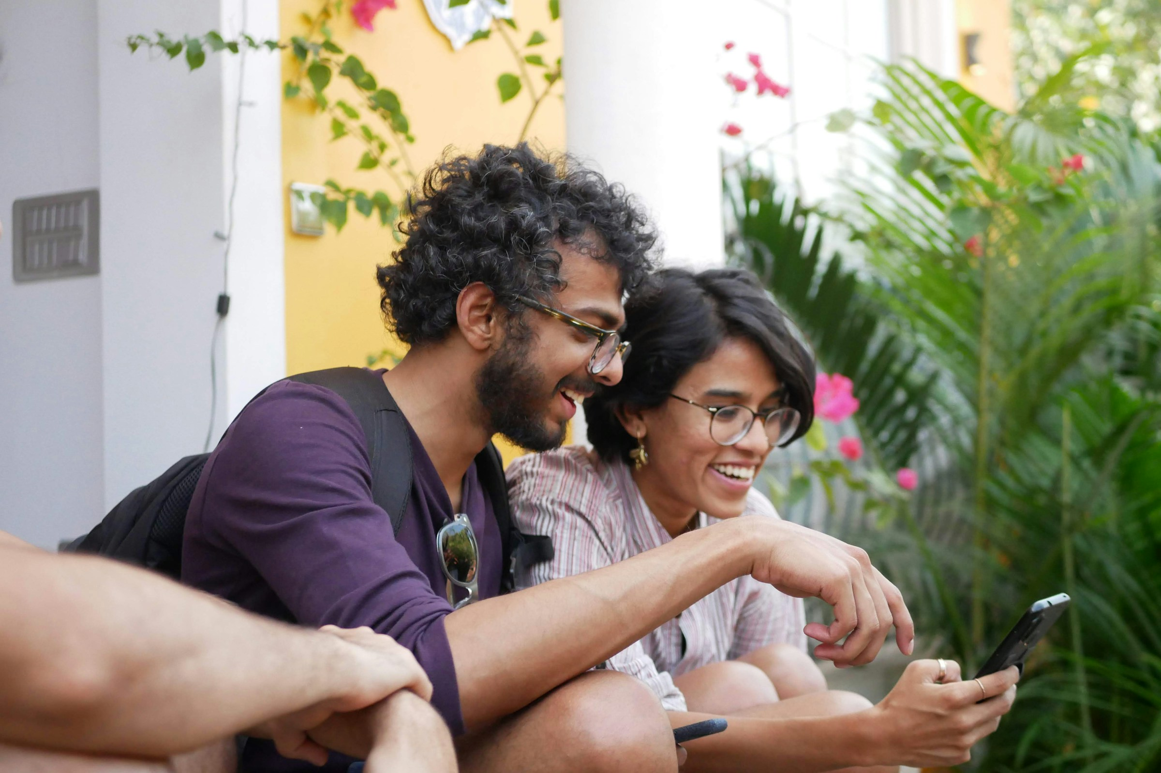
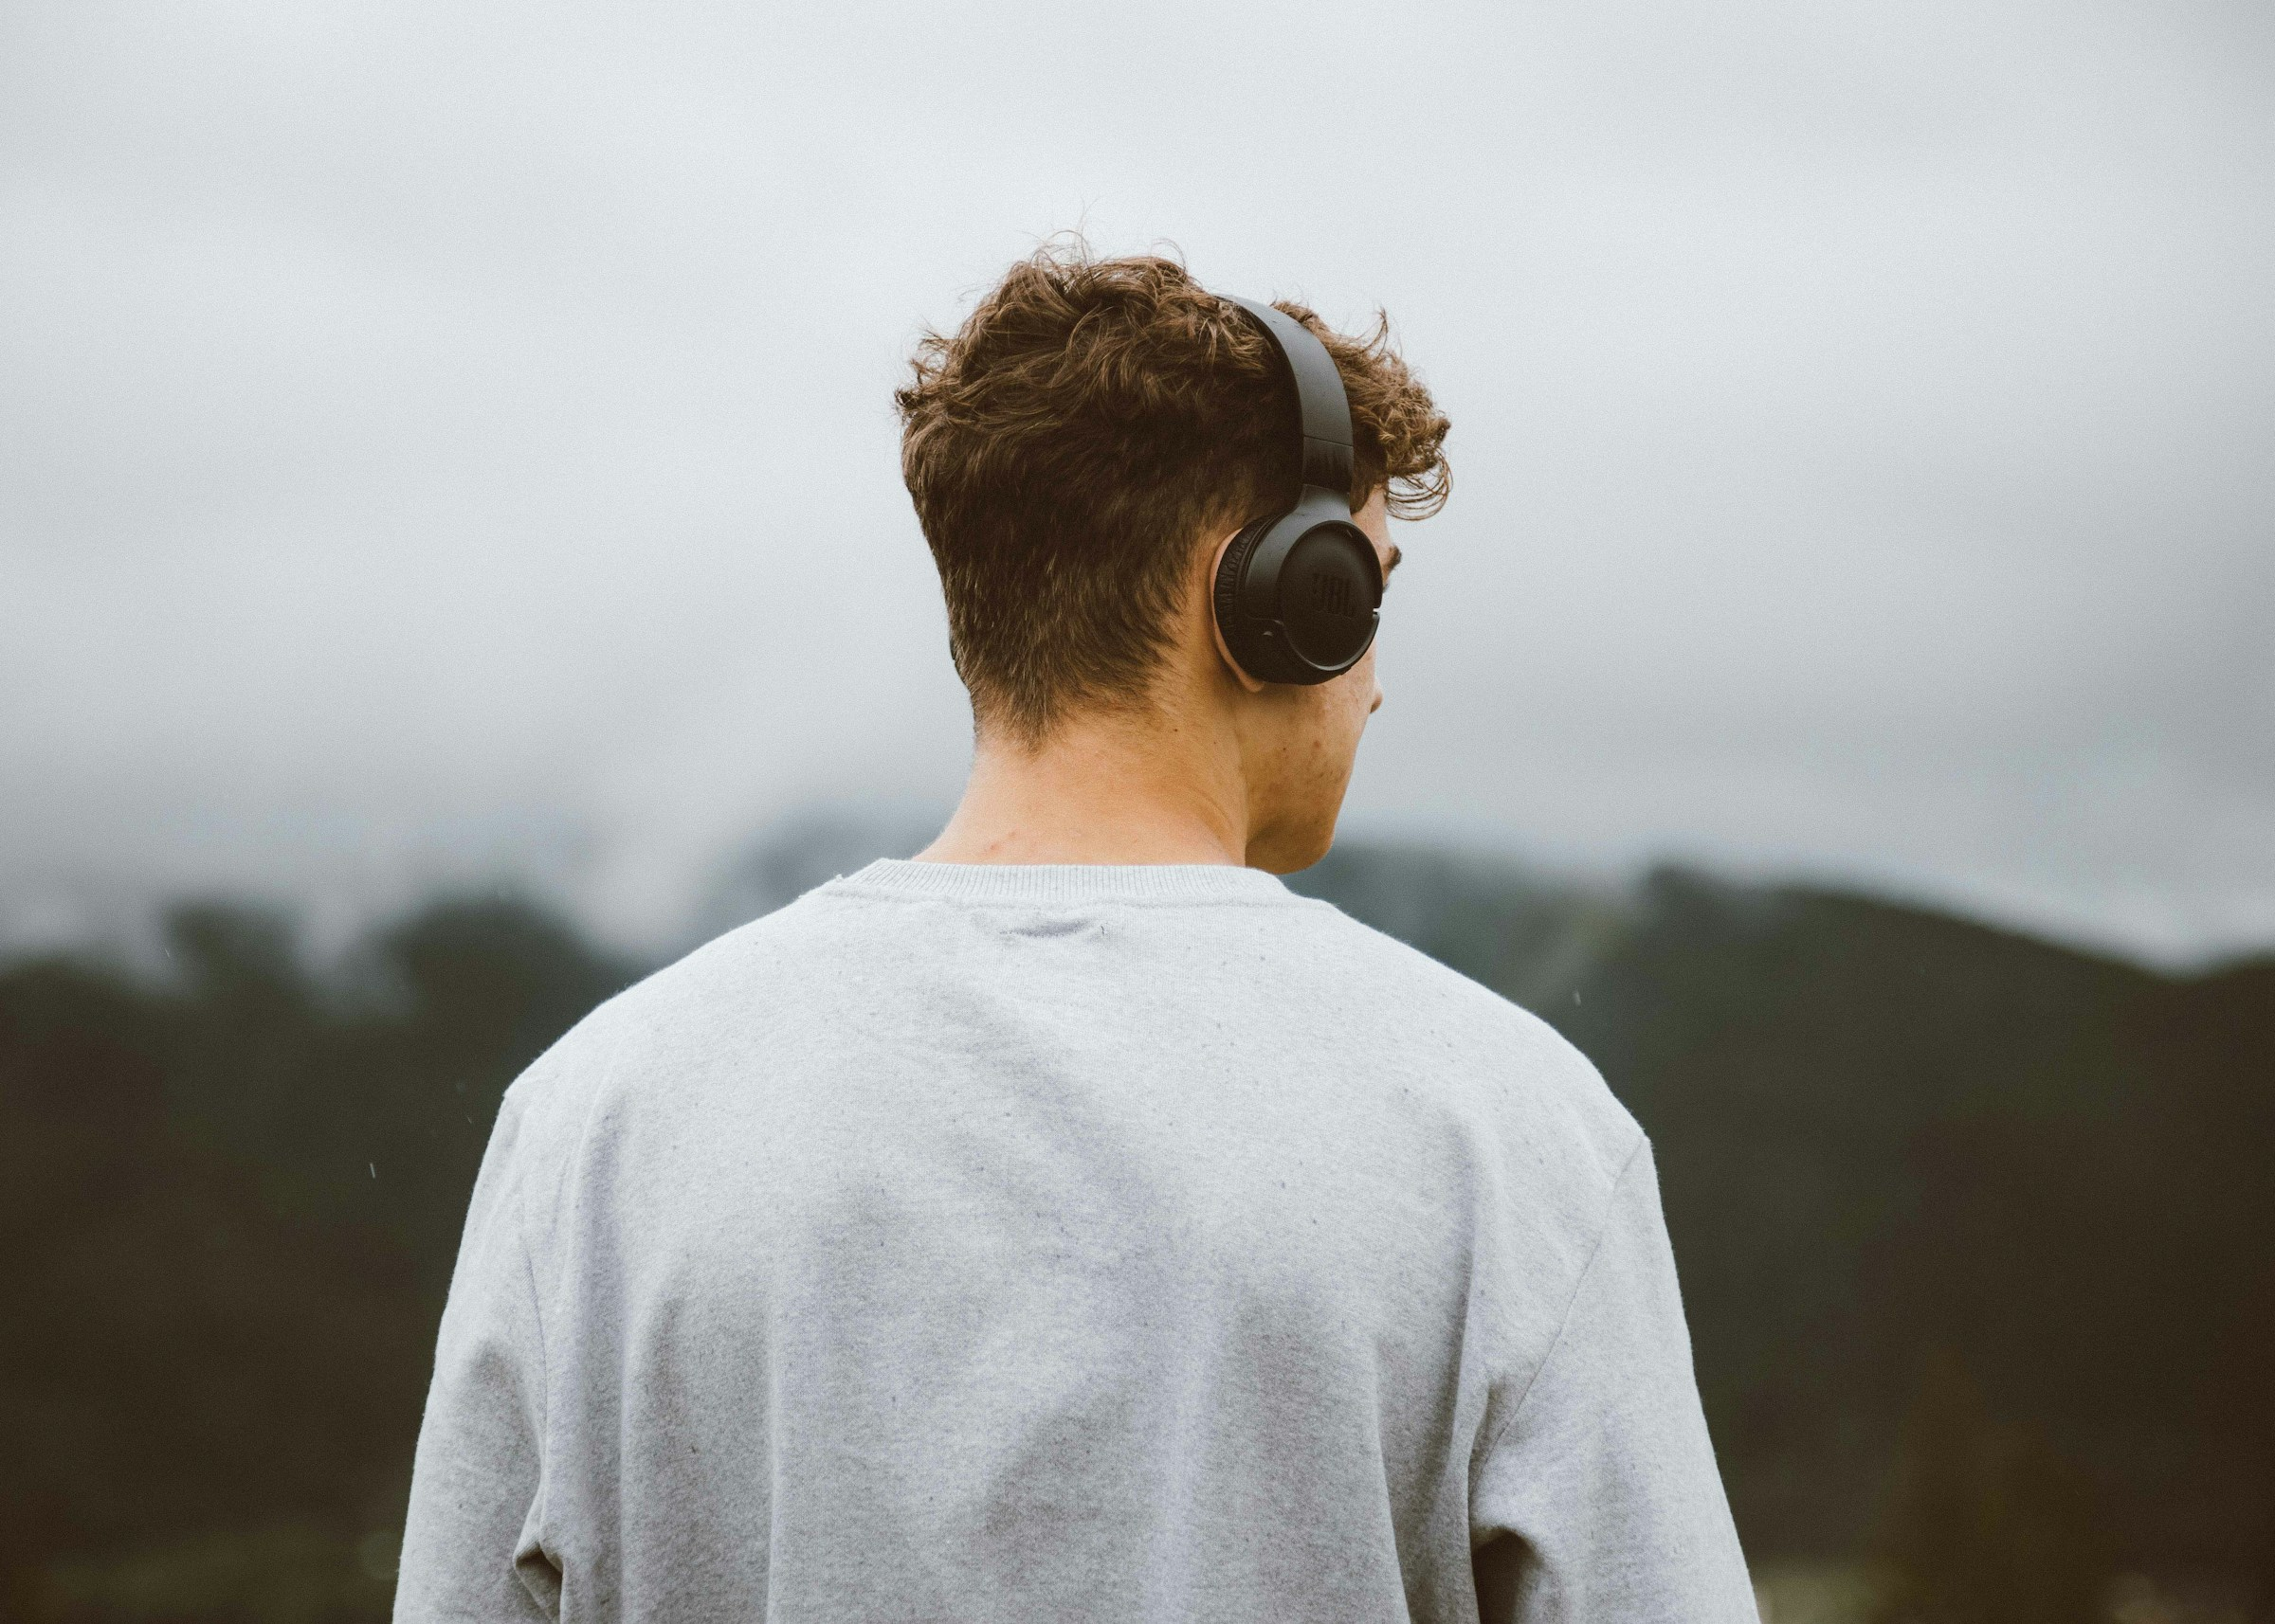

BLUMLER AND KATZ · USES AND GRATIFICATIONS
AUDIENCES AS ACTIVE CHOOSERS
Four jobs we need media to do
Diversion
Personal relationships
Escape and release: from routine, from problems, into feeling.
Company and connection: characters as friends, shared talk with real ones.
Personal identity
Surveillance
A mirror: comparing your own life and values against what you watch.
Information: knowing what is happening, in the world and your world.
MEDIA STUDIES 9607 · SEMESTER I
04
Notes:
Photographs are Unsplash, credited in CREDITS: Gariev (diversion), Balakrishnan (relationships), Ciprian (identity), Brunxs (surveillance). Each cell shows the practice, not a text: the theory is about what people do.

Slide 8
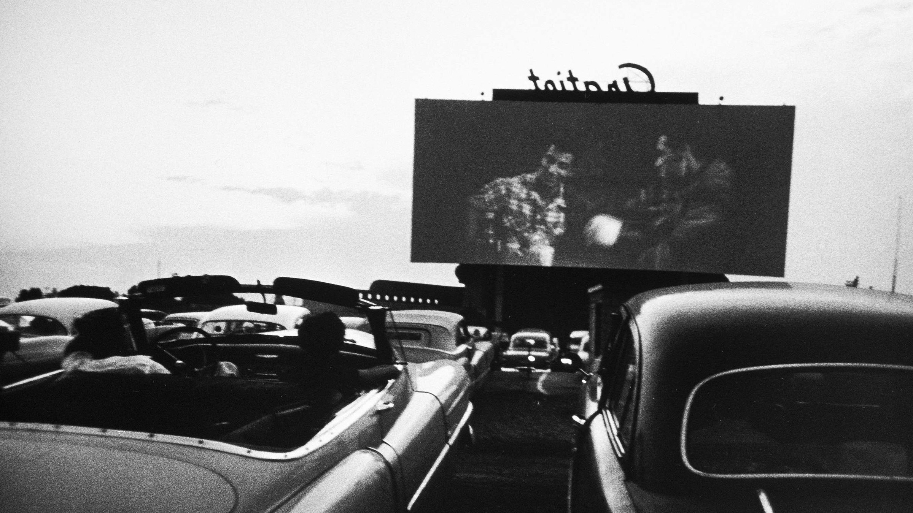
THE ACTIVE AUDIENCE
Parked in the dark, arranged around a screen, doing the watching. An audience is never blank or passive.
Robert Frank, Drive-in movie, Detroit, 1955
Notes:
Swapped 2026-08-24: was Daumier's theatre crowd. Frank's drive-in is a media audience, mid-century mass culture photographed from inside. Daumier's plate stays in img/ for rollback.

Slide 9
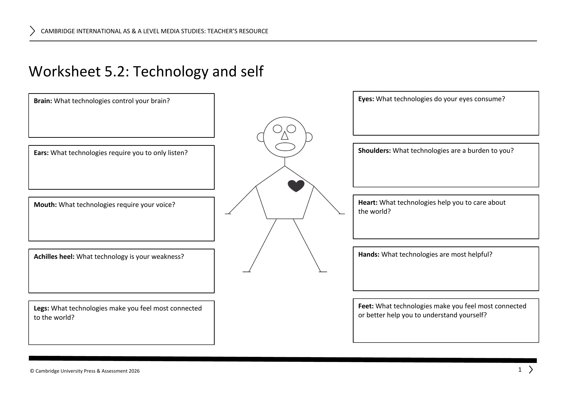
THE HONEST MAP
THE L01 LOG'S DESCENDANT, WITH THEORY ATTACHED
Your week, mapped onto
the four gratifications
TASK Map your real weekly media use onto the four gratifications.
THE RULE Total honesty. The comfort re-watch and the 2 a.m. scroll are data, not confessions.
THEN Which gratification does your own C1 product serve? How would you know if it worked?
WS 5.2, Technology and self: the body-map option for the honest map
MEDIA STUDIES 9607 · SEMESTER I
05
Notes:
Swapped 2026-08-24: was Manet's A Good Glass of Beer (kept in img/ for rollback; its diversion reading is still apt if wanted). WS 5.2 is the plan's own D5 option and shows students the instrument itself.

Slide 10
“
The people formerly known as the audience wish to inform media people of our existence, and of a shift in power that goes with the platform shift.
Jay Rosen, PressThink, 2006
IN PLAIN WORDS Audiences can now publish too. The old one-way power of media companies has shifted.

Slide 11
AUDIENCES SPEAK BACK
THE COURSEBOOK'S OWN ROSTER, 5.3
Three claims to carry
Hall
Jenkins
Shirky
Meaning is finished in the audience: dominant, negotiated, oppositional. You met this at L11; it is the floor of audience theory.
Participatory culture: fans borrow, remix, and build on texts (Jenkins calls it poaching). The audience is a workshop, not a hall.
Audiences produce: publishing is now a button, so the line between audience and maker is a choice, not a wall.
KEY POINT Your C1 blog proves the claim: you are an audience member who published. Say so in your CCR.
MEDIA STUDIES 9607 · SEMESTER I
06
Notes:
Coursebook 5.3 names Hall's three readings, Jenkins's participatory culture (poaching) and Shirky (audiences speak back). Claims stated as taught claims, not quotations.

Slide 12
THE LAST HELP WINDOW
TRIAGE ORDER, NOT HAND-RAISING
CCR surgery, by triage
THE WINDOW The double period is the last help before submission.
THE QUEUE Ordered by CS11 severity, not by raised hands. Everyone is seen.
THE RULE Each visit ends with one fix done, not promised. Friday is logistics only.
MEDIA STUDIES 9607 · SEMESTER I
07
Notes:
Coursebook 6.7's screening-feedback activity runs on two volunteers' near-final products before the triage opens.

Slide 13
FRIDAY 27 NOVEMBER
It goes in.
No edits after.
Product exported and playable, CCR posted, blog complete and dated, URLs logged. A3 in Friday 27 November. No edits after is in the register, and it is absolute.
Notes:
Submission is a protocol, not an event: the checklist is walked once, calmly, and the room leaves with nothing owed.

Slide 14
THE RETURN, AND THE TARGET
MONDAY 30 NOVEMBER · SELF-BAND BEFORE THE MARK
A3 back, one target forward
Self-band first
Band your own portfolio against the C1 criteria before you see the mark. The gap between the two bands is the conversation.
One target (LB4)
Specific and achievable in S2: “hold focus in low light” beats “get better at filming.”
A4 announced
Wednesday 16 December, Component 2 Section A. Sixteen days' notice; the one-week rule is cleared with room to spare.
MEDIA STUDIES 9607 · SEMESTER I
08
Notes:
A3 marking runs on the register's corrected economy: 50 marks, AO3 40 + AO2 10, nothing scaled.

Slide 15
NEXT
Institutions and
Section A Craft
Lesson 15. Morley, ownership, and Section A with the mark scheme open.
MEDIA STUDIES 9607 · SEMESTER I
09

