Slide 1
XVII
MEDIA STUDIES 9607 · UNIT VI
Consolidation and
the Coverage Matrix
Revision · Lesson 17 of 19
Two days · Monday 21 and Wednesday 23 December
Notes:
The semester's knowledge gets audited before the exam tests it. Every case study crossed against the four Key Concepts until the uncovered cell is found. Two days: Monday carries the A4 review and the argument trios (two rotations; the third went with the lost Tuesday), Wednesday the matrix and the break brief. Tue 12-22's End-of-Semester Activity no longer touches a Media day.

Slide 2
XVII
THE STANDARD OF COVERAGE
Every cell checked.
No gaps left.
Notes:
A century ago two astronomers photographed the entire moon, plate by plate, so that no region went unexamined. That is the week's standard.

Slide 3
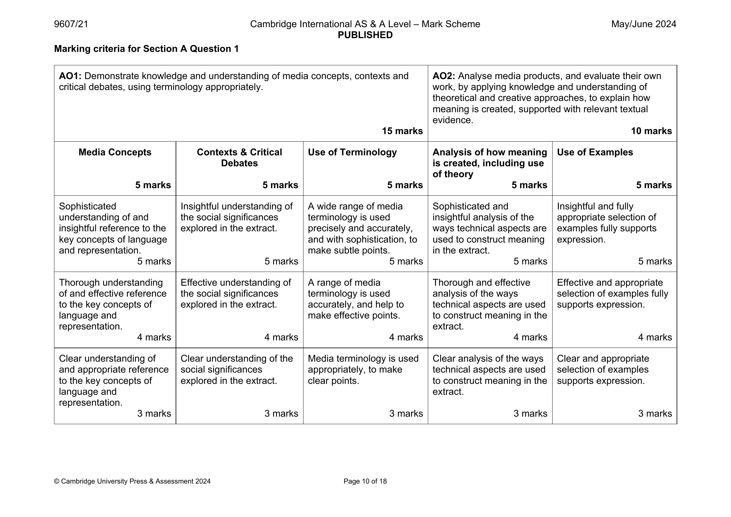
THE A4 REVIEW
SCRIPT AGAINST MARK SCHEME, NOT GRADE
Self-band first
Band yourself first
Re-read your A4 script against the five criteria and band each one, before you see the mark. The gap between the two is the conversation.
The target thread
Write one new target from your AO scores, linked to your L14 target. Two data points now: your Forecast Grade has evidence.
The instrument itself: June 2024 mark scheme, the five-criterion Section A grid
MEDIA STUDIES 9607 · SEMESTER I
01
Notes:
The grid on screen is the real June 2024 page: Media Concepts, Contexts and Critical Debates, Use of Terminology, Analysis, Use of Examples, five marks each. Band each criterion before the mark is revealed; the gap is the conversation.

Slide 4
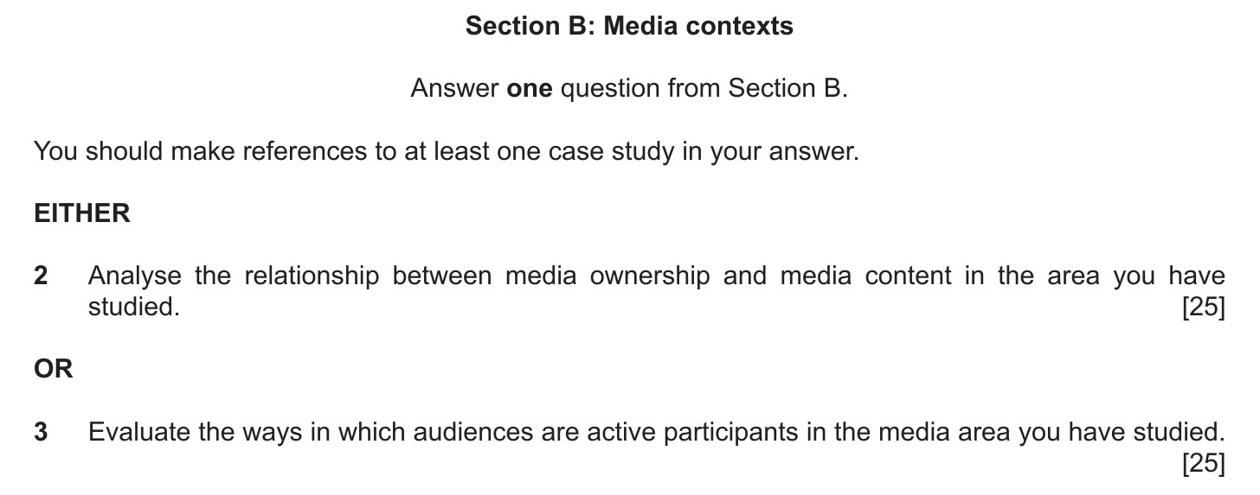
A SECTION B ARGUMENT
NOT A PLAN, AN ARGUMENT YOU COULD WIN ALOUD
Four moves
Claim
Evidence
Counter
Response
1
2
3
4
the position you will defend
case-study facts that back it
the strongest opposing case
why your claim still stands
The authentic register: June 2024 Paper 2, Section B. The trio questions imitate exactly this.
MEDIA STUDIES 9607 · SEMESTER I
02
Notes:
Argue it aloud in trios, one countering from the same case study; the talk is the drafting. Plans that survived a counter do not go stale. The menu on screen is the real June 2024 pair: ownership and content, or active audiences; every trio question keeps that register.

Slide 5
“
He who knows only his own side of the case knows little of that.
John Stuart Mill, On Liberty, 1859
IN PLAIN WORDS If you only know your own argument, you barely know it. Learn the counter-argument too.

Slide 6
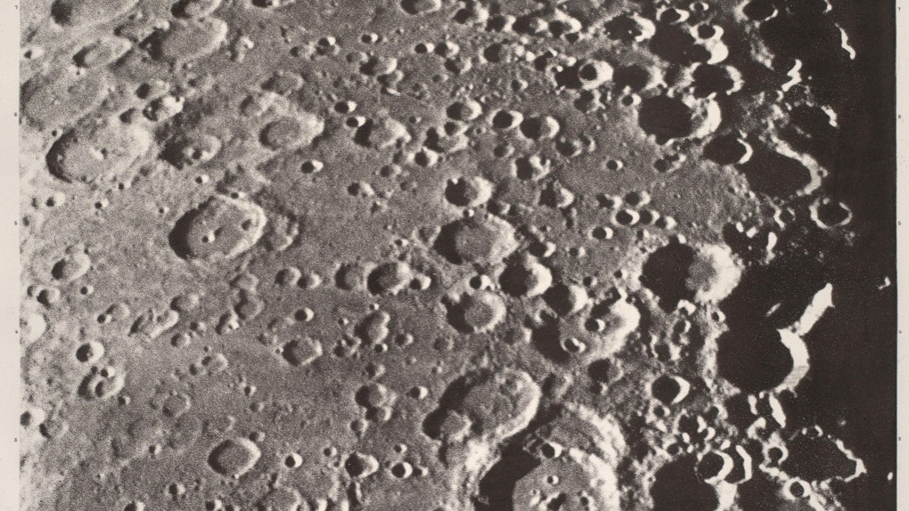
PLATE BY PLATE
Two astronomers photographed the entire moon, plate by plate, so no region went unexamined. The week runs on that standard.
Loewy and Puiseux, Atlas Photographique de la Lune, c. 1900
Notes:
Kept as the governing metaphor, one sentence and out. The matrix, not the moon, is the instrument; the next slide does the work.

Slide 7
THE COVERAGE MATRIX
CASE STUDIES AGAINST THE FOUR CONCEPTS
Find the empty cell
Language
Represent.
Industry
Audience
A film studio
●
●
thin
empty
A streaming platform
thin
empty
●
●
A public broadcaster
●
thin
●
thin
THE GAME Jeopardy: claim a cell by producing the evidence. The room verifies: evidenced, thin, or empty.
THE RULE An honest “empty” also scores. The game rewards the audit, not the bluff. These rows are examples; yours are the room's case studies.
MEDIA STUDIES 9607 · SEMESTER I
03
Notes:
Jeopardy procedure: claim, verify, score evidenced, thin, or empty. The room should see the teacher score a cell empty without ceremony; the audit only works if empty is a normal answer.

Slide 8
THE DELIVERABLE OF THE WEEK
Your weakest cell,
named in writing.
Every student leaves with the emptiest cell of their own matrix named. That cell is the HW2 target, and the break exists to fill it.
Notes:
A statement, not a quotation: the week's whole deliverable in one line. The named cell feeds HW2's essay plan directly.

Slide 9
THE BREAK, AND THE EXAM
SET THE LAST TEACHING SESSION BEFORE THE WINDOW
Two things on the record
HW2
One revision page per case study, plus one Section B essay plan aimed at the named weakest cell. Three to four hours across eleven days.
DUE MON 4 JAN
EoT announced
The full two-hour Component 2. Today is the last teaching session that clears the notice window; the format is A4's plus Section B, nothing new.
WINDOW FROM MON 11 JAN
MEDIA STUDIES 9607 · SEMESTER I
04
Notes:
Announcement wording matters: the window opens Mon 11 Jan and today clears the notice rule (the register's standing is one week; the old 14-day wording is superseded). HW2 sizing said aloud: three to four hours across the whole break, not a holiday of revision.

Slide 10
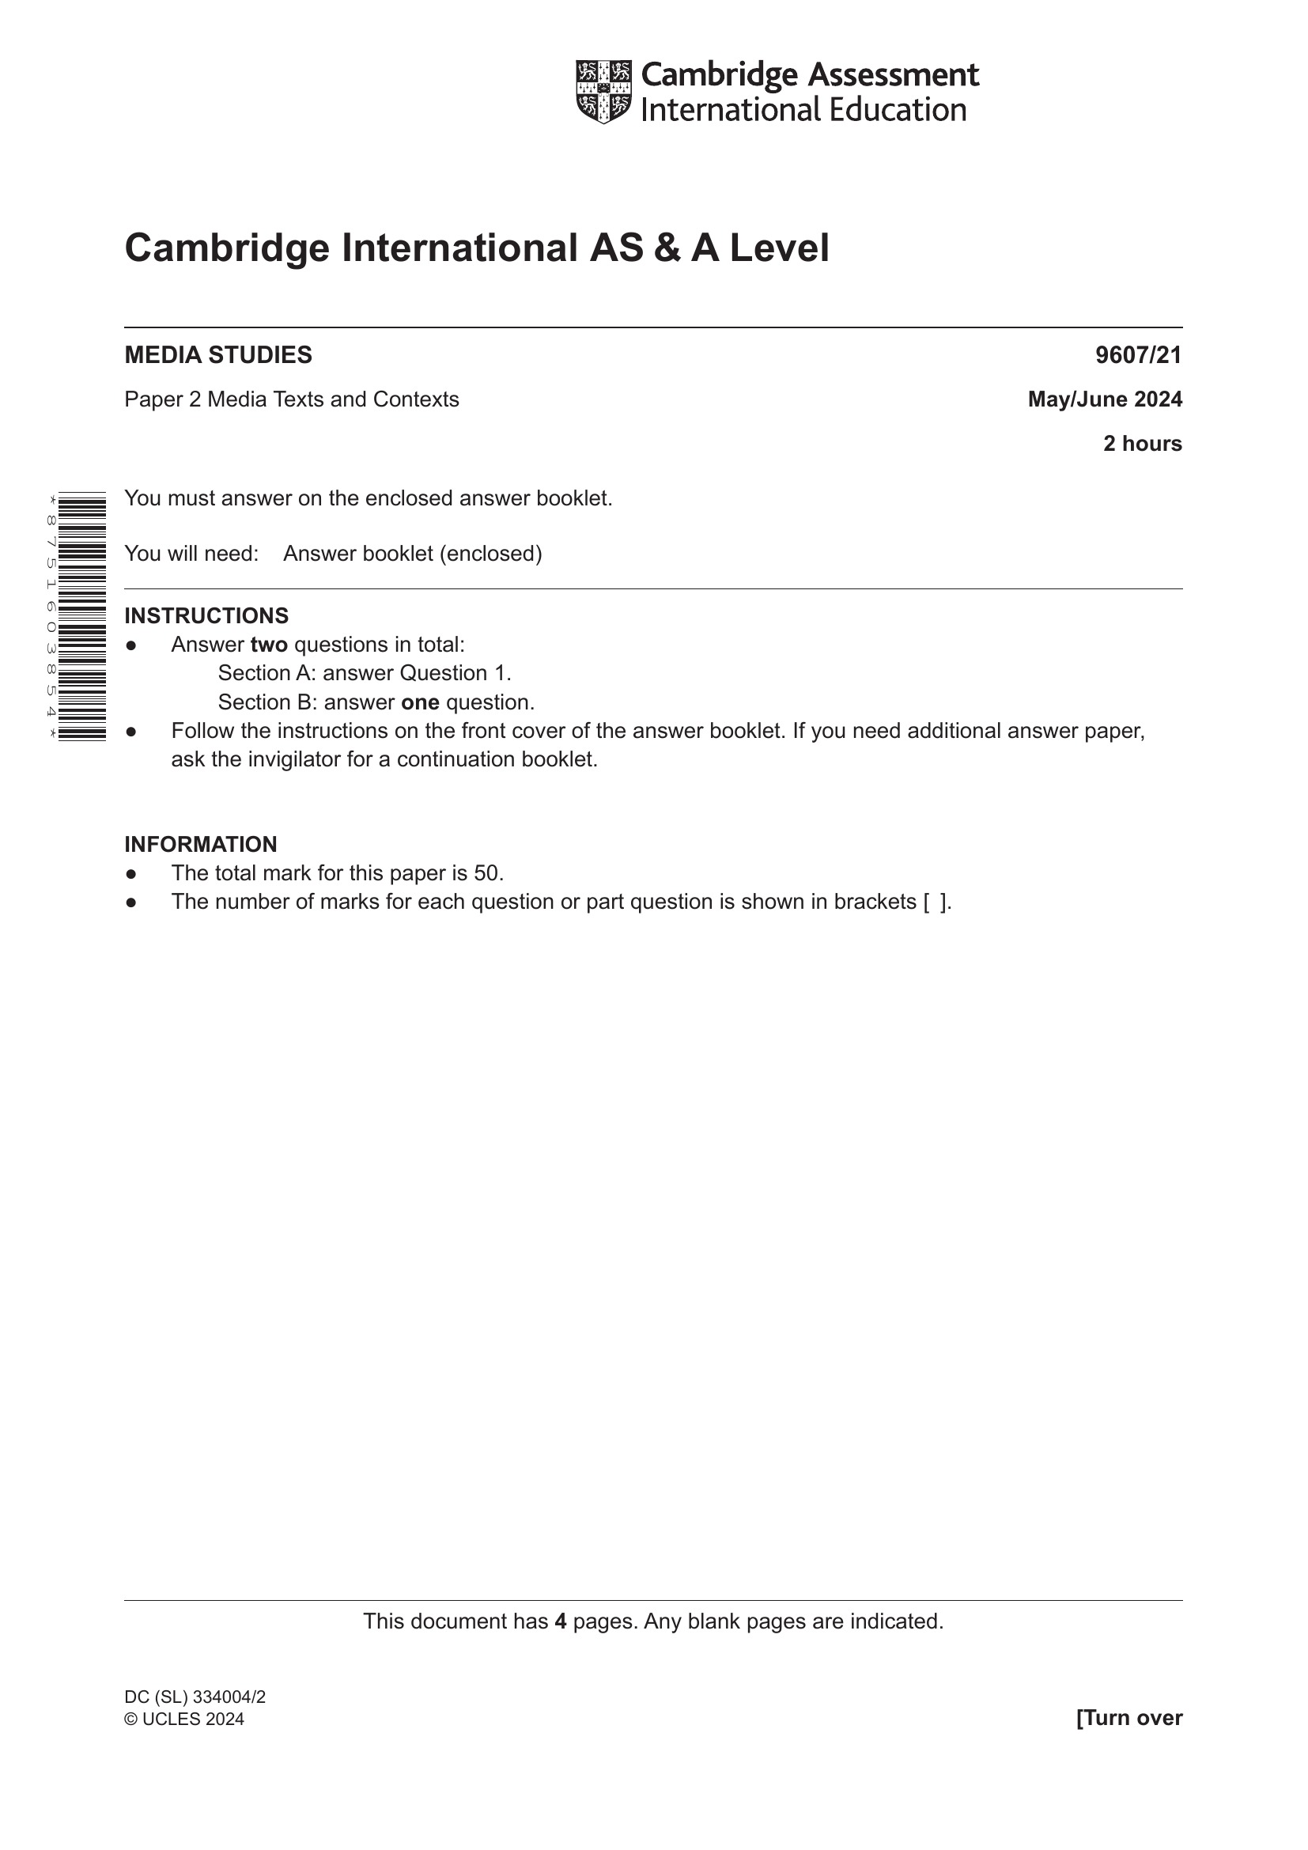
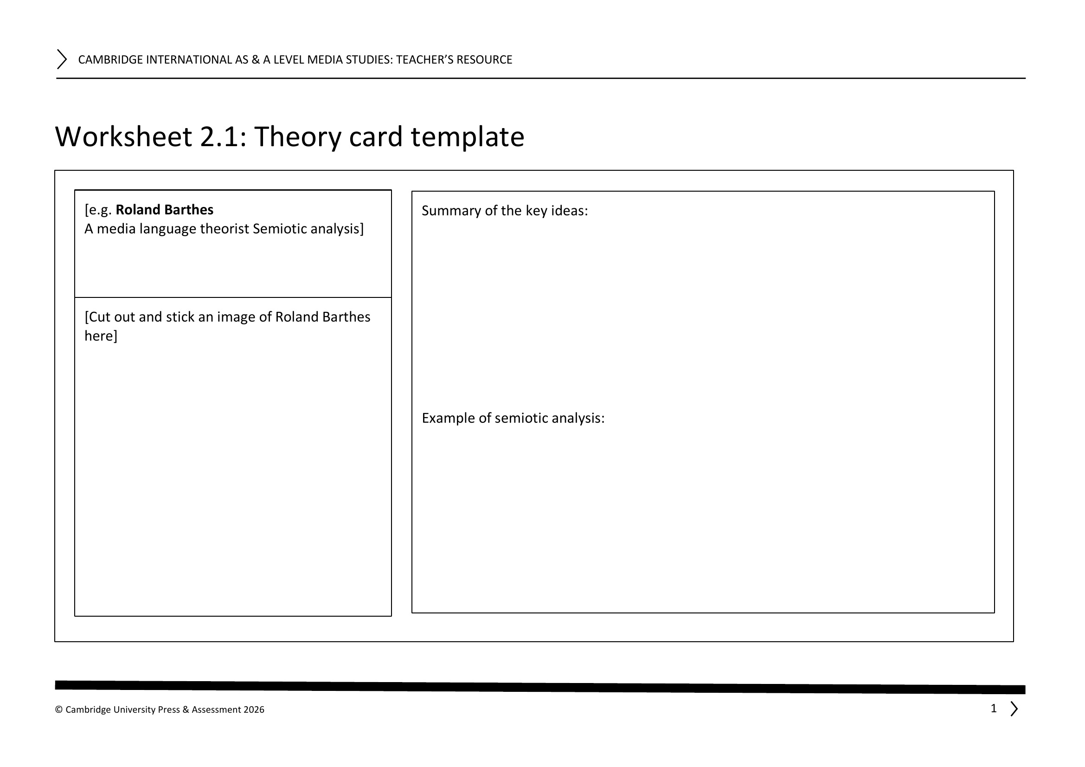
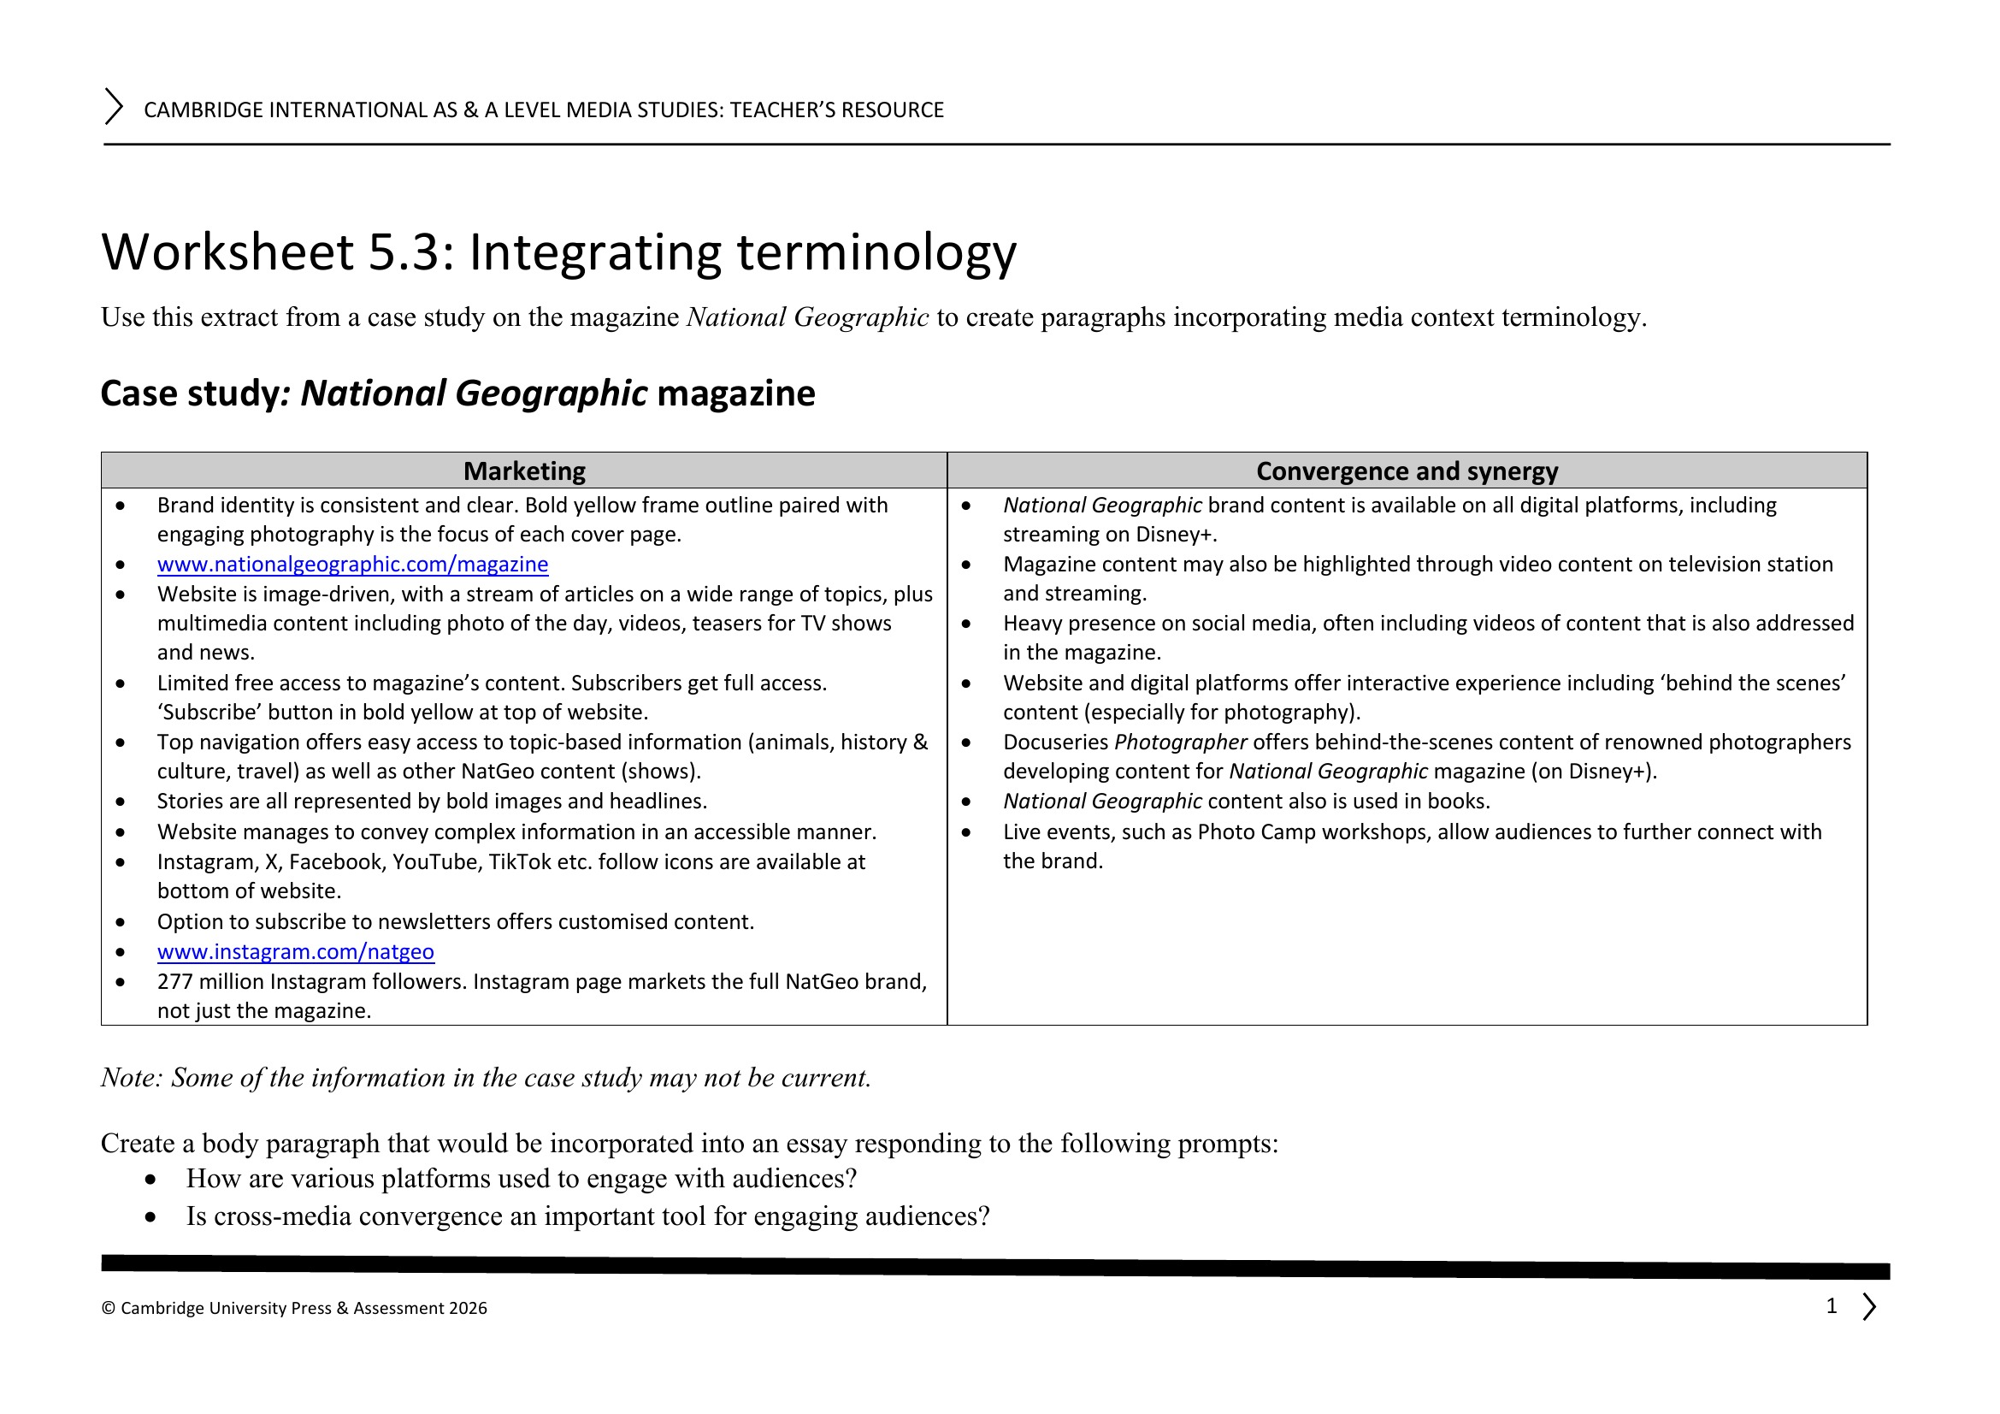
WHAT TRAVELS HOME
THE REVISION SPINE, IN DOCUMENTS
The theory-card deck
The model page
The paper it feeds
WS 2.1, built since Lesson 02: the consolidation spine, due back full
WS 5.3, the National Geographic sheet: what one revision page contains
June 2024 Paper 2 cover: two hours, two questions, fifty marks
MEDIA STUDIES 9607 · SEMESTER I
05
Notes:
Only the revision-card deck and the case-study document travel home; nothing else does. The cover on screen is June 2024 P2/21, the paper the room has already worked with. WS 5.3 is the model of what a page contains, not a sheet to fill.

Slide 11
NEXT
Exam Rehearsal
Lesson 18. Making the exam boring: no surprises left in format, timing, or the mark scheme.
MEDIA STUDIES 9607 · SEMESTER I
06

