Slide 1
XVIII
MEDIA STUDIES 9607 · UNIT VI
Exam
Rehearsal
Revision · Lesson 18 of 19 · the last teaching week
Four days · Mon 4 · Wed 6 (double) · Thu 7 · Fri 8 January
Notes:
The last teaching week is spent making the exam boring: no surprises left in format, timing, or the mark scheme's economics. No Tuesday session; Thursday carries round three and the compare.

Slide 2
XVIII
THE AIM
Make the exam
boring.
Notes:
Musicians rehearse until the score disappears and only the playing is left. Same principle: rehearse the format until nothing about it can surprise you.

Slide 3
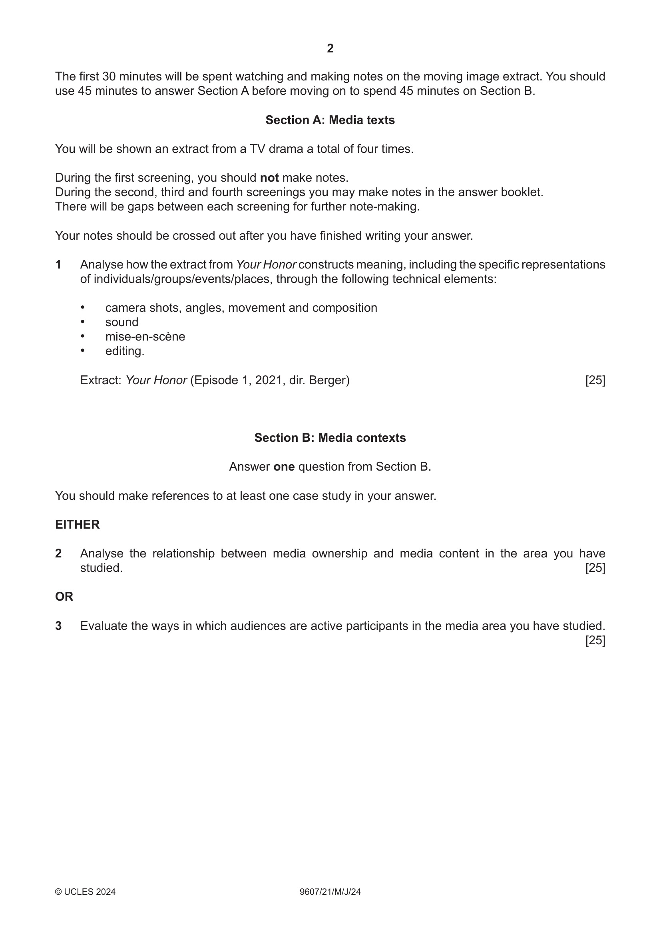
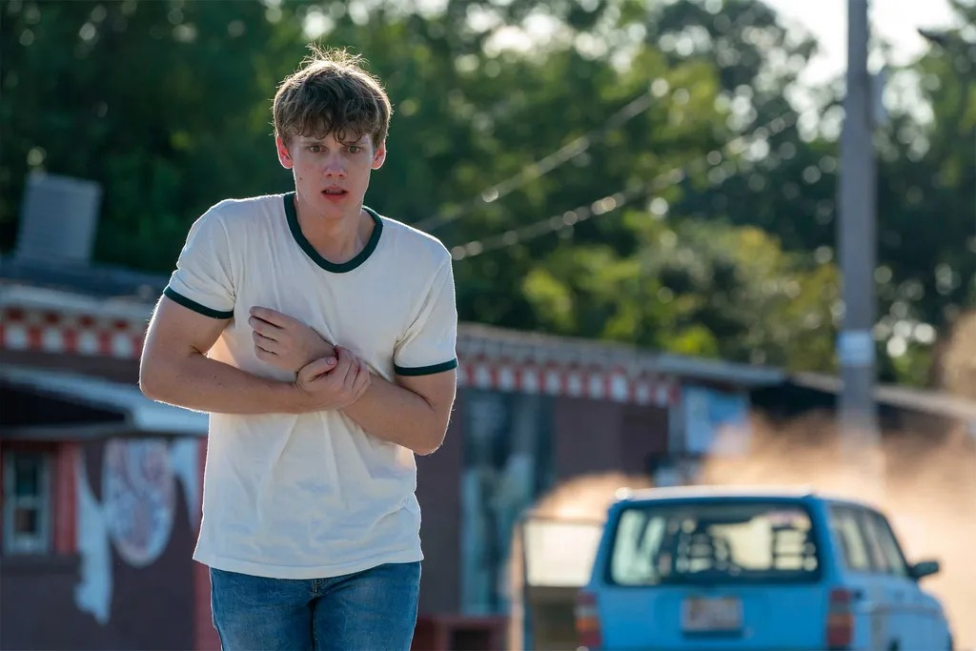
THE REHEARSAL PAPER
SEEN ONCE AT L08; KNOWN COLD BY FRIDAY
Adam Desiato, the extract's main character: the t-shirt, the injury, the middle-class Volvo, exactly as the mark scheme reads them
Showtime, Your Honor, S1 E1 'Part One' (2020), publicity still
June 2024 Paper 2/21, the whole paper on one page
MEDIA STUDIES 9607 · SEMESTER I
01
Notes:
The room met this paper at L08 as the held rehearsal text and sat A1 on the same format. This week the full paper is walked end to end on the rubric's own clock: 30 viewing, 45 Section A, 45 Section B, the frozen stem read aloud. The June 2025 variants stay sealed for the S2 mocks.

Slide 4
“
We are what we repeatedly do. Excellence, then, is not an act, but a habit.
Will Durant, on Aristotle, 1926
IN PLAIN WORDS You become what you practice. Practice the exam until doing it well is normal.

Slide 5
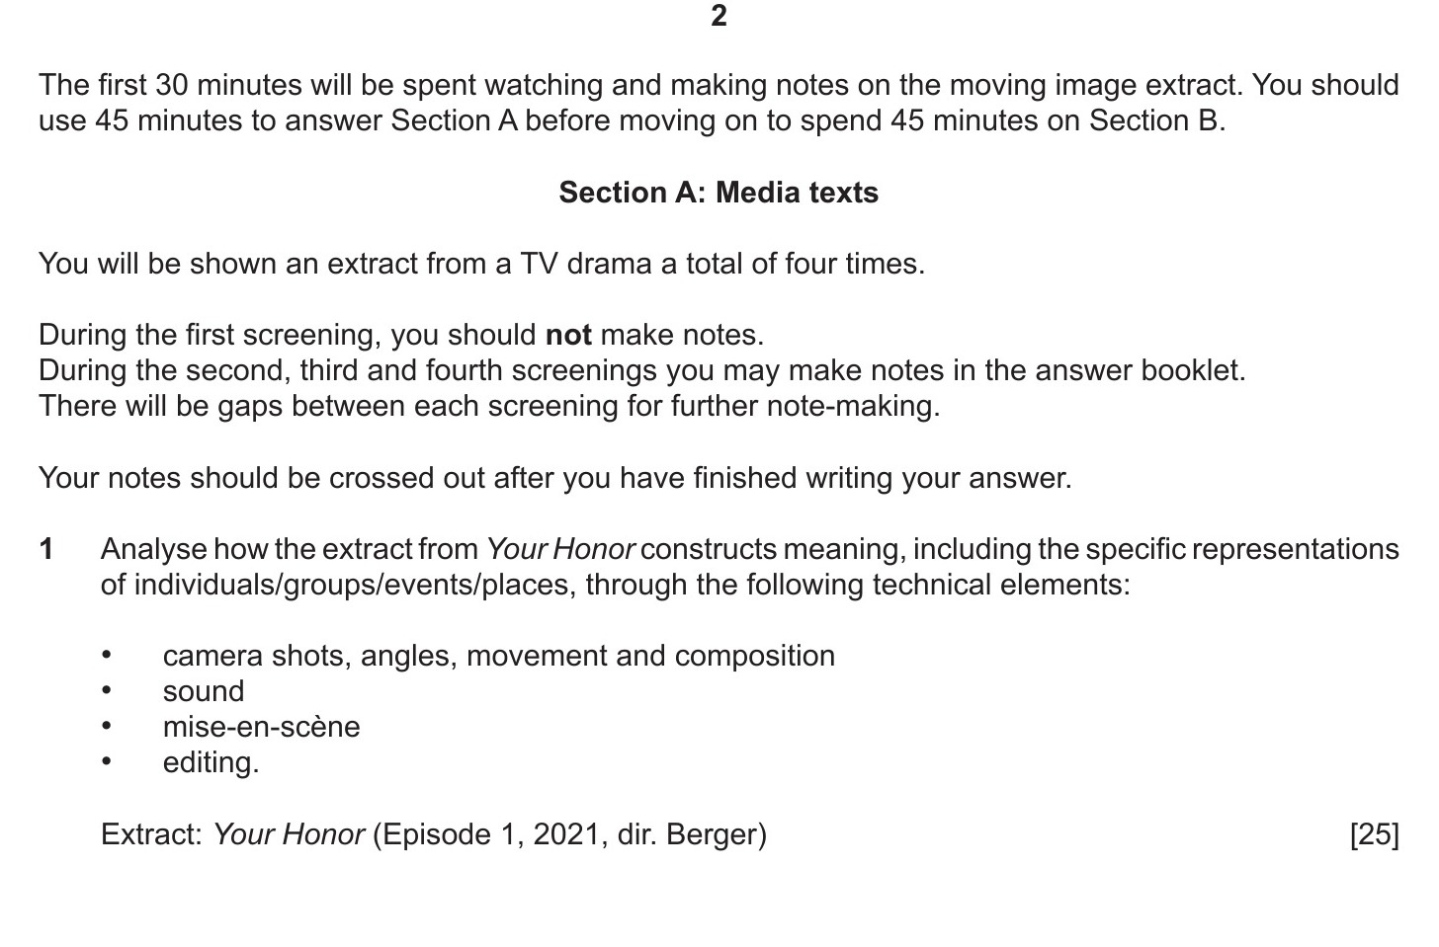
THE PAPER, END TO END
THE RUBRIC'S OWN CLOCK
Two hours, three segments
30 min
45 min
45 min
Viewing and notes
Section A
Section B
The rubric and the frozen Q1 stem, verbatim: four screenings, no notes on the first, notes crossed out. Know it cold.
MEDIA STUDIES 9607 · SEMESTER I
02
Notes:
Write your own minute budget inside each section: paragraphs, plan time, check time. A promise to Wednesday. The page on screen is the June 2024 paper's own wording; every sitting reuses the stem.

Slide 6
PLANS AGAINST THE CLOCK
THREE ROUNDS, FIVE MINUTES EACH
Read, plan, pens down at five
DRILL Three rounds. Read the question, plan the four moves plus your case-study facts, stop at five minutes exactly.
WHY Round by round, the plans get denser and calmer. That is the drill working.
SWAP TEST Could a stranger write the essay from your plan? What they cannot see, the examiner will miss too.
MEDIA STUDIES 9607 · SEMESTER I
03
Notes:
Round 1 is modelled: the teacher writes a five-minute plan on the board for one bank question, then photographs it as the exemplar for next year. Bank questions imitate the June 2024 Section B register.

Slide 7
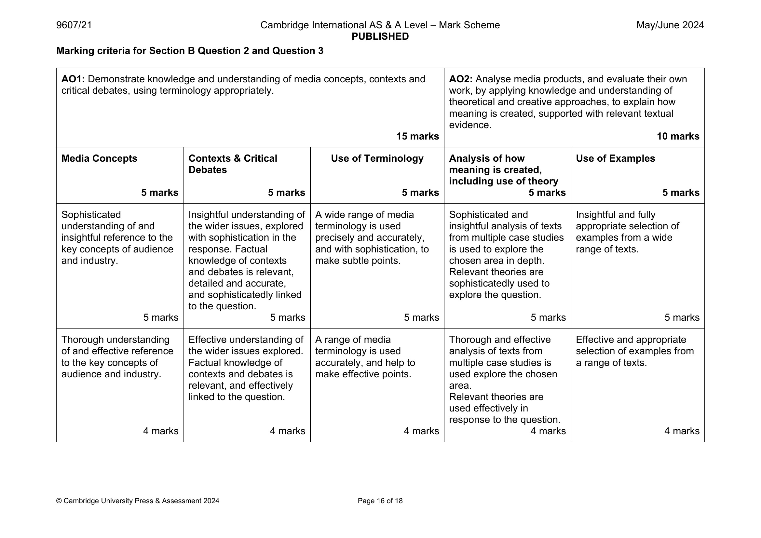
CS13 · FULL DRESS
READING THE SCHEME AS A MARKER
Peer-marked, then moderated
TASK A full Section B, timed exactly, on your own case studies.
THEN Mark a peer's script with the official rubric, band words and all. Closest banding to the moderated mark wins the round.
MODERATION The teacher moderates three scripts aloud, showing where peer marks drifted.
Section B's own grid: audience and industry, multiple case studies
MEDIA STUDIES 9607 · SEMESTER I
04
Notes:
Peer comments follow the WS 4.6 comment-bank style: tick-box rows plus one written action. The grid on screen is the June 2024 Section B page; its concepts criterion reads audience and industry, and its analysis criterion expects multiple case studies in the top bands, which is why one case study caps the band.

Slide 8
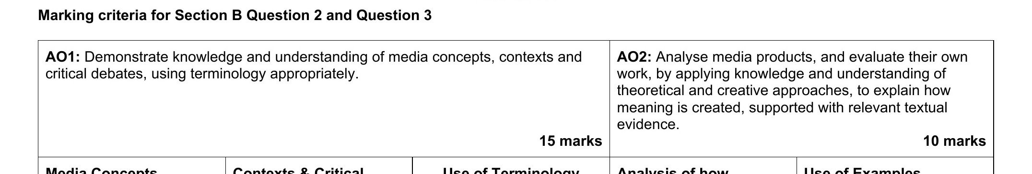
THE AO ECONOMY
WHERE THE 25 MARKS ACTUALLY SIT
AO1 fifteen, AO2 ten
AO1 · 15
AO2 · 10
Concepts · Contexts · Terminology
Analysis · Examples
READ IT The scheme's own header: AO1 15 marks, AO2 10. Five criteria, five marks each.
TASK Map it against your CS13 result: which criteria do you feed? Which do you starve?
MEDIA STUDIES 9607 · SEMESTER I
05
Notes:
Best-fit per criterion, five criteria of five marks. The header strip is from the Section B pages of the June 2024 scheme; Section A prints the identical economy.

Slide 9
LEAVING WITH IT IN WRITING
Two loss points.
Two counter-moves.
Each student leaves with two named places marks leak, and the fix for each, on one card: I list techniques without effects, so every technique gets a 'so that' clause.
Notes:
The card is personal calibration output from CS13 and the A4 review, written before the room leaves on Friday.

Slide 10
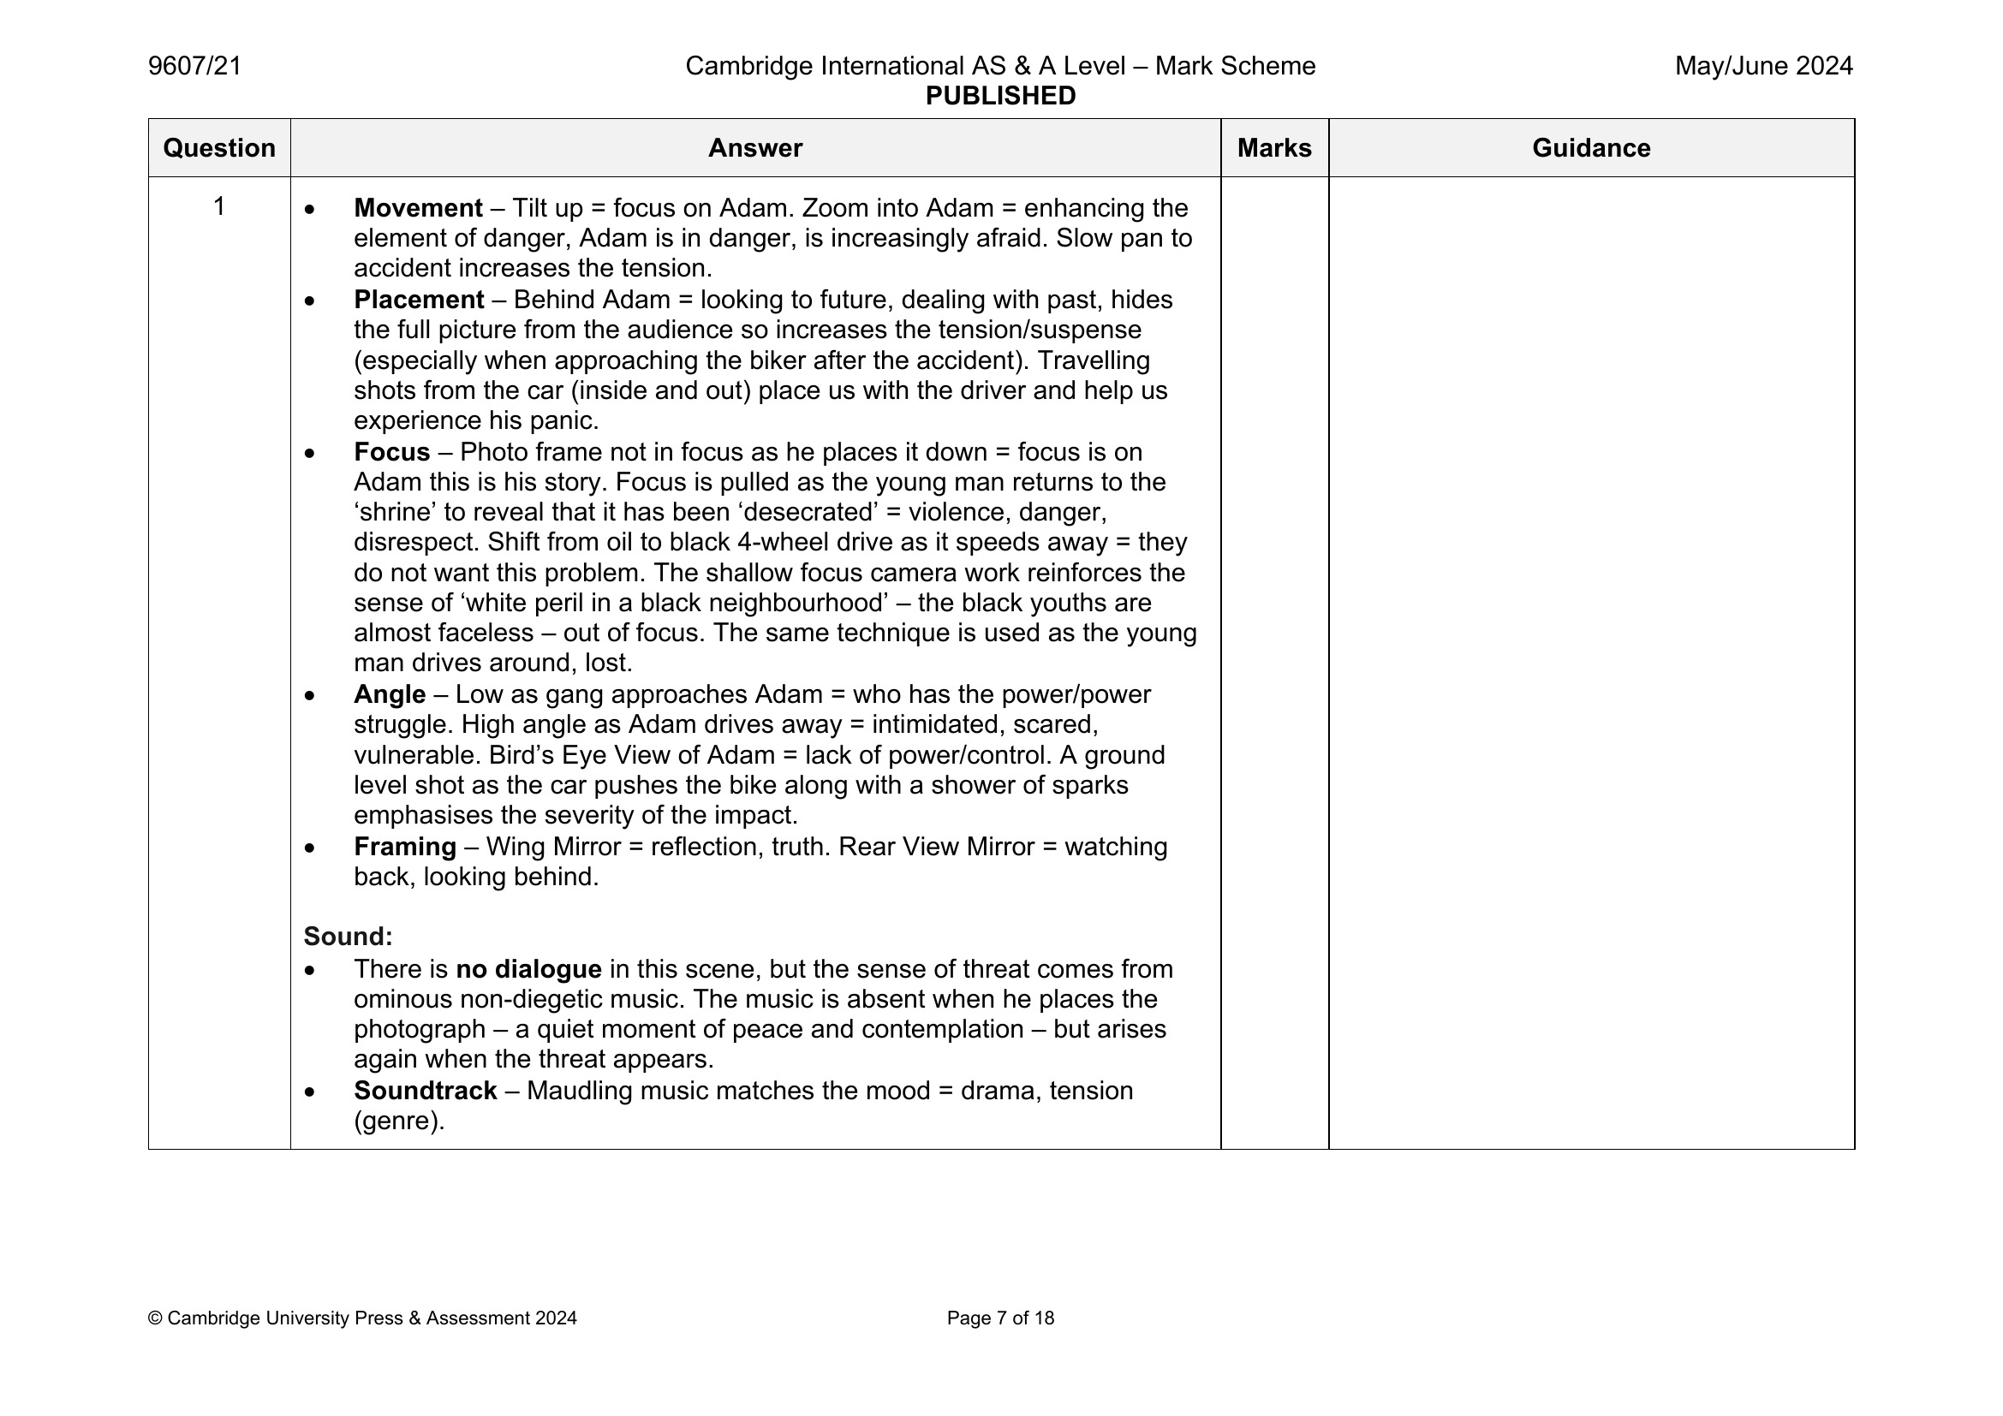
THE EXAMINER'S OWN SENTENCES
TECHNIQUE, THEN EFFECT, EVERY LINE
Read one line aloud
Every line pairs a technique with its effect. Tilt up: focus on Adam. Low angle: who has power. Copy this shape in your own sentences. Write like the people who mark you.
June 2024 mark scheme, the Your Honor worked reading: movement, placement, focus, angle
MEDIA STUDIES 9607 · SEMESTER I
06
Notes:
This is the debrief exemplar the plan names: the official annotated model reading. Students pick one line, read it aloud, and imitate its shape on their own extract sentence.

Slide 11
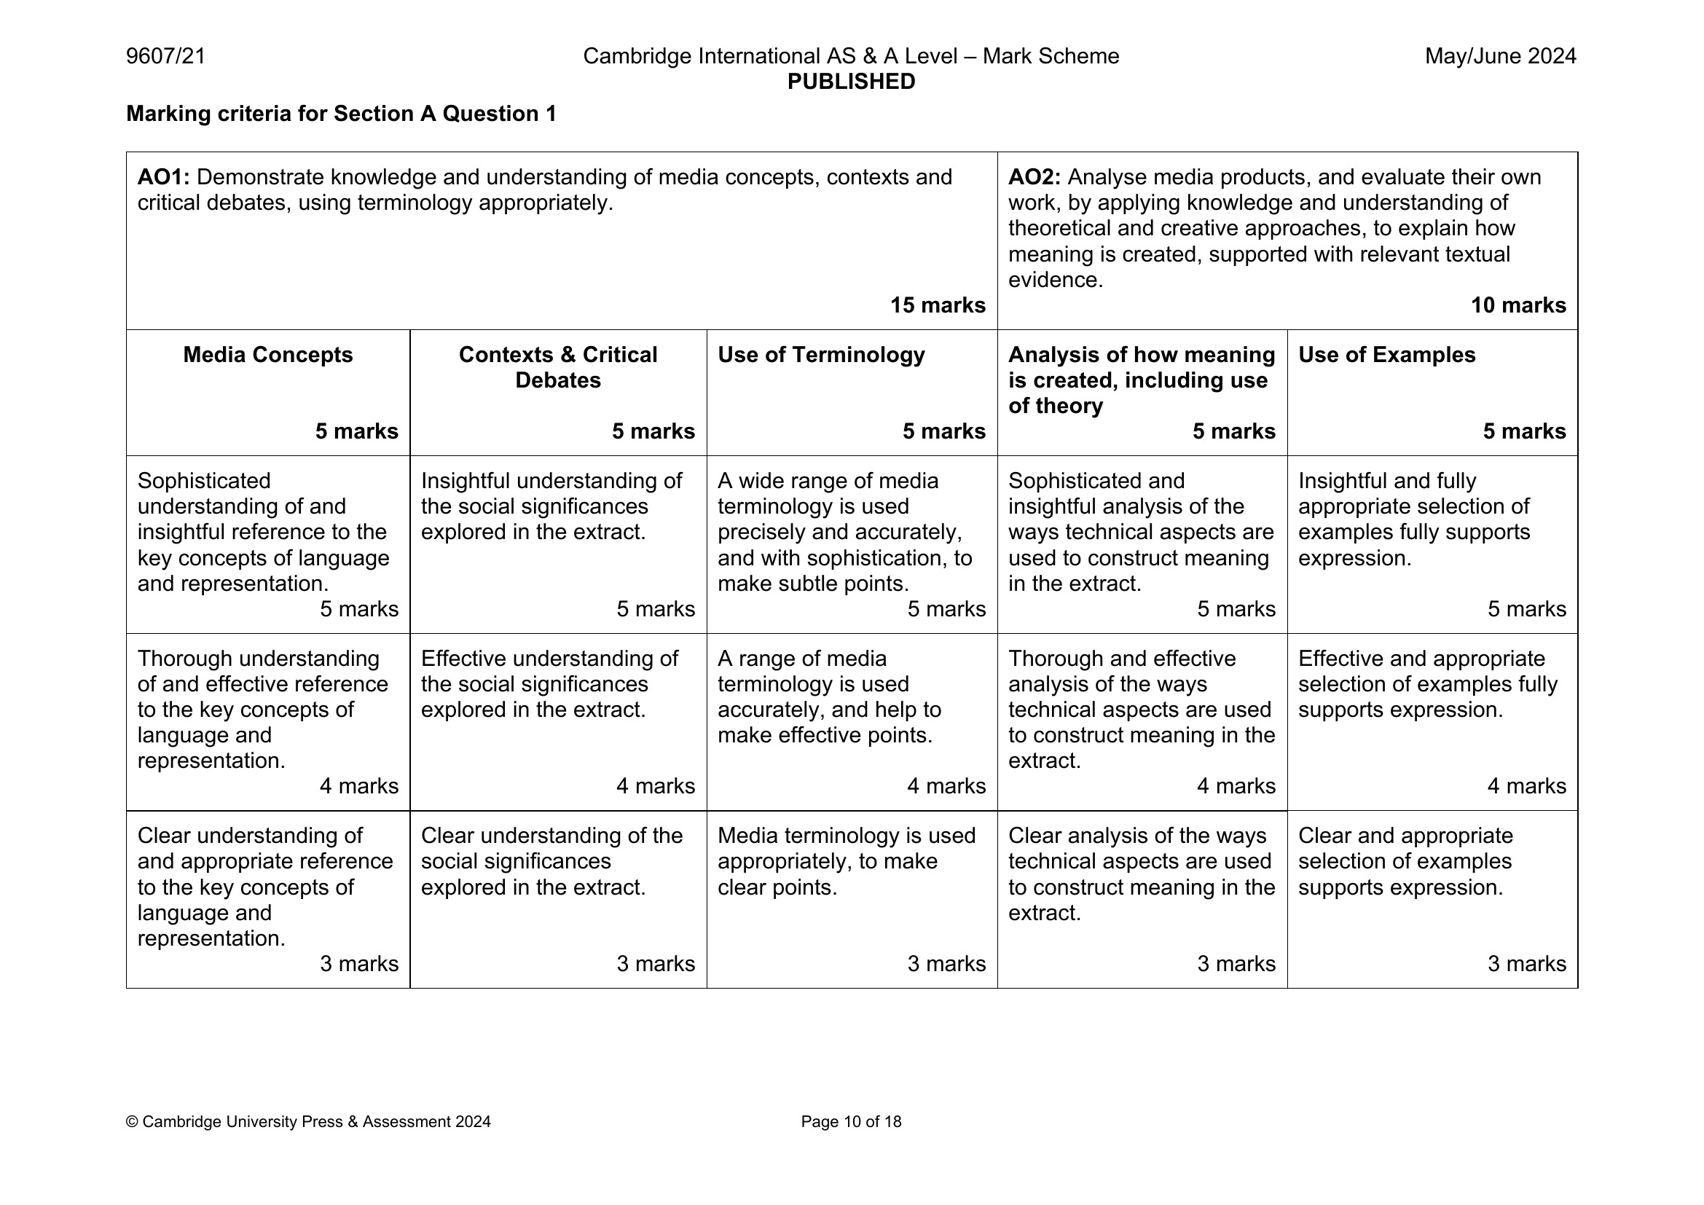
SAME LADDER, DIFFERENT WORDS
ONE ECONOMY, TWO VOCABULARIES
Section A: language and representation, of the extract
Section B: audience and industry, from multiple case studies
KEY POINT Section B uses the same five criteria, in different words. Treat it as a free essay and you give the marks away twice.
MEDIA STUDIES 9607 · SEMESTER I
07
Notes:
The two grids side by side end the assume-an-essay-is-marked-differently error. Point at the matching rows: concepts, contexts, terminology, analysis, examples.

Slide 12
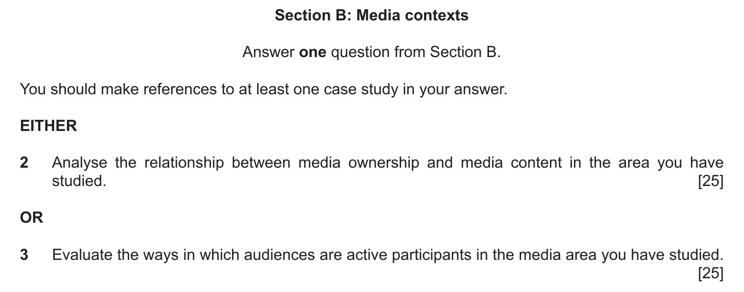
DELIVERABLE · CS13
WEDNESDAY, FULL DRESS
Timed Section B, peer-marked
FORMAT A 45-minute Section B on your own case studies. Peer-marked with the official rubric, then moderated live.
FRIDAY Say the success check from memory: the full paper structure and your per-section minute budget.
LOGISTICS Once, calmly: bring nothing but pens.
The register the bank imitates: June 2024, Section B
MEDIA STUDIES 9607 · SEMESTER I
08
Notes:
CS13 sits Wednesday 6 January per the register, fed by HW2 which came due Monday. Peer-marked then moderated; comments in the WS 4.6 style.

Slide 13
NEXT
End of Term Exam
and Return
Lesson 19. The semester closes the way Semester 2 will open: with evidence.
MEDIA STUDIES 9607 · SEMESTER I
09

