Slide 1
XIX
MEDIA STUDIES 9607 · UNIT VI
End of Term Exam
and Return
Revision · Lesson 19 of 19
Exam window from Monday 11 January · return and goals Wednesday 20 January
Notes:
The semester closes the way Semester 2 will open: with evidence. The full two-hour paper is sat in the exam window. Teacher-only: the paper is June 2024/22 (Servant, Ep 1, 'Reborn', 00:00 to 05:02, MS 23 in holdings); source the clip in advance, book the screening facilities, and never name the paper before the sitting.

Slide 2
XIX
HOW THE SEMESTER ENDS
Close with
evidence.
Notes:
Not close with a feeling, or a promise: close with evidence, so Semester 2 opens on data the student wrote themselves.

Slide 3
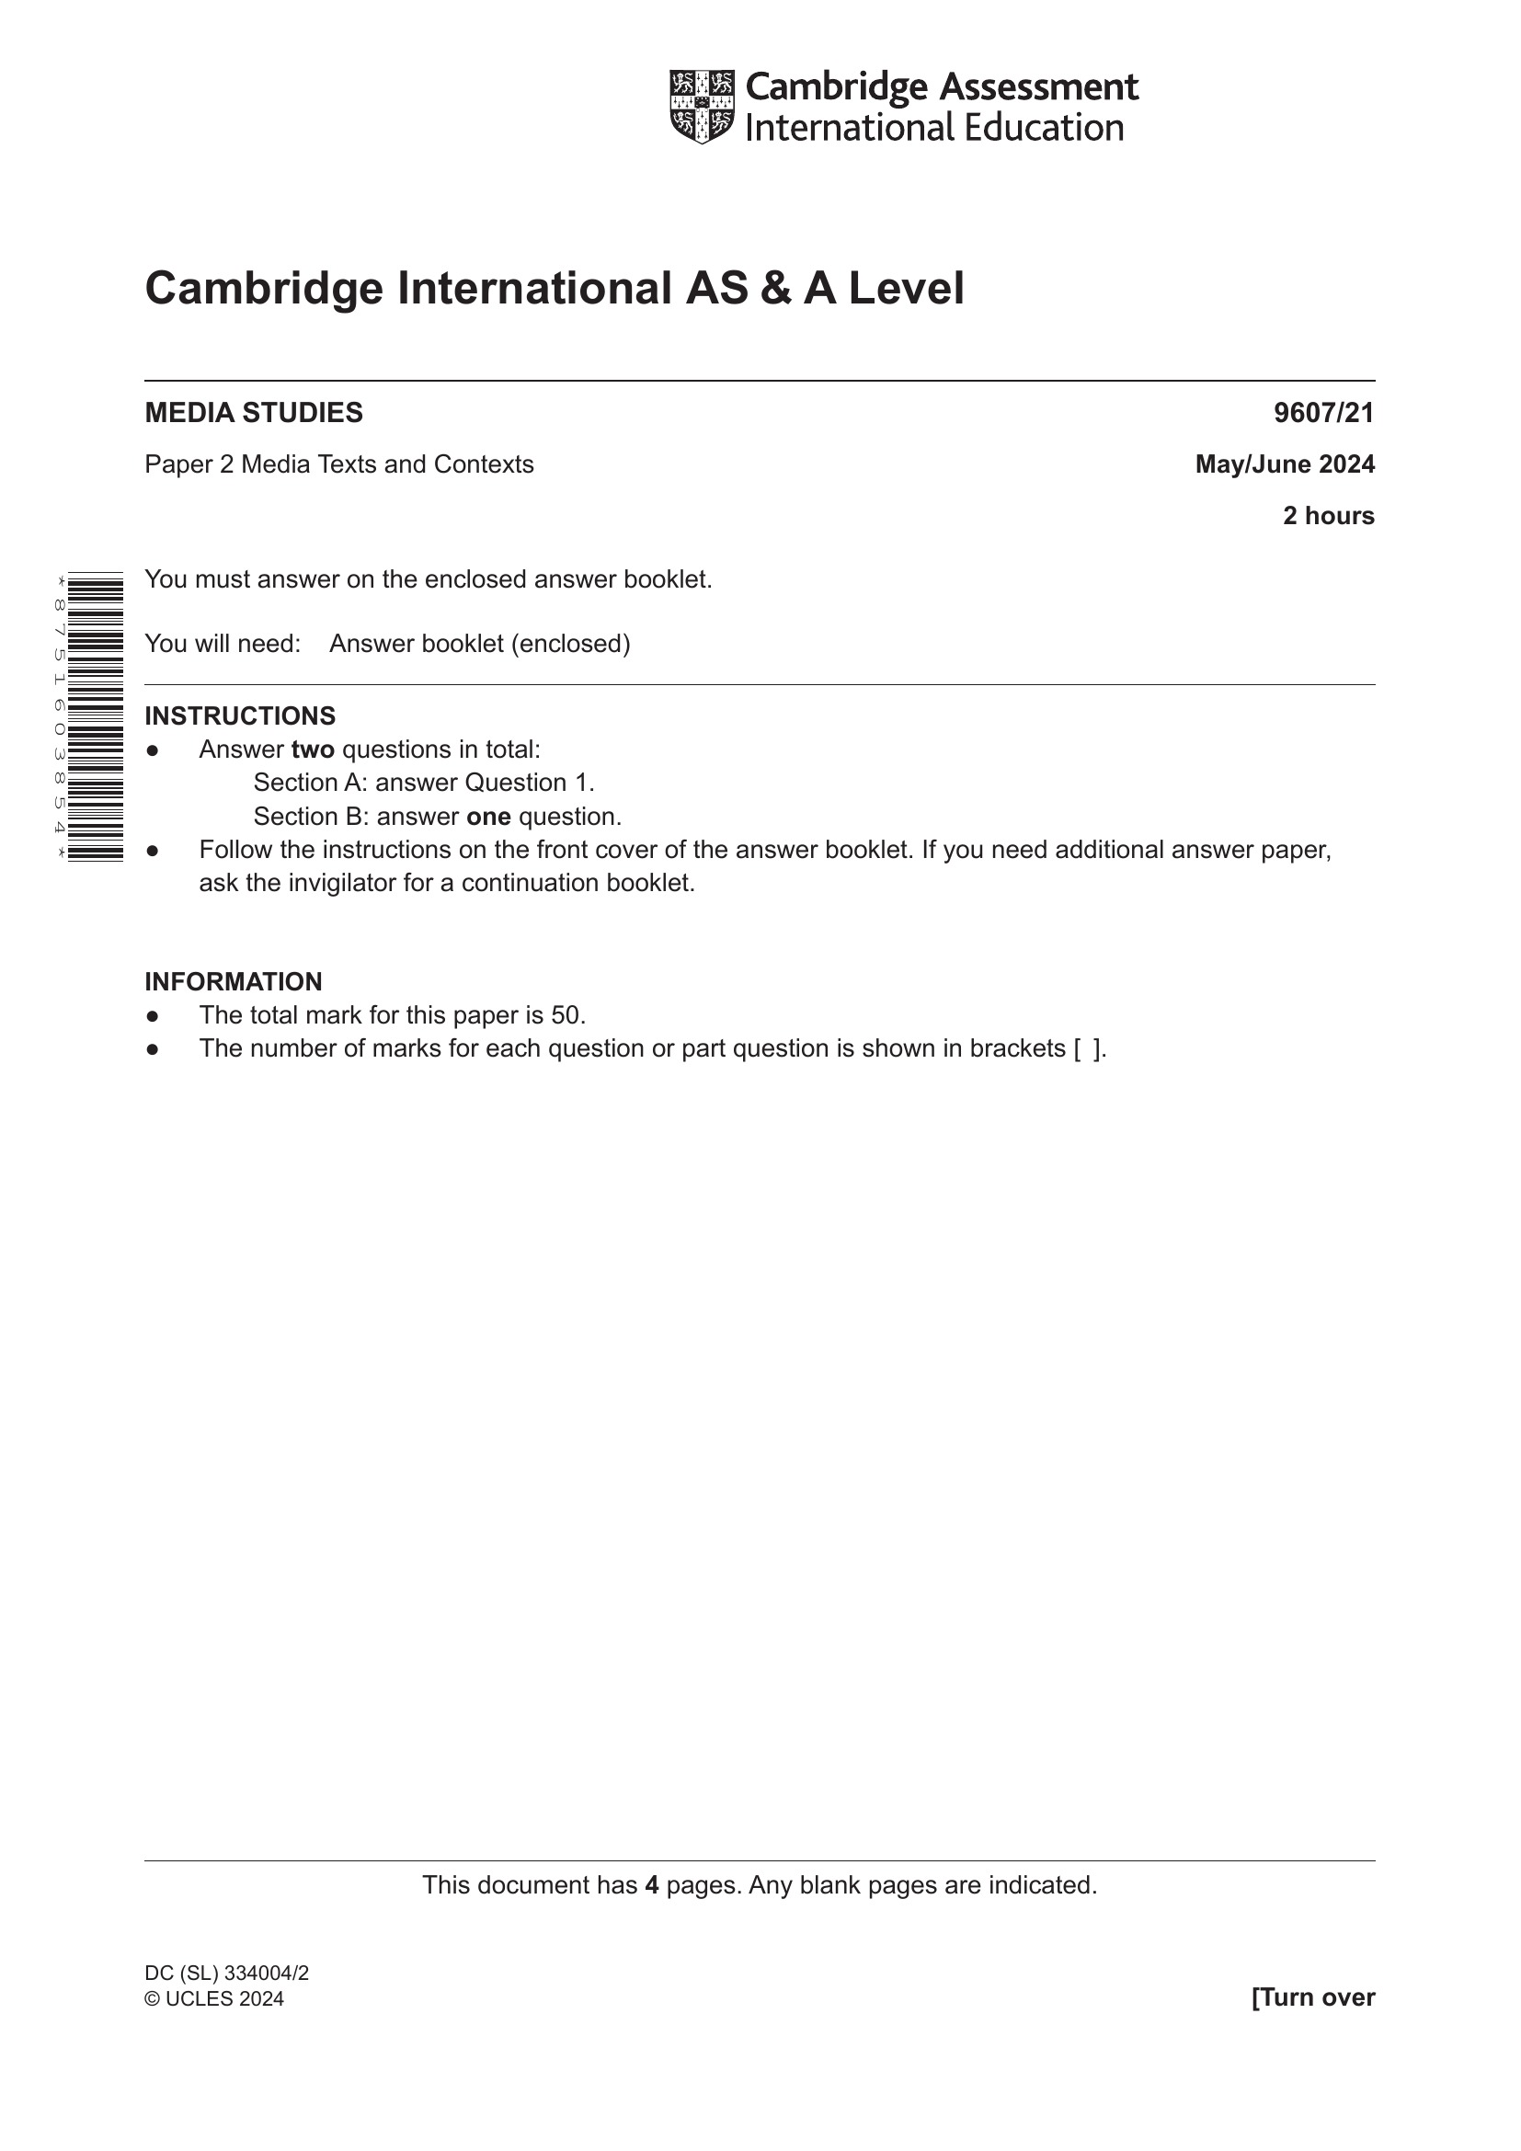
THE EXAM · COMPONENT 2
WINDOW MON 11 TO MON 18 JANUARY
Two hours, the real thing
FORMAT The full Component 2 paper: two hours, exam venue, full conditions.
SECTION A An unseen extract. Thirty minutes of viewing and notes, then forty-five of writing.
SECTION B One essay from the contexts menu, forty-five minutes.
The Section A screening is booked in advance. You bring pens; the format holds no surprises.
What the paper looks like (the June 2024 cover; yours differs only in date)
MEDIA STUDIES 9607 · SEMESTER I
01
Notes:
The cover shown is June 2024/21, the paper the room already worked with; the sitting's own cover is identical in format. The paper is never named before the exam.

Slide 4
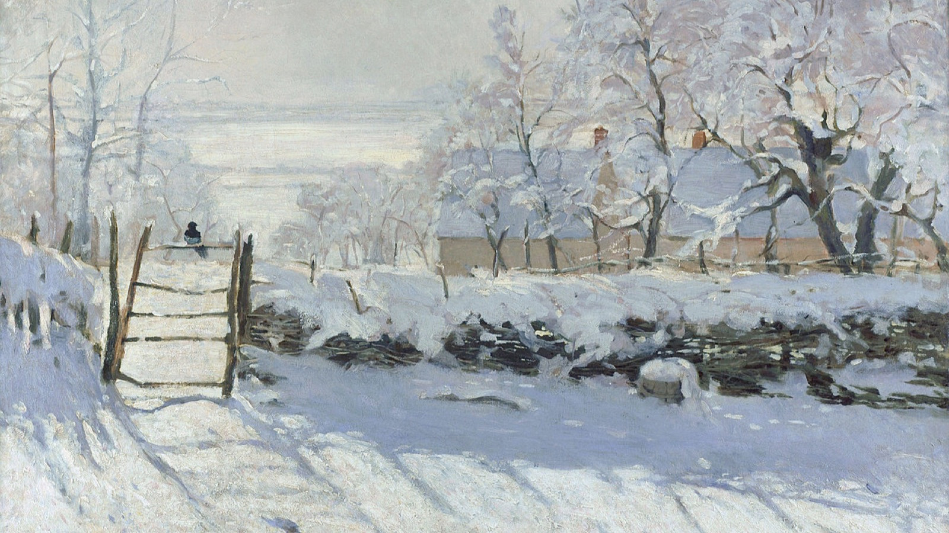
THE WORK IS DONE AND SAT
The paper is written. What is left is the reading of what it says about the term.
Claude Monet, The Magpie, 1869
Notes:
Monet's winter field, after the effort. Shown at the top of the return session to slow the room down before the scripts come back.

Slide 5
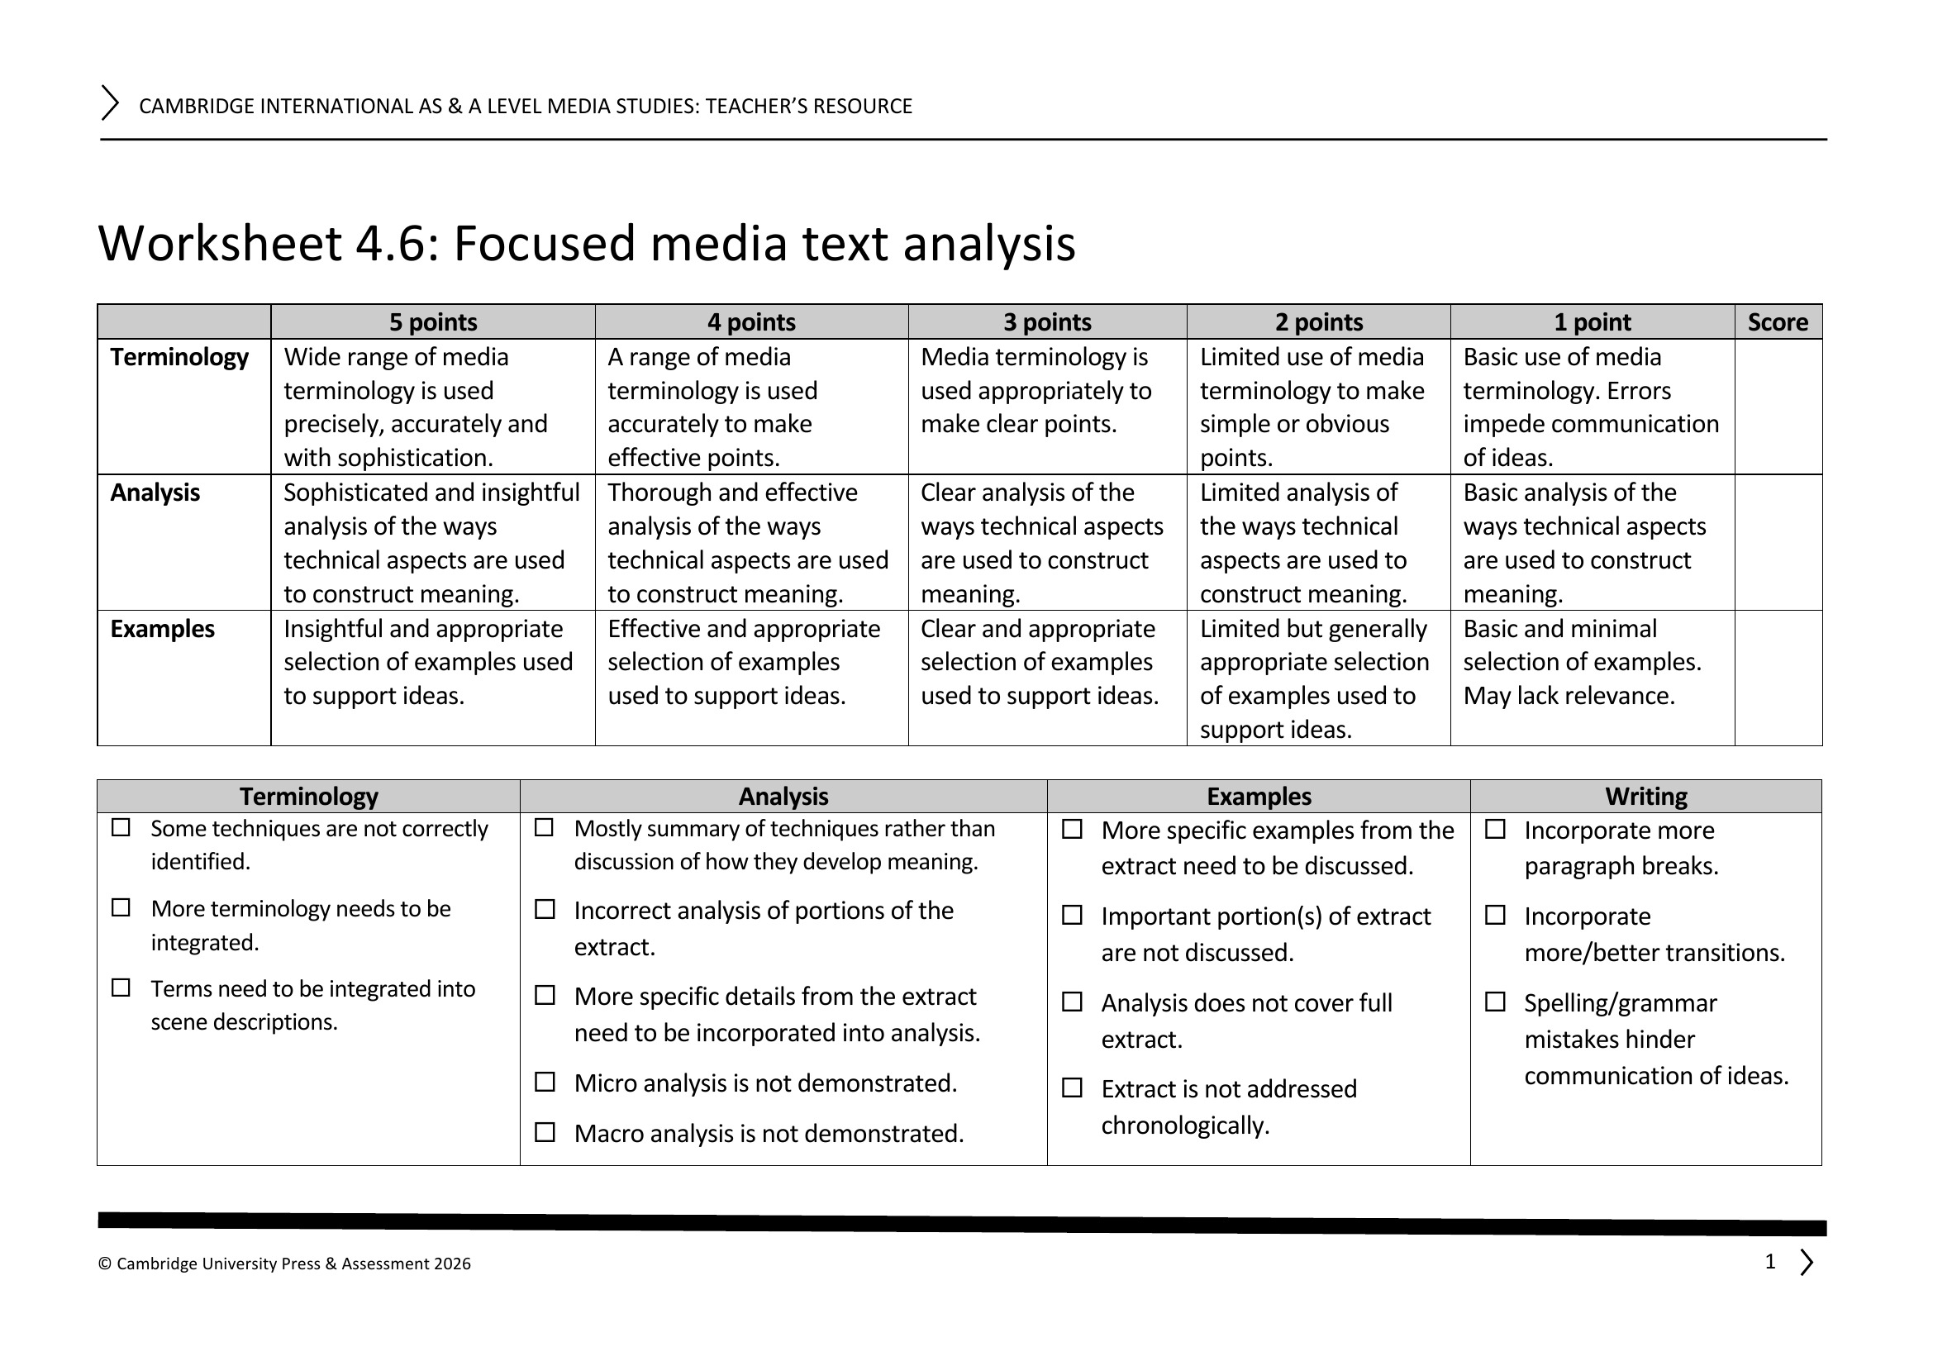
THE RETURN
SELF-ASSESSMENT FIRST, AT FULL DEPTH
The mark, then the gap
Self-band from memory
Scripts face-down; band yourself per criterion from memory of what you wrote, then see the mark. The gap is now a familiar number.
Gaps in AO language
Name your gaps in writing, in AO language, with the script as evidence: not Section B went badly, but AO1 contexts, my case-study facts were pre-2020.
WS 4.6: the instrument behind every per-criterion breakdown handed back today
MEDIA STUDIES 9607 · SEMESTER I
02
Notes:
WS 7.4's peer-editing checklist structures the peer step of the return. The nine-day marking window ran on WS 4.6's comment bank; showing the instrument makes the breakdown legible.

Slide 6
“
To make an end is to make a beginning.
T. S. Eliot, Little Gidding, 1942

Slide 7
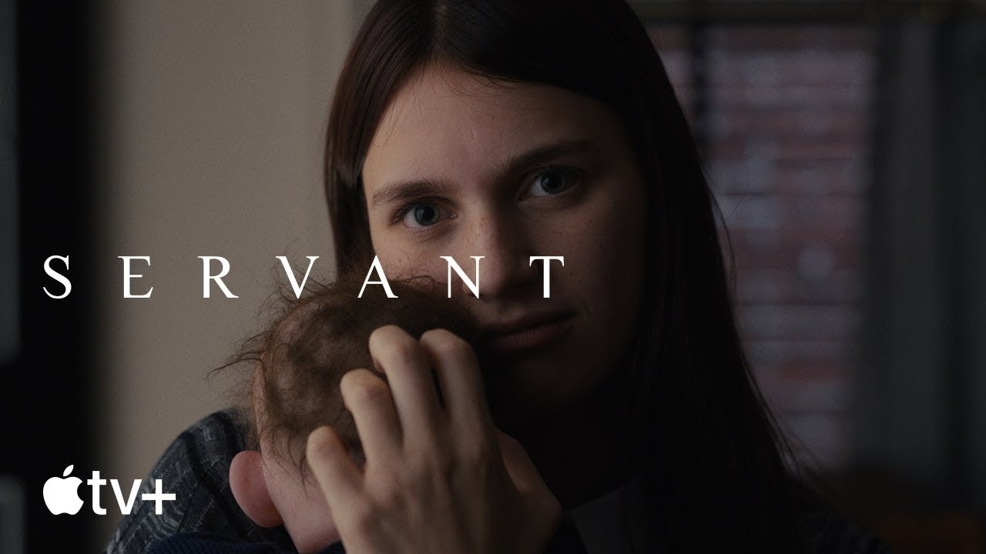
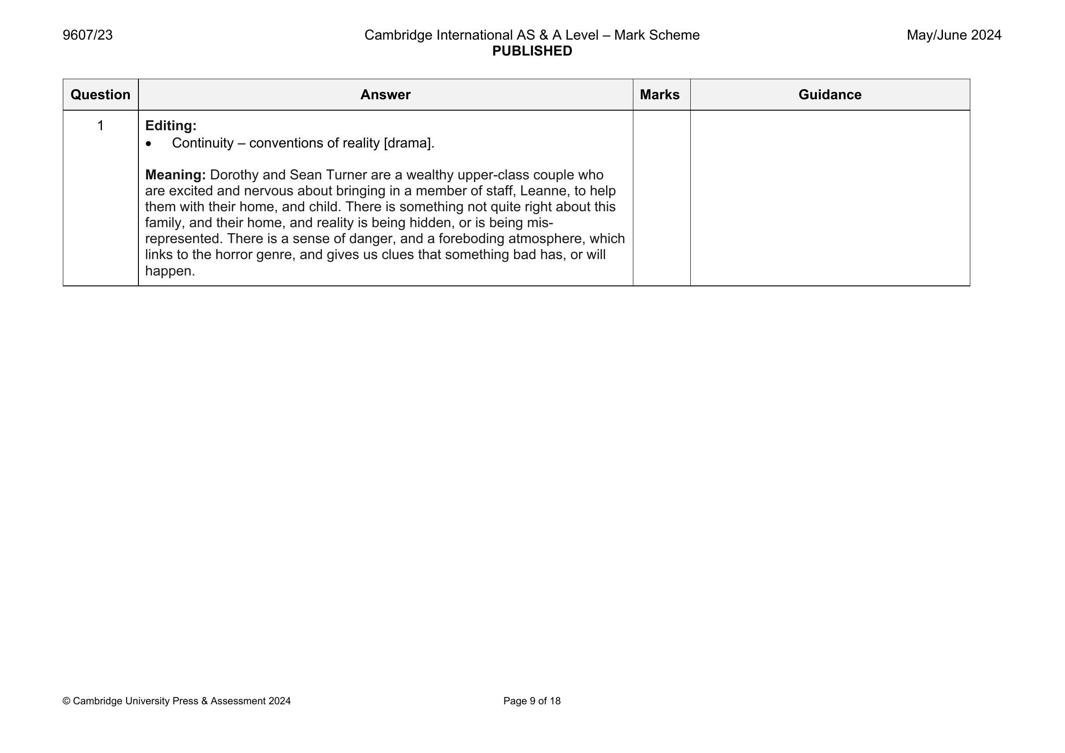
WHAT THE EXAMINERS SAW
RETURN DAY ONLY · AFTER EVERY SCRIPT IS IN
Apple TV+, Servant, S1 E1 'Reborn' (2019), dir. M. Night Shyamalan
The mark scheme's own Meaning paragraph for the extract you sat
READ IT The extract was Servant's opening five minutes. Compare the examiners' reading with what you wrote. That gap is your Semester 2 plan, in miniature.
MEDIA STUDIES 9607 · SEMESTER I
03
Notes:
HARD RULE: this slide is shown on the return day only, after the exam office confirms no make-up sitting is outstanding. If any student has not sat, skip the slide entirely; it names and shows the sealed text. MS 23 pages 6 to 9 carry the full worked reading if the room wants more than the Meaning paragraph.

Slide 8
THE TARGET SHEET
ONE PAGE, BUILT TO BE READ IN FEBRUARY
Four rows, per student
Gap
in AO language: which objective is the shortfall
WORKED EXEMPLAR (FICTIONAL)
Gap
AO1 contexts: my case-study facts were pre-2020.
Evidence
script plus the semester data: A1, A4, EoT
Evidence
EoT Section B, criterion 2 at band 3; A4 the same.
Action
specific and Semester 2 shaped, not a resolution
Review date
a named S2 week, before the first S2 attainment
Action
Rebuild the document's dated-facts row from this year's coverage, two entries a week.
Built to survive being read in February by the person who wrote it in January. Posted as LB7.
Review date
W3 of Semester 2, before the first S2 attainment.
MEDIA STUDIES 9607 · SEMESTER I
04
Notes:
The exemplar is written for a fictional student on the plan's own model sentence; it shows the grain of a usable sheet. Review dates land in a named S2 week, before the first S2 attainment.

Slide 9
SAID WITH THE NUMBERS
The gap has been
shrinking since October.
The distance between what you thought you wrote and what you scored: A1, A4, EoT, the same five criteria each time. For most of you it narrowed. Say that out loud, with the numbers.
Notes:
The thread runs through the three sittings marked on the Section A criteria: A1, A4, EoT. A3 is the portfolio on a different rubric and sits outside this thread; its self-band lives in the L14 return.

Slide 10
THE CLOSE
SEMESTER 2, PREVIEWED HONESTLY
Two living artifacts cross the break
THE RE-VOTE September's question again: “I'm not impacted by media.” Hands up. The count goes next to week one's count.
SPRING C1 goes to Cambridge. The film-industry case study opens. Paper 2 sits in June.
CARRY THESE The theory-card deck (since Lesson 02) and the case-study document (since Lesson 15). These two are the memory.
Grades and comments due today. The semester ends with every promise the register made, kept.
MEDIA STUDIES 9607 · SEMESTER I
05
Notes:
Wager procedure: same wording as September, hands up, count recorded beside the week-one number. The coursebook's U6 to U8 numbering is its own, not a calendar; do not read it as one aloud.

Slide 11
I
SEMESTER I COMPLETE
The theory cards and
the case study travel home.
Nineteen lessons, one arc: media language to the exam that tests it. Semester II opens with evidence.
MEDIA STUDIES 9607 · SEMESTER I
06

