Slide 1
III
CAMBRIDGE INTERNATIONAL · 9479
The Three
Components
What each one is, and what it wants from you
Notes:
Worth an hour early. Students who understand the three components in September stop asking why a semester is shaped the way it is.

Slide 2
50
WHERE THE MARKS ARE
Half the A Level is
one investigation.
Notes:
C3 is 50 per cent on its own. Say it now, because it explains why semesters two and three are both given to it.

Slide 3
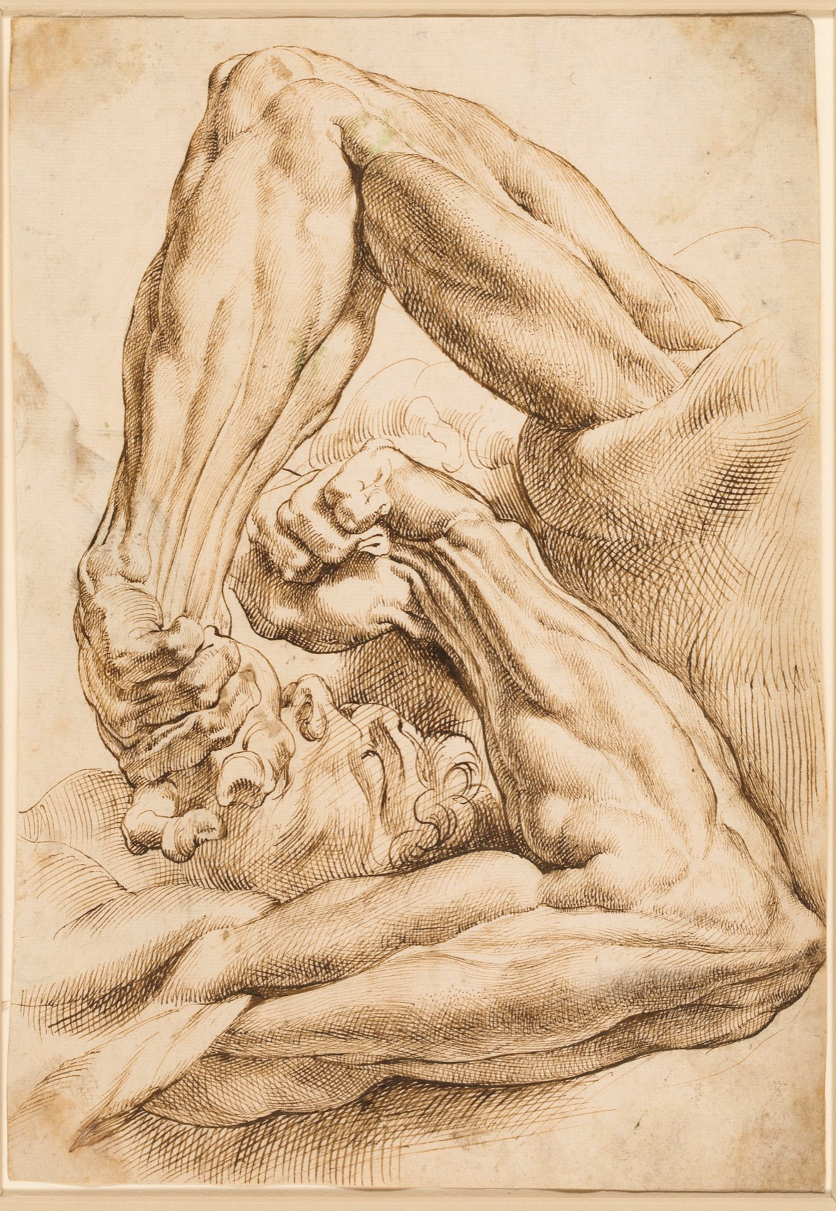
COMPONENT 1
The Portfolio
A selection of work made over the course, chosen and sequenced by you. Set internally, marked by Cambridge. This is what Semester 1 builds, from a theme you pick off a menu, so that the process is learned before the stakes rise.
Marks
60, weighted to 90
Weight
30 per cent of the A Level
AO split
15 / 15 / 20 / 10
Built in
Semester 1
Peter Paul Rubens, sheet of studies. Public domain

Slide 4
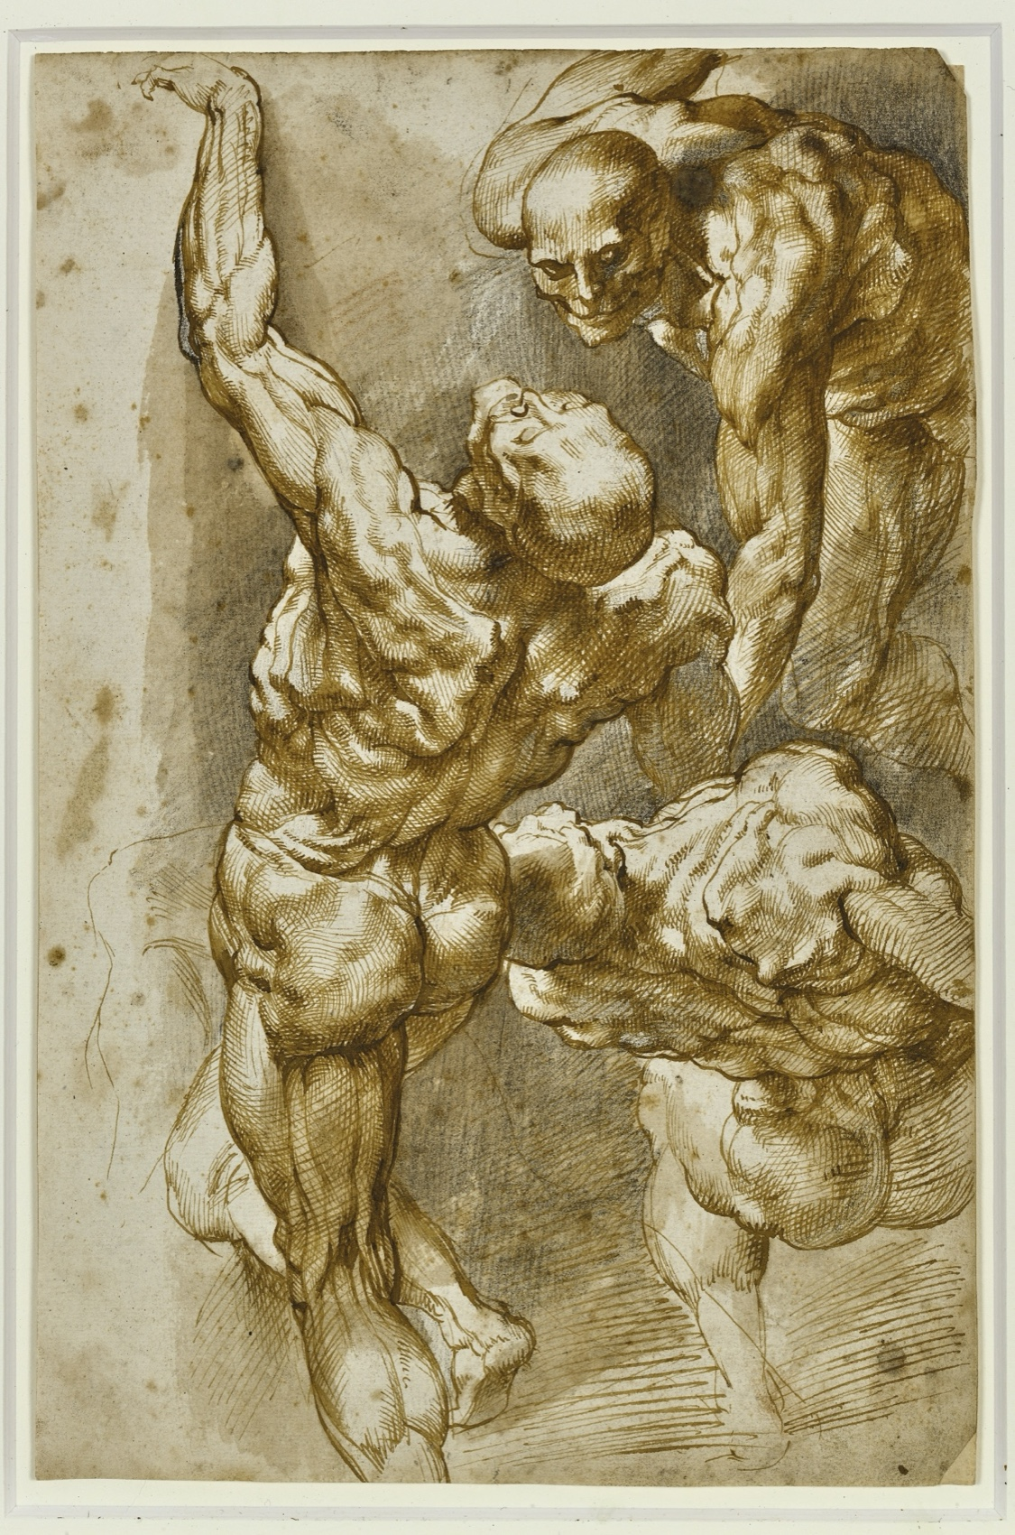
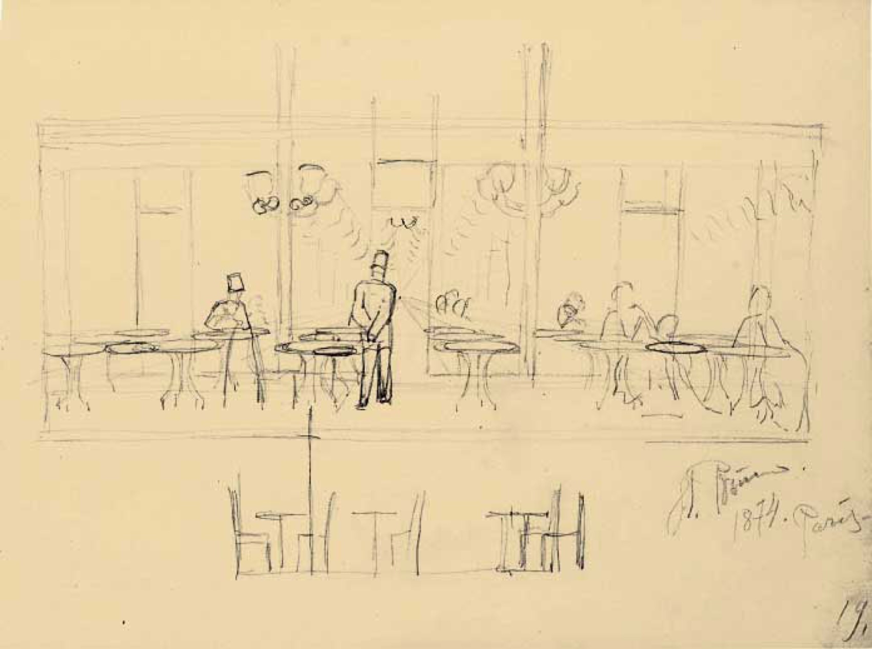
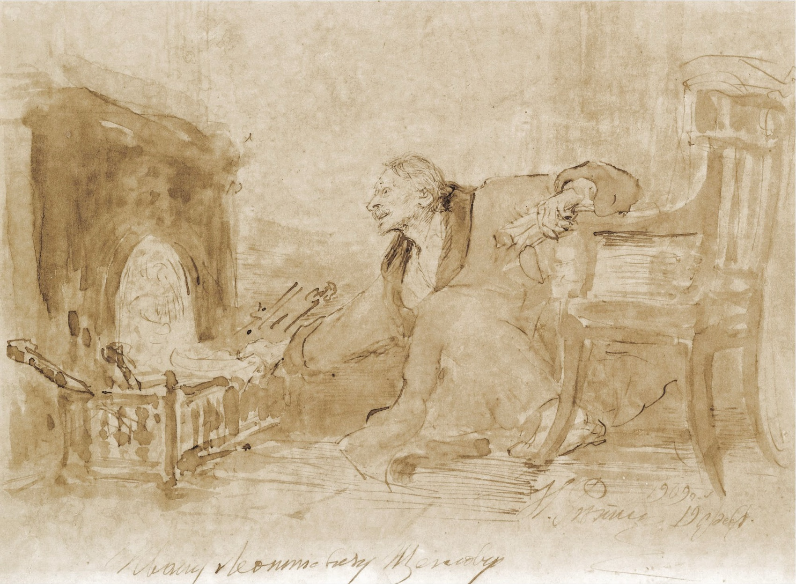
COMPONENT 1 · EXAMPLE
WHAT IS ACTUALLY IN THE FOLDER
A portfolio is a sequence, not a pile
Recording
Exploring
Developing
First-hand studies, sustained
Media tests and artist work
Compositions toward one outcome
Plates: Rubens and Repin, public domain. Shown whole, as study material rather than as a model to copy.
A LEVEL ART & DESIGN 9479
01

Slide 5
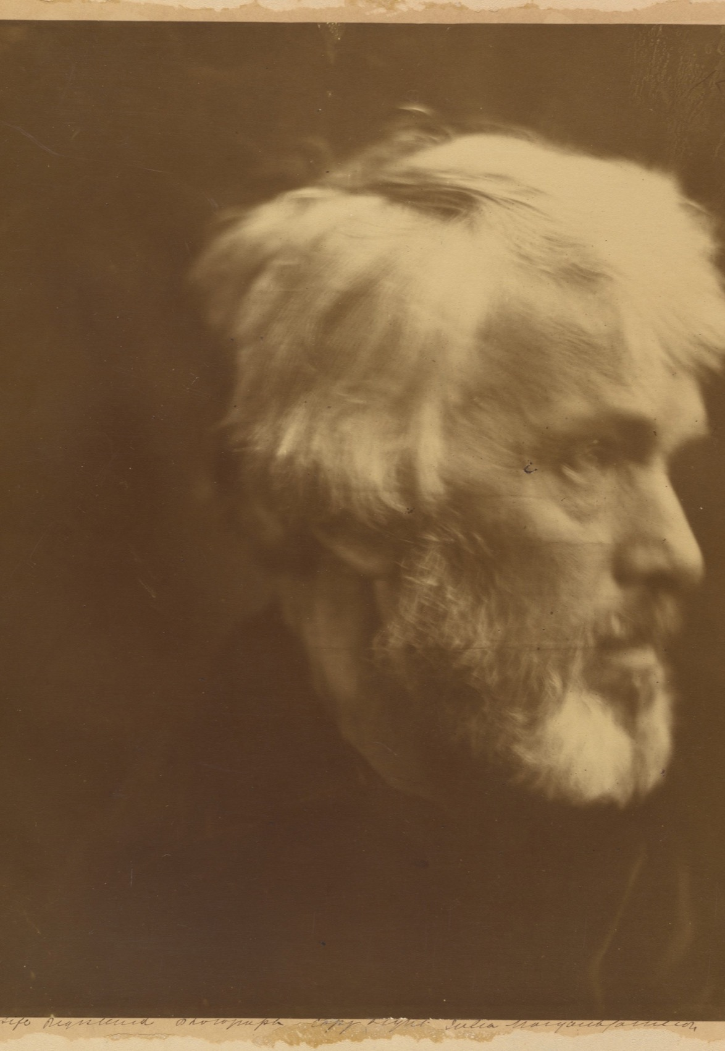
COMPONENT 2
The Externally
Set Assignment
A question paper arrives with three themes on it. You choose one, make supporting studies over a preparatory period, then realise the final outcome inside a 15-hour supervised test. Nothing may be invented in the test room: what you make there is what you planned before it.
Marks
60
Weight
20 per cent of the A Level
AO split
15 / 15 / 15 / 15
Sat in
Semester 4, spring 2028
Julia Margaret Cameron, Thomas Carlyle. Public domain

Slide 6
COMPONENT 2 · EXAMPLE
HOW THE 15 HOURS ACTUALLY WORK
The test realises a plan. It does not make one.
Before
During
After
The paper is released and you choose one of three themes. Recording, exploration and development all happen here, at pace, and the final composition is planned down to palette and materials.
15 supervised hours across several sittings. Work is stored securely between them and you have no access to it. You realise the piece you planned.
The outcome is photographed, the package is assembled exactly as the specification orders it, and it goes to the board with C1 and C3.
A LEVEL ART & DESIGN 9479
02

Slide 7
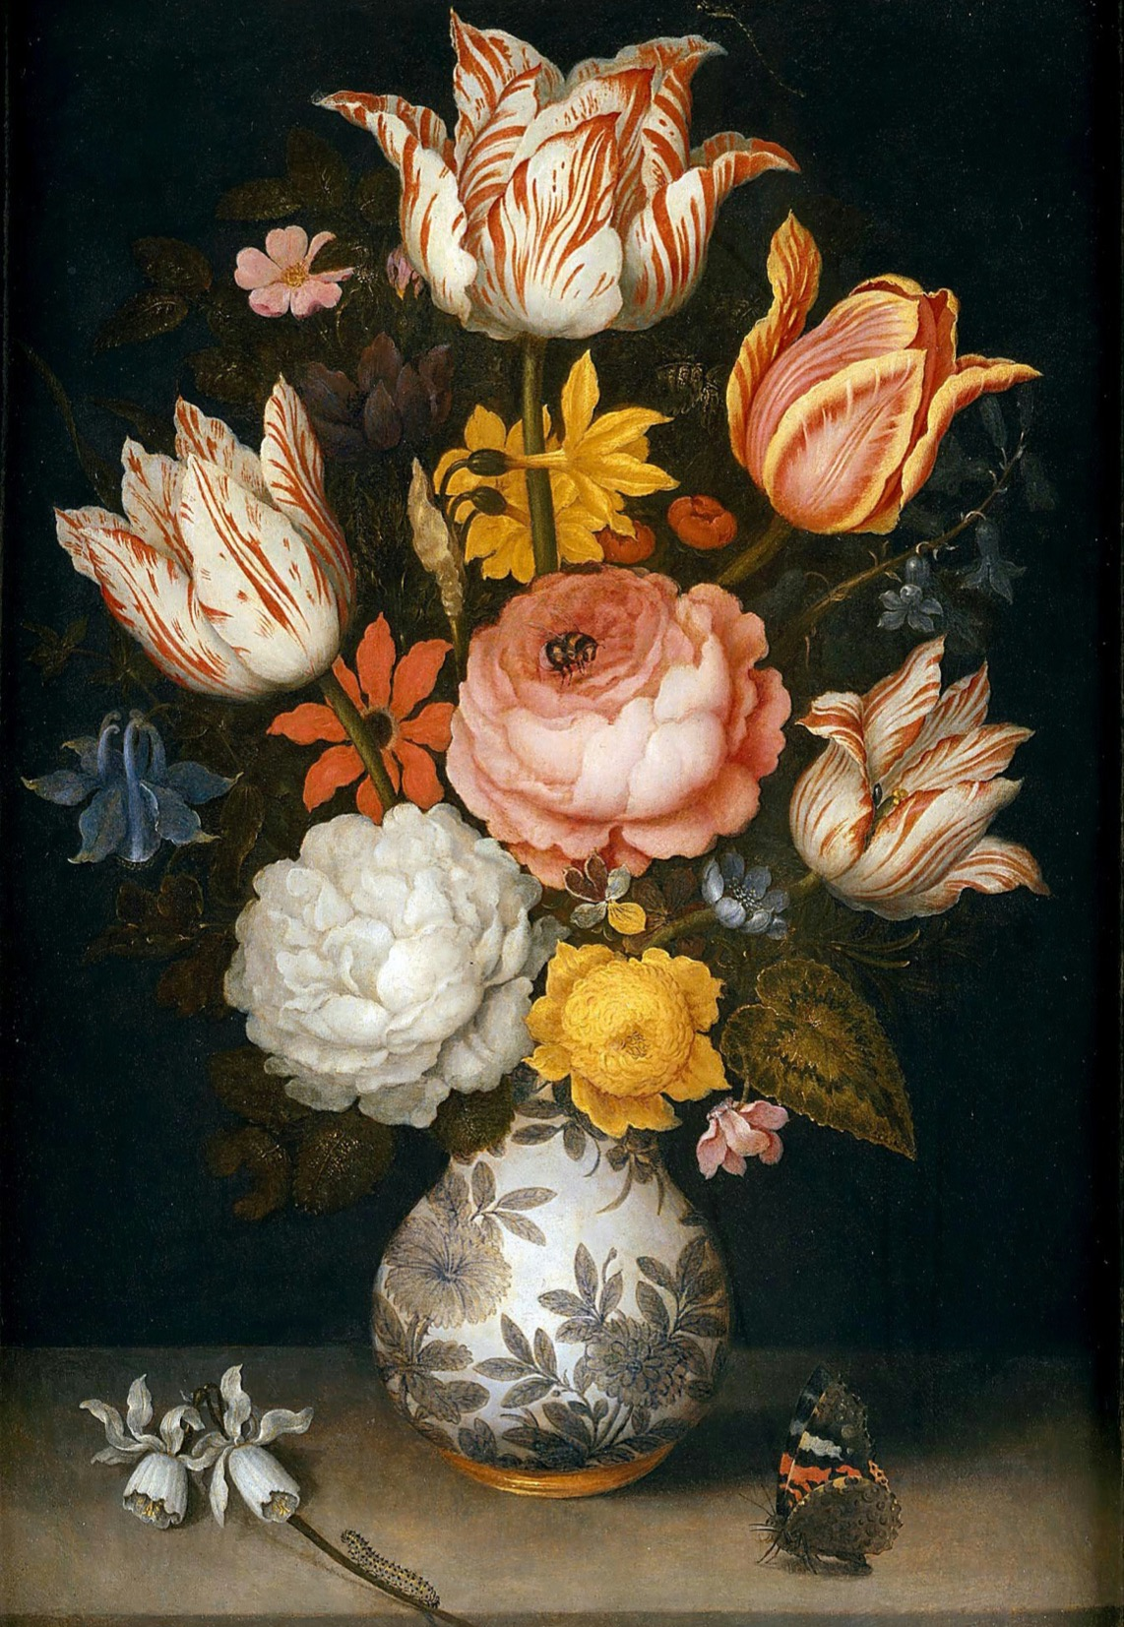
COMPONENT 3
The Personal
Investigation
Your own theme, proposed and locked in writing, investigated across a year. A body of visual work with two final outcomes, and a written discourse of 2000 to 2500 words integrated with it rather than bolted on, with a bibliography carried in the body of the work.
Marks
75, weighted to 150
Weight
50 per cent of the A Level
AO split
20 / 20 / 25 / 10
Built in
Semesters 2 and 3
Ambrosius Bosschaert the Elder, bouquet. Public domain

Slide 8
COMPONENT 3 · EXAMPLE
WHAT THE WRITING HAS TO DO
2000 to 2500 words, doing real work
Integrated, not appended
Argued, not surveyed
Bibliography in the body
Every claim in the writing points at real work in the portfolio. If a paragraph could survive with the pictures removed, it is in the wrong document.
One line of enquiry pursued, with artists brought in because they solve your problem. A tour of everyone who ever painted your subject is not an investigation.
Sources sit inside the work where they were used. A detached list at the back loses marks under AO1.
A LEVEL ART & DESIGN 9479
03

Slide 9
“
The theme is yours, not the menu's. You propose it and lock it in writing.
Component 3, from the first week of Semester 2

Slide 10
THE NUMBERS IN ONE PLACE
2028 TO 2030 SPECIFICATION
Marks, weights and the AO split
C1 Portfolio
C2 Set Assignment
C3 Personal Investigation
Raw marks
60
60
75
Weighted to
90
60
150
A Level weight
30 per cent
20 per cent
50 per cent
AO1 Record
15
15
20
AO2 Explore
15
15
20
AO3 Develop
20
15
25
AO4 Present
10
15
10
A LEVEL ART & DESIGN 9479
04
Notes:
Point at the AO3 row: Develop carries the most marks in C1 and C3 both. That is why so much of every semester is development rather than final pieces.

Slide 11
WHAT FOLLOWS FROM ALL THIS
Nothing you make
this year is practice.
Semester 1 builds the Portfolio that goes to Cambridge in 2028.
A LEVEL ART & DESIGN 9479
05

