Slide 1
I
ATTAINMENT 1 · COMPONENT 1
Recording
Everything recorded so far, looked at together
Sits Friday 9 October · Marked against AO1 · Announced Thursday 24 September
Notes:
The first attainment of the A Level. Say plainly that A1 is not a new task: it marks the recording you have been building since week one.

Slide 2
AO1
WHAT IS BEING MARKED
Record from the
thing itself.
Notes:
AO1 is first-hand recording. Working from someone else's photograph caps this objective no matter how well it is drawn.

Slide 3
THE BRIEF
FOUR THINGS, ONE FOLDER
What you hand in
01
Written intention
What you are looking at on your theme, and why. In your own words, in writing, before the studies.
02
Stage 1 page
Your recording composed so a stranger can follow the thinking, not a page of loose studies.
03
The sustained study
One observed study carried across two days without restarting it.
04
Supporting studies
Focused colour and texture work that supports the sustained study rather than repeating it.
A LEVEL ART & DESIGN 9479 · SEMESTER I
01

Slide 4
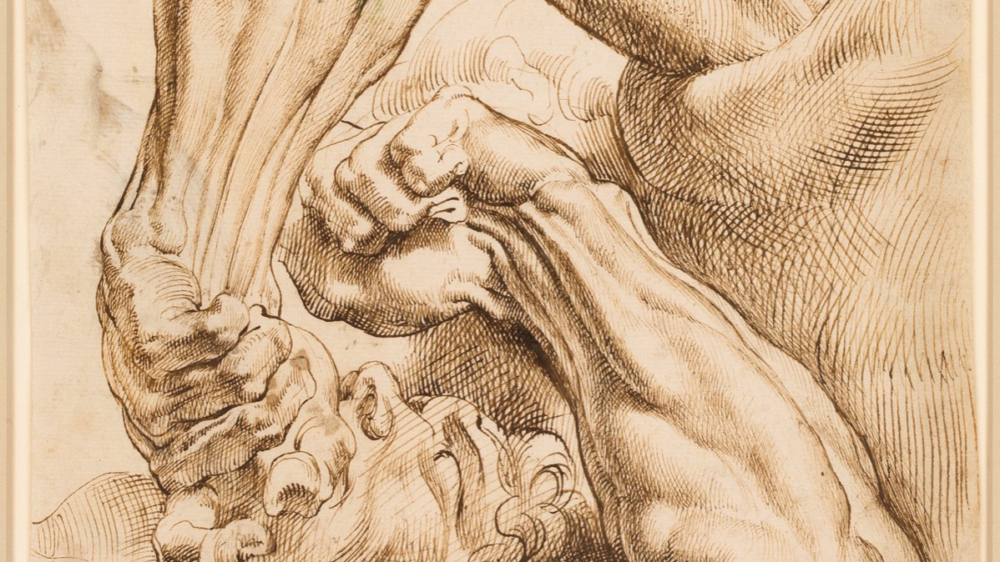
WHAT RECORDING LOOKS LIKE
One problem, returned to across a single sheet until it is solved.
Peter Paul Rubens, sheet of anatomical studies. Public domain
Notes:
Rubens draws the same forearm twice, from two positions, on one sheet. That is recording: the page shows a question being worked, not a result being displayed.

Slide 5
AO1 · RECORD
15 OF THE 60 MARKS IN C1
What the objective actually rewards
First-hand sources
Sustained observation
Recording that reads
Your own photographs, your own objects, in front of you. The marker can tell, and the difference between drawing from life and drawing from a screen is visible in the drawing.
Duration is the evidence. A study held across two sessions shows something that four quick studies cannot, which is why the timetable protects the two-day run.
Pages composed so the thinking is legible without you standing next to them. Annotation is typed, and it is marked inside AO3.
A LEVEL ART & DESIGN 9479 · SEMESTER I
02

Slide 6
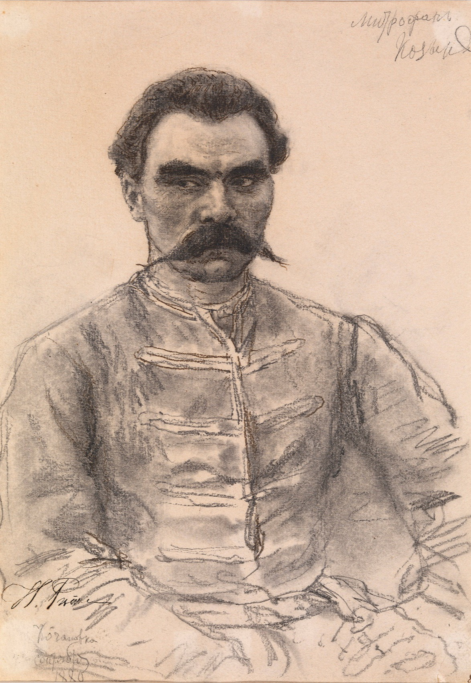
THE SUSTAINED STUDY
Do not
start again
The instinct when a study goes wrong at hour three is to turn the page. Resist it. A study carried through its bad patch and resolved is worth more here than three fresh starts, because what is being assessed is your capacity to keep looking after the interest has worn off.
Ilya Repin, Portrait of Mitrophan Kozy, 1880. Public domain
Notes:
Stamina is the content. Say this before the two-day run, not after it goes wrong.

Slide 7
“
Stamina is the content.
Unit 2, on the sustained study

Slide 8
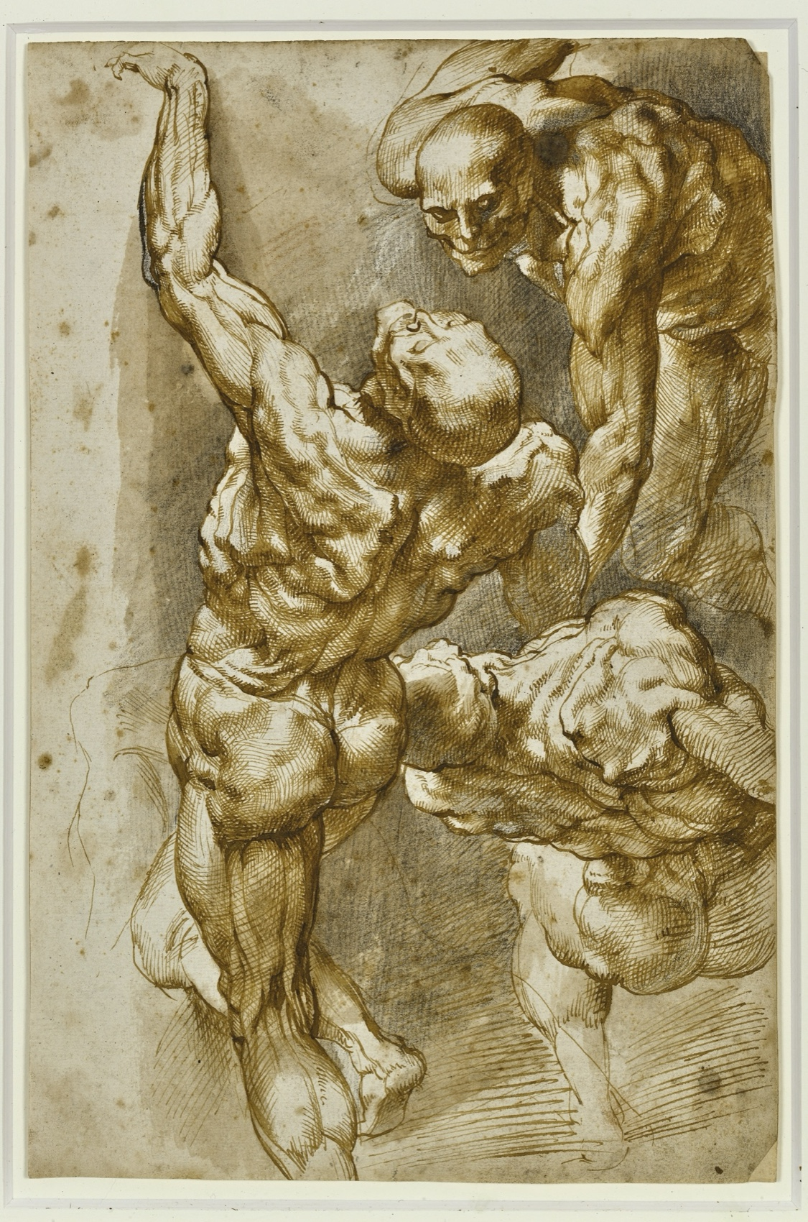
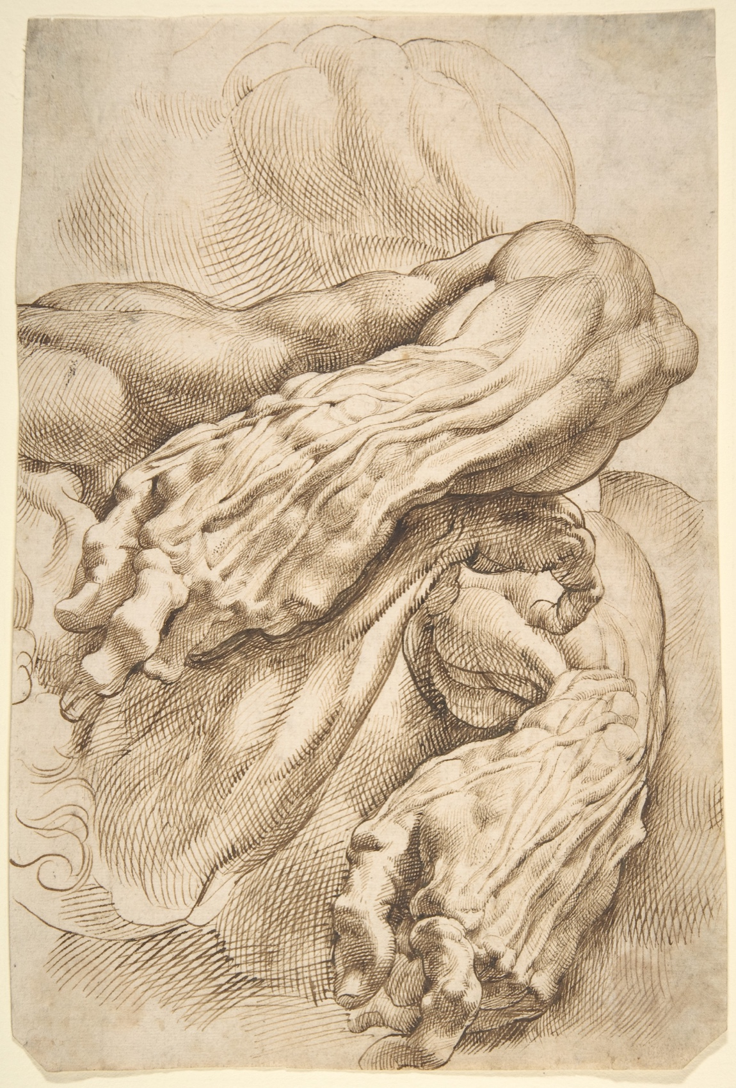
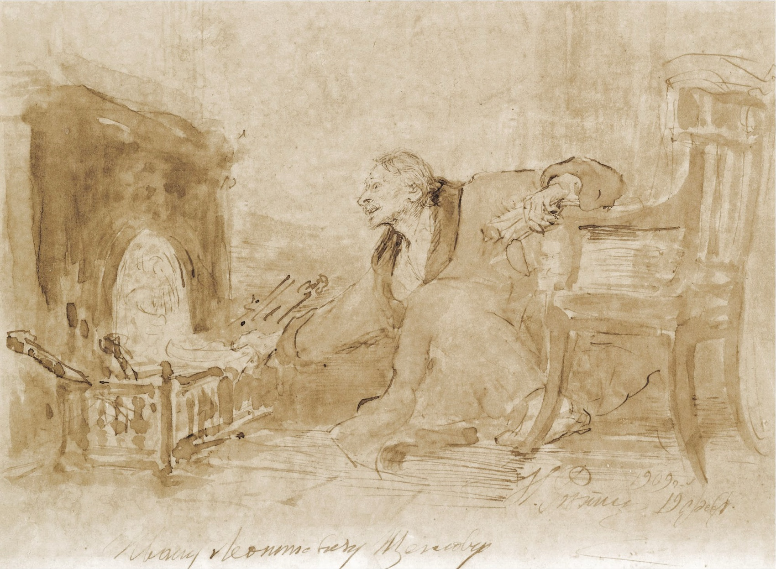
TWO WAYS OF RECORDING
BOTH COUNT, FOR DIFFERENT REASONS
The study and the sheet
Repeated
Analytical
Sustained
One subject, several positions
Structure worked out in the open
One long look, resolved
Rubens and Repin, public domain. Shown whole, as study material rather than as a style to copy.
A LEVEL ART & DESIGN 9479 · SEMESTER I
03

Slide 9
WHAT LOSES MARKS
EVERY ONE OF THESE IS AVOIDABLE
Four ways A1 goes wrong
Recording from a screen
The single most common cap on AO1. Photograph the thing yourself, then draw from the object and your own photograph.
Four restarts, no study
A folder of beginnings reads as avoidance. One resolved study outranks any number of promising openings.
A page of loose studies
Unsequenced work makes the marker do your job. Compose the page: what leads, what supports, what the sequence argues.
Annotation left for later
There is no later. Annotation written the week before submission reads as invented, because it is.
A LEVEL ART & DESIGN 9479 · SEMESTER I
04

Slide 10
DATES
ANNOUNCED AHEAD, IN WRITING
Three dates that matter
Announced
Sits
Feeds
Thu 24 Sep
Fri 9 Oct
Thu 29 Oct
Two weeks and a day of notice, well past the one-week minimum. The criteria are handed out at announcement, not at submission.
In class. This is a review of work already made, not a task begun on the day.
Mid-term grades. Which means feedback comes back inside a week rather than the usual five days.
A LEVEL ART & DESIGN 9479 · SEMESTER I
05

Slide 11
AFTER A1
Three actions,
not three feelings.
The banded feedback converts into three specific things you do differently in Unit 3.
A LEVEL ART & DESIGN 9479 · SEMESTER I
06

