Slide 1
III
ATTAINMENT 3 · COMPONENT 1
Development
Where the most marks in the component are
Sits Thursday 10 December · Marked against AO3 · Announced Thursday 26 November
Notes:
AO3 carries 20 of the 60 marks in C1, more than any other objective. Say that at the start: this is the attainment that moves a grade.

Slide 2
AO3
WHAT IS BEING MARKED
A reasoned no
earns as much
as a yes.
Notes:
Development is a trail of decisions. Choosing against something, in writing, with a reason, is development. Quietly dropping it is not.

Slide 3
THE BRIEF
THE WHOLE OF UNIT 4
What you hand in
01
Composition 1
Composed from your own recorded studies, built across two uninterrupted days, resolved and photographed.
02
Composition 2
The road not taken, built with the same effort so the comparison is honest.
03
Targeted tests
Tests on what the critique left unresolved, and nothing else. No decoration.
04
Evaluation and plan
The written evaluation against your intention, plus the final composition plan with palette and materials settled.
A LEVEL ART & DESIGN 9479 · SEMESTER I
01

Slide 4
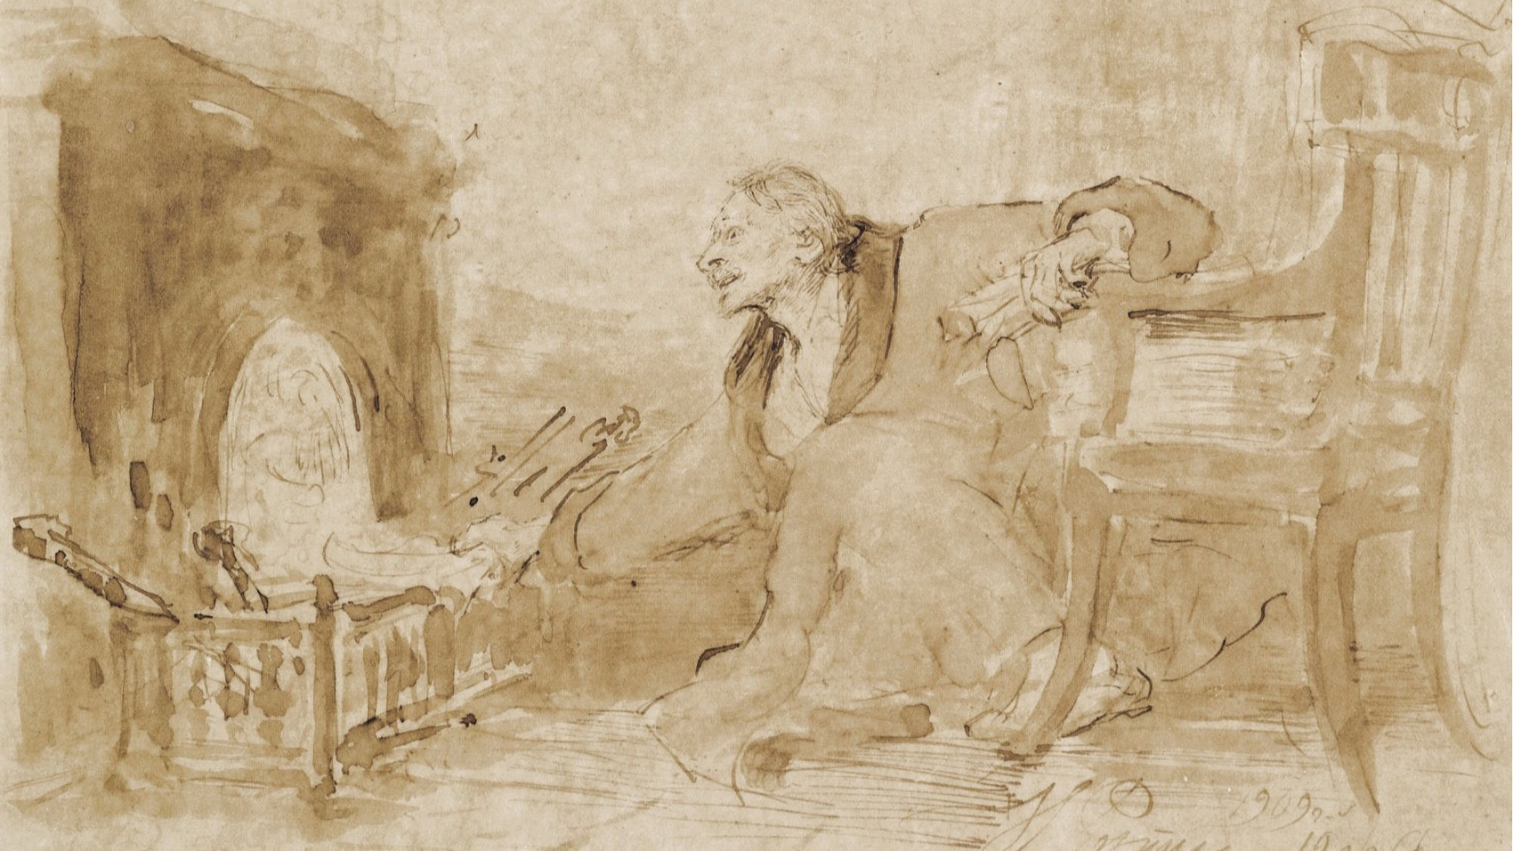
A RESOLVED COMPOSITION
Every part of it decided: the light, the edges, what is left unfinished on purpose.
Ilya Repin, Man in a Dressing Gown Stoking a Fire, 1909. Public domain
Notes:
Ask what is described most sharply and what is deliberately left loose. That contrast is a decision, and decisions are what AO3 marks.

Slide 5
AO3 · DEVELOP
20 OF THE 60 MARKS IN C1, THE LARGEST SHARE
What the objective actually rewards
Visible decisions
Honest alternatives
Typed annotation
The marker follows a path: this was tried, this was rejected for this reason, this was kept. A folder of good work with no path through it scores below a rougher folder that argues.
Composition 2 has to be a real attempt. A deliberately weak second option makes the comparison worthless and the marker can see it.
Annotation is assessed inside this objective. It is typed, it is written as the work happens, and it names decisions rather than describing what is visible.
A LEVEL ART & DESIGN 9479 · SEMESTER I
02

Slide 6
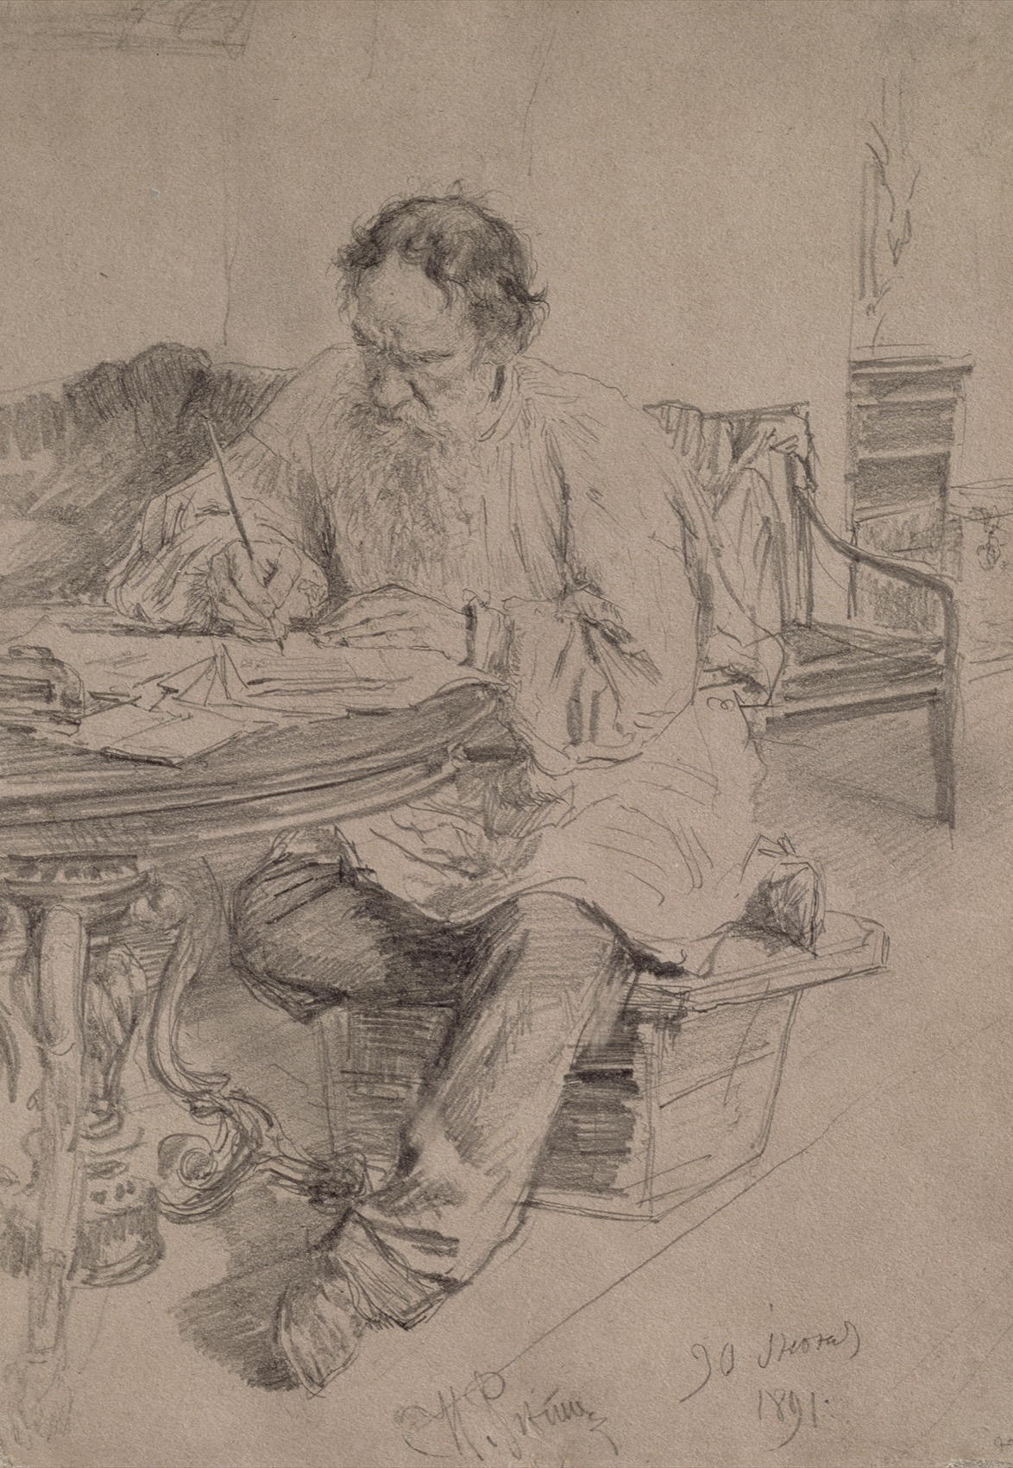
THE WRITTEN EVALUATION
Judge it against
the intention
Not against how much work went in, and not against whether you like it now. Go back to what you wrote in Unit 2 about what you were looking at and why, and say honestly how far the two compositions got you there. An evaluation that only praises is not an evaluation.
Ilya Repin, Tolstoy at Work, 1891. Public domain
Notes:
Students evaluate effort by default. Push them back to the written intention every time.

Slide 7
“
Unresolved work cannot be judged.
Unit 4, before the two-day build

Slide 8
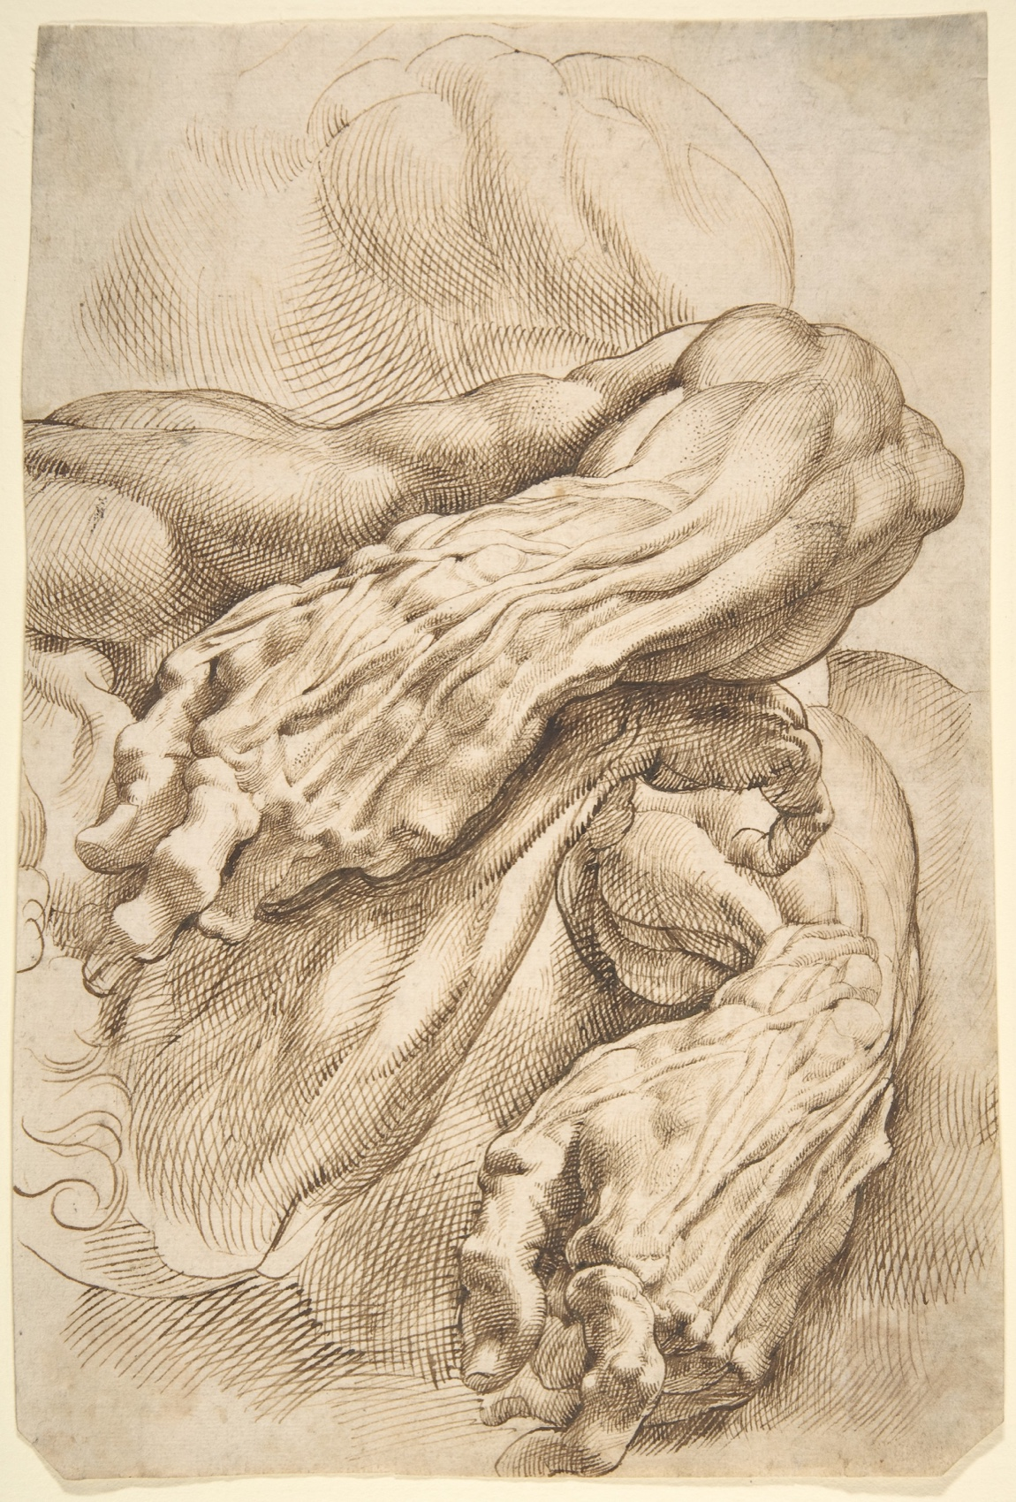
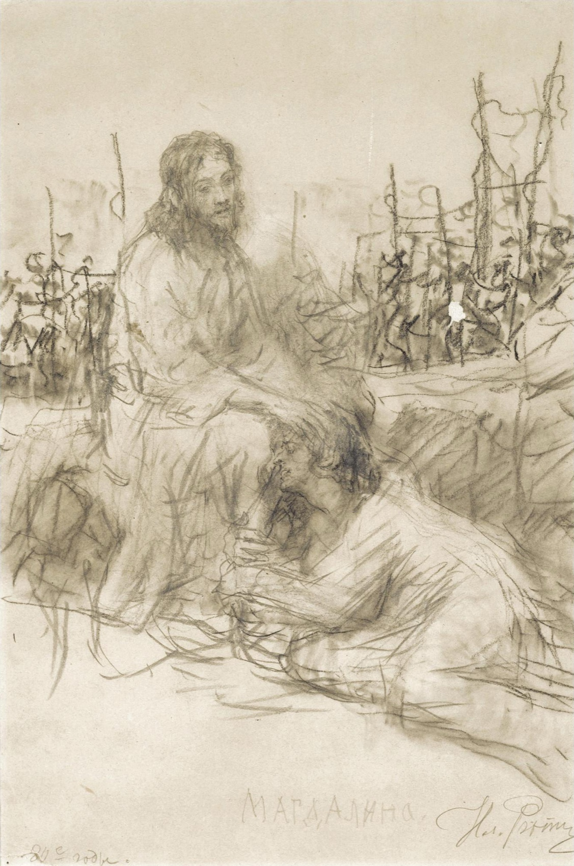

TWO COMPOSITIONS, EQUAL EFFORT
SO THE CHOICE MEANS SOMETHING
The comparison has to be fair
Worked out
Alternative
Resolved
Structure resolved before scale
The idea you set aside, built properly
Finished to a judgeable state
Rubens, Repin and Bosschaert, public domain. Shown whole, as study material rather than as a style to copy.
A LEVEL ART & DESIGN 9479 · SEMESTER I
03

Slide 9
WHAT LOSES MARKS
EVERY ONE OF THESE IS AVOIDABLE
Four ways A3 goes wrong
A token second composition
Half an hour on the alternative so the box is ticked. It reads instantly, and it takes the comparison down with it.
Tests as decoration
Pretty experiments that answer nothing the critique raised. Targeted means targeted.
Nothing changed after critique
If the work is identical before and after, the critique did not happen. Change something, and log what and why.
Badly photographed work
Real marks are lost to a phone snap at an angle in bad light. Photograph it square, lit evenly, cropped to the work.
A LEVEL ART & DESIGN 9479 · SEMESTER I
04

Slide 10
DATES
ANNOUNCED AHEAD, IN WRITING
Three dates that matter
Announced
Sits
Then
Thu 26 Nov
Thu 10 Dec
Fri 11 Dec
Two weeks of notice. Unit 4 runs through the announcement, so nothing stops for it.
In class, reviewing the whole development stage together.
Feedback becomes plan adjustments while there is still time for them to matter, before the final outcome starts.
A LEVEL ART & DESIGN 9479 · SEMESTER I
05

Slide 11
AFTER A3
Nothing is left
to the day itself.
The final outcome is planned, solved small, and its materials settled before it begins.
A LEVEL ART & DESIGN 9479 · SEMESTER I
06

