Slide 1
X
GRADE 10 · PRE A LEVEL
Art & Design
Welcome to the course
Eighteen Wednesdays · 2 September to 6 January · Four units, five submissions
Notes:
Keep this short and warm. The point of session one is that they leave with marks on paper, not with administration.

Slide 2
IV
WHAT THIS COURSE IS
You will make
four things.
Notes:
Four units, four finished works, plus the sketchbook that carries all of it. Say the shape of the semester out loud on day one.

Slide 3
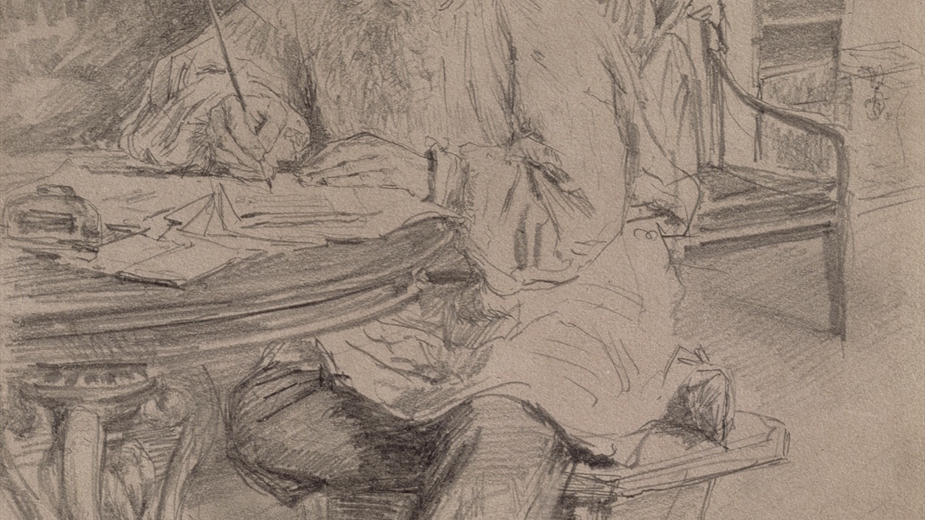
UNIT I · DRAWING
Everything here starts with looking longer than is comfortable.
Ilya Repin, Lev Nikolaevich Tolstoy at Work, 1891. Public domain
Notes:
Repin drew Tolstoy from life over many sittings. The point for a G10 room: the drawing is good because the looking was long, not because the hand was clever.

Slide 4
THE SEMESTER · FOUR UNITS
ONE FINISHED WORK EACH
Four ways of making a picture
01
Drawing
02
Photography
Observe. Line, tone, texture, negative space, composition. It ends with one observational drawing made in class.
Compose. The camera as a way of deciding, not recording. It ends with a series of six to eight photographs.
03
Collage
04
Poster
Combine. Cut images apart and make them argue. It ends with one collage built from a written main idea.
Communicate. One message, one audience, three seconds. It ends with a finished poster, handmade or digital.
GRADE 10 ART & DESIGN · SEMESTER I
01

Slide 5
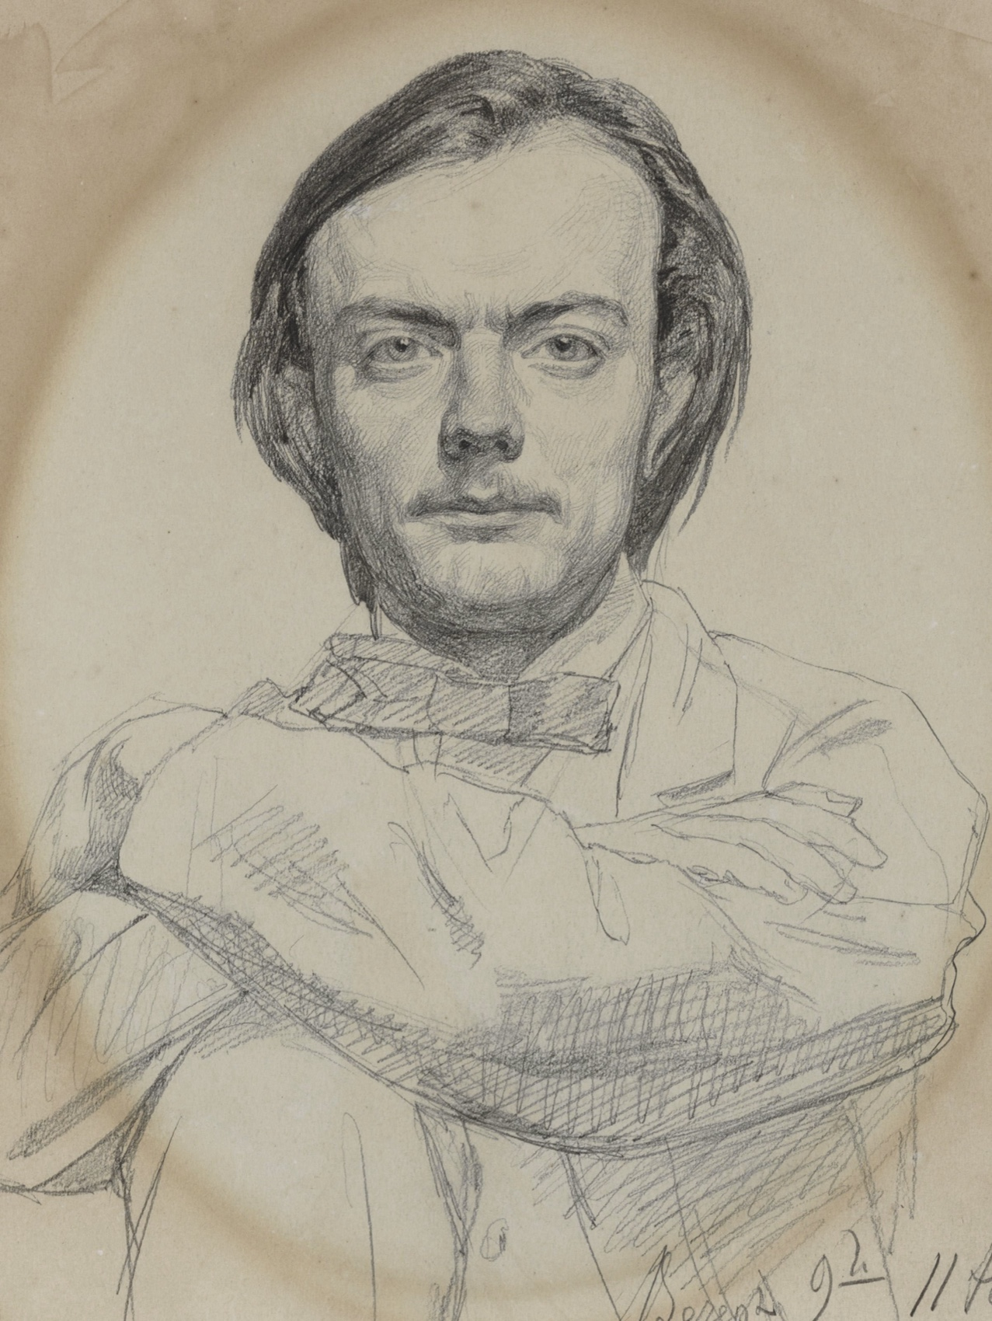
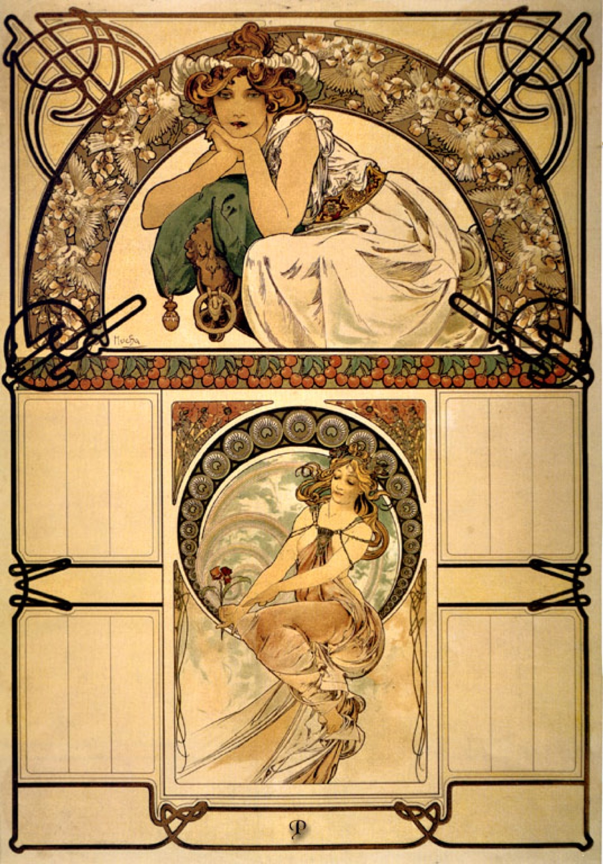
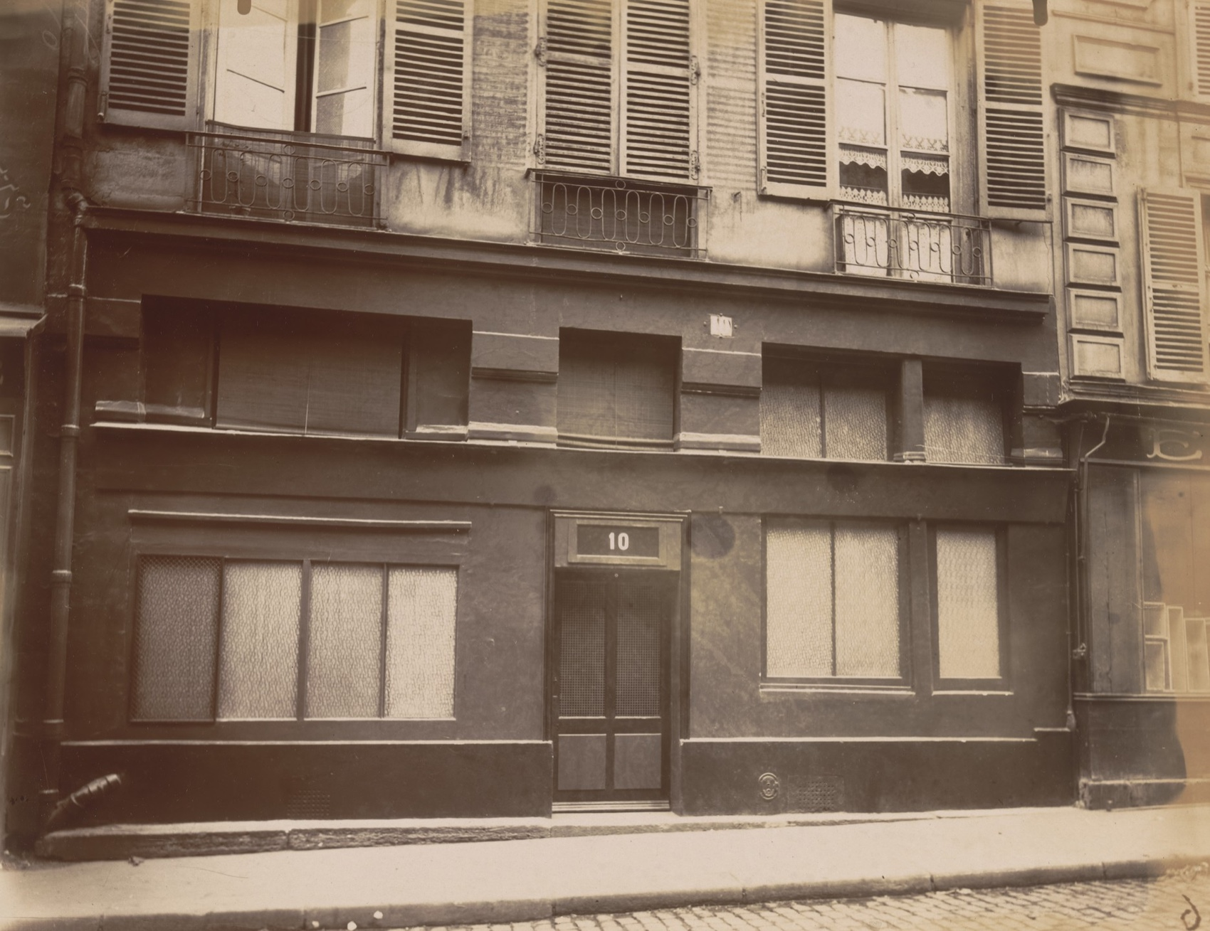
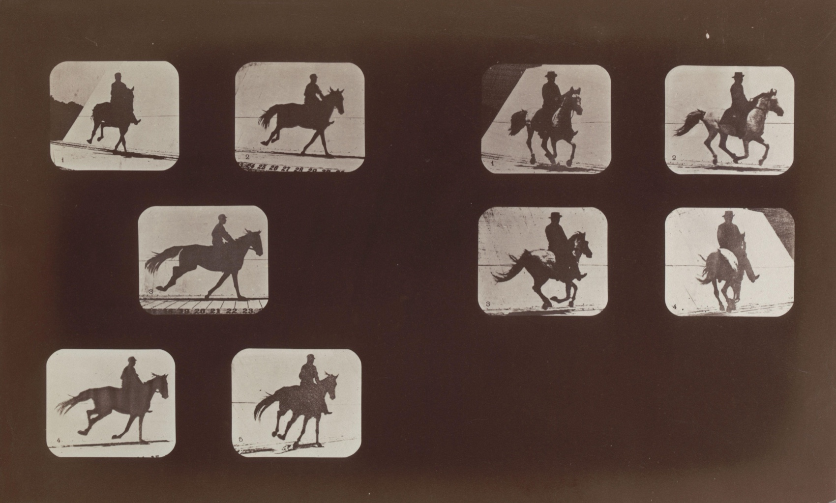
FOUR UNITS, FOUR KINDS OF LOOKING
WHOLE WORKS, SHOWN ENTIRE
Drawing
Photography
Sequence
Poster
Repin, drawing · Atget, photograph, 1907 · Muybridge, motion studies · Mucha, calendar poster, 1898. All public domain.
GRADE 10 ART & DESIGN · SEMESTER I
02
Notes:
Four whole works, none cropped. Ask which one looks hardest, then say that by January they will have made one of each.

Slide 6
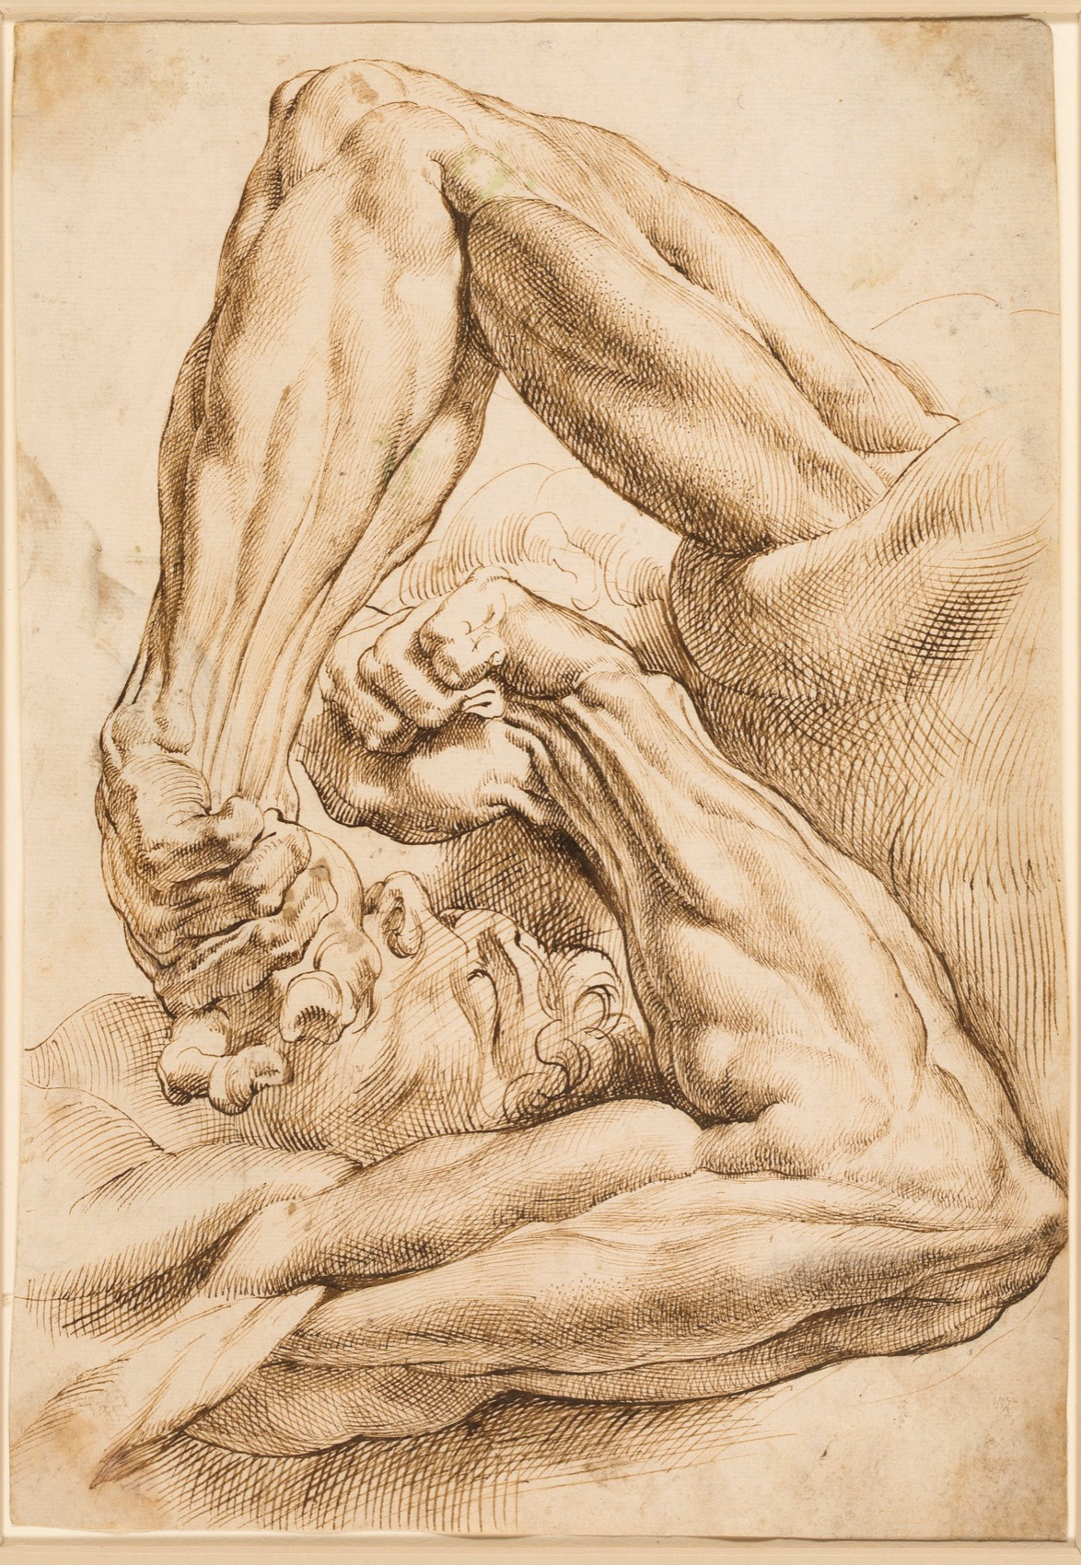
THE CONTRACT
Two to three pages
a week. Every week.
The sketchbook is not a neat book. It is where the thinking is visible: tests that failed, notes, sources, the drawing you abandoned. It is checked twice without warning during the semester, and it is submitted for a grade of its own in January.
Peter Paul Rubens, sheet of studies. Public domain
Notes:
Rubens filled sheets like this to work things out, not to display them. Spot-checks are 21 October and 2 December; the graded submission is 6 January.

Slide 7
“
The session ends with marks on paper, not with administration.
How this class runs, from day one

Slide 8
HOW THE GRADE WORKS
FOUR PARTS, ONE HUNDRED
Nothing here is a mystery
50
20
10
20
Attainment
Course Skills
Learning Behaviour
End of Term
The five submitted works. Announced at least a week ahead, made in class, marked against criteria you are given first.
The smaller checks along the way: sketchbook spot-checks, analyses, studies.
Posting on time, bringing materials, working in the room.
The portfolio: the semester assembled into one organised submission in January.
GRADE 10 ART & DESIGN · SEMESTER I
03

Slide 9
THE FIVE SUBMISSIONS
DATES YOU CAN PLAN AROUND
Everything you hand in this semester
A1
Wednesday 30 September
Final observational drawing, with a written reflection
A2
Wednesday 4 November
Photographic series, six to eight images, selected and sequenced
A3
Wednesday 9 December
Final collage, built from a written main idea
A4
Wednesday 23 December
Final poster, handmade or digital
A5
Wednesday 6 January
The sketchbook, the whole semester of it
Every one is announced at least a week before it is due, with the marking criteria handed out at the same time.
GRADE 10 ART & DESIGN · SEMESTER I
04

Slide 10
THE STUDIO
FOUR WORKING HABITS
How the room runs
01
02
03
Bring the book
Finish things
Say what you did
The sketchbook comes every Wednesday. Work made elsewhere still lives in it.
An unfinished piece cannot be marked. Deciding to stop is part of the work.
Every submission carries a short reflection. Name decisions, not feelings about the result.
GRADE 10 ART & DESIGN · SEMESTER I
05

Slide 11
TODAY
Set up the book.
Then draw.
No experience is assumed. Nobody fails a survey.
GRADE 10 ART & DESIGN · SEMESTER I
06

