Slide 1
A
CAMBRIDGE INTERNATIONAL · 9479
Art & Design
Welcome to the A Level
Two years · Three components · One submission, June 2028
Notes:
Say the two-year shape on day one. The single submission point is what makes the first semester matter: work made now goes in the same box as work made in 2028.

Slide 2
28
THE SHAPE OF IT
Two years.
One submission.
Notes:
Linear entry, June 2028. There is no AS award to bank and nothing is carried forward separately: all three components reach the board together at the end of April 2028.

Slide 3
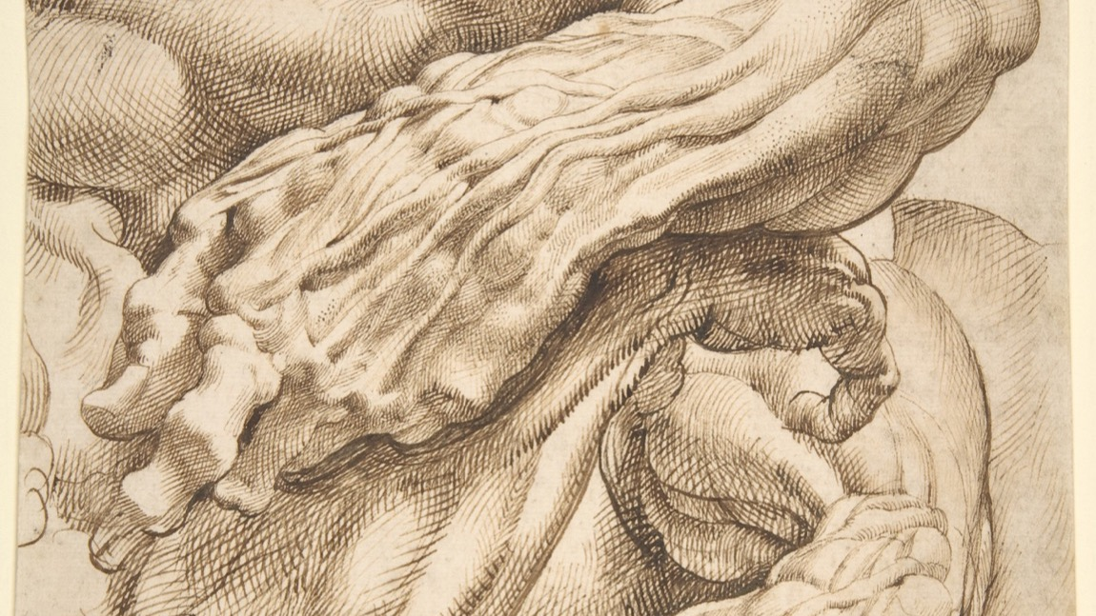
WHAT THE WORK LOOKS LIKE
Studies made to solve a problem, not to be admired.
Peter Paul Rubens, anatomical studies. Public domain
Notes:
This is closer to what a portfolio page looks like than a finished painting is. The examiner wants to see the thinking, and the thinking looks like this.

Slide 4
THE QUALIFICATION
THREE COMPONENTS
What you are actually assessed on
C1 · Portfolio
C2 · Externally Set Assignment
C3 · Personal Investigation
A selection of your work over the course. Set here, marked by Cambridge. 60 marks, weighted to 90, worth 30 per cent of the A Level.
A question paper with three themes to choose from, supporting studies, and a final outcome made in a 15-hour supervised test. 60 marks, 20 per cent.
Your own theme: a body of visual work with a written discourse of 2000 to 2500 words. 75 marks, weighted to 150, and half the A Level.
A LEVEL ART & DESIGN 9479
01

Slide 5
TWO YEARS, FOUR SEMESTERS
WHICH COMPONENT, WHEN
The route from here to the board
Semester 1
Autumn 2026
C1 Portfolio. The pipeline run once, start to finish, on a theme you choose from a menu.
Semester 2
Spring 2027
C3 part one. You propose your own theme, lock it, and build to a mid-point portfolio.
Semester 3
Autumn 2027
C3 part two. Two final outcomes and the research paper, submitted internally in December.
Semester 4
Spring 2028
C2. The question paper, the 15-hour test, then all three components go to the board.
A LEVEL ART & DESIGN 9479
02

Slide 6
THE FOUR ASSESSMENT OBJECTIVES
THE SAME FOUR, EVERY COMPONENT
Record, Explore, Develop, Present
AO1
Record
AO2
Explore
Observe and record from first-hand sources. Your own photographs, your own studies, made from the thing itself.
Test media and ideas, including tests that fail. Artists are studied here, for the problem they solve.
AO3
Develop
AO4
Present
Move from studies to a resolved idea, visibly. Your annotation is marked inside this one, and it must be typed.
Bring it to a finish and show it so a stranger can follow it. Sequence, documentation, bibliography.
A LEVEL ART & DESIGN 9479
03

Slide 7
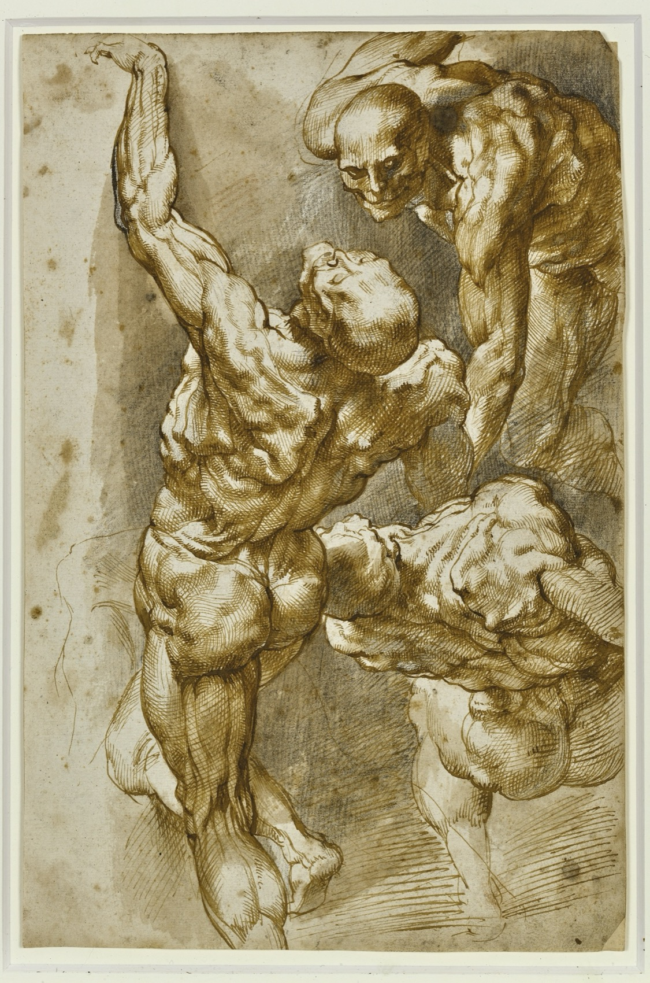
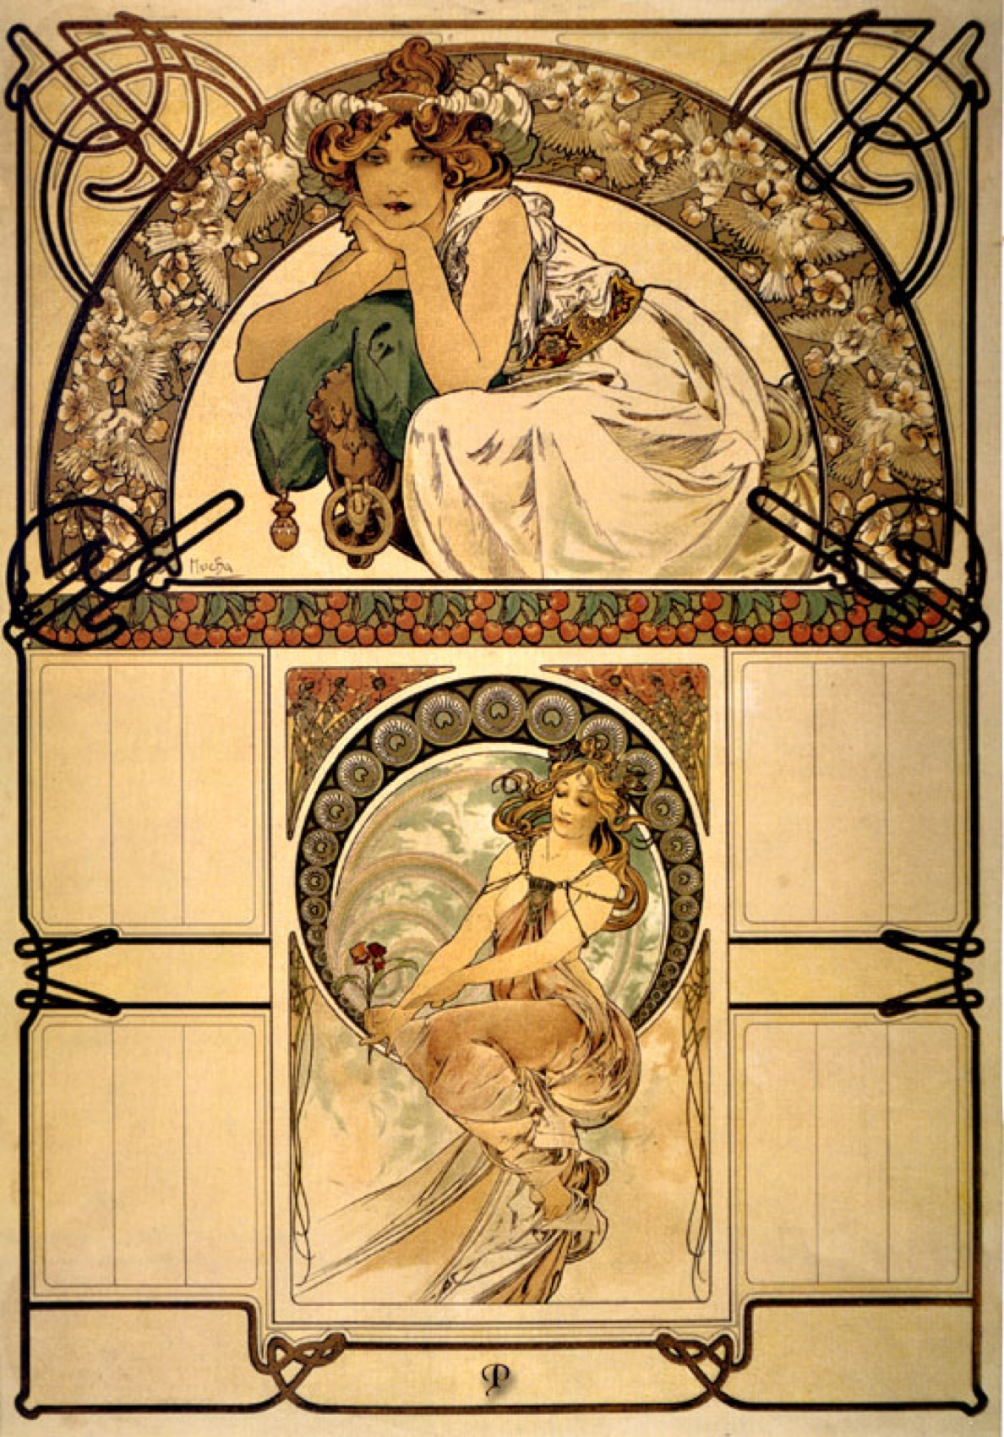
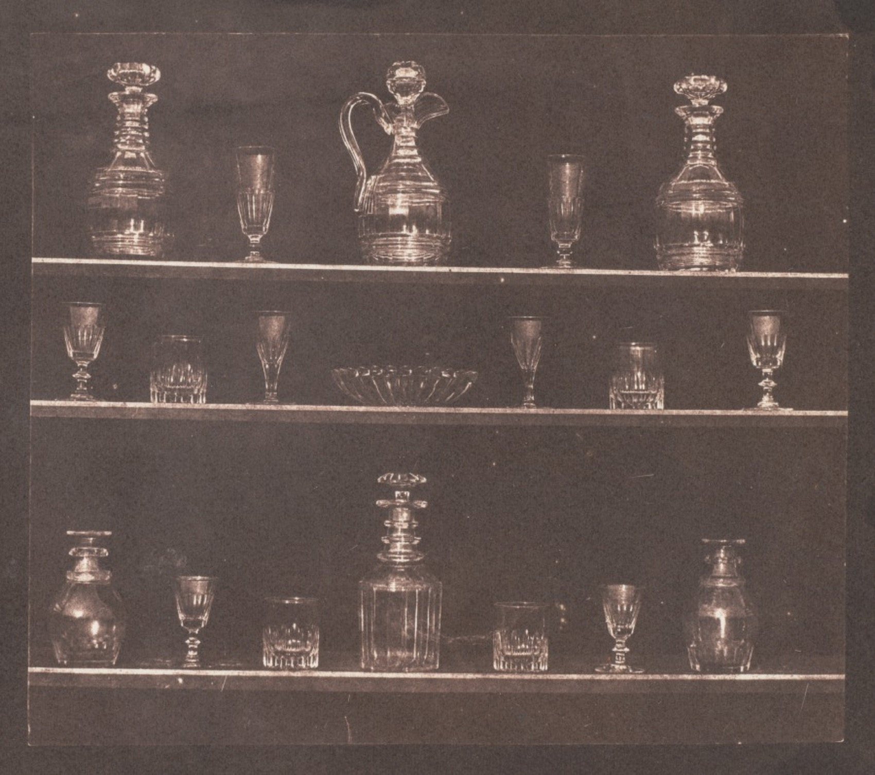
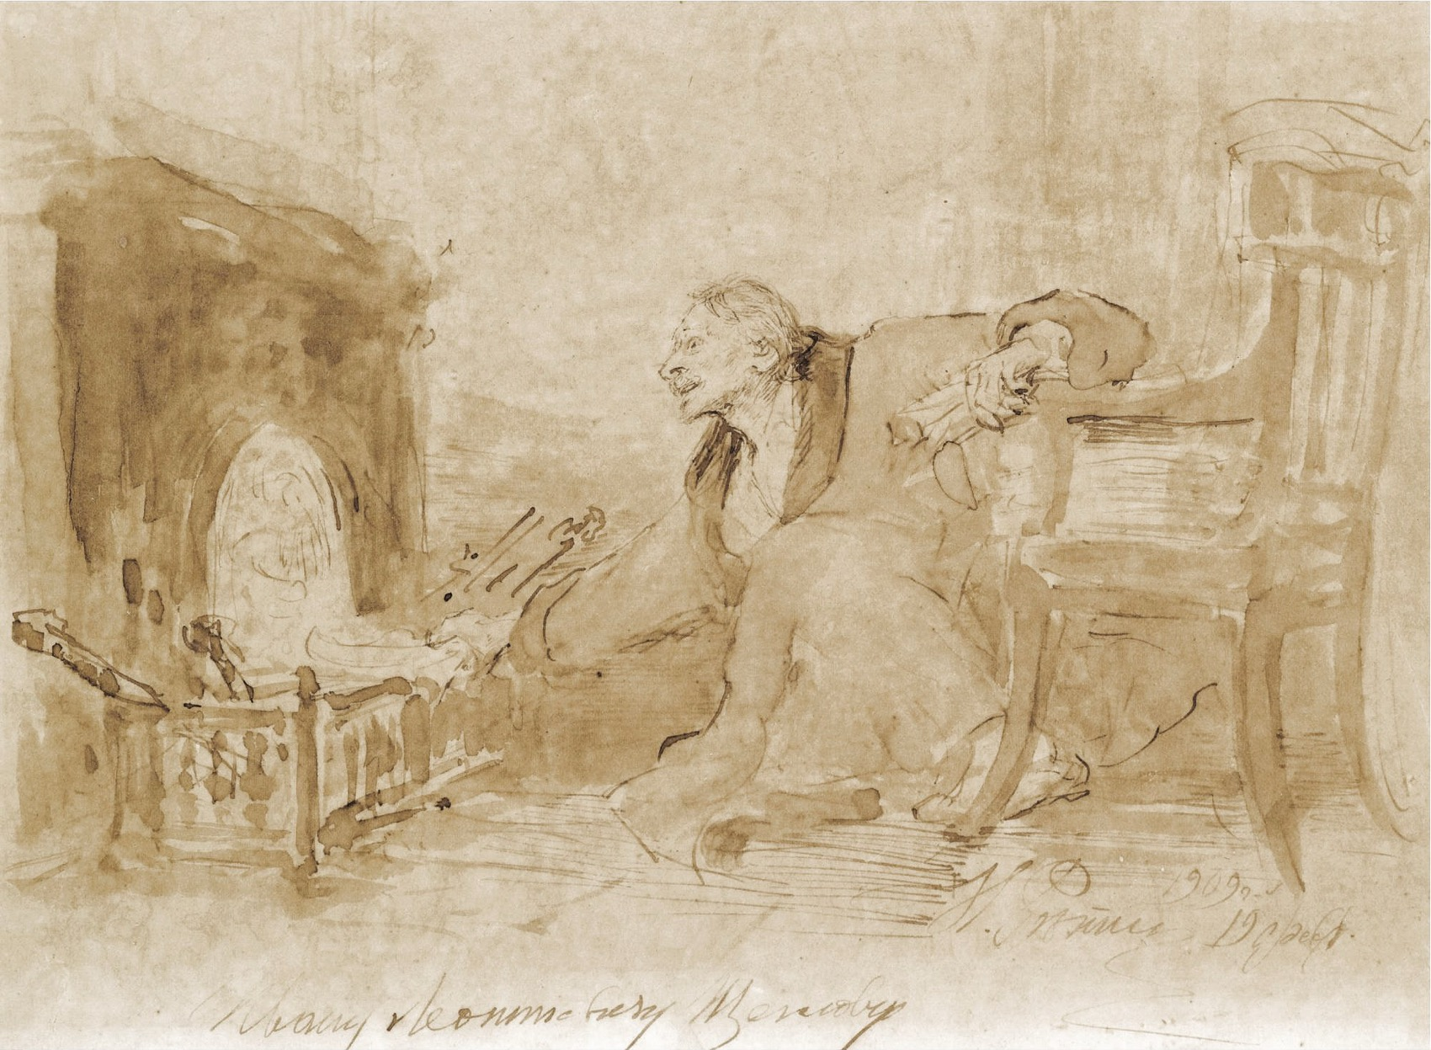
THE PIPELINE, IN PICTURES
WHOLE WORKS, SHOWN ENTIRE
Record, explore, develop, present
Record
Explore
Develop
Present
From the thing itself
Test what the medium does
Decide, and show the deciding
Finish it, and sequence it
Rubens, Talbot, Repin and Mucha, all public domain. Shown whole, as study material rather than as a style to copy.
A LEVEL ART & DESIGN 9479
04
Notes:
The same four stages recur in every component and every semester. Learn the shape once and the rest of the course is a variation on it.

Slide 8
“
Stamina is the content.
On the sustained study, Unit 2

Slide 9
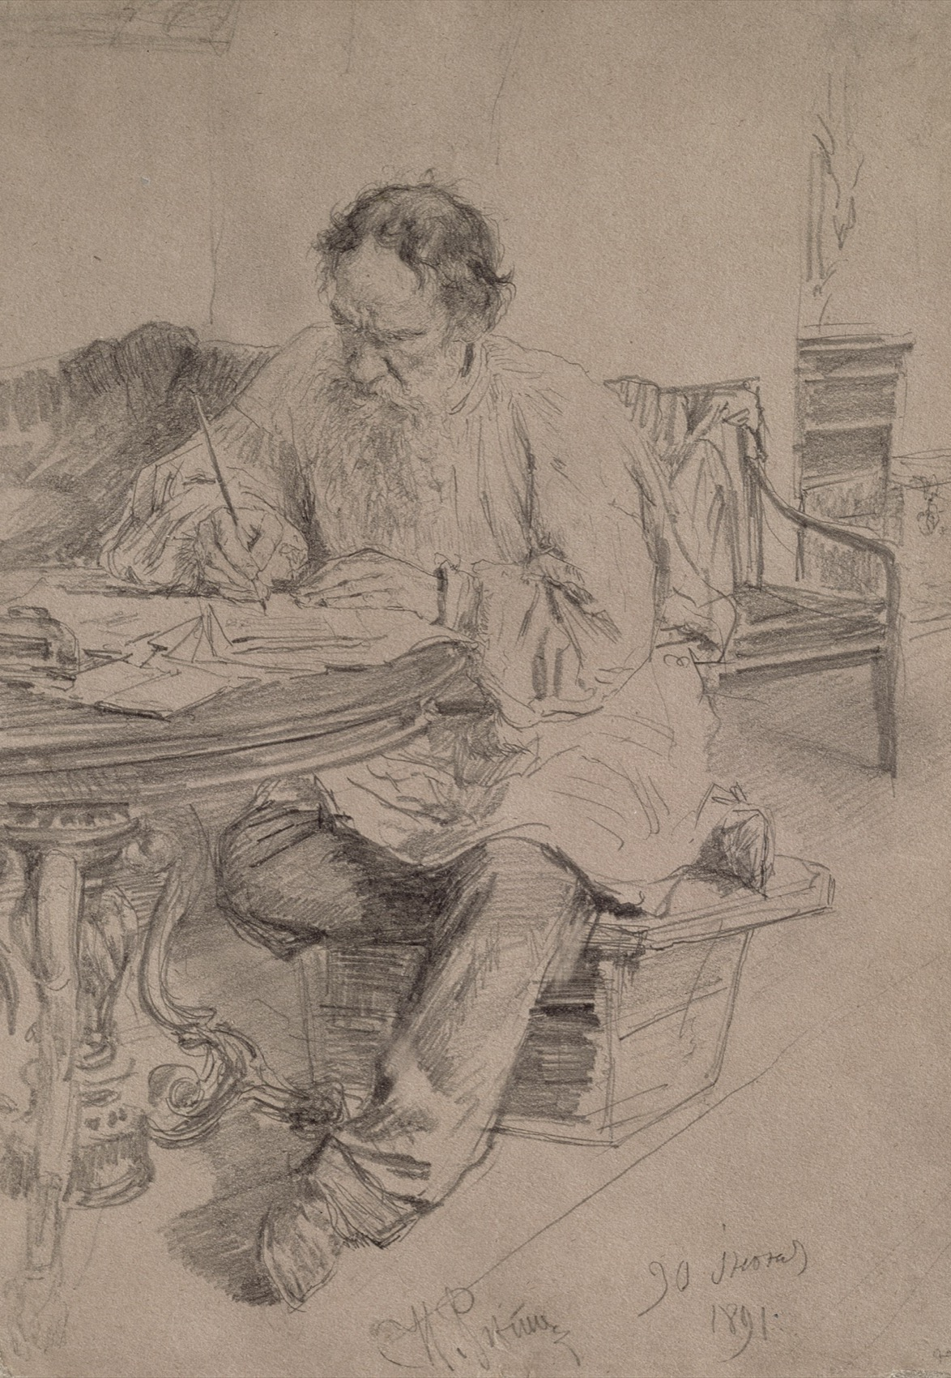
SEMESTER 1 · FIVE UNITS
One pipeline,
run once
01
Foundations on the theme
02
Recording and sustained study
03
Exploration and artist study
04
Development
05
Final outcome and portfolio
Ilya Repin, Tolstoy at Work, 1891. Public domain
Notes:
The same five stages recur every semester. Learning the pipeline in S1 is what makes C3 possible in S2, when the theme is yours instead of the menu's.

Slide 10
YOUR SCHOOL GRADE
SEPARATE FROM THE CAMBRIDGE MARK
Four parts, one hundred
50
20
10
20
Attainment
Course Skills
Learning Behaviour
End of Term
Four assessments, one at the close of each unit, announced at least a week ahead.
The smaller checks between them: studies, analyses, consultations.
Posting on time, materials, working through a studio session.
The Final: your portfolio so far, judged against the Cambridge criteria.
A LEVEL ART & DESIGN 9479
05

Slide 11
RULES WORTH KNOWING ON DAY ONE
CAMBRIDGE, NOT ME
Five that catch people out
01
Submission is digital
All of it. No hyperlinks and no QR codes: if the examiner cannot see it in the file, it does not exist.
02
Annotation is typed, and marked
It is assessed inside AO3. Handwritten notes on a page do not count as annotation.
03
No work goes to two components
A piece that appears in your Portfolio cannot reappear in the Personal Investigation.
04
Record from first-hand sources
Your own photographs and your own studies. Working from someone else's image caps AO1.
05
Misusing generative AI is plagiarism
Treated exactly as any other plagiarism would be.
A LEVEL ART & DESIGN 9479
06

Slide 12
THIS WEEK
Choose a theme
you can survive.
Four months on one subject. Choose it against the criteria, not by mood.
A LEVEL ART & DESIGN 9479
07

