Slide 1
II
ATTAINMENT 2 · COMPONENT 1
Exploration &
Artist Study
Twelve experiments, two artists, one decision
Sits Monday 9 November · Marked against AO2 and AO3 · Announced Monday 26 October
Notes:
A2 marks a whole unit at once: the experiments, the media selection, the scale trial, both artist studies and the bridge piece.

Slide 2
AO2
WHAT IS BEING MARKED
A test that cannot fail
teaches nothing.
Notes:
The single idea behind this unit. Experiments are built so they could fail, and the failures are kept, because a rejection with a reason is evidence of exploring.

Slide 3
THE BRIEF
ONE UNIT, MARKED WHOLE
What you hand in
01
Twelve experiments
Media tests run across three days, built so that some of them fail. All twelve are kept.
02
Media selection
The two or three media you will develop, chosen on evidence, with the rejections named in writing.
03
Scale trial
The idea tested at real size, and whatever broke at that size fixed.
04
Two artists and a bridge
Both artists analysed and answered in your own work, plus the piece that carries study into development.
A LEVEL ART & DESIGN 9479 · SEMESTER I
01

Slide 4
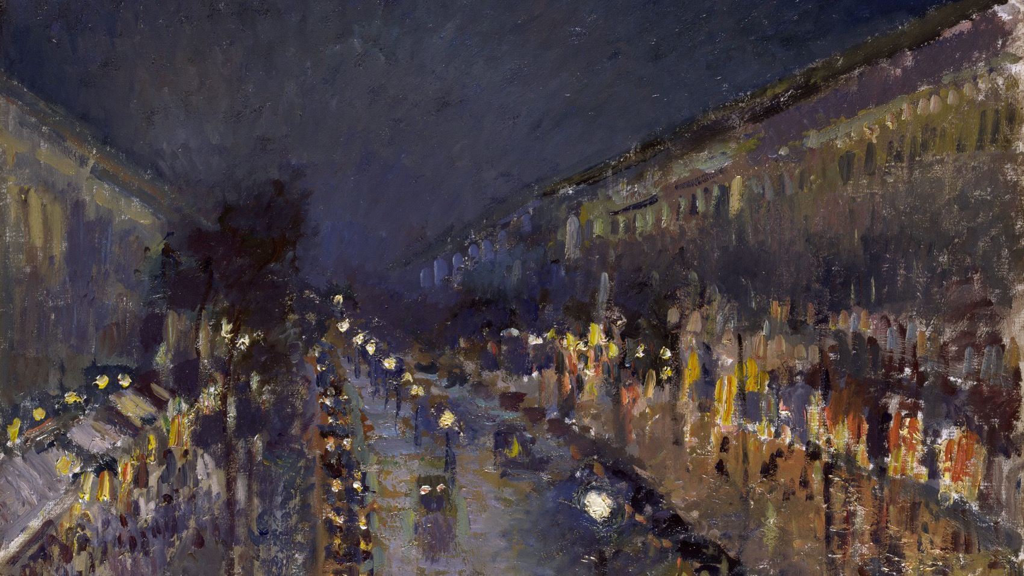
EXPLORING A MEDIUM
The medium was chosen because it could carry the subject, not because it was liked.
Camille Pissarro, The Boulevard Montmartre at Night, 1897. Public domain
Notes:
Pissarro painted this street repeatedly in different light and weather. The series is a test bed: same subject, changed conditions, kept results.

Slide 5
AO2 · EXPLORE, AND AO3 · DEVELOP
35 OF THE 60 MARKS IN C1
What the two objectives reward here
Range with a reason
Selection you can defend
Influence you can see
Twelve experiments beats three, but only if the twelve were chosen to answer different questions. Twelve tidy samples of the same question is one experiment repeated.
The mark is in the choosing. Write down which media you rejected and what the test showed, because that sentence is the evidence of exploring.
An artist study earns nothing if the influence exists only in the writing. It has to be visible in the work you made afterwards.
A LEVEL ART & DESIGN 9479 · SEMESTER I
02

Slide 6
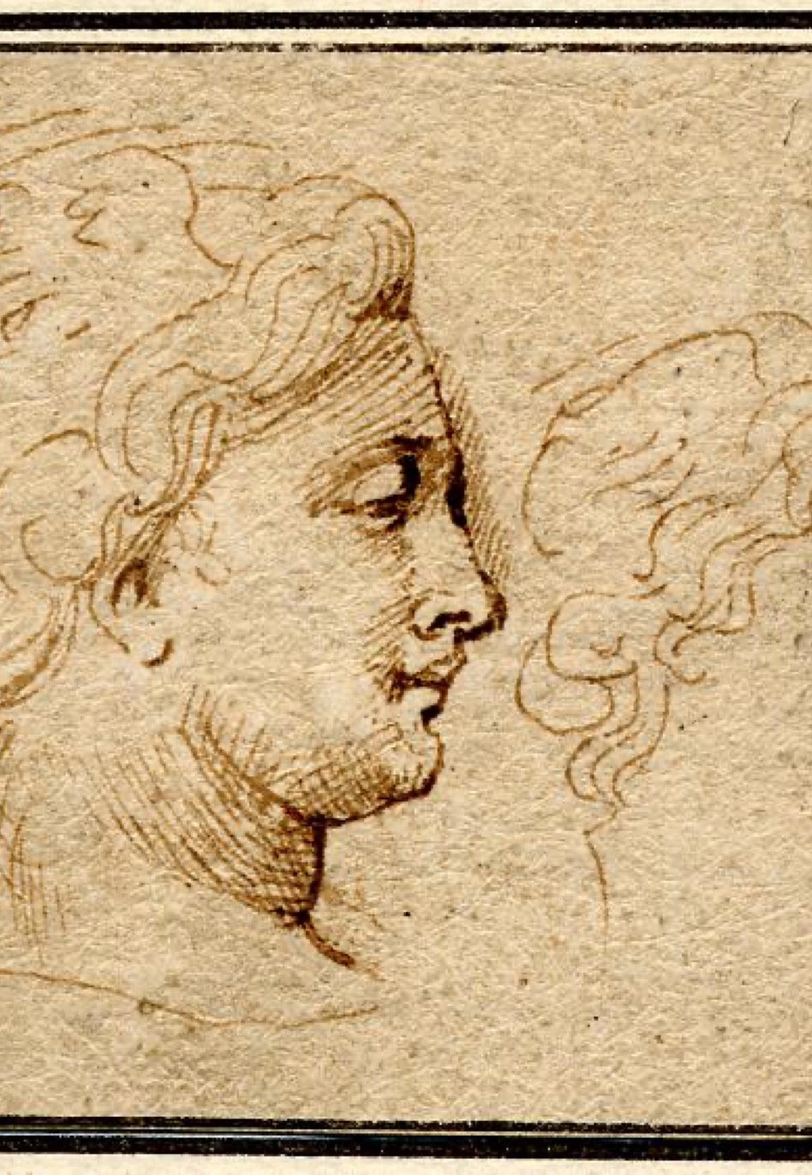
THE ARTIST STUDY
Chosen for the
problem they solve
Pick your artist because they have already solved something you are stuck on: a way of handling an edge, a colour problem, a way of composing a crowd. Liking the work is not a reason. Then copy the method to understand it, and answer them with a piece of your own.
Peter Paul Rubens, Head of Medusa. Public domain
Notes:
The four-step arc: analyse, place in context, copy the method to learn it, then answer with your own work.

Slide 7
“
Safe tests teach nothing.
Unit 3, on the twelve experiments

Slide 8
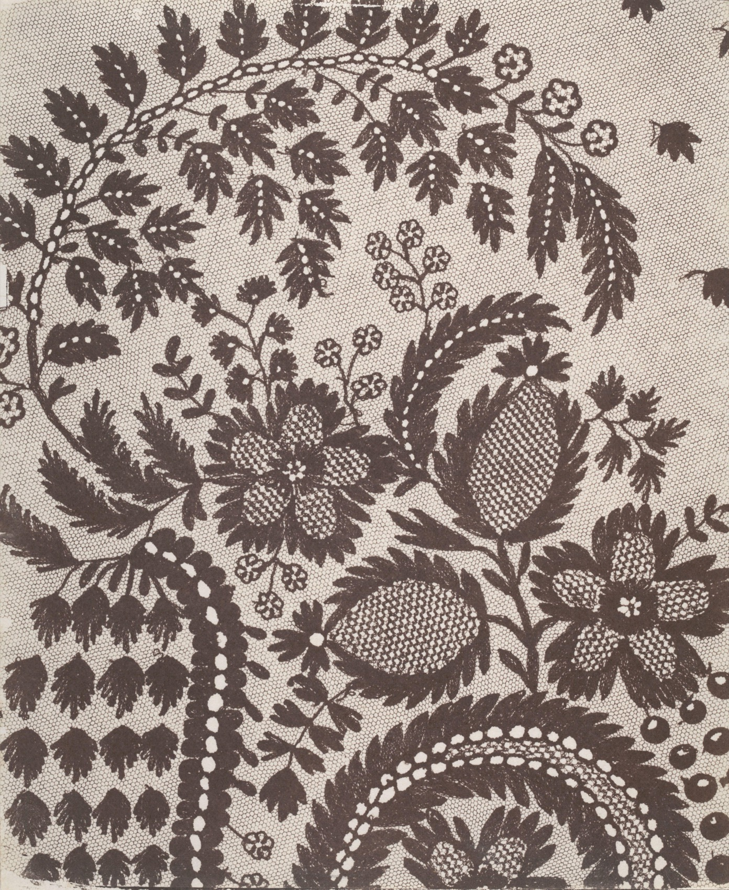
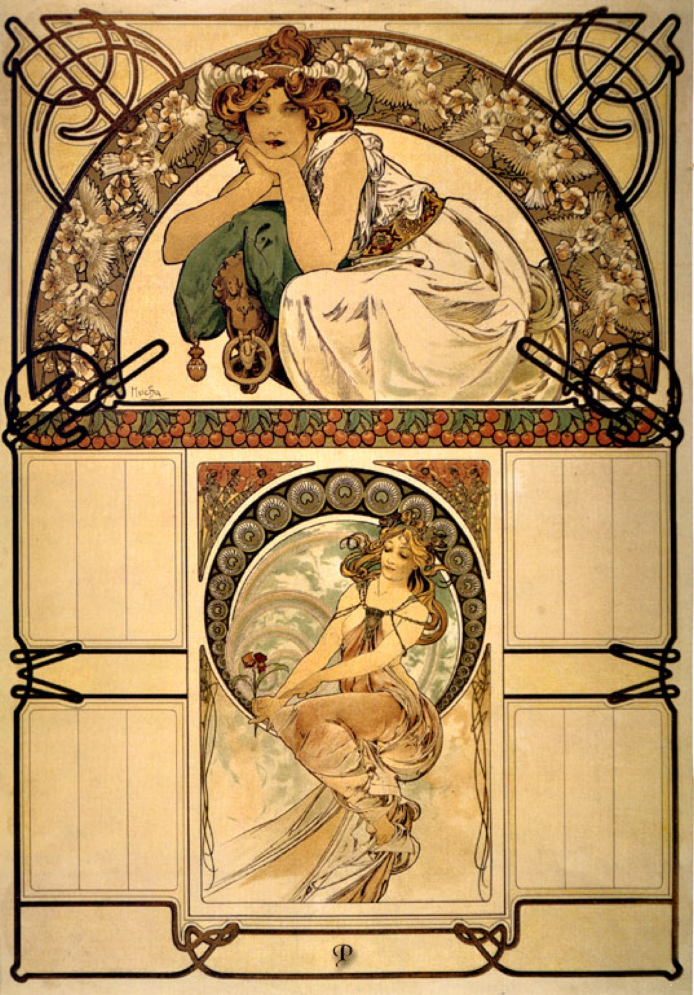
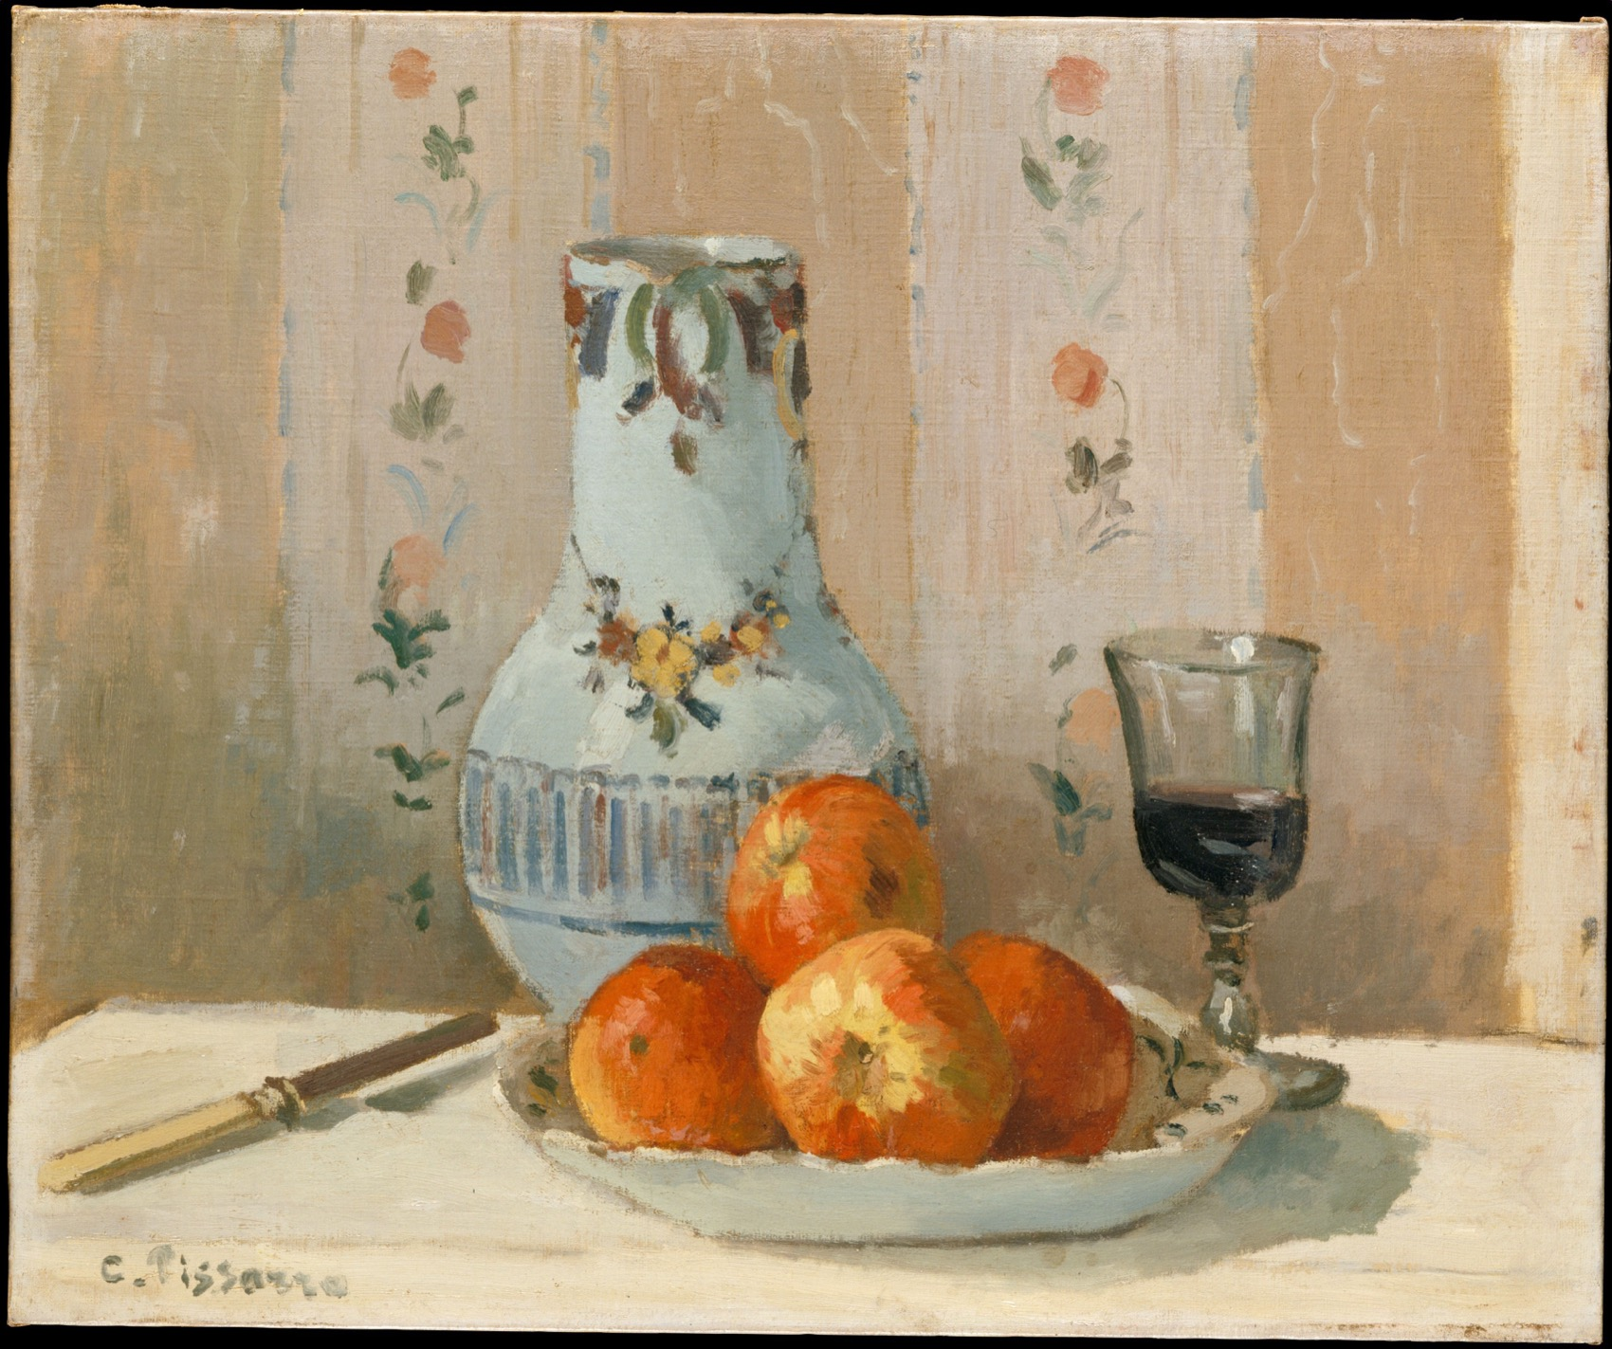
THREE QUESTIONS WORTH TESTING
NOT THREE VERSIONS OF ONE
What an experiment is for
Surface
Process
Scale
How does the medium hold light?
What does the process do on its own?
Does it survive at real size?
Pissarro, Talbot and Mucha, public domain. Shown whole, as study material rather than as a style to copy.
A LEVEL ART & DESIGN 9479 · SEMESTER I
03

Slide 9
WHAT LOSES MARKS
EVERY ONE OF THESE IS AVOIDABLE
Four ways A2 goes wrong
Twelve safe samples
A grid of neat swatches with nothing at risk. It looks industrious and scores as one experiment.
The artist as decoration
Two pages about an artist, then work that shows no trace of them. Cite less, respond more.
Rejections thrown away
The discarded tests are the argument. Keep them, label them, and say what each one ruled out.
A swatch chart, not a page
The Stage 3 page has to read as reasoning. Sequence it so the decision is legible from the layout.
A LEVEL ART & DESIGN 9479 · SEMESTER I
04

Slide 10
DATES
ANNOUNCED AHEAD, IN WRITING
Three dates that matter
Announced
Sits
Then
Mon 26 Oct
Mon 9 Nov
Tue 10 Nov
Two weeks of notice. The unit is already underway, so the announcement names what will be collected rather than setting new work.
In class, after the Juniors Days. It reviews the whole of Unit 3 together.
The feedback day. It ends with one direction you can defend going into Development.
A LEVEL ART & DESIGN 9479 · SEMESTER I
05

Slide 11
AFTER A2
One direction
you can defend.
Development starts from a decision, not from a shortlist you are still holding.
A LEVEL ART & DESIGN 9479 · SEMESTER I
06

