Slide 1
I
ART APPRECIATION · UNIT I
Opening
the Atlas
Origins and Ancestral Memory · Lesson 01
Three sessions · Tuesday 1 to Thursday 3 September
Notes:
Day one is the only time all year the whole course is visible at once. Warm, scholarly open.

Slide 2
I
THE METHOD
Look before
you explain.
Notes:
The atlas method is genuinely strange to students taught art history as a timeline. Say the strange thing out loud and do not apologise for it.

Slide 3
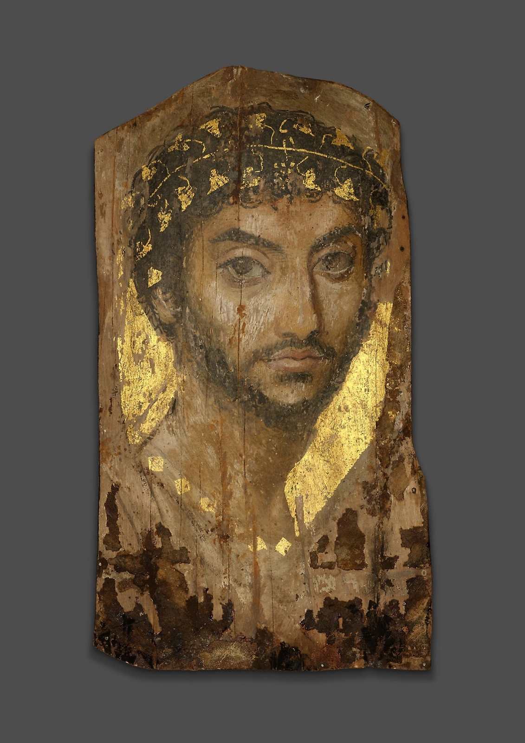
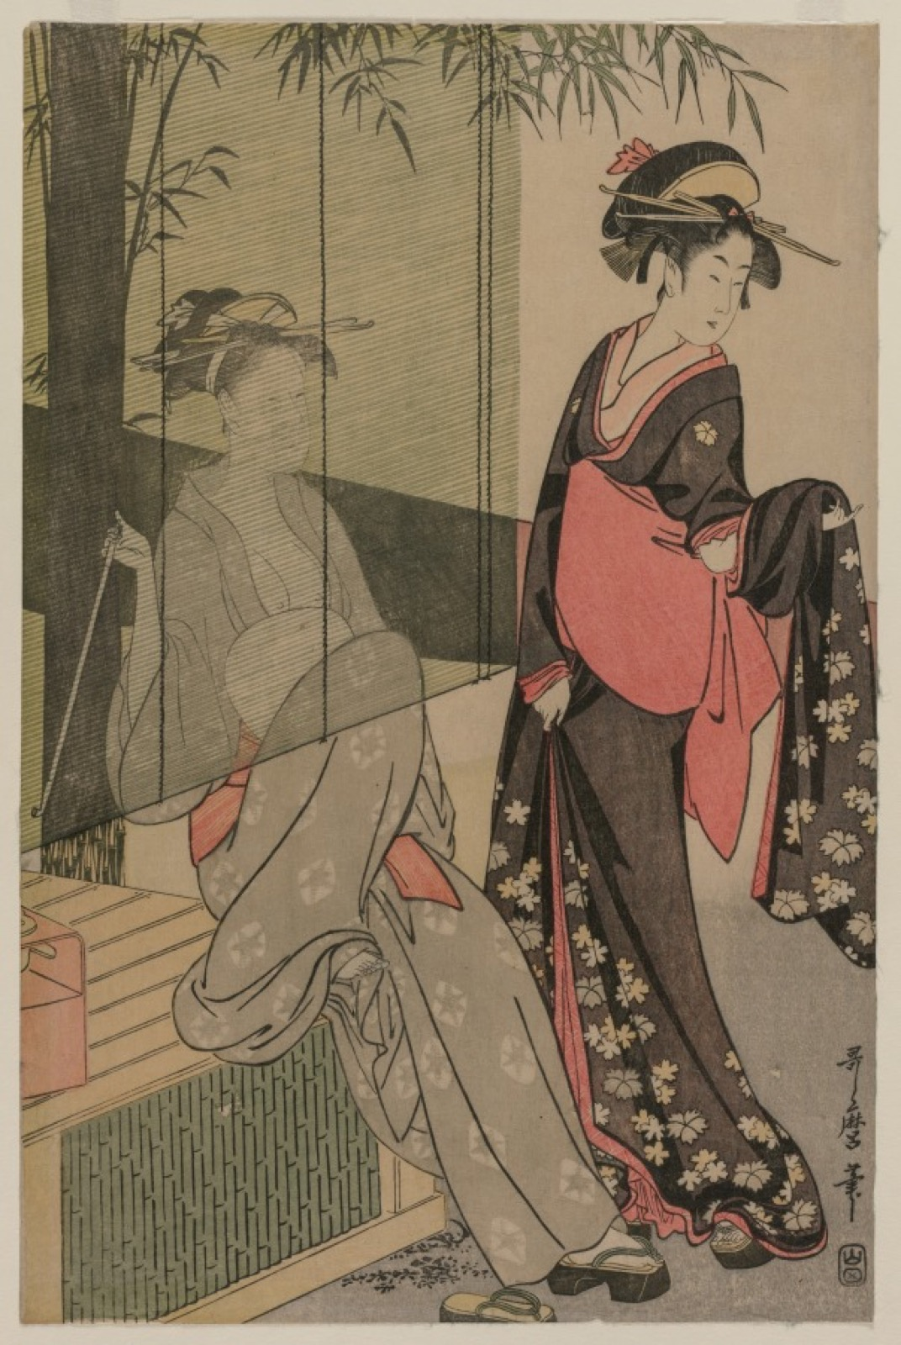
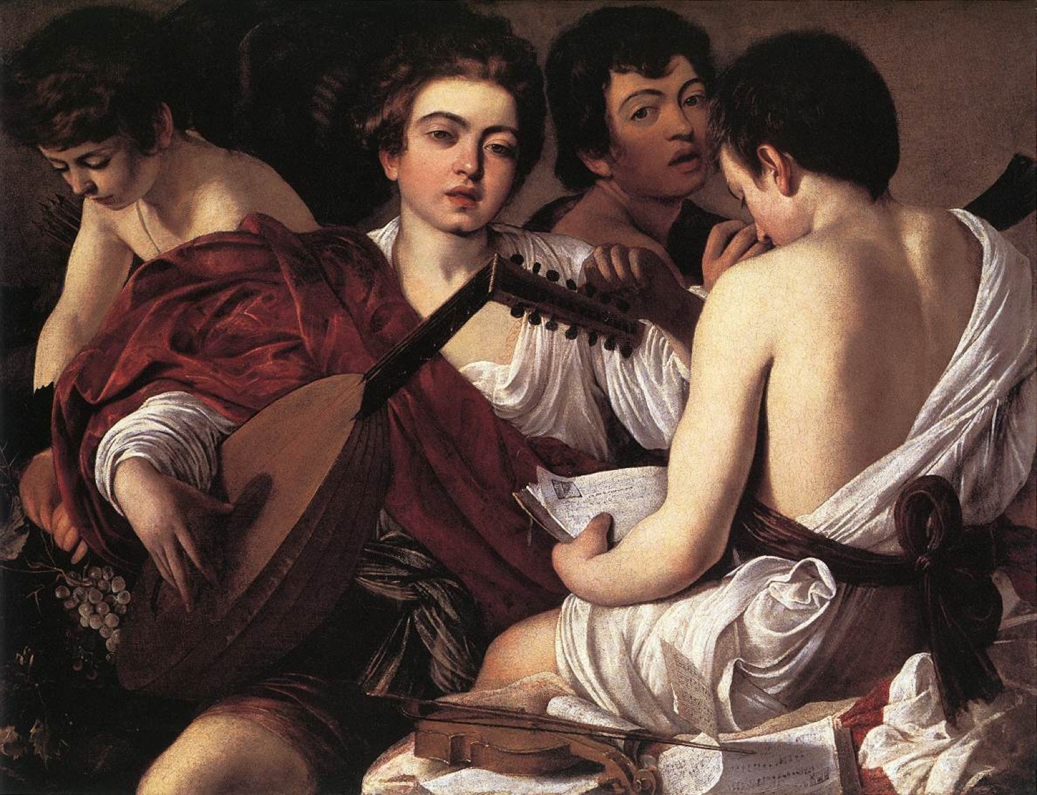
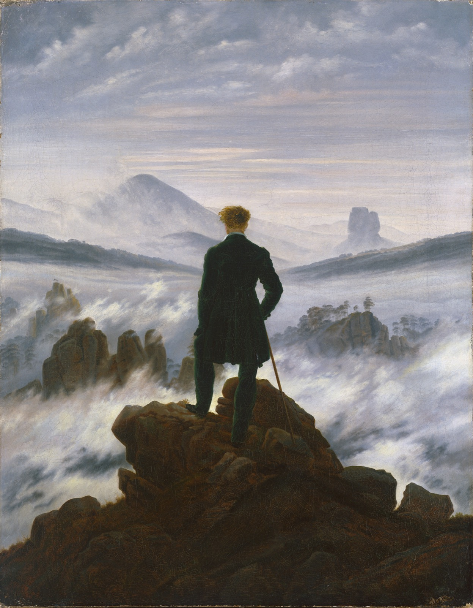
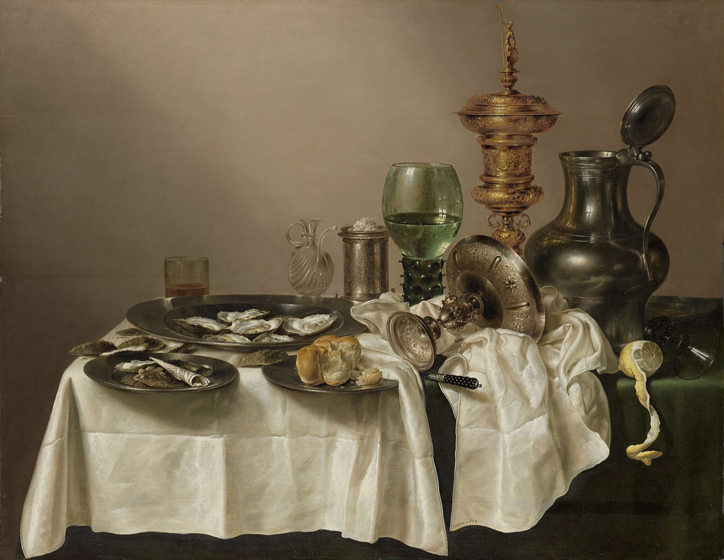
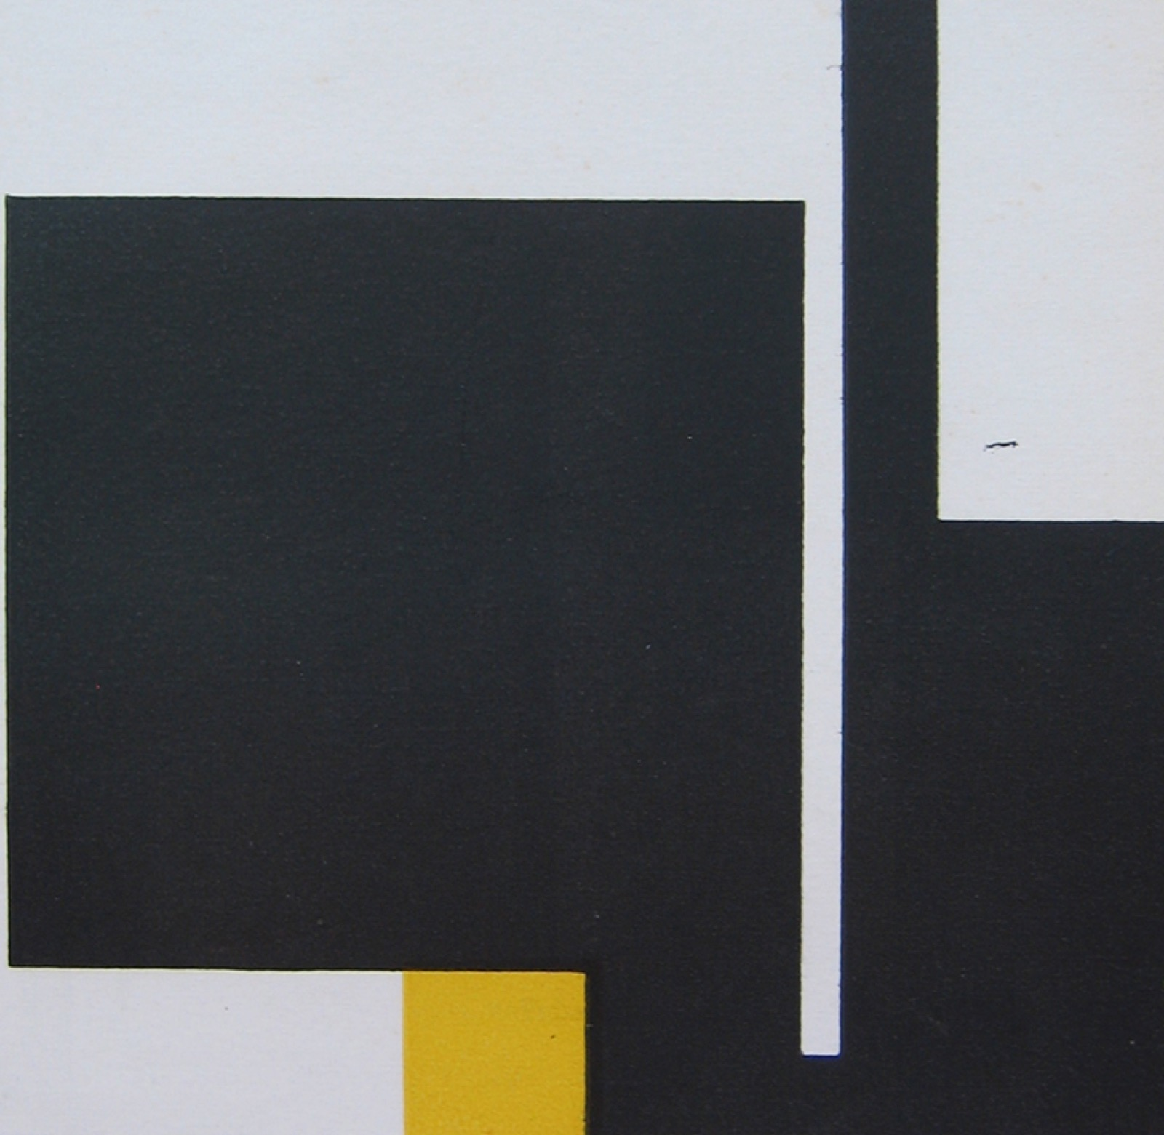
THE METHOD
AN ATLAS PANEL
Six works, six centuries
Placed side by side, unlike images argue by resemblance, not by date. This is the move every unit repeats.
Notes:
Roman mummy portrait, Utamaro, Caravaggio, Friedrich, Heda, Munari. The point is adjacency, not chronology.

Slide 4
“
Resemblance
beats date.
The atlas method, after Aby Warburg. Images argue by adjacency, not chronology.

Slide 5
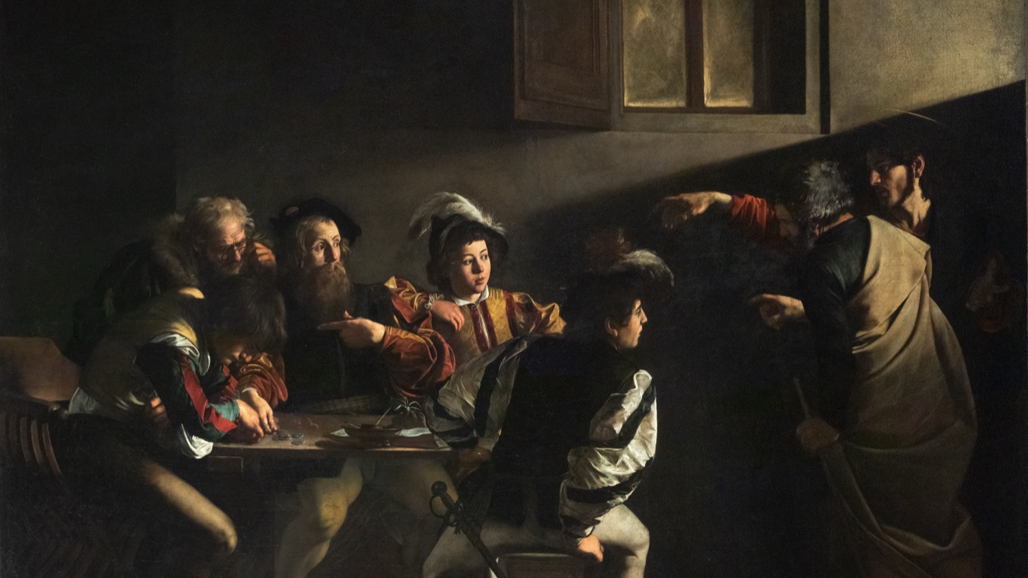
DAY TWO · LOOK FIRST
Ten minutes, in silence, before the title.
Caravaggio, The Calling of Saint Matthew, 1599
Notes:
Ten minutes silent on one image, title withheld; describe in writing for two minutes, then spoken. Close: what did someone else see that you did not.

Slide 6
HOW IT RUNS
THREE SESSIONS
Three days, one job
01
02
03
Tuesday
Wednesday
Thursday
Introductions across the year groups, then the atlas method: Warburg's panels, and why resemblance beats date.
Look before you explain. Ten minutes silent on one image, the title withheld; describe in writing, then out loud.
The darkroom: an image stops being a screen and becomes a thing that light did to a surface.
ART APPRECIATION · SEMESTER I
01

Slide 7
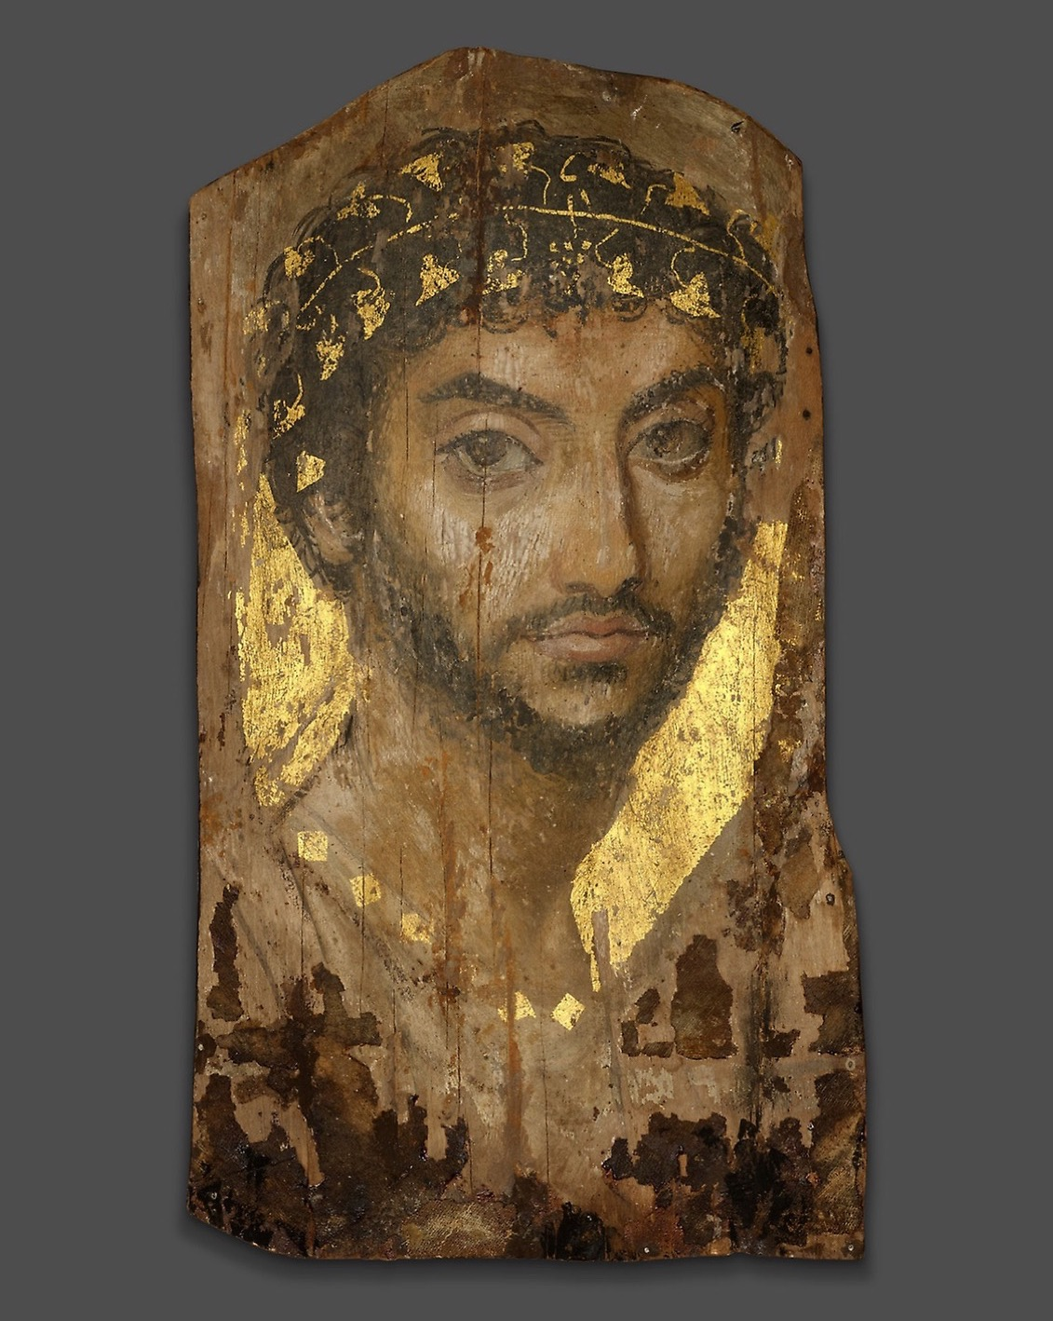
ORIGINS
Ancestral
memory
Unit I asks what an object does, not only what it depicts. A face painted to keep a person present is not a picture of memory. It is the memory, made to survive.
Mummy Portrait of a Man, Roman Egypt, c. 101 CE
Notes:
Ritual objects and ancestral presence: what an object does. This sets up the first constellation board (A1).

Slide 8
“
The painted gaze is entirely concentrated on the life it knows it will one day lose.
John Berger, on the Fayum portraits

Slide 9
THE HABIT · THE MOVE
WHY IT'S STRANGE
Two ways to hold a picture
01
02
Taught as a timeline
Read as a constellation
Students arrive holding art history as dates and periods, a line from earlier to later. It sorts, but it does not make anyone look.
The atlas sets unlike images side by side and asks what the adjacency argues. Looking comes first; the date can wait.
ART APPRECIATION · SEMESTER I
02

Slide 10
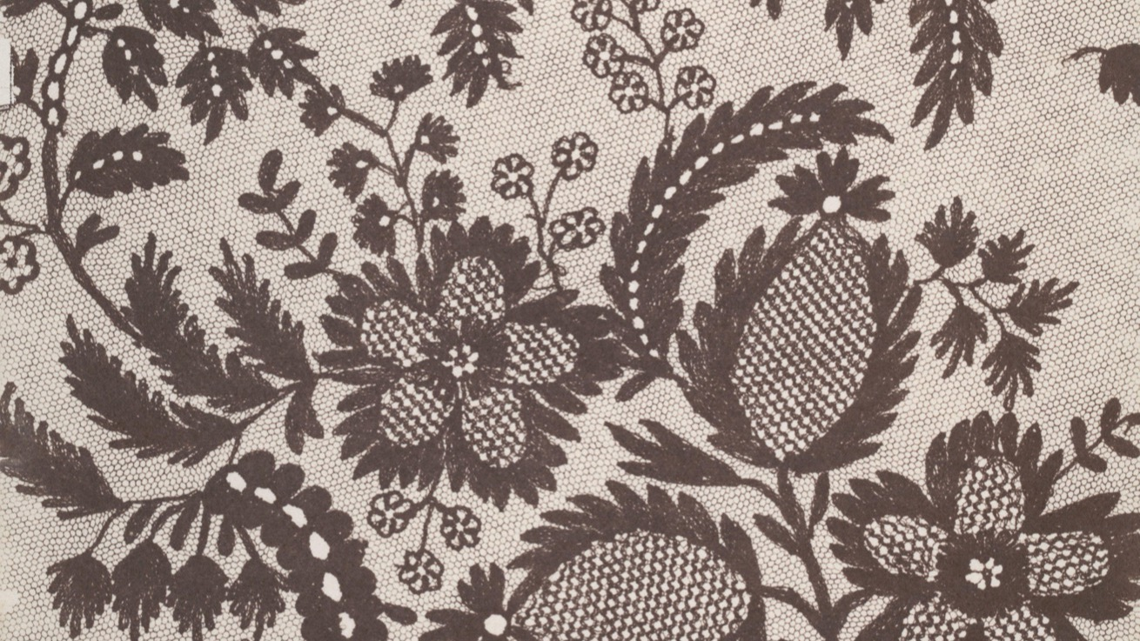
DAY THREE · THE DARKROOM
A photogram: the thing itself, laid on the paper and printed by light.
William Henry Fox Talbot, Lace, c. 1845
Notes:
The darkroom will overrun. Let it. The reflection is the graded thing and its fifteen minutes are protected. CS1 collected at the door.

Slide 11
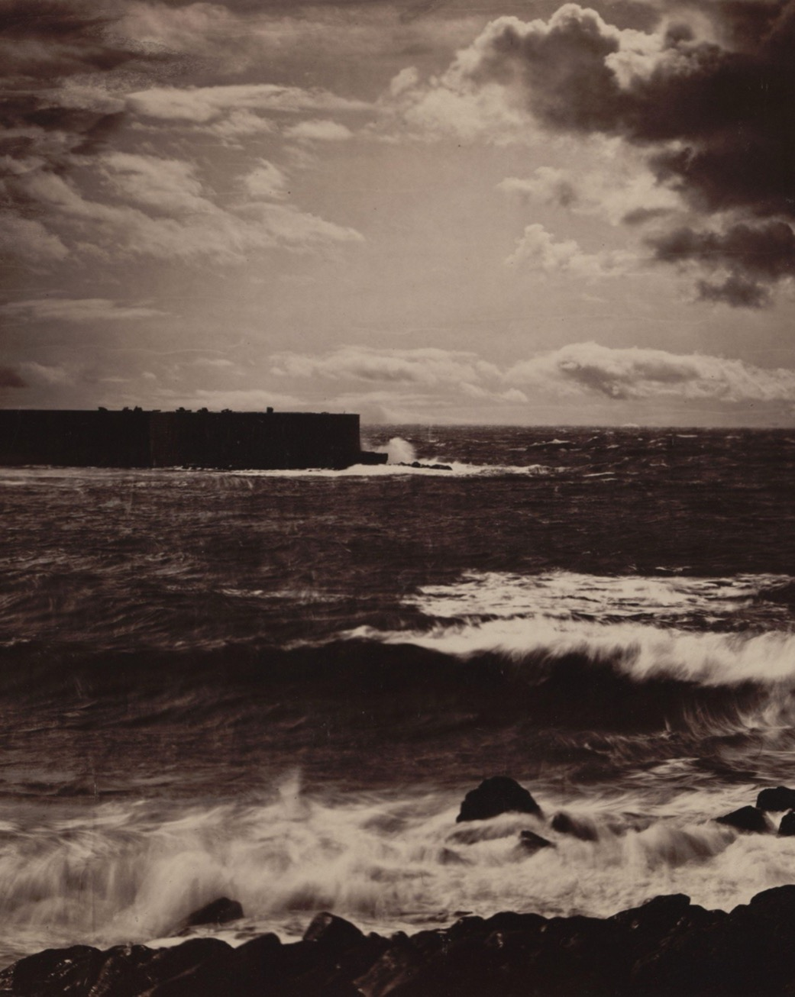
THE TRACE
The index of
a real thing
An image light made, not a hand drew: a trace of something that was really there. Hold onto the distinction, because it is load-bearing for the whole of Unit IV in December.
Gustave Le Gray, The Great Wave, Sete, 1857
Notes:
Twenty-five minutes making, fifteen writing the reflection while the print is still wet.

Slide 12
NEXT
What Survives
and Why
Lesson 02. A1 gets its own air.
ART APPRECIATION · SEMESTER I
04

