Slide 1
II
ART APPRECIATION · UNIT I
What Survives,
and Why
Origins and Ancestral Memory · Lesson 02
Six sessions · Friday 4 to Friday 11 September
Notes:
The notice week and the cave week at once. Put A1 first, in the first ten minutes, before the content.

Slide 2
II
ORIGINS
The wall is
the evidence.
Notes:
Five days on people who left no writing. Resist filling the silence with anthropology. They argue from the wall.

Slide 3
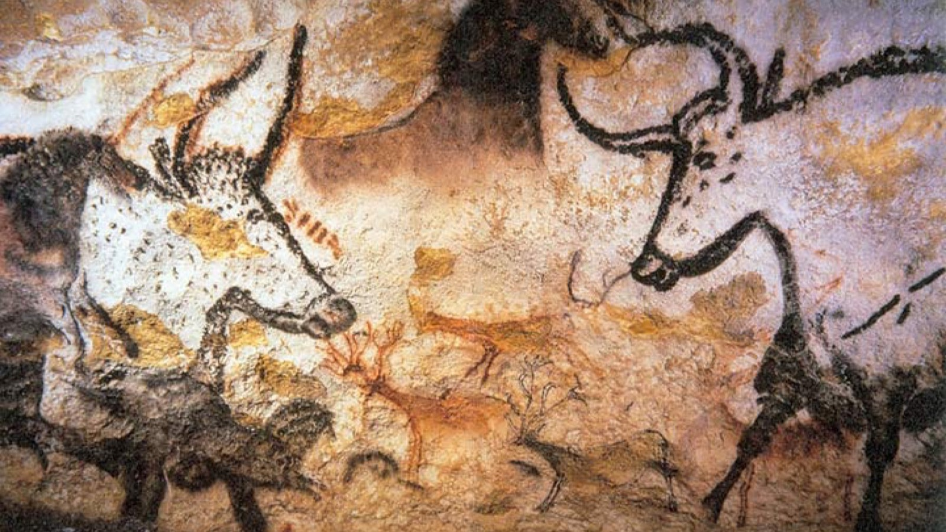
WHAT SURVIVES
Aurochs, horses and deer, painted where no daylight reaches.
Lascaux, Dordogne, c. 17,000 years ago · public domain
Notes:
Name what had to happen for an object to reach you at all: sealed cave, stable air, no rediscovery until 1940.

Slide 4
ASSESSMENT · A1
THE MOST FRAGILE DATE
The first board
Announced today, in the first ten minutes, before any content.
Your first constellation board and its written justification.
Due Friday 18 September.
Fourteen days, exactly. There is no session before today, so if it is not set now it cannot be set this term.
ART APPRECIATION · SEMESTER I
01
Notes:
The announcement genuinely is the most fragile thing in the semester. If Friday 4 September falls, A1 moves and the whole board run compresses.

Slide 5
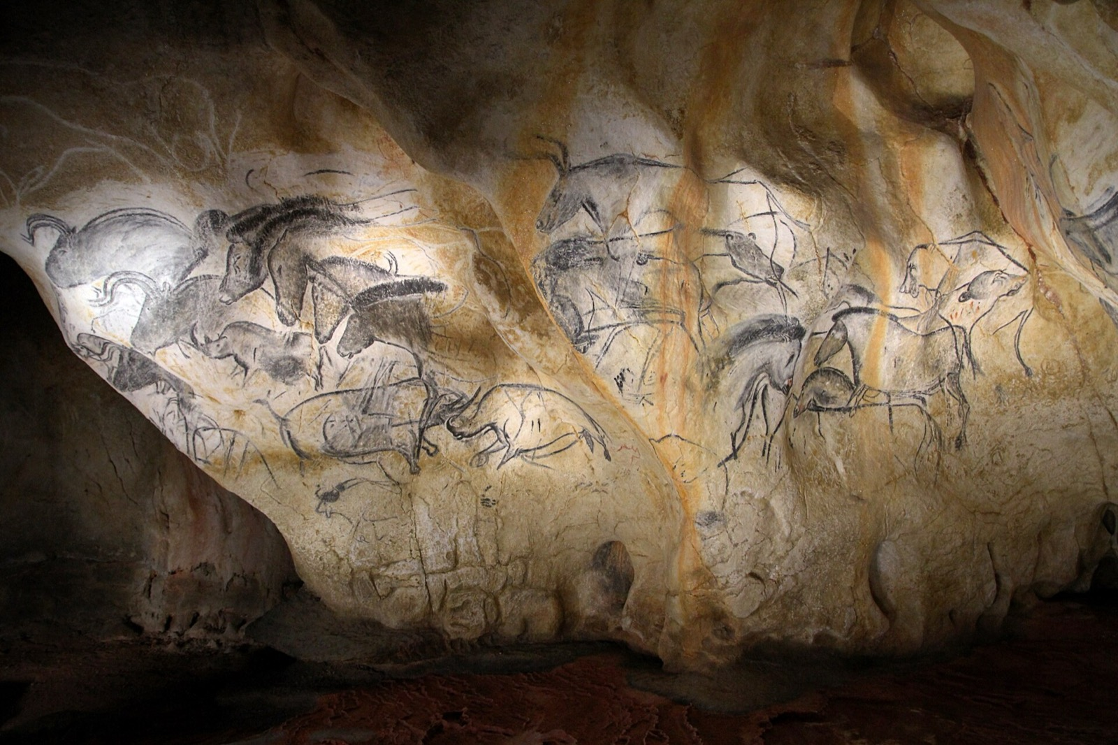
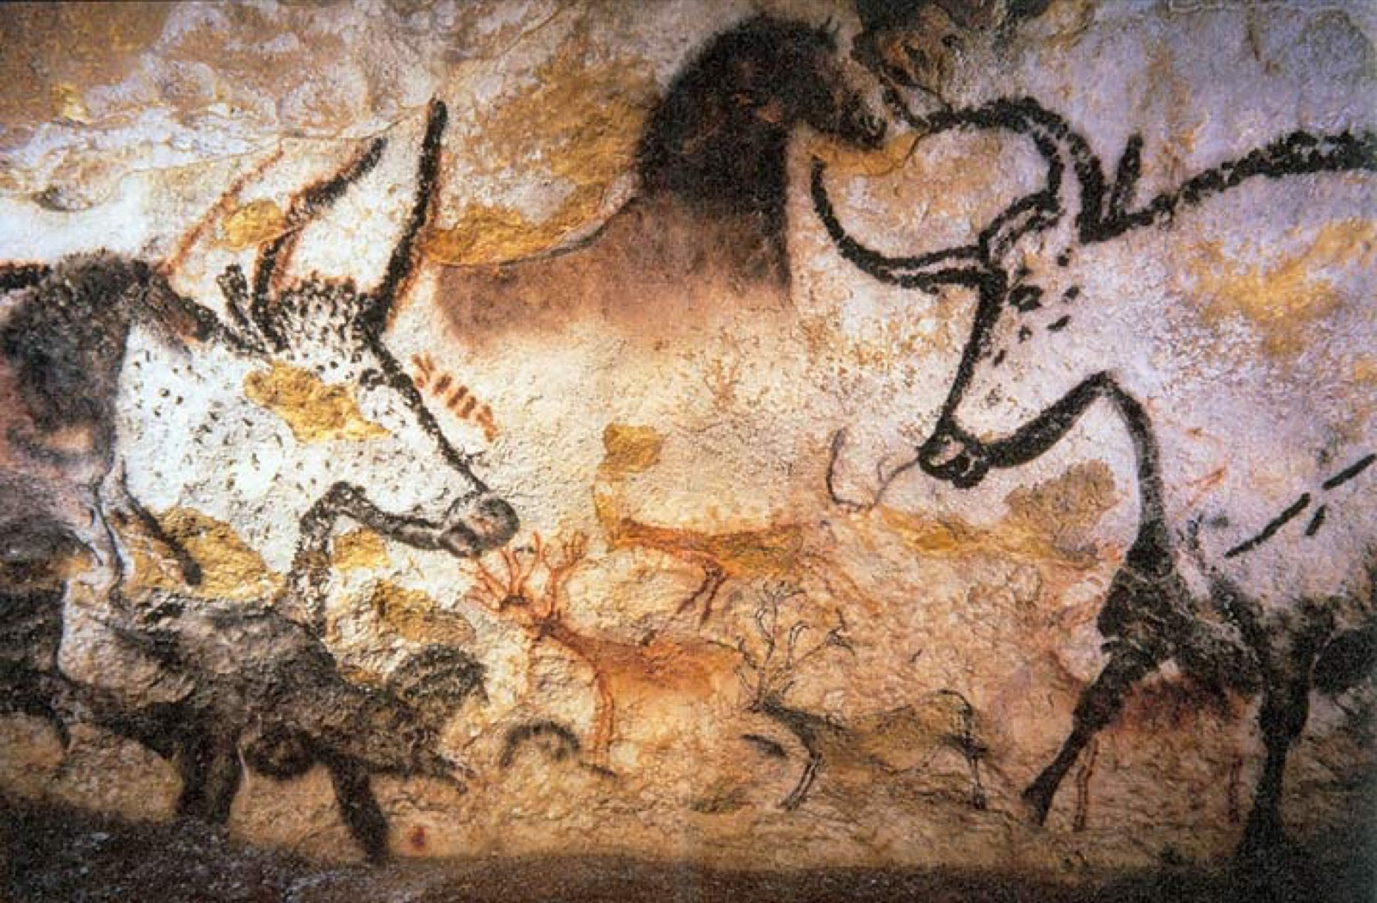
THE METHOD RETURNS
READ THE WALL LIKE A PANEL
Two panels, one question
Chauvet, Panel of Horses · CC BY-SA
Lascaux, Hall of the Bulls · public domain
Set side by side, they stop being illustrations and start arguing. What does the proximity claim that neither claims alone?
Notes:
The pairing is inside one thing, cave against cave, so the difference does the work rather than the exoticism.

Slide 6
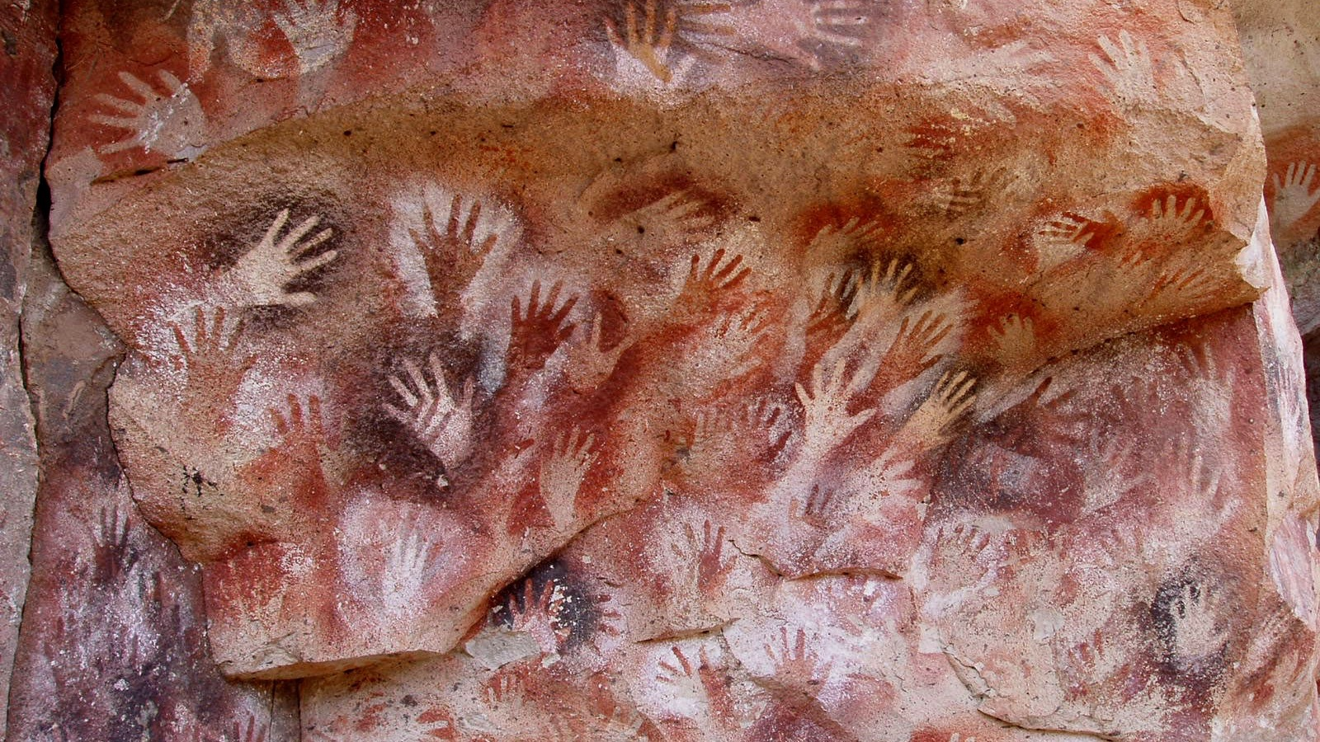
HANDS, ANIMALS, THE DARK
The maker's own hand, held to the wall and blown around in pigment.
Cueva de las Manos, Argentina, c. 7,000 BCE · public domain
Notes:
Account for the choice of animal, wall, and depth. The hand is the one image that is unmistakably a person saying: I was here.

Slide 7
“
We have no word for this darkness. It is not night and it is not ignorance.
John Berger, on the Chauvet cave

Slide 8
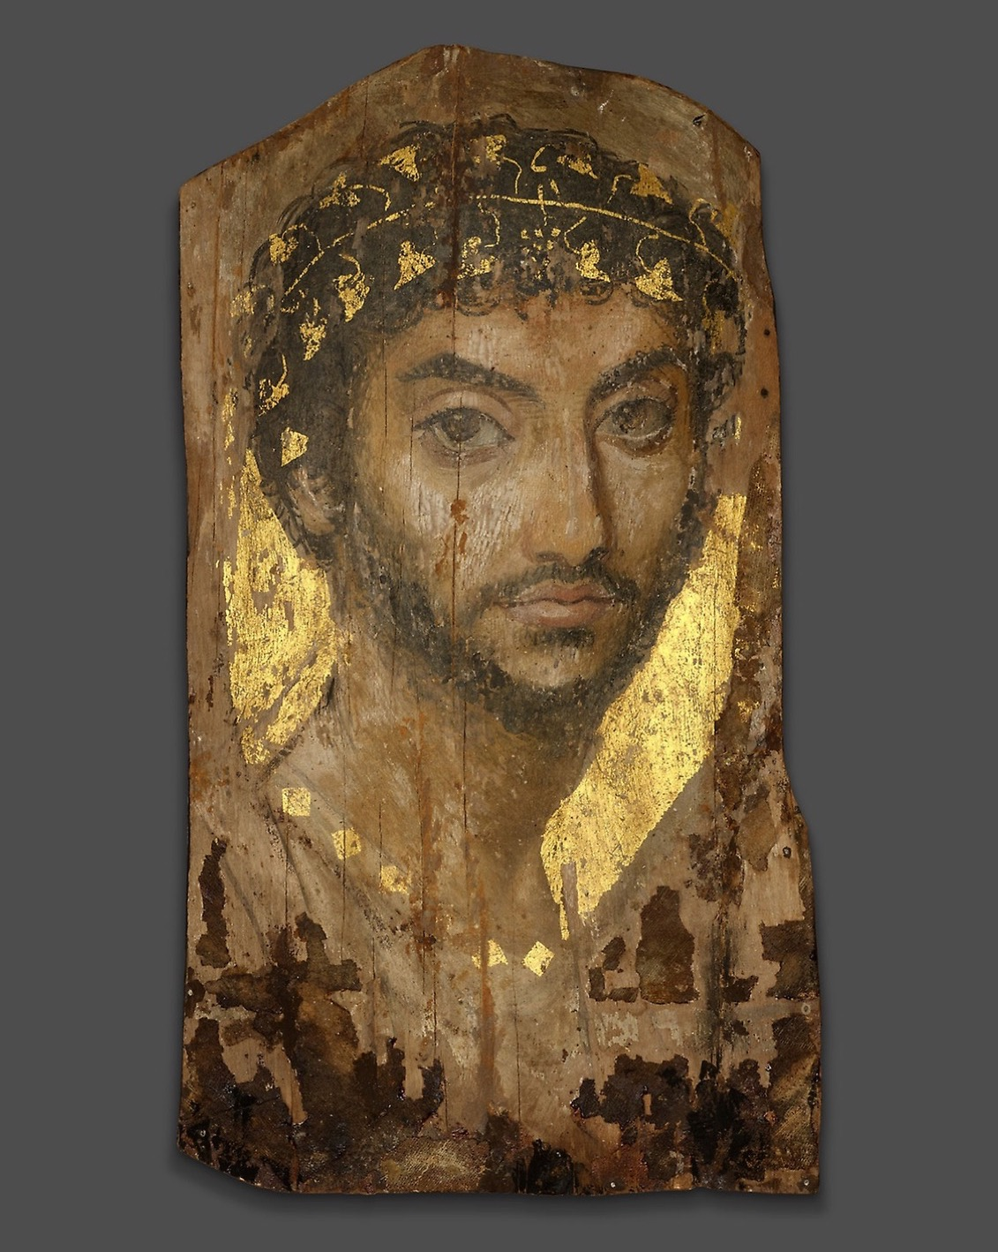
SURVIVAL
What reaches
you at all
Almost nothing survives, and never at random. Dry air, a sealed tomb, a buried wall. What you get to look at is already a survivor, and the survival is part of the meaning.
Mummy Portrait of a Man, Roman Egypt, c. 101 CE
Notes:
The Fayum portrait survived the same way the caves did: kept from air and light. Survival is not neutral.

Slide 9
“
What did the
first images want?
The Friday seminar. Take a position, then let the room move it.

Slide 10
WHY MAKE A MARK
ARGUE IT FROM THE WALL
Not decoration
01
02
The easy answer
The harder one
That people drew for beauty, or to pass the time. It explains nothing about why here, this animal, this depth, in the dark where no one would see it.
Pick one reason and argue it from the evidence: the placement, the overpainting, the choice of surface. A claim you can point at beats a claim you feel.
ART APPRECIATION · SEMESTER I
02

Slide 11
HOW IT RUNS
SIX SESSIONS
The week, day by day
FRI 4 SEP
A1 announced, then: what survives, and why
MON 7 SEP
Lascaux and Chauvet, first pass, no commentary
TUE 8 SEP
Hands, animals and the dark
WED 9 SEP
Why make a mark: one reason, argued
THU 10 SEP
Read a cave wall the way Warburg read a panel
FRI 11 SEP
Seminar: what the first images wanted (LB1)
ART APPRECIATION · SEMESTER I
03

Slide 12
NEXT
The First Board
Lesson 03. The move every unit repeats, made for the first time.
ART APPRECIATION · SEMESTER I
04

