Slide 1
III
ART APPRECIATION · UNIT I
The First
Board
Origins and Ancestral Memory · Lesson 03
Five sessions · Monday 14 to Friday 18 September · A1 due Friday
Notes:
The board is the course in miniature and this is the first time they do it. Days 1 to 2 content, days 3 to 5 the build. The build must not start early.

Slide 2
III
THE MOVE
A board without
reasons is a
mood board.
Notes:
The justification is what separates the two, and it is the thing to be hard about.

Slide 3
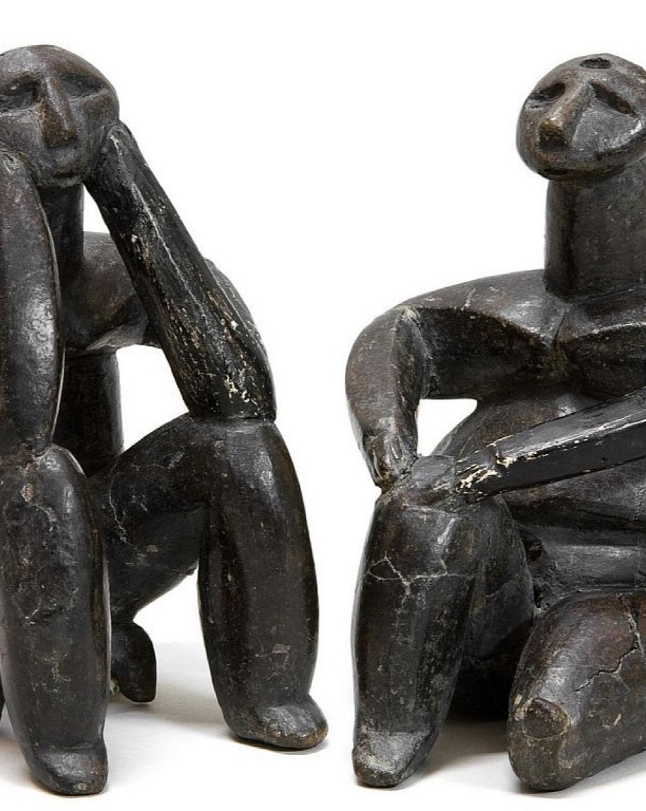
DAY ONE
The made
object
When people stop moving, the object changes. It is kept, buried, set down on purpose. What appears in images when a place becomes a home?
Hamangia culture, The Thinker and The Sitting Woman, Romania, c. 5000 BCE
Notes:
Neolithic settlement and the made object: what changes in images when people stop moving.

Slide 4
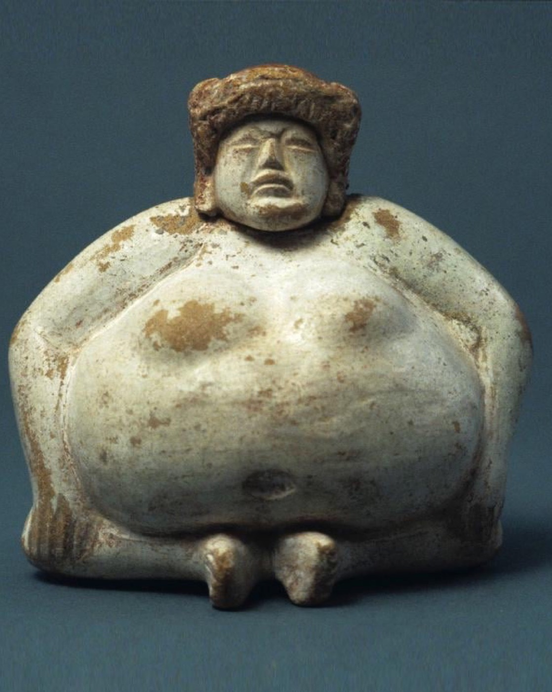
DAY TWO · ANCESTRAL PRESENCE
What an
object does
Describe it by what it does, not only by what it depicts. A figure set in a grave is not a picture of a person. It stands in for one, and it is expected to act.
Seated figure, Olmec, Mexico, c. 1200 to 900 BCE
Notes:
Ritual objects and ancestral presence: what an object does, not only what it depicts.

Slide 5
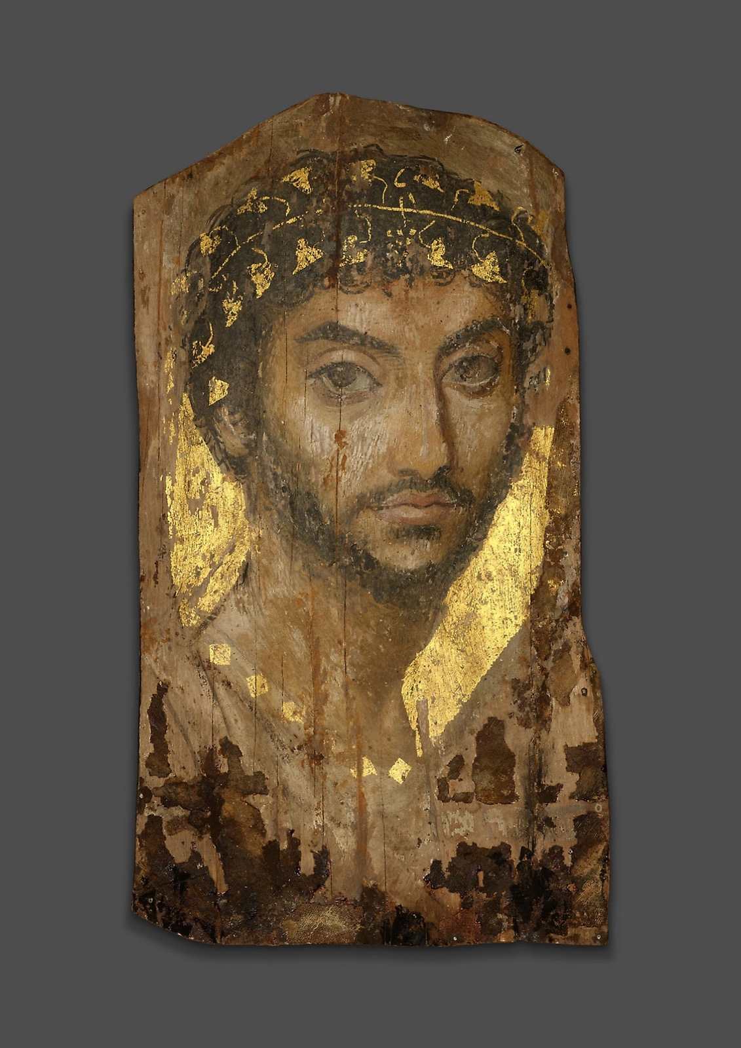
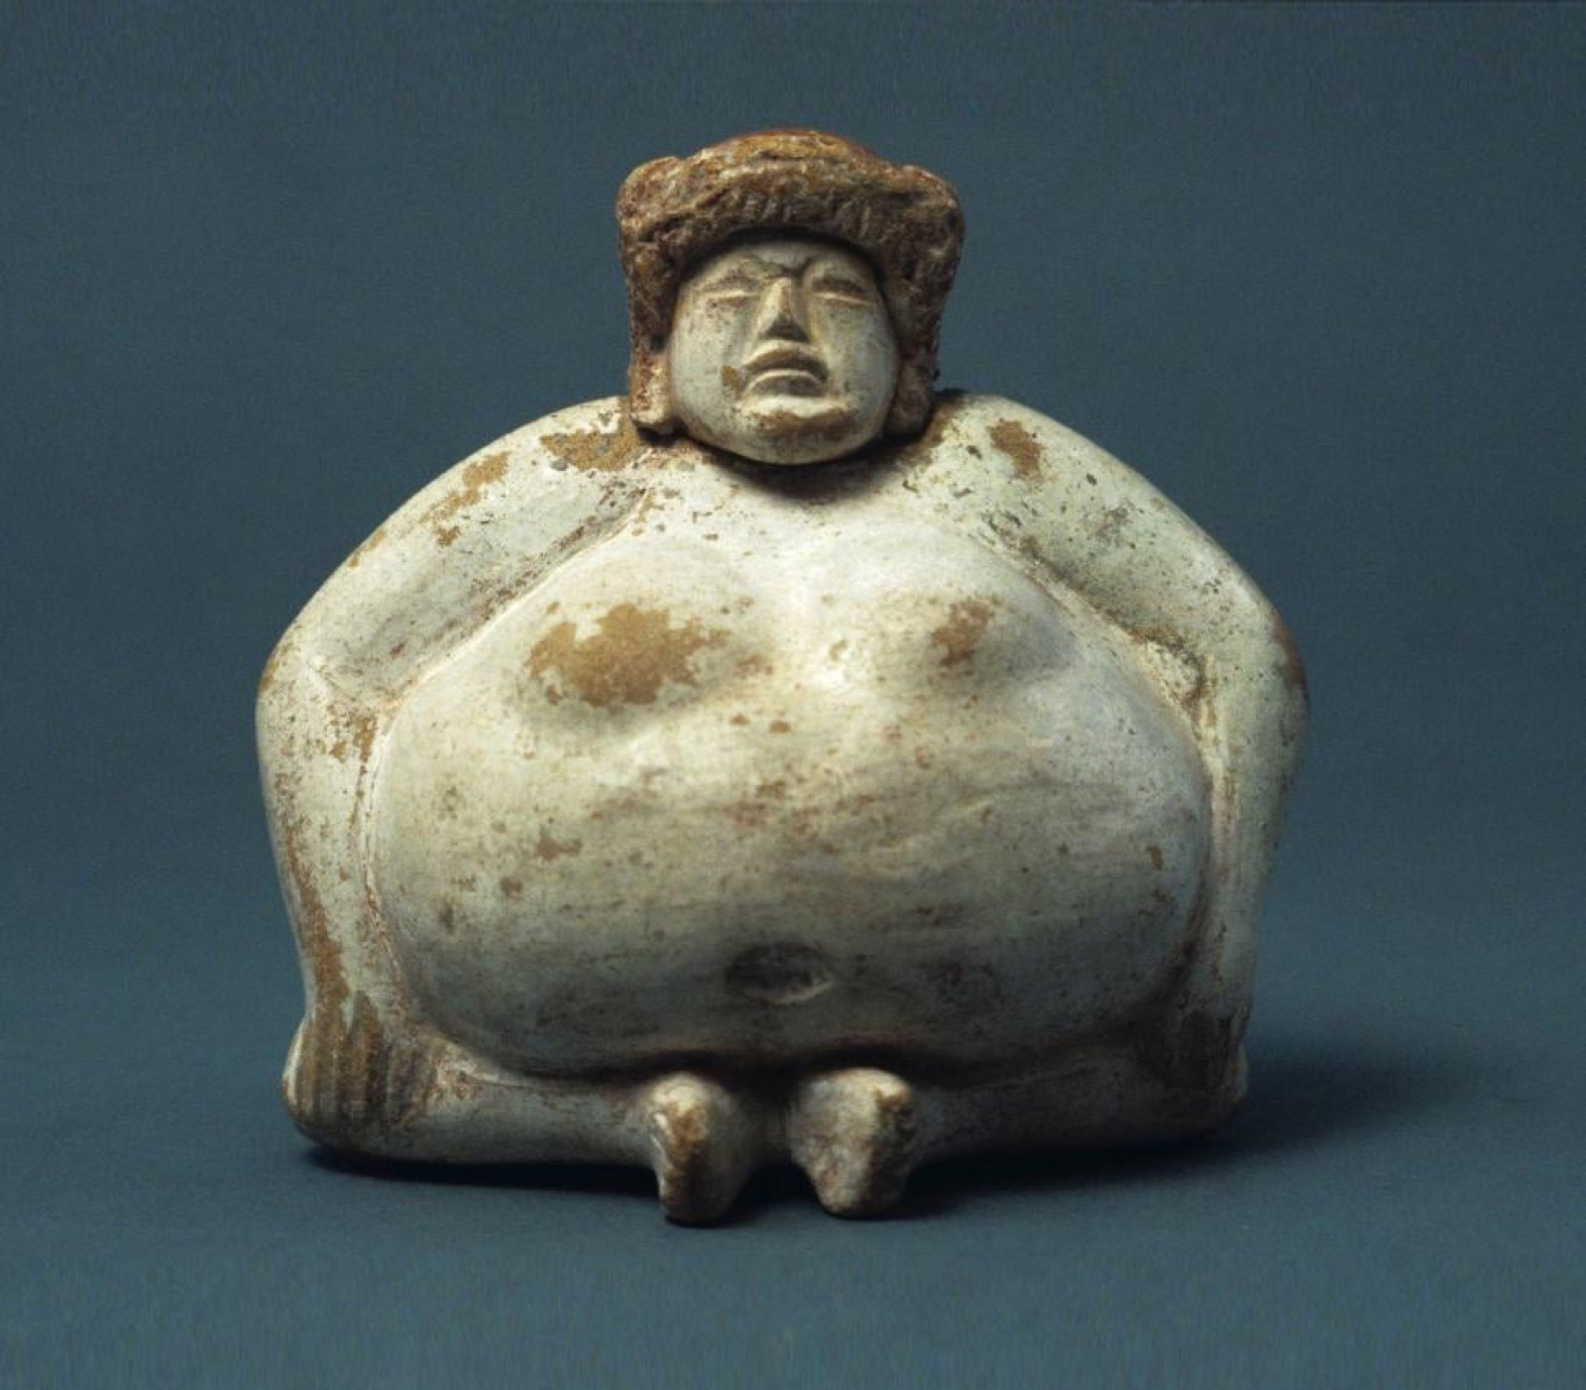
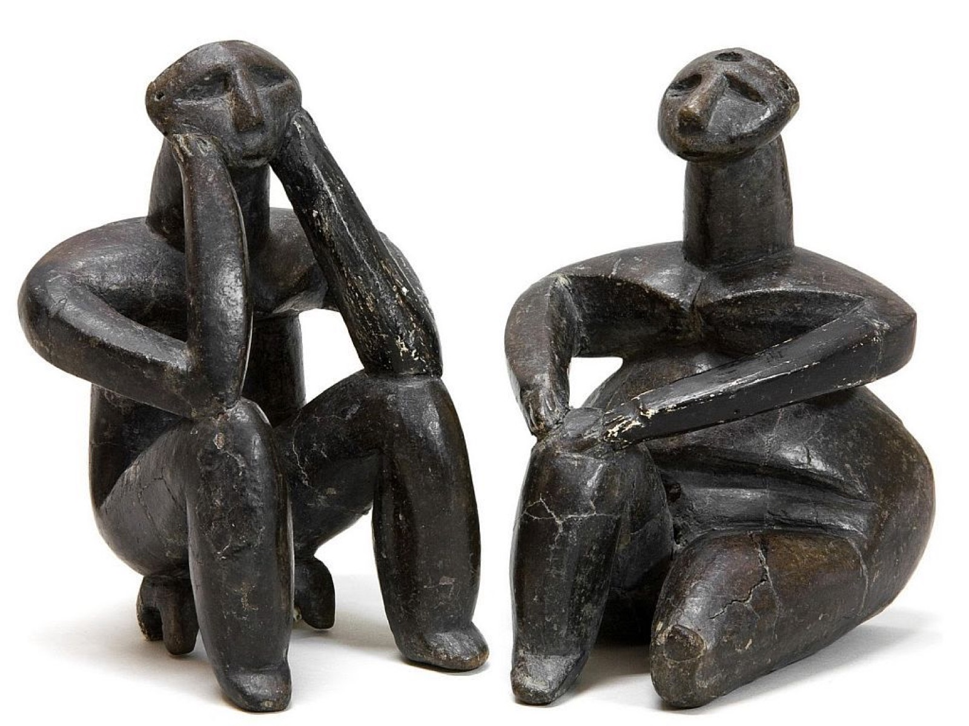
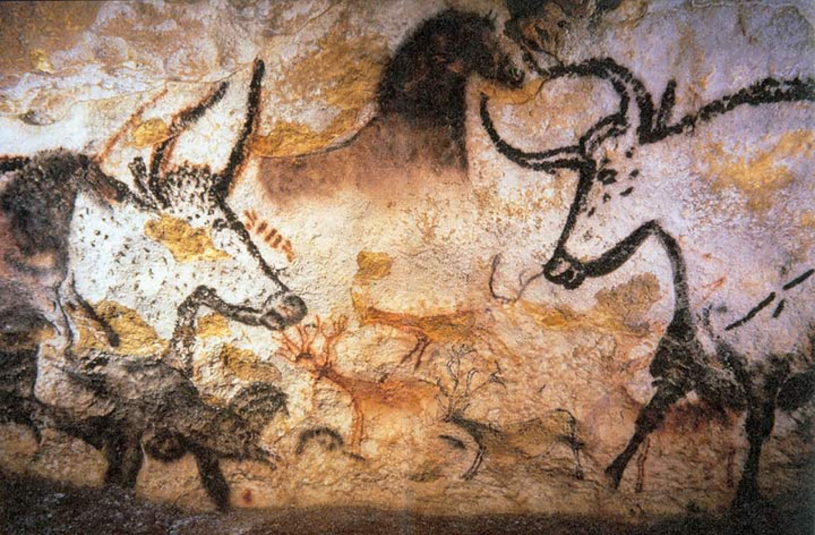
DAY THREE · THE WORKSHOP
WHAT A BOARD LOOKS LIKE
Four objects, one wall
Neolithic figure, Fayum portrait, Olmec figure, Lascaux wall. Placed together, they make you ask what they share. The pairing is the argument.
Constellation workshop: two unlike images, one defended pairing, out loud, everybody. Direct practice for A1.
Notes:
Students who begin arranging before they have enough candidates arrange what they have. Gather first.

Slide 6
“
Ideas are to objects
as constellations
are to stars.
Walter Benjamin, The Origin of German Tragic Drama, 1928

Slide 7
THE A1 MOVE
ONE DEFENDED PAIRING
The reason that cannot move
01
02
A mood board
A board
Puts things that look nice together. The adjacency has no reason, so it could be reshuffled and nothing would be lost.
Every adjacency carries a reason that could not be moved to a different pair. Break the pair and the argument breaks with it.
ART APPRECIATION · SEMESTER I
01

Slide 8
ASSESSMENT · A1
DUE FRIDAY 18 SEPTEMBER
Marked on three things
01
Every adjacency justified
with a reason that could not be moved to a different pair.
02
The argument legible
from the layout, before a word of the write-up is read.
03
Objects by what they do
described for their action, not only their appearance.
The group board is hung together; the write-up is individual. Say early how the split grade works.
ART APPRECIATION · SEMESTER I
02
Notes:
Say early how the group/individual split works, or day five is spent arguing about it instead of hanging.

Slide 9
“
The argument is
legible from the
layout.
Before a word of the justification is read.

Slide 10
HOW IT RUNS
FIVE SESSIONS
The week, day by day
MON 14 SEP
Neolithic settlement and the made object
TUE 15 SEP
Ritual objects and ancestral presence
WED 16 SEP
Constellation workshop: one defended pairing
THU 17 SEP
Build the Unit 1 board on the wall
FRI 18 SEP
Final hang, justification written, A1 collected
ART APPRECIATION · SEMESTER I
03

Slide 11
NEXT
Telling It
Without Words
Lesson 04. Unit II opens: narrative, myth and allegory.
ART APPRECIATION · SEMESTER I
04

