Slide 1
IV
ART APPRECIATION · UNIT II
Telling It
Without Words
Narrative, Myth and Allegory · Lesson 04
Eight sessions · Sunday 20 to Wednesday 30 September
Notes:
Longest lesson of the semester. Five days of vocabulary, then three turning it into a thing they make.

Slide 2
IV
THE QUESTION
Read what the
picture decided.
Notes:
A picture with no words still makes choices. The whole unit is learning to read them.

Slide 3
“
Seeing comes
before words.
John Berger, Ways of Seeing, 1972

Slide 4
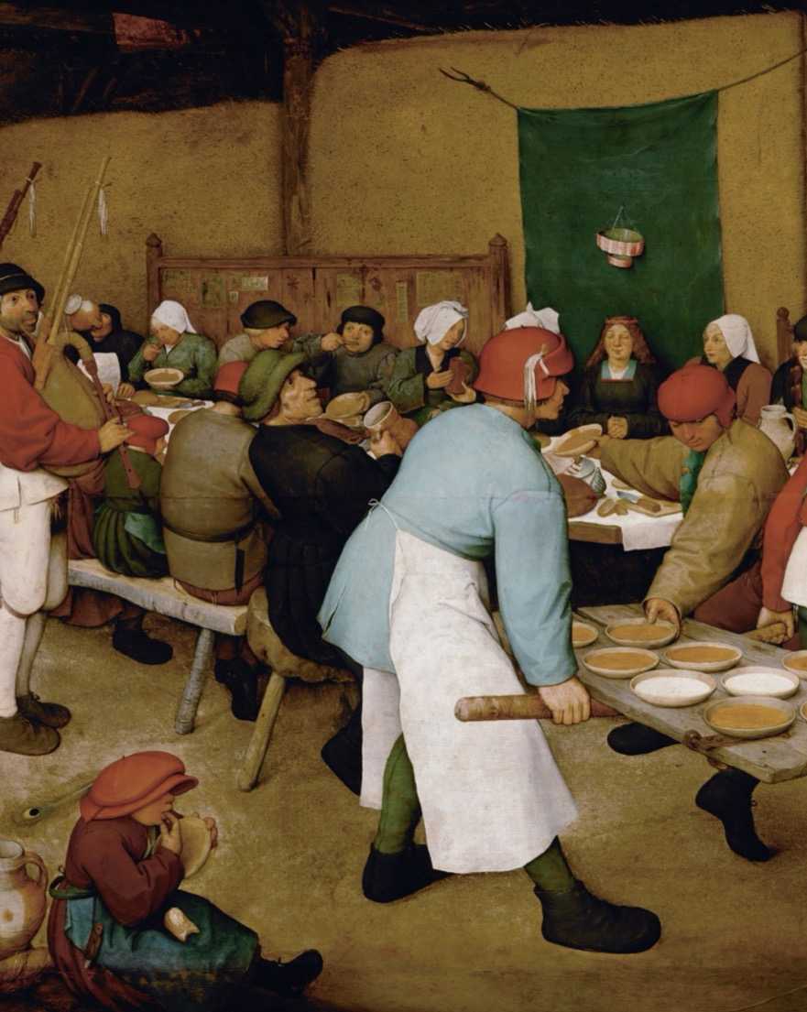
DAY ONE · THE FLOW
Describe,
account, judge
Run it cold on a picture nobody has seen. Describe what is there, account for why it is arranged so, then judge whether it works. In that order, every time.
Pieter Bruegel the Elder, The Peasant Wedding, 1567
Notes:
The critique flow taught explicitly and cold, on an image nobody has seen, so the flow gets tested rather than recited.

Slide 5
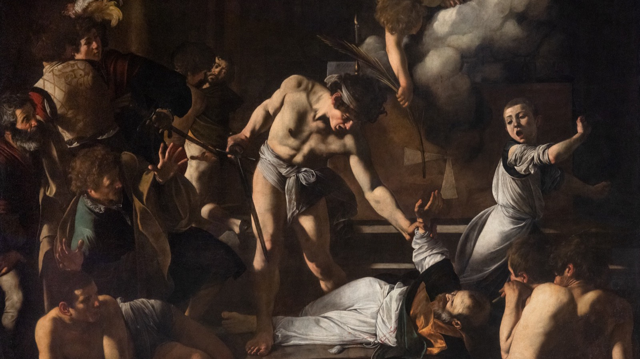
NARRATIVE · WHERE TIME GOES
One instant, with a before and an after pressed into it.
Caravaggio, The Martyrdom of Saint Matthew, 1599
Notes:
What a narrative image has to solve: find where a still image puts time. The raised sword is the hinge between what was and what will be.

Slide 6
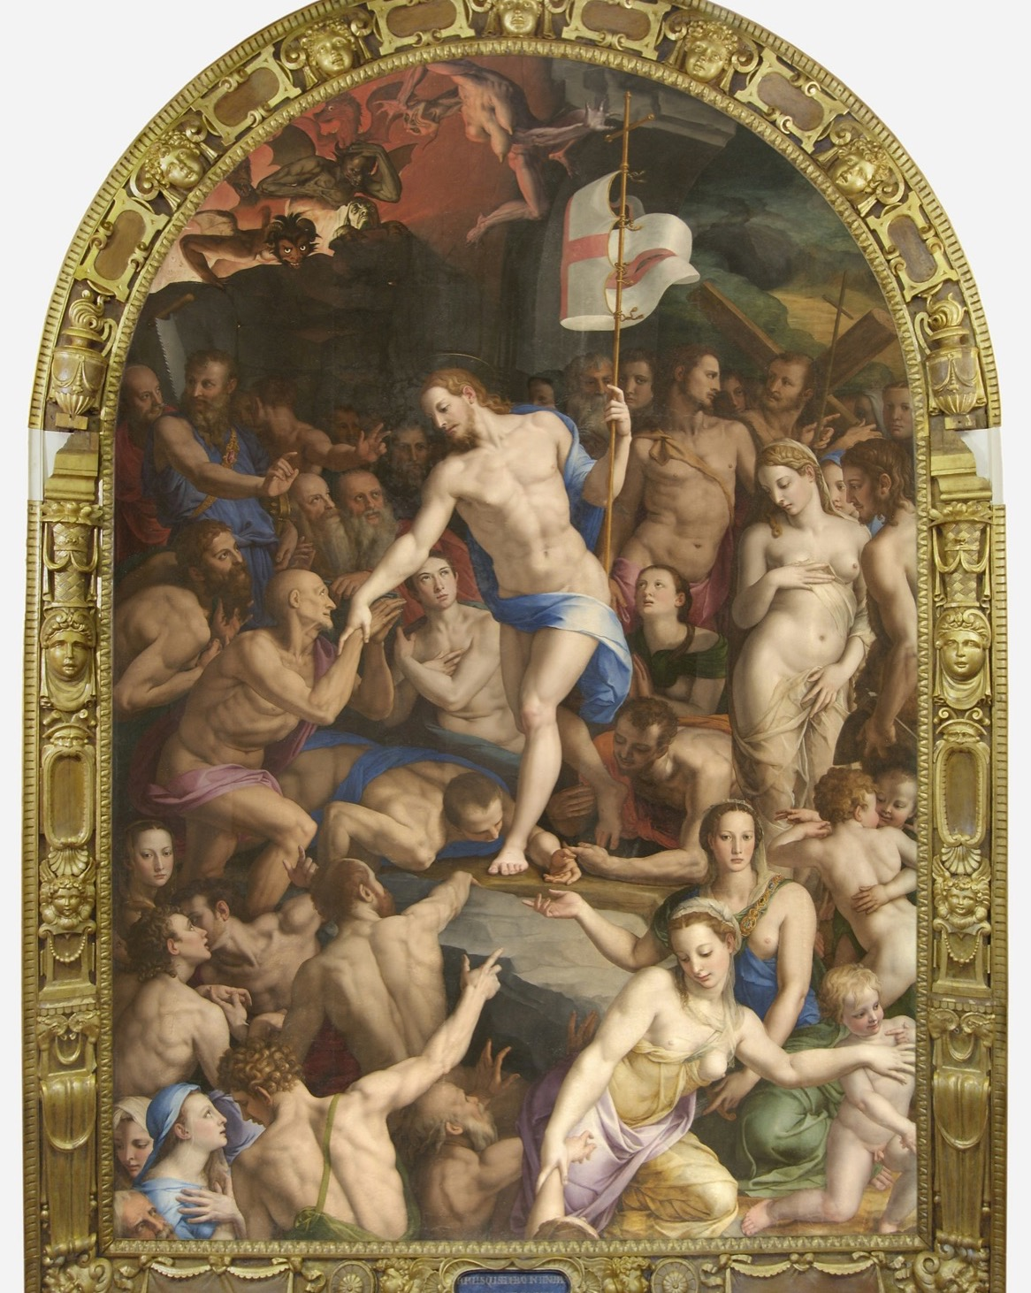
MYTH · SHARED SHORTHAND
What if you
do not know?
Myth lets a picture say a great deal with a single figure, but only to an audience that already knows the story. Watch what happens to the image when that knowledge is gone.
Bronzino, Descent of Christ into Limbo, 1552
Notes:
Myth as shared shorthand; what happens when the audience does not know.

Slide 7
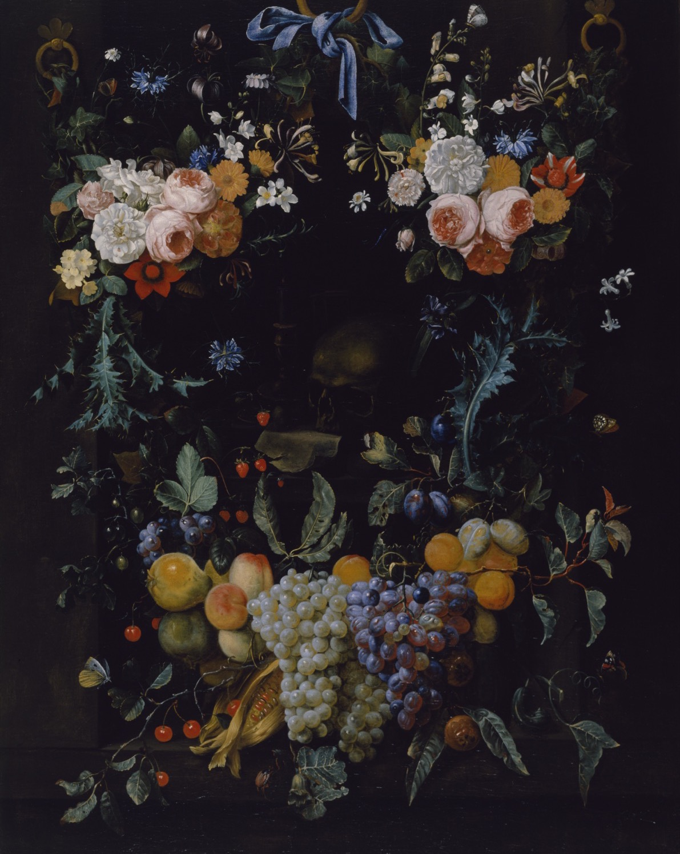
ALLEGORY · SHOWN AND MEANT
Shown, and
stood for
Separate what is shown from what it stands in for. A skull is a skull and also death; fruit is fruit and also time running out. Allegory asks you to hold both at once.
Joris van Son, Allegory of Human Life, 1658 to 1660
Notes:
Allegory: separate what is shown from what it stands in for.

Slide 8
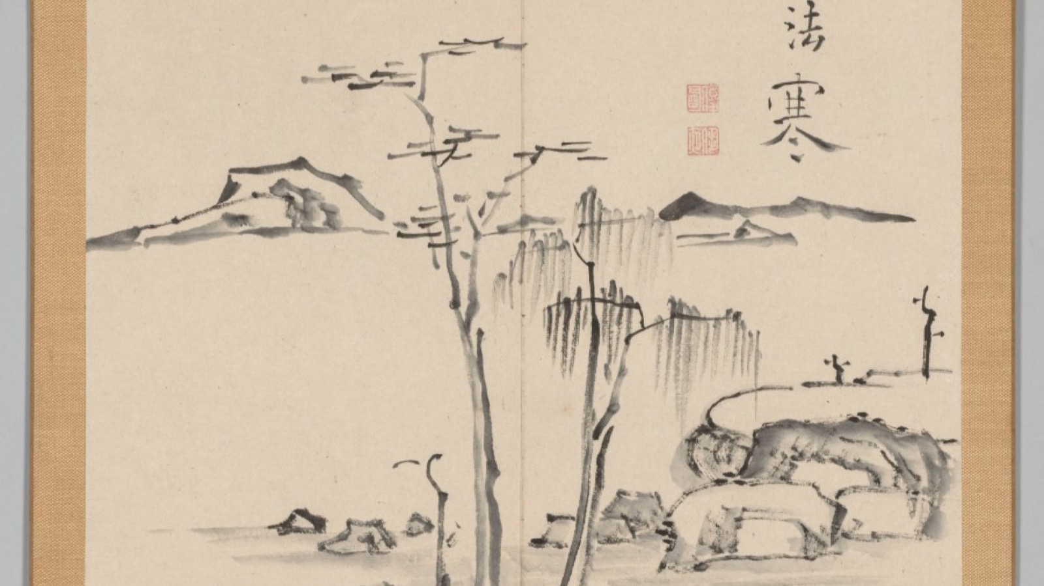
CYCLE · ACROSS PANELS
The meaning lives in the sequence, not inside any single leaf.
Aoki Shukuya, Double Album of Landscape Studies, 18th century
Notes:
Reading a cycle across panels, not inside one. Warburg read a panel this way too.

Slide 9
“
What did the picture
decide, and what
did it refuse?
Narrative, myth, allegory, cycle: four names for choices a picture makes without words.

Slide 10
DAYS SIX TO EIGHT
MAKE IT, WITHOUT WORDS
One story, three framings
01
02
The task
Why it matters
Storyboard a single story ten frames long. No captions, no dialogue. A stranger has to read it in the right order from the pictures alone.
It is the practice for A2, and the link is invisible unless said aloud. Both are about reading what a picture decided.
ART APPRECIATION · SEMESTER I
01

Slide 11
ASSESSMENT · A2
ANNOUNCED FIRST, DAY EIGHT
Titian against Manet
Announced in the first ten minutes of Wednesday 30 September, before the break homework.
Sits Tuesday 13 October, on the Tuesday double, the first Tuesday back from the holiday.
Break homework, set second: the ten-frame sequence, three to four hours across the twelve-day holiday. No more.
Announce A2 first. Do not let the break homework brief eat the announcement.
ART APPRECIATION · SEMESTER I
02
Notes:
Day eight carries two jobs and both are non-negotiable. Announce A2 first, in the first ten minutes.

Slide 12
HOW IT RUNS
EIGHT SESSIONS
The fortnight, day by day
SUN 20 SEP
The critique flow, cold: describe, account, judge
MON 21 SEP
Narrative: where a still image puts time
TUE 22 SEP
Myth as shared shorthand
WED 23 SEP
Allegory: shown against stood-for (LB2)
THU 24 SEP
Reading a cycle across panels
MON 28 SEP
Storyboarding: one story, three framings
TUE 29 SEP
Make the ten frames; read a stranger's (CS2)
WED 30 SEP
A2 announced, then the break homework set
ART APPRECIATION · SEMESTER I
03

Slide 13
NEXT
Titian to Manet
Lesson 05. One pose, three hundred years, and what changed.
ART APPRECIATION · SEMESTER I
04

