Slide 1
V
ART APPRECIATION · UNIT II
Titian
to Manet
Narrative, Myth and Allegory · Lesson 05
Six meetings · Friday 9 to Friday 16 October · A2 on the Tuesday double
Notes:
Opens on a debrief, closes on feedback, essay on the Tuesday double. The comparison is the whole point.

Slide 2
V
THE ESSAY
A list is not
a comparison.
Notes:
The essay wants one claim about two pictures. Differences only count if they carry meaning.

Slide 3
DAY ONE · FRIDAY 9 OCTOBER
BACK FROM THE BREAK
Your own decisions first
01
02
The storyboards, returned
The right way round
Ten minutes, silent, with the criteria in hand. Find the one frame where the sequence stopped being legible to a stranger.
You look at your own decisions before you look at anyone else's, so the reading is honest rather than defensive. CS3 posts from this.
ART APPRECIATION · SEMESTER I
01

Slide 4
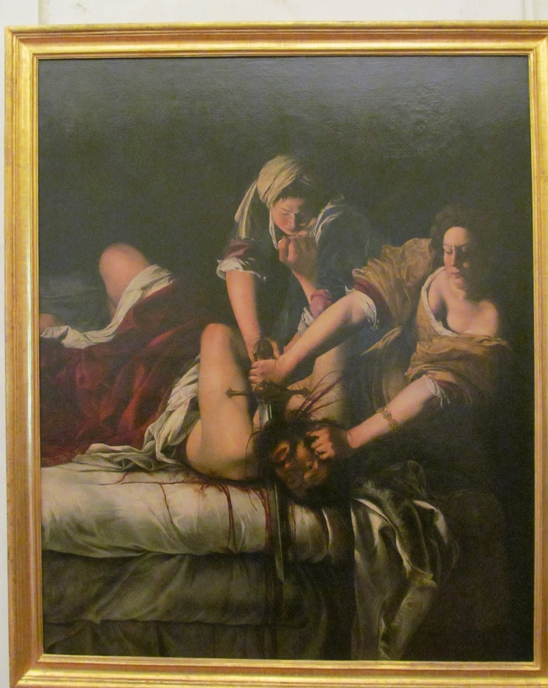
DAY TWO · CLOSE LOOKING
The violence,
then the painter
Describe the violence in the painting before you describe the painter. Account for the effort in the arms, the grip, the spilled weight, before a single word about who made it.
Artemisia Gentileschi, Judith Slaying Holofernes, c. 1620 · public domain
Notes:
Gentileschi's Judith, large. Describe the violence before the painter.

Slide 5
THE WITNESS
WHERE THE PICTURE STANDS YOU
Who are you next to?
01
02
What is shown
Where you stand
A killing, at the moment of most effort. Every hand in the picture is doing work.
The picture places you close, inside the act rather than watching it from safety. That placement is a choice, and it is part of what the picture argues.
ART APPRECIATION · SEMESTER I
02

Slide 6
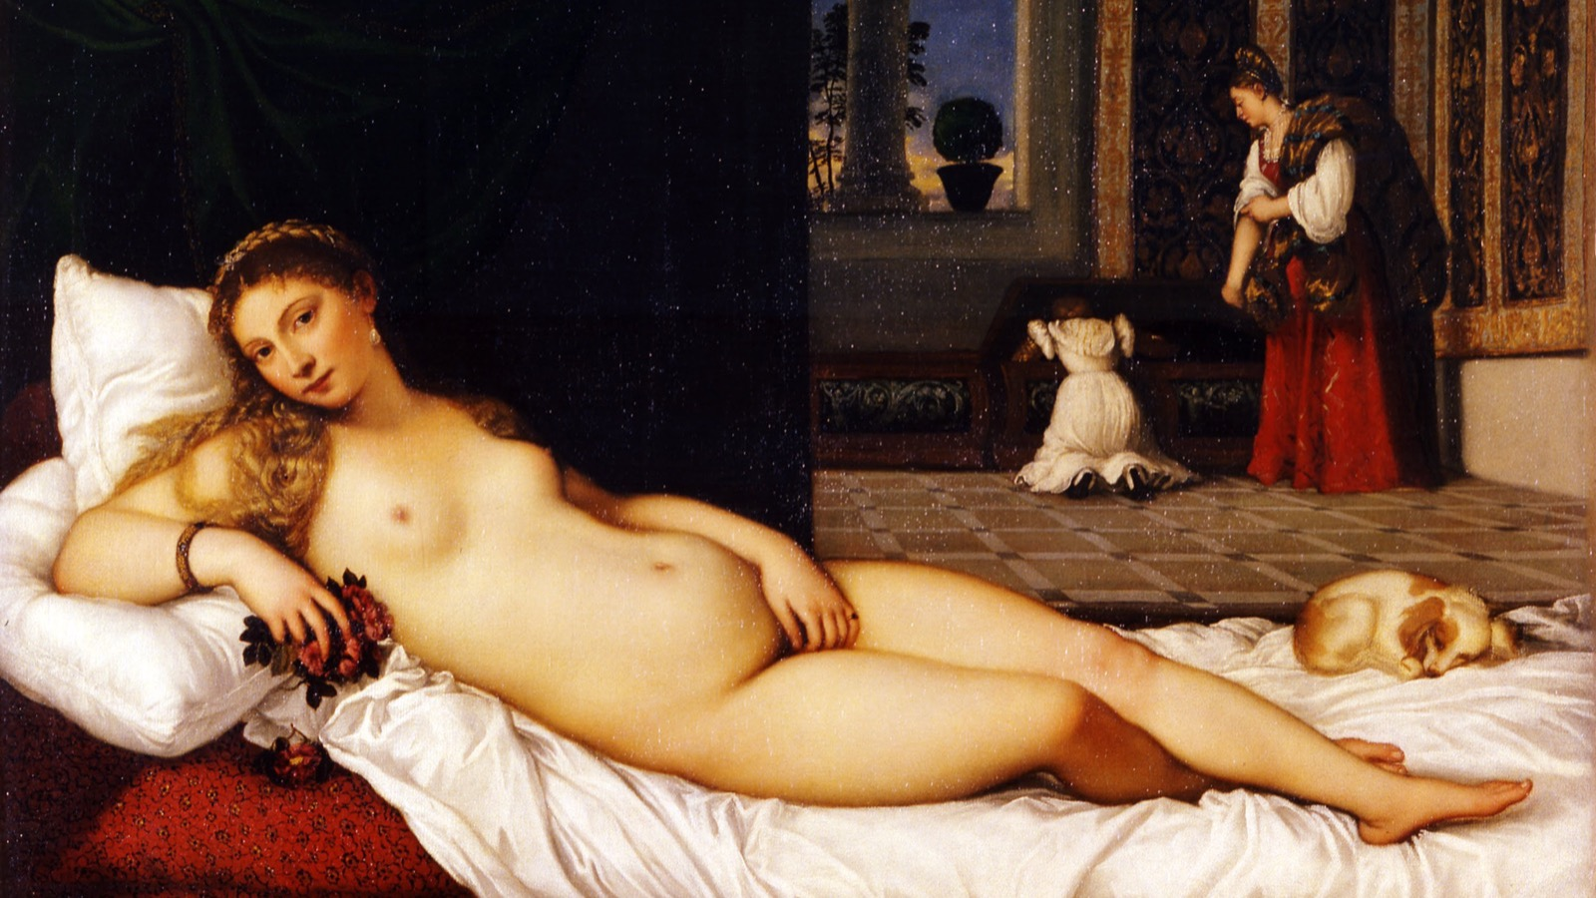
DAY THREE · TITIAN
What does it ask you to accept as natural?
Titian, Venus of Urbino, 1538 · public domain
Notes:
Titian, Venus of Urbino. Reception reading set. Note the ease, the invitation, the way the picture asks nothing of you but to look.

Slide 7
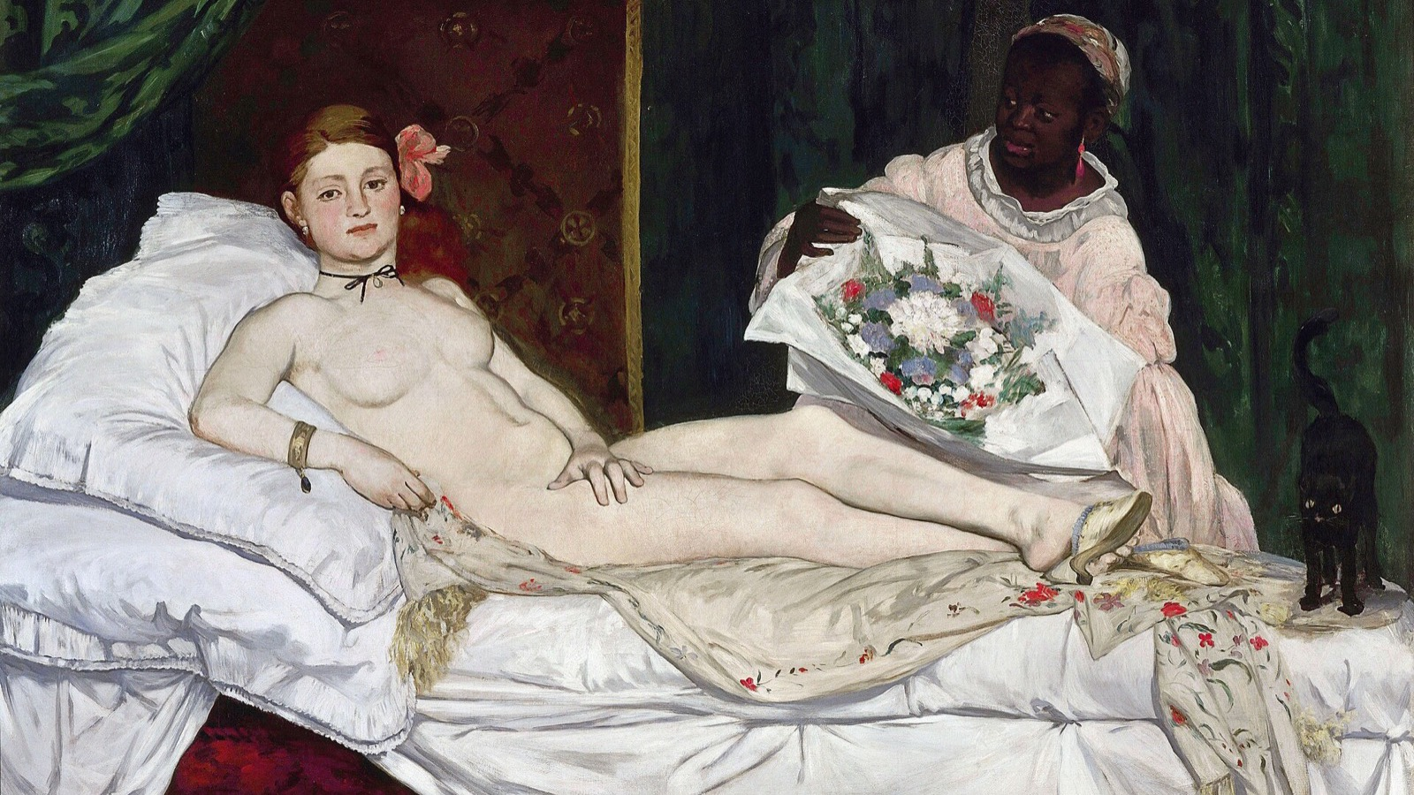
DAY FOUR · MANET, SILENT
Locate the exact refusals, one by one.
Édouard Manet, Olympia, 1863 · public domain
Notes:
Manet, Olympia, silent, no context. Locate the exact refusals Manet is making of Titian, one by one, before the two are set side by side.

Slide 8
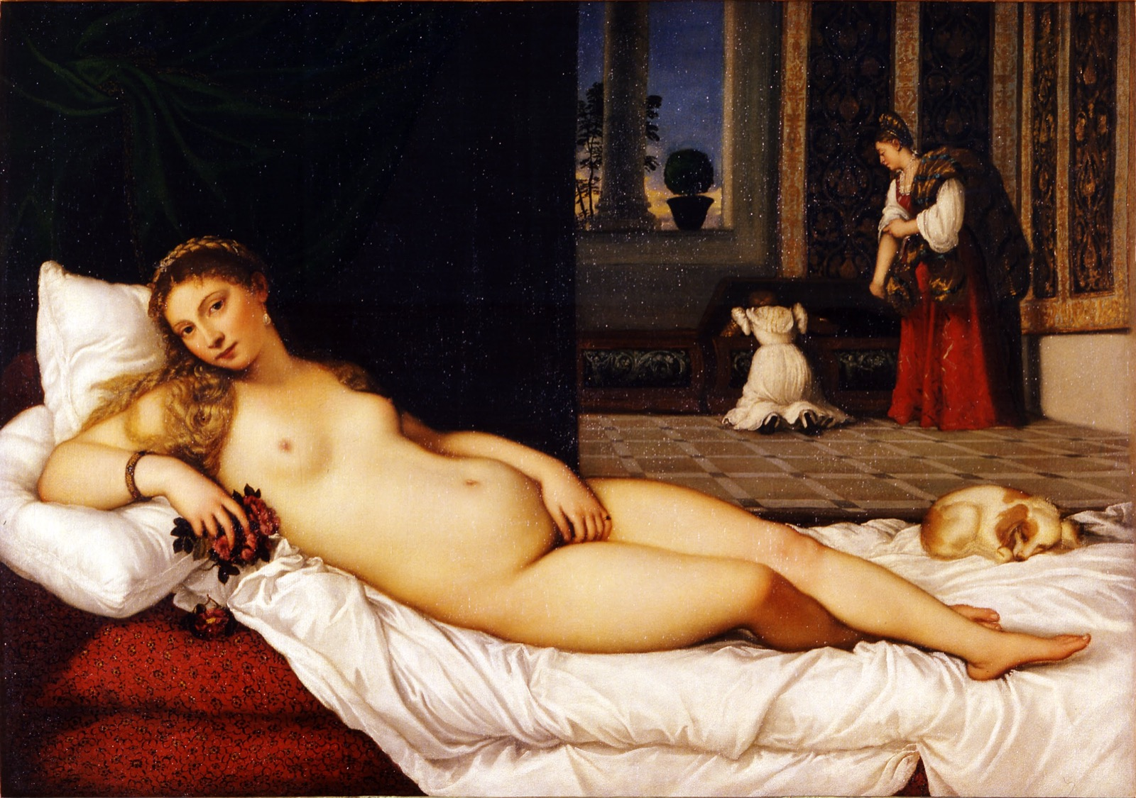
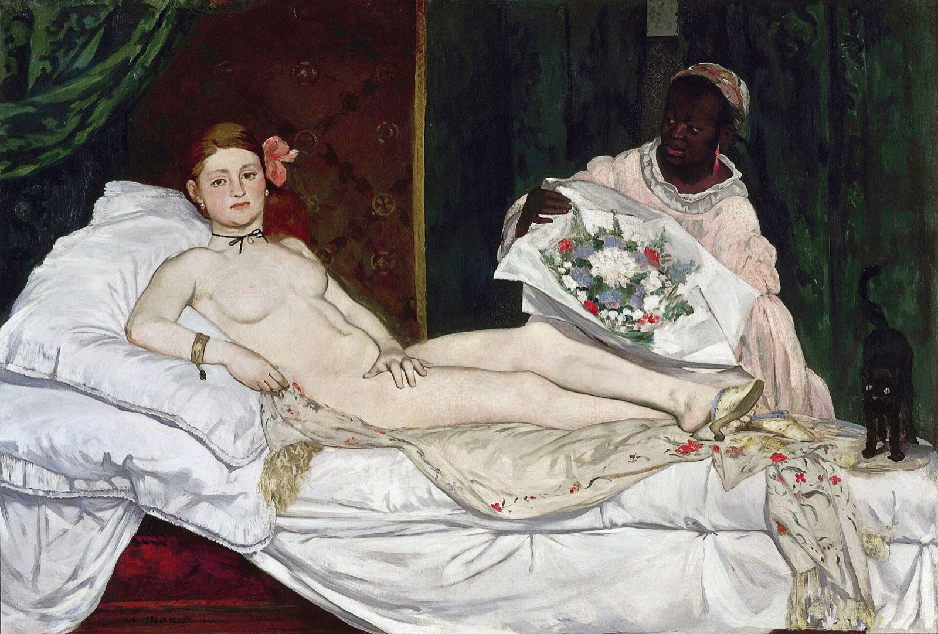
THE COMPARISON
ONE CLAIM, TWO PICTURES
Set side by side
Titian, Venus of Urbino, 1538
Manet, Olympia, 1863
Same pose, three hundred years apart. The essay is one claim about what Manet changed, and why the change carries meaning.
Notes:
Do not put these together until now. If they see them together first they find the joke and stop looking.

Slide 9
“
Differences only count
if they carry meaning.
A list of what is different is not a comparison. A comparison says what the difference is for.

Slide 10
ASSESSMENT · A2
THE COMPARATIVE ESSAY
One claim about two pictures
Sits Tuesday 13 October, on the double: in class, closed, 40 minutes.
Marked on one claim about Titian against Manet, evidenced from the pictures rather than the reception reading.
Announced Wednesday 30 September, before the break. It carries the mid-term grades, so it is marked inside a week.
ART APPRECIATION · SEMESTER I
03
Notes:
A2 carries the mid-term grades (due Thu 2026-10-29), which means marking it inside a week rather than five days.

Slide 11
HOW IT RUNS
SIX MEETINGS, TUESDAY A DOUBLE
The fortnight, meeting by meeting
FRI 9 OCT
Break-homework debrief; storyboards returned (CS3)
SAT 10 OCT
Gentileschi's Judith; the problem of the witness
MON 12 OCT
Titian, Venus of Urbino: what it asks you to accept
TUE 13 OCT, DOUBLE
Manet's Olympia; the comparison; A2 sits
WED 14 OCT
First read-back; the bridge into food
FRI 16 OCT
Continued read-back; the unit closes
ART APPRECIATION · SEMESTER I
04

Slide 12
NEXT
The Table as
Moral Space
Lesson 06. Unit III opens: food, the table and ethics.
ART APPRECIATION · SEMESTER I
05

